Slide 1
CEITEC MU
Scientific Board
Meeting
5th November 2020

Slide 2
Agenda
CEITEC MU Strategic plan 2021-2028 draft
Priorities for 2021
Proposal of the honorary doctorate for prof. Křivánek

Slide 3
Strategic Plan of the Institute

Slide 4

Strategic Plan up to 2020
Vision (2020)
Internationally recognized research institute in life sciences with links to material science
One scientific community bridging disciplinary boundaries
Role model for a university research institute in Czech and Central European context
Source of inspiration and innovation to the university, a driver of internationalization of the university
An institute with open, international, fair and friendly environment

Slide 5
Strategic Plan up to 2020: Key performance indicators

Slide 6
NEW Strategic Plan 2021-2028

Slide 7
NEW Strategic Plan 2021-2028

Slide 8
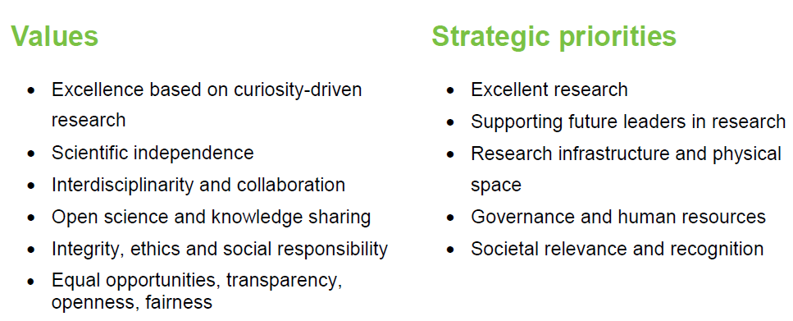
NEW Strategic Plan 2021-2028

Slide 9
NEW Strategic Plan 2021-2028
Profile topics
RNA/nucleic acids in health and disease
Cancer biology
Brain disorders
Infectious diseases
Harnessing knowledge of plant biology for crop improvement
At the frontiers of technology: Correlative approaches to connect dynamics and structure of living systems

Slide 10
NEW Strategic Plan 2021-2028
Key performance indicators

Slide 11
Priorities for 2021

Slide 12
Priorities for 2021
Approval of the new Strategic Plan for CEITEC MU in line with the MUNI Strategic Plan 2021-2028
Readiness for National Plan of Renewal
Cellular and Molecular Imaging Initiative (see profile topic Correlative approaches to connect dynamics and structure of living systems)
HR Excellence in Research Award implementation
Upgrade of institutional governance so that the role of Group Leaders’ Meeting increases
Implementation of IT Policy together with strengthening collaboration with ICS MUNI
Strengthening the Institute’s position in the EU-LIFE and serve as a bridge between West and East in transferring experience and good practice to Alliance4Life

Slide 13
Budget 2021
Per rollam vote by members of the Scientific board
  YES = 15 votes
  YES, with reservations = 2 votes
  NO = 0 vote
85 % members participated
The budget was supported by the Scientific board and was submitted for the final approval to Rector and Academic Senate of the Masaryk University.

Slide 14
Proposal of the honorary doctorate for prof. Křivánek

Slide 15
CEITEC
@CEITEC_Brno
Thank you for your attention and for the discussion.
www.ceitec.eu

