Slide 1
Scientific Board of CEITEC MU Meeting
5th May 2022

Slide 2
Management priorities
2022-2023 update
In implementation of the Strategical Plan of CEITEC MU 2021-2028

Slide 3
GRANTS
Update of grants strategy – position to operational programmes and NPO, dealing with ineligible VAT and co-financing obligations
Selected grant applications of 2022:
  HEU Teaming and OP JAK Teaming calls: CORMIC – BRIDGING ACADEMIA AND INDUSTRY IN CORRELATIVE MICROSCOPY – preparation of the application for the 2nd round
  National recovery and resilience plan („NPO“) – submitted
    National Institute of Virology and Bacteriology
    National Cancer Research Institute
    National Institute of Metabolic Disorders and Cardiovascular Diseases
  Dioscuri programme (related to new research group opening)
  ERA Chair

Slide 4
RESEARCH AND INFRASTRUCTURE
PhD School – unification of PhD programme principles and standards – Memorandum of CEITEC, SCI, MED, FSpS and PHARM to be signed in May
Redesign of the evaluation system and definition of financial consequences (at the institute level) – link to the amendment of budgetary rules
Preparation for scientific evaluation – The internal research evaluation, which will take place for the first time at MU in October 2022, will suitably follow the long-term evaluation system at CEITEC MU. It will also be complemented by an international evaluation of CFs in September 2022.
Establishment of IT Core Facility – pilot testing, bottom-up approach initiated by research group leaders.
School of microscopy – preparation (as a part of Teaming project)

Slide 5
RESEARCH AND INFRASTRUCTURE
To be developed:
Reinvestment policy/strategy – definition of principles, committee, procedure – how to decide on the allocation of budget on reinvestments (including repair costs), a decision on regular annual allocation of the (institutional) funding dedicated to reinvestments

Slide 6
SPACE ALLOCATION
Focus on optimisation of using the available space and using new space in BioPharmaHub and Biology Park for consolidation of research groups and facilities with the same research focus and using the same facilities
  Molecular medicine teams and facility => BioPharmaHub
  Consolidation of the CELLIM CF in E35
  Space for new research groups in E35 and (possibly) Biology Park
To be developed:
Initiation of debate about a Campus space allocation board establishment, rules of operation

Slide 7
HUMAN RESOURCES (1/2)
Call for new group leader 2021/2022 (ongoing) – link to ERC and Dioscuri calls
Leadership policy including evaluation of leadership skills and managerial performance of group leaders and CF heads approved and published
  Leaders‘ training academy to be established (under development)
  Assessment interviews with a focus on managerial and leadership skills will be organized for the first time in the end of 2022
Outplacement and retirement policy
  Amendment of budgetary rules that would reduce institutional funding for group leaders in the retirement age (65 years) – internal discussion opened

Slide 8
HUMAN RESOURCES (2/2)
To be developed:
Wage analysis, including gender pay gap analysis => wage policy, setting minimal/maximum wage for a concrete position – planned to be launched after new MU wage regulation is implemented (July 2022)
Necessity to adress in a systemic manner situation of combined leadership roles at CEITEC and faculties or elsewhere – to be developed

Slide 9
ORGANISATIONAL STRUCTURE, GOVERNANCE
Upgrade of institutional governance so that the involvement of research group leaders increases - group leaders meetings should be used as tool for constructive consultations with monthly or every 2 weeks frequency
  Current frequency once per 2 months
  Using focus groups with group leaders and CF heads to discuss new policies and systems
Overall revision of budgetary rules – preparation of analytical background material to assess if rules support effectively desired behaviour of groups
  Flat rate and link to evaluation of scientific excellence
  No institutional budget to group leaders of 65+ age
To be developed:
Organisational structure – research departments – internal analysis of departments’ structure and their role (exp. implementation in 2023/2024)
Reinvestments to buildings – analysis and prediction
These ideas are under discussion

Slide 10
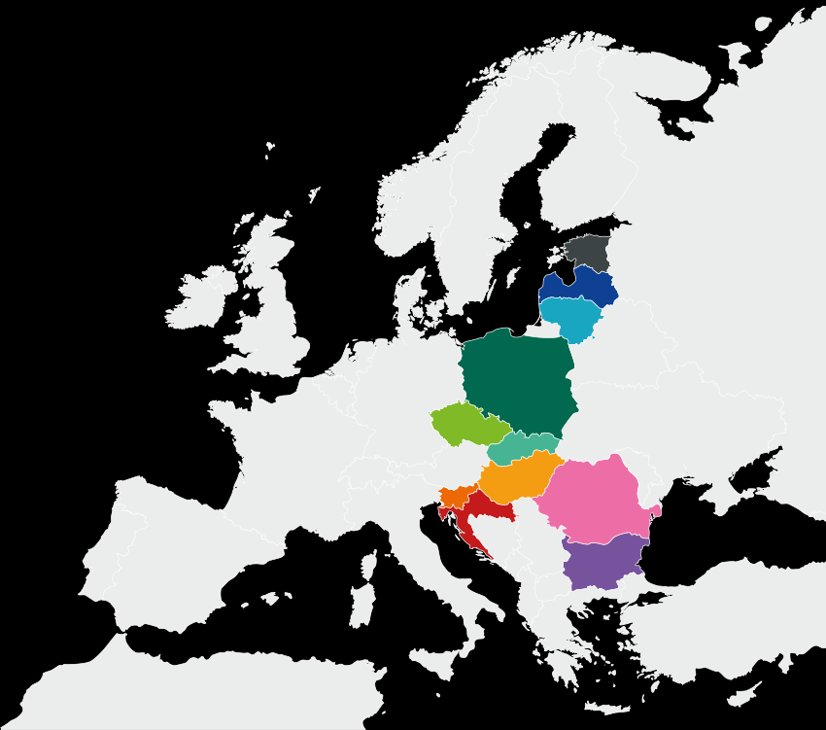
ALLIANCE4LIFE – SPILLOVER EFFECTS
Institutional practice makes a difference between good and excellent research institutions
Community meeting in Tartu, Estonia, 28-30 April 2022
Research Evaluation Reform in the EU
  Self-assessment – quantitative performance indicators and SWOT
  Anonymous survey of institutional culture
  Peer evaluation (CEITEC 2022 evaluation as one of „pilots“)
  Member of “Coalition of Willing“
Careers in Health Research & Innovation
  18 best practices and principles for sustainable, systematic change formulated HR action plans
Skills Academy
  Trainings for ESRs and professional Research Administration
Collaboration supported with seed funding
  Joint database of core facilities and open access
  Scientific mini-conferences to develop new projects

Slide 11
Budget 2022

Slide 12
BUDGET 2022
The total budget in 2022 is growing by 4 % compared to the budget spending of 2021 and reaches 822 mil. CZK.
The budget plan includes use of reserves in the volume of 45 mil. CZK.
We expect a growth of gross institutional revenues by 8 % in the amount of 13 mil. CZK.
The budget plan reflects rapid growth of prices of energies (e.g. by 130 % in case of electricity, by 45 % in case of heating).
In total, running costs of CEITEC buildings increases by 50 % (27 mil. CZK).
Cost of CEITEC administration remain at the level of 2021 budget.
Institutional budget of research groups persists at the same level as in 2021.
Newly, there is a contribution to the CF Biological Data Management and Analysis (CF BioData), established in 2022, in the amount of 500 th CZK. The CF is predominately funded by the ELIXIR project.
Three projects are planned within the National Recovery and Resilience Plan („NPO“) with total budget over 300 million CZK and obligatory co-funding in the amount of 40 mil. CZK - ineligible VAT (for years 2022-2025).

Slide 13
Budget 2022 (noninvestment) - Structure of Revenue

Slide 14
Budget 2022 (noninvestment) - Structure of Expenditure

Slide 15
Budgetary rules (ideas under discussion)
Termination of the institutional funding for group leaders in the retirement age (age of 65)?
Flat rate system differentiated based on the results of the evaluation of scientific excellence?

Slide 16
Thank you for your attention!

