Slide 1
Role of Retailing in Empowering Women- A study of Unorganised sector in Karnataka – Dr. Radhika Jade

Slide 2
Years ago a person, he was unhappy, didn’t know what to do with himself – he’d go to church, start a revolution – something. Today you’re unhappy? Can’t figure it out? What is the salvation? Go Shopping.
(Arthur Miller, US Dramatist,1968)
Retailing

Slide 3
International Retailing
Retailing is the world’s largest private industry, ahead of finance (U.S. $ 5.1 trillion) and Engineering (U.S. $ 3.2 trillion).
Global Retailing is worth as staggering U.S. $ 6.6 trillion (Mc Kinsey and CII report 2007).
More than 80% of the retail trade is organized and contributes to three-fourths of the total retail revenues in the developed economies (A.T. Kearney 2007).
More than 50 fortune 500 companies and around 25 of the Asian top 200 firms are organised retail outlets and 10 % of the world’s billionaires are retailers (A. T. Kearney 2007)
80% of the US Retailing is organized and Wal-Mart alone handles 6% of the total retail trade and the top 50 retailers control 36% of the organized retail (Bellenger N. Danny et al, 1977).
A majority of 16% of the employment and 10% of GDP is the result of this industry in the US (Chakrabarti Amit Baran & Ganesh K 2007)

Slide 4
Indian Retailing
Indian retailing is a vital business to the socio-economic equilibrium of the country.
India, like Britain is a nation of shopkeepers with over 15 million retail outlets (Ramesh Kumar S, 2009).
It contributes to nearly 12% of nation’s GDP (India Retail Report, 2009).
It is the largest source of employment (about 4% of the total Indian population (1.2 Billion), census 2001) after agriculture. (Guruswamy Mohan et al, 2005).
The organized sector commands just three to five percent of the total retail industry is valued at about $300 billion and is expected to grow $637 billion in 2015 (Purushottam K, 2008)

Slide 5
Need for the Study
Changing Demographics of India
Woman flattering QUEEN of Shopping
Consumer Empowerment: A new ‘mantra’ of differentiation

Slide 6
Changing Demographics of India
India is the second most populous country in the world with a population of approximately 1.17 billion people (National Commission on Population), which accounts for almost one-sixth of the world's population.
Youngest population in the world- 65 % of the population is below 35 years old and over 50% of the population below 20years old (Marketing White book, 2010).
Surging working population driving consumerism- 91.3 million households earning between US $ 1,969 to US $ 4,376 (Bijapurkar Rama, 2007).
According to a study by McKinsey Global Institute, India is likely to leap-frog from being the twelfth largest consumer market to become the fifth largest in the world. Also the study reveals that, over 23 million Indians -more than the population of Australia-will number among the country's wealthiest citizens.
India Spending Engine -India’s consumption to around $428.69 billion in 2005, and it is expected to touch $ 1.76 trillion by 2025 (IBEF, 2008)

Slide 7
Woman flattering QUEEN of Shopping
‘Shopping’ for a woman is not just an activity of ‘purchase’; it is indeed
an opportunity for her social expression (Cross, 1993),
social image and status symbol (Fischer and Arnold 1990),
most importantly leisure activity (Jansen-Verbeke, 1987; Martin and Mason, 1987) and
an excursion trip of joy (Helen R, 1997).
Shopping for woman is an activity which she naturally likes to do (Kelly 1991).
Whereas ‘shopping’ for their male counterparts is seen as an ‘forced’ ‘disliked’ ‘rational’ or just a labour of love activity (Fischer, Eileen and Arnold, S.J. 1990).

Slide 8
Women participation in Family and Purchase Decision Making
(Jejeebhoy, 1997) | (Kishore 1997) | (Hashemi et al 1996 and Cleland et al 1994)(Source: Kabeer.N (1999)) | (Sathar and Kazi, 1997) | (Becker. 1997) | (Morgan and Niraula, 1995 | (Razavi, 192)
Schooling for children
Child education
Disciplining the child | Use of family planning methods | Taking livestock for raising: leasing of land and purchase of major assets
Courses of action if child falls ill | Children’s health |  | Jewellery and gifts for wife’s relatives
Jewellery | Children education |  | Purchase of clothes
Purchase of small items | Visits | House repair | Household expenses | Number of children | Major market transactions)
Major households | Food cooked | Ability to make large consumer purchases | Sale and purchase of livestock | Making a major purchase | Decision by women to work outside | Inputs; labour and sale in agricultural production
Purchase of food | Household budget | Ability to make small consumer purchases | Purchase of food | Wife working outside | What food to buy | Types and quantities of food
India | Egypt | Bangladesh | Pakistan | Zimbabwe | Nepal | Iran
Countries Covered in Study

Slide 9
Consumer Empowerment: A new ‘mantra’ of differentiation
Len Tiu Wright (2006),"a mental state usually accompanied by a physical act which enables a consumer or a group of consumers to put into effect their own choices through demonstrating their needs, wants and demands in their decision-making with other individuals or organizational bodies in the marketplace"
Luc Wathieu et al, (2002), “consumer empowerment is a subjective experience of an individual aroused as a result of three specific elements viz., control of choice set composition, progress cues and information about other consumers”.

Slide 10
Research Gaps
The existing consumerism and retail studies focuses more on buyer to beware from the retailers activities. They do not explain retailing and retailers’ as the ‘sources’ of ‘creating empowerment among consumers’.
Prevailing studies are on women being considered as the ‘topic of poverty debate and developmental studies’ in the social sciences. Focus on women as potential consumer / decision maker is less discussed in the Indian retail and consumer context.
Consumer satisfaction and delight are the major topics of discussion in the emerging economies and the concept of ‘Consumer Empowerment’ is an innovative topic and the model generated can be an unique contribution towards the theory.
The research gaps identified enabled the researcher to frame the operational definition for the study.

Slide 11
Operational Definition
Consumer empowerment is defined as, “the process of getting consumers involved in retailing activities encompassing expansion & control over choice, conducive retail environment, convenience, and relevant communication to make them confident in their purchase decision making process while shopping- that they naturally like to do.”

Slide 12
Statement of Research Problem
The major problem underlying was to identify the ‘’major retailing factors those result in the subjective experience of empowerment among women shoppers’’.
“To assess whether retailers can act as source of empowering the consumers”

Slide 13
Research Questions
RQ1. Do the demographic and psychographics of the customers differ based on the nature of the outlet they visit?
RQ2. Are women serious shoppers and decision makers related to household decisions making?
RQ3. Which are the major store factors that contribute in the subjective experience of consumer empowerment?
RQ4. To what extent expansion and control over choice set provided to consumers result in experiencing subjective feeling of empowerment?
RQ5. What is the effect of soothing retail atmosphere as a part of retail image can make consumers experience of empowerment while shopping?
RQ6. What is the impact of relevant communication (product/service information) provided to the consumer on consumer experience of empowerment while shopping?
RQ7. How important is service convenience in bringing subjective experience of empowerment among the women consumers?
RQ8. What are the consequences subjective experiences of consumer empowerment on retail business?
RQ9. What optimal blend of the retail factors might result in the subjective experience of empowerment?

Slide 14
Specific Questions
SQ1. How do women customers select the store for shopping?
SQ2. Is it the “Visual Merchandising/Physical outlook” of the store that attracts them to shop?
SQ3. Whether large “choice” is their top most priority in the store selection?
SQ4. Do women customers prefer knowledgeable sales clerks to attend / counsel them while they shop?
SQ5. Whether providing relevant retail information (oral and written) to women consumers encourages their shopping activity?
SQ6. Giving special prominence and attention to the women customers boosts their confidence while shopping?
SQ7. What are the roles of convenient location / place, spacious shopping area, parking facility etc., in motivating women shoppers in case of patronizing store?
SQ8. Does the customers really feel confident gaining product and market knowledge by the retailers?
SQ9. Whether woman customers feel high /confident by deciding on their own when they shop for the family and themselves?
SQ10. What is the importance of efficient customer care in making women consumers feel ‘considered or given importance’?
SQ11. Does the decision making factor in shopping makes women feel self reliant and empowered?

Slide 15
Research Objectives
The research problem was broken down into various researchable objective statements. The main objective of the study is to identify major factors contributing towards the subjective experience of empowerment among the women consumers.
Following are the sub-objectives:
1. To identify the various product categories those are shopped by the women consumers in two different retail formats viz. traditional outlets and modern / organized outlets.
2. To investigate the product categories those are independently decided and shopped by the women consumers on their own.
3. To assess the amount of time spent by the women shoppers in shopping per week.
4. To study the impact of demographics and psychographics of women consumers in considering shopping as their best free time activity.
5. To measure the impact of demographics and psychographics on the subjective experience of empowerment among women shoppers while shopping.
6. To explore the characteristics exhibited by the empowered women consumers.

Slide 16
Scope of Research

Slide 17
Scope of the Research
Theoretical Scope:
Literature related to retailing, women and shopping, empowerment and consumer empowerment are focused.
Literatures related to six major product categories viz. Groceries/Vegetables, Apparels, Home Decors’, Major Home Appliances, Electronic Gadgets (like iPods, laptops etc) and Jewellery are studied.
Industry and Format Scope:
Department stores, Malls, Hypermarkets, Exclusive Brand Stores, Supermarkets and Traditional (stand alone) stores.
Geographical scope:
Five zones, 15 areas in Bangalore city
Demographics Scope:
Women shoppers who are working/non working, 18-50years aged, SSLC-more than P,G are studied.

Slide 18
Limitations of the study
The study was limited only to Bangalore city in Karnataka.
The study was focused only on women shoppers of Bangalore city.
The study is considered only six product categories and five retail formats in the sample city.
Time, cost and other resources constrained the research results from generalising them to population.

Slide 19
Literature Review

Slide 20
Literature reviewed
Nearly 160 relevant research studies (both national and international) are reviewed and categorized in four parts viz. Retailing, Women Empowerment, Women and Shopping and Consumer Empowerment.

Slide 21
Research Methodology

Slide 22
Research Methodology
Exogenous/Independent Latent Variable (constructs)
Retail Store Image/Atmosphere (RSI) (Wu, Bob T.W. & Susan M. Petroshius 1987)
Expansion and control over choice (EFC) (Wathieu et al, 2002)
Store Convenience (SC) (Kelly et al 1967)
Relevant Communication (INFO) (Mishra, Umesh & Stem 1993)
Consumer Involvement (CINV) (Hunter & Garnefeld, 2008)

Slide 23
Endogenous / Dependent Variables (constructs)
Customer Satisfaction (CSAT) (Babokus et al, 2004)
Value Co-Creation(VCOC) (Prahalad and Ramaswamy 2004)
Consumer Empowerment (CONEMP) (Luc Wathieu et al, 2002)
Note: CSAT and VCOC have established marketing scales. Whereas, CONEMP is measured using another set of five latent / independent variables (explained further).

Slide 24
CONEMP is measured using five latent / independent variables given below
Product Expertise -PE (4 items) (Mishra et al, 1993)
Confidence -CON (3 items) (Lumpkin et al 1989)
Consumer Power -CP (7 items) (Lambert & Zarrel, 1980)
Freedom of Movement inside store -FOM (5 items) (Unger & Lynene S. 1981)
Attitude to Choose the Best -ACB (3 items) (Cooper Martin, 1993)
(Totally 22 items defined CONEMP)

Slide 25
Constructs Reliability Scores
Variable | No. of items | Cronbach’s Alpha | Items deleted if any
Consumer Empowerment variables | 22 | 0.701 | None
Retailing activities variables | 33 | 0.831 | None
Satisfied customer value creation variables | 11 | 0.996 | None

Slide 26
Analytical Model Flow Chart
Customer first visits the store
- Awareness created
–
•
Merchandise
Retailing activities
mix
–
Creates interest and desire by
•
Physical
providing pleasant environment (visual
Aspects
merchandising), choices, effective communication
•
Store
(product and market knowledge), convenience,
Personnel
servic
es and counseling (Personnel)
•
Store Policies
-
(pre
& post )
services,
billing,
Customer becomes knowledgeable and confident
operating
as well independent in decision making
hours,
customer care
Empowered customer
–
brings lifetime value to
the retail business

Slide 27
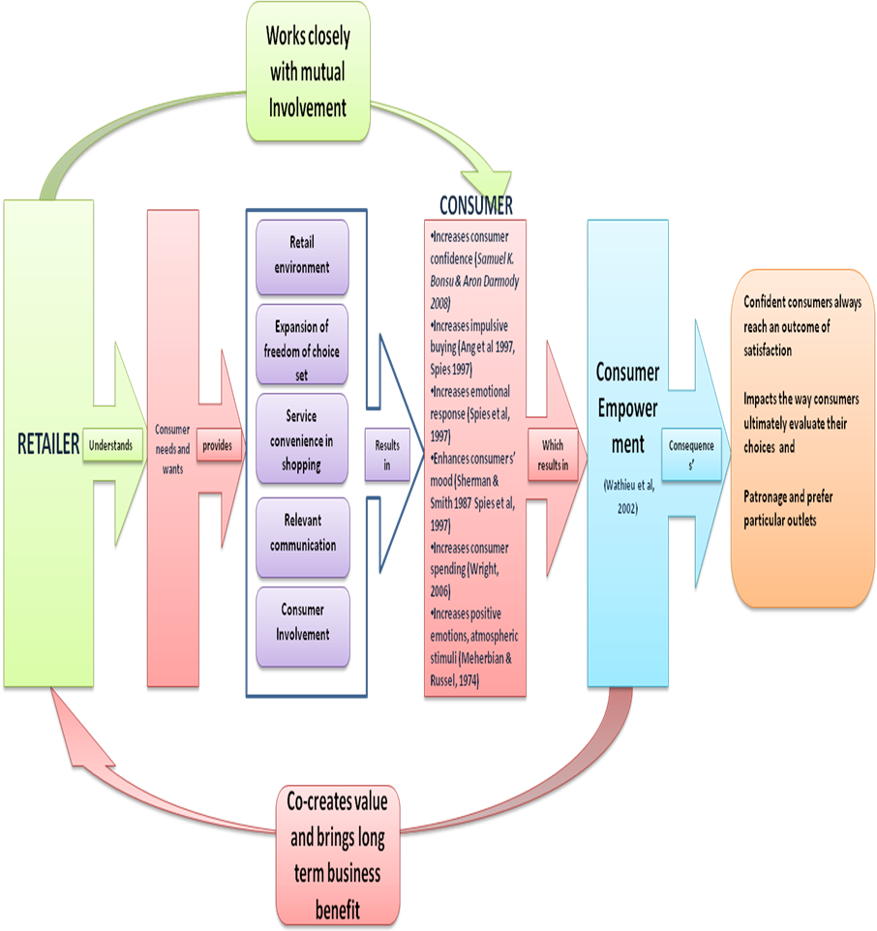
Theoretical Consumer Empowerment Model

Slide 28
Structured Equation Modeling (SEM)
SEM is an extension of several multivariate techniques, most notably multiple regression and factor analysis. SEM modeling examines a series of dependence relationships simultaneously. It is particularly useful when one dependent variable becomes an independent variable in subsequent dependence relationships. This set of relationships, each with dependent and independent variables forms the basis of SEM.
(1) It provides a straight forward method of dealing with multiple relationships simultaneously while providing statistical efficiency, and
(2) It has the ability to assess the relationships comprehensively and provide a transition from exploratory to confirmatory analysis.
Note: This transition corresponds to greater efforts in all fields of study towards developing a more systematic and holistic view of problems.

Slide 29
Distinguishing Characteristics of SEM
SEM techniques are distinguished by two characteristics:
(1)Estimation of multiple and interrelated dependence relationships, and
(2) The ability to represent unobserved concepts in these relationships and account for measurement error in the estimation process.

Slide 30
Stages in SEM
Stage 1: Developing a theoretical model
Stage 2: Constructing a path diagram
Stage 3: Converting the path diagram into a set of Structural and Measurement Models
Stage 4: Choosing the input matrix type and estimating the proposed model
Stage 5: Assessing the identification of the structural model
Stage 6: Evaluating Goodness-of-fit criteria
Stage7: Interpreting and Modifying the Model

Slide 31
Testing SE Models
Joreskog (1993) distinguishes three scenarios
1. Strictly Confirmatory (SC)
2. Alternative models (AM)
3. Model Generating (MG)
Note: According to MacCallum, Roznowski, & Necowotz, 1992; MacCallum et al 1993), SC scenario is not commonly found in practice. Although the AM approach to modeling has also been a relatively uncommon practices, but the analytic strategy MG is found more actively precipitated.

Slide 32
Mathematical Model
Structural Model: η = B η + γ ξ + ζ in the proposed. The three structural equations (CSAT and VCOC are two mediating variables) look as given below
(CSAT) η₁ = γ₁₁ ξ₁ + γ₁₂ ξ₂+ ζ₁
(VCOC) η₂ = γ₂₃ ξ₃ + β₂₁ η₁ + ζ₂
(CONEMP) η₃ = β₃₂ η₂₊ γ₃₄ ξ₄ + γ₃₅ ξ₅ + ζ₃
NOTE: Traditional multivariate procedures are incapable of either assessing or correcting for measurement error, SEM provides explicit estimates of these parameters. Whereas the former methods are based on observed measurements only, SEM can incorporate both unobserved and observed variables (Byrne 1998: 3-4)

Slide 33
Measurement Model
y= Λ_{y} η + ε and x = Λx ξ + δ, which specifies how latent variables (η’s & ξ’s) depend upon or are indicated by the observed variables (Ys & Xs) .
(CSAT)η₁ is explained by 6 Ys (Y1,Y2,Y3,Y5,Y6)
(VCOC)η₂ associated with 5Ys (Y7,Y8,Y9,Y10,Y11) and
(CONEMP)η₃ is associated with 22 items that is (4PE+3CON+7CP+5FOM+3ACB) i.e Ys (Y12,Y13….Y33)
(totally 33 observed variables i.e Ys. Errors of Ys are ε)
(RSI)ξ₁ is associated with 12 Xs (X1,X2….X12)
(SC)ξ₂ is associated with 5 Xs (X13, X14, …X17)
(CINV)ξ₃ is explained by 4 Xs (X18,X19,X20,X21)
(INFO)ξ₄ is explained by 5 Xs (X22,X23…X26) and
(EFC)ξ₅ is explained by 7 Xs (X27,X28….X33)
(totally 33 observed variables i.e Xs. Errors of Xs are δ)
(Errors associated with η’s and ξ’s is given by ζ)

Slide 34
Matrix representation of Structured Equations and Measurement Equations Model
=
=
*
+
and
=
*
+

Slide 35
Hypotheses
In general, Ho: Σ= Σ (θ) is equivalent to the hypothesis that [Σ- Σ (θ) = 0.0]; The Chi-square test, then, simultaneously tests the extent to which all residuals in Σ- Σ (θ) are zero (Bollen, 1989b).
In other words the null hypotheses should be accepted to defend the model under study.

Slide 36
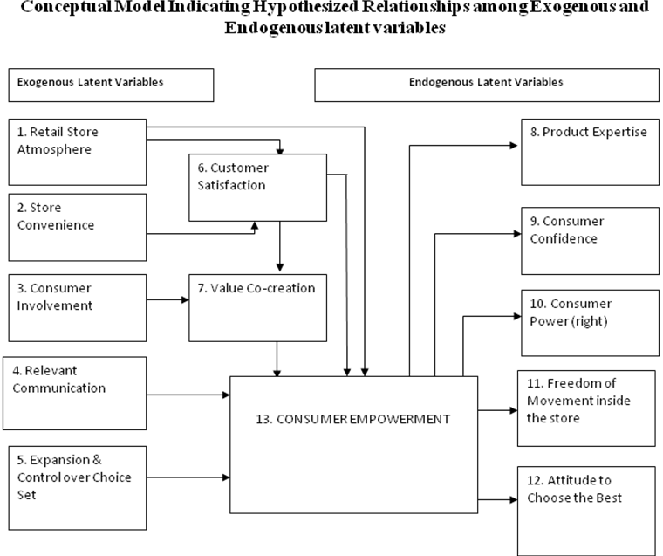
Hypotheses

Slide 37
Sampling Design
Population: Women comprise 47.5% of the total Bangalore population i.e. 70,00,000 (IISC Report, 2007).
Sample frame: Government released database on retail stores and commercial establishments KSCE-AR 2000’ , Census (2001) area classification and TATA Yellow pages ‘Just Dial Software Database7’(Total 34 areas and 74 outlet details provided).
Sample Unit: ‘Individual Female Shoppers’ of the age grater than 18 years (less than 50 years), with a qualification of < SSLC, married/ single, working/ home maker, who are exposed to shopping from the given six different retail formats under study.
Sample size criterion: Based on extensive literature review (Heir et al 2006) and stringent or ideal item-respondent ratio scale of 1:10 (Hinkin 1995 and Heir et al 2006) criterion, sample size of 660 (66 items * 10) observed data set was selected.
Sample Size: N=585 valid samples (75 invalid responses were discarded)
Sampling procedure: 'Purposive Sampling’ (Patton 1990) procedure is adopted to collect the samples for the study based on specific criteria.
Time and day of survey: Prime time of shopping derived from primary research as 4 pm – 8 pm on all the seven days of the week by both working and non working female shoppers.
Statistical techniques: Factor analysis and multivariate statistical technique Structured Equation Modelling ( SEM)

Slide 38
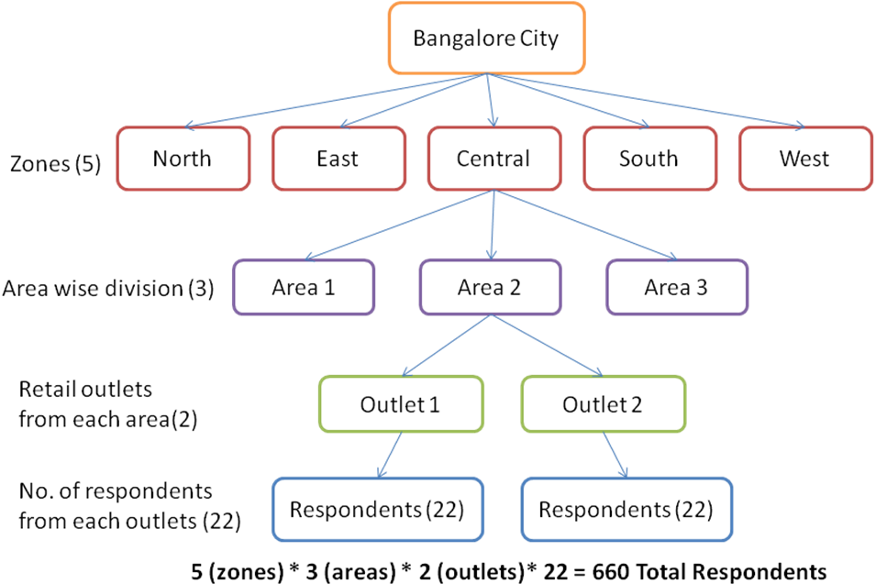
Sampling procedure

Slide 39
Consumer Empowerment Model

Slide 40
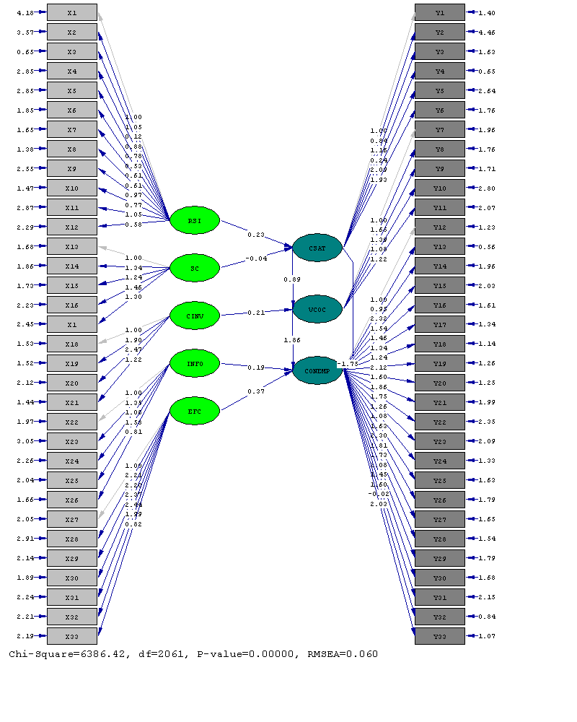
Consumer Empowerment Model – Path Diagram (66 items)

Slide 41
Goodness of Fit Statistics
Degrees of Freedom = 2061
Minimum Fit Function Chi-Square = 6873.14 (P = 0.0)
Normal Theory Weighted Least Squares Chi-Square = 6386.42 (P = 0.0)
Estimated Non-centrality Parameter (NCP) = 4325.42
90 Percent Confidence Interval for NCP = (4088.29 ; 4569.99)
Minimum Fit Function Value = 11.77
Population Discrepancy Function Value (F0) = 7.41
90 Percent Confidence Interval for F0 = (7.00 ; 7.83)
Root Mean Square Error of Approximation (RMSEA) = 0.060
90 Percent Confidence Interval for RMSEA = (0.058 ; 0.062)
P-Value for Test of Close Fit (RMSEA < 0.05) = 0.00
Expected Cross-Validation Index (ECVI) = 11.45
90 Percent Confidence Interval for ECVI = (11.04 ; 11.87)
ECVI for Saturated Model = 7.57
ECVI for Independence Model = 20.14
Chi-Square for Independence Model with 2145 Degrees of Freedom = 11631.05
Independence AIC = 11763.05
Model AIC = 6686.42
Saturated AIC = 4422.00
Independence CAIC = 12117.58
Model CAIC = 7492.17
Saturated CAIC = 16298.63
Normed Fit Index (NFI) = 0.41
Non-Normed Fit Index (NNFI) = 0.47
Parsimony Normed Fit Index (PNFI) = 0.39
Comparative Fit Index (CFI) = 0.49
Incremental Fit Index (IFI) = 0.50
Relative Fit Index (RFI) = 0.38
Critical N (CN) = 189.06
Root Mean Square Residual (RMR) = 0.15
Standardized RMR = 0.067
Goodness of Fit Index (GFI) = 0.75
Adjusted Goodness of Fit Index (AGFI) = 0.73
Parsimony Goodness of Fit Index (PGFI) = 0.70

Slide 42
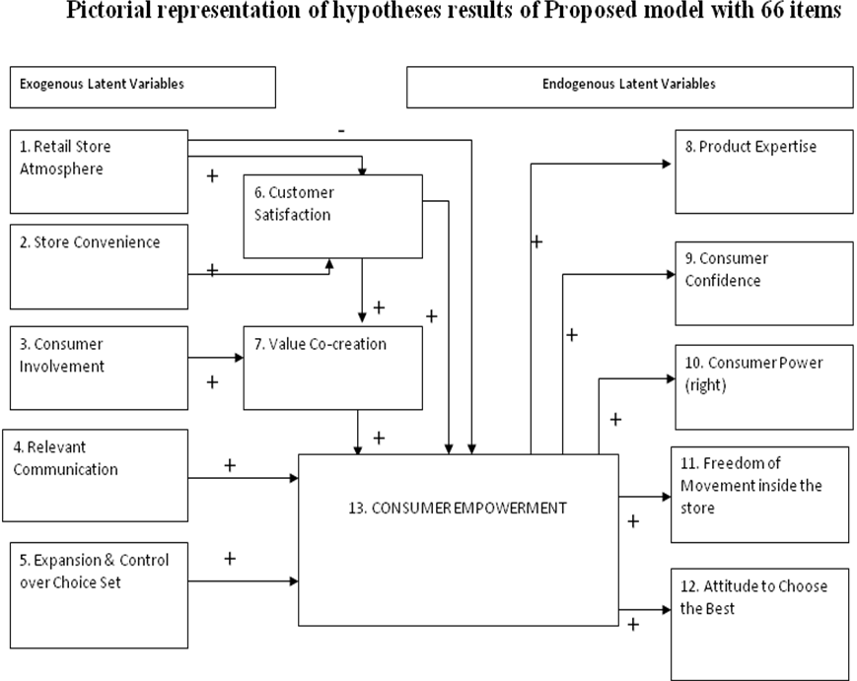
Hypotheses results of the proposed model
-

Slide 43
Model Respecification
Model Development Strategy: In this even though a model is proposed, the purpose of the modeling effort is to improve the model through modifications of the structural and/or measurement models.
In this stage of respecification, the strategy is no more to confirm but gets extended to explore the factors under study.
Note: Respecification has to be done to the model based on exhaustive theoretical support and not just relying on empirical justification.

Slide 44
Resultant model parameters
The resultant consumer empowerment model derived from the exploratory factor analysis resulted in four major retail constructs viz.,
Retail Store Image (RSI)
Store Convenience (SC)
Relevant Communication (INFO)
Expansion and Control over Choice Set selection (EFC).
Note: the fifth retail construct Consumer Involvement (CINV) was found insignificant in defining mediating construct VCOC hence CINV was dropped from further analysis. Also, construct CSAT could not directly measure the CONEMP so it was dropped from the further study. Proper theoretical justification was provided (Prahalad and Ramaswamy, 2004) and (Hart O. Oawa, 2010).

Slide 45
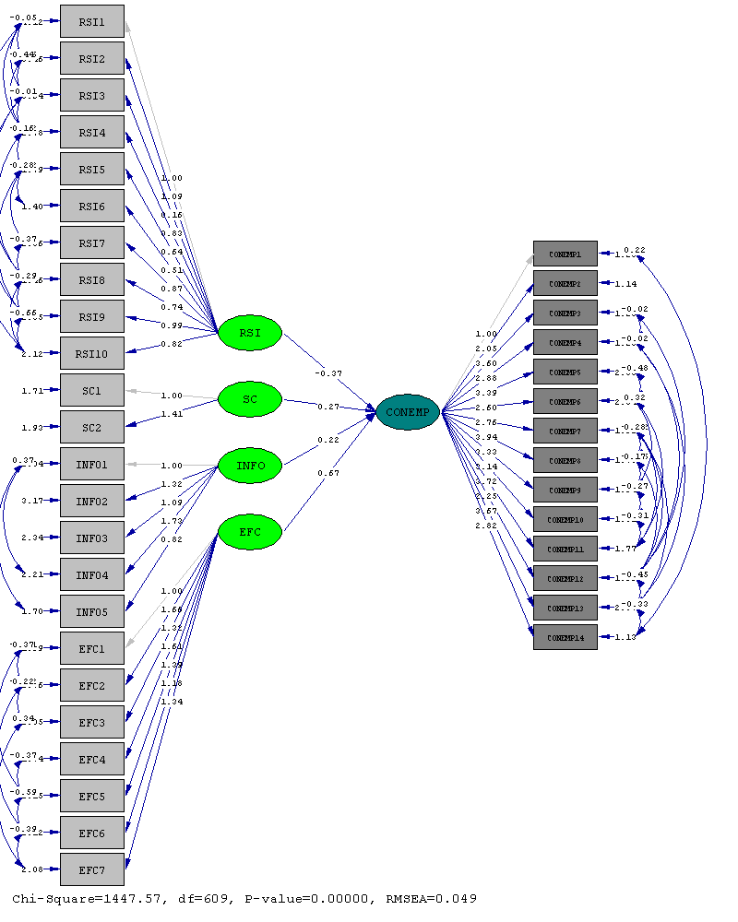
Resultant Consumer Empowerment Path

Slide 46
Goodness-of-Fit
Degrees of Freedom = 609
Minimum Fit Function Chi-Square = 1553.98 (P = 0.0)
Normal Theory Weighted Least Squares Chi-Square = 1447.57 (P = 0.0)
Estimated Non-centrality Parameter (NCP) = 838.57
90 Percent Confidence Interval for NCP = (731.15 ; 953.67)
Minimum Fit Function Value = 2.66
Population Discrepancy Function Value (F0) = 1.44
90 Percent Confidence Interval for F0 = (1.25 ; 1.63)
Root Mean Square Error of Approximation (RMSEA) = 0.049
90 Percent Confidence Interval for RMSEA = (0.045 ; 0.052)
P-Value for Test of Close Fit (RMSEA < 0.05) = 0.77
Expected Cross-Validation Index (ECVI) = 2.93
90 Percent Confidence Interval for ECVI = (2.75 ; 3.13)
ECVI for Saturated Model = 2.54
ECVI for Independence Model = 8.39
Chi-Square for Independence Model with 703 Degrees of Freedom = 4824.65
Independence AIC = 4900.65
Model AIC = 1711.57
Saturated AIC = 1482.00
Independence CAIC = 5104.77
Model CAIC = 2420.62
Saturated CAIC = 5462.36
Normed Fit Index (NFI) = 0.68
Non-Normed Fit Index (NNFI) = 0.74
Parsimony Normed Fit Index (PNFI) = 0.59
Comparative Fit Index (CFI) = 0.77
Incremental Fit Index (IFI) = 0.78
Relative Fit Index (RFI) = 0.63
Critical N (CN) = 261.48
Root Mean Square Residual (RMR) = 0.12
Standardized RMR = 0.056
Goodness of Fit Index (GFI) = 0.88
Adjusted Goodness of Fit Index (AGFI) = 0.86
Parsimony Goodness of Fit Index (PGFI) = 0.7

Slide 47
Hypotheses outcomes, Findings and Conclusions

Slide 48
Findings
Major Objective: To identify major factors contributing towards the subjective experience of empowerment among the women consumers.
The retail construct Store Convenience (SC) has positive and significant (+2.11) impact on consumer empowerment, followed by Relevant Communication (INFO) (+1.71) and Expansion of Freedom of Choice (+1.27). The Retail Store Image (RSI) has significant negative (-1.89) impact on Consumer Empowerment (CONEMP)

Slide 49
Supporting hypotheses to major objective
Retail store factors Store Convenience (SC), Relevant Communication (INFO), Expansion and control over choice set (EFC) positively and significantly influence the experience of subjective experience of consumer empowerment among women shoppers.
Whereas, Retails Store environment / image (RSI) and Consumer Involvement (CINV) are found insignificant in influencing the subjective experience of empowerment among women consumers while shopping.

Slide 50
Objective 1: To identify the various product categories those are shopped by the women consumers in two different retail formats viz. traditional outlets and modern / organised outlets.
Findings
Supporting Hypotheses
:
Ho: Age of the women shoppers has no significant influence on the nature of outlet selected for shopping – Reject (Z=0.891 Insignificant at 5% LoS)
Ho: Marital status of the women respondents has nothing to do with the nature of outlet selected for shopping – Reject Ho (Z=0.055 Insignificant at 5% LoS)
Ho: Qualification of the respondents has nothing to do with the outlets selected for shopping – Reject Ho (Z=0.382 Insignificant at 5% LoS)
Ho: Working status of the has no significant influence on the nature of outlet selected for shopping – Reject (Z=0.282 Insignificant at 5% LoS)
Ho: Monthly Household income of the respondents has no significant influence on the nature of outlet selected for shopping – Accept Ho (Z=0.045 significant at 5% LoS)
Ho: Use of credit cards by the shoppers has no significant influence on the nature of outlet selected for shopping – Accept Ho (Z=0.001 significant at 5% LoS)
Ho: Use of vehicle used for shopping and nature of outlet selected for shopping are independent of each other – Accept Ho (Z= 0.002 significant at 5% LoS)
Sl.No | Product Categories | Traditional outlets (%) | Modern Outlets (%) | Shopped in Both stores (%)
1 | Groceries / Vegetables | 48.4 | 51.3 | 0.3
2. | Apparels | 15 | 84 | -
3 | Furniture | 21.2 | 78.8 | -
4. | Home decorative | 33 | 67 | -
5. | Major Appliances / Electronic items | 18.5 | 81.5 | -
6 | Jewellery | 30.9 | 69.1 | -

Slide 51
Objective 2: To investigate the product categories those are solely decided and shopped by the women consumers on their own.
Supporting Hypotheses
Ho: Women consumers make 100% decision with respect to all the product categories under study.
Ho: Demographics and psychographics of the women consumers has nothing to do with their decision making with respect to the product categories under study.
Findings
Sl.No | Products | Solely decided (%)
1 | Apparels | 67.4
2 | Grocery / vegetables | 46
3 | Jewellery | 35.9
4 | Home décor’ | 7.2
5 | Furniture | 6

Slide 52
Objective 3: To assess the amount of time spent by the women shoppers in shopping per week
Supporting Hypotheses:
Ho: Demographics (Education, Working status, Age, Monthly Household Income) and psychographics (use of credit cards, use of personal vehicles for shopping) of the women consumers do significantly influence their opinion towards considering shopping as their best free time activity.
Ho: Marital status of the women shoppers insignificantly influences their opinion in considering shopping as their best free time activity.
Findings:
A majority 41.5% of the women shoppers spend nearly 20-30% of their time in shopping per week.
Age: 45 % of 29-39 years
Marital status: 48% of married
Qualification 42% PUC-Degree
MHI 46% of 60K-80K INR
Working status 41% of working
Credit card 46% always use cards
Transport 45% four wheeler use

Slide 53
Objective 4: To study the impact of demographics and psychographics of women consumers in considering shopping as their best free time activity.
Supporting Hypotheses
Ho: Marital status has nothing to do with the considering shopping as their best free time activity – Accepted (Z=0.03 significant at 0.05 level)
Ho: Educational qualification of the respondents and considering shopping as best free time activity is independent of each other – Reject (Z= 0.305 Insignificant at 0.05 level)
Ho: Working status of the women shoppers has no significant influence in considering shopping as their best free time activity – Reject (Z=0.371 Insignificant at 0.05 level)
Ho: Monthly Household income and shopping as best free time activity of women shoppers are independent of each other – Reject (Z= 0.081 Insignificant at 0.05 level)
Ho: Age of the women shoppers and considering shopping as best free time activity are independent of each other – Reject (Z=0.107 Insignificant at 0.05 level)
Ho: Using of credit card for the shopping and shopping being best free time activity of women are independent of each other – Reject ( Z=0.120, Insignificant at 0.05 level)
Ho: Using own transport means for shopping and shopping being best free time activity are independent of each other – Reject (Z= 0.279, Insignificant at 0.05 level)
Findings
Demo/Psychographics | Category | % women saying yes
Age | 18-28 | 47.9
Qualification | Degree to P.G | 47.6
Marital status | Single | 48.5
Work status | Employed | 44.3
MHI | <80,000 | 47.9
Credit card | Always /rarely | 45/ 46.1
Transport | Four wheeler/ auto | 43.2

Slide 54
Objective 5: To measure the impact of demographics (Age, Marital status, Qualification, Working status and monthly Household income) and psychographics (use of credit card, vehicle possession) on the subjective experience of empowerment among women shoppers while shopping.
Supporting Hypotheses
H₀: Women consumers’ age has nothing to do with feeling of subjective experience of empowerment while shopping. – Reject Ho (Z=0.719 Insignificant at 5% LoS)
H₀: Marital status of the women shoppers has no significant influence on the experience of empowerment while shopping.- Reject Ho (Z=0.569 Insignificant at 5% LoS)
H₀: Qualification of women consumers has no significant influence on the experience of empowerment while shopping. – Accept Ho (Z=0.000 significant at 5% LoS)
H₀: Working status of the women consumers has no significant influence on the experience of empowerment while shopping. - Reject Ho (Z=0.582 insignificant at 5% LoS)
H₀: Monthly Household salary of the women consumers has no significant influence on the experience of empowerment while shopping.- Reject Ho (Z=0.396 insignificant at 5% LoS)
H₀: The use of credit cards by the women shoppers for shopping and feeling of subjective experience of consumer empowerment are independent of each other. – Reject (Z=0.383 Insignificant at 5% LoS)
H₀: Use of own transport system for shopping and feeling of subjective experience of consumer empowerment are independent of each other. - Reject (Z=0.832 Insignificant at 5% LoS)
Findings
Quartile / no. of women shoppers | Consumer Empowerment Index (CEI) Range | CEI Level
Q1. 146 | 1.33-1.78 | Low degree
Q2. 292 (50%) | 1.79-1.91 | Moderate
Q3. 147 | 1.92-2.04 | High degree

Slide 55
Objective 6: To explore the characteristics exhibited by the empowered women consumers.
Supporting Hypothesis
Empowered consumers significantly exhibit certain qualities such product expertise (PE), confident (CON), consumer power (CP), freedom of movement (FOM), and attitude to choose the best (ACB)
Findings
Characteristics of empowered consumer | Age group in yrs | %
PE | 29-39 | 56
CON | 29-39 | 55.7
CP | 18-28 | 33
FOM | 18-28 | 36
ACB | 29-39 | 56

Slide 56
Importance of empowered consumers to the Market & Society
Empowered consumers are
Confident
Make informed choices
They defend themselves
They promote their own interests
They are good for the competitiveness of the economy and for the business (David BYRNE 2004)
‘Empowered Consumers’ results in very important outcomes for marketers as:
They spread positive word of mouth (Anderson and Sullivan 1993; Wangenheim and Bayon 2007),
They are loyal (Fornell et al, 1996; Olsen 2002),
Willingness to pay more among consumers (e.g., Fornell et al, 1996; Homburg, Koschate, and Hoyer 2005),
They result in an improved firm’s financial performance (Anderson, Fornell, and Rust 1997).

Slide 57
Managerial implications
La destination vaut le voyage’ which means ‘Consumer Empowerment -A revolution is underway’. (Weil Birdseye Henry & Weil Endicott Elisabeth, 1999). Managers must focus on
Building effective customer information management system that drives a value based relationship.
Involve and treat customers as business partners by delivering value.
Don’t think about extracting value from customers (i.e. zero sum game), create and share value with them.
Build the customer trust
Make the customers ‘experience’ their shopping.
Be the first to give up control of the relationship to the customer before the customer can empower the provider.
Don’t try to capture customers (as prisoners), captivate them.
The empowerment relationship model is difficult to envision and complex to achieve. Be understanding, sensitive, patient, committed, and above all have a positive attitude.

Slide 58
Conclusion
Empowering Women Consumers’ is going to increase the ‘responsible shopping or buying’ among women folk. This in turn helps the families to spend responsibly and strike a balance between earning and spending. A debt free family builds awareness in its community; a debt free community is potential enough to create debt free society and economically stable nation. Hence it can be construed as ‘Empowered Consumers’ are not only an asset to the retailers but even to the society at large.

Slide 61
Literature related to Retailing
Bucklin P. Louis (1962), “Retail Strategy and the Classification of Consumer Goods”, Journal of Marketing, October, 1962, Pp: 50-55.
Fisher L. Marshall, Raman Ananth & McClelland Sheen Anna (2000), “Rocket Science Retailing is Almost Here – Are You Ready?”, Harvard Business Review, July-August 2000, PP:115-124.
Lahart, Justin. “Shop till you drop”, Wall Street Journal - Eastern Edition, 3/28/2005, Vol. 245 Issue 60, pC1-C1, 1p, 1 graph.
Gupta C.P. & Chaturvedi Mitali (2007), “Retailing: An Emerging Trend in India”, Indian Journal of Marketing, June 2007, PP: 39-44.
Mishra Gaurav & Seshan Radhika, “Emerging Retail Formats in India: The Role of the Independent Retailer”, CCS.PGP.P1-25, E-20413, IIMB.
Berry L. Leonard (et al) (2002), “Understanding Service Convenience”, Journal of Marketing, July 2002, Vol.66, No.3, PP: 1-17.
Kline Barbara and Wagner Janet (1994), “Information Sources and Retail Buyer Decision-Making: The Effect of Product-Specific Buying Experience”, Journal of Retailing, Vol.70, No. 1, 1994, PP: 75-88.
Kaul Subhashini (2007), “Measuring Retail Service Quality: Examining Applicability of International Research Perspectives in India”, Viklpa, Vol.32 32, No.1, January-March 2007.
Rachman J. David and Kemp J. Linda (1964),”Are Buyers Happy in Their Jobs?” Journal of Retailing, Vol.40, No. 2, summer 1964, PP: 1-10.
Reddy P. Narayana (1990), “Efficiency Benefits Pass on to Consumers: New Development in Retail Market Environment in India”, Indian Journal of Marketing, PP: 23-25.

Slide 62
Literature related to Women Empowerment
Bisanth Savitri (2001), “Globalization, poverty and women’s empowerment”, United Nations division of advancement of women (online) 8
Malhotra Anju, Schuler Ruth Sidney and Boende Carol (2002) Measuring Women’s Empowerment as a variable in International Development, World Bank workshop on poverty and gender: New perspectives, June 28, 2002.
Kabeer N. (2005), “Gender Equality and Women’s Empowerment: a critical analysis of the third millennium Development Goal”, Gender and Development Vol. 13, No. 1, March, PP: 13-20.
Khosla Renu (2000), “From Disempowerment to Empowerment: Building urban Poor Communities for Change”, IIMB library RP.She.P.18418.
Ford C. Robert and Fottler D. Myron (1995), “Empowerment: A matter of degree”, Academy of Management Executive, 1995, Vol. 9, N0.3, PP: 21-29.
Juliet Hunt and Nalini Kasynathan (2001), ‘Pathways to empowerment? Reflections on microfinance and transformation in gender relations in South Asia’, Gender and Development Vol. 9, No. 1, March 2001.
Arneson Haanna and Ekberg Kerstin (2006), “Measuring empowerment in working life: A review”, Work. 26, 2006, 37-46, IOS Press.
CHARMES JACQUES and WIERINGA SASKIA (2003), “Measuring Women’s Empowerment: an assessment of the Gender-related Development Index and the Gender Empowerment Measure”, Journal of Human Development, Vol. 4, No. 3, November 2003.
Pradhan Bina ((2003), “Measuring Empowerment: A methodological approach”, SID On-line Dialogue, Sage Publications, Development 46(2), copy right 2003, PP: 51-57.

Slide 63
Literature related to Women & Shopping
Davis, Harry L. (1970), “Dimensions of Martial Roles in Consumer Decision making,” Journal of Marketing Research, 7, 168-77.
Filiatrult Pierre & Ritchie Brent J.R. (1980), “Joint Purchasing Decisions: A Comparison of Influence structure in Family and Couple Decision-Making Units”, Journal of Consumer Research, Vol.7, September 1980, pp: 131-140.
Wolgast H. Elizabeth (1958), “Do Husbands Or Wives Make the Purchasing Decisions?” The Journal of Marketing, October, PP: 151-158.
Kameshwari Moorthy and Renuka (2001), Are women Better Buyers? - Gender a Case Study Indian management, October 2001, Pp: 66-72.
Alladi Venkatesh (1980), “Changing Roles of Women-A Life-Style Analysis, Journal of Consumer Research, Vol.7, No.2 September 1980, and Pp: 189-197.
Barbieri Annalisa (2006), “Don’t shop till you drop”, New Statesman, Arts & Culture, 20 November 2006, Pg. 58.
Campbell Carol (2006), “‘What Women Want’ When Shopping For CE”, Retailing, TWICE06/06/2006.
Bellante Don and Foster C.Ann 1984, ‘Working Wives and Expenditure on Services’, Journal of Consumer Research, Vol 11, September 1984, Pp: 700-718.
Bhattacharya Priyanka (2007), “Cosmetics Retailing in India: Obvious Excitement” GCI Cover Story Part II, GCI February 2007, PP: 38-40.

Slide 64
Literature related to Consumer Empowerment
Hollander C. Stanley (1972), “Consumerism and Retailing: A Historical Perspective”, Journal of marketing, Vol. 48, No.4, winter 1972-1973, PP: 6-21.
Davies Andrea, Ellliott Richard (2006), “The evolution of the empowered consumer”, European Journal of Marketing, Vol.40, No.9/10, 2006, PP: 1196-1121.
Lincoln Nicola Denham, Travers Cheryl, Ackers Peter & Wilkinson Adrian (2002), “The meaning of empowerment: the interdisciplinary etymology of a new management concept”, International Journal of Management Reviews, Vol.4, Issue 3, September 2002, PP: 271-290.
Rogers, E.S., Chamberlin, J., Ellison, M.L., Crean, T., (1997). A consumer-constructed scale to measure empowerment among users of mental health services. Psychiatric. Serv. 48, PP: 1042-1047.
Weil Birdseye Heary and Well Endicott Elisabeth (1999), “The Road From Dependency to Empowerment: The Destination is Worth the Journey” MIT Sloan School of Management Working Paper (WP #4102) paper 141, Center for Business @MIT, 18 August 1999, PP:1-10.
Wright Tiu Len (2007), Consumer Empowerment special issue, Guest Editorial, European Journal of marketing, PP: 1-6.
Wright Tiu Len, Newman Andrew, Dennis Charles (2006), “Enhancing consumer empowerment”, Commentary, European Journal of Marketing, Volume 40, No.9/10, 2006, PP: 925-935.
Shaw Deirdre, Newholm Terry, Dickinson Roger (2006), “Consumption as voting: an exploration of consumer empowerment”, European Journal of Marketing, Volume 40, No.9/10, 2006, PP: 1049-1067.
Wathieu Luc (et al) (2002), “Consumer Control and Empowerment: A Primer”, Marketing Letters 13:3, PP: 297-305, 2002.
Len Tiu Wright Consumer Empowerment special issue, Guest editorial from: European journal of marketing, Volume 40, Issue 9/10.

Slide 65
Literature related to Consumer Empowerment (Continued)
Outi Niininen, Dimitrios Buhalis & Roger March (2007), “Customer empowerment in tourism through consumer centric marketing (CCM)”, Qualitative Market Research: An International Journal, Vol.10, No.3, 2007, PP: 265-281.
Prewo Wilfried (2000), “Consumer Empowerment as a Solution to Health System Financing”, Pharmacoeconomics, 18 Suppl. 1: 77-83, 2000.
Wynne, J. (1993), “Power relationships and empowerment in hotels”, Employee Relations, Vol.15 No.2, Pp: 42-50.
Pires D. Guilherme, Stanton John, Rita Paulo (2006), “The internet, consumer empowerment and marketing strategies”, European Journal of Marketing, Volume 40, No.9/10, 2006, PP: 936-949.
Rha Youn-Jong (et al) (1998), “E-Consumerism as a Tool for Empowerment”, Journal of Consumer Education, PP: 1-9.
Bonsu, Samuel K.; Darmody, Aron (2008). “Co-creating Second life: Market Consumer Cooperation in Contemporary Economy” Journal of Macromarketing, Dec2008, Vol. 28 Issue 4, p355-368, 14p, 1 chart, 1 graph;
Boshoff Christo and Leong Jason (1998), “Empowerment, attribution and apologizing as dimensions of service recovery-An experimental study”, International Journal of Service Industry Management, Vol.9, No.1, 1998, PP: 24-47.
Goutam Aditya (2007), “Consumers! Wake Up…” Consumer Rights, Marketing Mastermind, 2007, PP25-28.
Charlie McKelvey (2006), “Marketers ‘in the dark over consumer empowerment”, Precision Marketing, 22 September 2006, Pg.11.
Hunter L. Gary and Garnefeld (2008), “When does Consumer Empowerment Lead to Satisfied Customers? Some Mediating and Moderating Effects of the Empowerment-Satisfaction Link”, Journal of Research for Consumers, Issue 15, 2008, PP: 1-4.
Kaur Surinderjit (2006), “Empowerment of Women as Consumers in Ludhiana City”, Finance India, Vol. XX, No.2, June 2006, PP: 607-610.

Slide 66
Other Multivariate techniques
Multiple regressions, factor analysis, multivariate analysis of variance, discriminant analysis and the other techniques provides the researcher with powerful tools for addressing a wide range of managerial and theoretical questions. But they all share one common limitation: each technique can examine only a single relationship at a time. Even the techniques allowing for multiple dependent variables, such as multivariate analysis of variance and canonical analysis, still represent only a single relationship between the dependent and independent variables.

Slide 67
Distinguishing Characteristics of SEM
SEM techniques are distinguished by two characteristics:
(1)Estimation of multiple and interrelated dependence relationships, and
(2) The ability to represent unobserved concepts in these relationships and account for measurement error in the estimation process.

Slide 68
Developing a Modelling Strategy
Confirmatory Modeling Strategy: Researcher specifies a single model, and SEM is used to assess its statistical significance. Here the researcher is saying, “It either works or it doesn’t”. It tries to confirm the proposed model is one of several possible acceptable models.
Competing Models Strategy: Numerous alternative models may provide an equal or an even better fits. As a means of evaluating the estimated model with alternative models, overall model comparisons can be performed in a competing models strategy.
Model Development Strategy: The model development strategy differs from prior two strategies in this although a model is proposed, the purpose of the modeling effort is to improve the model through modifications of the structural and/or measurement models.

Slide 69
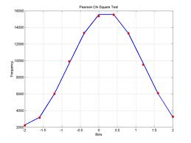
Hypothesis and Results

Slide 70
Hypotheses and Results..
Retail store factors Store Convenience (SC), Relevant Communication (INFO), Expansion and control over choice set (EFC) positively and significantly influence the experience of subjective experience of consumer empowerment among women shoppers under study while shopping.
Whereas, Retails Store environment (RSI) and Consumer Involvement (CINV) are found insignificant in influencing the subjective experience of empowerment among women consumers while shopping.
Demographics (Education, Working status, Age, Monthly Household Income) and psychographics (use of credit cards, use of personal vehicles for shopping) of the women consumers do significantly influence their opinion towards considering shopping as their best free time activity.
It is interesting to note that the Marital status of the women shoppers insignificantly influences their opinion in considering shopping as their best free time activity.

Slide 71
…..Hypotheses and Results
Demographics (Age, Marital Status, MHI, Working status, Education ) of the women shoppers significantly influences the nature of the (Traditional or modern) outlet selected for shopping. On the contrary, the psychographics (use of credit cards and use of personal vehicles for shopping) of the consumers and selection of nature of outlet for shopping are independent of each other. That means, even the person possessing the credit card may buy from the traditional outlets.
Empowered consumers significantly exhibit certain qualities such product expertise (PE), confident (CON), consumer power (CP), freedom of movement (FOM), and attitude to choose the best (ACB)
The demographics (age, working status, marital status, MHI) and psychographics (use of credit cards and use of personal vehicle for shopping) of the women shoppers significantly influence the subjective experience of consumer empowerment among women shoppers.
Whereas, qualification of the women shoppers is the only one demographic factor found insignificantly influencing the subjective experience of empowerment among women shoppers while shopping.

Slide 72
Managerial Implications
Empowerment is an ongoing process and hence dynamic by nature. It is very well said as ‘La destination vaut le voyage’ which means ‘Consumer Empowerment -A revolution is underway’. (Weil Birdseye Henry & Weil Endicott Elisabeth, 1999)
Effective customer information management drives a relationship value. The starting point is the customer experience, i.e. how is the customer treated, and how does he or she feel as a result. A positive customer experience is based on individualization (“We know and deal with customers as individuals and we treat them with respect, Honesty, and fairness”)
First engaging the customer depends on delivering value. The “value” can come in a wide variety of forms, e.g., a better deal, greater convenience, a sense of accomplishment, recognition as an individual, a feeling of confidence, a sense of accomplishment, a recognition as an individual, a feeling of confidence and control.
Second engagement over a period of time is required to build the customer’s trust. The worst thing to spoil the relationship is to frustrate, disappoint, irritate, or abuse the customer for instance, stepping over the ones “acceptable behaviour”.

Slide 73
Managerial Implications (Continued)
Most important lesson is that the service provider must give up control of the relationship to the customer before the customer can empower the provider.
The empowerment relationship model is difficult to envision and complex to achieve. Success requires understanding, sensitivity, patience, commitment, and above all a positive attitude.
Don’t try to capture customers (i.e. Hold them prisoners), captivate them
Don’t think about extracting value from customers (i.e. zero sum game), create and share value with them.

