Slide 1
Serving the Research Community
Marta Dyson- Senior Account Manager for Central Europe
Notes:
Welcome to today’s publishing event at XXXXX
Please note that any presentations from today will be made available for you to download. As long you registered with us, we will be sending a link to you from where you can download copies of all today’s slide decks.

Slide 2
Agenda
1. About Wiley – Marta Dyson
2. How to Publish – part 1 – Anne Deveson
3. Break
4. How to publish – part 2 – Anne Deveson
5. Q&A
6. Certificates
Notes:
Three areas that I’m going to go through with you:
About Wiley who we are, our strengths and what we publish. This will help frame the rest of today’s event and really set the context of our organisation and the journals that you may choose to publish with.
Journal Innovations - the way that content is made available has changed dramatically over recent times. This section will show you how Wiley is transforming the reading experience for journal content
Your consortium profile

Slide 3

Wiley has been a valued source of information and understanding for more than 200 years.
Our content, products, and services help researchers, professionals, educators and students around the world meet their needs and fulfill their aspirations.
Notes:
Wiley has been a valued source of information and understanding for more than 200 years.
Our content, products, and services help researchers, professionals, educators and students around the world meet their needs and fulfill their aspirations.

Slide 4


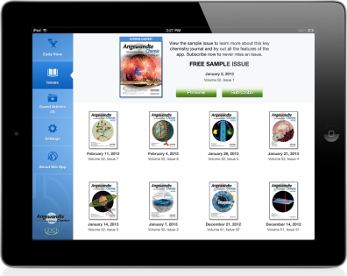

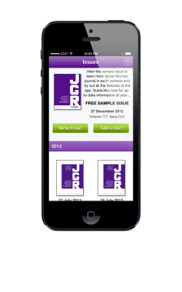

Leaders in Quality
We have evolved from being a producer of content in static form, to a provider of dynamic new types of products and services.
Notes:
In 1807, 25-year-old Charles Wiley opened a small printing shop at 6 Reade Street in lower Manhattan, initially printing titles for other publishers and eventually adding financing and distribution to his printing skills to become a full-fledge publisher.
Today, we have evolved from being a provider of content in static form to a provider of dynamic new types of products and services.

Slide 5
Serving the Research Community
We publish in every major academic, scientific and professional field.
Health
Social Science
Humanities
Physical Sciences
Life Science
Economics
Engineering
Statistics
Notes:
We publish in every major academic, scientific and professional field
Wiley's Global Research business is a provider of content-enabled solutions to improve outcomes in research, education and professional practice, we publish in every major academic, scientific and professional field.

Slide 6































The World’s Largest Society Publisher
942 societies globally partner with Wiley to publish their journals,
-a total audience
over 2 million
members
Notes:
We are the World’s Largest Society Publisher:
942 societies globally partner with Wiley to publish their journals, this on its own equates to a total audience over 2 million experts in their field

Slide 7


Marie Curie
Nobel Prize Winners
Ivan Pavlov
Kofi Annan
Nelson Mandela
Günter Grass
Out of 869 Nobel Laureates,
more than 479 have published with Wiley
Mikhail Gorbachev
Woodrow Wilson
Milton Friedman
Akira Suzuki
Albert Einstein
Ei-ichi Negishi
George Bernard Shaw
Christopher A. Sims
Sir Alexander Fleming
Leymah Gbowee
Earl Bertrand Russell
Bruce A. Beutler
Henry Kissinger
Jules A. Hoffman
Brian P. Schmidt
Linus Pauling
Thomas J. Sargent
Frédéric Joliot & Irène Joliot-Curie
Notes:
A measure of our pedigree is the number of Nobel Prize Winners who have chosen to publish with us.
Out of 850 Nobel Laureates, more than 460 have published with Wiley.

Slide 8
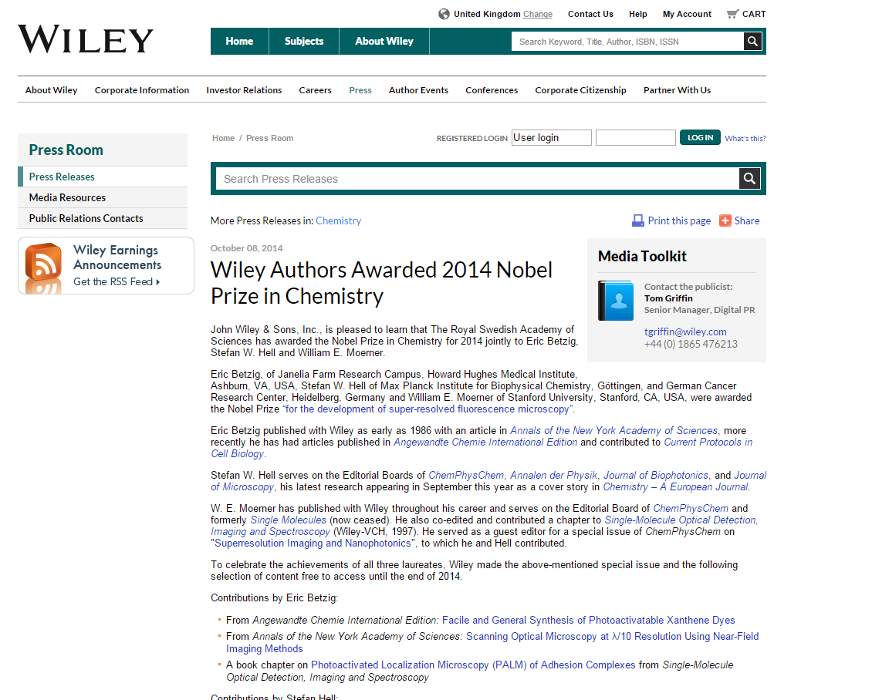

Slide 9
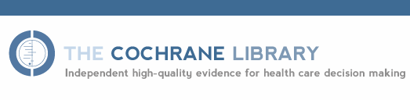

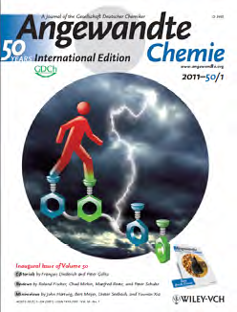

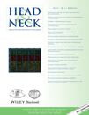
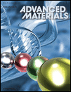
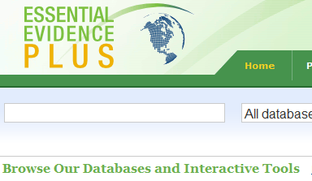


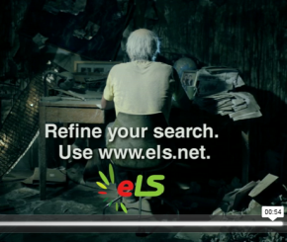
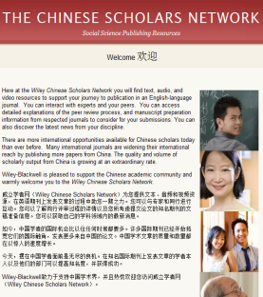
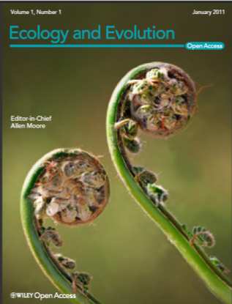


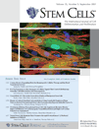

Our Portfolio
Health Sciences
Physical Sciences & Engineering
Life Sciences
Social Sciences & Humanities

Slide 10
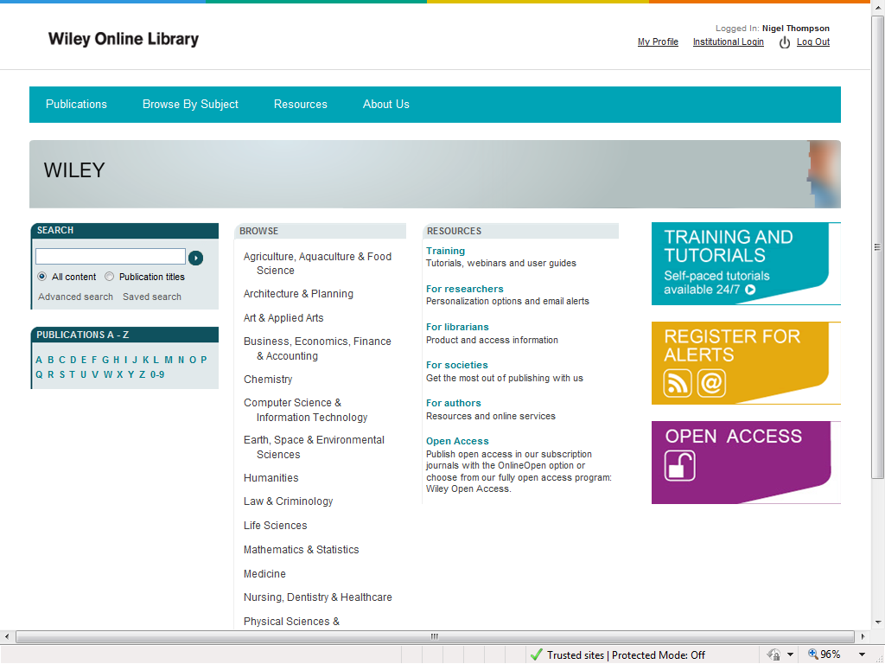
The home for Wiley content
5 million articles
13.5 million unique visitors visit our journals each month
wileyonlinelibary.com
Notes:
The home for all of our content is Wiley Online Library.
this world renowned resource contains 5 million peer reviewed research articles and a measure of our engagement with the greatest minds sees 13.5 million unique visitors to our journals each month via wileyonlinelibrary.com

Slide 11


Green and Gold (Wiley)
No payment
Article goes through Wiley’s editorial processes
Self-deposited (archived) in institutional or subject repository
Author accepted version of the document archived
Repository responsible for maintenance of archive and for integration of articles with other documents
Embargo period of up to 24 months may apply
Pay to publish (Authors, funders or institutions pay an APC)
Article goes through Wiley’s editorial processes
Article deposited by Wiley into PubMed Central
Final edited, corrected and formatted PDF version archived
Wiley Online Library contains Open Access and Subscription articles in the one place and integrated links to all other documents
Article immediately accessible online after publication
Notes:
Wiley Open Access is a program of fully open access journals. All research articles published in Wiley Open Access journals are immediately freely available to read, download and share. .e. that we have over 50 fully OA journals etc
OnlineOpen is Wiley's hybrid open access option available on over 1300 journals.
And then move onto how Wiley Supports Institutional Customers:
Wiley Open Access Account
Wiley Partner‘s Fee
No double-dipping policy
Standard self-archiving policy
Discoverability

Slide 12
Digital
Output
1,500 journals
16,000+ online books
180+ multi-volume references and handbooks
17 Current Protocols (Laboratory Manuals featuring over 10,000 protocols)
11 databases
(chemistry & evidence based medicine)
Notes:
Our digital output through WOL delivers a blend of 1,500 journals, 16,000+ books, and 130+ reference works and 11 databases (chemistry & evidence based medicine).

Slide 13
Wiley journals with Impact Factor
1,202 journals indexed
137,526 articles indexed
5,435,025 citations to Wiley titles
#1 in 29 JCR categories
Wiley makes up more than 10% of the latest 2013 JCR in terms of journals and articles indexed and citations to our content.
Notes:
The impact factor was first applied in the 60’s and was used to measure the relative influence of molecular biology and biochemistry journals.
Today impact factors from Thomson Reuters’ Journal Citation Report are the globally recognised measure for the quality of journals
1,202 journals indexed Wiley #3
137,526 articles indexed Wiley #3
5,435,025 citations to Wiley titles Wiley#2
#1 in 29 JCR categories
Wiley makes up more than 10% of the latest JCR in terms of journals and articles indexed and citations to our content.

Slide 14
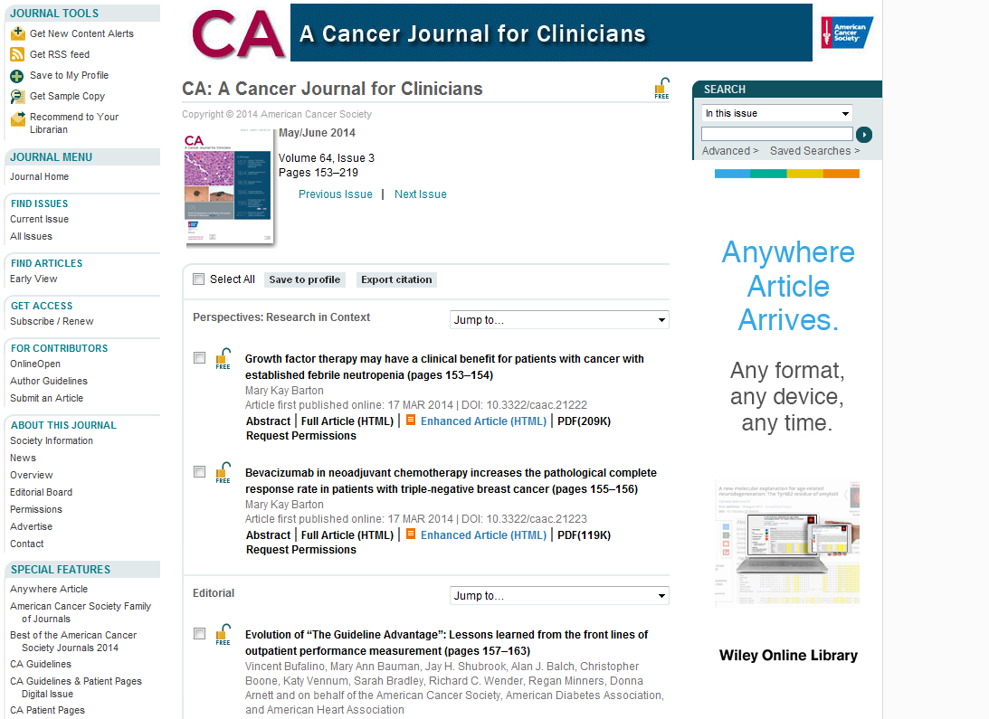
#1 Journal in the whole of JCR
CA – A Cancer Journal for Clinicians, has the highest IF in the JCR with an IF of 162.5 with 0% self-citation!
Notes:
CA – A Cancer Journal for Clinicians, has the highest IF in the JCR with an IF of 153.459 with 0% self-citation! (more than 100 points above the 2nd ranked title New England Journal of Medicine).
Still the only journal with an impact factor of more than 100

Slide 15


Wiley in Czech Republic

Slide 16
No. of articles published –
All Publishers

Slide 17
2013 Research Output – Top 20 Subjects
Notes:
Anthropology is especially high because of the high number of papers from the journal of the Croatian Anthropological Society (Collegium Anthropologicum) which is why they are fourth largest ‘publisher’ in slide 25. Aside from that we can see that top subject area are in the sciences. (Branka, Wiley is not prolific in Physics as other subject areas which is why there are no papers).

Slide 18
Top 25 Publishers 2013

Slide 19
Wiley Market Shares - 2013 Articles vs 2013 Citations (20 Largest Categories)
Notes:
Wiley’s share of citations is greater than its share of articles
This demonstrates the overall citability of the Wiley portfolio together with our breadth of discipline coverage.

Slide 20
Growth by Institute
Institute | Citable Items 2009 | Citable Items 2010 | Citable Items 2011 | Citable Items 2012 | Citable Items 2013 | Citable Items 2014 | Avg. Growth per Year | Total Growth 2009-2013 | Wiley Share 2013
Liberecky kraj | 1 | 20 | 15 | 20 | 40 | 1 | 502% | 3900% | 0%
Fakultni Nemocnice Ostrava | 28 | 15 | 124 | 206 | 313 | 311 | 200% | 1018% | 1%
Fakultni Nemocnice u svate Anny v Brne | 82 | 139 | 150 | 321 | 544 | 660 | 65% | 563% | 3%
Fakultni Thomayerova nemocnice s poliklinikou | 59 | 85 | 116 | 155 | 238 | 162 | 42% | 303% | 5%
CESKA NARODNI BANKA | 18 | 42 | 73 | 71 | 70 | 24 | 51% | 289% | 13%
Vysoka Skola Ekonomicka v Praze | 96 | 131 | 165 | 182 | 330 | 162 | 39% | 244% | 1%
UNIVERZITA HRADEC KRALOVE | 48 | 97 | 85 | 75 | 158 | 121 | 47% | 229% | 6%
ANGLO-AMERICAN UNIVERSITY | 4 | 20 | 13 | 8 | 13 | 2 | 97% | 225% | 8%
CESKE VYSOKE UCENI TECHNICKE V PRAZE | 2077 | 2898 | 5543 | 8323 | 6487 | 4495 | 40% | 212% | 1%
STATNI USTAV RADIACNI OCHRANY | 28 | 61 | 80 | 26 | 75 | 80 | 67% | 168% | 0%
VYSOKE UCENI TECHNICKE V BRNE | 940 | 1324 | 1608 | 2169 | 2468 | 1844 | 28% | 163% | 4%
MENDELOVA UNIVERZITA V BRNE | 832 | 899 | 1051 | 1800 | 2001 | 1525 | 27% | 141% | 10%
Fakultni Nemocnice Hradec Kralove | 294 | 375 | 493 | 542 | 707 | 499 | 25% | 140% | 8%
Vlada Ceske Republiky Ministerstvo kultury | 6 | 3 | 10 | 13 | 14 | 5 | 55% | 133% | 14%
SLEZSKA UNIVERZITA V OPAVE | 121 | 162 | 197 | 196 | 279 | 237 | 24% | 131% | 0%

Slide 21
Journal Innovations from Wiley
Notes:
Not only does Wiley lead the way in terms of publishing output, we are also at the forefront when it comes to innovations in journal deployment…

Slide 22



Key Journal Innovations
Anywhere
Article
Journal Apps
Notes:
There are currently 4 major journal initiatives that are underway at Wiley:
Anywhere Article – the new version of the HTML article
Readcube – the enhanced journal PDF format
Altmetric – a new system for measuring the impact of journal articles (Jill will present this later on)
Journal Apps that allow you to read our Journals from your mobile device

Slide 23
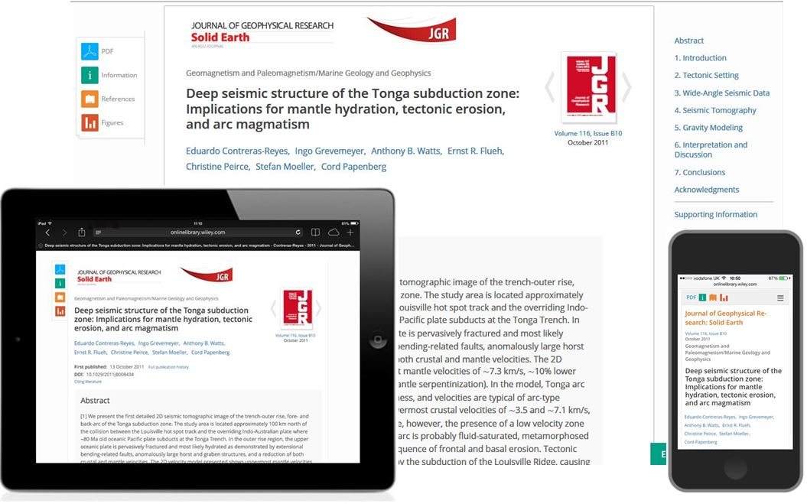
What is Anywhere Article?
The Anywhere Article is the new version of the HTML article.
It makes journal content more readable, more portable and more useful.
Notes:
The Anywhere Article is the new version of the HTML article.
It makes journal content more readable, more portable and more useful.

Slide 24
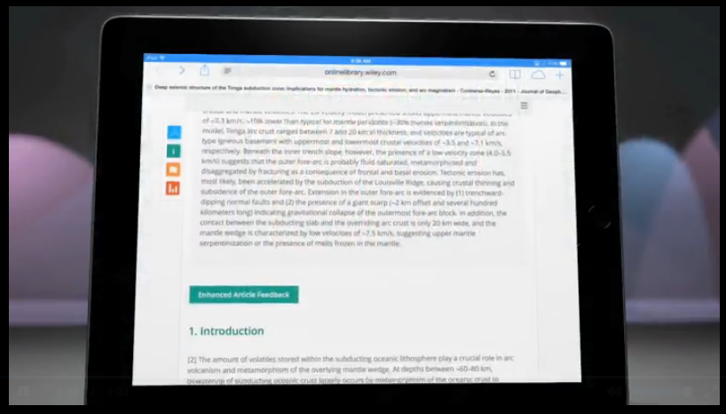
The Anywhere Article in action
Notes:
Play AA promo video

Slide 25
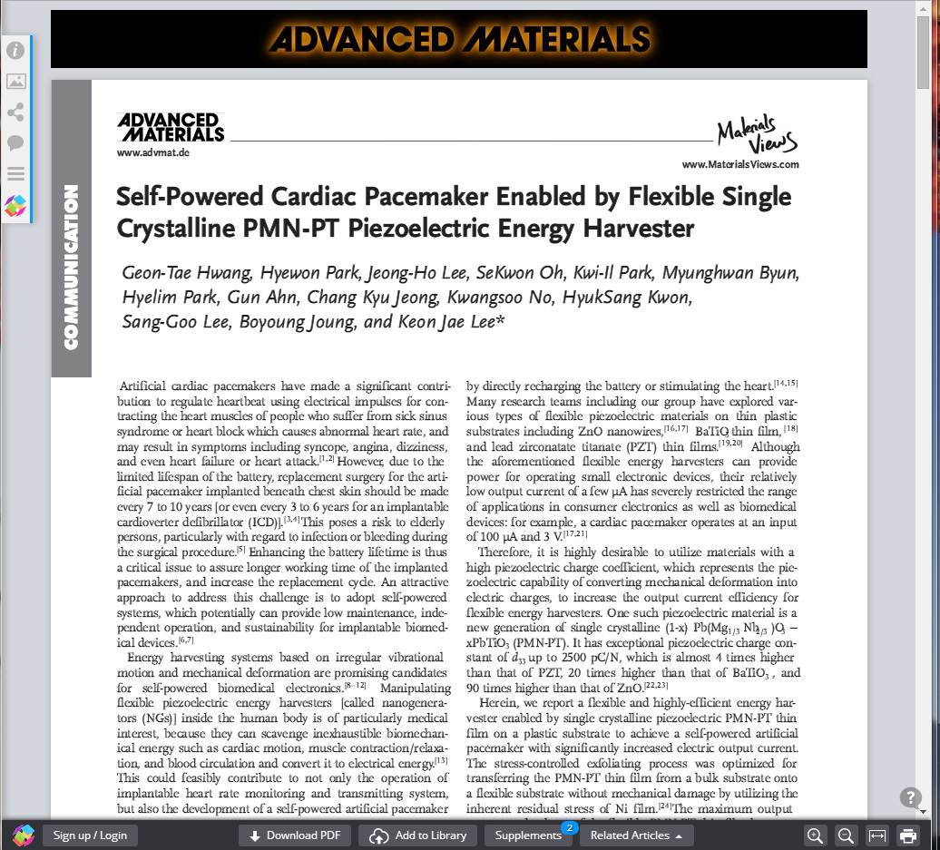

We have also enhanced the PDF experience…
Notes:
Play: ReadCube on Wiley Online Library and Cochrane.mp4

Slide 26
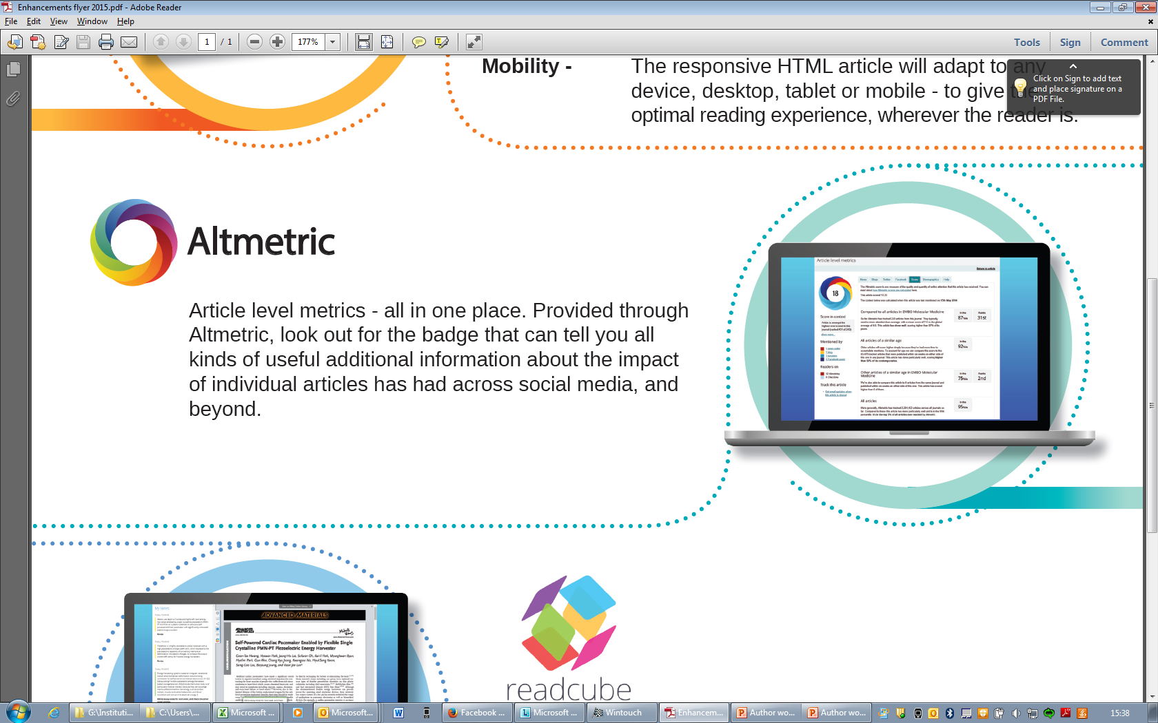

Article level metrics - all in one place. Provided through Altmetric, look out for the badge that can tell you all kinds of useful additional information about the impact of individual articles has had across social media, and beyond.

Slide 27


220 Wiley Journals are now available on the Apple Newsstand
To take advantage of your institutional subscription, you must create a personal ID on Wiley Online Library, then activate “roaming access”
Notes:
You can also find 220 Wiley Journals as Apps on the Apple newsstand.
To take advantage of your institutional subscription, you must create a personal ID on Wiley Online Library, then activate “roaming access”

Slide 28

Wiley Editing Services

Slide 29
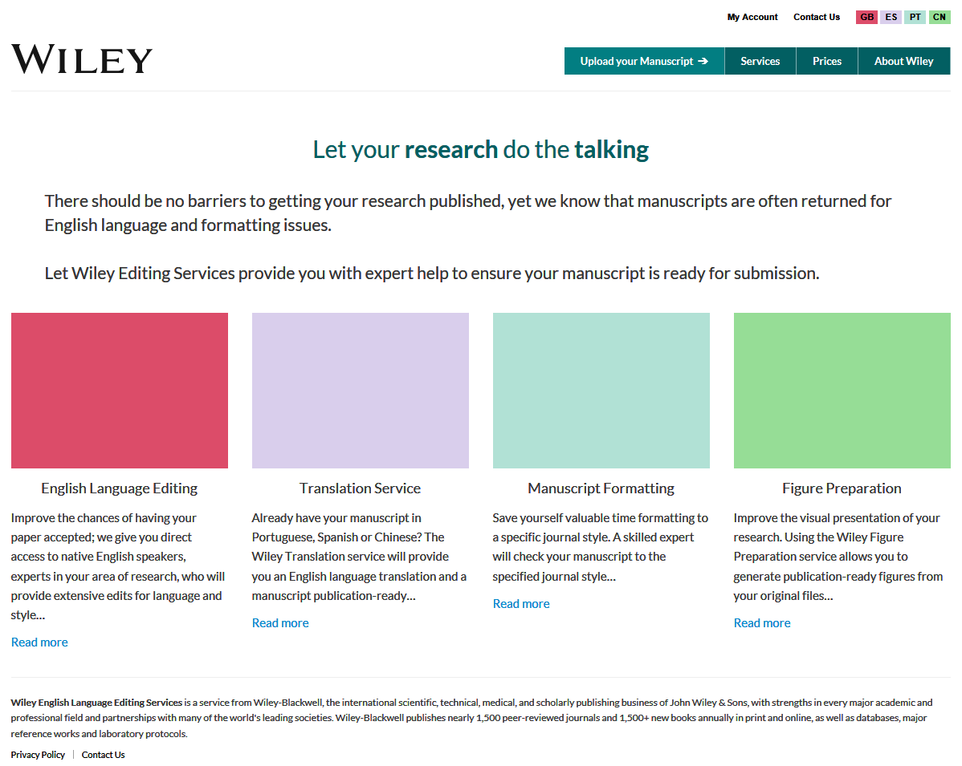



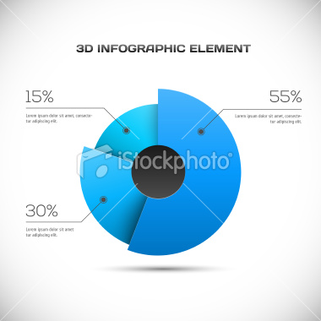
wileyeditingservices.com

Slide 30

English Language Editing
Improve the chances of having your paper accepted
Two levels of editing available
Technical Specialists in your subject area
Experts based at the highest profile US universities
Notes:
Every year hundreds of papers are rejected due to English language editing requirements. At Wiley we know that language shouldn’t be a barrier to getting your quality research published.
With Wiley Editing Services it needn’t be. We have hundreds of specialist researchers ready to edit your paper, all native language English speakers, with a minimum of Masters level education, at the most respected US and Ivy League Universities.
It couldn’t be simpler – just submit your manuscript, decide how quickly you need the work done, and we will do the rest.

Slide 31

Translation Services
Provides you with an English language translation and a manuscript publication-ready
Portuguese, Spanish, Chinese
Experienced translators are all academics with advanced degrees
Notes:
For information, in case you come across this on the website. It’s a translation service we currently provide for the most widely spoken languages in the world but if publishing output increases from Czech Republic / Slovakia then something Wiley will consider for future.

Slide 32

Manuscript Formatting
Saves your valuable time by formatting to a specific journal style
Skilled experts to format manuscripts
Adjust the citations, references, and layout of the document to the correct conventions
Notes:
Our skilled formatters will ensure that your manuscript and references are formatted according to the style guide of your target journal. We'll focus on the small details so that you can focus on the big picture.
Our managing formatters check each manuscript against your journal’s style guide and adjust the citations, references, and layout of the document to the correct conventions. All figures and tables are moved to the correct location in the manuscript, and figure titles and legends are standardized according to your journal's specifications.

Slide 33
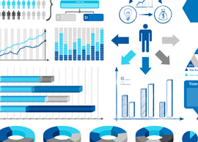
Figure Preparation
Improve the visual presentation of your research
Publication ready figure files
Correct size, resolution and layout to suit a specific journal
Notes:
The impact of your research article can be significantly enhanced with the careful placement of the right graph, illustration, photograph or diagram. However this can be massively time consuming with many journals requesting specific layout and format requirements. With the Wiley Figure Preparation service we provide you with publication ready figure files, set to the correct size, resolution and layout to suit the specific journal you are submitting your research to.

Slide 34
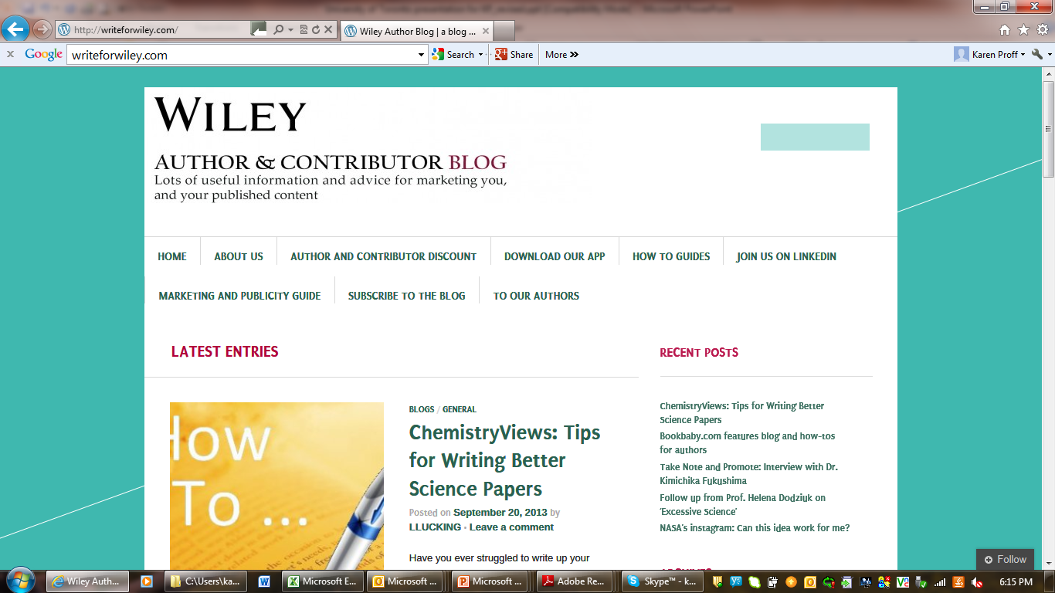
writeforwiley.com
Notes:
And check site out for advice and guidance on marketing yourself and your published content.

Slide 35
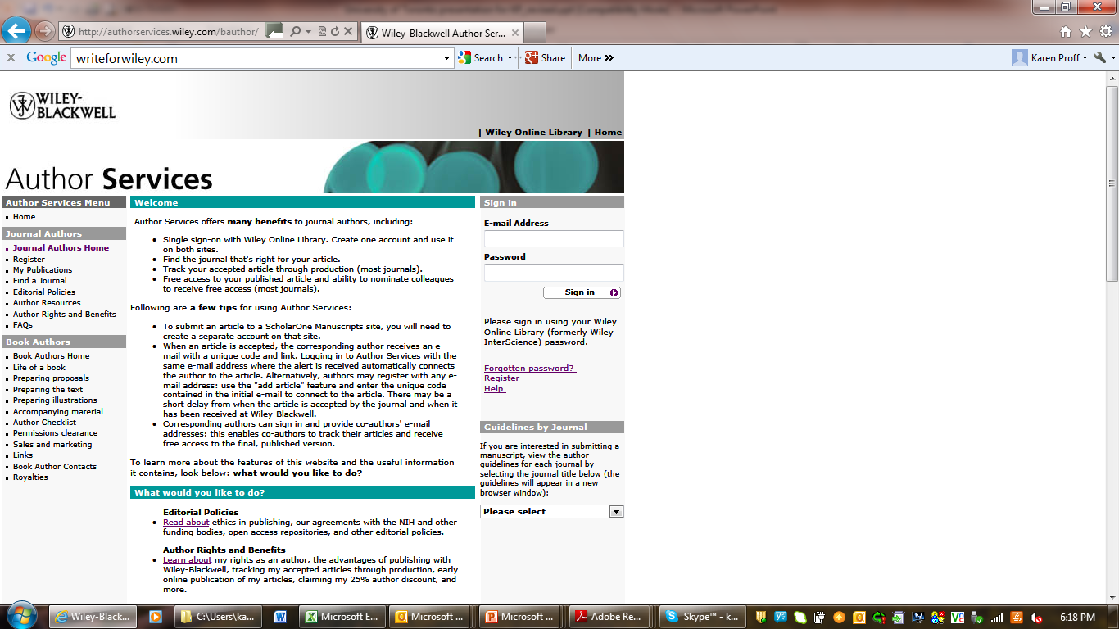
authorservices.wiley.com
Notes:
This site is for journal and book authors. It’s free and you can use it to:
Track the production status of an accepted article.
Sign the license agreement for an accepted article.
Add a second or further article to your profile if you are already registered.
Gain free subscription access to your published article.
Nominate up to 10 colleagues for free access to your article (most journals).
Provide your co-authors' e-mail addresses so they can track their articles and receive free subscription access to the final published version.

