Slide 1

Studying in Huddersfield 2023/24

Slide 2
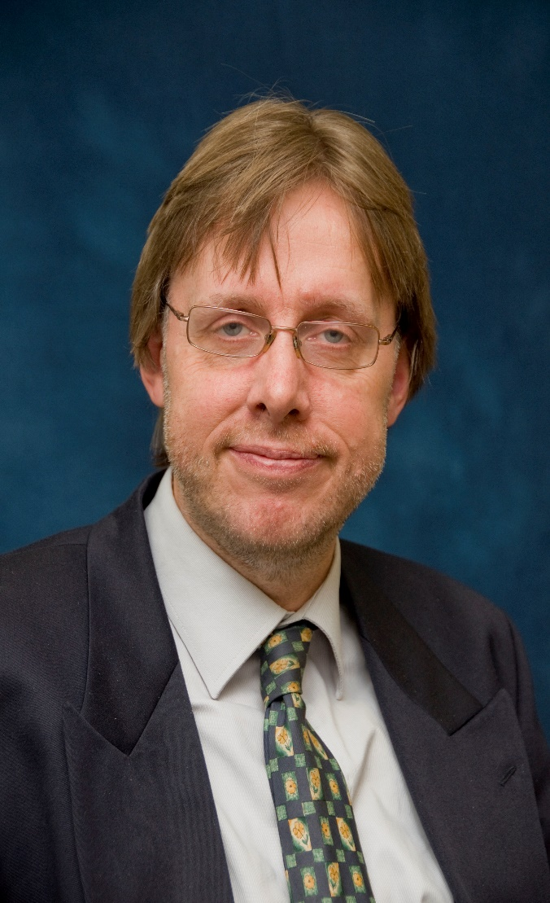
Prof John Anchor
Associate Dean (International), Huddersfield Business School
My name is John Anchor and I am Professor of International Strategy in the University of Huddersfield. My research is focused on emerging markets, especially in Central and Eastern Europe and the Middle East. Studies have been undertaken of students’ earnings expectations in Central Europe and political risk assessment and strategic planning use in the Middle East. The main research question which I am seeking to answer is “do emerging markets make a difference to organisational conduct and performance and/or individual behaviour?”.
Notes:
This slide has been left blank for you to add in an introduction about yourself

Slide 3
This presentation
Huddersfield
University of Huddersfield
Huddersfield Business School
Arriving and Living in Huddersfield

Slide 4
Huddersfield

Slide 5
Location
Edinburgh
Newcastle
Huddersfield
Leeds
Huddersfield
London
Manchester

Slide 6








Surroundings

Slide 7

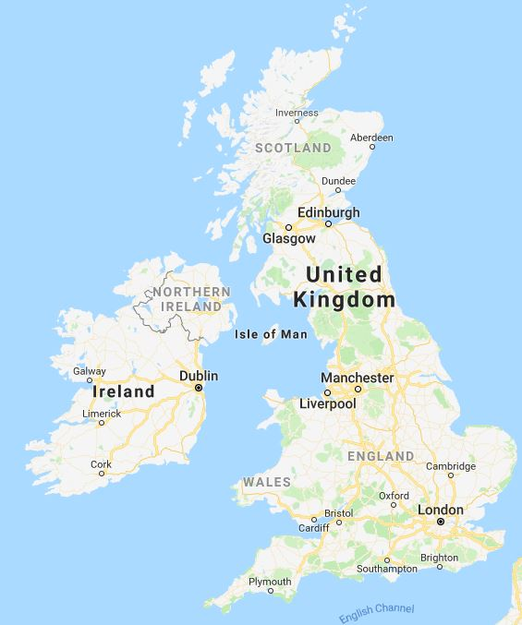

… and ABOUT by train …

Slide 8


… or by bus
Locally
Local buses run regularly and connect all areas of Huddersfield very well
Bus prices are higher than in many other countries
You can plan your travels around Yorkshire on the following website: www.wymetro.com
Nationwide
Coach prices are very cheap compared to trains for long distance travels
You can travel with megabus or National Express

Slide 9
University of
Huddersfield

Slide 10



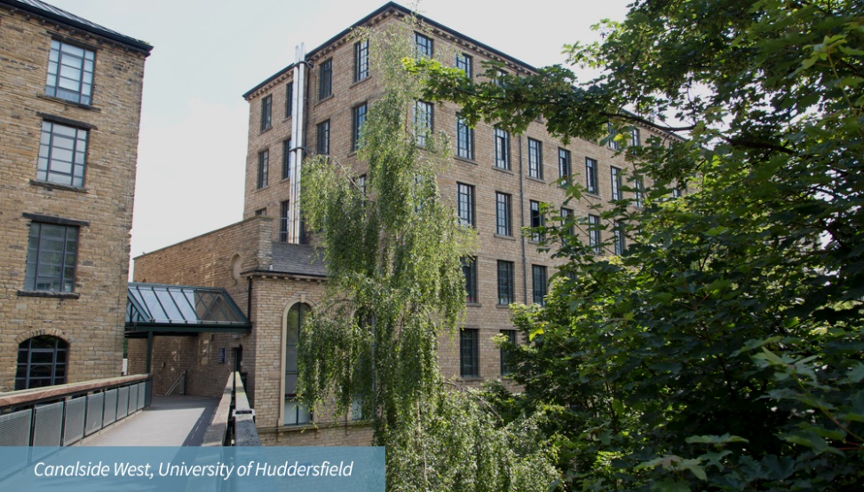
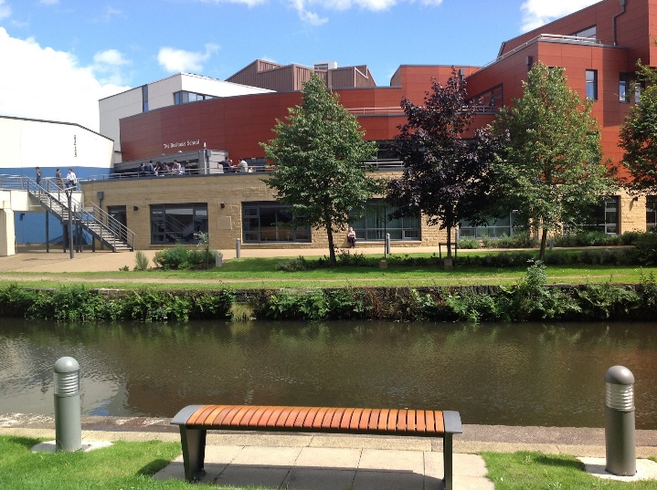


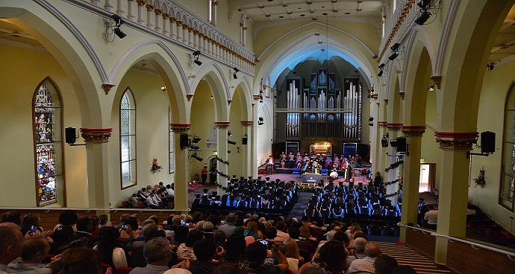
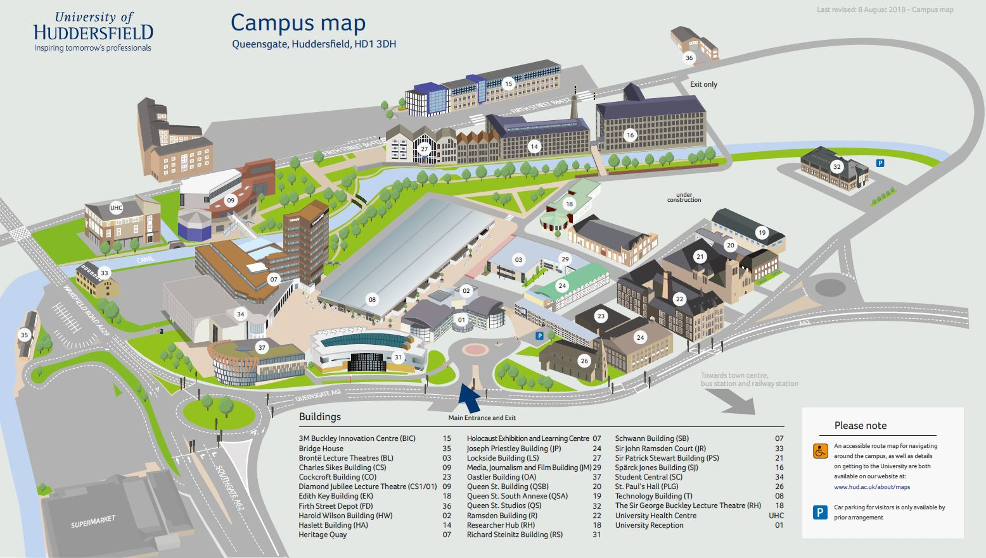
The Campus

Slide 11

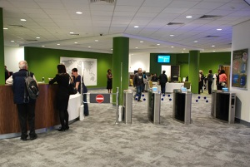
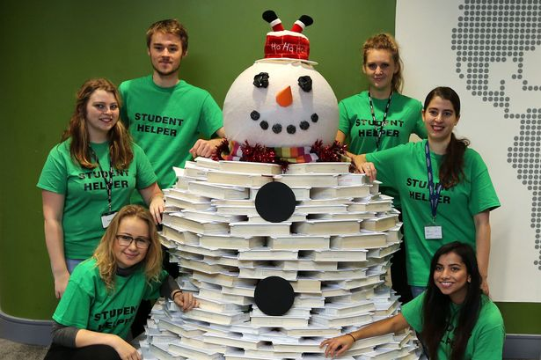


Library

Slide 12

Huddersfield Business School

Slide 13
Why Huddersfield Business School ?
Working with Czech partners since 1991
  faculty development
  curriculum development
  student exchange
  staff exchange
  600 Czech students since September 2004

Slide 14
Student Support
You will have a personal academic tutor (PAT) from the very first day at Huddersfield
The tutor will provide advice your studies in general and can provide some guidance about non-academic matters
The Business School has International Learning Development Tutors, who are very helpful in relation to skills development and academic writing in English

Slide 15






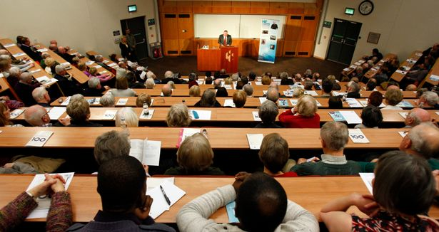
Huddersfield Business School

Slide 16
BA International Business (Year 3, Top Up)
Course (Programme) Structure
BHS0003 International Business: 10 ECTS
BHS0035 Strategy in Context: 10 ECTS
BHO0034 Cross Cultural Studies: 20 ECTS
and
two optional modules: 20 ECTS
including BHS0020 Management Project:10 ECTS (this may be required by your Czech university)
and Languages (if you have studied them before)
Note: Bigger modules than in Czech universities!

Slide 17
The Project/Dissertation
This is your largest single task!!
You will be provide with a Supervisor
You choose a business topic and develop a research question
The length of the dissertation should be normally 13-15,000 words
Regular meetings and/or e-mail contact with your Supervisor is essential

Slide 18
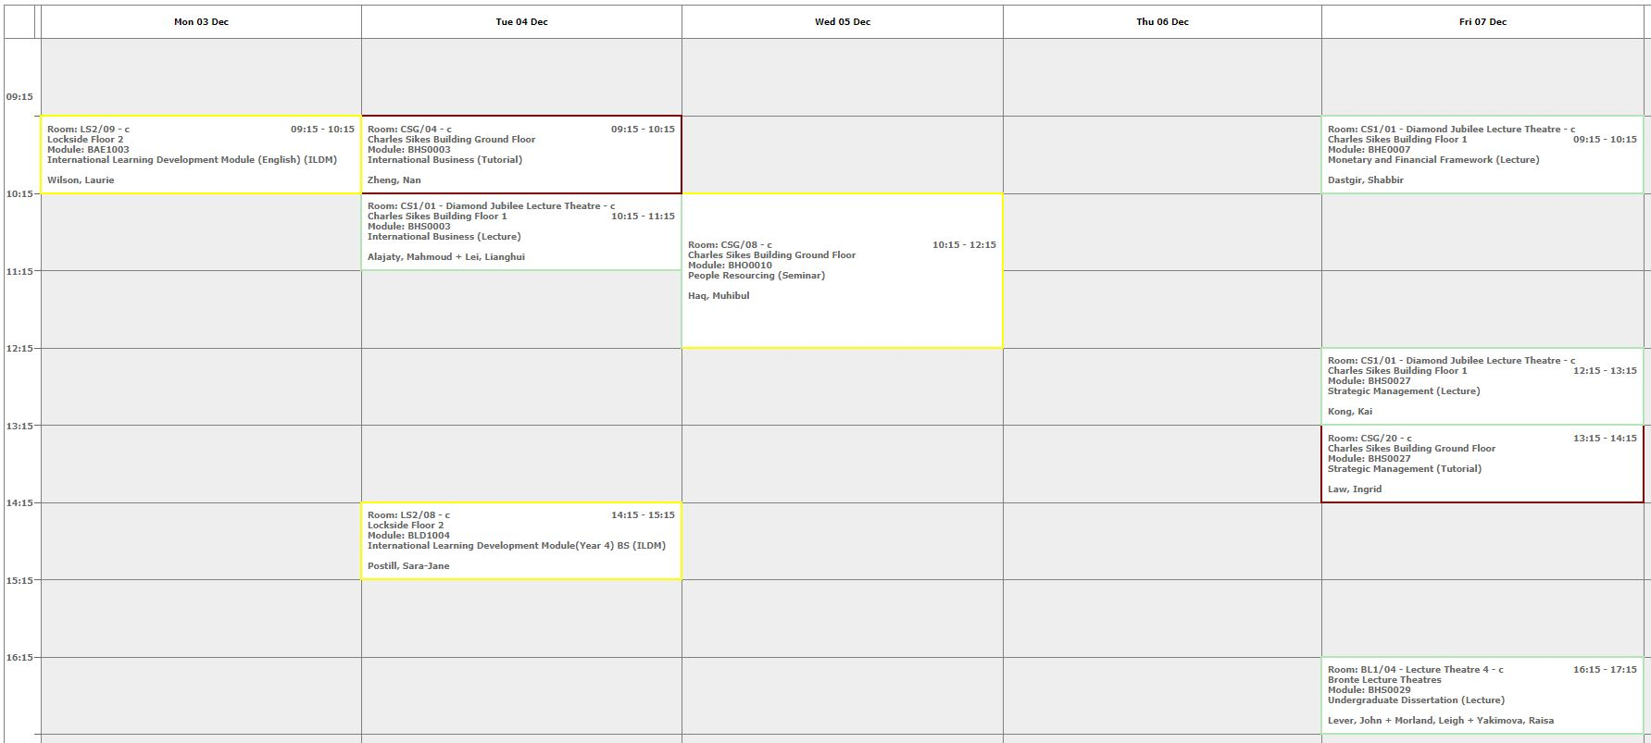
Academic Study
Only 10 hours per week in classroom, plus dissertation supervision, but 30 hours per week in private study/library.

Slide 19
Tuition Fees 2023/24
International Student Fees are £15,000 per annum with a scholarship of £2,000 i.e. £13,000 nett
UK student fees are £9,250 per annum
Huddersfield Business School is offering a reduced fee of £6,000 to some of our historic partners
Fees are payable in up to three instalments

Slide 20
Financial Support
Czech Government & Your Faculty
As a result of the agreement signed between our two universities, you may be able to obtain further financial support
Bank of Mum and Dad
Your family may be able to help you
Loan
You can apply for a loan from a bank – but not the UK Government since Brexit

Slide 21
Master Programmes
We have a large number of Master programmes.
The ones which are displayed on the next slides are examples.
For further information, please look at our Course (Programme) Finder
List of courses for 2023-24 (hud.ac.uk)
All our Master programmes have both a September and a January start

Slide 22
MSc Economics
Programme (Course) Structure
Principles of Economics: 15 ECTS
Context of International Business: 15 ECTS
Quantitative Economic Methods: 15 ECTS
Financial Markets and Institutions: 7.5 ECTS
The Global Professional: 7.5 ECTS
Individual Research Project: 22.5 ECTS
and
one optional module: 7.5 ECTS
Note: the modules are bigger than in Czech universities

Slide 23
MSc International Business
Programme (Course) Structure
Context of International Business: 15 ECTS
Strategy of International Business: 15 ECTS
The Global Professional: 7.5 ECTS
Research Methods: 7.5 ECTS
Individual Research Project: 22.5 ECTS
and
Three optional modules: 22.5 ECTS
Note: the modules are bigger than in Czech universities

Slide 24
Optional Modules
Functional Areas
e.g. International Marketing, International Human Resource Management, International Trade Operations, International Business Finance, Data Analytics
Sectoral Areas
e.g. International Tourism Management and Development, Emerging and Alternative Financial Markets, Globalisation and Financial Crises

Slide 25
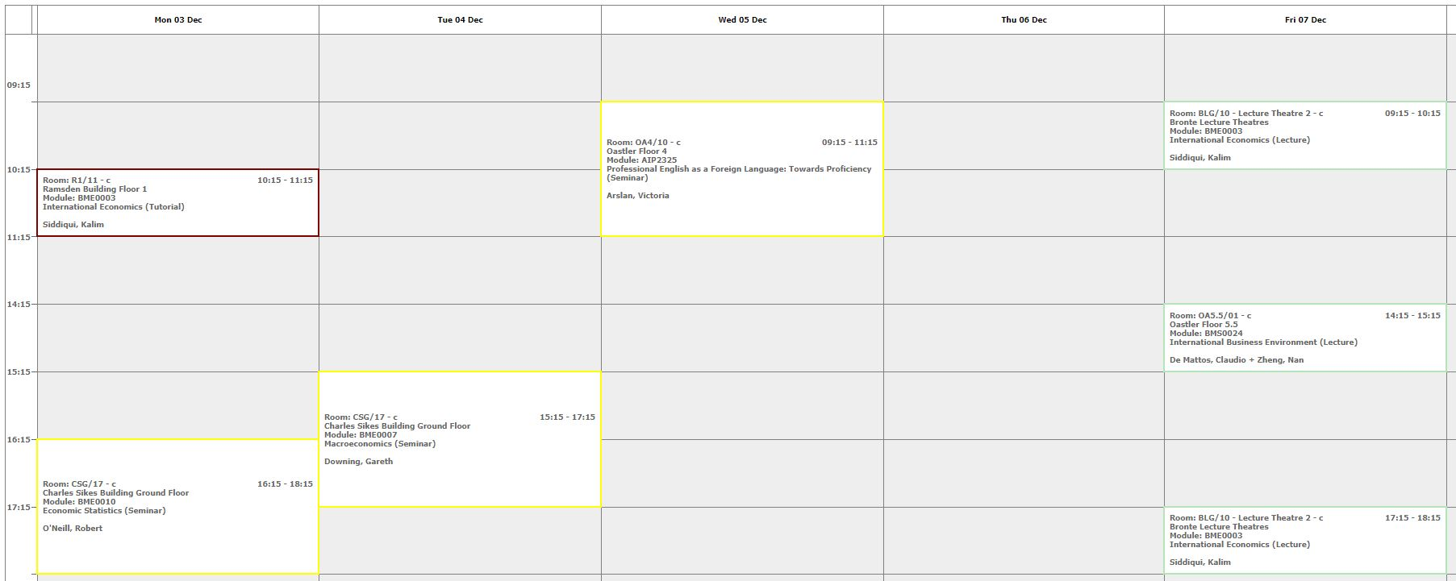
Terms 1 & 2: September - May
Only 10 hours per week in classroom but 30 hours per week in private study/library.

Slide 26
Semester 3: May - September
Individual Research Project (30 ECTS)
This module involves conceptualising, designing and conducting a piece of research using methods appropriate to your field of study.
You will select a research topic which corresponds to your own particular interests and develop a more specialised knowledge and understanding of this area.
  The Research Paper is about 8000 words
Consultancy Group Project (30 ECTS)
This module involves undertaking a practical project for a company and writing it up in the form of a report. Only selected students can take this!

Slide 27
Tuition Fees 2023/24
The fee for the programme (3 semesters) is £16,000 for international students with a £2,000 scholarship i.e. nett £14,000
The fee for UK students is £8,900 (with an optional UK Government loan available)
Huddersfield Business School is offering a reduced fee for some of our historic partners of £6,000
Fees are payable in up to three instalments

Slide 28
Financial Support
Czech Government & Your Faculty
As a result of the agreement signed between our two universities, you may be able to obtain further financial support
Bank of Mum and Dad
Your family may be able to help you
Loan
You may be able to obtain a loan from a bank – but not the UK Government since Brexit

Slide 29
Arriving and Living in Huddersfield

Slide 30
Living Costs
Housing and transport is more expensive in England
Clothing and houseware is more expensive in ČR
Food is about the same
Pivo is more expensive in England … and not so good!

Slide 31
Accommodation
There are various sites offered by private companies but we advise you to stay at the University accommodation (DIGS).
Cost of DIGS
Ashenhurst £70 per week
Storthes Hall £90 per week
Private House £85 per week (please check whether Gas and Electricity charges are included in the rent)
After sending your application to the University, you will receive Joining Instructions and will include accommodation options from DIGS.

Slide 32
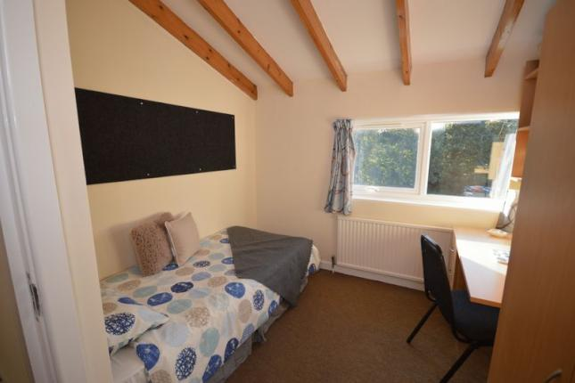
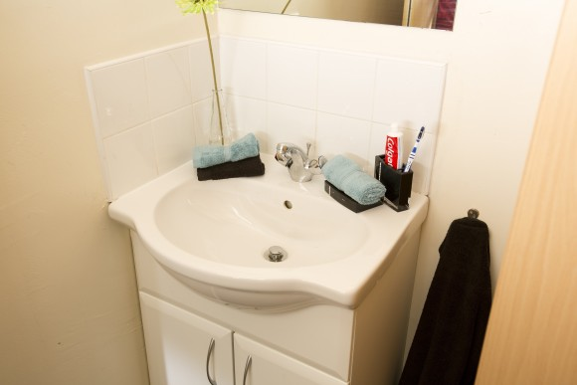


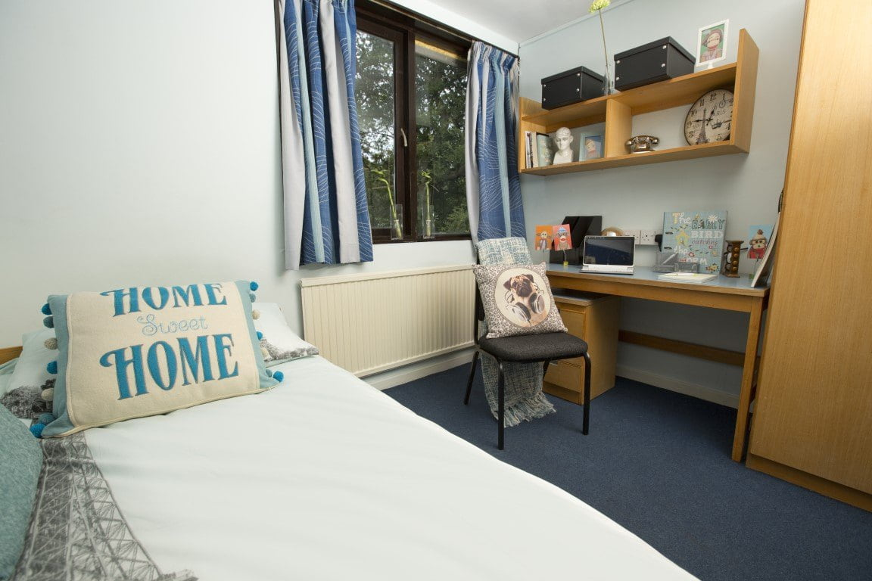
DIGS (koleje) Ashenhurst

Slide 33
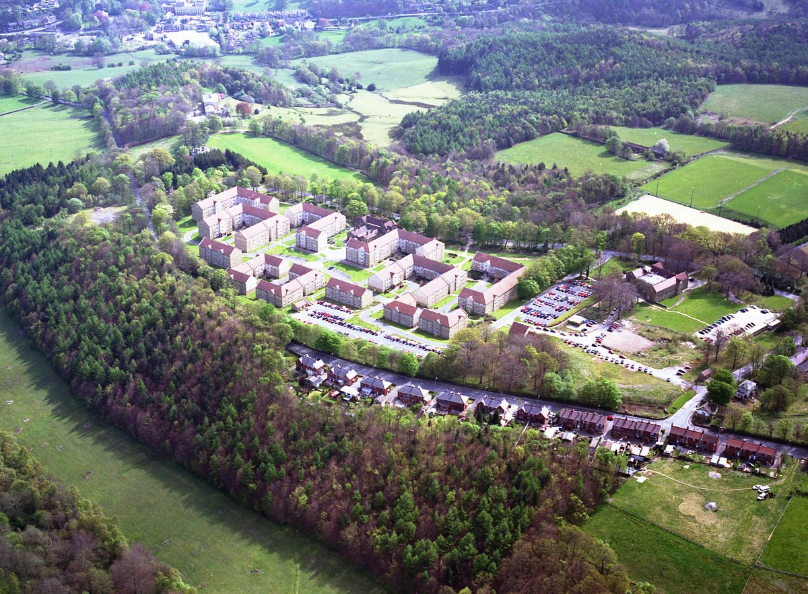


DIGS Storthes Hall Park
DIGS Storthes Hall

Slide 34
Employment
UK minimum wage per hour from 1 April 2023 is £10.18 (aged 21-22) and £10.42 living wage (aged 23+)
The legal maximum is working for 20 hours per week in term time and 48 hours in the vacations (Christmas, Easter and Summer for Bachelor students). However the University recommends no more than 15 hours
The University will not employ students for more than 15 hours per week in term time
The University job shop advertises part time jobs and pays a living wage which is higher than the national minimum wage
There is usually plenty of bar and restaurant work
Administrative jobs and factories are another possibility

Slide 35

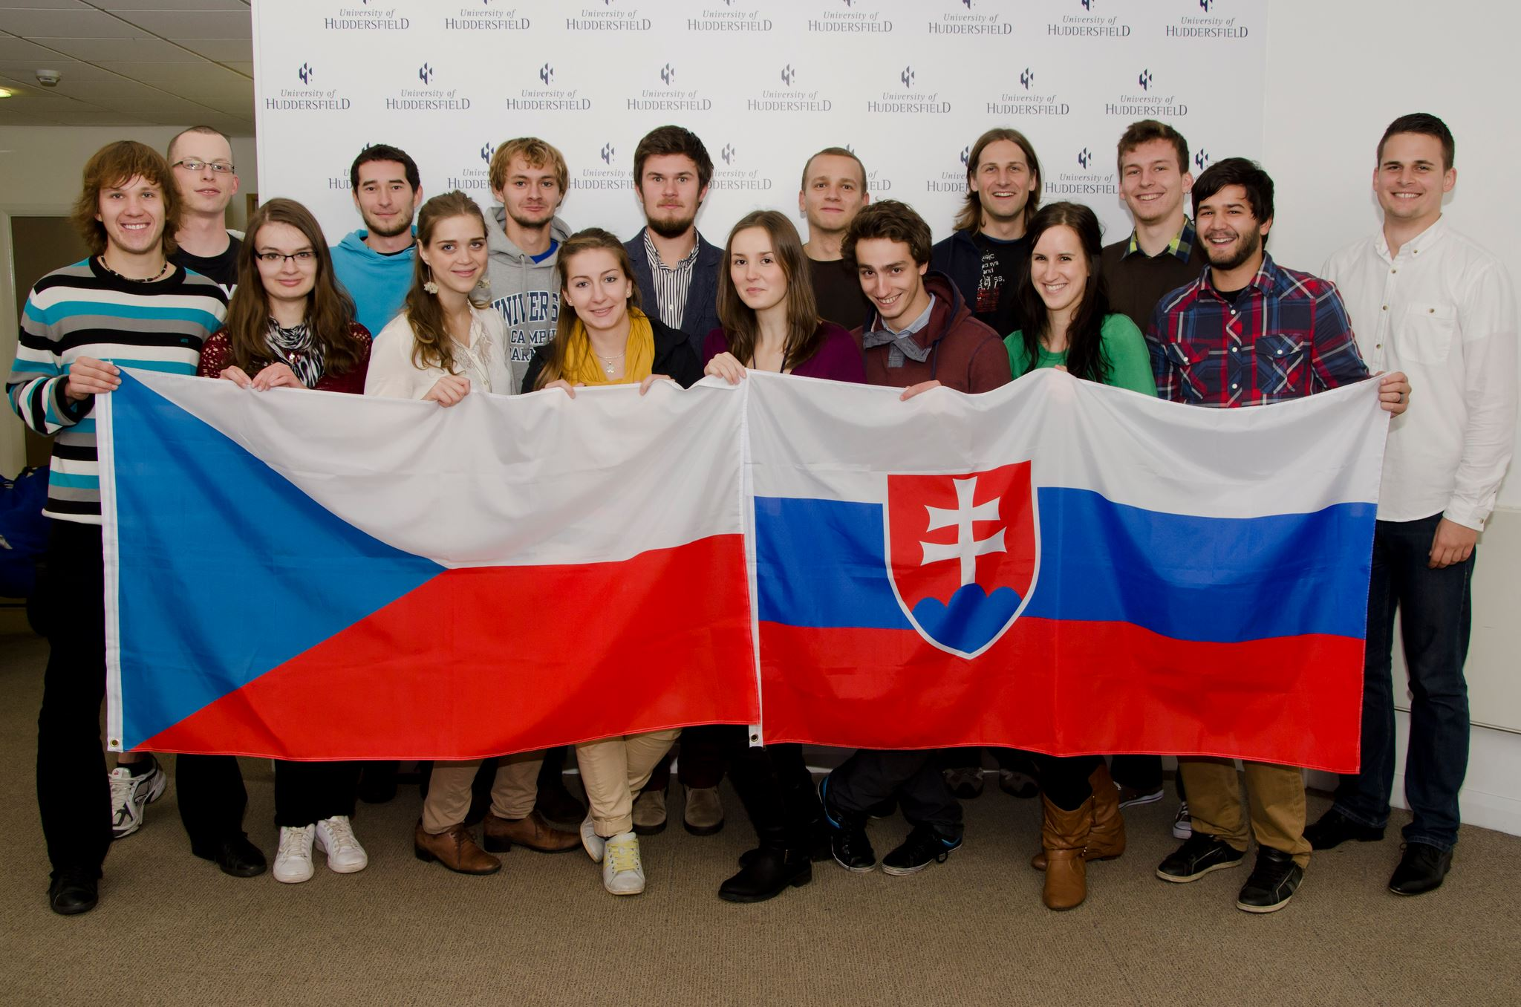
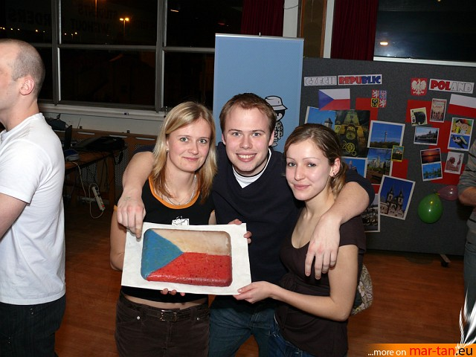
Peer Support
The best way to find your way around is from someone who has been in your shoes … previous Czech students have established a Czech and Slovak Student Society which participates in various cultural campus events and organises regular get-togethers for its members
https://www.facebook.com/czechoslovakhudsoc

Slide 36
Arrival
1 August 2023 is the earliest date to get housing
It is recommended to come to Huddersfield by 1 September 2023 if possible
It is recommended that you arrive earlier than 1 September if possible in order to get the best jobs - if you want one!
Important Dates –September Start
30 April 2023 – Application Deadline
11 September 2023 – Enrolment Week
18 September 2023 - Induction Week
25 September 2023 - Start of Teaching
Important Dates –January Start
31 October 2023 – Application Deadline
8 January 2024 – Induction Week
15 January 2024 – Start of Teaching

Slide 37
Transportation of goods to the UK
Please do not send boxes by courier. Use suitcases. It is more cost effective, post Brexit!

Slide 38
The Graduate Route to employment
International graduates can work in the UK for two years via the post study work visa https://www.gov.uk/graduate-visa
This is also known as the Graduate Route.
You must apply while still in the UK and before your Student visa expires. You can apply after the University has told you that you have successfully completed your Bachelor or Master degree programme. You do not have to wait until you have been given your degree certificate or attended a graduation ceremony.

Slide 39
How do I apply ?
You can apply and join our 100 other nationalities in the Huddersfield Business School at via our Priority Application System for partners. Your Faculty will help you with this.
Student visa information:
https://www.gov.uk/student-visa

Slide 40

ANY QUESTIONS?
Contact
Prof John Anchor - Associate Dean (International) j.r.anchor@hud.ac.uk

