Slide 1
Studying in Huddersfield 2021/22

Slide 2
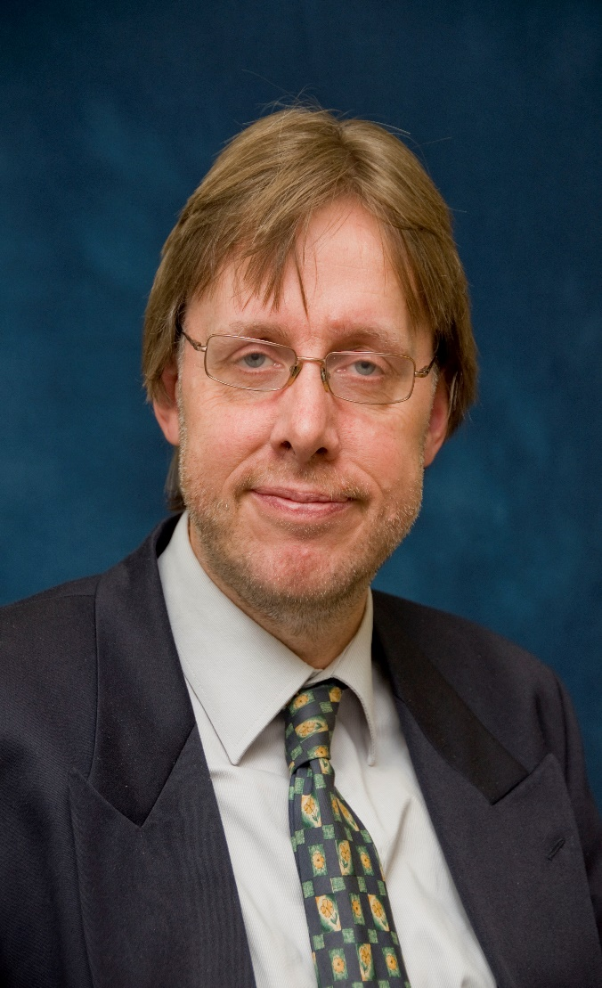
Prof John Anchor
Associate Dean (International), Huddersfield Business School
My name is John Anchor and I am Professor of International Strategy in the University of Huddersfield. My research is focused on emerging markets, especially in Central and Eastern Europe and the Middle East. Studies have been undertaken of students’ earnings expectations in Central Europe and political risk assessment and strategic planning use in the Middle East. The main research question which I am seeking to answer is “do emerging markets make a difference to organisational conduct and performance and/or individual behaviour?”.
Notes:
This slide has been left blank for you to add in an introduction about yourself

Slide 3
Brexit – changes

Slide 4
This presentation
Huddersfield
University of Huddersfield
Huddersfield Business School
Arriving and Living in Huddersfield

Slide 5
Huddersfield

Slide 6
Location
Edinburgh
Newcastle
Huddersfield
Leeds
Huddersfield
London
Manchester

Slide 7
Surroundings

Slide 8
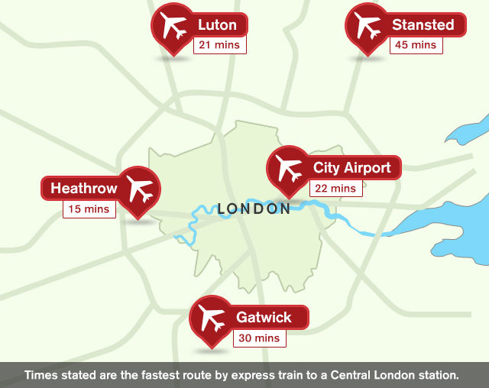
Getting IN …

Slide 9
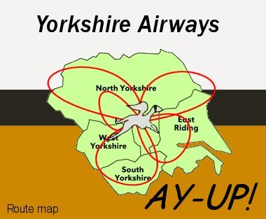
… OUT …
… once you’re in, you’re in because … if it’s outside of Yorkshire, it’s not worth visiting …
“God’s own country”

Slide 10
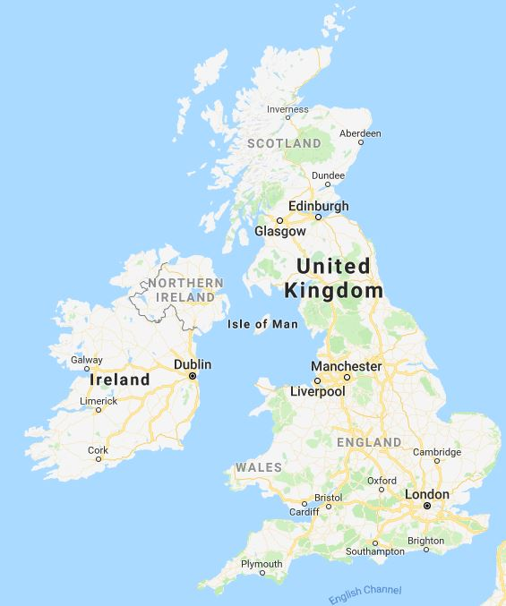
… and ABOUT by train …

Slide 11
… or by bus
Locally
Local buses run regularly and connect all areas of Huddersfield very well
Bus prices are slightly higher than in other countries
You can plan your travels around Yorkshire on the following website: www.wymetro.com
Nationwide
Coach prices are very cheap compared to trains for long distance travels
You can travel with megabus or National Express

Slide 12
University of Huddersfield

Slide 13
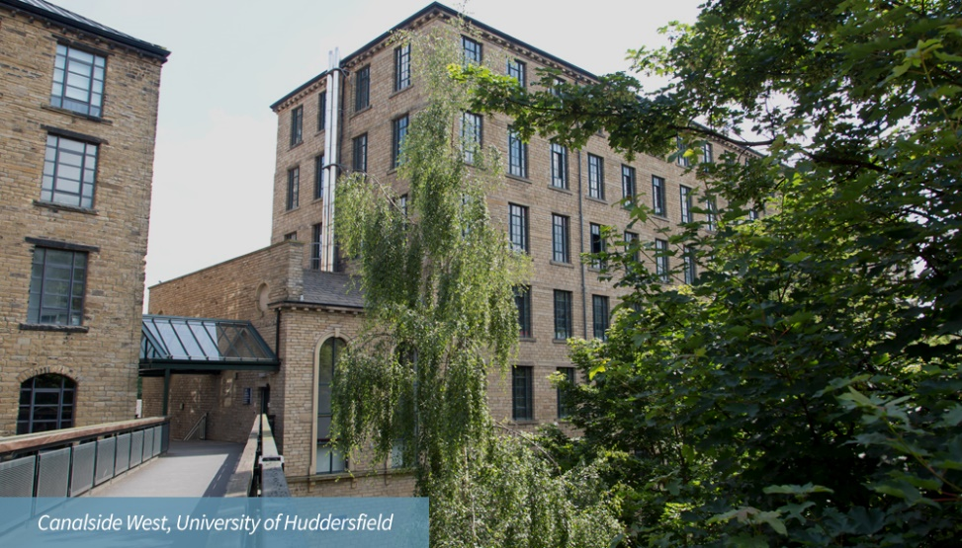
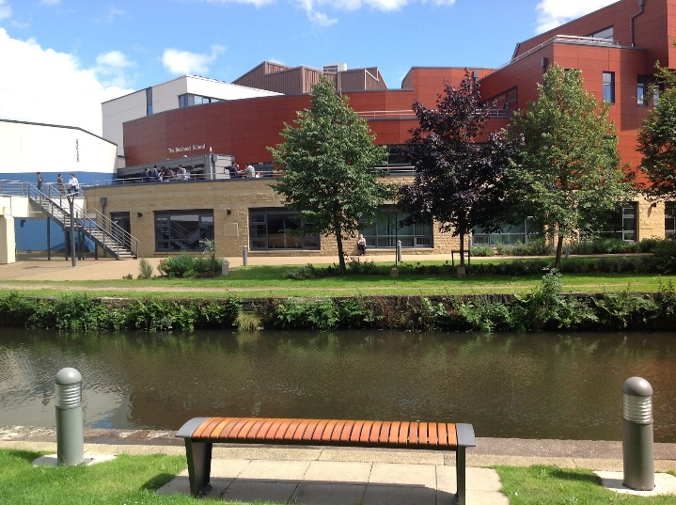
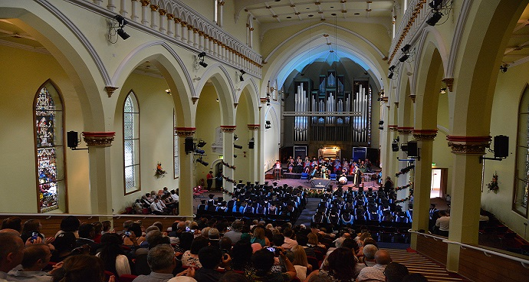
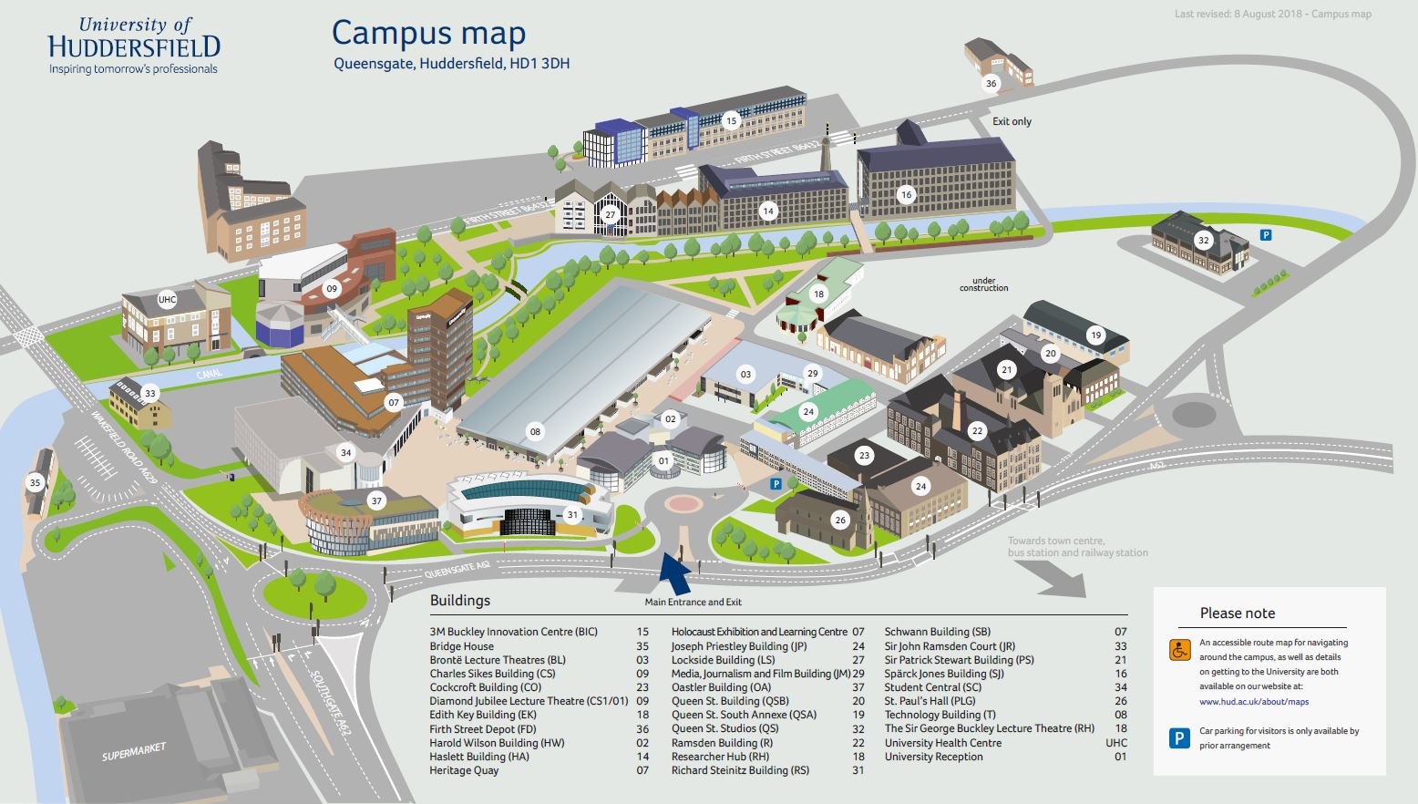
The Campus

Slide 14
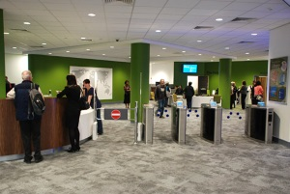
Library

Slide 15
Huddersfield Business School

Slide 16
Why Huddersfield Business School ?
Working with Czech partners since 1991
faculty development
curriculum development
student exchange
staff exchange
600 Czech students since May 2004

Slide 17
Student Support
You will have a personal academic tutor (PAT) from the very first day at Huddersfield
The tutor will provide advice your studies in general and can provide some guidance about non-academic matters
The Business School has International Learning Development Tutors, who are very helpful in relation to skills development and academic writing in English

Slide 18
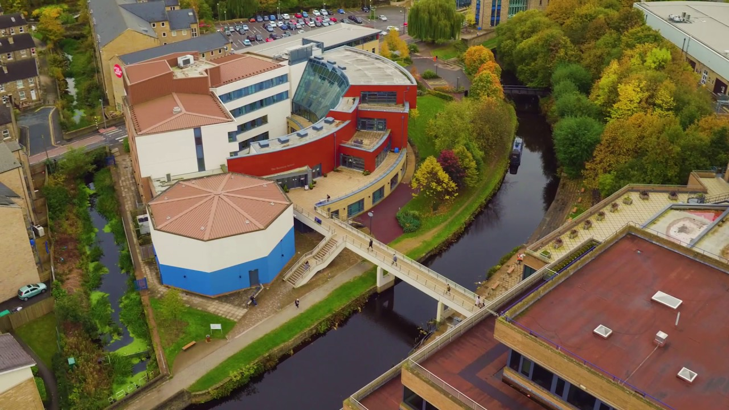
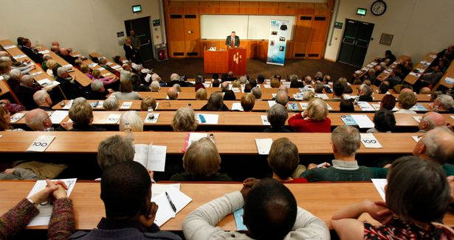
Huddersfield Business School

Slide 19
BA International Business (Year 3, Top Up)
Course Structure
International Business: 10 ECTS
Strategic Management: 10 ECTS
Business Dissertation: 20 ECTS
and
two optional modules: 20 ECTS
Note: Bigger modules than in Czech universities

Slide 20
The Business Dissertation
This is your largest single task (20/60 ECTS credits)!!
You choose a business topic and develop a research question
The length of the dissertation should be normally 13-15,000 words
Regular meetings and/or e-mail contact with your Supervisor is essential

Slide 21
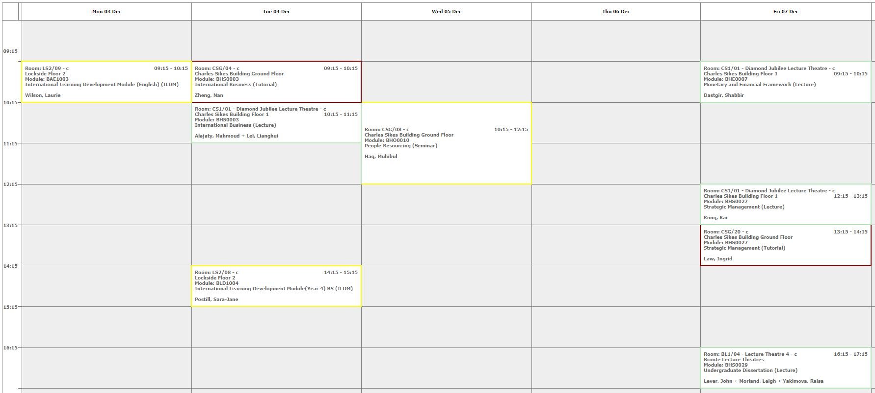
Academic Study
Only 10 hours per week in classroom, plus dissertation supervision, but 30 hours per week in private study/library.

Slide 22
Tuition Fees 2021/22
International Student Fees are £16,000 per annum with a scholarship of £2,000
Huddersfield Business School is offering a fee of £6,000 to our historic partners – payable in up to three instalments
UK student fees are £9,250 per annum (UK government loan available)

Slide 23
Financial Support
Czech Government & Your Faculty
As a result of the agreement signed between our two universities, you may be able to obtain further financial support
Bank of Mum and Dad
Your family may be able to help you
Loan
You can apply for a loan from a bank – but not the UK Government

Slide 24
MSc Economics
Programme (Course) Structure
Principles of Economics: 15 ECTS
Context of International Business: 15 ECTS
Quantitative Economic Methods: 15 ECTS
Financial Markets and Institutions: 7.5 ECTS
The Global Professional: 7.5 ECTS
Individual Research Project: 22.5 ECTS
and
one optional module: 7.5 ECTS
Note: the modules are bigger than in Czech universities

Slide 25
MSc International Business
Programme (Course) Structure
Context of International Business: 15 ECTS
Strategy of International Business: 15 ECTS
The Global Professional: 7.5 ECTS
Research Methods: 7.5 ECTS
Individual Research Project: 22.5 ECTS
and
Three optional modules: 22.5 ECTS
Note: the modules are bigger than in Czech universities

Slide 26
Optional Modules
Functional Areas
e.g. International Marketing, International Human Resource Management, International Trade Operations, International Business Finance, Data Analytics
Sectoral Areas
e.g. International Tourism Management and Development, Emerging and Alternative Financial Markets, Globalisation and Financial Crises

Slide 27
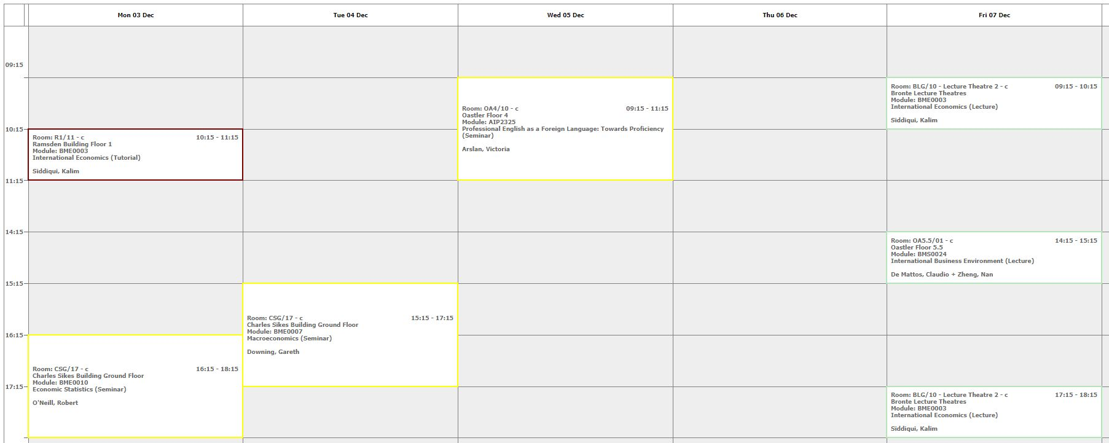
Terms 1 & 2: September - May
Only 10 hours per week in classroom but 30 hours per week in private study/library.

Slide 28
Semester 3: May - September
Individual Research Project (30 ECTS)
These modules entail conceptualising, designing and conducting a piece of research using methods appropriate to your field of study.
You will select a research topic which corresponds to your own particular interests and develop a more specialised knowledge and understanding of this area.
The length of the Dissertation should be normally 15-20,000 words
The Research Paper is about 7000 words
Consultancy Project (30 ECTS)
This module involves undertaking a practical project for a company and writing it up in the form of a report.

Slide 29
Tuition Fees 2021/22
The fee for the programme (3 semesters) is £16,000 for international students with a £2,000 scholarship
The fee for our historic partners will be £6,000
The fee for UK students is £8,900 (with an optional UK Government loan available)

Slide 30
Financial Support
Czech Government & Your Faculty
As a result of the agreement signed between our two universities, you may be able to obtain further financial support
Bank of Mum and Dad
Your family may be able to help you
Loan
You may be able to obtain a loan from a bank – but not the UK Government

Slide 31
Arriving and Living in Huddersfield

Slide 32
Living Costs
Housing and transport is more expensive in England
Clothing and houseware is more expensive in ČR
Food is about the same
Pivo is more expensive in England … and not so good!

Slide 33
Accommodation
There are various sites offered by private companies but we advise you to stay at the University accommodation (DIGS).
Cost of DIGS
Ashenhurst £70 per week
Storthes Hall £85 per week
After sending your application to the University, you will receive Joining Instructions which will be sent to you automatically and will include accommodation options.

Slide 34
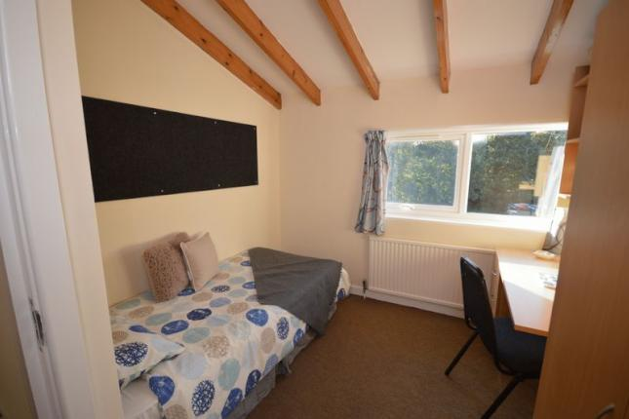
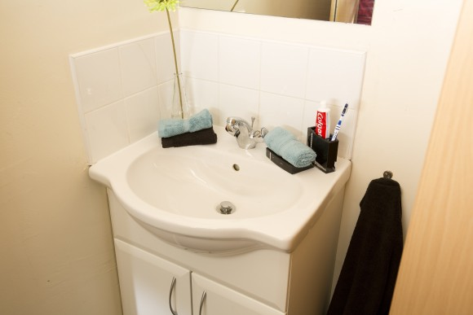
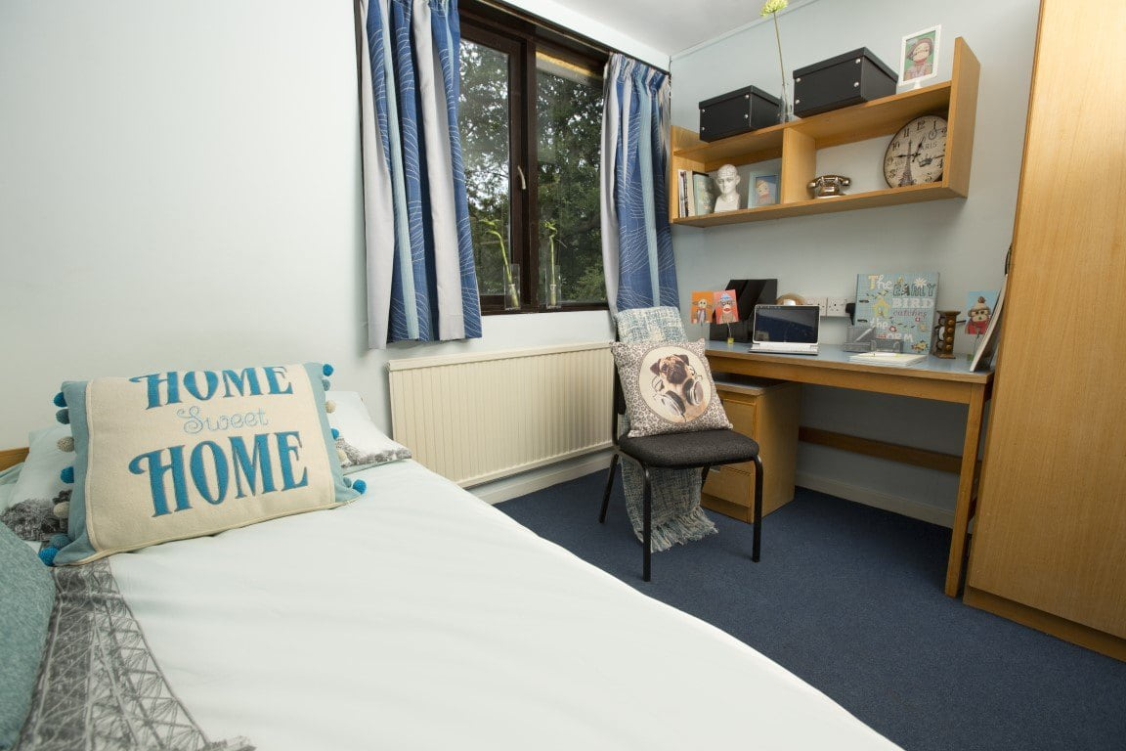
DIGS (koleje) Ashenhurst

Slide 35
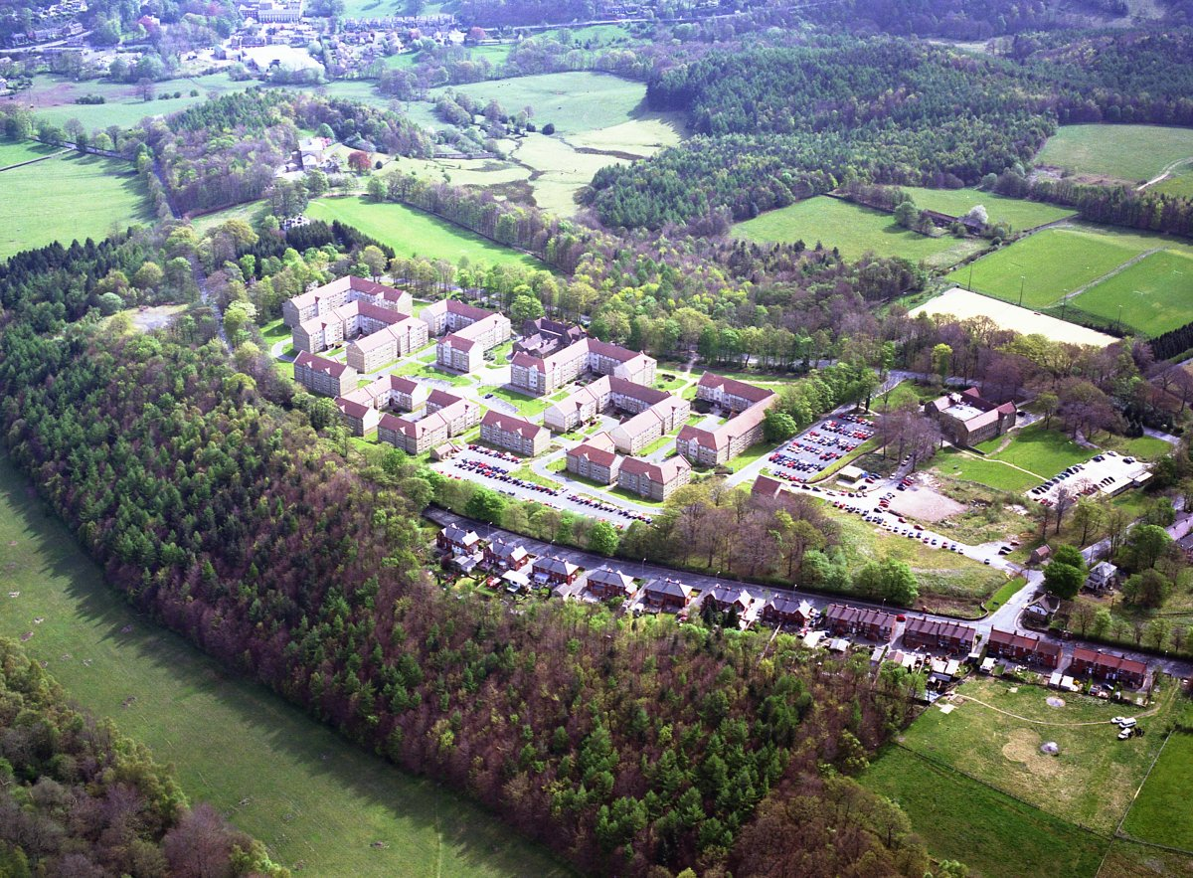
DIGS Storthes Hall Park
DIGS Storthes Hall

Slide 36
Employment
UK minimum wage per hour from April 2021 is £8.36 ( aged 21-22) and £8.91 (aged 23+)
The legal maximum is working for 20 hours per week in term time and 48 hours in the vacations (Christmas, Easter and Summer for Bachelor students)
Working for 15 hours per week is the University maximum
The University job shop advertises part time jobs and pays a living wage which is higher than the national minimum wage
There is usually plenty of bar and restaurant work
Administrative jobs and factories are another possibility

Slide 37
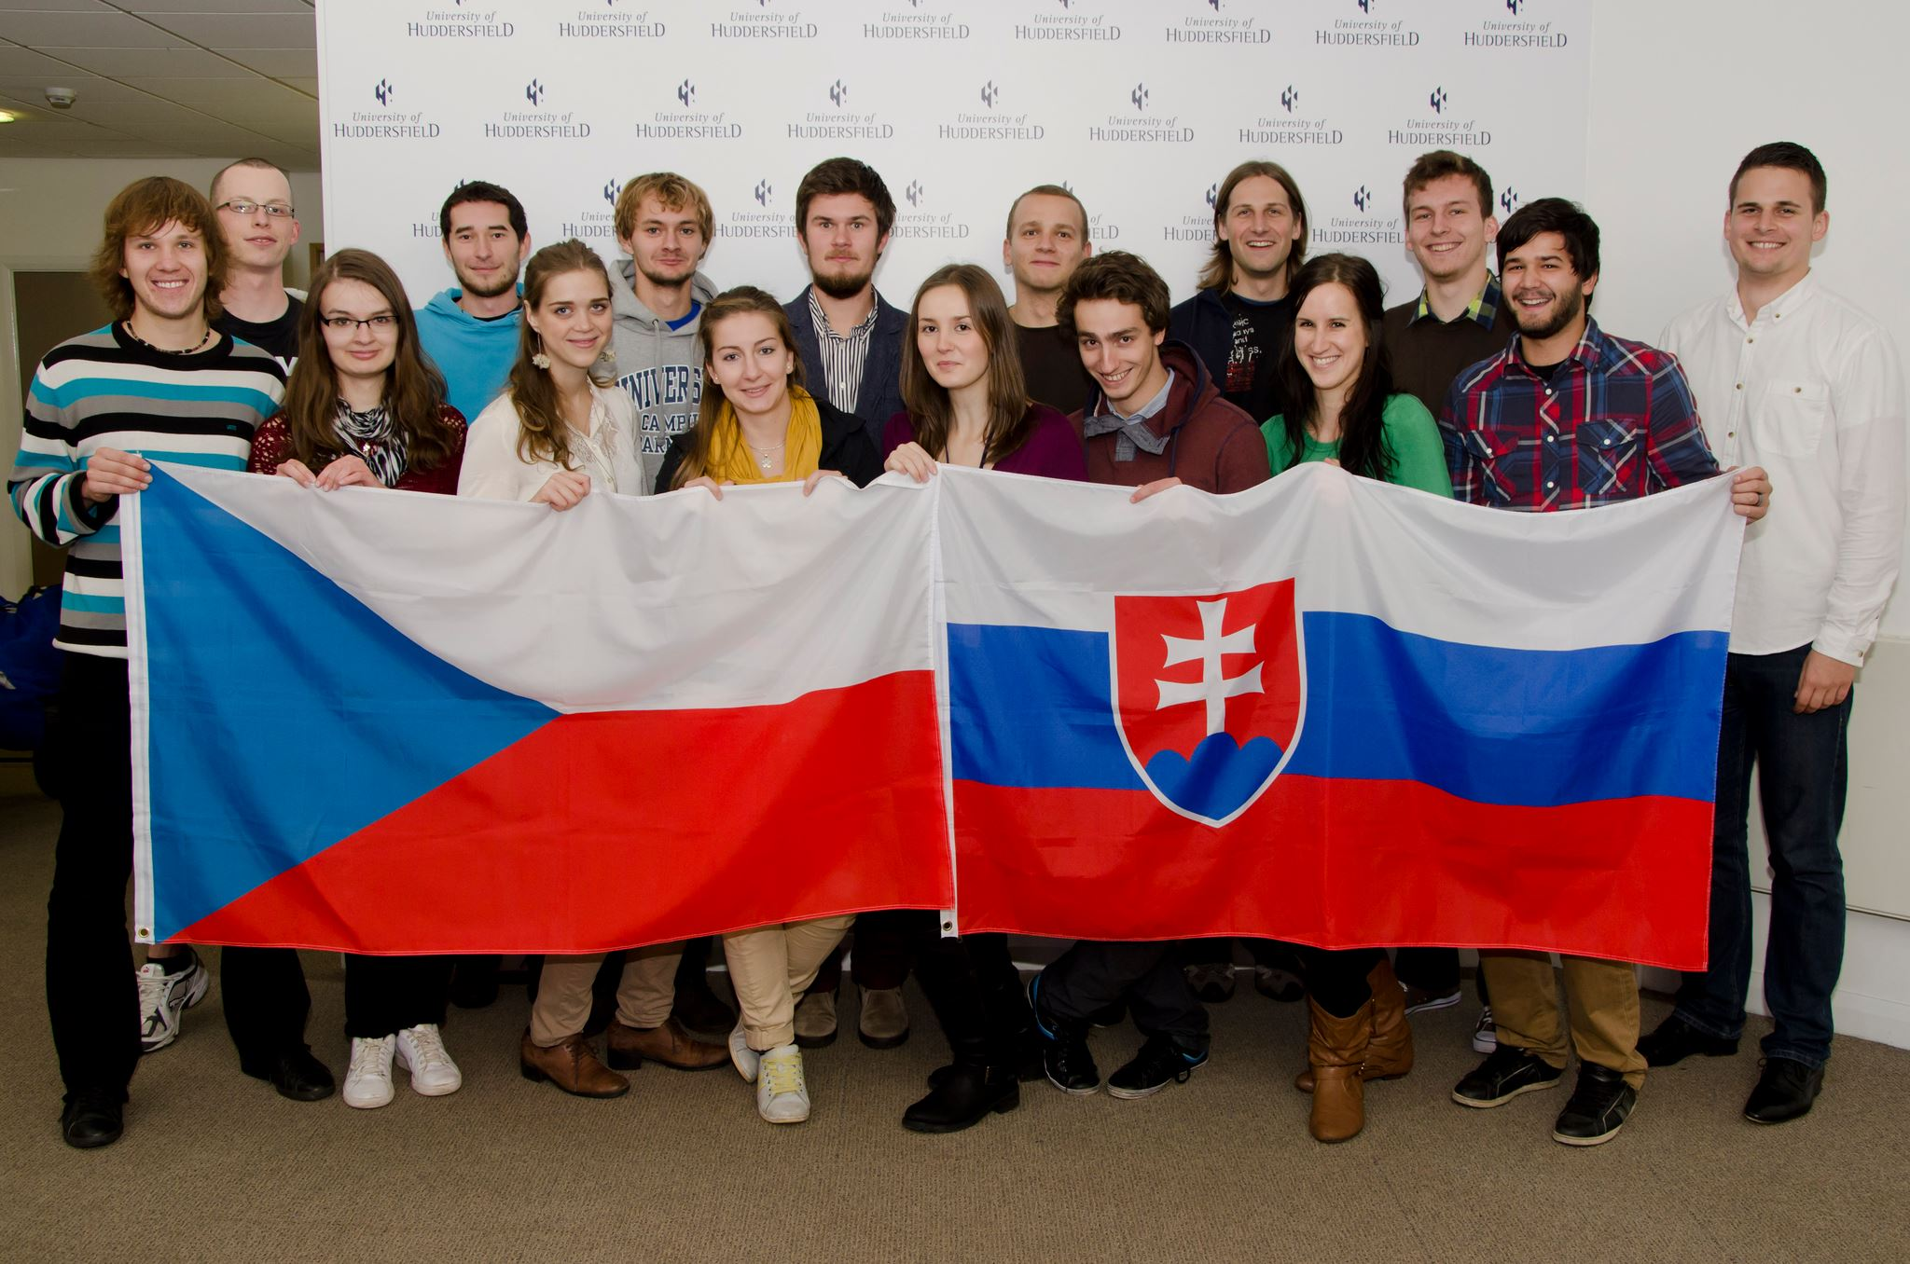
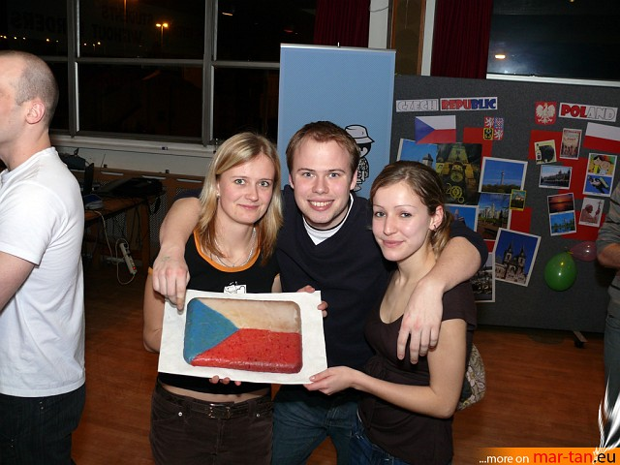
Peer Support
The best way to find your way around is from someone who has been in your shoes … previous Czech students have established a Czech and Slovak Student Society which participates in various cultural campus events and organises regular get-togethers for its members
https://www.facebook.com/czechoslovakhudsoc

Slide 38
Arrival
1 August 2021 is the earliest date to get housing
It is recommended to come to Huddersfield by 1 September 2021 if possible
It is recommended that you arrive earlier than 1 September if possible in order to get the best jobs - if you want one!
Important Dates
13 September 2021 - Welcome Week
20 September 2021 - Induction Week
27 September 2021 - Start of Teaching
10 January 2022 – Induction Week
17 January 2022 – Start of Teaching

Slide 39
How do I apply ?
You can apply and join our 100 other nationalities in the Huddersfield Business School at:
http://www.hud.ac.uk/international/apply/
Student visa information:
https://www.gov.uk/student-visa

Slide 40
ANY QUESTIONS? Contact Prof John Anchor - Associate Dean (International) j.r.anchor@hud.ac.uk

