Slide 1
Physical Activity and Lifestyle Change
Pre-arrival information
František Hurt
4. 4. 2023

Slide 2
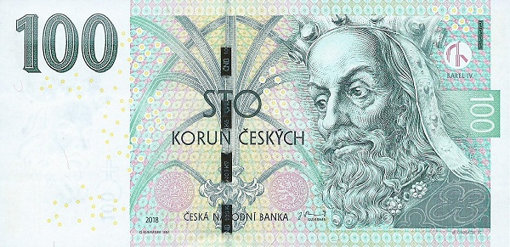
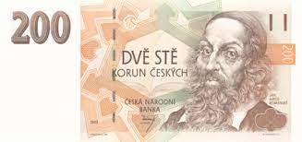
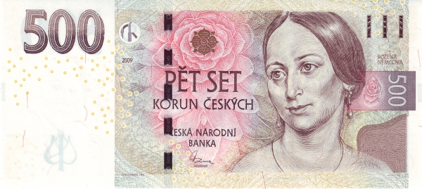
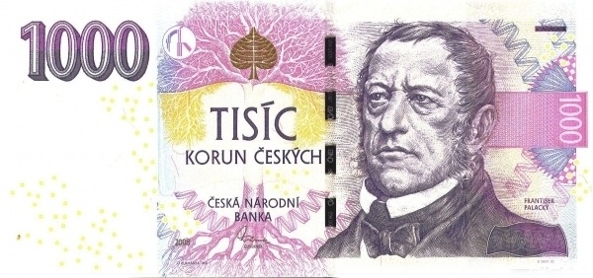
Czech republic
- Since 1993
National emblem:
Flag:
Currency: czech crown
(1€ = approx. 24 CZK)

Slide 3
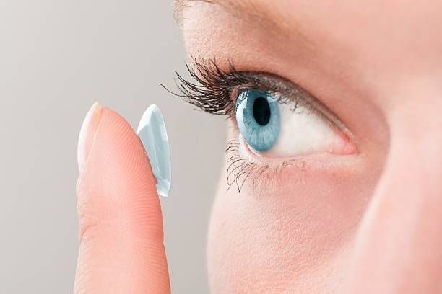
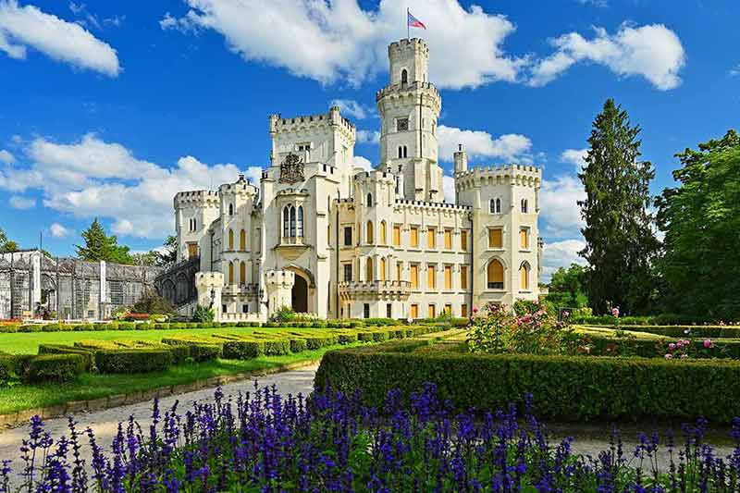
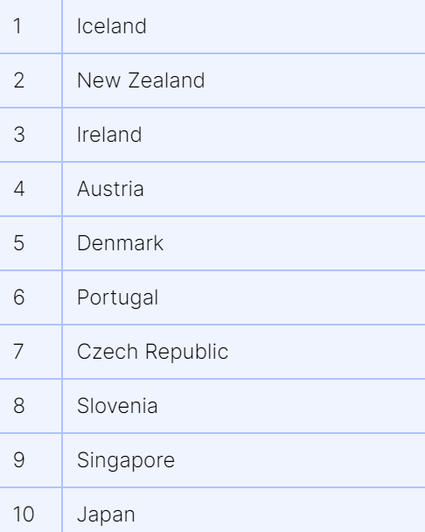
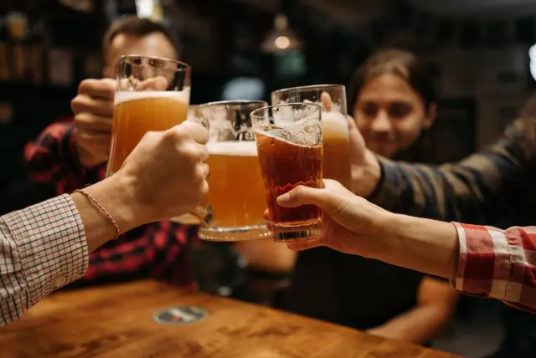
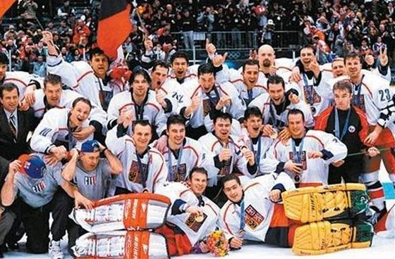
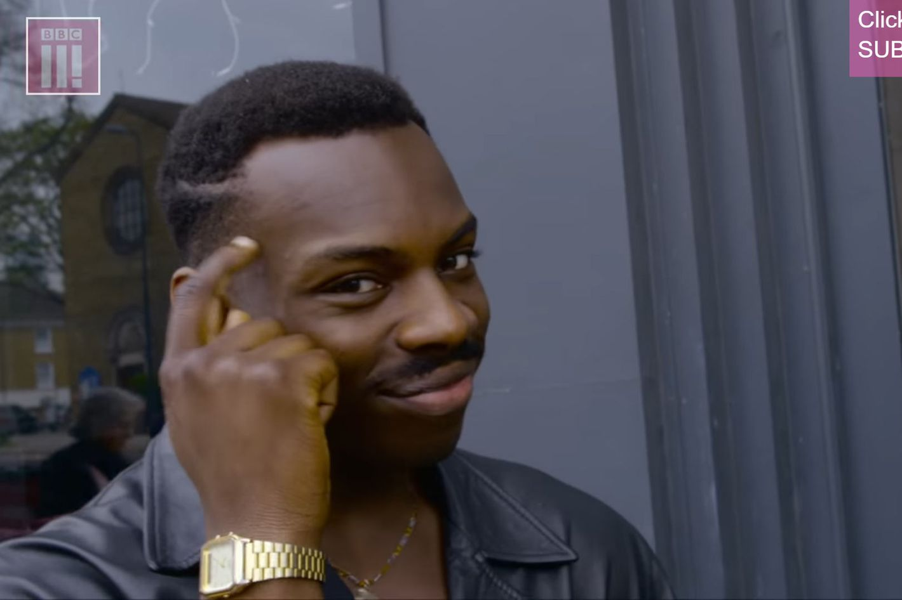
7 facts about the Czech republic
6) Czechs are a quite smart nation - 90% of the adult population has successfully completed at least high school
1) It is 7th safest country in the world.
2) The Czech republic has the most castles in the Europe
3) Contact lenses were invented by the Czech Otto Wichterle
5) Czechs are one of the biggest consumers of alcohol in the world
According to the National Statistical Office, every Czech drank 163.5 litres of alcoholic beverages in 2022 (135l was beer).
4) Škoda is a Czech car company
7) The 2 most popular sports in the Czech Republic are Football and Ice Hockey
You may know: Jaromír Jágr, David Pastrňák, Dominik Hašek, Petr Čech, Pavel Nedvěd

Slide 4
Brno
2nd biggest city in the Czech Republic
known for for its wide range of cafés, restaurants and bars
Student city
80 000 students (every 5th citizen of Brno is student, 23% international)
13 universities

Slide 5
Established in 1919
2nd biggest university in the Czech Republic
10 faculties (all in Brno)

Slide 6
Faculties of Masaryk University
Faculty of Law
Faculty of Pharmacy
Faculty of Medicine
Faculty of Economics and Administration
Faculty of Science
Faculty of Informatics
Faculty of Arts
Faculty of Social Studies
Faculty of Education
Faculty of Sports Studies

Slide 7
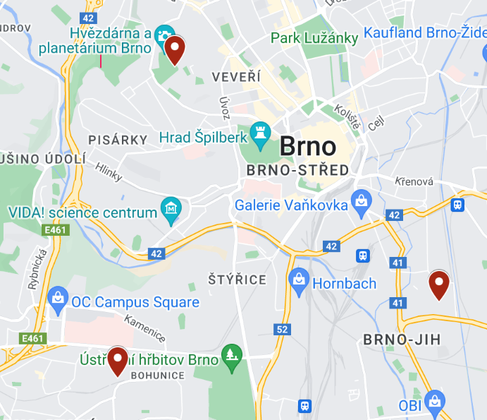
Questions and answers
What is the weather going to be like?
5°C – 15°C
Czech spring weather – sunny / windy / sometimes rainy.
Check the forecast for Brno before departure.
Where is a basketball court to play a little?
Basketball field at Kraví hora
Outside court Brno-Bohunice
Basketbal Mírová

Slide 8
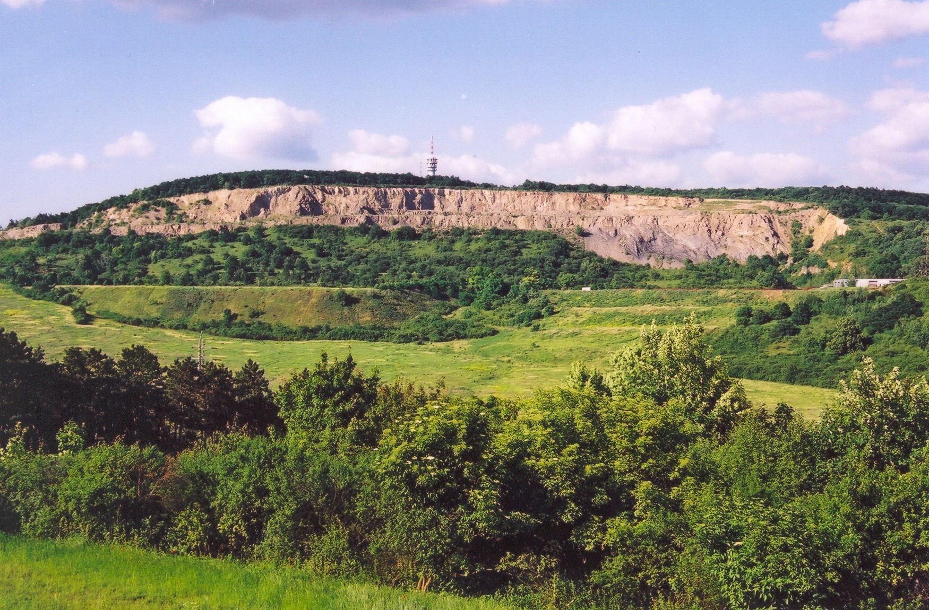
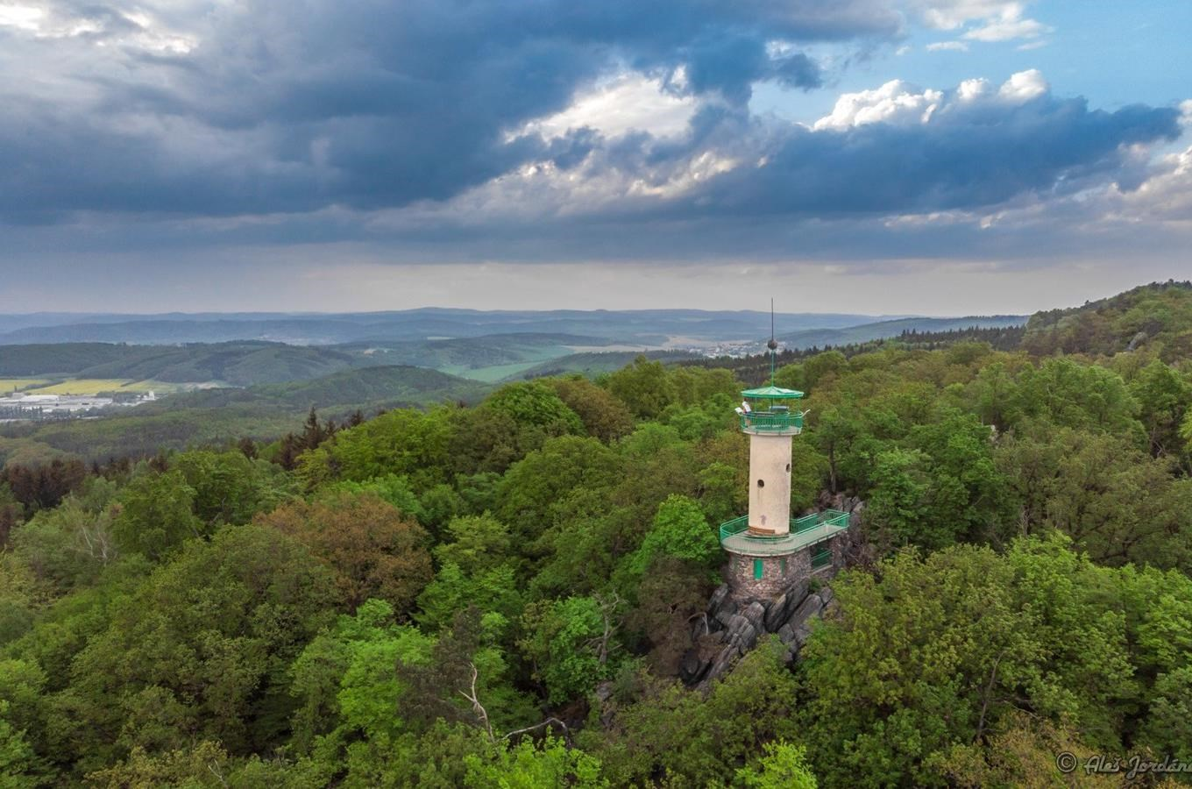
Questions and answers
What time do we eat lunch and dinner in Czechia?
There will be a lunch break every day between 12 - 13:30.
Our program ends before 5 pm every day (except Tuesday).
Dinner is on each participant's own. Czechs normally dine between 6 - 7 pm.
Where is the best place to go for a hike?
Natural preserve Holedná
Lookout tower Babí lom
Mariánské údolí
Querry Hády
Veveří castle

Slide 9
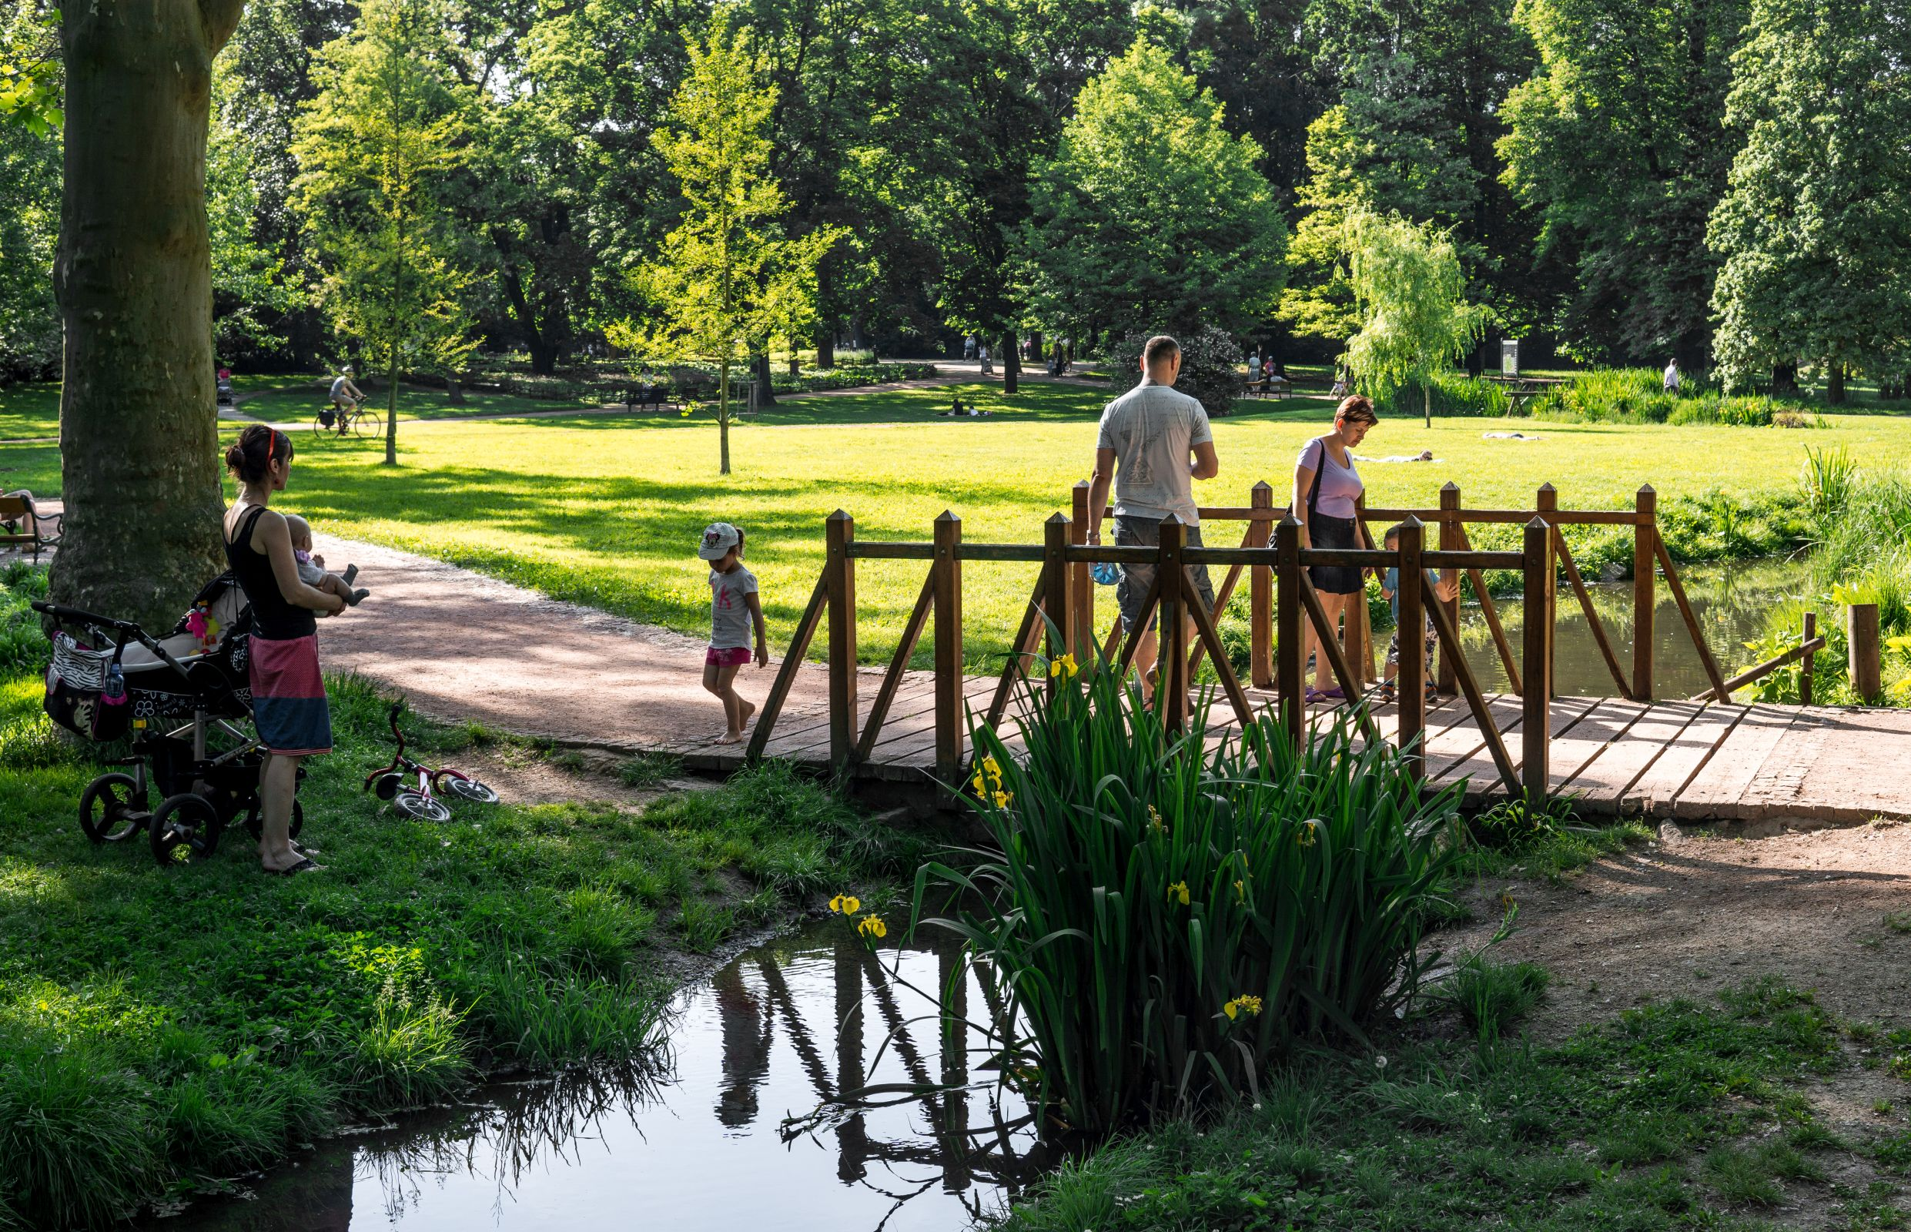
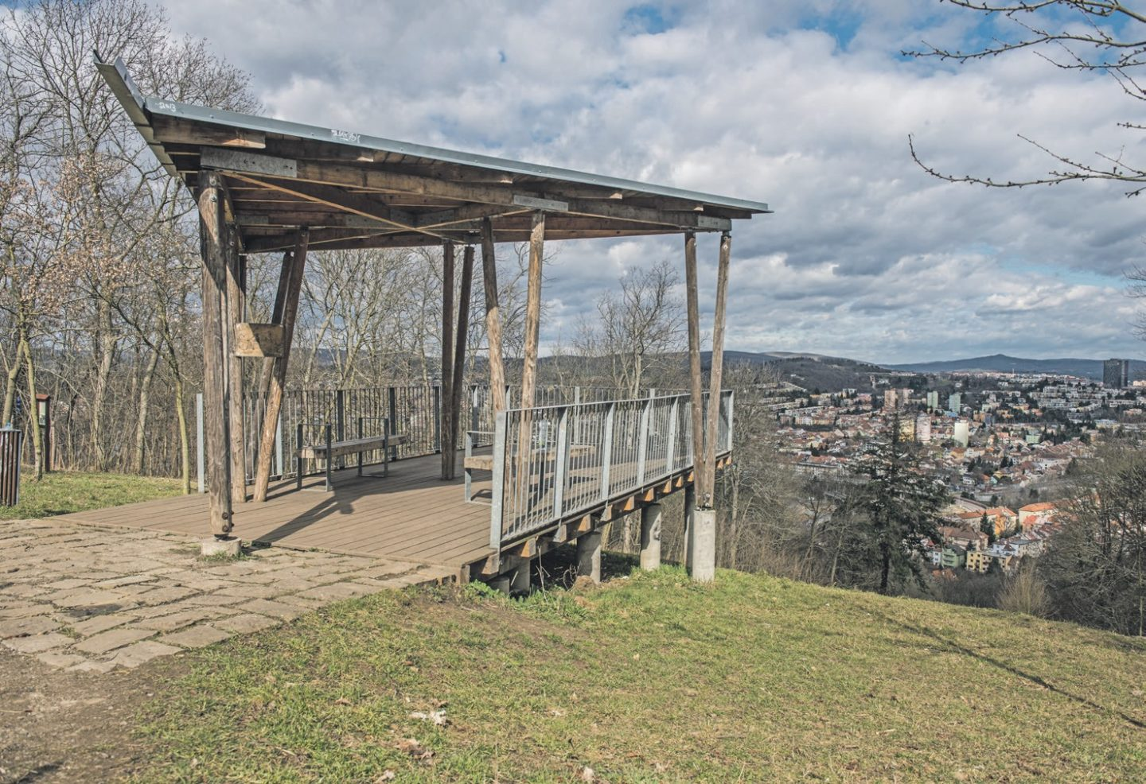
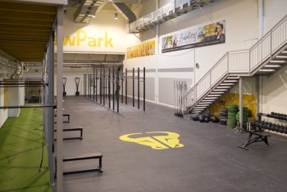
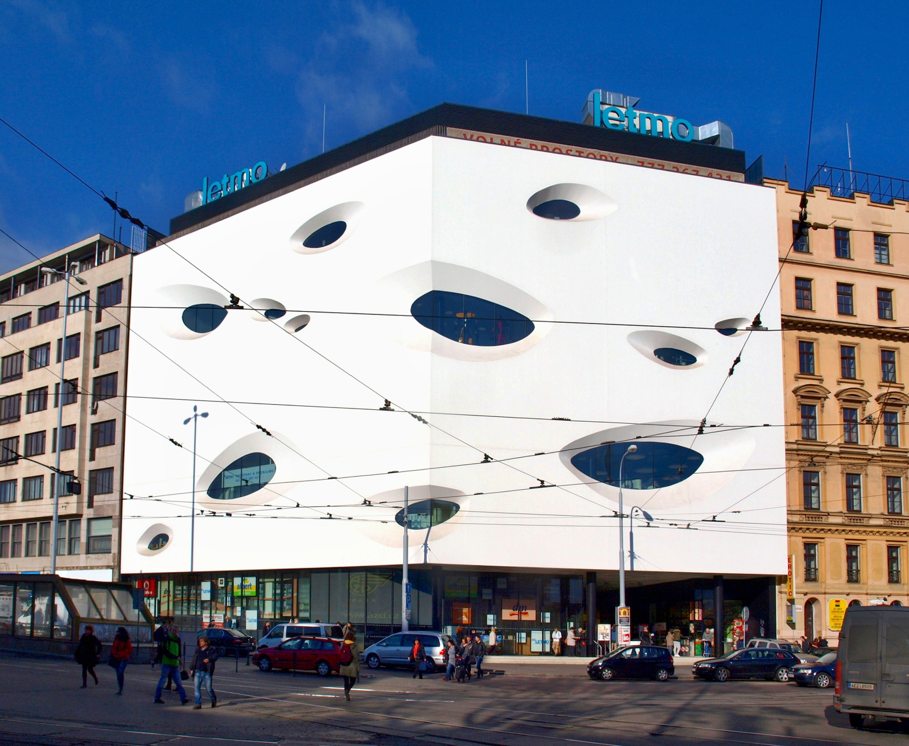
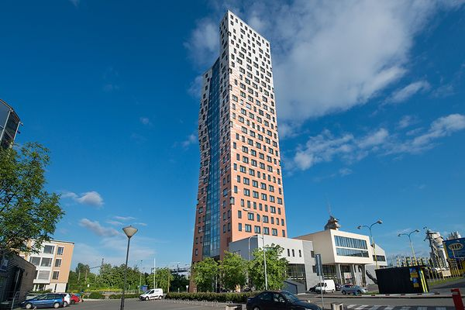
Questions and answers
What are some green spaces in the area?
Koniklecova field
Lužánky city park
Wilsons forest
Gyms?
NewPark gym
FitINN Fitnesstudio
AZ Fitness

Slide 10
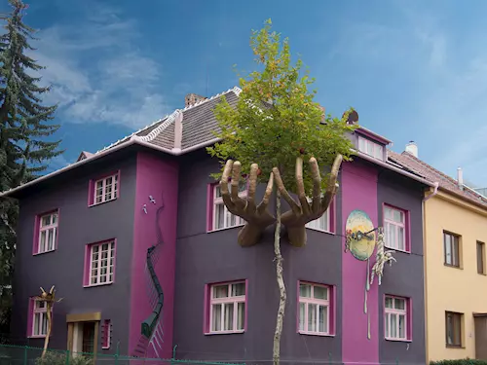
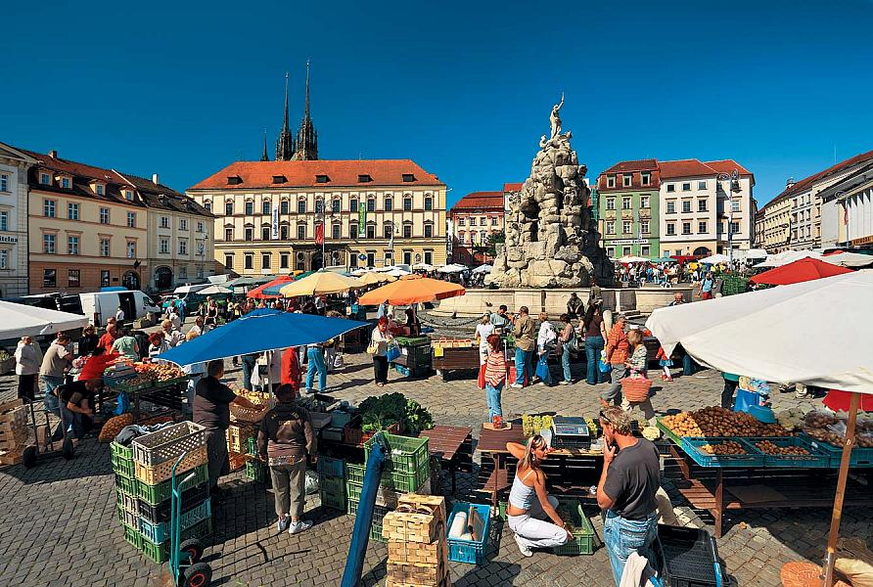
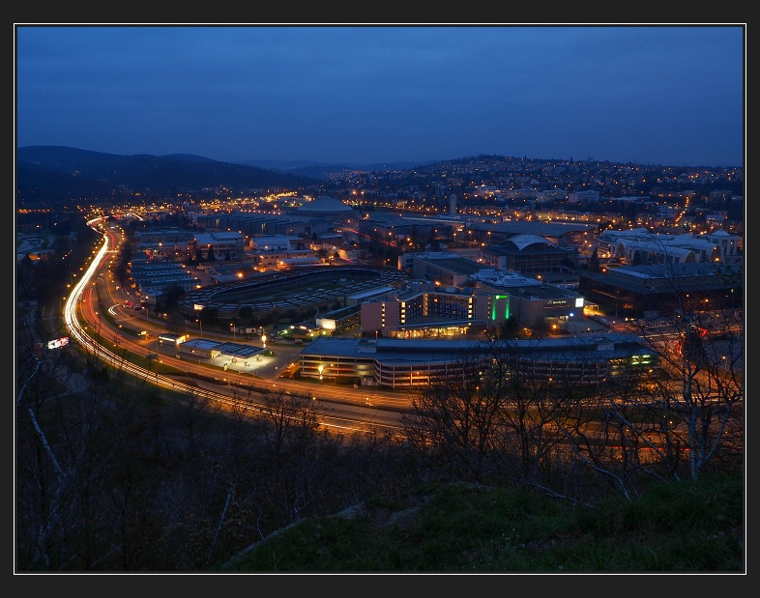
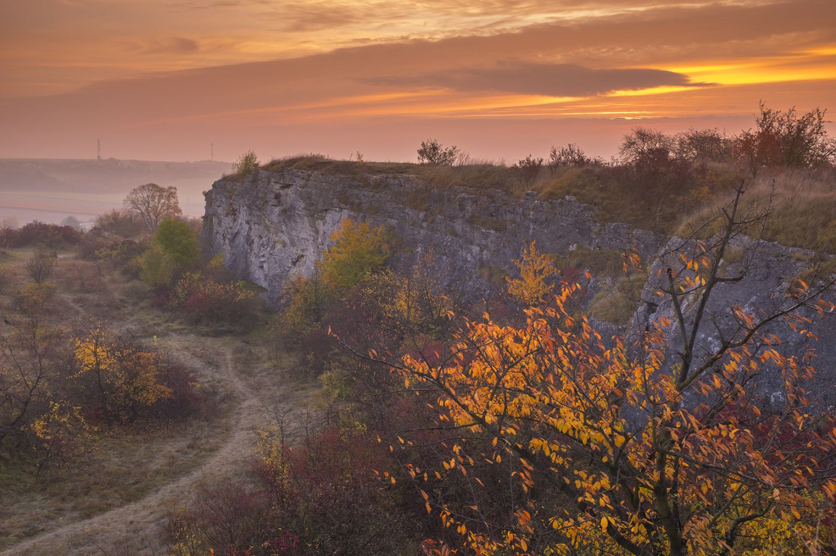
Questions and answers
Places to visit in Brno that aren't common to find in Google?
Kristek house
Cabbage market
Čertův hill
Stránská skála

Slide 11
Questions and answers
Is it expensive to stay 5 days in Brno?
 |  | Cheaper option | More expensive option
Accommodation | 500 - 621czk/ night | 2000 CZK | 2484 CZK
Meals | 300 - 500 czk/ day | 1500 CZK | 2500 CZK
Public transportation | 250 czk/ 5 days | 250 CZK | 250 CZK
 | Total: | 3750 CZK (156 €) | 5234 CZK (218 €)

Slide 12
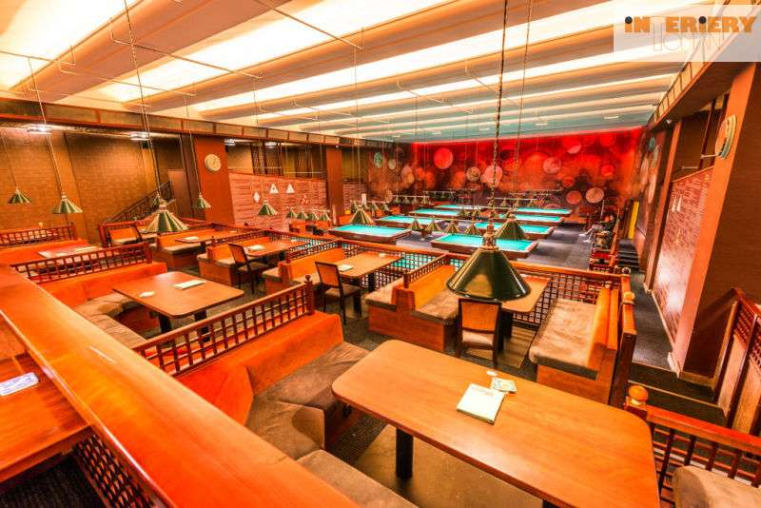
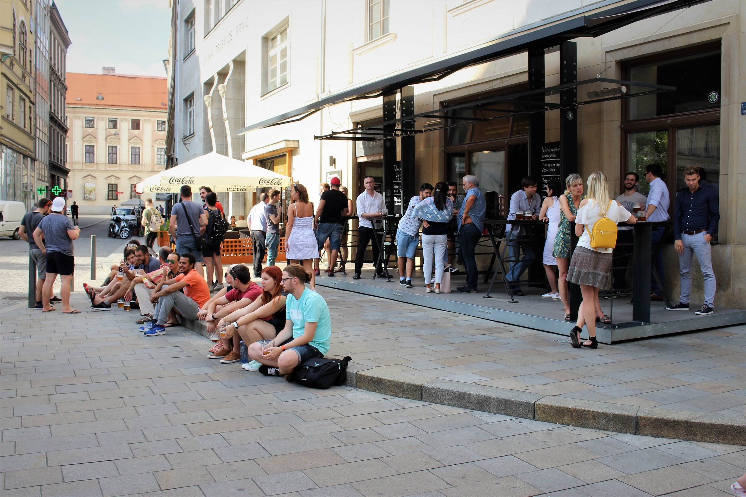
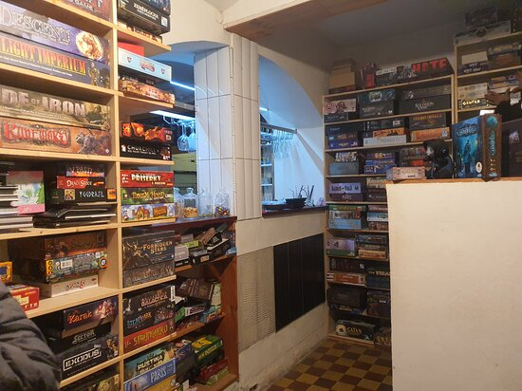
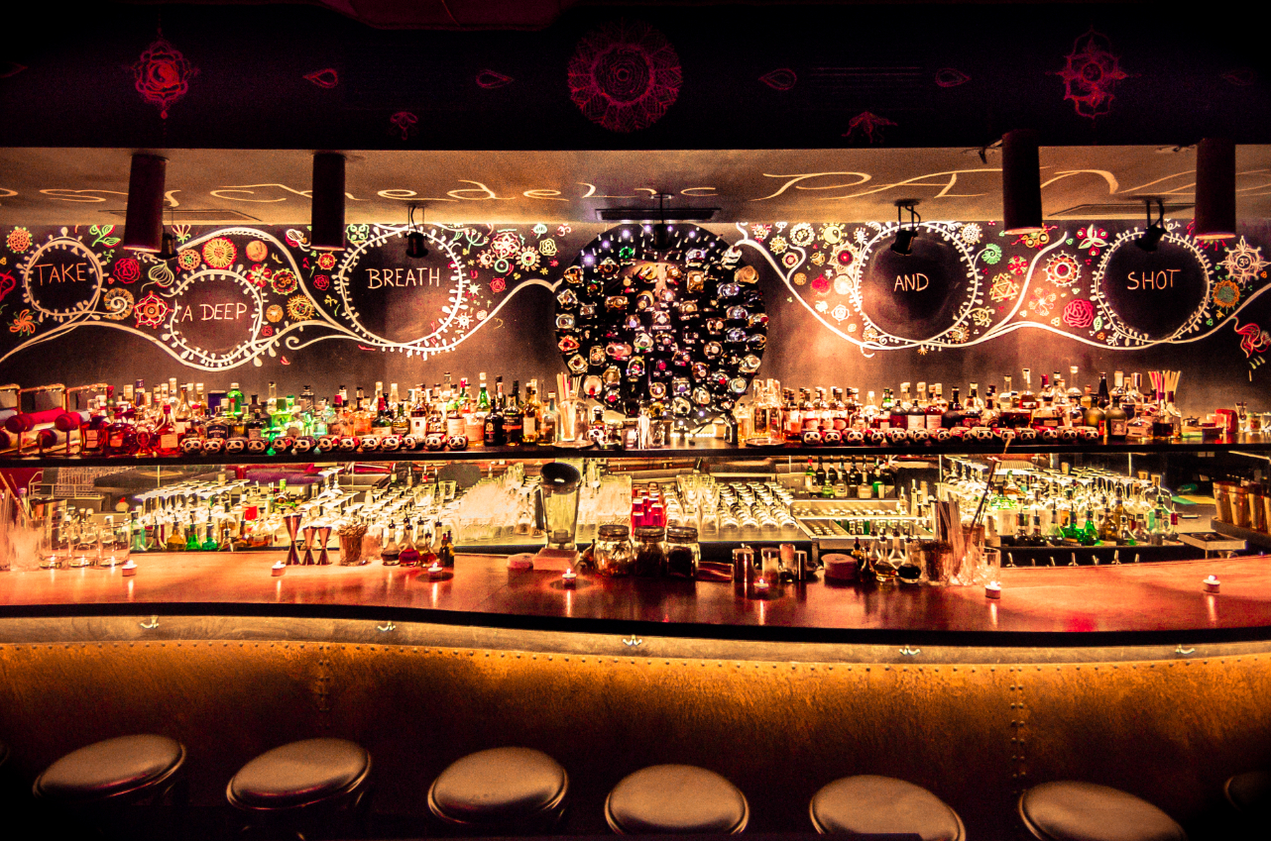
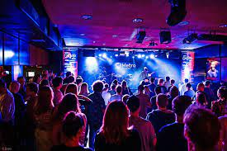
Questions and answers
Places to hang out at night (only parties)?
Mystica Brno
Super Panda Circus $$$
Metro music bar
Utopie Brno
Na stojáka
Where we could spend the evenings?

Slide 13
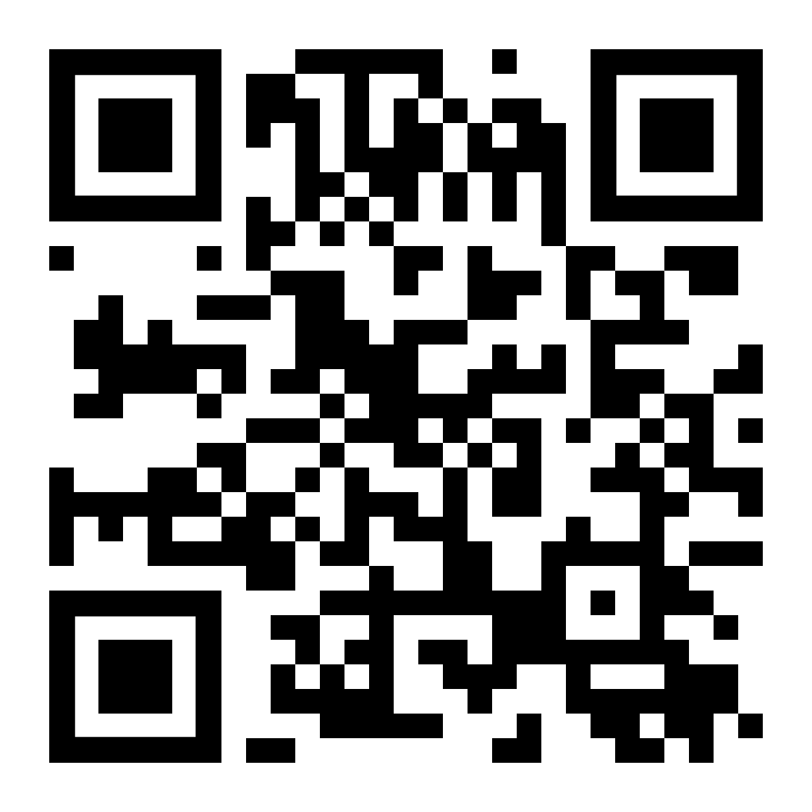
Questions and answers
How about places to eat?
Bonjour Vietnam (asian)
Ještě jednu (ice cream)
Stopkova (czech)
U třech čertů (czech)
Doe Boy (pizza)
Bavard Cafe (brunch)
William Thomas Bakery (pastry)
Element (modern)
Forky‘s (Vegan)
Padagali (Indian)
Bistro Bastardo (Mexican)
Butcheck (burgers – street food)
Where to go for a good lunch?

Slide 14
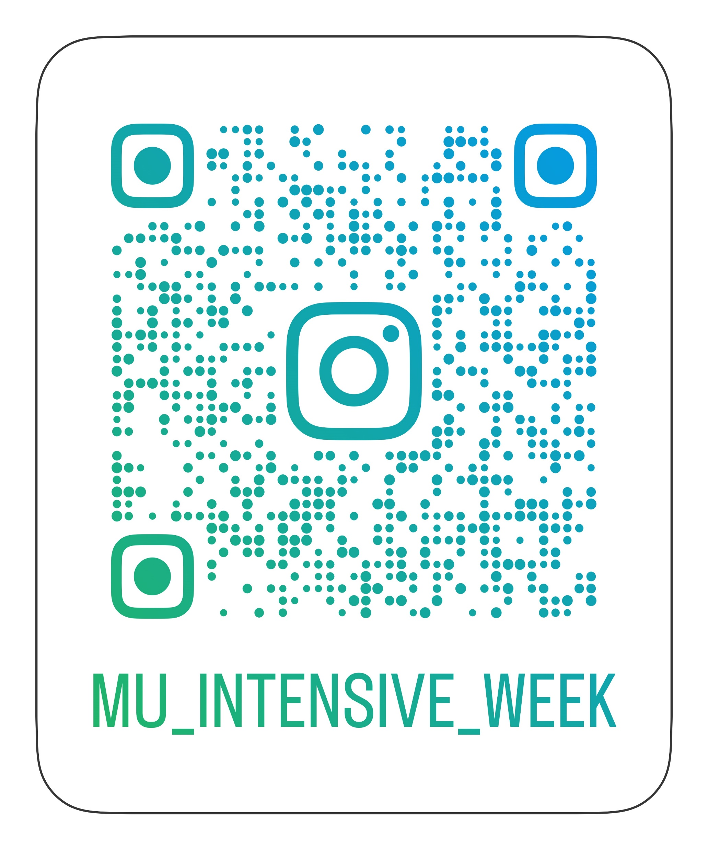
Do you have further questions?
Ask our students on instagram:

