Slide 1


Students Practice in GREECE AND CYPRUS
www.amberjob.eu www.facebook.com/amberjob.eu

Slide 2






OUR PARTNERS
Luxury 4-5* Hotels;
Located in Greek islands like Kos, Rhodes, Corfu, Crete, Santorini, Zakynthos, Samos, Mykonos and many more... And Cyprus

Slide 3
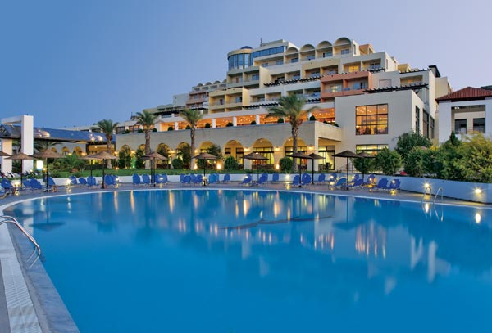

Slide 4
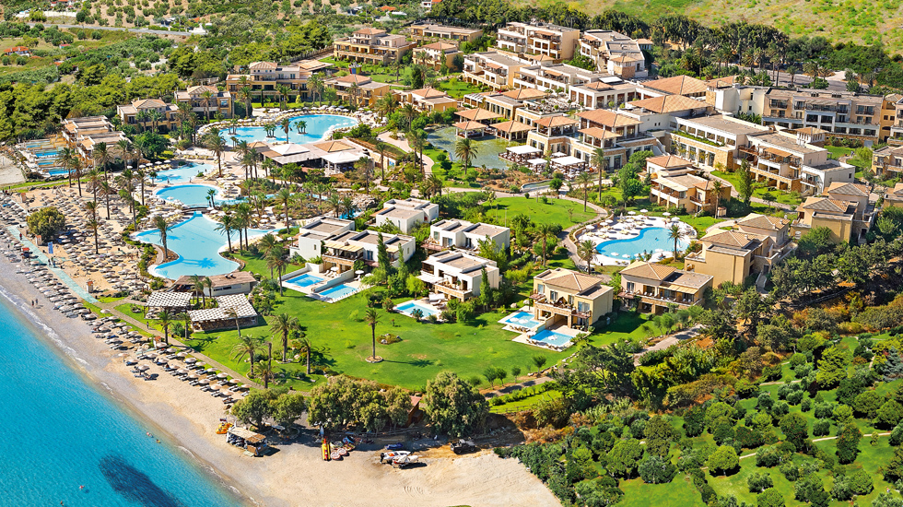

Slide 5


Slide 6
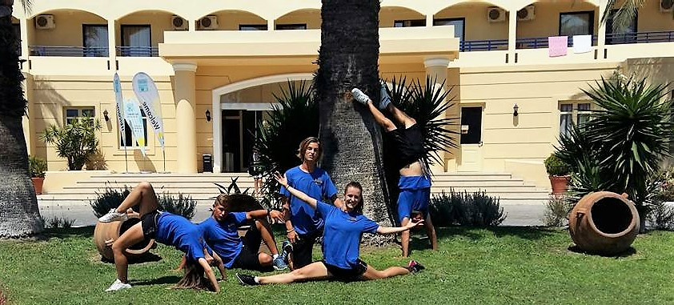
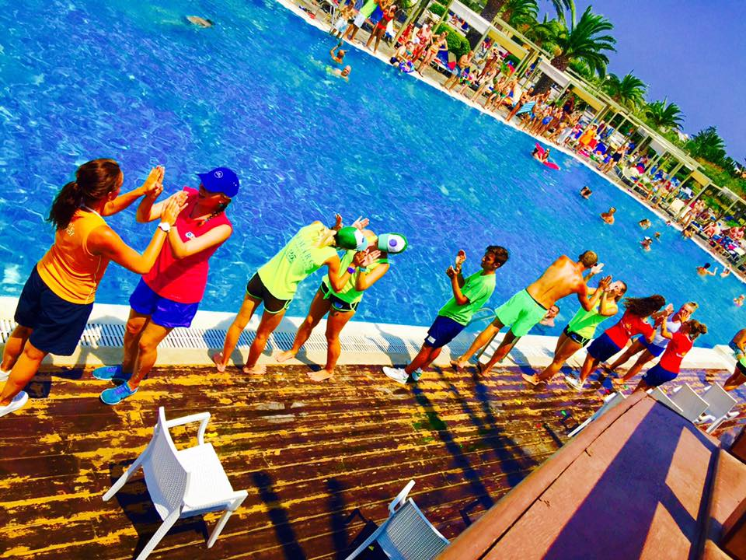
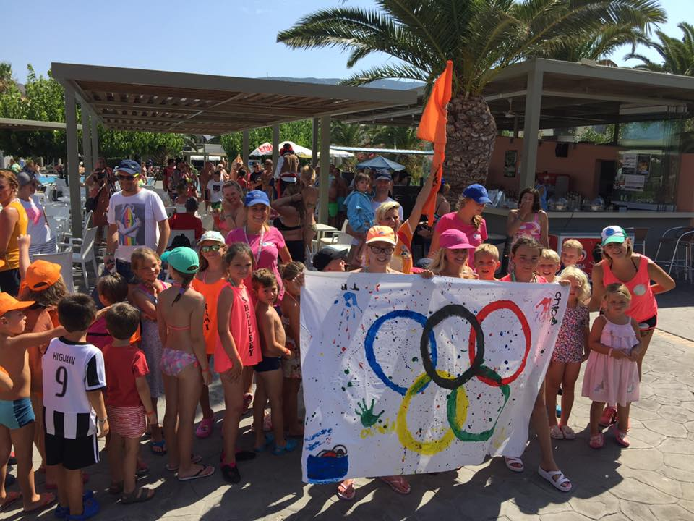
ANIMATION
DEPARTMENT

Slide 7
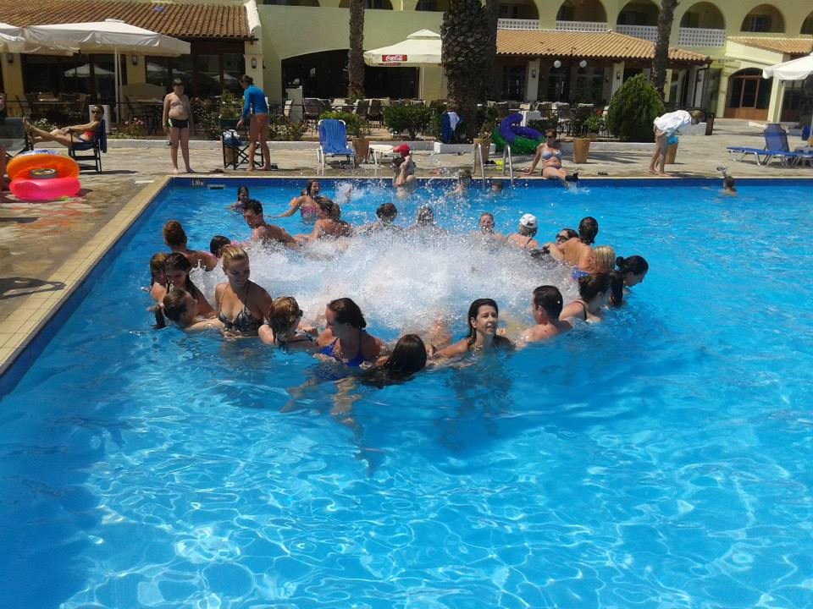
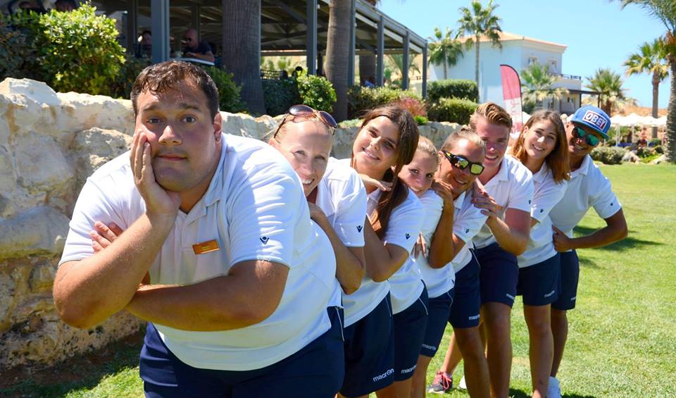
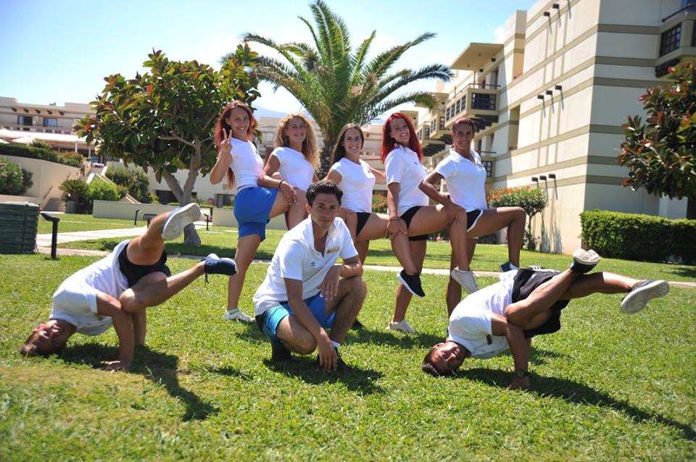
Sport/Fitness Animation organizing various sport activities and tournaments for hotel guests

Slide 8
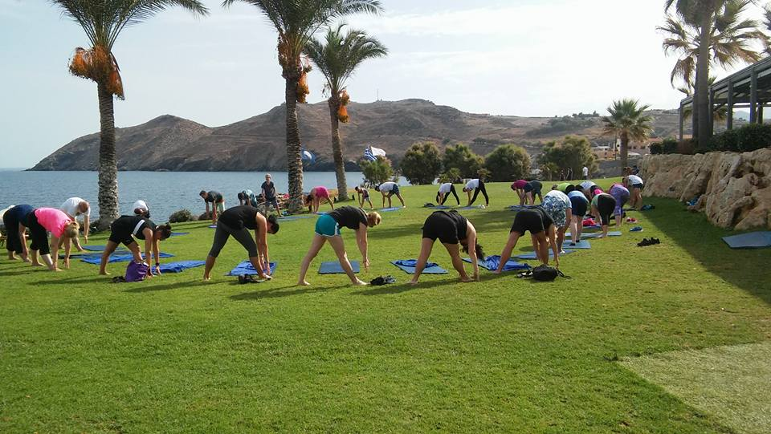
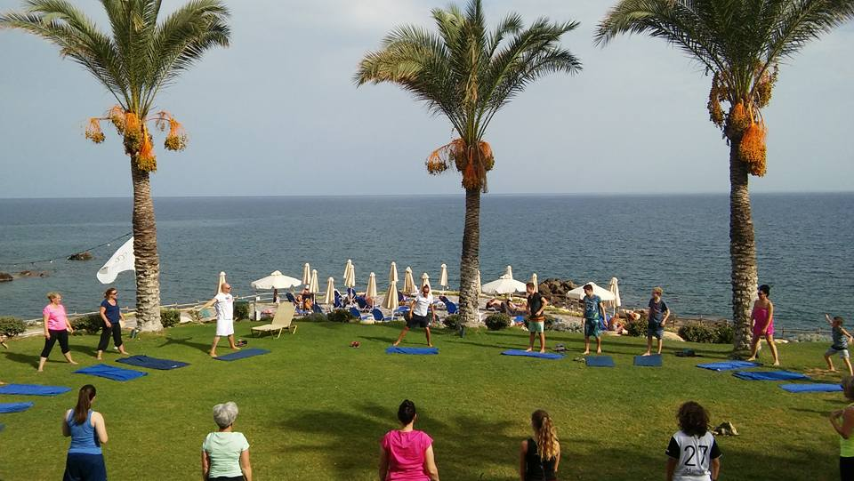
Yoga, Pilates,
Stretching

Slide 9
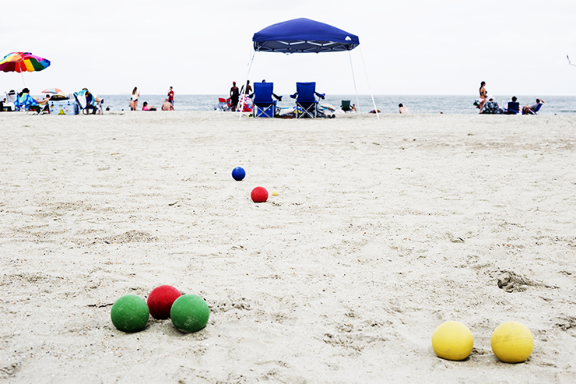

Bocce and beach volleyball

Slide 10
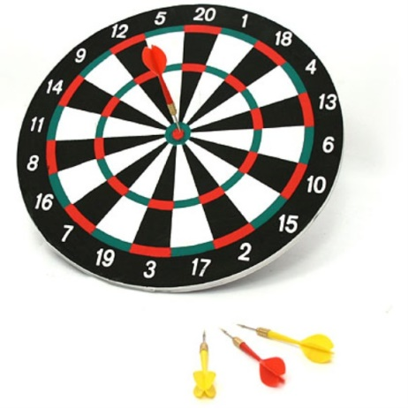
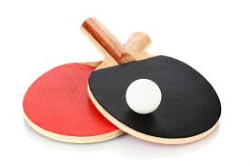
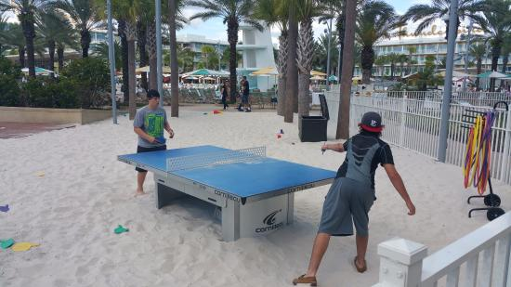
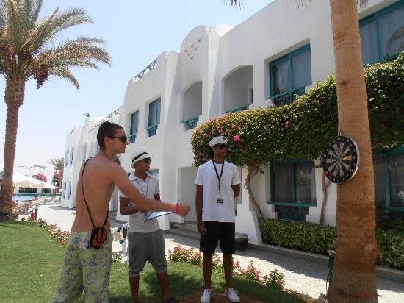
Ping pong and darts

Slide 11
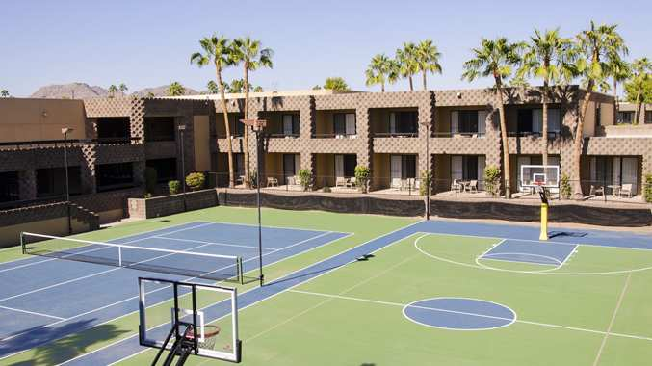
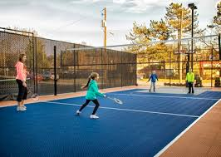
Football, basketball, badminton

Slide 12
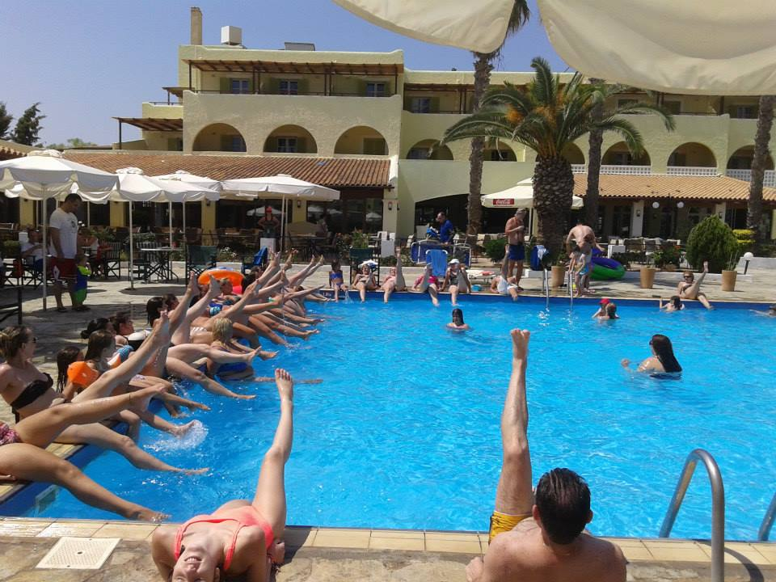
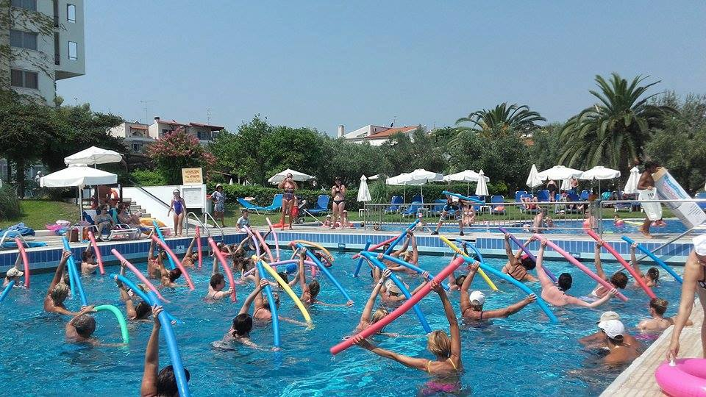
Aqua Aerobics, Water polo, Aqua fitness,
Aqua Zumba, Aqua Fun

Slide 13
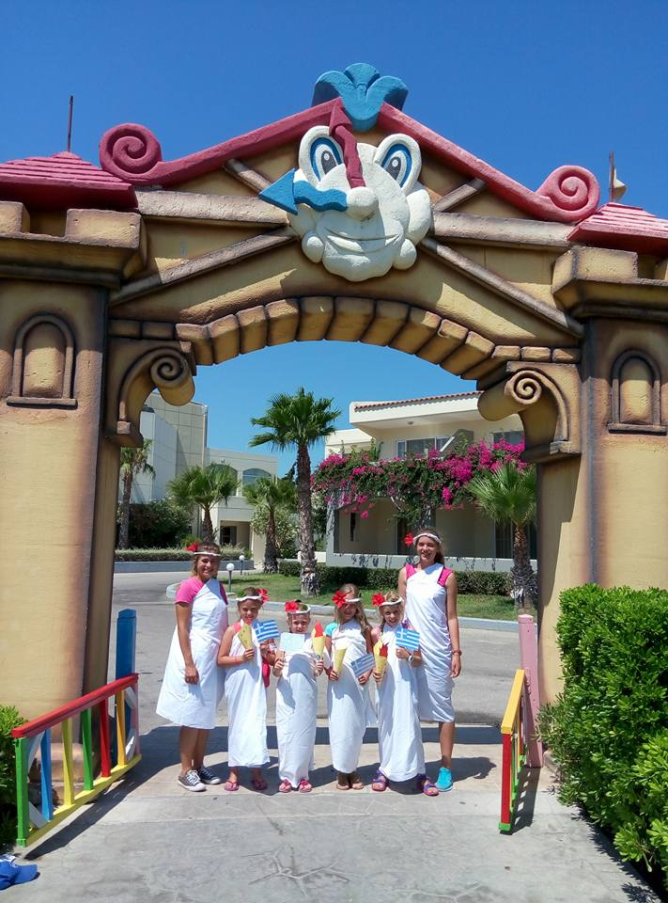
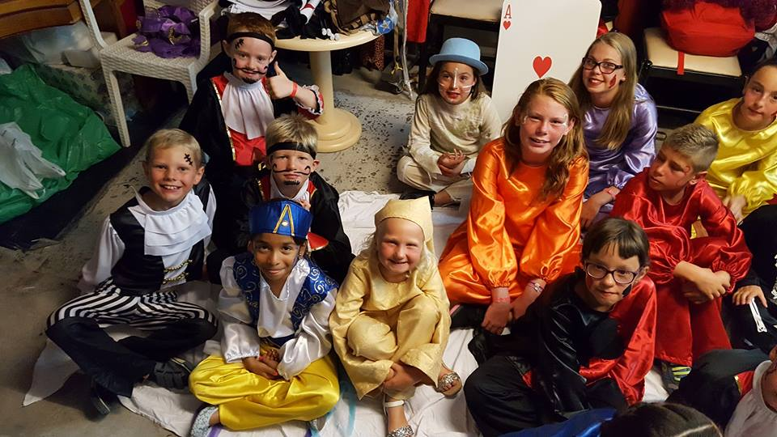
Kids Animation – organizing thematic days and events for smallest hotels guests

Slide 14
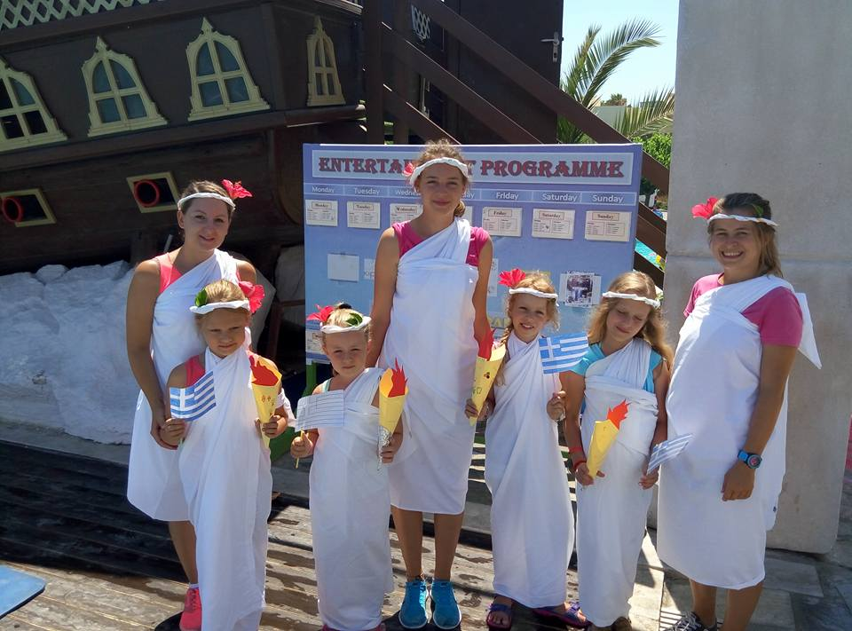
Thematic days

Slide 15
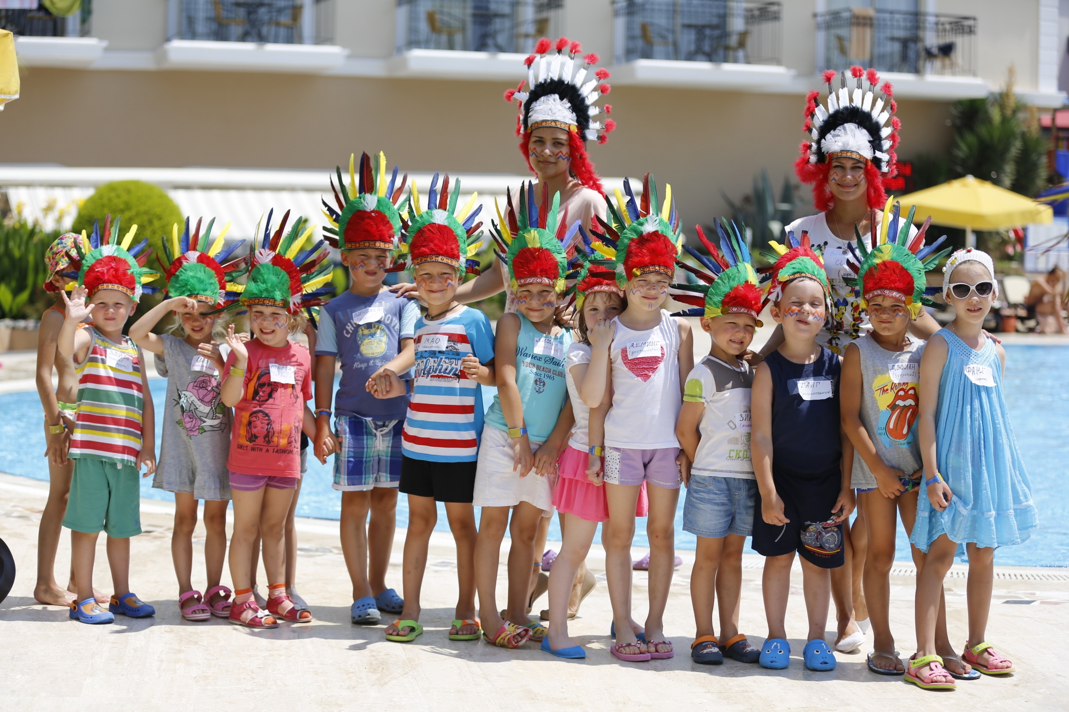

Slide 16
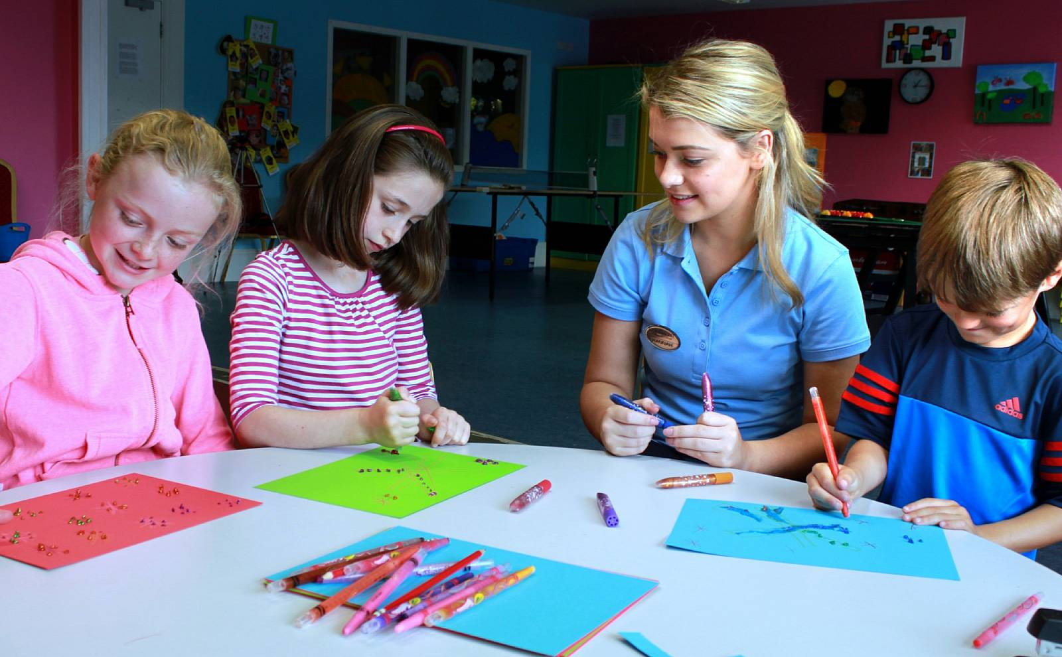
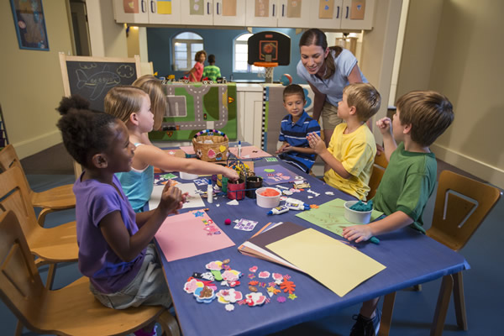
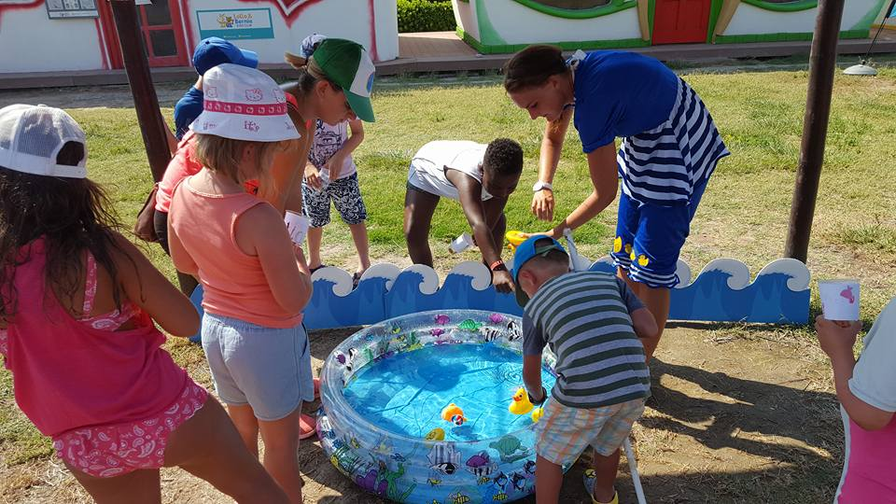
Games, arts, crafts and fun

Slide 17
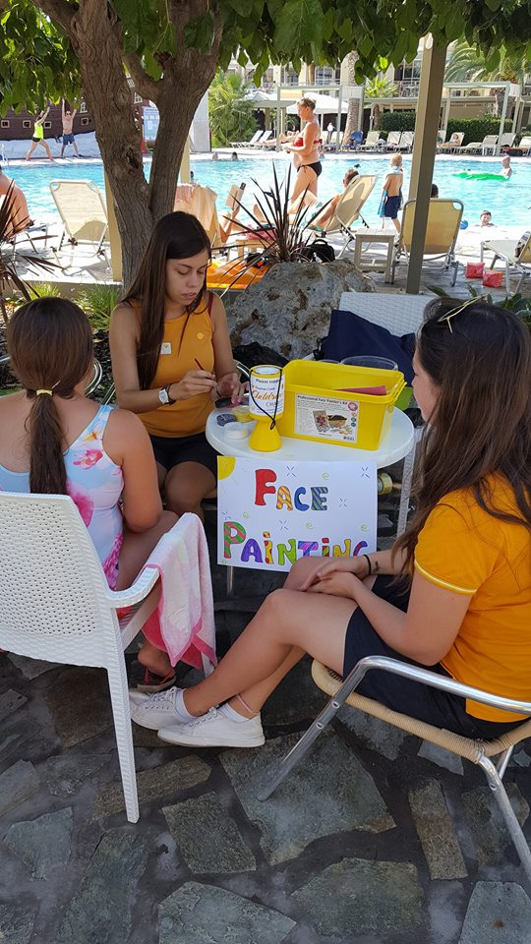
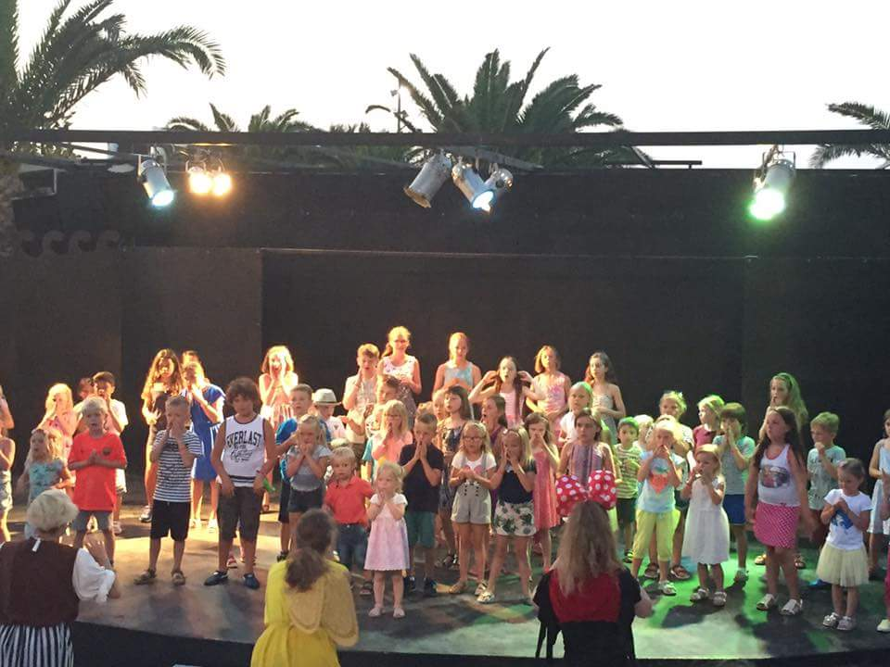
Face painting and mini disco

Slide 18
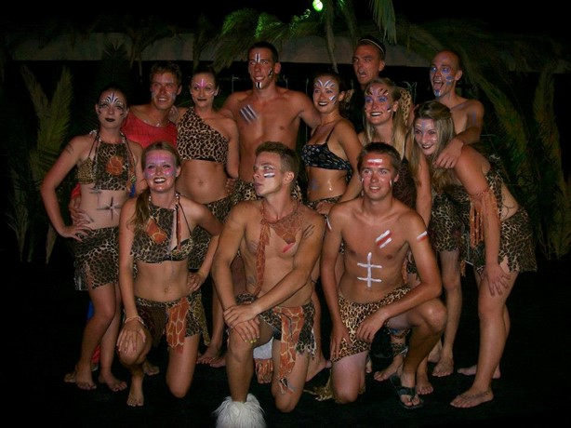
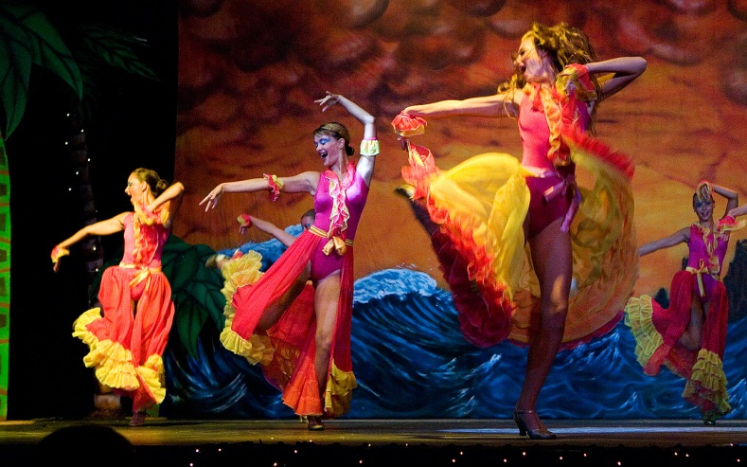
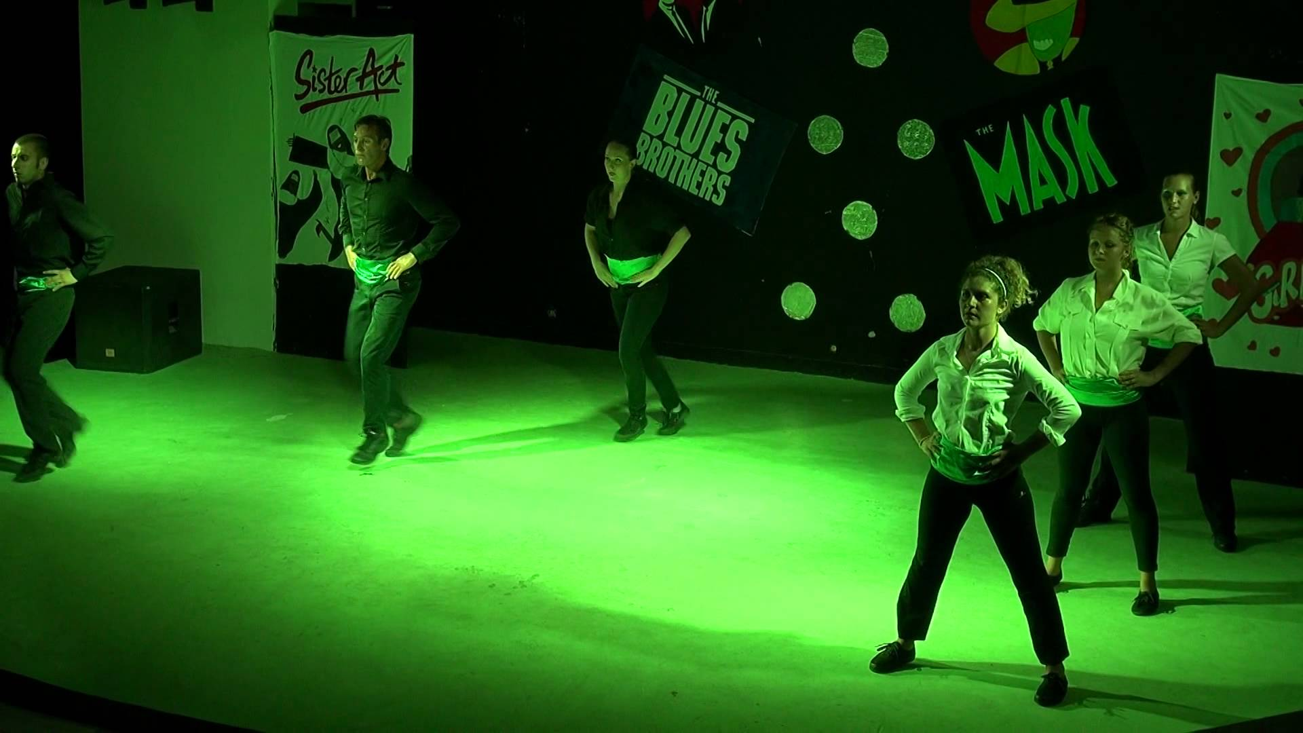
Evening Animation – organizing evening shows

Slide 19
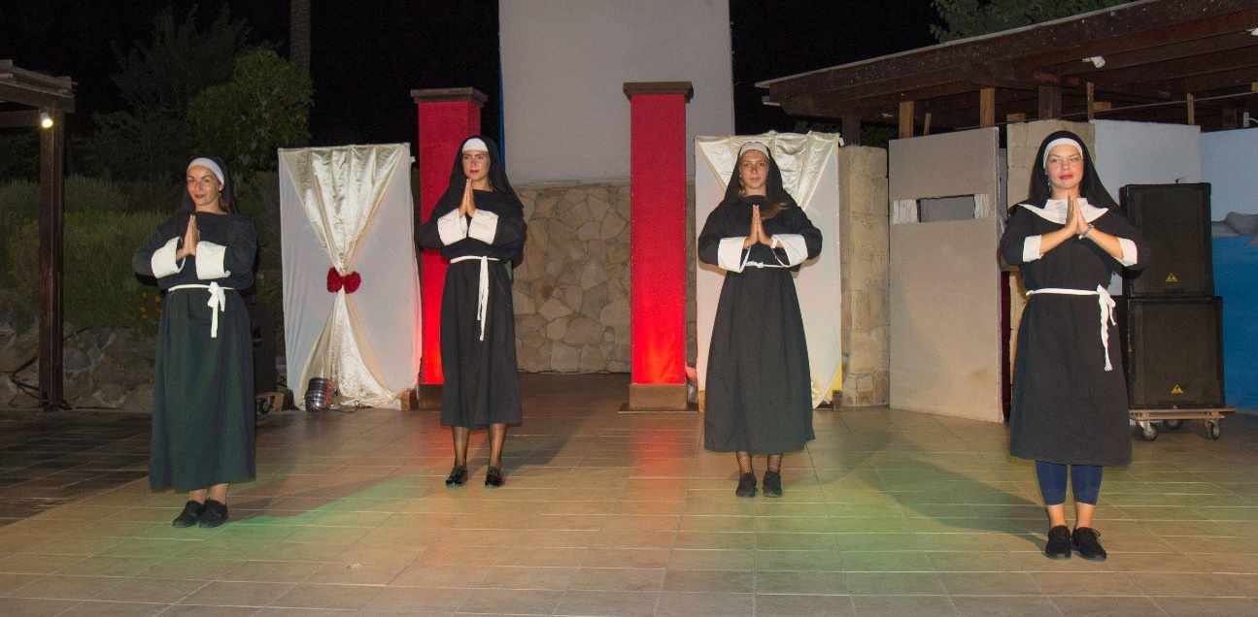
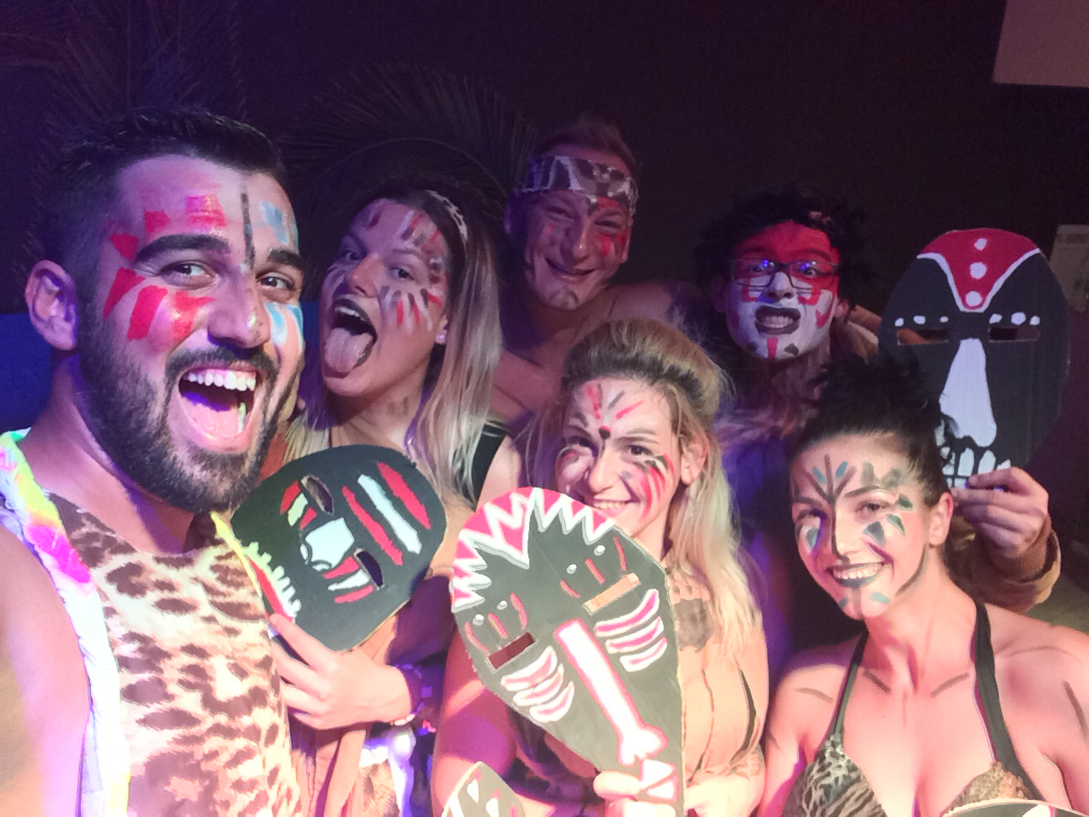
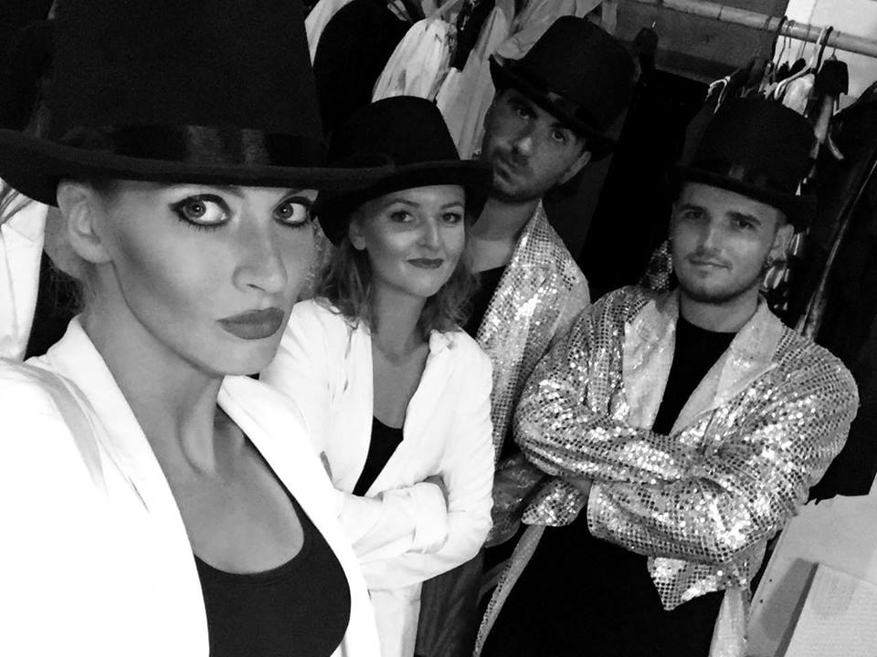
Evening Shows

Slide 20


Working conditions
Practice period from 3 months
6 days per week

Slide 21



Benefits and bonuses
Salary 400 euro per month
Free accommodation
3 meals per day
On real job training
Holiday working environment
Official training certificate
New friendship
Foreign language improvement
Combination of work and vacation

Slide 22
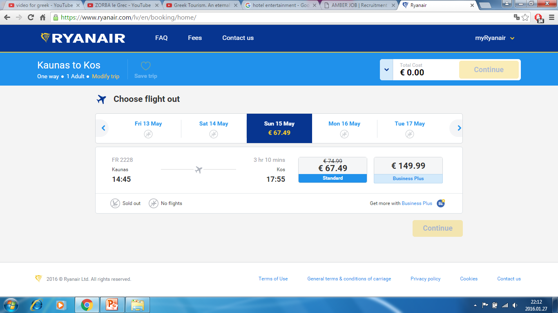
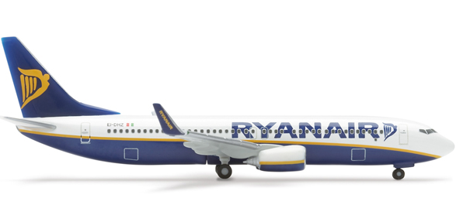
Reaching destination
Flight tickets to practice place (Ryanair; Wizzair);

Slide 23

Students present:
CV in english with recent picture to
amberjobeu@gmail.com;
Copy of valid passport or
copy of EU resident permit card;
European health insurance card.

Slide 24
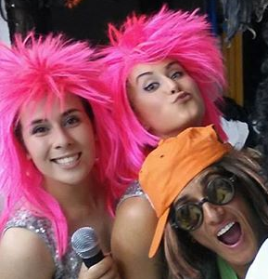
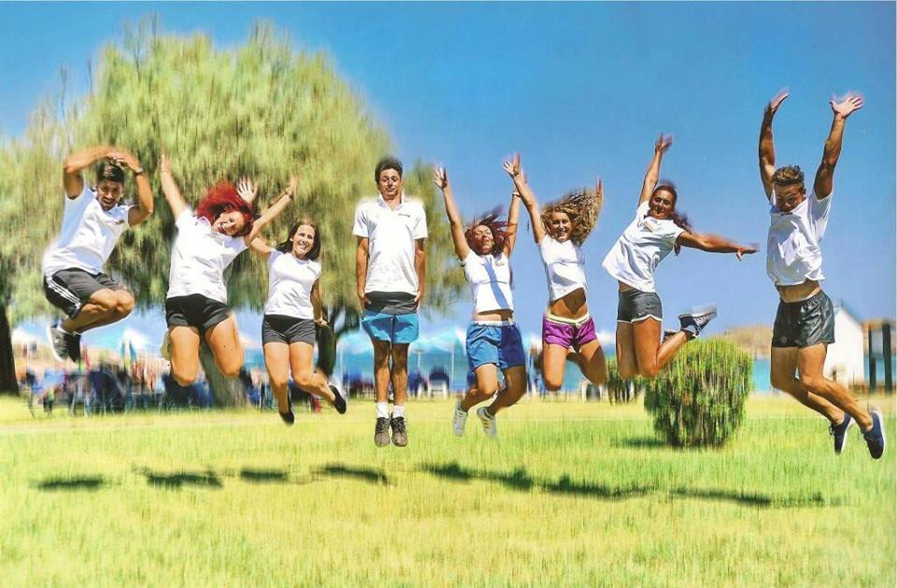
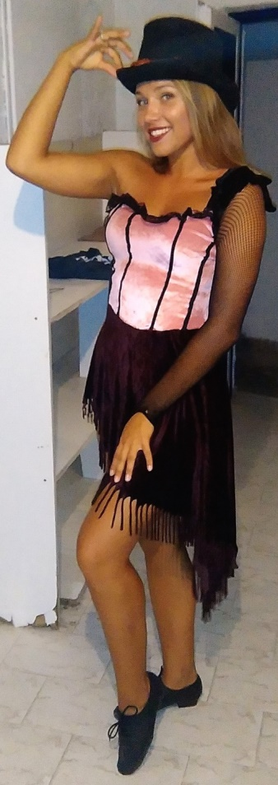
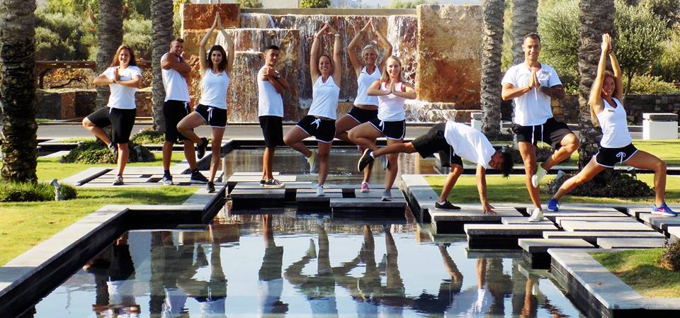
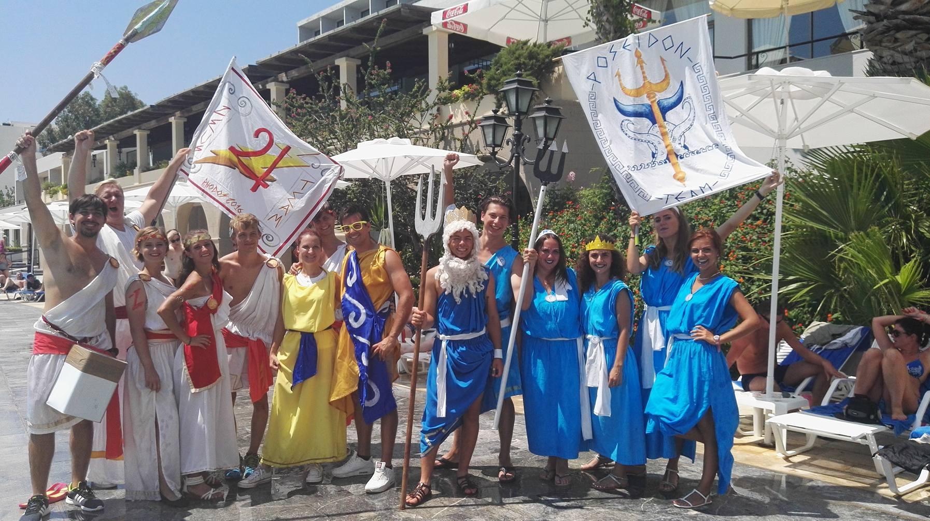
Our students in Greece, 2016

Slide 25
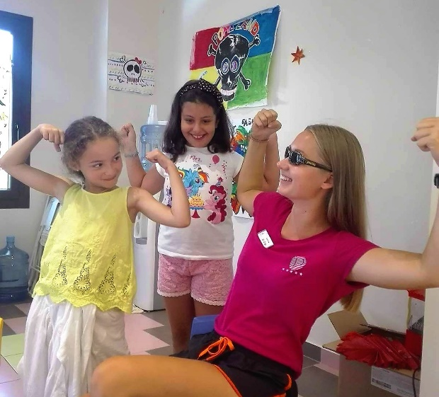
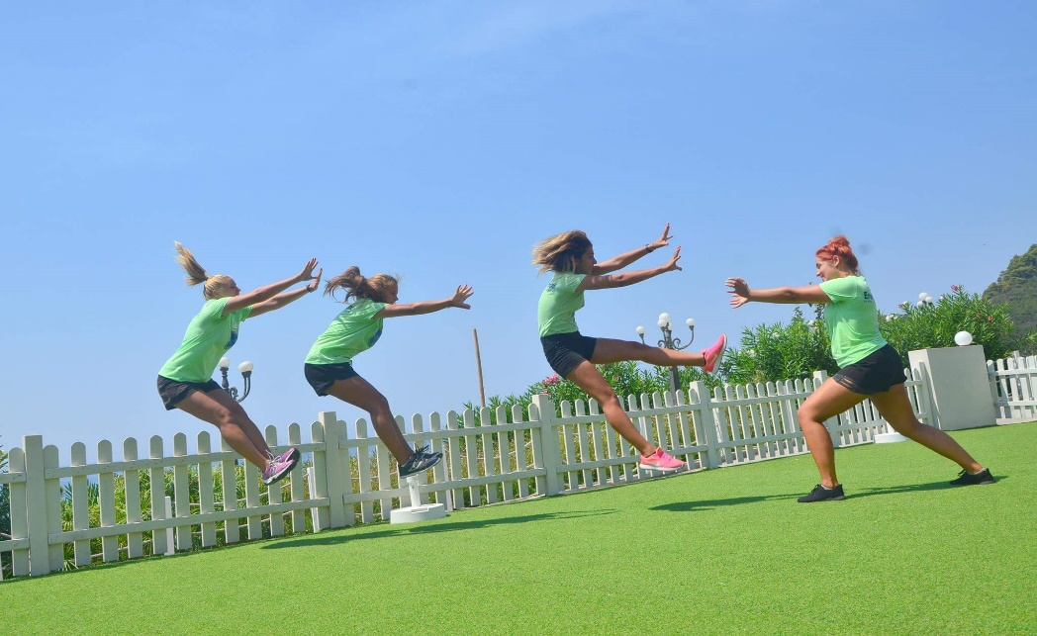
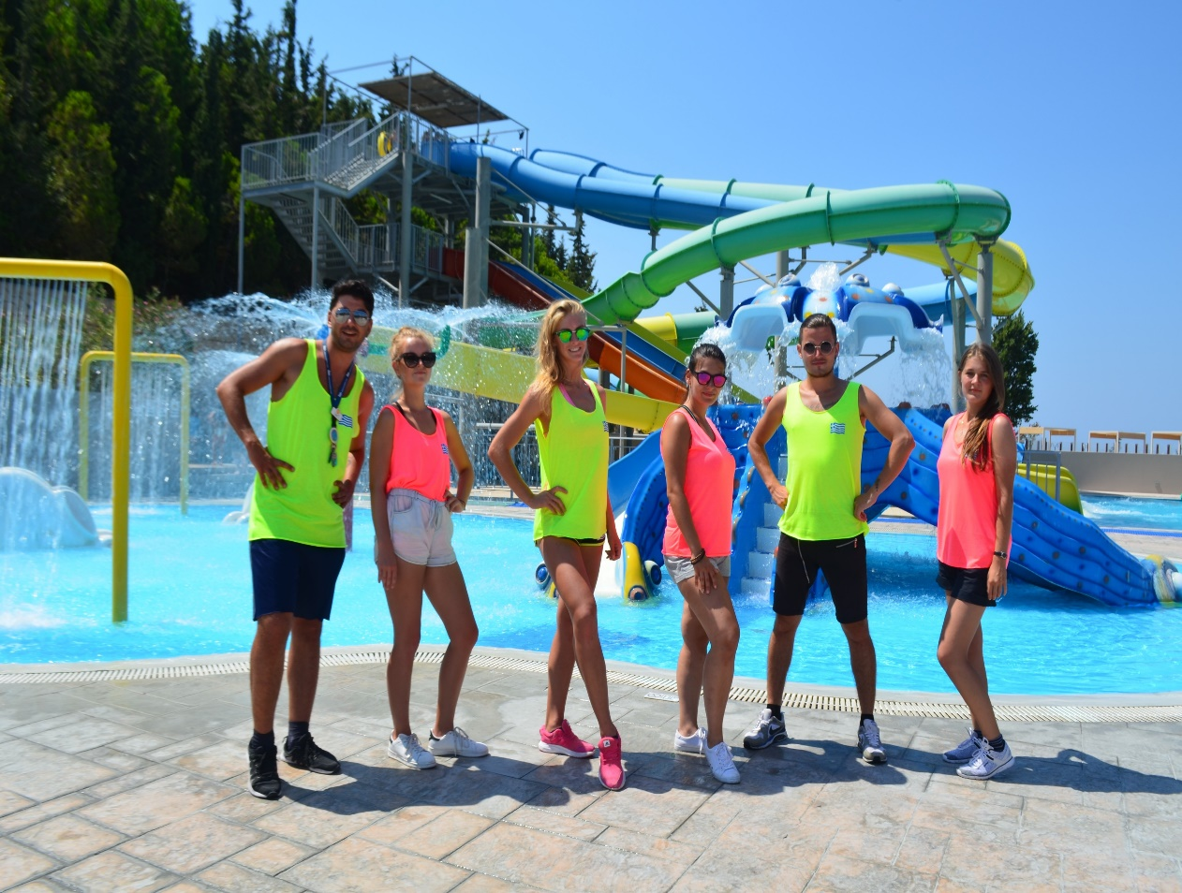
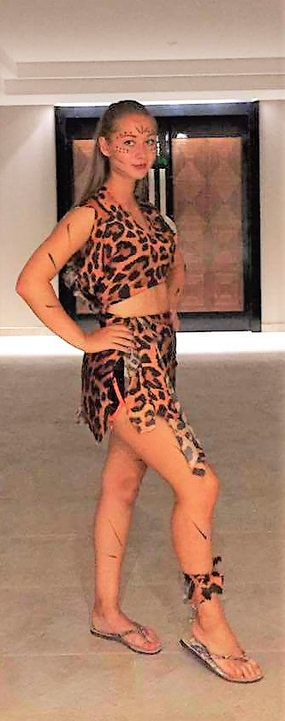
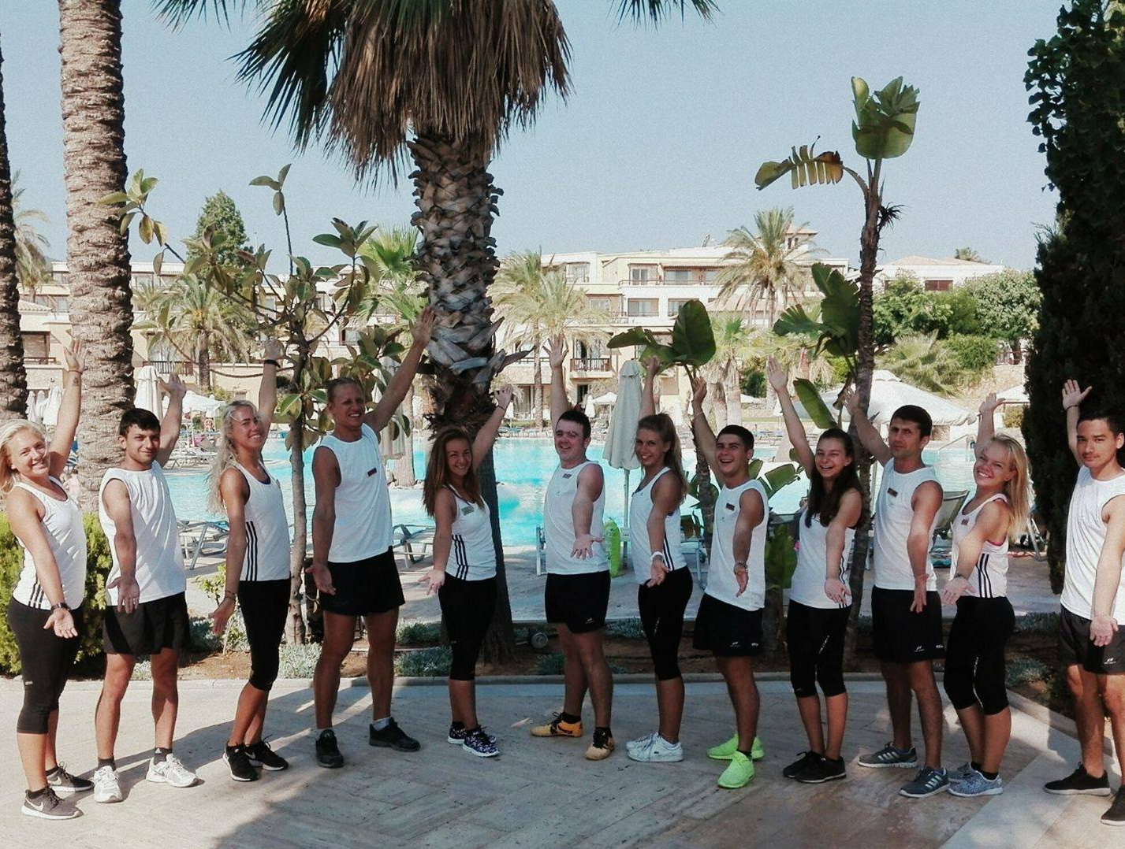
Our students in Greece, 2017

Slide 26
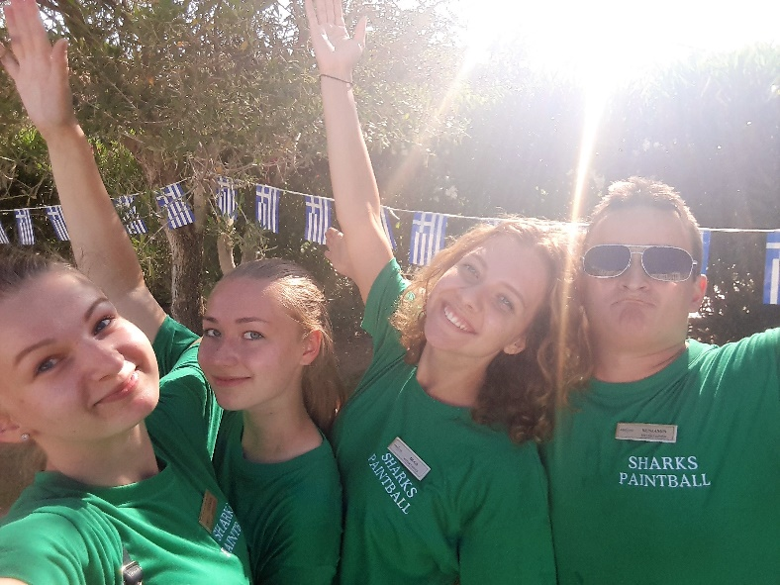
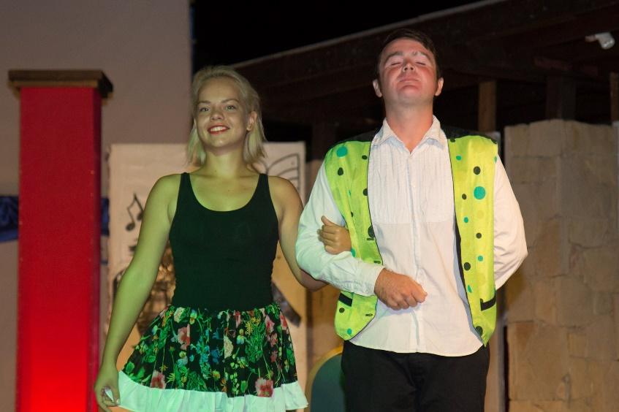
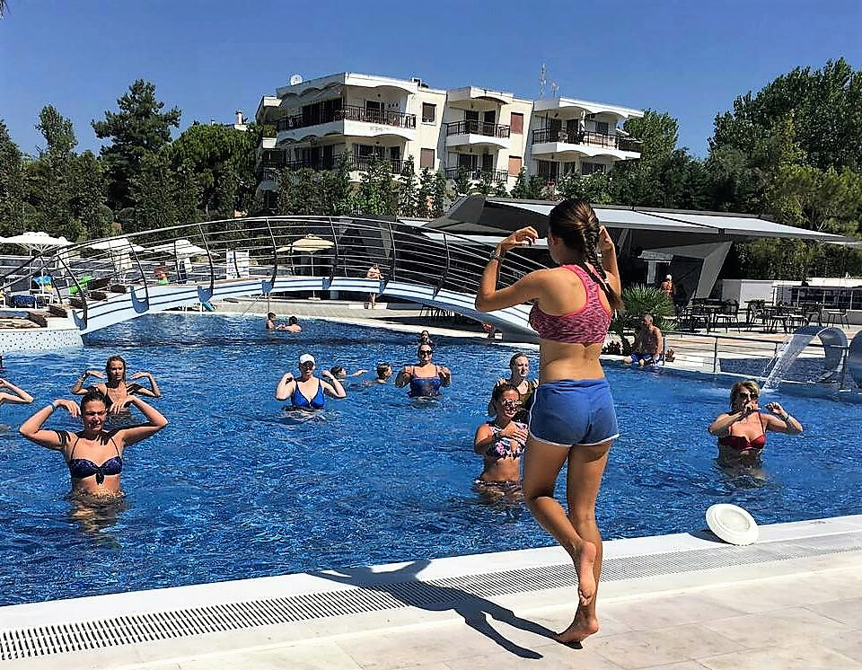
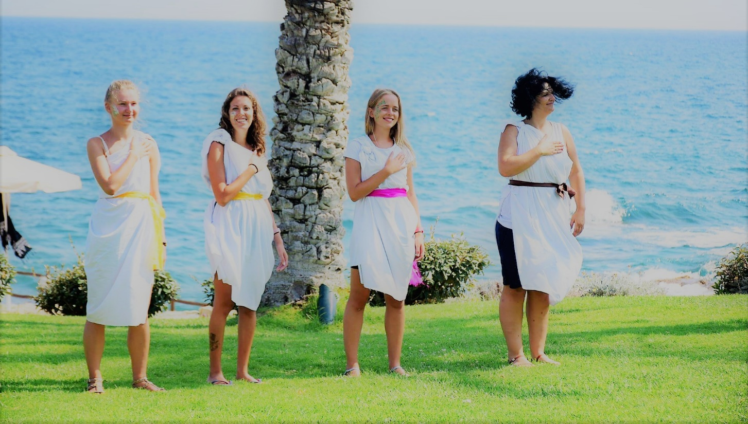
Our students in Greece, 2017

Slide 27

Personal experience
Some of our partners:
Lithuanian Sports University, Kaunas, Lithuania;
Riga State Technical school, Riga, Latvia;
War Studies University, Warsaw, Poland;
Kolping University of Applied Sciences, Kaunas, Lithuanian;
University of Applied Social Sciences, Vilnius and Klaipėda, Lithuanian
Vilnius University, Lithuanian;
Mykolas Riomeris University, Vilnius, Lithuania;
Lithuania Business University of Applied Sciences, Klaipėda, Lithuanial
Lithuanian University of Educational sciences;
College of Vilnius, Lithuania;
Northern Lithuanian College, Šiauliai, Lithuanian
Etc…

Slide 28







Do not wait apply now !
www.amberjob.eu
amberjobeu@gmail.com
+370 67603174
www.facebook.com/amberjob.eu
Amberjobeu

Slide 29




Life is an open book full of white pages.
You write the story as you go.

