Slide 1
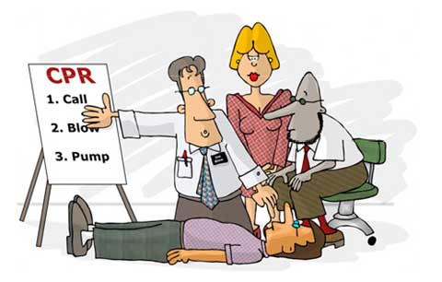
First Aid
Devangna Bhatia

Slide 2
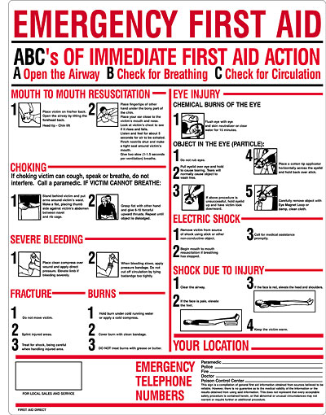
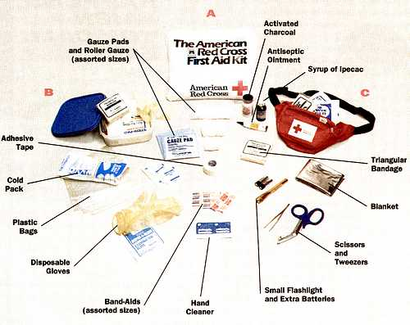
ABC’s:
A: Airways
B: Breathing
C: Circulation
Equipment:

Slide 3
What is First Aid and what are its aims?
“Provision of initial care for an illness or injury.”
3 aims:
Preserve life
Prevent further harm - this covers both external factors, such as moving a patient away from any cause of harm, and applying first aid techniques to prevent worsening of the condition, such as applying pressure to stop a bleed becoming dangerous.
Promote recovery - first aid also involves trying to start the recovery process from the illness or injury, and in some cases might involve completing a treatment, such as in the case of applying a plaster to a small wound.

Slide 4
Before CPR – Primary Survey
1) Danger - Are you or the casualty in any danger? If you have not already done so, make the situation safe and then assess the casualty.
2) Response - If the casualty appears unconscious check this by shouting:
‘Can you hear me?’, ‘Open your eyes’ and gently shaking their shoulders.
If there is a response AND no further danger:
1) leave the casualty in the position found and summon help if needed.
2) Treat any condition found and monitor vital signs - level of response, pulse and breathing.
3) Continue monitoring the casualty either until help arrives or he recovers.
If there is no response:
1) Shout for help.
If possible, leave the casualty in the position found and open the airway.
2) If this is not possible, turn the casualty onto their back and open the airway.

Slide 5
3) Airway - Open the airway by placing one hand on the casualty’s forehead and gently tilting the head back, then lift the chin using 2 fingers only.
This will move the casualty's tongue away from the back of the mouth.
4) Breathing:
Look to see if the chest is rising and falling.
Listen for breathing. no more than 10 seconds
Feel for breath against your cheek.
If the casualty is breathing normally , place them in the recovery position.
2)Check for other life-threatening conditions such as severe bleeding and treat as necessary.
1) If the casualty is not breathing normally or if you have any doubt whether breathing is normal begin CPR!!

Slide 6
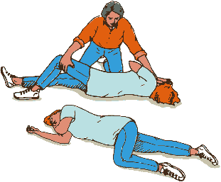
Recovery Position

Slide 7
CPR – Cardiopulmonary Resuscitation
Physical interventions to create artificial circulation by chest compressions, and artificial respiration by the rescuer exhaling into the patient (or using a device to simulate this).
Its main purpose is to maintain a flow of oxygenated blood to the brain and the heart – both are vulnerable to damage from hypoxia.
Some brain cells start dying within less than 5 minutes of hypoxia!

Slide 8
CPR for adults: DEEP INHALATIONS AND EXHALATIONS!
30 compressions : 2 breaths for 2 minutes
rate of 100/min ventilation: 8 – 10 breaths/min
CPR for children (1 year to puberty): SHALLOW BREATHS AND DON’T EMPTY YOUR LUNGS COMPLETELY!
Start: 5 rescue breaths & 30 compressions
then continue with 30 compressions: 2 breaths
CPR for babies (birth to 1 year): FILL YOUR CHEEKS WITH AIR AND USE THIS!
Start: 5 rescue breaths & 30 compressions
then continue with 30 compressions: 2 breaths
Agonal breathing : This is common in the first few minutes after a sudden cardiac arrest. It usually takes the form of sudden irregular gasps for breath. It should not be mistaken for normal breathing and if it is CPR should be started.

Slide 9
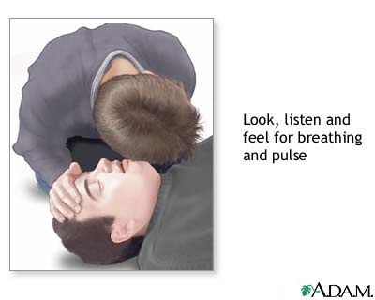
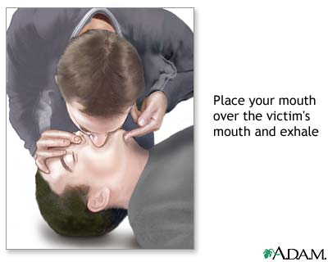

Slide 10
CPR on adults

Slide 11
CPR on children: 1yr - puberty

Slide 12
CPR on infants:

Slide 13
ALS – Advanced Life Support
Advanced life support, including intravenous drugs and defibrillation (the administration of an electric shock to the heart) is usually needed to restore a viable rhythm. This only works for certain heart rhythms:
1) ventricular fibrillation (VF) (uncoordinated contraction of the cardiac muscle of the heart ventricles, making them quiver rather than contract properly.)
2) pulse less ventricular tachycardia (fast heart rhythm, that originates in one of the ventricles.)
NOT useful in a 'flat line' asystolic patient, since the heart is already depolarised. CPR and injections of epinephrine/atropine will help.
CPR is generally continued, usually in the presence of advanced life support, until the patient regains a heart beat (called "return of spontaneous circulation" or "ROSC") or is declared dead.

Slide 14
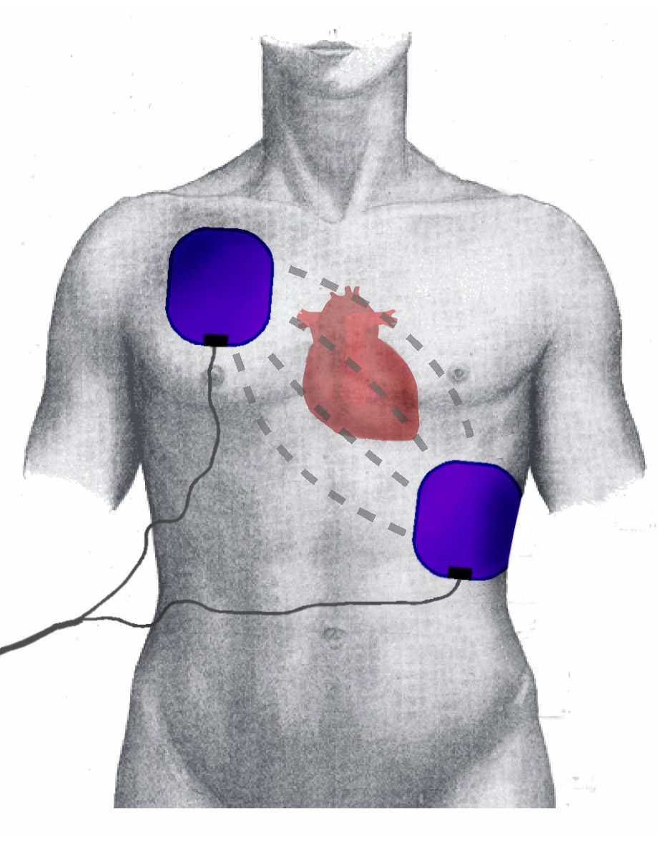
Defibrillation
Consists of delivering a therapeutic dose of electrical energy to the affected heart, using a defibrillator.
This depolarizes a critical mass of the heart muscle, terminates the arrhythmia, and allows normal sinus rhythm to be re-established by the sinoatrial node of the heart.

Slide 16
CPR Videos
http://www.youtube.com/watch?v=5r7haVfZXek
http://www.youtube.com/watch?v=qSsHcdy4GnA
ALS Video:
http://www.youtube.com/watch?v=zO3r50mIgr4

Slide 17
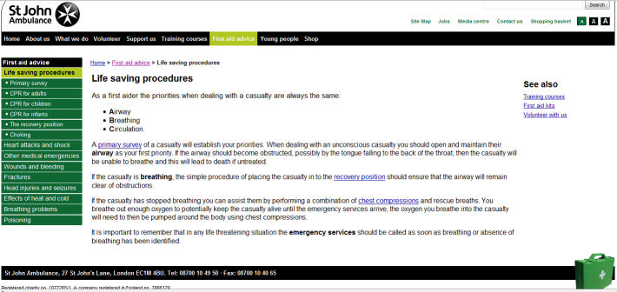
http://www.sja.org.uk/sja/first-aid-advice.aspx

