Slide 1
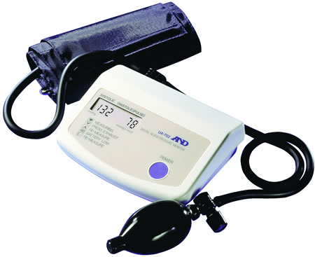
Measurement of Blood Pressure
By Bhavin Doshi
22nd March 2011

Slide 2
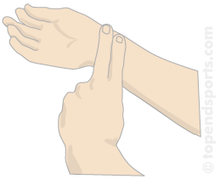
Pulse measurement by palpation
Measure for 1 minute
Less time is not accurate due to:
1. One cannot count fractions of pulses but only whole units
2. First and last pulse cannot be caught with certainty
3. Heart rate fluctuates periodically

Slide 3
Qualities of Peripheral Pulse
Pulsus celer (fast)
Pulsus tardus (slow)
Pulsus mollis (soft or weak)
Pulsus durus (hard or strong)
Pulsus magnus (big amplitude)
Pulsus parvus (small amplitude)

Slide 4
Description of pulse
Mean HR
Regular vs. irregular
Respiratory arrhythmia - ↑ in inspiration
- ↓ in expiration
Postural changes - ↑ in standing than sitting
- ↓ in sitting than supine
ORTHOSTATIC REACTION
CLINOSTATIC REACTION

Slide 5
NOW EVRYBODY TRY IT ON EACH OTHER

Slide 6
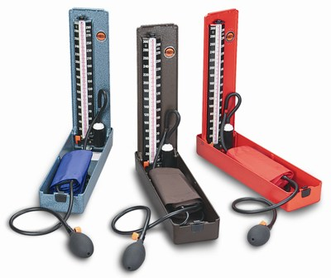
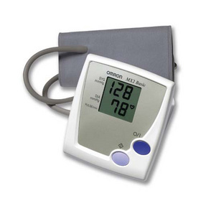
MEASURING Blood Pressure

Slide 7
Indirect measurement of blood pressure
BY PALPATION
Is possible to due to compliance of arterial walls
When cuff reaches a pressure just above systolic pressure the artery is occluded
At this point the pulse is no longer felt distal to the compression
Measures systolic blood pressure only

Slide 8
In direct measurement of blood pressure
BY AUSCULTATION
If outer pressure is lower than systolic pressure (SP), but higher than diastolic pressure (DP), the blood flow is interrupted and renewed alternately
These sudden changes cause vibrations in the acoustic frequency range – Heard by STETHOSCOPE distal to compressed area

Slide 9
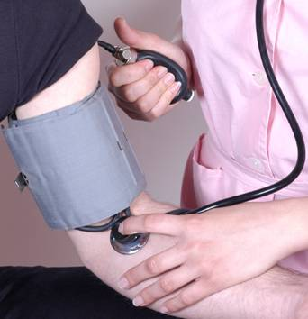
Rules for measuring blood pressure
Patient is sitting for a few minutes
Only validated apparatus must be used
Perform at least two measurements in the course of 1-2 minutes
Use cuff of correct size
Cuff must always be at the
level of the heart
Pressure in cuff should be
decreased slowly (2mmHG/s)
ALWAYS REMEMBER ABOUT
WHITE COAT HYPERTENSION

Slide 10
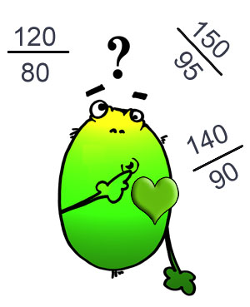
INTERPRETATION OF BLOOD PRESSURE VALUES

Slide 11
Classification of blood pressures in adults according to Guideline of European society for hypertension and European cardiology society for diagnostics and treatment of arterial hypertension at general practitioner’s (2003)
Category | Systolic pressure (mmHG) | Diastolic pressure (mmHg)
Optimal | <120 | <80
Normal | 120-129 | 80-84
High normal | 130-139 | 85-89
Hypertension
Stage 1 | 140-159 | 90-99
Stage 2 | 160-179 | 100-109
Stage 3 | ≥180 | ≥110
Isolated systolic hypertension | ≥140 | <90

Slide 12
AND WHAT NEXT?
Encourage a healthy diet
Obesity management
Control causative diseases
Control stress levels
Initiate pharmaco-therapeutic regime
Constant monitoring and vigilance of causative factors
Regular check-ups at the G.P.’s

