Slide 1
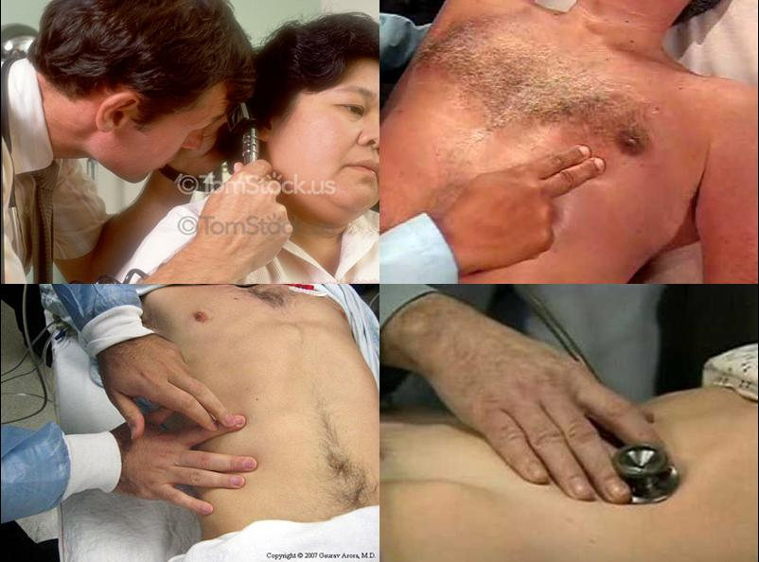
PATIENT HISTORY & PHYSICAL EXAMINATION

Slide 2
Making a diagnosis
Anamnesis = history taking
Physical examination – inspection, palpation, percussion, auscultation, vital signs, weight, height
Working diagnosis - preliminary dg., diff. dg. considerations
Further diagnostic examinations – lab, endoscopy, X-ray, EKG etc.
Final diagnosis
Therapy

Slide 3
Making a diagnosis
Anamnesis = history taking
Physical examination – inspection, palpation, percussion, auscultation, vital signs, weight, height
Working diagnosis - preliminary dg., diff. dg. considerations
Further diagnostic examinations – lab, endoscopy, X-ray, EKG etc.
Final diagnosis
Therapy

Slide 4
Patient history
Generally
Summary of all data regarding the patient’s health from birth to present.
Direct vs. indirect
Rules:
Create an atmosphere of confidence and trust
Privacy
Comfortable environment
Eliminate haste/stress
Ask open questions
Let the patient choose his/her own words

Slide 5
Patient history
Personal data
name, address, date of birth, referring physician, next of kin
Chief complaint
Social status
occupation, family, daily function, …
Medical history
Family illnesses – parents, siblings, children
Prior illnesses – in chronologic order. Duration, treatment, complications
Present illnesses – onset, symptoms, course of symptoms, present status
Review of systems
Skin, head, eyes, ears, nose, mouth, throat, respiratory tract, cardiovascular + lymphatics, GIT, urinary tract, genitalia, locomotor, nervous, psychological state, endocrine, allergies
Natural functions: voiding, defecation, eating habits/weight changes, sleep
Stimulantia
Tobacco, alcohol, drug abuse etc.
Medication
All drugs, strength, doses, duration

Slide 6
Physical examination
Basic methods
Inspection
Pigmentation, asymmetry, oedemas, scars
Lesions, erythemas, hematomas etc
Palpation
Skin, muscle tonus, temperature, moisture
Superficial vs. deep
Pain, masses
Percussion
Indirect percussion – “ finger on finger”
Superficial vs. deep
Quality of sound: resonance, hyperresonance, tympanity, flatness, dullness
Borders
Auscultation
Indirect – stethoscope with membrane and bell
Heart, lungs, intestines, vessels
Smell
Hygiene, ketoacidosis, alcohol, bad breath, foetor hepaticus

Slide 7
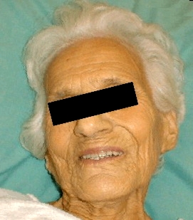
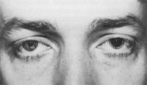
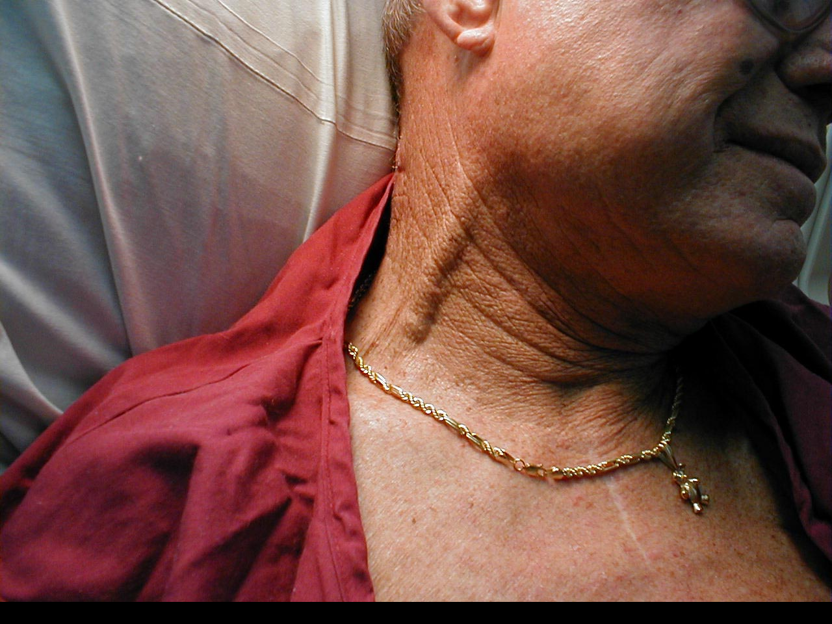
Physical examination
General examination (general impression)
Mental state, voice, speech, nutrition, posture, walk
Skin
Pigmentations, rashes, moisture, elasticity
Scars, hematomas, hemorrhages, erythemas
Head
Direct percussion of skull
CN V exit points – tenderness?
CN VII – make grimaces
CN XII – protrude tongue
Eyes: conjunctiva, pupils round and equal (CN III) – anisocoria?, symmetric accommodation reflex and reaction to light, movements, eyelids
Mouth: teeth (prostheses), moist and clean mucosa and tongue, central cyanosis
Neck
Stiffness
Venous congestion
Palpable gl. thyreoidea
Carotid stenosis
Lymph nodes

Slide 8
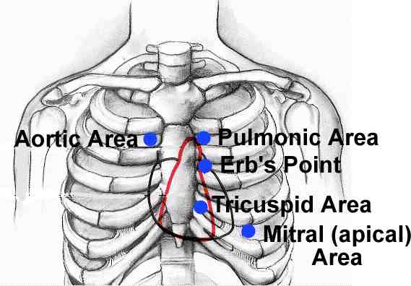
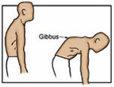
Physical examination
Thorax
Normal shape and movements, breathing
Breasts
description in women >40 years
Tenderness, masses, skin changes
symmetry of areolae, discharge
Axilla
Lymph nodes
Heart
Normal heart sounds, clean tones, no murmurs, respiratory arrhythmia
Lungs
Breathing sounds (stridor?) and frequency, resonant percussion, borders
Auscultation sounds - alveolar vs. tubal breathing, wet or dry sounds, friction murmur
Spine
Pain, stiffness, asymmetry – lordoses/ kyphoses/ scolioses
Ex. Schober’s distance test, Stibor’s distance test

Slide 9
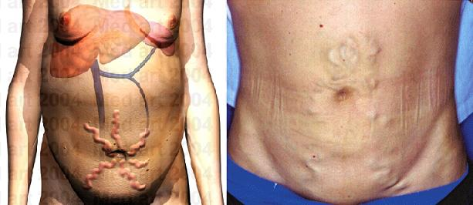
Physical examination
Abdomen
Symmetry: any signs of enlargements or masses? Hernia?
Dilated veins – caput medusae
Palpation: texture, tenderness/pain?, palpable spleen or liver? – borders, palpable masses or possible tumors?
Appendicitis: Rowsing’s sign – palpation of LEFT hypogastrium
Plenie’s symptom – percussion tenderness of right hypogastrium
Percussion: borders of liver/spleen, tympanites?, ascites?
Direct percussion of flanks – kidney tenderness?
Auscultation: intestinal sounds
Urinary bladder

Slide 10
Physical examination
Ext. genitalia
tumors, rash, discharge, pain
Testes
Rectal exploration
normal tonus of sphincter, tumors
Prostata: size (walnut), shape, consistency
Brown faeces on glove

Slide 11
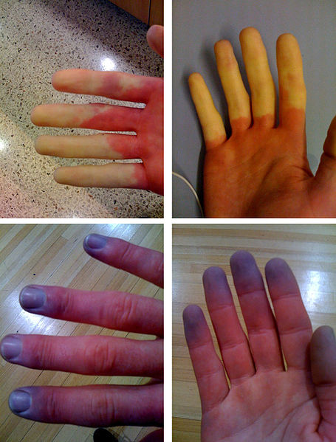
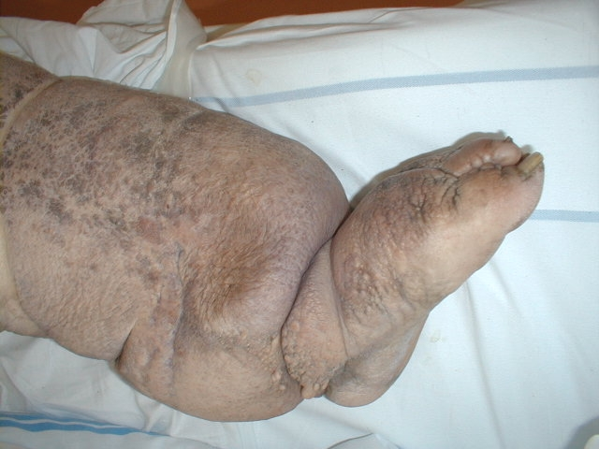
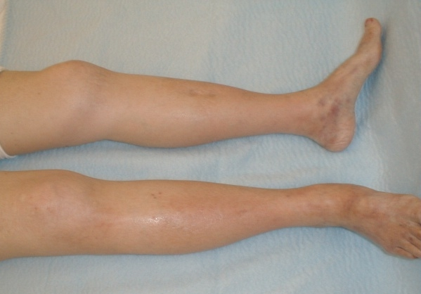
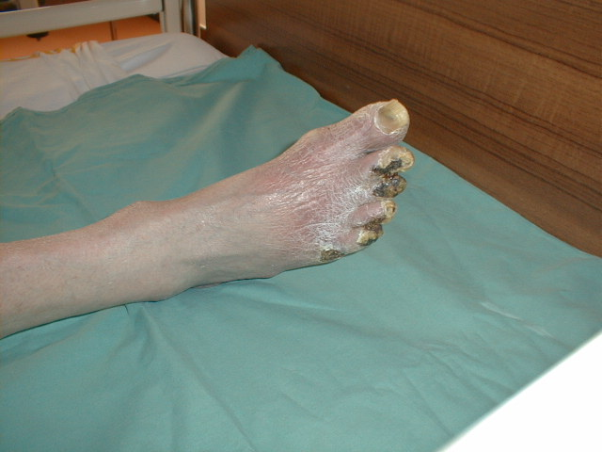
Physical examination
Upper extremities
Radial pulse
Raynaud’s phenomenon (SLE)
Finger clubbing
Lower extremities
Pulse of a. dorsalis pedis and a. tibialis posterior
Ischemia – diabetic microangiopathy
Edema, varicose veins
Lymphedema - elephantiasis

Slide 12
Physical examination
BASIC NEUROLOGICAL EXAMINATION
Cranial nerves
N. olfactorius: rarely examined, smell
N. opticus: normal visual fields, read letters on table, ophtalmoscopy
N. oculomotorius: round pupils, reaction to light and accommodation
N. trochlearis: no ptosis, paresis, deviation, nystagmus
N. abducens: no pareses, double vision, movements (follow the finger), normal saccadic movements
N. trigeminus: normal sensibility for pain and touch in all three branches
N. facialis: Asymmetry of face, normal force of muscles of forehead, eyes, nose, mouth. Sentral vs. peripheral paresis
N. vestibulocochlearis: Normal hearing, conduction through air better than through bone
N. glossopharyngeus & vagus: normal voice, swallowing, elevation of uvula and soft palate
N. accessorius: turn head and lift shoulders symmetrically against resistance
N. hypoglossus: no deviations upon protrusion of tongue, normal speech

Slide 13
Physical examination
Mobility
Bradykinesia, dyskinesia, akinesia, tremors
Rigidity, spasticity, hypotonicity
Force
Muscle force over joints: shoulders, elbows, fist, hip, knee, ankle
Tempo and fine motor skills
Coordination
Reflexes
Each side
Biceps, triceps, radial
Patellar, achilles, plantar
Sensibility
Normal sensibility for pain, touch and temperature
Balance and walking
Normal walk, stand on heels and toes, rise up from crouching position

