Slide 1
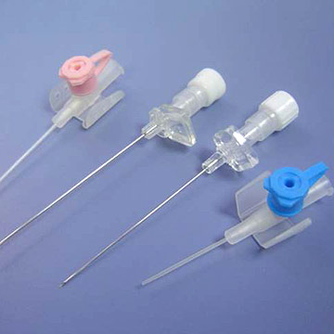
INTRAVENOUS CANNULAS

Slide 2
Aims & Objectives
This presentation aims to present students with an overview of cannulation, the knowledge and skills required to undertake the procedure safely and competently, how to recognise, prevent and manage associated complications.

Slide 3
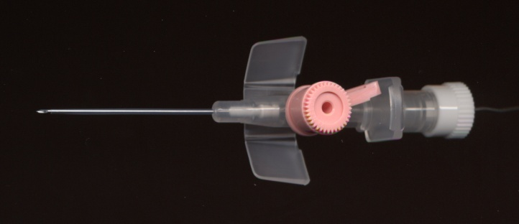
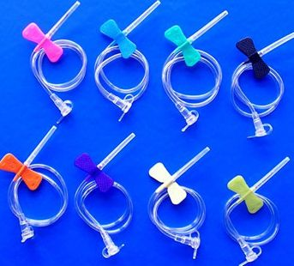
Introduction
Peripheral cannulation provides access for the purpose of IV hydration or feeding and the administration of medications.
A Cannula is a flexible tube, usually containing a needle (stylet), which can be inserted into a body cavity, duct, or vessel in order to drain fluid or administer a substance such as medications.
A Catheter is a flexible tube that is inserted into a body cavity in order to withdraw or introduce fluids.
Peripheral cannulation is a common procedure with more than 24 million cannulae of all designs sold in the U.K.

Slide 4
Selection of a vein
Palpation of the vein should be performed before every cannulation to determine veins from arteries (arteries pulsate and veins do not), and also to locate valves.
Palpation is achieved by placing one or two fingers over the vein and pressing lightly; then releasing the pressure to assess the vein’s elasticity and rebound filling.
The ideal vein is bouncy, refills when depressed, is straight and free of valves.
Must choose a suitable vein for the intended purpose; (rate of flow, type of infusion, duration of therapy, avoid joints since it will lead to mechanical phlebitis or tissuing of cannula. And also restricts the patient’s movement.

Slide 5
Factors that may affect cannulation
Age of the patient – small and very fragile veins in young and elderly
Nutritional status – friable veins in those who are malnourished, deep difficult veins in obese patients
Medical history – E.g. Amputations, lymphoedema, cerebrovascular accident, mastectomy (the arm on the side of the unaffected breast should be used), some surgical procedures or the presence of a haemodialysis shunt
Prescribed medications such as anticoagulants or long-term corticosteroids, which make the veins more fragile and prone to bruising
The physical condition of the patient, for example venous access is more difficult if the patient is dehydrated, in shock or hypothermic
Skill of the practitioner

Slide 6
Improving venous access
Use a tourniquet – apply 7-8 cm above the chosen site, must be tight enough to impede venous return but not affect atrial flow
Opening and closing the fist along with gravity both improve vasodilation
Gentle tapping or stroking may improve vasodilation – but can be painful
Apply heat – such as warm pack, or soaking limb in a bowl of warm water
Which vein?
For prolonged courses of therapy, it is recommended, although not always practical, to start distally and cannulate at proximal points since sites can be maintained for longer
Cephalic vein – takes a large gauge cannula and provides a natural splint, but is at a joint
Basilic vein – awkward for cannulation due to location, but is quite large
Dorsal venous network – easily accessible, visualised and palpated – contraindicated in older patients due to loss of turgor, so veins are not stable

Slide 7
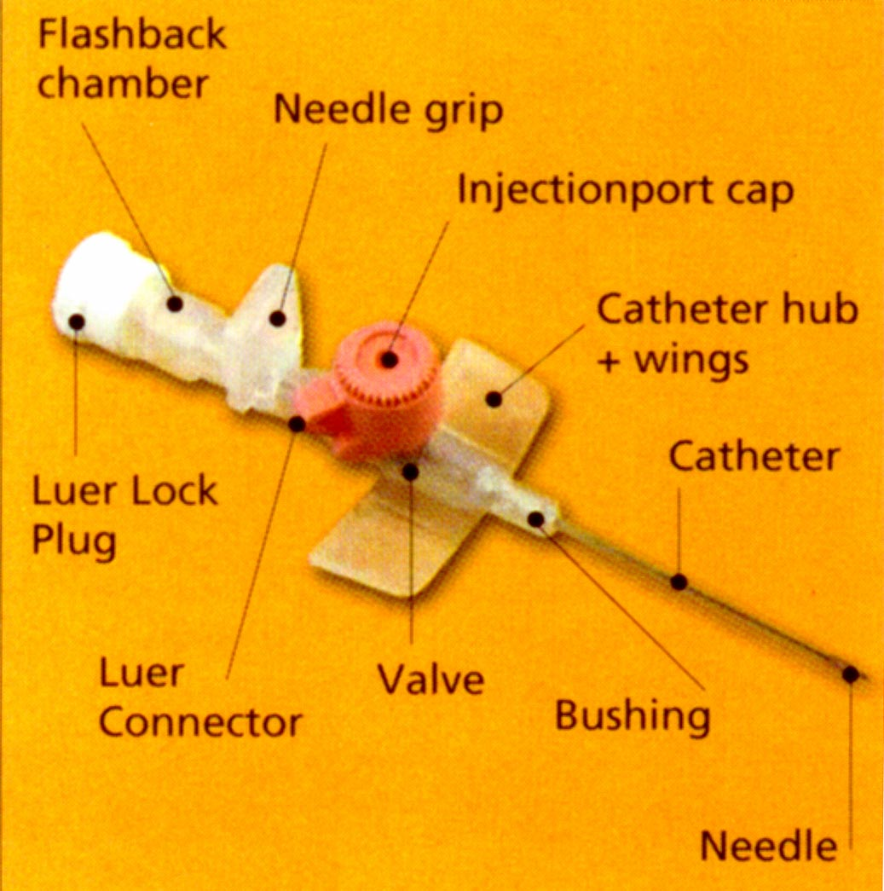
Choosing a cannula
Use “over the needle” type of cannula – where cannula is mounted on the needle – available in various gauges (16–24g), lengths (25-45mm), compositions and designs. Also different materials have differing flow rates.
Smallest gauge should be used to minimise damage to the vessel intima and ensure adequate blood flow around the cannula (reduce risk of phlebitis).
Cannula comprises of different components
Some have wings to help fix it to the skin, others have ports on top to enable the administration of medications without interfering with a continuous infusion. Safety cannulae are liable to reduce the risk of needlestick injury (have a safety button).

Slide 8
Preparation of the environment, the practitioner and the patient
There should be adequate lighting and the room should be warm enough to encourage vasodilation
Practitioner should be in a comfortable position (alter height of bed or chair)
Wear properly fitting gloves to protect from contamination by blood spillage
Anxiety in patient due to needle phobia or previous bad experience could present
Provision of clear and comprehensive information should alleviate anxiety
A careful explanation should be provided of the procedures and patient consent must be gained (Verbal consent is usually acceptable)
Patient should be in a comfortable position. Placing arm on a pillow or rolled towel provides support and a firm, flat surface

Slide 9
Pain Relief
Non-pharmacological methods
Relaxation
Distraction – E.g. Coughing at time of insertion of needle
Pharmacological methods
Local anaesthetics in the form of cream or gel or intradermal injection has been advocated to reduce pain, and anxiety in children and selected adults
Local anaesthetic is also recommended if the cannula is larger than 18g, when a sensitive site is used or at the patient’s request.

Slide 10
Skin preparation
It is important to clean the skin properly – wash with soap and water to remove visible dirt (removes transient flora)
Use anti septic solution - E.g. Chlorhexidine (2%) or alcohol (70%) for 30-60s
Allow skin to dry – ensures disinfection and avoids stinging from needle
Do not touch or repalpate the skin – avaoids recontamination
Hair removal is not neccessary – but can be trimmed with scissors or clippers

Slide 11
The procedure
Stabilisation of the vein – apply traction with non-dominant hand to the side of the insertion site or below it, using thumb and forefinger
Stabilisation of vein should be maintained throughout the procedure until cannula is sited
Needle enters skin with bevel side up, so sharpest side penetrates skin first
Angle needle enters varies depending on type of device used and the depth of the vein in the subcutaneous tissue, from 10 to 45 degrees
Once entry into the vein is achieved, angle is reduced to prevent puncturing posterior wall of the vein
When blood appears into chamber, it is known as “flashback”, indicating initial entry into the vein is successful
Followed by a “giving way” sensation felt by the practitioner – overcoming of the resistance of the vessel wall

Slide 12
The procedure….continued
Flashback may stop is posterior wall is pierced, or may slow if gauge of cannula is small or patient is hypotensive
Cannula should be advanced gently and smoothly into the vein. The one-handed technique – the same hand that performs cannulation also withdraws the stylet and advances the cannula into the vein
The one-step technique – where the practitioner can slide the cannula off the stylet in one movement once the cannula has entered the vein
The two-handed technique – where the practitioner performs the cannulation with one hand but releases the skin traction to advance the cannula off the stylet, which can result in puncturing of the posterior wall of the vein
If cannulation is unsuccessful the stylet should never be reintroduced as this could result in catheter fragmentation and embolism. The device should only be used once.
Only two attempts should be made at cannulation before passing the patient onto a more experienced practitioner

Slide 13
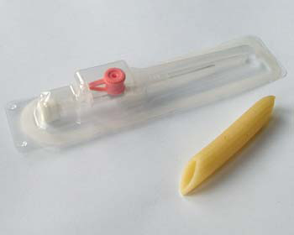
Step – by – step
Step 1: Use a BD Venflon and a cooked piece of penne pasta. Using a BD Venflon is essential because the depth of its plastic casing means that the pasta sits nicely at an accessible height for cannulation (other brands often have deeper casings).

Slide 14
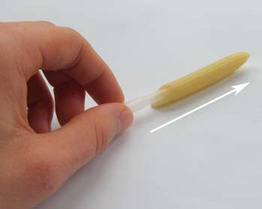
Step 2: Open the cannula, unfold its wings, and remove the plastic sheath that covers the needle. Insert the sheath through the pasta to stent it. The pasta simulates the skin, and the tapering end of the sheath creates a space to cannulate, simulating the vein

Slide 15
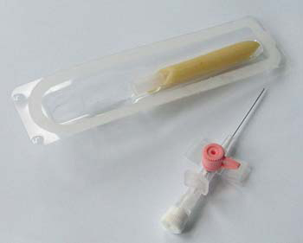
Step 3: Put the stented pasta into the cannula box ready for practice. In a real scenario remember to wear gloves, clean the overlying skin, and locate a sharps box before starting. Cannulation is easier if you first try to increase venous filling. It helps to use a tourniquet; to lower the arm below the level of the heart; to ask the patient to open and close their fist; and gently to tap above the vein

Slide 16
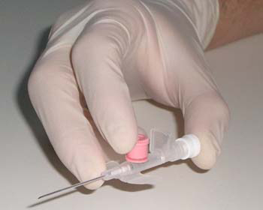
Step 4: Take a three point grip of the cannula, with your thumb on the white cap, index finger on the coloured cap, and middle finger on the wing. In a real scenario apply counter-traction to the overlying skin with your other hand to help anchor the vein during insertion

Slide 17
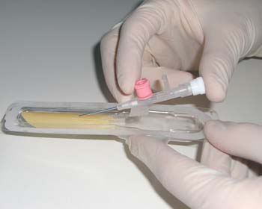
Step 5: Approach at a 30° angle to go through the skin (the outer layer of pasta) then reduce to a 15° angle to advance the needle inside the vein (the space between sheath and pasta) until you see the first flashback (in a real scenario). The flashback provides visual indication of venous entry. The first flashback occurs as you enter the vein, and the second occurs as the needle is withdrawn and blood moves to fill this space. There are three main explanations for failed needle insertions—missing the vein; perforating the posterior wall of the vein; and hitting a valve within the vein

Slide 18
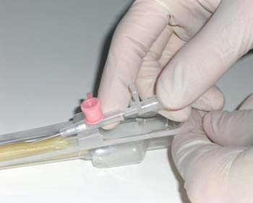
Step 6: Now change your grip, so the thumb and middle finger are on the white cap to withdraw the needle about 5 mm to produce the second flashback. Importantly the index finger provides counter-traction on the wing

Slide 19
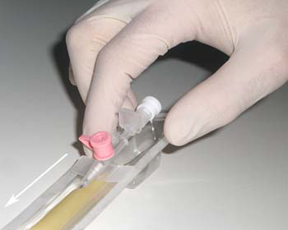
Step 7: With just the index finger remaining in place at the wing, advance the cannula along the vein. In a real scenario this is the time to release the tourniquet

Slide 20
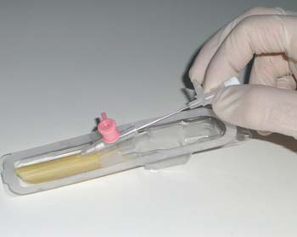
Step 8: Fully withdraw the needle. Remove the white cap and use it to cap the cannula promptly. To prevent bleeding in a real scenario, occlude the vein with your other hand at the tip of the inserted cannula while you remove the needle until you cap the cannula.

Slide 21
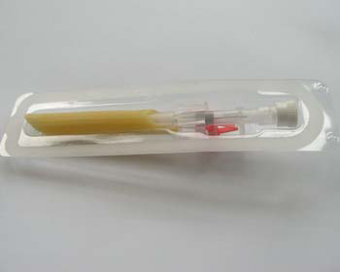
Step 9: When finished practising, remove the cannula, return the needle to the cannula, and return this unit to its sheath for safe storage and further practice

Slide 22
Care and management
Flushing should be performed before and after each use of the cannula
If not used, the cannula should be flushed every 24 hours with 0.9% sodium chloride, using a pulsated (push pause) flush to create turbulent flow and positive pressure
Needleless injection caps are used to reduce significantly the incidence of catheter occlusions.
Cannula can be secured using clean tape or a securement device, which have been shown to reduce the risk of dislodgement and other complications such as mechanical phlebitis.
A transparent dressing or low-linting gauze should be applied and then a bandage may be applied. Transparent dressings, particularly moisture-permeable dressings, should not be bandaged as visibility and moisture permeablity are obscured

Slide 23
Never forget…Documentation
Date and time of insertion
The location of device
Type and gauge size of device
Signature of the practitioner inserting the device
Any other information that the practitioner feels is neccessary to ensure continuity of care, such as problems with access and/or anxiety related to needles
Assessment of the site should be documented using relevant tools (Visual Infusion Plebitis Score) – next slide

Slide 24
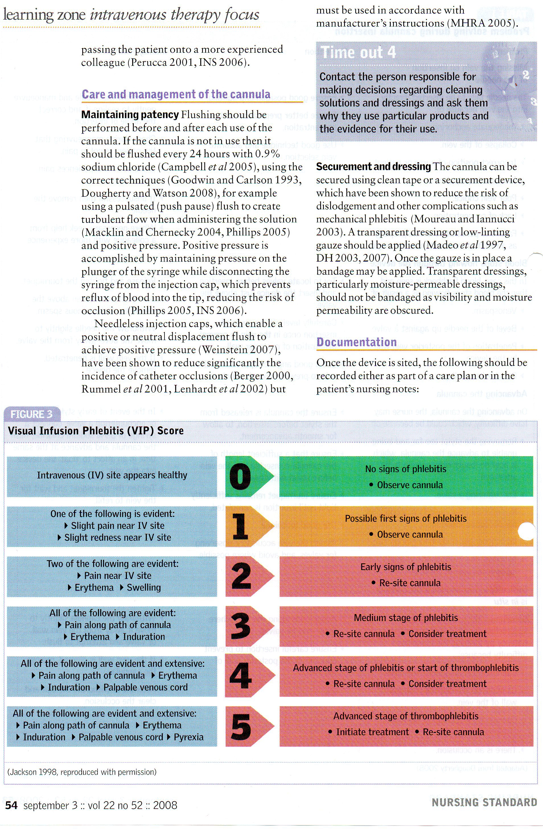

Slide 25
Removal of the device
It is recommended that peripheral devices should be re-sited every 72-96 hours, although some literature supports extending the dwell time up to 144 hours under certain circumstances (E.g. Infusion of non-irritant medications or fluids).
Removal of cannula should be conducted under aseptic conditions
Site should be inspected to ensure bleeding has stopped and should be covered with a sterile dressing.
Cannula intergrity should be checked to ensure that the complete device has been removed
Date, time and reason for removal of the cannula should be DOCUMENTED

Slide 26
Complications
Complications need to be recognised and managed at the earliest possible stage, as they can result in pain, patient anxiety, haematoma, inflammation, infiltration or extravasation.
Haematoma formation
Inadvertent arterial puncture
Neural puncture
If these occur, then they MUST BE DOCUMENTED and the patient must be informed of who and when to contact if they develop numbness or tingling in the limb
Phlebitis and infiltration are most common complications – management depends on cause and also depends on extravated materials

Slide 27
A Little test
1.Peripheral cannulation provides intravenous access for:
a) Hydration
b) Feeding
c) Medications
d) All of the above
2. Which of the following statements is correct?
a ) Arteries and veins pulsate
b) Arteries do not pulsate
c) Veins do not pulsate
d) Veins pulsate
3. Which of the following is not a form of phlebitis:
a) Chemical
b) Physical
c) Infectious
d) Mechanical

Slide 28
4. The ideal vein for cannulation should:
a) Have a number of valves
b) Refill when depressed
c) Be rigid
d) Be located over a joint
5. How often should a cannula that is not in use be flushed?
a) Every hour
b) Twice a day
c) Every other day
d) Every 24 hours
6. The success of cannulation may be influenced by a patient’s
a) Age
b) Nutritional status
c) Physical condition
d) All of the above
7. What percentage of chlorhexidine solution should be used to clean the skin?
a) 2
b) 5
c) 10

Slide 29
References
Department of Health (2007) High Impact Intervention No 2 Peripheral Intravenous Cannula Care Bundle. www.clean-safe-care.nhs.uk/toolfiles/16_SL_HII_2_v2.pdf (Last accessed March 2nd 2010.)
Dougherty L (1996) Intravenous cannulation. Nursing Standard. 11, 2, 47-51
Dougherty L (2008) Peripheral cannulation. Nursing Standard. 22, 52, 49-56
Dougherty L, Lamb J (Eds) Intravenous Therapy in Nursing Practice. Second edition. Blackwell Publishing Oxford, 167-196; 225-270.
Infusion Nurses society (2006) Infusion Nursing standards of practice. INS, Norwood MA
Lavery I, Ingram P (2005) Venepuncture: best practice. Nursing Standard. 19, 49, 55-56
Perucca R (2001) Obtaining vascular access. In Hankins J, Lonsway RAW, Hedrick C, Perdue MB (Eds) Infusion Therapy in Clinical Practice. Second edition. WB Saunders, Philadelphia PA, 375-388
Royal College of Nursing (2005) RCN Standards for infusion Therapy. RCN, London

Slide 30
Springhouse (2002) IV Therapy Made Incredibly Easy. Second edition. Lippincott Williams & Wilkins, Philadelphia PA.
http://archive.student.bmj.com/issues/08/06/education/244.php (Last accessed on March 6th 2010)

