Slide 1
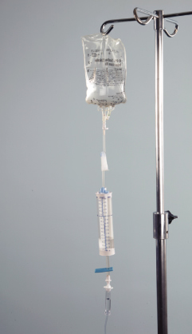
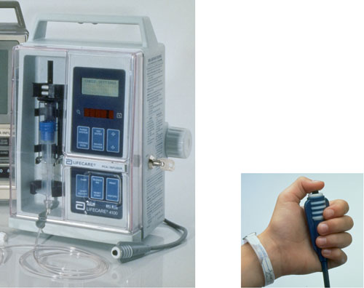
Intravenous infusions (IVs)

Slide 2
Introduction to IVs
Direct administration of fluids into the vein of choice
SC (subcutaneous) or IM (intramuscular) injections are limited to 3 mL since larger quantities lead to local problems
Only limit on IV is the total body fluid content, since total fluid intake should be 35-50 mL / kg body weight / day is acceptable (in 100kg man – 3.5 – 5L per day!!)
IVs are given when we need to give a lot of fluid, or if we need to dilute a medication a lot to reduce irritation
Usually given over longer periods of time (15 minutes to several hours) in contrast to SC and IM which give entire dose instantly
IV administration allows fastest method of administration (bioavailability / bioequivalence is high) because it goes directly into the blood, so may be used for rapid onset of medication

Slide 3
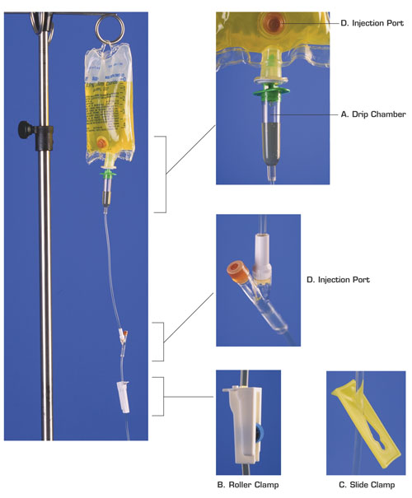
Basic IV setup
IVs are usually administered by bags of fluid that come premixed. The standard sizes range from 50 mL to 1000 mL.
The bag is hung from an IV pole, and IV tubing is attached to the bottom of the bag.
The tubing has several important parts:
a) Drip chamber
b) Roller clamp
c) Side clamp
d) Injection port

Slide 4
a) Drip chamber
Located just below the bag
Used to visualise the fluid dripping into the tubing from the bag
This is where we measure the speed of a manual IV setup – we look at the chamber and count the number of drops per minute
The drip chamber should always be about half full.
If it is too full, we cannot see the drops, so cannot count them
If it is not full enough, then this will allow air to get into the IV tubing and therefore into the patient’s circulatory system, which can be very dangerous, blocking a blood vessel (venous air embolism – VAE),or stopping the heart

Slide 5
b) Roller clamp
This is what we use to control the rate at which the IV fluid infuses
If we roll it one way, it squeezes the tubing more tightly, making it more narrow and therefore slowing the fluid flow through it
If we roll it the other way, it loosens its pinching of the IV tubing, making the tubing less narrow, increasing the fluid flow through it
All roller clamps on a set of IV tubing should be closed before we attach a bag of IV fluid the top of the tubing, ensuring no air gets into the tubing
Every medication is ordered at a specific infusion rate (or flow rate)

Slide 6
c) Side clamp
This is used when we want to completely stop the IV from flowing, without having to adjust the roller clamp
It is useful for momentary breaks in the flow, without having to reset the flow rate again by readjusting the roller clamp all over again
It woks by completely pinching off the IV tubing when we slide the tube through the narrowest part of the clamp

Slide 7
d) Injection port
This is the place where medicine or fluids other than those in the current IV bag can be injected so that they will infuse into the patient’s vein through the IV tubing
Here we can see 2 ports, one in the bag and one below the drip chamber, there is also usually one where the needle goes into the patient’s vein
The injection port on the IV bag is used if we want to mix some kind of medication with the fluid in the bag (need to be compatible)
If we want to inject medication or a second kind of IV fluid that we’ve already attached, then we will use one of the ports that are located below the drip chamber

Slide 8
Height of the IV bag
IV infusion works because of GRAVITY – pushes fluid down through tubing into the vein
The higher the bag is hung, the greater the gravitational pressure on the IV fluid to go downward through the tubing, if the bag is not high enough, there will not be enough pressure to force fluid into the vein
All IV bags must be hung above the patient’s heart in order for there to be enough pressure for the fluid to infuse – usually 3 feet above an adult patient’s heart
Change in the movement of the patient will result in changes in the infusion rate, so constant monitoring is required – usually every hour and after any major change in position
Sometimes needle can be dislodged from the vein so that the fluid is infusing into the tissue – infiltration – eventually IV will stop due to a higher pressure in the tissue compared with the IV tube. Look for swelling, coolness and pain

Slide 9
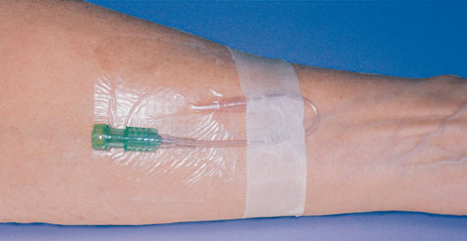
How is IV attached to patient
Can attach a peripheral line (to limb) – these can only be used for a short period, usually 3 days due to risk of infection, so if it is required for longer then it is standard procedure to move the injection site to a new location every 3 days
A central line is an IV attached to a vein in the chest – usually through the chest wall, or neck veins, but it is also possible to insert the cannula into a peripheral vein and move the tip of the cannula slowly upward until it reaches a central vein

Slide 10
Continuous vs Intermittent
IV medication can be given continuously, or intermittently
A patient who requires continuous infusion has a constant IV setup
A patient who only requires intermittent IVs have a cannula setup to them continuously, which is independent of the IV infusion equipment
The cannula has an injection port attached to it’s end called an infusion port adapter (sometimes referred to as a heplock or saline lock/port)
Cannula should be flushed since it can become blocked by clotted blood – can use 2mL saline or 2mL heparin (concentration of 100U/mL) every 6-8 hours
FOR MORE INFORMATION ON CANNULAS, SEE LECTURE ON INTRAVENOUS CANNULATION

Slide 11
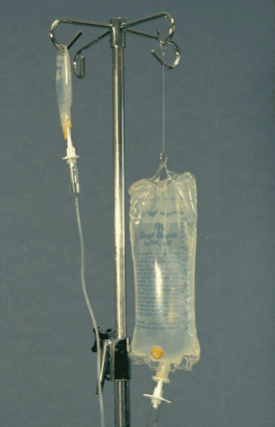
Secondary IV or IV Piggyback
If patient is receiving continuous IV fluids and/or medication and in addition must receive a second kind of intermittent infusion, or if a patients current IV infusion must be interrupted in order to administer a second IV medication or fluid that is more pressing, then we need to hang a secondary IV for the patient
Secondary IV = IV Piggyback = IVPB = Second IV bag hung next to first and enters patient through first set of IV tubing through an injection port below the drip chamber
Usually used for medications which have smaller volumes than the primary IV (50 – 250 mL). Is also, usually given intermittently
Since we want the secondary infusion to infuse faster, we hang it higher than the first bag

Slide 12
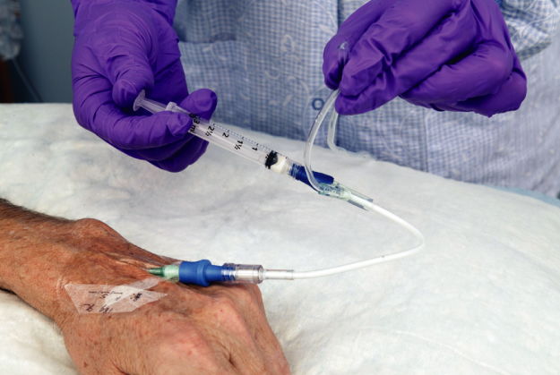
IV Push or Bolus
Sometimes we want to give an injection by intravenous administration, but want to give a small volume all at once. This could be for a few reasons: could be larger than 3mL; It will be better absorbed; avoid the first pass effect.
We can give the IV injection all at once by inserting a syringe into one of the injection ports and this is called an IV push or Bolus
It can be given alongside a continuous infusion or can be given into a heplock which has previously been setup

Slide 13
Smaller volume IV doses
If the volume of fluid we wish to infuse is relatively small (E.g. For an infant or small child, then we need to use a method where small volumes can be controlled.
We use a volume-controlled burette ( allows measurement of 120 mL in graduations of 1mL
Still has drip chamber, roller clamp (on top so we can hang an IV bag above it, to mix a single dose) and injection port at the top

Slide 14
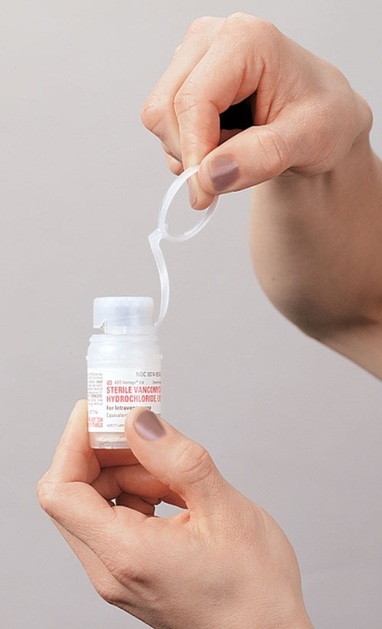
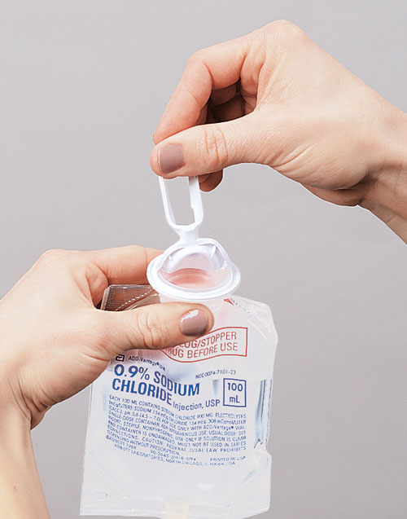
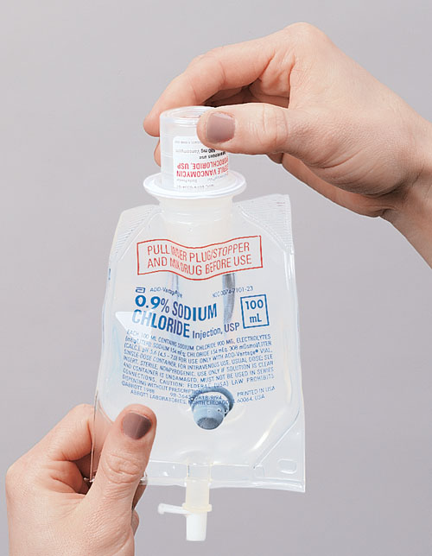
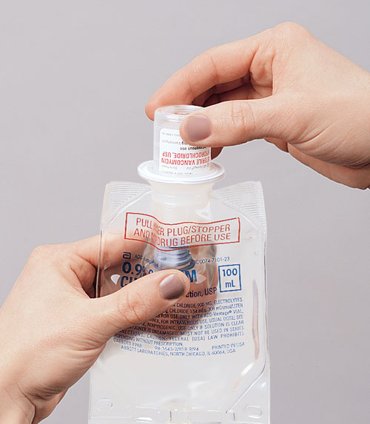
Medication vial ports
Most medications are mixed with IV fluids by injecting them directly into a premixed IV fluid bag
Some drug manufacturers also produce special IV bags which contain a medication vial port, which allows specially shaped vials of powdered medication to be attached directly to the top of a special IV fluid bag
E.g. Powdered Vancomycin hydrochloride into 100 mL of 0.9% Sodium Chloride

Slide 15
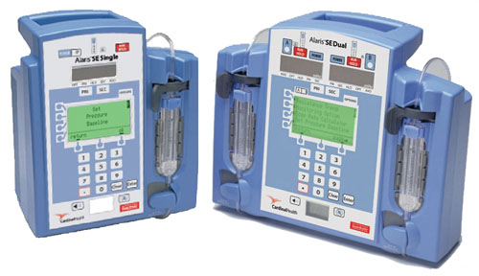
Electronic infusion devices
It is becoming more and more common to for many IV setups in hospitals to be implemented using machines which control the infusion rate on their own, only requiring the practitioner to enter infusion rate in mL/hr. There are 3 common kinds of electronic infusion devices:
Volumetric Pumps – force fluid into the vein under pressure and against resistance, but DO NOT depend upon gravity. Rates need to be monitored regularly. Some have an inbuilt alarm when rate is not being maintained. Also we need to monitor regularly for infiltration

Slide 16
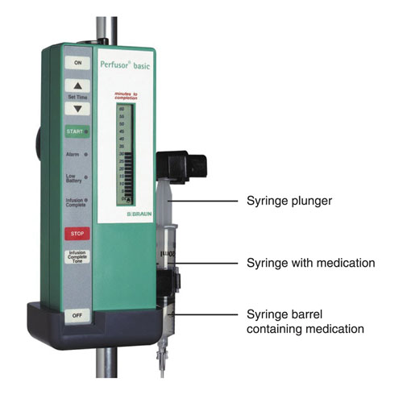
Electronic infusion devices
2. Syringe pumps - these are used for infusion of a very small amount of fluid over an extended period of time, but we need to control the speed that the plunger is depressed. This is difficult to conduct manually, therefore syringe pumps are very useful. Some medications cannot be diluted without losing their efficacy, so these kinds of medications may be given using a syringe pump

Slide 17
Electronic infusion devices
3. Patient controlled analgesia – allows patient to choose when they can take their IV medication, based on how they feel. The device includes a button which the patient can press whenever they feel in need of pain relief, which triggers the machine to dispense the pre-programmed dose of medication, The machine is also pre-programmed to “time-out” so that the patient cannot over-dose. Some machines record the frequency with which the patient presses the button, so that the practitioner is able to monitor how often the patient is in pain

Slide 18
IV Fluids
There are many different types of IV fluids, and often these fluids are expressed using abbreviations when they are written into the drug order form.
Any number that appear in an IV abbreviation indicate percentages. E.g. D5W is 5% dextrose in water and D2.5NS is 2.5% dextrose in 0.9% salt in water
Remember that percentages in IV fluids and other medications actually represent number of grams in 100mL of diluent, so D2.5NS is 2.5g dextrose per 100mL normal saline, which is actually 2.5g dextrose and 0.9g salt per 100mL water

Slide 19
Priming an IV infusion set
Before fluid can be given via the IV route the infusion set must be primed. This involves running the fluid to be infused through the set, to prevent an air embolus. Asepsis should be maintained during the procedure to prevent any internal or exposed areas being contaminated
There are various types of infusion sets available:
Large-bore sets which have large internal diameter (reduced drops per mL ratio) so that there can be fast flow rate
Smaller-bore sets offer larger drops per mL value so can be used to administer crystalloid and diluted drug infusions
Both types of devices are gravity dependent and flow is controlled by means of the roller clamp
Only recommended sets may be used with electronic volumetric infusion devices
All sets have a trocar and a luer lock connector
Packaging should be sterile, intact and within expiry date

Slide 20
Equipment required
Fluid to be infused
Administration set
Clean gloves / apron
Receptacle for any discarded fluid
Drip stand
Alcohol swab
Air inlet if using glass or rigid containers)

Slide 21
The procedure….I
The correct patient should be identified , consent obtained and information and reassurance given
The fluid to be infused should be checked against the prescription by two practitioners – check date of prescription, expiry date of fluid and directions
Check infusion set contents for signs of contamination
Wash hands, don clean gloves and apron

Slide 22
The procedure….II
Remove any packaging. Maintaining asepsis, snap the seal where the administration set trocar is to enter the bag (invert the bag). If possible, hang fluid on a drip stand
Close any flow controllers on the administration set. Expose the trocar without touching and advance into the appropriate port

Slide 23
The procedure….III
Gently squeeze the drip chamber, allowing it to partly fill with fluid
Partially release the flow controller to allow fluid to fill and move through the tubing. This may require removing the protective cap at the luer lock connector to allow air to be expelled

Slide 24
The procedure….IV
Expel any air by allowing the fluid to run through the set into a receptacle
Connect to patient’s intravascular device according to local policy and DOCUMENT the procedure

Slide 25
References
http://www.cwladis.com/math104/lecture6.php (Last accessed on March 7th 2010)
Higgins, D. (2004) Priming an IV infusion set. Nursing Times
Jamieson, E.M. (2002) Clinical Nursing Practices. Edinburgh: Churchill Livingstone
Medical Devices Agency (2003) Infusion System Device Bulletin. MDA Device Bulletin 2003: 02. London: MDA
Quinn, C. (2000) Infusion devices, functions and management. Nursing Standard; 14: 26, 35-41
RCN (2003) Standards for Infusion Therapy. London: RCN

