Slide 1
Clinical Sessions
Gynecology

Slide 2
Topics:
Examination and main conditions
Breast examination
Bimanual vaginal examination
Cervical (pap) smear

Slide 3
Gynecology
From the Greek, gynaika meaning woman, is the medical practice dealing with the health of the female reproductive system (uterus, vagina and ovaries)
Literally, outside medicine, it means "the science of women"

Slide 4
Main conditions:
Cancer and pre-cancerous diseases of the reproductive organs including ovaries, fallopian tubes, uterus, cervix, vagina, and vulva
Incontinence of urine;
Amenorrhea (absent menstrual periods);
Dysmenorrhea(painful menstrual periods);
Infertility;
Menorrhagia(heavy menstrual periods). This is a common indication for hysterectomy;
Prolapse of pelvic organs;
Infections of the vagina, cervix and uterus (including fungal, bacterial, viral and protozoal).

Slide 5
History
The questions shoud seek information about woman’s:
Menstrual history;
Obstetric history;
Previous medical history (past illnesses and operations) and family history;
Current medications;
Sexual history;
Details of contraceptive use, including any side-effects
History of the main complaint;

Slide 6
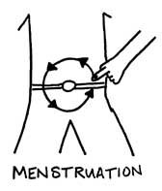
History
Menstrual History:
Age at menarche
Duration of menstrual cycle
Menstrual pain
Durantion and severity of menstruation

Slide 7
History
Obstetric history (if any):
The number of pregnancies and the outcome (spontaneous miscarriages or induced aborptions);
Ectopic gestation;
Children born, thir birth weights and the year of birth of each;
Complications occurring during pregnancy, labour or the puerperium (the end of the third stage of labour until involution of the uterus is complete, i.e. approximately 6 weeks)

Slide 8
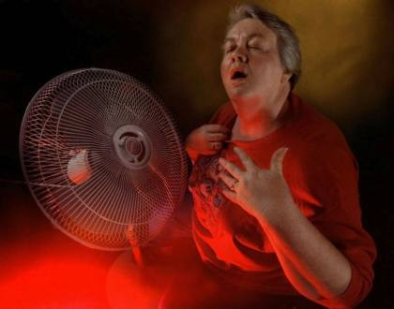
History
Note:
In an older women more emphasis should be placed on the menopausal history rather than menarche and menstruation

Slide 9
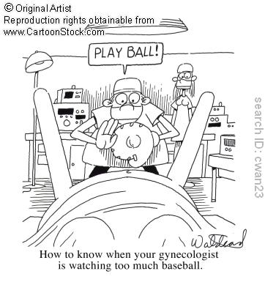
Examination
Breast examination;
Abdominal examination;
Inspection of external genitalia;
Pelvic examination, by speculum, and then digitally as a bimanual vaginoabdominal examination;
Rectal examination in certain instances.

Slide 10
Breast Examination
Inspection of the breasts - the patient’s arms at her side
Inspection of the breasts – the patient’s arms are raised above her head
Contour of the breasts
Size and shape of aureola
Condition of the nipples
Placing hand on hip tenses the pectoralis major, accentuating any tethering from an infiltrating neoplasm
Palpation of the upper outer quadrant of the breast
Systemic examination of four quadrants of the breast
Axillary and supraclavicular palpation (with relaxed pectoral muscles)

Slide 11
Note
Palpation should be gentle and orderly, using the flat of the fingers of one hand.
Each portion of the breat should be palpated systematically, beginning at the upper quadrant, inner quadrante, followed by palpation of each portion sequentially until the upper, outer quadrant is finally examined.

Slide 12
http://www.youtube.com/watch?v=YC0VZzOxIlY

Slide 13
When to do the breast examination?
First consultations of women over the age of 45
Presence of secretions of milk at times not associated with pregnancy (galactorrhoea)
Breast lumps/nodules felt on palpation
Discoloration or change in the quality of the skin:
Redness suggests infection/inflammation
‘Peau d'orange’ quality - an "Orange Peel" like texture that's caused by an uncommon, aggressive inflammatory malignancy

Slide 14
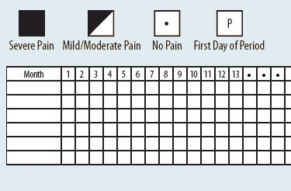
Breast Pain Chart

Slide 15
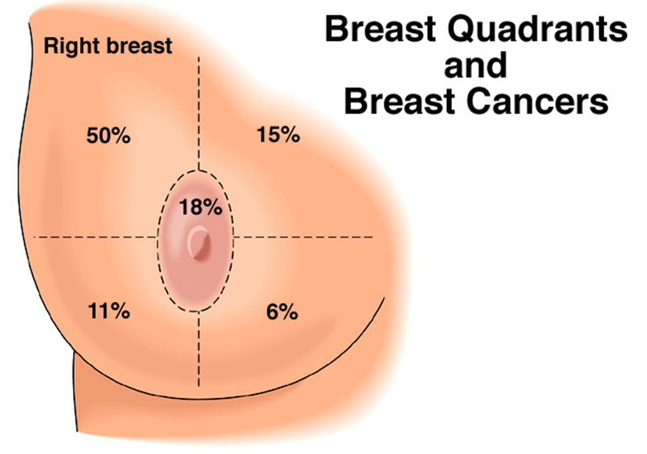

Slide 16
Breast self-examination
Breast self-examination (BSE) is a screening method used in an attempt to detect early breast cancer. The method involves the woman herself looking at and feeling each breast for possible lumps, distortions or swelling.
Method:
stand in front of a mirror with the torso exposed to view.
Find visual signs of dimpling, swelling, or redness on or near the breasts.
Repeat in several positions, such as while having hands on the hips, and then again with arms held overhead.

Slide 17
Breast self-examination
The woman then palpates her breasts with the pads of her fingers to feel for lumps (either superficial or deeper in tissue) or soreness.
Common patterns (designed to ensure complete coverage):
The vertical strip pattern involves moving the fingers up and down over the breast.
The pie-wedge pattern starts at the nipple and moves outward.
The circular pattern involves moving the fingers in concentric circles from the nipple outward.
Some guidelines suggest mentally dividing the breast into four quadrants and checking each quadrant separately.
The palpation process covers the entire breast, including the "axillary tail" of each breast that extends toward the axilla (armpit).
This is usually done once while standing in front of the mirror and again while lying down.

Slide 18
Abdominal examination
Patient is lying confortable on her back, after having emptied her bladder immediately beforehand.
Inspection of the abdomen (contour, striae, scars, and dilated veins) – If patient raises her head and coughs, hernias and divarication of the rectus abdominis muscles will be evident;
Palpation of the viscera is performed systematically (liver, gallbladder, spleen and kidneys);
The ceacum and colon are palpated next (the hand pressing down gently as the patient breaths out);
Percussion may be required if the presence of free fluid is suspected.

Slide 19
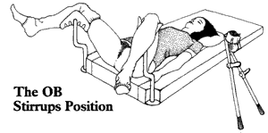
Pelvic Examination
Should follow the abdominal examination, and should never be omiited unless the patient is virgin.
The external genitalia are first inspected under a good light, with the patient in a dorsal position, the hips flexed and abducted, and knees flexed.

Slide 20
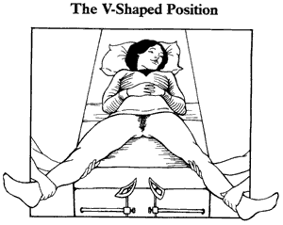
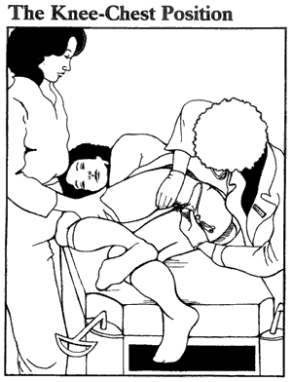
Pelvic Examination
Other positions:

Slide 21
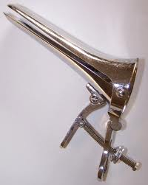
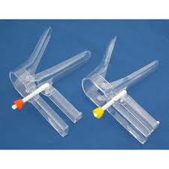
Pelvic Examination – Bivalve Speculum
The patient is asked to strain down – detection of any evidence of prolapse
Insertion of a bivalve speculum and visualization of cervix

Slide 22
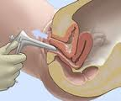
How to use a speculum?
Should be warmed
Use a lubricant
Insert it initially obliquely
Doctor’s approach sensitive and communicative

Slide 23
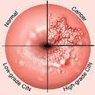
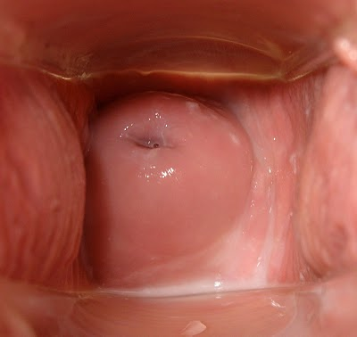
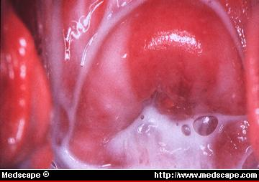
Pelvic Examination – Bivalve Speculum
The vagina and cervix are inspected
Perform Pap Test (in this case, no lubricant apart from wated should be used on the speculum)

Slide 24
Cervical (pap) Smear

Slide 25
Cervical (pap) Smear
Definition:
A Pap smear, also called a Pap test, is a procedure to test for cervical cancer in women. A Pap smear involves collecting cells from your cervix — the lower, narrow end of your uterus.
Pap smear is your first step in halting the possible development of cervical cancer.

Slide 26
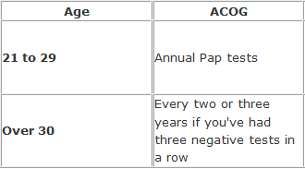
Cervical (pap) Smear
Why it's done?
Is typically done in conjunction with a pelvic examination, although pelvic examinations can screen for reproductive problems or abnormalities, only a Pap smear will detect early cervical cancer or precancers.
Who should have a Pap smear?
First Pap smear should be
done about three years after
first having sexual relations
or at age 21,whichever comes
first.
(ACOG - American College of
Obstetricians and Gynecologists)

Slide 27
Cervical (pap) Smear
If you have certain risk factors you should undergo a Pap smear annually, regardless of your age. These risk factors include:
A diagnosis of cervical cancer or a Pap smear that showed precancerous cells;
Exposure to diethylstilbestrol (DES) before birth;
HIV infection;
Weakened immune system due to organ transplant, chemotherapy or chronic corticosteroid use;

Slide 28
Cervical (pap) Smear
Who can consider stopping Pap smears?
After total hysterectomy:
Due to a noncancerous condition, such as fibroids - discontinue routine Pap smears.
Due to a precancerous or cancerous condition - annual vaginal Pap smear.
Older age:
ACS (American Cancer Society ) guidelines - stop having tests at 70 if she's had three negative tests in the last 10 years.
USPSTF (U.S. Preventive Services Task Force ) guidelines - stop Pap testing at 65.
Discuss your options with your doctor and together you can decide what's best for you based on your risk factors.

Slide 29
Cervical (pap) Smear
How you prepare?
To ensure that your Pap smear is most effective:
Avoid intercourse, douching or using any vaginal medicines or spermicidal foams, creams or jellies for two days before having a Pap smear, as these may wash away or obscure abnormal cells.
Try not to schedule a Pap smear during your menstrual period. Although the test can be done, it's best to avoid this time of your cycle, if possible.

Slide 30
Procedure
Insert a speculum into the woman's vagina, which spreads the vagina open and allows access to the cervix
Collect a sample of cells from the outer opening or os of the cervix by scraping it with an Aylesbury spatula
An endocervical brush is rotated in the central opening of the cervix
The cells are placed on a glass slide and taken to the laboratory to be checked for abnormalities.
The sample is stained using the Papanicolaou technique, in which tinctorial dyes and acids are selectively retained by cells.
Unstained cells cannot be seen with a light microscope

Slide 31
Cervical (pap) Smear
Aylesbury spatula

Slide 32
Notes:
When performing a Pap Test no lubricant apart from water should be used on the speculum;
Depending on the type of Pap test you're undergoing, your doctor transfers the cell sample collected from your cervix onto a glass slide or into a container holding a special liquid to preserve the sample (liquid-based Pap test).

Slide 33
Liquid-based Pap test
Liquid-based Pap test, also referred to as liquid-based cytology, is a procedure used to microscopically test a small sample of cells.
The sample of cells is preserved in liquid rather than smeared on a microscope slide, provides fewer false-negative results .
In USA is preferred by most laboratories and has largely replaced conventional Pap tests .
"The choice comes down to cost-effectiveness issues related to laboratory productivity, slide adequacy, and ease of ancillary molecular testing”.

Slide 34
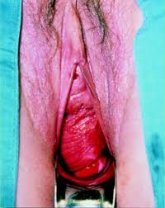
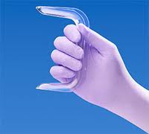
Pelvic examination
If the patient has a prolapse, the dregree of the vaginal wall or uterine descent can be best assessed:
With a Sims speculum
Patient in the left position

Slide 35
Pelvic examination Bimanual examination
One or two fingers of the gloved hand are introduced (usually right hand for a right-handed person)
After labia minora have been separated with the left hand to expose the vestibule, the fingers are introduced, passing upwards and backwards to palpate the cervix.
The left hand simultaneously palpates the pelvis through the abdominal wall
As the intravaginal fingers push the cervix backwards, the abdominally located hand is placed just below the umbilicus and the fingers reach down into the pelvis, slowly and smoothly, until the fundus is caught between them and the fingers of the right hand and the anterior fornix of the vaginal fornix

Slide 36
http://www.youtube.com/watch?v=dhbOELmVkTc

Slide 37
Pelvic examination Bimanual examination

Slide 38
Pelvic examination Bimanual examination
Information obtained:
By palpation of the uterus
Position, size, shape, consitency, mobility, tenderness, attachments;
Normal uterus is positioned either anteriorly or posteriorly and is about 9 cm long;
Is pear-shaped and firm in consistency, and can be moved in all directions
Is normally tender when squeezed between the two hands

Slide 39
Pelvic examination Bimanual examination
By palpation of the ovaries and Fallopian tubes:
Normal fallopian tubes are never palpable!
Ovary may or may not be felt, but if palpable is extremely tender to examinations
Procedure:
The tips of the vaginally located fingers are placed in each lateral fornix in turn and then pushed back- and upwards as far as possible without causing pain. The abdominally located fingers simultaneously press backwards about 5 cm medial and parallel to the superior iliac spine.

Slide 40
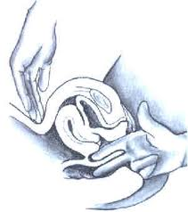
Rectal examination
Rectal examination, or a rectoabdominal bimanual examination, may replace a vaginal examination in children and virgin adults.
Less efficient and more painful
Is a usefull adjunct to a vaginal
examination (when either the outer parts
of the broad ligaments or the uterosacral
ligaments require to be palpated)
A rectovaginal examination (index
finger on vagina and middle finger in
the rectum) may help to determine if a lesion is in the bowel or between the rectum and the vagina.

Slide 41
Tests
Vaginal discharge – swabs
Urinary symptoms – midstream specimen
Sexually active women – cervical smear (Pap smear)

Slide 42
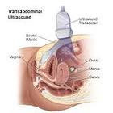
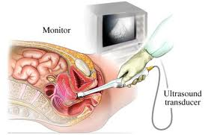
Investigations
Pelvic Ultrasound
Cystic, benign and malignant tumours of the internal genitalia
May be made transabdominally through full bladder, or transvaginally when bladder is empty

Slide 43
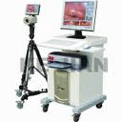
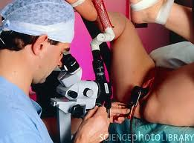
Investigations
Colposcopy
Colposcope – low-powered microscope for inspecting the cervix and the vagina in cases where abnormal cells have been detected by a Pap smear
With a bivalve speculum, exposing cervix and vagina, the colposcope is placed in front of vagina and its focal lenght is adjusted to examine the suspected part of the lower genital tract

Slide 44
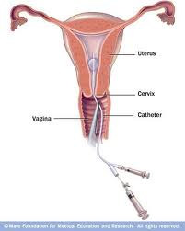
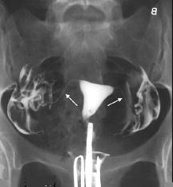
Investigations
Hysterosalpingography
Injection through the cervix of a radio-opaque subs. and following on a screen as it fills the uterus and fallopian tubes
Provides information in cases of infertility

Slide 45
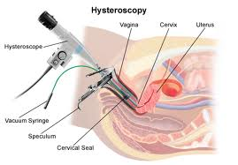
Investigations
Hysteroscopy
A small fibreoptic telescope is inserted through the cervix into the uterine cavity, which is inspected.
Reach a diagnosis in case of menstraul disorders.
Endometrial polyps, submucous fibroids and intrauterine and septae can be removed and endometrium ablated using this technique

Slide 46
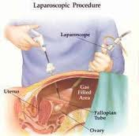
Investigations
CT and MRI
Role in assessing the nature and spread of malignant disease in genital organs
Laparoscopy
Inspection of the pelvic organs with a laparoscope inserted into the peritoneal cavity through a small subumbilical incision
Provides information about: pelvic organs, chronic pelvic pain, ectopic pregancy and cases of infertility

Slide 47
Investigations
Endometrial Biopsy
To obtain a sample of endometrium for histological examination
Done by introducing a small curette through the cervix without anaesthesia.
Infertility and postmenopausal bleeding

Slide 48
Thank you for your attention!
Joana Almeida

