Slide 1

PREGNANCY TESTING

Slide 2

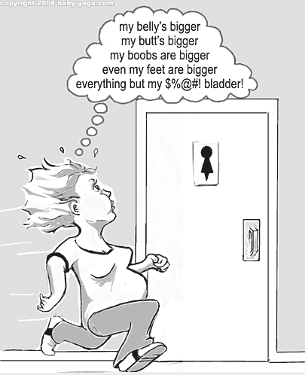
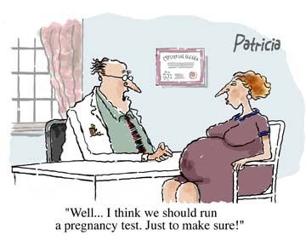
Signs and symptoms

Slide 3
Signs and symptoms
Missed Period
Just "Feeling" Pregnant
Breast Tenderness
Fatigue
Frequent Urination
Nausea
Dizziness
Fainting
Food Cravings
Aversions to Foods
Sensitivity to Aromas
Morning Sickness
Heartburn
Constipation
Mood Swings
Irritability
Higher body temperature
Low Back Pain
Implantation Bleeding
A Positive Pregnancy Test
Bloating and Weight Gain

Slide 4

Pregnancy Tests
When pregnant, the amount of HCG hormone in the body rises rapidly in the early days & weeks
A home pregnancy test can detect this in the urine or blood (the chemical markers)
However, the HCG hormone can only be detected accurately after implantation (there is also a false result if the test is done too early)

Slide 5
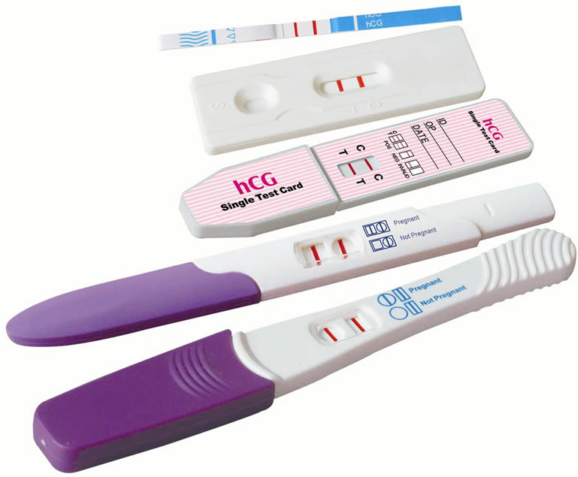
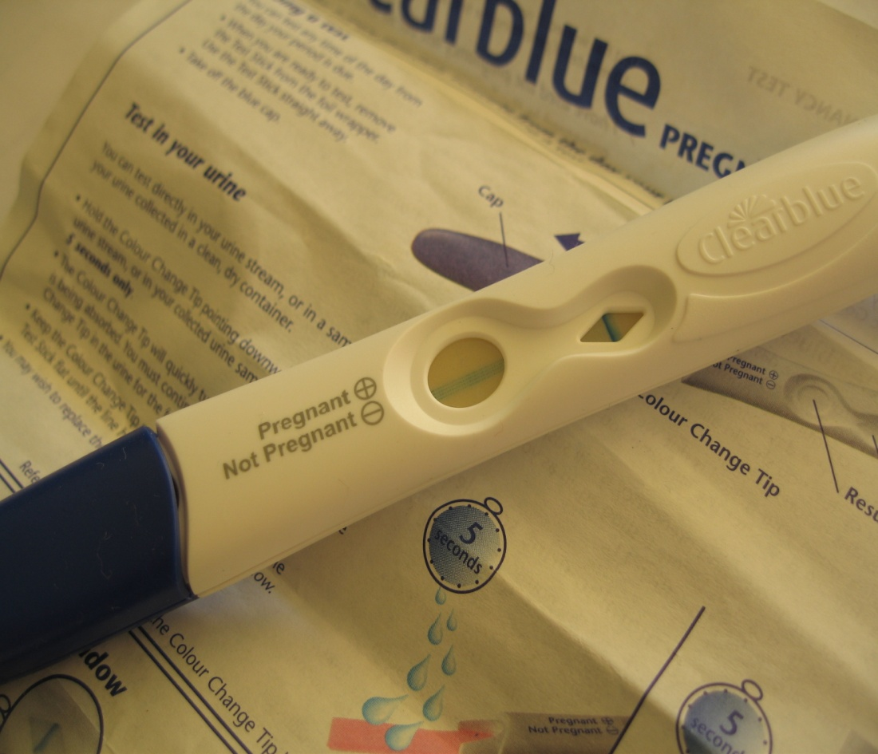
Common test examples

