Slide 1
Nasogastric tube insertion
GastroIntestinal Tract Week
12th of April. 2011
Rita Matos

Slide 2
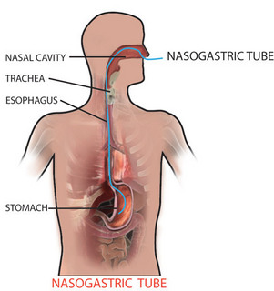
Definition
Insertion of a tube through the nose, down the back of the throat, through the esophagus and into the stomach.
Max. time: 4 to 6 weeks

Slide 3
Indications:
Aspiration of gastric contents (fluid, air, blood) Decompress the stomach
Acess to the Stomach to introduce fluids (lavage fluid, tube feedings, activated charcoal into the stomach)
Obtain a specimen of the gastric contents
Analysis of substances Clinical diagnose
In trauma
aid in the prevention of vomiting and aspiration, as well as for assessment of GI bleeding

Slide 4
Contraindications:
Patients with sustained head trauma, maxillofacial injury, or anterior fossa skull fracture.
Patients with a history of esophageal stricture, esophageal varices
Patients in coma have the potential of vomiting during a NG insertion procedure, thus require protection of the airway prior to placing a NG tube.

Slide 5
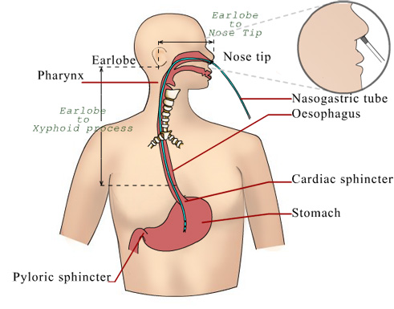
Process:
Measure the length of tube:
From the tip of the nose,
to the ear lobe and
until xiphoid process.
http://www.youtube.com/watch?v=TwjKravpygQ

Slide 6
Care
Work hygienically and Aseptically
Change Hypo-allergenic tape daily
Take care of nose and mouth
Check tube position prior to feeding and at leats 3x per day.

Slide 7
Thanks for your attention
Rita Matos

