Slide 1
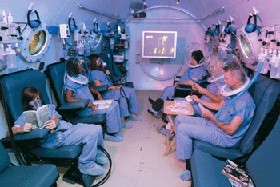
Oxygen Therapy

Slide 2
Definition
Administration of oxygen as a medical intervention.
The main indication for this therapy is respiratory failure.
Also, used in chronic or acute patient care.

Slide 3
Respiratory failure
Inadequate gas exchange by the respiratory system
Result: arterial oxygen and/or carbon dioxide levels cannot be maintained within their normal ranges.
Can be acute or chronic
Type -1: hypoxemia without hypercapnea
Type-2: hypoxemia and hypercapea

Slide 4
Indications for use
In chronic conditions such as COPD (chronic obstructive pulmonary disease)
In acute conditions such as resuscitation, major trauma, anaphylaxis, major hemorrhage, shock, active convulsions and hypothermia.

Slide 5
Considerations
Oxygen can be given in high or low concentration in all the conditions associated with hypoxaemia.
In conditions like COPD in which there is a risk for hypercapnea, low concentration should be used.
Room air only contains 21% oxygen. It is often only required to raise the fraction of oxygen delivered to 30–35%

Slide 6
Oxygen delivery systems

Slide 7
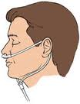
Supplemental oxygen
Many patients require only a supplementary level of oxygen in the room air they are breathing.
*Nasal cannula (NC) is a thin tube with two small nozzles that protrude into the patient's nostrils.
Provides oxygen at low flow rates,2-6
liters per minute (LPM), delivering a concentration of 24-40%

Slide 8
*simple face mask, often used at between 6 and 12 LPM, with a concentration of oxygen to the patient of between 28% and 50%.
*air-entrainment masks, also known as Venturi masks, which can accurately deliver a predetermined oxygen concentration to the trachea up to 40%
*partial rebreathing mask, which is based on a simple mask, but featuring a reservoir bag, which increases the provided oxygen rate to 40-70% oxygen at 5 to 15 LPM.

Slide 9
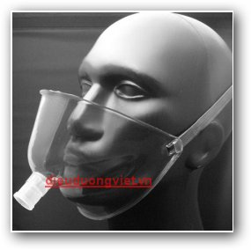
Face tent can replace oxygen masks when masks are poorly tolerated by patients.
Provides varying concentrations of oxygen such as 30% to 50% concentration of oxygen at 4 to 8 liters per minute.

Slide 10
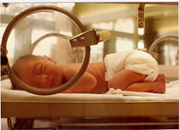
High flow oxygen delivery
When patient requires a flow of up to 100% oxygen.
*Non-rebreather mask (or reservoir mask), similar to the partial rebreathing but has a series of one-way valves preventing exhaled air from returning to the bag – most commonly used.
*Incubator

Slide 12
Positive pressure delivery
Patients who are unable to breathe on their own will require positive pressure to move oxygen in to their lungs for gaseous exchange to take place.
*Bag-valve-mask (BVM), which is a maleable bag attached to a face mask
*Automated versions of the BVM system, known as a resuscitator or pneupac, deliver measured and timed doses of oxygen directly to patient through a facemask.

Slide 14
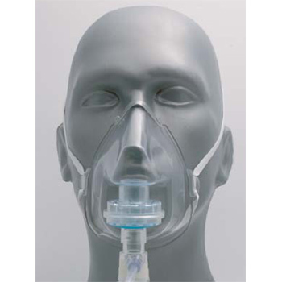
Filtered oxygen masks
Have the ability to prevent exhaled, potentially infectious particles from being released into the surrounding environment.

Slide 15
Therapeutic Benefits
Additional Benefits of Oxygen Therapy:
* Increased clarity * Relieves nausea * Can prevent heart failure in people with severe lung disease *Allows the bodies organs to carry out normal functions
Long-Term Benefits of Oxygen Therapy:
* Prolongs life by reducing heart strain * Decreases shortness of breath * Makes exercise more tolerable * Results in fewer days of hospitalization

Slide 16
Dangers of oxygen therapy
1. Physical risks
Oxygen being combustible, there is always
risk of fire hazard and tank explosion.
Catheters and masks can cause injury to the
nose and mouth.
Dry and non-humidified gas can cause dryness and
crusting.

Slide 17
2. Functional risks
Hypoventilation can lead to hypercapnia and CO2 narcosis although the risk is small with low flow oxygen therapy.

Slide 18
3. Cytotoxic damage
COPD patients on long term oxygen therapy, on autopsy, show proliferative and fibrotic changes in their lungs.
Oxygen can lead to the release of various reactive species which attack the DNA, lipids, and Sh containing proteins.

Slide 19
References :
http://en.wikipedia.org/wiki/Oxygen_therapy
http://medind.nic.in/jac/t01/i3/jact01i3p178.pdf
http://dieuduongviet.net/diendan/showthread.php?t=1178

Slide 20
Thank you for your attention!!

