Slide 1

ELF teachers´ use of Czech and/or English language when commenting on EFL classroom videos
Eva Minaříková, Tomáš Janík,
Michaela Píšová, Klára Kostková
EARLI SIG 11
Vznik a prezentace tohoto příspěvku byly podpořeny Stipendijním fondem PdF MU a projektem GA ČR GA13-21961S.

Slide 2
Overview
Overview
Teachers‘ competencies
Professional vision
Professional language
Research questions and methodology
Results
Discussion

Slide 3
Teacher professionalism
Working on teachers´ competencies…
Professional action
Professional knowledge
Professional vision

Slide 4
Teacher professionalism
Professional vision
Based on knowledge
Informs action – adaptive teaching
Two-fold
  Teachers – „doers“
    Tied to action, need for immediate response
  Teachers – observers
    Watching myself, watching others; time to think
    Professional vision more deliberate
(Sherin et al., 2008)

Slide 5
Teacher professionalism
Professional vision – teacher research
Selective attention
  What teachers pay attention to
Knowledge-based reasoning
  How they reason about it

Slide 6
Teacher professionalism
Professional vision - Goodwin
Event being seen – interplay between a domain of scrutiny and discursive practices within a specific activity
Coding
Highlighting
Producing and articulating material representations

Slide 7
Teacher professionalism
Professional vision - Goodwin
Coding schemes
  Assigning an event/object to a category
  „when disparate events are viewed through a single coding scheme, equivalent observations become possible“ (Goodwin, 1994, p. 608)

Slide 8
Teacher professionalism
Professional language
Language is important in representing thoughts (Vygotsky)
The limits of my language mean the limits of my world (Wittgenstein)
Language signals membership in a (professional; discourse) community
A need to develop a language to describe and reason about teaching (Santagata, 2011, p. 165)

Slide 9
Teacher professionalism
Noticing and professional language
An intervention showed to improve noticing and change terminology used for describing mathematics classroom disussions (Scherrer & Stein, 2013)
Professional language linked to pre-service education (difference between Finnish and Norwegian novice teachers; Afdal & Nerland, 2014)
Changes in student teachers‘ professional language after a semester of teaching practice (Yayli, 2012)
Project Lexicon (D. Clarke)

Slide 10
Teacher professionalism
Context of our research
Main research question: What is the nature of prospective teachers´ professional vision?
Context: Czech EFL student teachers watching videosequences of EFL classroom instruction and providing written comments before and after participating in an online videocase-based course

Slide 11
Teacher professionalism
Context of our research
Czech as mother tongue vs. English as (desired) language of instruction in their prospective teaching practice
Different pedagogical naming systems from different didactical cultures
    Terminology of Czech didactic tradition
    Terminology of EFL methodology tradition

Slide 12
Teacher professionalism
Research questions
37 EFL student teachers
Written comments to 8 videosequences
(A, B, C, D – before participating in an online videocase-based course;
B, C, G, H – after participating in the course)
  What language do they use when given the choice between CZ, EN or mixture?
  Does this differ for different videosequences?
  What themes do the prospective teachers mention?
  What words do they use when addressing these themes? Are the words consistent across students?
13 EFL student teachers
Written comments to video B before and after participating in the online videocase-based course

Slide 13
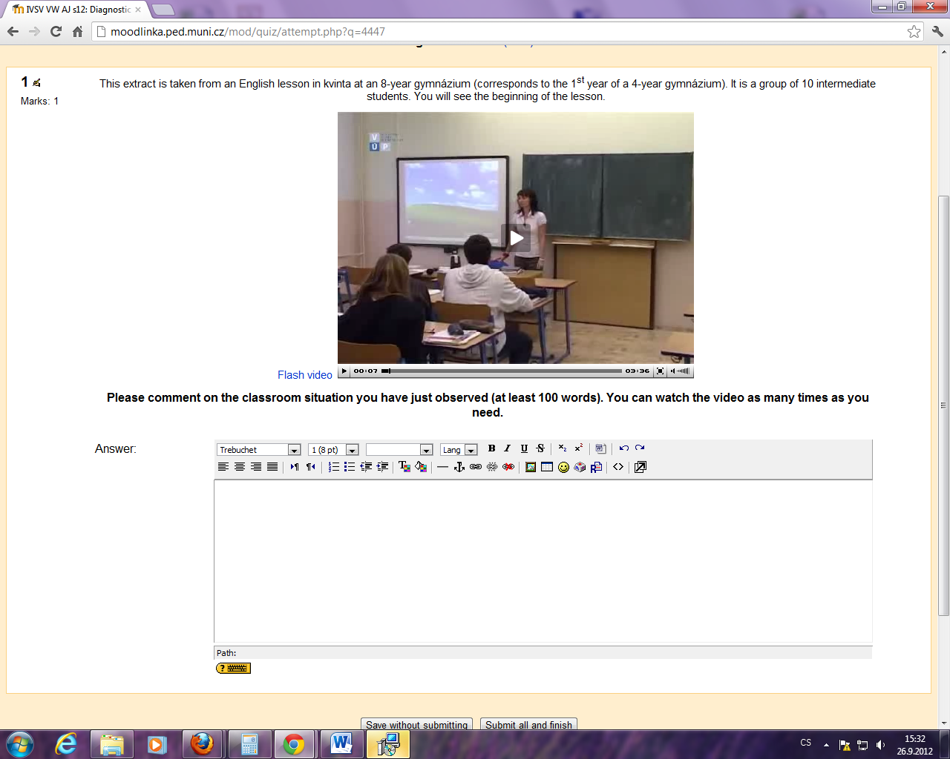

Slide 14
Videos
Student | A | B | C | D | B | C | G | H
S02
S03
S04
S05
S06
S08
S09
S10
S11
S12
S15
S17
S18
S19
S20
S21
S22
S23
S25
S26
S28
S29
S30
S31
S34
S35
S36
S38
S39
S40
S41
S42
S43
S44
S45
S46
S47
Students
Notes:
Mean(SD)

Slide 15
Videos
Student | A | B | C | D | B | C | G | H
S02
S03
S04
S05
S06
S08
S09
S10
S11
S12
S15
S17
S18
S19
S20
S21
S22
S23
S25
S26
S28
S29
S30
S31
S34
S35
S36
S38
S39
S40
S41
S42
S43
S44
S45
S46
S47
Czech
Czech with EN
English
English with CZ
Students
Notes:
Mean(SD)

Slide 16
Teacher professionalism
Results – language used (students)
2 students (S06, S45) almost always complemented the Czech comment with English pieces of „transcript“ from the video
EN | CZ | EN⇨CZ |  | CZ⇨EN
 |  | In 1 | After 1 | In 1 | After 1
12 | 9 | 2 | 2 | 1 | 7

Slide 17
Teacher professionalism
Results – language used (videos)
No apparent regularity in what language is used in relation to the videosequence

Slide 18
Teacher professionalism
Results – English in Czech comments
N=50
EN sentence(s) inserted (5x)
„transcribing“ what was said in the video (24x)
Making use of EN terminology (21x)
  E.g. Speaking, listening, reading, pronunciation
  Native speakers, discourage, one-man show
  Feedback, giving instructions, teacher talking time, classroom management
  Moving, mingling, brainstorming

Slide 19
Teacher professionalism
Themes addressed
Provided opportunities to learn
  Grammar focus, speaking, interview/dialogue
Organization of teaching processes
  Grouping, pairwork, time management, monitoring, pace
Students
  Reactions, emotions, attention, involvement
Teacher
  Code switching, emotions
Error correction
Giving instructions

Slide 20
Teacher professionalism
Words
Themes selected for further investigation:
  Pairwork (12x)
  Monitoring (18x)
  Code switching (9x)

Slide 21
Teacher professionalism
Pairwork
Only the word „pair“ or its CZ equivalent used
Comments
  The word is a part of everyday language
  There is a one for one equivalent in CZ and EN
  Straightforward connection between the actual „thing“ and the term
Hypothesized conclusion:
  Both the concept and the term have been acquired

Slide 22
Teacher professionalism
Monitoring
Words used:
  T circulates and listens
  Monitors (5x)
  Helps and explains
  Walks around the classroom
  Walks among the students
  Makes sure everybody knows what to do
  Goes through the aisle
Notes:
CZ words translated to EN

Slide 23
Teacher professionalism
Monitoring
Comments
  The term does exist in ELT methodology; the word is also used in everyday language (esp. in English)
  BUT: no direct translation into Czech term or everyday word
  The variety of the words used shows the „width“ of the term
Hypothesized conclusion:
  The concept has been acquired (internalized) but the word was not used on this particular occassion (or possibly has not been acquired)

Slide 24
Teacher professionalism
Code-switching
Words used:
  Switching into CZ
  Translates instructions
  Inconsistent as for the language she uses
  Says instructions in EN and repeats them in CZ
  She uses CZ
  She repeats the instructions in CZ and then in EN again

Slide 25
Teacher professionalism
Code-switching
Comments
  The terminology is inconsistent even in ELT publications – code-switching, translating, use of mother tongue, concurrent usage etc.
  The respondents make use of everyday language to describe the events
Hypothesized conclusion:
  The concept has been acquired, but the term not (or is not used as the students are not sure)

Slide 26
Teacher professionalism
Conclusions
Language used (CZxEN) linked to the student rather than the videosequence
Various themes identified in the videosequences
The use of „term“ influenced by:
  Its use in everyday language
  Its use in professional / academic discourse
  The link between CZ and EN variation
  Its connection to real life phenomena
A difference between acquiring the concept and the term?

Slide 27
Teacher professionalism
Outlook
We can only study professional vision as it is demonstrated in words – we have to understand the language teachers use
This research in line with an effort to develop a shared language for describing learning and teaching
  From theory
  From practice (accumulated wisdom of practice)
Questioning our language – critical interrogation of established theory (D. Clarke)

Slide 28
Thank you for your kind attention!
minarikova@ped.muni.cz
tjanik@ped.muni.cz

