Slide 1
What is the goal of reflection in teacher education: personal development or social justcice?
Petr Svojanovský, Masaryk University, Czech republic, Brno

Slide 2
Reflection as necessary part of professional teaching
Professional standards: OECD (1990), European commision (2007), Framowork for teacher qualities (Tomková et al. 2012)
OECD (2005) – reflection as a heart of key competencies
specific types of support of teacher professional development such as mentoring (Mullen 2012) and coaching (Fletcher 2012)
Theory and research in area of teacher education

Slide 3
„reflection is currently a key concept in teacher education” (Korthagen and Vasalos 2005, 47)
„the concept of Reflective Practice has become one of the most influential professional development theories within teacher education over the last 30 years” (Canning 2011, 609).

Slide 4
Conceptualization of reflection
Calderhead (1989, 44) – process, content, preconditions and product of reflection
But important are also goal, quality and definition of reflection
I will focus on content of reflection
In defining content of reflection various authors are influced by educational perspectives (and goals), they represent
The goal of reflection follows the goal of education and these goals are embedded in desirable content of reflection
I will demonstrate it using reflective frameworks

Slide 5
Content dimension in reflective frameworks
We can notice that in reflective frameworks two types of content can be identified:
internal content dimension of reflective thinking – content which is oriented „inside“ of reflective practitioner (self-reflection)
external content dimension of reflective thinking – content which is oriented „outside“ of reflective practitioner (reflection)

Slide 6
Frameworks focused „outside“
Desirable levels of reflection are oriented primarly „outside“
The „highest level“ of reflection demonstrates the practitioner´s ability to preblematize broader educational context (e.g. social justice)
Tradition of social theory in education: goal of education is society transformation (Bertrand 1998, 152)
Reflection as a tool for social change
E.g. Sparks-Langer, et al. 1990; Tsangaridou and O’Sullivan 1994; Zeichner and Liston 1987

Slide 7
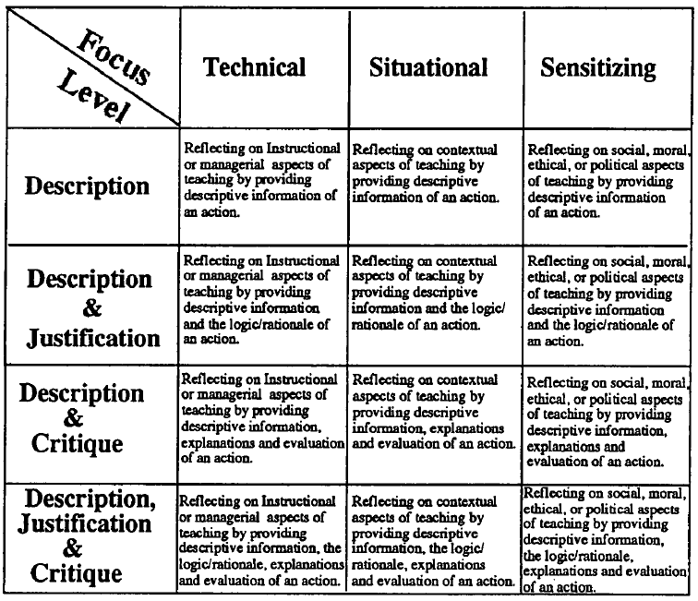
Tsangaridou and O‘Sullivan (1994, 20)

Slide 8
Frameworks focused „inside“
Desirable levels of reflection are oriented primarly „inside“ and are focused on practitioner´s autonomous self-realization
Humanistic (personalistic) tradition in education: goal of education is personal transformation (Bertrand 1998)
Reflection as a tool for personal development
E.g. Korthagen and Vasalos (2005)

Slide 9
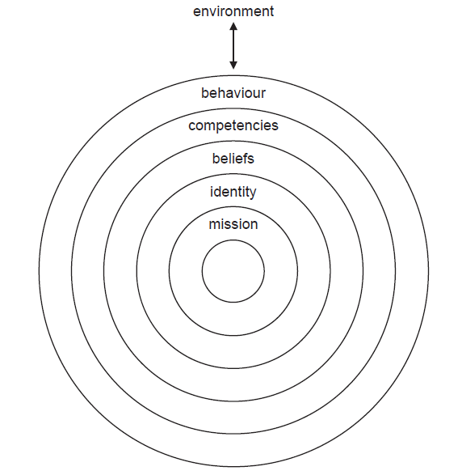
Korthagen (2004, 80)

Slide 10
However it is not possible to completely separate internal and external dimensions
Organism and environment are in constant interaction (Hildebrand 2008, 15)
Reciprocal process of adaptation; a continuous dynamic process of renewal of equilibrium.
„Inner” reorganisation of the organism is happening as a reaction to the effect of the “outer” environment (accommodation), during which this “inner” adaptation is simultaneously a process of active construction of the “outer” (assimilation). (Piaget 1961/1999, 20)

Slide 11
Content of reflection as continuum
Rather then trying to decide what is more important – emphasis on person or emphasis on society in (self)reflection – we need to concentrate on specific contexts related to reflection
It is useful to see this problem both: from specific „personal point of view“ as well as from specific „social point of view“
Example 1: Teacher reflection
Personal
Social

Slide 12
This example is about communication between a teacher and a Roma pupil who lives in a socially excluded area and whose classmates are children from the majority population.
It is a pupil with specific learning needs which are a consequence of language disadvantage, cultural difference etc. The pupil displays a slower learning pace which excludes him or her from the classroom.
A desirable goal of the teacher’s interaction with such pupil is to contribute to support a tolerant classroom climate through careful comments.
Reflection (focusing in this example attention “outwardly”) allows the teacher to e.g. support the ability to empathise with the disadvantaged pupil’s needs and to use appropriate communication devices which allow him or her to achieve a set goal.
Self-reflection (focusing in this example attention “inwardly”) can assist the teacher in e.g. constructively processing his or her own negative emotions which can for various reasons accompany the relationship with a Roma pupil.

Slide 13
Exaple 2: facilitation of student teacher reflection in seminar to internal reflection
S1 (student1): in my last class pupils were very noisy and I was not able to calm them. So I identified the most noisy pupil and I wrote him bad note for his parents – but I had bad feeling about it later
E (educator): well, where did this bad feeling come from?
S1: I was not sure If I was fair … but I needed somehow solve out that situation – that seemed to me most important
E: And how do you know what is most important for you in such a situation?

Slide 14
facilitation of student teacher reflection in seminar to external reflection
E: and who was the the most noisy pupil ?
S1: Roma pupil, he is problematic – also other teachers in school said that
E: how do you understand the term „problematic“ in this context? (asked to the whole group)
S2: when pupil does something which is contrary to teacher instruction
E: and when does it happen, what is the reason?
S3: reasons could be different…
S1: yes, in this case the most noisy pupil was Roma – maybe it is because of where he lives – Roma are used to behave like this – I don´t say that they are bad, but just that it is fact
E: And what does it mean „that it is fact“ – how do you understand it? (asked to the whole group)
S4: well, it is not possible to do anything with that
E: but finally we as teachers need to do something - like you said. So what are the consequences of your choice to act in some way?

