Slide 1
Analysis of Learning Situations Developing the Problem-solving Competence in Primary Science Instruction
Tereza Češková
Institute for research in school education, Faculty of Education, Masaryk University, Brno, Czech Republic

Slide 2
Aim of the presentation
to present my home Institute
to present my research design
Structure of the presentation
Background
Aims
Problem task
Annotation
Alteration
Analysis
Problem learning situation

Slide 3

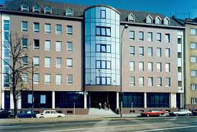
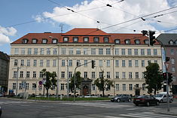
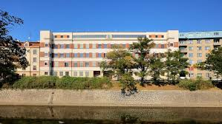
Background
Aims
Problem task
Annotation
Alteration
Analysis
Problem learning situation

Slide 4
History of the faculty in dates
1918 - Establishment of the faculty of education (or teaching faculty) was discussed for the first time as part of preparation of the Act at Masaryk University.
1945 - Decree of the President of the Czechoslovak Republic on education of teachers No 132/1945 Coll. was issued.
1946 - The Faculty of Education, MU was founded; its first Dean was František Trávníček.
1948 - First professors of the faculty were appointed
1950 - Long-distance study was arranged for teachers in active service.
1959 - Transformation of the Higher School of Education into the Teacher Training College.
1964 - Restoration of the Faculty of Education.
1977 - Reform of study – introduced study of teaching subjects of general education for secondary schools as well.
2014 - Ceremonial opening of the new building CVIDOS
Background
Aims
Problem task
Annotation
Alteration
Analysis
Problem learning situation

Slide 5
Study Programmes
Bachelor programmes graduates
work as a teaching assistant to a teacher at primary and lower secondary schools
work as instructors in leisure centres
graduates are prepared for socially-educative work with people of all ages and from all social groups
graduates are prepared for activities in special education in special kindergartens
Master programmes graduates
acquiring a teacher qualification in a chosen specialization for elementary, lower secondary and secondary schools and schools for learners with special study needs
Graduates from doctoral programmes
academic staff at universities – in the fields of pedagogy, and research in education
professional careers in the public sector or in company management
Background
Aims
Problem task
Annotation
Alteration
Analysis
Problem learning situation

Slide 6
Doctoral studies at the Faculty provided in the following programs:
study programme Pedagogy – field Pedagogy
study programme Special Education – field Special Education
study programme Special Education – field Special Education (taught in English)
study programme Special Education – field Special Education (taught in German)
study programme Specialization in Pedagogy – field Art
study programme Specialization in Pedagogy – field Art (taught in German)
study programme Specialization in Pedagogy – field Foreign Language Curricular Studies
study programme Specialization in Pedagogy – field Theory of Music and Pedagogy
Background
Aims
Problem task
Annotation
Alteration
Analysis
Problem learning situation

Slide 7
Departments & Institutes
http://www.ped.muni.cz/en/about-the-faculty/departments-and-institutes
Background
Aims
Problem task
Annotation
Alteration
Analysis
Problem learning situation

Slide 8


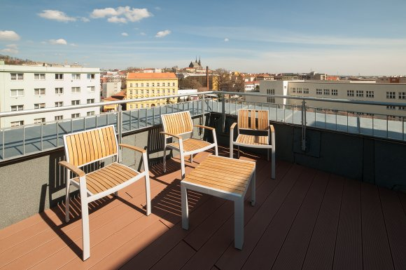
Institute for Research in School Education
Background
Aims
Problem task
Annotation
Alteration
Analysis
Problem learning situation

Slide 9

Institute for Research in School Education
The motto of the institute:
better education through research
Doc. PhDr. Tomáš Janík, Ph.D., M. Ed.
Background
Aims
Problem task
Annotation
Alteration
Analysis
Problem learning situation

Slide 10
Main Research Themes
Classroom processes
Teacher education
Curriculum
Background
Aims
Problem task
Annotation
Alteration
Analysis
Problem learning situation

Slide 11
International cooperation of IRSE
Lehrstuhl für Schulpädagogik und Didaktik, Friedrich-Schiller-Universität Jena, Deutschland – area of research of emotions, organising joint workshops and conferences, joint publications, academic stays (Prof. Dr. Michaela Gläser-Zikuda).
IPN – Leibniz-Institut für die Pädagogik der Naturwissenschaften und Mathematik an der Universität Kiel, Deutschland – area of video-based metodology, organising joint workshops and conferences, joint publications, academic stays (Dr. Inger Marie Dalehefte, Dr. Mareike Kobarg).
School of Education, Technische Universität München, Deutschland – area of methodology of video-based research and using video in teacher education, joint publications (Prof. Dr. Tina Seidel).
Interfakultärer Fachbereich Sport- und Bewegungswissenschaft an der Universität Salzburg, Österreich – area of research on curriculum and instruction in physical education, joint publications, academic stays (Prof. Dr. Rudolf Stadler).
National Institute for Education, Slovakia – expertise and cooperation in curricular research and development (Doc. Dr. Viliam Kratochvíl).
Background
Aims
Problem task
Annotation
Alteration
Analysis
Problem learning situation

Slide 12
Institute for Research in School Education
The focus of the IRSE is put on the pedagogical methodology, especially the relation between the theory and practice, general didactics and subject didactics, mixed methods, video-based methodology, comparative methodology in the research of curriculum and the contrastive approaches in the research of teacher education.
Between acceptance and resistance: Teachers’ perceptions of curricular changes 10 years into the reform implementation
Classroom interaction in English language teaching in higher education
Producing pedagogical knowledge for improvement: altering teaching situations for the better
Exploring professional vision and its development through video-based analysis (from the perspective of teachers of English as a foreign language)
An Expert Teacher: his/her characteristics and the determinants of his/her professional development (in the context of foreign language teaching)
Opportunities to develop problem solving competence in textbooks and in the classroom
Background
Aims
Problem task
Annotation
Alteration
Analysis
Problem learning situation

Slide 13
Institute for Research in School Education
The focus of the IRSE is put on the pedagogical methodology, especially the relation between the theory and practice, general didactics and subject didactics, mixed methods, video-based methodology, comparative methodology in the research of curriculum and the contrastive approaches in the research of teacher education.
Between acceptance and resistance: Teachers’ perceptions of curricular changes 10 years into the reform implementation
Classroom interaction in English language teaching in higher education
Producing pedagogical knowledge for improvement: altering teaching situations for the better
Exploring professional vision and its development through video-based analysis (from the perspective of teachers of English as a foreign language)
An Expert Teacher: his/her characteristics and the determinants of his/her professional development (in the context of foreign language teaching)
Opportunities to develop problem solving competence in textbooks and in the classroom
Background
Aims
Problem task
Annotation
Alteration
Analysis
Problem learning situation

Slide 14
Analysis of Learning Situations Developing the Problem-solving Competence in Primary Science Instruction
Background
the Czech educational system has undergone a curricular reform
emphasis on pupils’ key competencies
problem-solving competence
PS competence in primary Science instruction
Background
Aims
Problem task
Annotation
Alteration
Analysis
Problem learning situation
Notes:
primary Science lessons focus mostly on pupil's close surroundings, they are especially suitable for including problem-solving tasks (PST) and thus developing problem-solving competence

Slide 15
A lot of critique concerning the concept of competences (e.g. Willbergh, 2015; Westera, 2001)
Our approach: competences as a vehicle for bringing or developing constructivist approaches,
      they must be connected to a subject matter,
      as a transfer is one of their main characteristic (c.f. Barrows, 1996, Delisle, 1997) they elicit higher order thinking
In PS competence we can see the problem as a motor of the vehicle we have concentrated on problem tasks (resp. problem learning situations) in the primary instruction
Background
Aims
Problem task
Annotation
Alteration
Analysis
Problem learning situation

Slide 16
What´s the problem?
Problem – a discrepancy between an actual and goal state which we are motivated to discharge. In order to solve the problem we have to use operations so that we could eliminate all constrains (cf. Chi & Glaser, 1985, p. 229, Jonassen, 1997, Lipták, 1987, p. 26, comp. Getzels, 1982, p. 40–41).
Cognitivist psychologists divide problems into well- and ill-structured ones (Jonassen, 1997).
Ill-structured problems possess multiple solutions, solution paths, fewer parameters which are less manipulable and contain uncertainty about which concepts, rules and principles are necessary for the solution or how they are organized and which solution is the best (Jonassen, 1997, p. 65).
Problem task – a task that contains an ill-structured problem
Background
Aims
Problem task
Annotation
Alteration
Analysis
Problem learning situation

Slide 17
Aims of the Thesis
to describe how learning situations that develop the problem-solving competence in primary Science education are used in real instruction as captured by a video study
(1) to analyse the learning situations that develop problem-solving competence in primary Science instruction (identification and description)
(2) to suggest alternative approaches to the analysed learning situations in order to increase their potential for developing the problem-solving competence
Background
Aims
Problem task
Annotation
Alteration
Analysis
Problem learning situation

Slide 18
Research design
Learning tasks
Problem learning tasks
Problem learning situations
Learning task - any question or a command calling for/eliciting a learning activity
Problem learning task – As PBL is characterized as follows: learning is student centred,
occurs in small groups,
teachers are facilitators and guides,
form the organizing focus and stimulus for learning,
new information is acquired through self-directed learning,
learning is based on a problem connected to real life and has an interdisciplinary character (Barrows, 1996, pp. 5—6),
thus we consider a problem learning task as a task that:
must: 1. be connected to a real life
2. contain an ill-structured problem
3. have an interdisciplinary character
may (at least one of these characteristics):
4. teacher is just a facilitator
5. contain a system of follow-up tasks
6. be solved in groups
7. be open-ended or be divergent
Background
Aims
Problem task
Annotation
Alteration
Analysis
Problem learning situation

Slide 19
Problem Learning Situation
Problem learning situation – contains a problem task, based on PBL approach; see the model of PLS
My characterisation of PLS follows the 3A methodology – a developing „hospitation“ built on an analysis that follows the methodological imputs from research based on video-recordings (Janík et al., 2013, pp. 218—245). That consists of Annotation, Analysis and Alteration.
Annotation – brings basic information about the topic, foregoing activities, didactic processing of subject matter, activities of pupils
Analysis – investigates the PLS more deeply from the angle of aims – in my Thesis PS competence
Alteration – brings an evaluation of quality of the situation and a suggestion of potentially better alternatives
Background
Aims
Problem task
Annotation
Alteration
Analysis
Problem learning situation

Slide 20
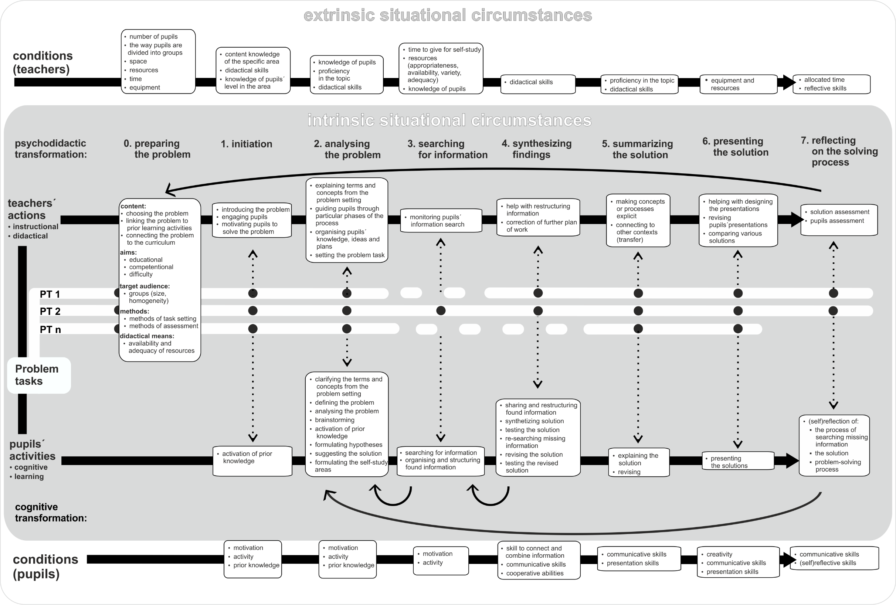

Slide 21
1. Structured annotation – describes how is PT approached, oriented mainly on intrinsic situational circumstances that can be changed during the process:
Characteristic | Phase which it occurs in
(1) Topic of the PLS | P0
(2) Link to the foregoing LS – the story of the lesson | P0
(3) Learning phase in which the PLS is situated (revision, introduction, presentation of new subject matter, exercising, application, recapitulation, examining/assessing and others – based on Seidel, Prenzel, & Kobarg et al., 2005, adapted by Najvar et al., 2011) | P0
(4) Organisation form (whole-class, individual work, pair work, group work, more forms together, other – adapted from Janík and Miková, 2006) | P1-P7
(5) Placement in the classroom (in the desk, in front of the blackboard, on the carpet, anywhere in the classroom, changing, outside the classroom – Češková, 2014) | P1-P7
(6) Didactical means (without any, blackboard, worksheet, exercise book, textbook, book, model/realia, picture/map/cards, audio, video, ICT, other - adapted from Janík et al., 2007) | P1-P7
Background
Aims
Problem task
Annotation
Alteration
Analysis
Problem learning situation

Slide 22
2. Structured analysis:
(7) Concept diagram – shows a schematic model of subject matter – shows concepts (contents) and main relations among them (based on Janík et al., 2011, p. 103)
CONCEPT LEVEL
- terms
generalisation
COMPETENCE LEVEL
- transfer to new contexts
THEMATIC LEVEL– concepts used with children
abstraction
content anchoring
aims
Background
Aims
Problem task
Annotation
Alteration
Analysis
Problem learning situation

Slide 23
(8) Phases of PLS - based on PBL process (Delisle, 1997; Edens, 2000; Hmelo-Silver & DeSimone, 2013; Hung, Jonassen, & Liu, 2007; Kličková, 1989; Maňák & Švec, 2003; Schmidt, 1983; Segers, 1997; Tchibozo, 2011; Torp & Sage, 2002; Zumbach, Kumpf, & Koch, 2004).
Phase 0 – Problem structuring – Teacher judges external and internal situational conditions and designs the problem.
Phase 1 – Initiation – Teacher poses preparatory tasks connected to the issue developed in PST and motivates pupils.
Phase 2 – Analysing the problem
Phase 3 – Searching for information
Phase 4 – Synthesizing findings
Phase 5 – Summarizing the solution
Phase 6 – Presenting the solution
Phase 7 – Reflecting on the solving process
Background
Aims
Problem task
Annotation
Alteration
Analysis
Problem learning situation

Slide 24
3. Alteration
- Assessment of the quality
- Suggestion – creating of the potentially better alternatives
- Re-consideration – Does it work? Where might be a problem?
Background
Aims
Problem task
Annotation
Alteration
Analysis
Problem learning situation

Slide 25
Thank you for attention!

