Slide 1
CEITEC Masaryk University Board of Directors Meeting
Markus Dettenhofer, PhD
Executive Director
Brno, Czech Republic, 25 February 2013

Slide 2
Aim and Vision
Aim and Vision
CEITEC is a scientific centre in the fields of life sciences, advanced materials and technologies whose aim is to establish itself as a recognized European center of science.
CEITEC is leading a path to
global scientific recognition
through synergy and collaboration,
in order to achieve a regional knowledge-based economy.

Slide 3
Pillars for Success
To produce excellent scientific results and to utilize synergies
State-of-the-art infrastructure
Pillars
To support high-quality education
To encourage the transfer of research results into practice

Slide 4
Partnering institutions

Slide 5
CEITEC overview
6 partners
557 researchers (2015)
7 research programmes
64 research groups
26,000 m² of new laboratories
10 core facilities
Budget (eligible cost): EUR 208/ USD 275 mil.
Start of research activities: Q1 2011
Project completion: Q4 2015

Slide 6
Vision
Roadmap

Slide 7
Research Programmes

Slide 8
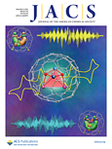
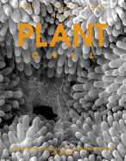
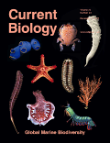
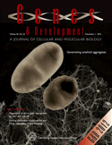
Recent CEITEC Publications
Impact factor: 3.8
Impact factor: 9.9
Impact factor: 10.2
Impact factor: 9.6
Impact factor: 9.9
Impact factor: 14.2

Slide 9
Strategy – Goals 2013
Set the scientific strategy through to 2015
The scientific strategy is key to the success of CEITEC.
The new Scientific Director will lead the effort to
define the scientific strategic goals,
the specialties to place emphasis on,
Group Leader hiring strategy.
Determine and initiate our market strategy for positioning
Establish a functional Technology Transfer office with partners
New CEITEC web to be functional and utilized
Information System successful implementation
Establish a CEITEC endowment

Slide 10
Strategic Outline
2013-2015
Strategic Outline
2013-2015
People
Facilities and Equipment
Funding
Funding Strategy
Grants
Commercialization
Endowment
Idea Generation Strategy
Research Group Leaders
Students
Internationalization

Slide 11
Roadmap
Roadmap
2013
Formulation and kick-off of the CEITEC identity marketing campaign
Initiate programs to enhance the human developmental potential across CEITEC
Formation of a CEITEC-wide technology transfer office

Slide 12
Roadmap
Roadmap
2014
Fund raising campaign to help ensure financial sustainability
Renewed scientific recruiting after the 2014 scientific evaluation
Increase commercial activity and agreements

Slide 13
Roadmap
Roadmap
2015
Participation and hosting international events and conferences
Build scientific synergies and collaborative efforts
Student development and internationalization

Slide 14
Technology Transfer Overview
Academia
Industry
Industry
Publication
Commercialization
Contractual Agreement
Internships
Research Cooperation

Slide 15
CEITEC-Technology Transfer Overview
Aim
Objectives
Utilize the research and development capacity of CEITEC to generate revenues
Develop commercial know-how
Develop personnel so as to relate to the private sector

Slide 16
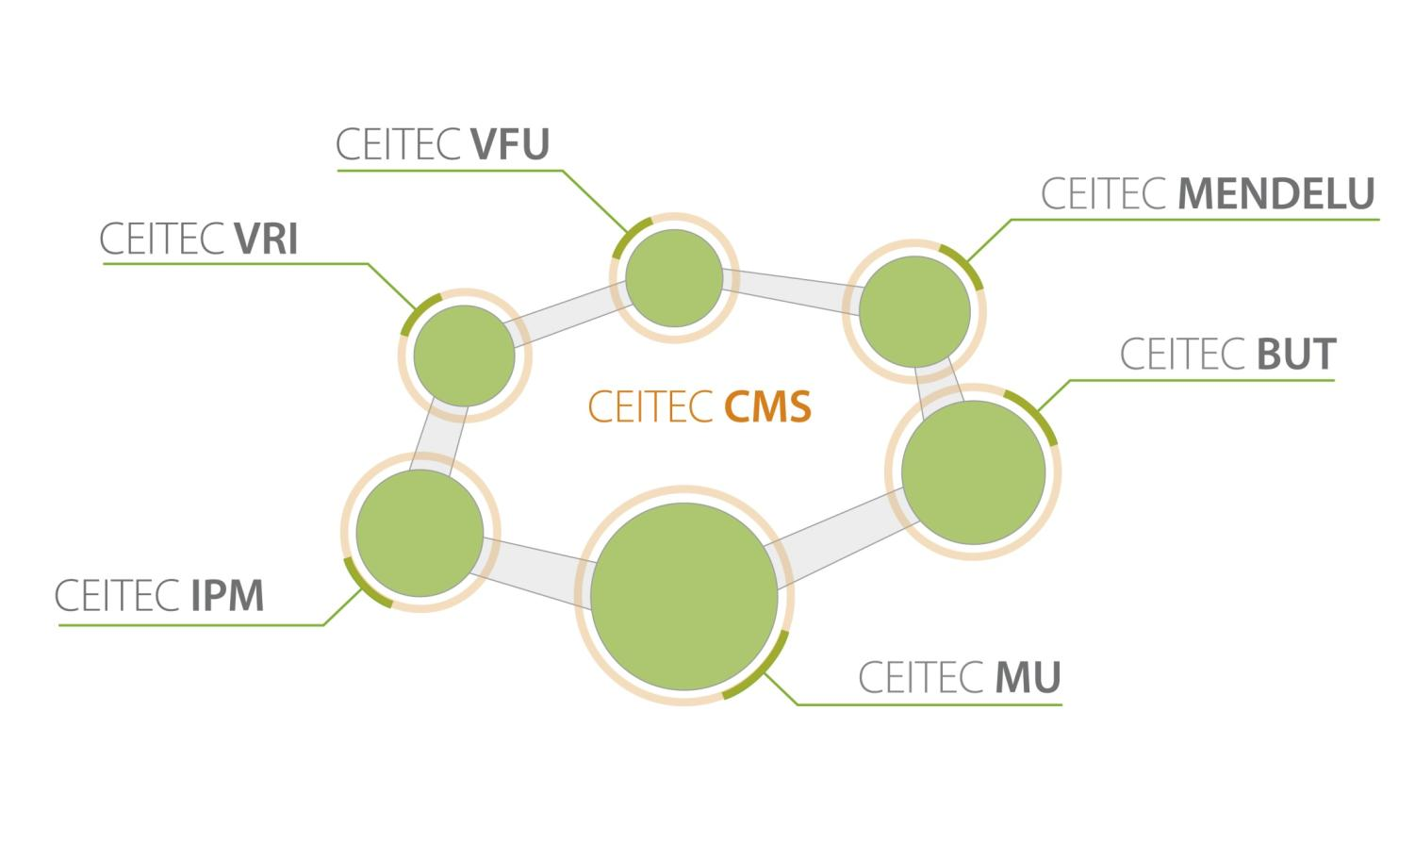
Organizational Structure

Slide 17
Organizational Chart
CEITEC-CMS
Executive Director-Markus Dettenhofer
Organizational Director-Jiri Deml
Scientific Director-to be hired
Commercialization Director-to be hired
Grant Office
Scientific Project Management
Finance Office
Project Management
Information System
Human Resources
Marketing and PR
Science Scouting

Slide 18
CEITEC-administrative working groups
Management Group (ED, SD, OD, OU heads)
CMS
CMS
CMS
MU
BUT
MU
BUT
MU
BUT
Partner
Partner
Partner
Groups:
TT/ Commercialization
Grants
Marketing/PR
Procurement
Finance
Project management
HR/Internationalization
Working and management groups: meet monthly

Slide 19
The Goals for the CEITEC-CMS 2013
The goals will
reflect the expected growth and long-term interests of the project
focus on
cornerstones for the CMS’s development,
financial sustainability
development of our capabilities.
areas of essential operational needs.
reflect the interests of the office as a whole
achievement of those goals will regularly assessed

Slide 20
CEITEC - Facts and Status of The Project Jiri Deml Operational Director

Slide 21
Project facts and status – 7 MR - 30.11. 2012
 | Investment | Non-investment | Total budget plan
CMS | 18 266 500,00 | 181 832 226,00 | 200 098 726,00
MU | 2 420 553 181,00 | 464 124 559,00 | 2 884 677 740,00
BUT | 1 541 275 232,00 | 308 264 963,00 | 1 849 540 195,00
Mendelu | 70 705 919,00 | 14 086 801,00 | 84 792 720,00
VFU | 51 567 947,00 | 10 273 926,00 | 61 841 873,00
IPM | 92 697 878,00 | 18 468 277,00 | 111 166 155,00
VRI | 44 930 958,00 | 8 951 633,00 | 53 882 591,00
Total | 4 239 997 615,00 | 1 006 002 385,00 | 5 246 000 000,00
Institution | INVESTMENTS | NON-INVESTMENTS | Total
CMS | 9 823 408,04 | 45 039 225,18 | 54 862 633,22
MU | 566 150 906,34 | 73 900 024,71 | 640 050 931,05
BUT | 173 428 848,89 | 26 404 601,32 | 199 833 450,21
Mendelu | 3 183 355,00 | 2 685 637,14 | 5 868 992,14
VFU | 12 936 772,29 | 2 249 307,00 | 15 186 079,29
IPM | 7 066 800,00 | 5 299 593,50 | 12 366 393,50
VRI | 26 338 165,62 | 2 600 580,69 | 28 938 746,31
Total | 798 928 256,18 | 158 178 969,54 | 957 107 225,72
To 30th of November 2012

Slide 22
Project facts and status – 7 MR - 30.11. 2012

Slide 23
Monitoring Indicators

Slide 24
CEITEC Total – Monitoring indicators
 | Indicators name | Commitment plan 2015 (TA) | Expected performance 2015 | Achieved value 31.12.2012 | Implementation rate for 31.12.2012
 | Volume of contract research (thousands CZK) | 50 906 000,00 | 23 360 575 | 3 757 179 | 7,03%
 | Volume of funds for R&D from international sources (thousands CZK) | 99 544 000,00 | 129 320 287 | 34 379 681 | 32,89%
 | Number of PhD graduates | 207,00 | 211 | 24 | 11,06%
 | Number of collaborative projects with application sphere | 15,00 | 30 | 3 | 20,00%
 | Number of students of master and doctor study programs using the new infrastructure | 1 296,00 | 1 113 | 58 | 4,26%
 | Number of researchers using the new infrastructure | 557,00 | 559 | 145 | 26,03%
 | Share of the new infrastructure used by other subjects (%) | 30,00 | 25 | 0% | 0,00%
 | Gross new jobs - total R&D personnel | 460,90 | 461 | 334 | 72,57%
 | Gross new jobs - researchers total | 344,75 | 345 | 287 | 83,23%
 | Gross new jobs - researchers under 35 years | 112,60 | 116 | 135 | 120,27%
 | Reconstructed premises | 195,00 | 381 | 195 | 100,00%
 | Newly constructed premises | 24 937,00 | 25 954 | 201 | 0,81%
 | Scientific publications (according to R&D Council methodology)*** | 809,00 | 1 041 | 285 | 33,57%
 | Protected R&D results (according to R&D Council methodology) | 2,00 | 7 | 0 | 0,00%
 | Applied research results (according to R&D Council methodology) | 163,00 | 115 | 2 | 1,18%

Slide 25
CEITEC MU – Monitoring indicators
 | Indicators name | Commitment plan 2015 | Expected performance 2015 | Achieved value 31.12.2012 | Implementation rate for 31.12.2012
 | Volume of contract research (thousands CZK) | 38 217 313,00 | 8 779 600,00 | 2 649 600 | 6,93%
 | Volume of funds for R&D from international sources (thousands CZK) | 69 730 201,00 | 96 515 681,34 | 32 515 681 | 46,63%
 | Number of PhD graduates | 133,00 | 127,00 | 19 | 14,29%
 | Number of collaborative projects with application sphere | 8,00 | 8,00 | 1 | 12,50%
 | Number of students of master and doctor study programs using the new infrastructure | 782,00 | 500,00 | 30 | 3,84%
 | Number of researchers using the new infrastructure | 297,00 | 297,00 | 60 | 20,20%
 | Share of the new infrastructure used by other subjects (%) | 30,00 | 30,00 | 0 | 0,00%
 | Gross new jobs - total R&D personnel | 254,70 | 254,70 | 231,77 | 91,00%
 | Gross new jobs - researchers total | 182,45 | 182,45 | 201,23 | 110,29%
 | Gross new jobs - researchers under 35 years | 58,30 | 58,30 | 105,55 | 181,05%
 | Reconstructed premises | 195,00 | 380,92 | 195 | 100,00%
 | Newly constructed premises | 10 770,00 | 11 786,80 | 201 | 1,86%
 | Scientific publications (according to R&D Council methodology)*** | 478,00 | 678,00 | 218,00 | 45,61%
 | Protected R&D results (according to R&D Council methodology) | 1,00 | 1,00 | 0 | 0,00%
 | Applied research results (according to R&D Council methodology) | 97,00 | 25,00 | 2,00 | 2,06%

Slide 26
CEITEC BUT – Monitoring indicators
 | Indicators name | Commitment plan 2015 | Expected performance 2015 | Achieved value 31.12.2012 | Implementation rate for 31.12.2012
 | Volume of contract research (thousands CZK) | 11 158 643,00 | 10 627 279,00 | 0 | 0,00%
 | Volume of funds for R&D from international sources (thousands CZK) | 27 730 974,00 | 26 410 451,00 | 1 200 000 | 4,33%
 | Number of PhD graduates | 75,00 | 71,00 | 3 | 4,00%
 | Number of collaborative projects with application sphere | 5,00 | 20,00 | 2 | 40,00%
 | Number of students of master and doctor study programs using the new infrastructure | 490,00 | 510,00 | 10 | 2,04%
 | Number of researchers using the new infrastructure | 177,00 | 177,00 | 20 | 11,30%
 | Share of the new infrastructure used by other subjects (%) | 30,00 | 20,00 | 0 | 0,00%
 | Gross new jobs - total R&D personnel | 153,50 | 153,50 | 52,73 | 34,35%
 | Gross new jobs - researchers total | 120,00 | 120,00 | 43,73 | 36,44%
 | Gross new jobs - researchers under 35 years | 50,80 | 50,80 | 21,80 | 42,91%
 | Reconstructed premises | 0,00 | 0,00 | 0 | 0,00%
 | Newly constructed premises | 14 167,00 | 14 167,00 | 0 | 0,00%
 | Scientific publications (according to R&D Council methodology)*** | 235,00 | 245,00 | 32,00 | 13,62%
 | Protected R&D results (according to R&D Council methodology) | 1,00 | 6,00 | 0 | 0,00%
 | Applied research results (according to R&D Council methodology) | 64,00 | 84,00 | 0,00 | 0,00%

Slide 27
Central Management Structure (CMS)

Slide 28
Operational Management – Goals 2013
Establish regular finance control/ management for entire period of the project + horizon 2020
Establish quarterly reporting of financials from all units (partners, CMS, core facilities)
Establish quarterly managerial finance reporting of entire project
Establish process of budget preparation for year 2014 + rules
Establish the full visibility and planning till end of the project + vision for 2020
Establish system for management/reporting monitoring indicators for entire project
Establish and execute new risk management plan and measurements
Set the HR strategy through to 2015
The HR processes and motivation systems of all units needs to be analyzed and orchestrated
The HR needs to be set as key part of the success of the project

Slide 29
Core Values - Key Cultural Factors
Strive for ambitious results (Leadership)
Keep a big-picture, long-term approach (Strategic Discipline)
Maintain a Global Mindset (Strategic Discipline )
Get more and better for less (Operational Excellence)
Aspire to professional mastery (Operational Excellence )
Innovate (Creativity & Openness )
Be informal and direct (Creativity & Openness )
Be open to change (Creativity & Openness )

Slide 30
Thank you for your attention
Central European Institute of Technology
c/o Masaryk University
Žerotínovo nám. 9
601 77 Brno, Czech Republic
www.ceitec.eu | info@ceitec.cz

