Slide 1
Central Europe during and after the Napoleonic Wars
The Rise of National Movements revolutions 1848/49
Jana Hrabcova

Slide 2
Central Europe during the Napoleonic Wars
1789 – the French Revolution broke out
1792–1815 – anti-French wars
1792–1802 – the wars against the French Revolution
Several coaliations against France (Austria + Prussia + Great Britain + Russia + several smaller German states against France), several military campaigns
1803–1805 – Napoleon’s Invasion of Great Britain - unsuccesfull
1804 – Napoleon Bonaparte crowned the Emperor of France
March 1805 – Napoleon proclaimed King of Italy
Than he marched via Bavaria towards Austria
The French army occupied Vienna

Slide 3
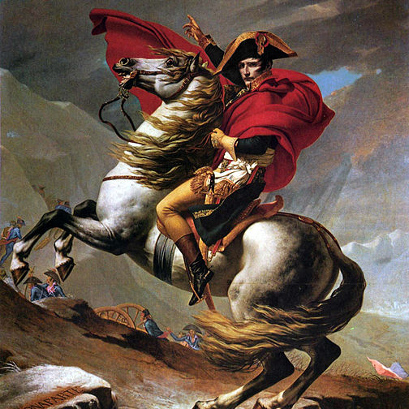
Central Europe during the Napoleonic Wars
Napoleon by Jacqoues-Louis David

Slide 4
Napoleon continued to South Moravia where the Russian troops supporting the Austrians were situated
Napoleon occupied Brno
December 2, 1805 – the Battle of Three Emperors near the Moravian town of Slavkov (Austerlitz) – a great victory of Napoleon – he defeated Austrian Emperor Francis I and Russian Tzar Alexandr
Napoleon had 73 000 men, austro-russian coalition had 85 000 men
Peace Treaty of Pressburg between Napoleon and Francis II of Austria (Austrian withdrawal from the Third Coalition)
Austria had lost terriotories in Italy, Istria and Dalmacia (Iliric Kingdom was formed) and some German terriories – ceded to Napoleon’s allies (Bavaria)
The effective end of the Holy Roman Empire
1806 – Austrian Empire – Francis I
Rhineland Confederation was formed in German territory
http://www.ceskatelevize.cz/ivysilani/10099029347/
http://www.austerlitz.org/
http://www.youtube.com/watch?v=mdd1a90CFio
http://www.zamek-slavkov.cz/en/

Slide 5
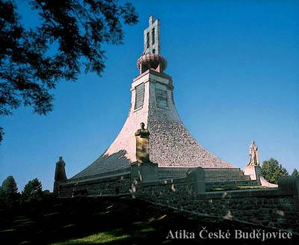
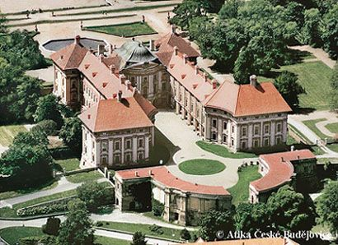
Austerlitz
Cairn of Peace
Chateau Austerlitz

Slide 6
Central Europe during the Napoleonic Wars
October 14, 1806 – Napoleon defeated Prussia at Jena and Auerstad
1806 – Berlin was occupied by Napoleon
Napoleon invaded Polish territory – wars with Russians
1807 – the Treaty of Tilsit with Russians –
The Grand Duchy of Warsaw was established in Poland (Duke – Napoleon’s ally the King of Saxony) – big impact – legal code, abolition of serfdom, modernization
1809 – Austro-British Coalition against France – uncuccesfull
1809 – Napoleon entered Vienna again
1809 – Napoleon married Austrian Archduchess Marie Luisa - with the aim of ensuring a more stable alliance with Austria and of providing the Emperor with an heir

Slide 7
1812 – Napoleon controlled: the French Empire, the Swiss Confederation, the Confederation of the Rhine, the Duchy of Warsaw and the Kingdom of Italy
Territories allied with the French included: Kingdom of Spain (Joseph Bonaparte – N. brother), Kingdom of Westphalia (Jerome Bonaparte – N. brother, Kingdom of Naples (Joachim Murat – N.sister’s Caroline husband), Principality of Lucca (N.sister Elisa and her husband)
1812 – Napoleon launched an invasion of Russia – 650, 000 men, but unsuccesful – Russians – the Patriotic War, Scorched Earth tactics, severe winter
September 7, 1812 – Battle of Borodino
Napoleon entered Moscow – mas burnt by Russians before that
November 1812 – Napoleon crossed the Berezina River, but his army weak (380,000 men dead or missing, 100,000 captured during the campain)
Napoleon left his army and escaped to Paris
1813 – the Battle of Leipzig – the Battle of the Nations – Austria, Prussia, Russia, Sweden against France – Napoleon defeated and forced to abdicate
1814–1815 – the Peace Congres in Vienna
interrupted by Napoleon – June 1815 – the Battle of Waterloo – Napoleon finaly defeated
The Napoleonic wars changed the map of Central Europe

Slide 8
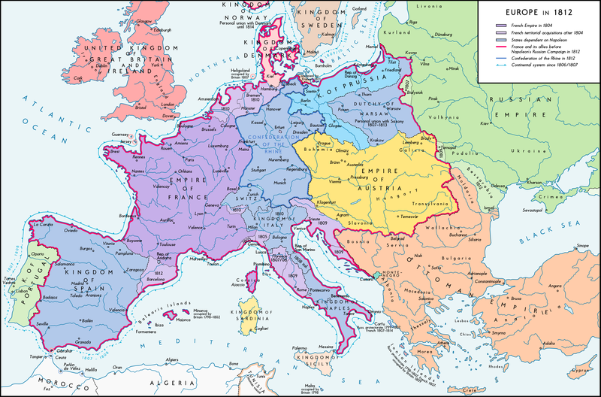
Europe in 1812

Slide 9
Central Europe during the Napoleonic Wars
Readings:
Lefebvre, Georges (1971). The French Revolution: From Its Origins to 1793. Columbia University Press.
Furet, Francois (1995). Revolutionary France, 1770–1880. Blackwell Publishing.
Englund, Steven (2004): Napoleon: A political Life.

Slide 10
Habsburg Monarchy
Francis II (1792 – 1836), since 1804 ruled as the Austrian Emperor Francis I
the era of absolutism
the first minister – Prince Klemens Wenzel von Metternich – convinced conservative monarchist – The Metternich absolutism
1811 – General Civil Code (ABGB)– compromis between old and new ideologies
1811 – devastating collpase of the state finances in February (paper currency was devalued to one fifth of its original value)

Slide 11
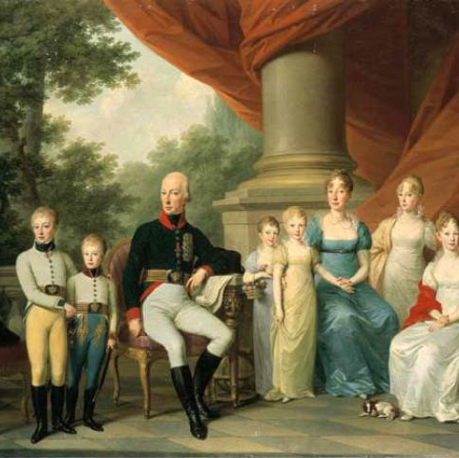
Francis II
Emperor Francis and his Family, a portrait by Jozef Kreutzinger

Slide 12
Europe After the Congress of Vienna
Congress of Vienna
a conference of ambassadors of European states chaired by Klemens Wenzel von Metternich, and held in Vienna from September, 1814 to June, 1815
the aim – finishing the wars with France and restauration of old principles – the situation before the revolution (no revolutions, no republicanism, lesser civil rights etc.)
4 Great Powers: Russia (Tzar Alexandr I, Foreign Minister Count Carl Robert Nesselrode), Prussia (King Frederick William III, Chancellor Karl August von Hardenberg) , Austria (Emperor Francis I., the Foreign Minister Prince Metternich) and Great Britain (Foreign Secretary Viscount Castelreagh, later Duke of Wellington)
surprisingly important role of defeated France – thanks to Ministre of Foreign Affairs Maurice de Talleyrand – a very good diplomat

Slide 13
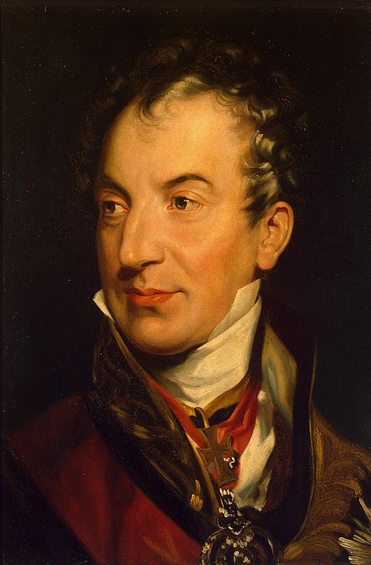
Prince of Metternich
Clement Wenceslas Nepomuk Lothar von Metternich-Winneburg-Beilstein (1773 – 1859)

Slide 14
Europe After the Congress of Vienna
The Final Act – June 1815:
Russia was given most of the Duchy of Warsaw (so called Congress Poland was formed) and was allowed to keep Finland (annexed from Sweden in 1809)
Prussia was given two fifths of Saxony, parts of the Duchy of Warsaw, Danzig, and the Rhineland/Westphalia.
A German Confederation of 38 states was created from the previous 360 of the Holy Roman Empire, under the presidency of the Austrian Emperor
the United Kingdom of the Netherlands was established
The neutrality of Switzerland was guaranteed.
The Bourbon Ferdinand IV, King of Sicily was restored to control of the Kingdom of Naples
The slave trade was condemned

Slide 15
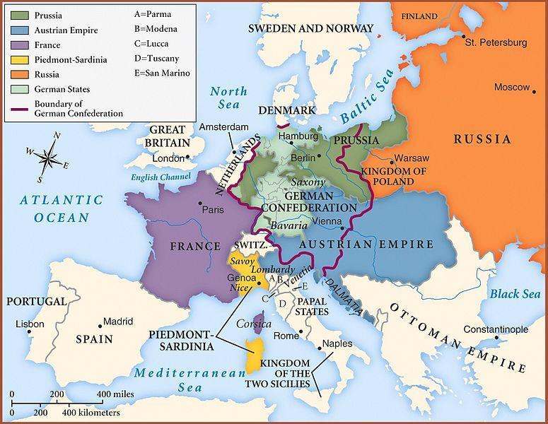
Europe after congress of vienna

Slide 16
The most important results:
so called The Concert of Europe, also known as the Congress System or Vienna System – it was the network of treaties, institutions and practices that should ensure the balance of power that existed in Europe from the end of the Napoleonic Wars (1815) to the outbreak of World War I (1914)
1815 – the Quadruplle Aliance was established – the winners over Napoleon (United Kingdom, Austria, Prussia, Russia)
1815 – the Holy Alliance was signed by Russian Tzar, Austrian Emperor and Prussian King – the aim of this document was to implement the Christian values and principles into the political life, the moral principles were emphasized, the main goal was again the cooperation against revolutionary, liberal and democratic movements
later it was signed by almost all European rulers, except those from Skandinavia, Osman Sultan and the Pope, the Great Britain left the systém of the Holy Alliance in 1822
1818 – the occupation of France was finished – France acceded the Quadrupple Alliance → the Quintupple Alliance was established
the meetings of the Great Powers during this period: Aachen (1818), Carlsbad (1819), Verona (1822), London (1832), Berlin (1878)

Slide 17
The Rise of National Movements
The first wave of the national movements – 1820s:
German states
Italian states
The second wave of national movements in 1830s:
almost in the whole Europe
started in France (against extremly conservative king Charles X) , then spread to Belgium, to Italy and to other states

Slide 18
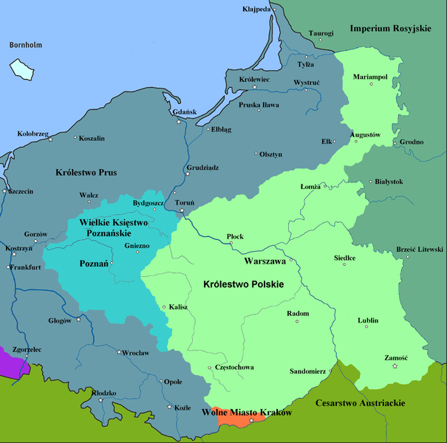
Poland – November Uprising 1830
after Napoleonic wars and the Congress of Vienna there were three states in Poland:
the semi-autonomous so-called Congress Poland controlled by Russia – it was united with Russia through a personal union
the semi-autonomous Grand Duchy of Poznań controlled by Prussia
the semi-autonomous Kingdom of Galicia and Sandomer controlled by Austria

Slide 19
Poland – November Uprising 1830
the outbreak of the uprising – November 29, 1830 in Warsaw
On 25 January 1831, the Sejm passed the Act of Dethronization of Tsar Nicolas I and ended the personal union with Russia
on 29 January 1831 Prince Adam Czartoryzski became President of the new Polish National Government
the Russians formed very strong army and defeated Polish army at the Battle of Ostrolenka in May 1831
the Polish Uprising was supressed
cruel persecution succeded, the leaders of the uprising were sentenced to death so they emigrated
the cosequence of the vawe of national movements during the 1830s – the collapse of the Holy Alliance

Slide 20
The third wave of national movements in 1840s
general economical crisis spread from England to the rest of Europe in mid-1840s
bad harvest, potato blight and drought in 1846 → famine
strong influence of industrial revolution on politics
bourgeouisie (owners of factories, businessmen) had money but only small political influence
bad living conditions of working classes
the revolution started in January 1848 in Italy (Sicily) – against the Bourbons
February 1848 – revolution in France – ended constitutional monarchy of Louis Phillipe of Orleans

Slide 21
German States
the March Revolution, southern and western parts
it was led by well educated students and intellectuals, but there were also many mass demonstrations
there were 39 states – demand of German national unity
wanted civil rights
two conceptions:
"greater German solution" (including German-speaking areas of Austria)
"smaller German solution"
March 1849 - the new German constitution was proclaimed
they decided to proclaim constitutional monarchy – the crown was offered to Prussian king Frederick William IV – refused to accept the crown from the hands of revolutionary parliament
the new constituion was refused by most of the German rulers
the revolution was unsuccesful

Slide 22
Habsburg Monarchy
Ferdinand I (1836–1848)
weak ruler, mentally challenged, the real ruler of the monarchy was the konservative Chief Minister Klemens Wenzel von Metternich
so called pre-March period - restricted freedom of the press, of the speech, of association
limited many university activities, strong censorship, police control
the empire, ruled from Vienna, included Austrian Germans, Hungarians, Slovenes, Poles, Czechs, Croats, Slovaks, Ukrainians, Romanians, Serbs and Italians,
all of them wanted to either achieve autonomy, independence, or even hegemony over other nationalities

Slide 23
1848 in habsburg monarchy
the first unrests in Prague in March 1848
the conception of austroslavism
June 1848 – the Pan-Slav Congress was held in Prague
uprising in June – supressed by an Austrian army led by Alfred I, Prince of Windisch-Grätz
March 1848 – revolution in Vienna
Metternich was removed from the office and escaped from Vienna
in September 1848 – the Emperor´s decree – the serfdom was completely cancelled (citizens got civil rights but the suffrage was not general)
October – new uprising in Vienna - supressed
December 1848 – Ferdinad I resigned, lived in Prague till 1875

Slide 24
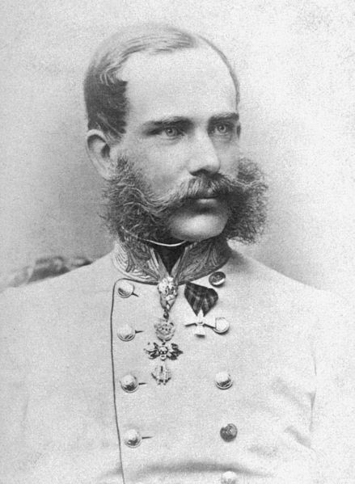
Habsburg Monarchy
Franz Joseph I
of Austria
(1848–1916)
absolutism again
so called Stadion´s constitution – was not accepted by an assembly

Slide 25
1848 in habsburg monarchy
March 1848 – revolution also in Hungary
12 Demands – among others: authonomy, control over its foreign policy, budget and army, general taxes
Hungary was multinational (Slovaks, Croats, Rumanians, Ruthenians, Serbs, Germans etc.) but no politic nor national rights – their demands were refused so they fought against Hungarians
April 1849 – proclaimed independent Hungarian state
Franz Joseph asked Russian Tzar for a help
13 August 1849 – the Battle of Villágos – Hungarians defeated
Repressions

Slide 26
Habsburg monarchy
Readings:
Evans, R. J. W. (ed.) (2000): The Revolutions in Europe 1848–1849. From Reform to Reaction. Oxford.
Okey, Robin (2001): The Habsburg Monarchy c. 1976–1918: From Enlightenment to Eclipse. London: Macmillan Press LTD.

