Slide 1
Central europe during the interwar period
Jana Hrabcova

Slide 2
Germany
serious problems as the consequences of the war:
Economic depression, high reparation payments
restrictions of the area, lost of the colonies,
restrictions of army, navy and air force
1919 – 1933 – Weimar Republic, parliamentary republic, federation of 16 states
the first President – Friedrich Ebert (Social Democratic Party)
1919 – the first elections
general dissatisfaction
1918 – Communist Party of Germany was founded (headed by Rosa Luxemburg and Karl Liebknecht) – rejected the parliamentary democracy
strong revolutionary wave (strikes, rebellions etc.)
in Bavaria – Bavarian Soviet Republic was proclaimed in October, defeated in April 1919
March 1920 – right-wing monarchistic Kapp Putsch – former volunteers (Freikorps)
1923 – suppression of Hitler-Ludendorff Putsch in Munich, Hitler was arrested and wrote his programme book Mein Kampf, his political party NSDAP was banned

Slide 3
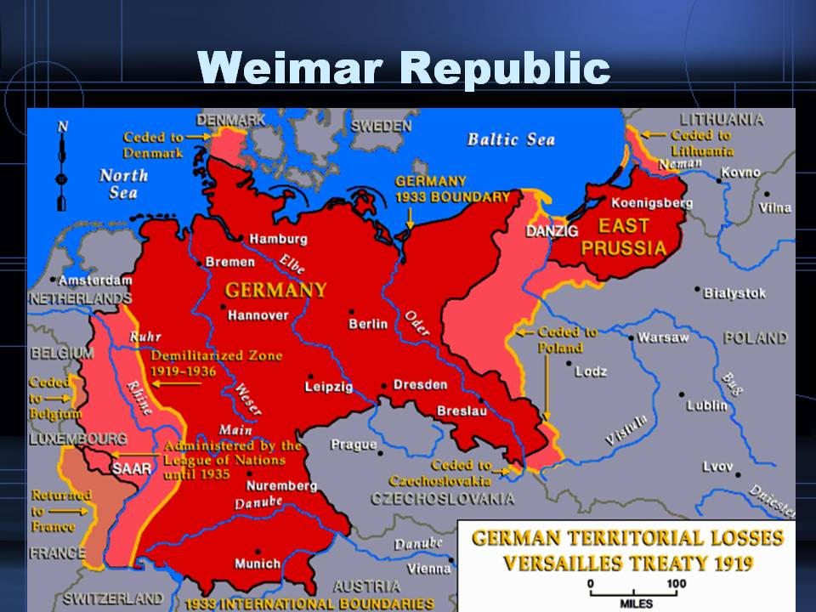

Slide 4
Germany during 1920s
1923 - Industrial territory around the River Ruhr was occupied by France (Germany was delayed with paying of reparation payments)
1923 – the new government – Prime Minister (Chancellor) Gustav Stresemann – stabilization of Golden mark, succesful foreign policy
1925 – the second President became Paul von Hindenburg
weak democracy – governments changes very often
since 1929 – Great Depression – in Germany very serious effects (1932 – unemployment was 44,5 %),
the growth of extreme nationalism and revanchism
a political crisis: the political parties represented in the Reichstag were unable to build a governing majority in the face of escalating extremism from the far right (the Nazis, NSDAP) and the far left (the Communists, KPD)
1932 – NSDAP won the elections (over 30 %, the communists were third)

Slide 5
Germany during 1930s
1933 – Adolf Hitler was appointed as Chancellor
1933 – Germany left the League of Nations
1934 – Hitler became a Führer – the head of the state
The Nazi regime restored economic prosperity and ended mass unemployment using heavy spending on the military, while suppressing labor unions and strikes → enourmous popularity
Political oposition was destroyed
Secret police – Gestapo (Heinrich Himmler)
Concentration camps
Propaganda – Joseph Goebbles
1934 – The Night of the Long Knives – the top leaders of SA were killed – internal opposition in Nazi party was destroyed
1935 – Nüremberg laws – anti-Semitism, the Jews excluded from political, economical and public life, had to wear a yellow star

Slide 6
Germany during 1930s
1935 – Germany introduced general military service and began to re-arm
1935 – Germany won the Saar (was under the protection of the League of Nations)
1936 – Germany occupied de-militarized zone in Rheinland
both were breaching of Versailles Peace Treaty and of Rhineland Pact but only formal prostest of great powers succeded
1936 – pact with fascist Italy headed by Benito Mussolini – Berlin-Rome Axis
1936 – Anti-Commintern Pact against the communism – with Japan
March 1938 – Anschluss of Austria
September 1938 – the Munich Agreement – the occupation of Sudetenland (borderland of Czechoslovakia)
1938, November 9–10 – Crystal Night – great pogrom against Jews
September 1, 1939 – attack on Poland – WW II started

Slide 7
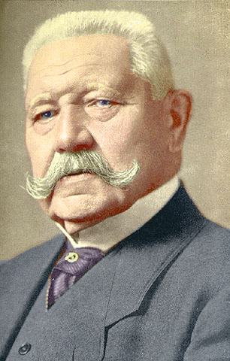
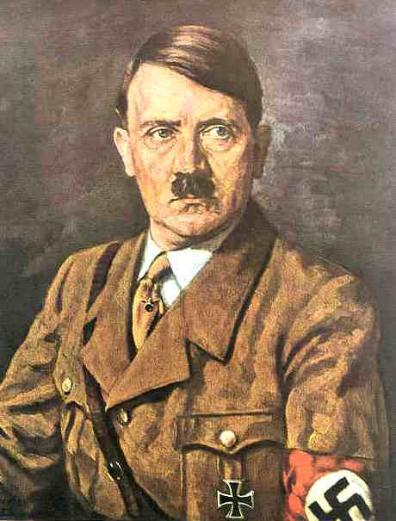
Germany
Paul von Hindenburg
Adolf Hitler

Slide 8
Germany
Readings:
Kaes, Anton – Jay, Martin – Dimendberg, Edward, (eds.): The Weimar Republic sourcebook. Berkeley: University of California Press, 1994.
http://books.google.cz/books?id=J4A1gt4-VCsC&printsec=frontcover&hl=cs&source=gbs_ViewAPI&redir_esc=y#v=onepage&q&f=false

Slide 9
Austria
1919–1934 – the Republic of Austria, first Chacellor Ignaz Siepel
Austria's government was dominated by the Christian Social Party
the country was unstable, severe economic consequences of the war
many paramilitary forces had been formed during the early 1920s - Schutzbund (social democratic) X Heimwehr (rightist)
the clash between right-wing and left-wing paramilitary forces is known as July Revolt of 1927
1932 – authoritarian regime of Chancellor Engelbert Dollfuss, austrofascism, gravitagted to Italy (Austria felt threatened by German demands on Austria – Anschluss)
Dollfuss was assassinated by Nazi agents who attempted coup d'état in 1934 – July Putch – unsuccessful
The remaining Austrian Nazis started to make use of terrorist attacks against Austrian governmental institutions, causing a death toll of more than 800 between 1934 and 1938

Slide 10
Austria
new Chancellor – Kurt Schuschnigg – similar political course
But still also an effort to keep Austria’s independence – focused on the history of Austria and opposed the absorption of Austria into the Third Reich, according to his philosophy the Austrians were „better Germans“
eventually Schuschnigg gave up his anti-Nazi program and in July 1936 he signed the Austro-German Agreement, which, among other concessions, allowed the release of Nazis imprisoned in Austria and the inclusion of National Socialists in his Cabinet
Strenghtening of pro-German Nazis in Austria
1938 – Anschluss – March 11 – German troops crossed Austrian frontiers and Austria was occupied by Germany
after Anschluss in March 1938 (Fall Otto) Austria became a part of German territory
in April a plebiscite that confirmed annexation of Austria into Nazi Germany

Slide 11
hungary
The official proclamation of democratic republic on November 16, 1918, Mihály Károlyi was named as the republic's Prime Minister
the area of Hungary was of only one third of pre-war Hungary – dissatisfaction, attpemts to restore the Great Hungary
the rapid rise of power of Hungarian Communist Party, the Hungarian Soviet Republic was proclaimed on March 21, 1919 – an attpemt to restore the Great Hungary, the head of this republic was Béla Kun, Hungarian communists wanted to connect with Soviet Russia
Czechoslovakia and Rumania were threatened by Hungarian demands → their armies attacked Hungary and the Hungarian Soviet Republic was defeated
the new Government – fascist party of Admiral Miklós Horthy
1920 – the monarchy was restored in Hungary but no king
Horthy ruled over it as a regent 1921–1931 – the Prime Minister was István Bethlen (till 1931)

Slide 12
Hungary
Hungary's signing of the Treaty of Trianon on June 4, 1920, ratified the country's dismemberment, limited the size of its armed forces, and required reparations payments
1920s – the white terror - led to the imprisonment, torture, and execution without trial of communists, socialists, Jews, leftist intellectuals, sympathizers with the Károlyi and Kun regimes, and others who threatened the traditional Hungarian political order that the officers sought to reestablish
the former Austrian Emperor, Charles I, unsuccessfully attempted to retake Hungary's throne in March 1921
No democracy – the suffrage – only 29 % of population, public vote

Slide 13
Hungary
1932–1936 – the Prime Minister was Guyla Gömbös - the radical right's ascendancy in Hungarian politics
1938 – territorial gains – from Czechoslovakia,
Later also from Rumania and Yugoslavia (1941)
hungarian nazism
1939 – Arrow Cross Party (Hungarian Equivalent of Nazi Party) won the elections
1940 – Hungary joined the Tripartite Pact (Germany, Italy and Japan)
1940 - joined Axis Berlin – Rome – Tokyo
1941 – Hungary participated on the invasions of Yugoslavia and of the Soviet Union

Slide 14
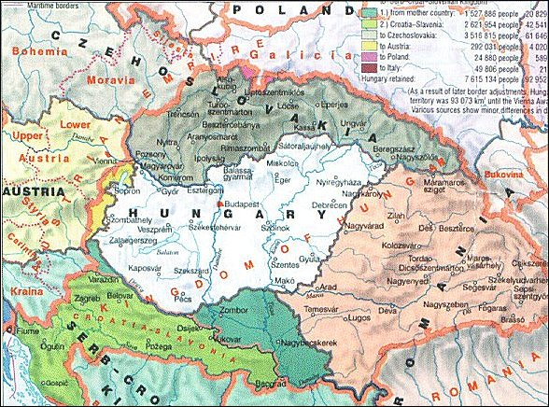
Hungary 1920–1938

Slide 15
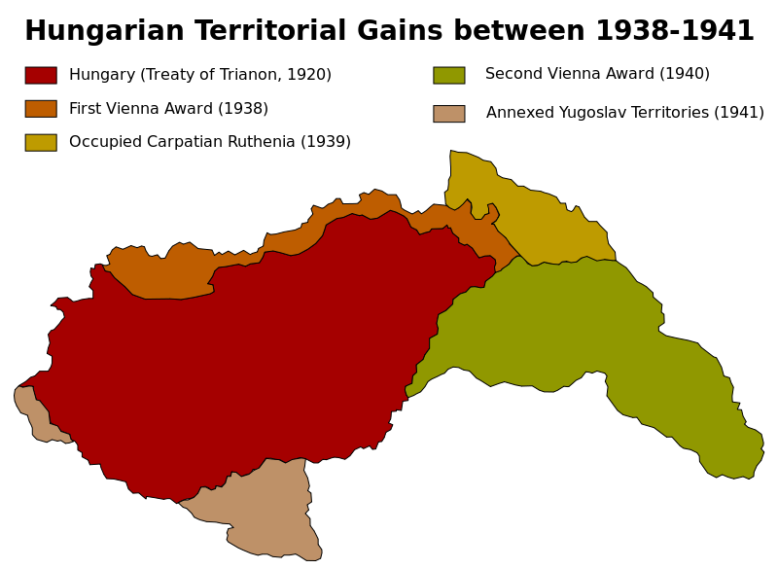

Slide 16
poland
the Republic of Poland was reestablished in 1918
several regional conflicts:
1918 – 1919 – Polish – Ukrainian War –
border conflicts with Czechoslovakia - Juanuary 1919 – Seven day war broke out
a new demarcation line – the western part of the disputed territory was given to Czechoslovakia while Poland received the eastern part
1919 – 1921 – Polish-Soviet War – Poles attacked Russia – they wanted to use Russian civil war to ensure their eastern borders, but later Soviet counteroffensive – they wanted to establish Soviet Republic in Poland
August 1920 – the battle of Warsaw - the Soviet troops were defeated
the Peace Treaty of Riga – Poland got parts of Belarus and Ukraine
1922 – annexation of Vilnius Region from Lithuania

Slide 17
Poland
1926 – the May Coup d´État – leftist politician and a popular Marshall Jozef Piłsudski,
he became most influential politician in Poland and became its de facto a dictator till his death in 1935 though he was not a president but only a Minister of defence
1932 – non-agression pact with Soviet Union
October 1938: annexation of Zaolzie, Górna Orawa, Jaworzyna from Czechoslovakia
March 31, 1939: military guarantees from United Kingdom and France
August 23, 1939: non-aggression pact between Soviet Union and Germany: Ribbentrop-Molotow Pact with a secret military alliance protocol targeting Poland
September 1 – October 6, 1939: Invasion of Poland

Slide 18
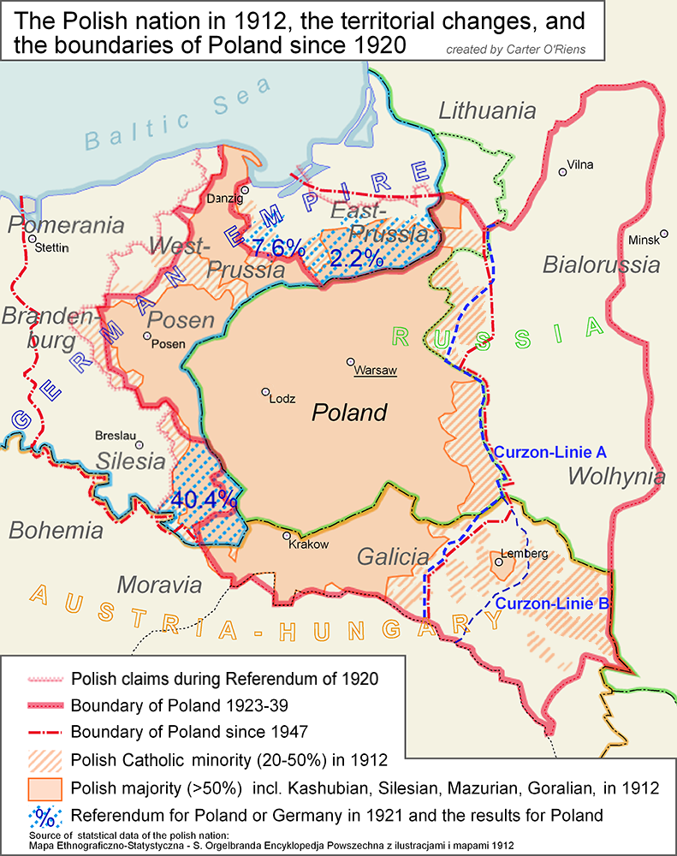
poland

Slide 19
czechoslovakia
in Czechoslovakia numerous German minortity, Sudeten German Party with the leader Konrad Henlein
April 1938 – Karlsbader Decrees demanding the authonomy for Sudeten Germans and the freedom to profess Nazi ideology, Sudeten Germans expected that President Beneš will refuse their exaggerated requirments
Czechoslovak government was forced to coclude an agreement with Henlein but he refused all their suggestions according to Hitler’s instructions
several negotiations on Czechoslovakia between Hitler and British Prime Minister Neville Chamberlain during September 1938
15th September – Berchtesgaden – Great powers were putting pressure on Czechoslovak government to accept Hilter´s requirments – he wanted Sudeten, firstly Czechoslovak government refused British and French pressure but on 21st September was forced to accept Hitler´s requirments
22nd September – Bad Godesberg – new Hitler´s requirments – he wanted to occupy Czechoslovak fortification and some border areas for Poland and Hungary

Slide 20
czechoslovakia
Hitler announced that he will attack Czechoslovakia on 28th September (according to the Fall Grün prepared already in April 1938)
change of the government in Czechoslovakia – Prime Minister General Syrový
23rd September – general mobilization in Czechoslovakia
29th to 30th September – negotioations of four Great powers in Munich (Germany – Hitler, Italy – Mussolini, Great Britain – Chamberlain, France – Daladier) – about Czechoslovak frontiers and German requirments but without Czechoslovakia – France and Great Britain were Czechoslovak allies but they signed the agreement with the enemy:
the Munich Agreement, Czechoslovakia(Czechoslovak troops) had to evacuate Sudeten and cede it to Germany,
the USSR did not reply for the Czechoslovak application for the help
from 1st to 10th October Czechoslovak borderland was occupied by German troops and annexed to Germany, Poland got the area around Těšín and Spiš, Hungary got Carpathian Ruthenia and southern parts of Slovakia

Slide 21
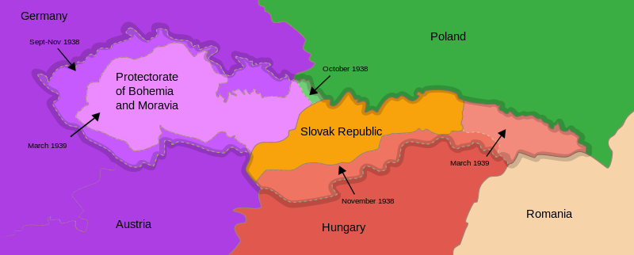
Dissolution of czechoslovakia in 1938
Czechoslovakia lost 1/3 of its area, 1/3 of light industry, in southern Slovakia fertile soil important for agriculture was lost
the First Czechoslovak republic was dissoluted,
so called Second Czecho-Slovak Republic was proclaimed - till March 1939 – President Emil Hácha, no parliamentary democracy anymore
7th October – autonomy of Slovakia was proclaimed – Czecho–Slovakia

Slide 22
Protectorate bohemia and moravia, slovak state
13th March 1939 – Slovak Prime Minister Jozef Tiso was invited into Berlin – he was made to enforce the separation of Slovakia
14th March 1939 – Slovak State separated from Czecho-Slovakia, formally independent but really the satelite of Nazi Germany
14th March 1939 – President Hácha and Foreign Minister Chvalkovský invited to Berlin – Hitler threatened with bombing of Prague – they were forced to sign the document asking Germany for protection what was in fact forced capitulations
15th March 1939 – German army occupied Bohemia and Moravia – dissolution of Second Czechoslovak Republic
16th March 1939 – the occupants proclaimed Protectorate of Bohemia and Moravia –
it was part of German Reich, formaly autonomous state with so called State President Emil Hácha and Prime Minister Rudolf Beran
but the real power was in hands of Reichsprotektor Konstantin von Neurath and later Reinhard Heydrich

