Slide 1
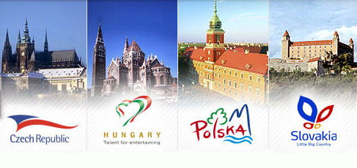
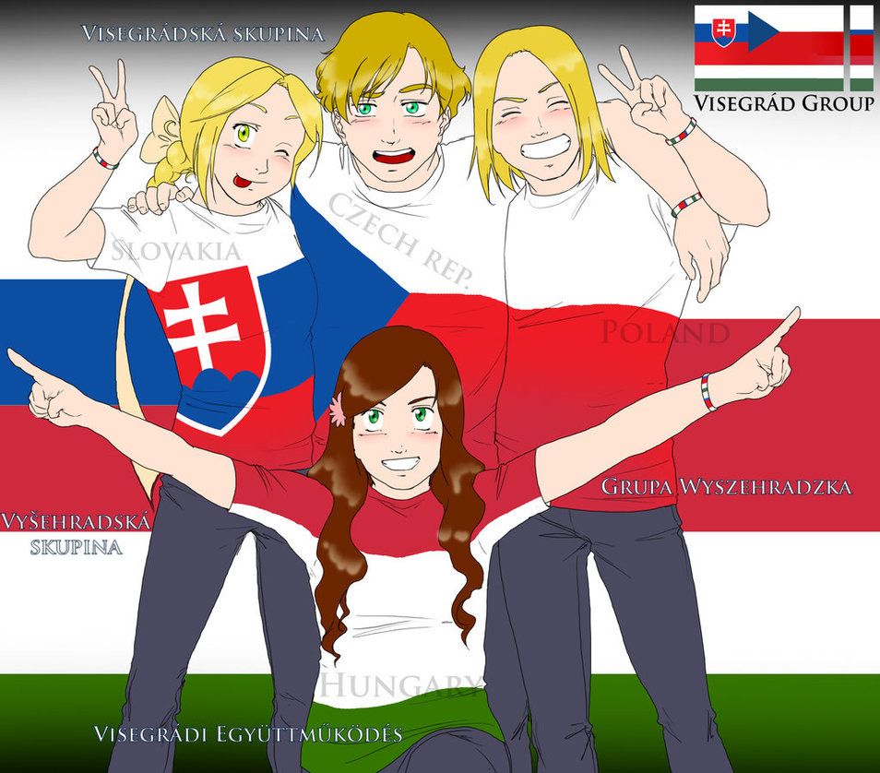

Slide 2
PL + CZ + HU + SK = Visegrad Group (V4)
Population: 64 million (~ UK)
Area: 533 thousands sq. km (~ France)
GDP (PPP): 1.6 trillion USD (~ Spain)
GDP per capita: 25 thousands USD (~ Portugal or Greece)
Membership in international organizations: UN, IMF, WB, WTO, OECD, EU, Council of Europe, OSCE, NATO, V4
Voting in the Council of the EU
4 countries out of 16/28
13 % of the EU population (need to be 65 %)
Seats in European Parliament: 107 (more than Germany)

Slide 3
Political freedom
Before 1989:
Partly Free (Poland and Hungary in 1980s)
Not Free (Czechoslovakia)
After 1990
Free
(Slovakia Partly Free in 1994-1998)
Today
Free 1-1
(Hungary 2-1)

Slide 5
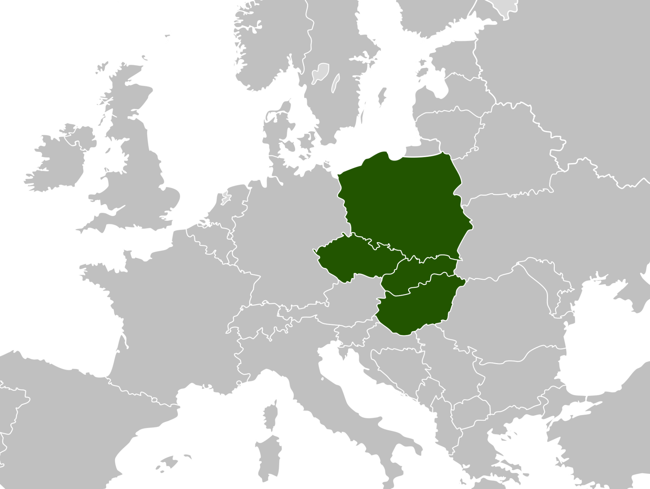

Slide 6
What is Central Europe?
Between West and East, North and South
1948 – 1989: “Culturally part of the West, politically part of the East” (Milan Kundera)
The borderland of the Western Christian civilization
Small countries, never played a significant role outside of the region, always at the receiving end of conflicts, always behind the West, yet ahead of the East.
Internally very heterogeneous – major dividing lines in Europe
A cultural and historical concept

Slide 7
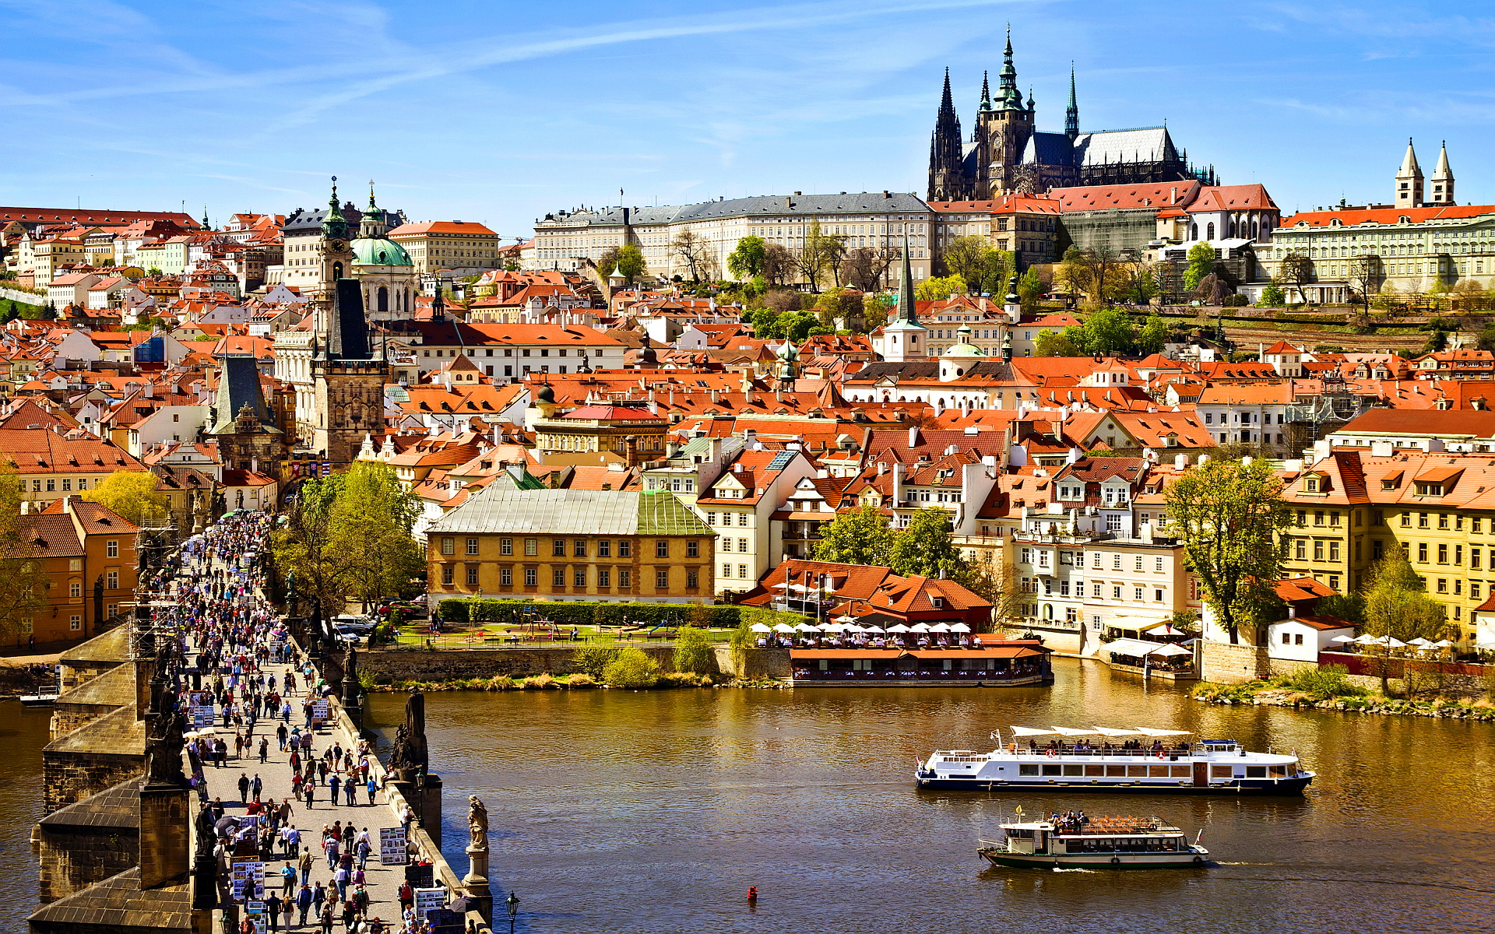

Slide 8
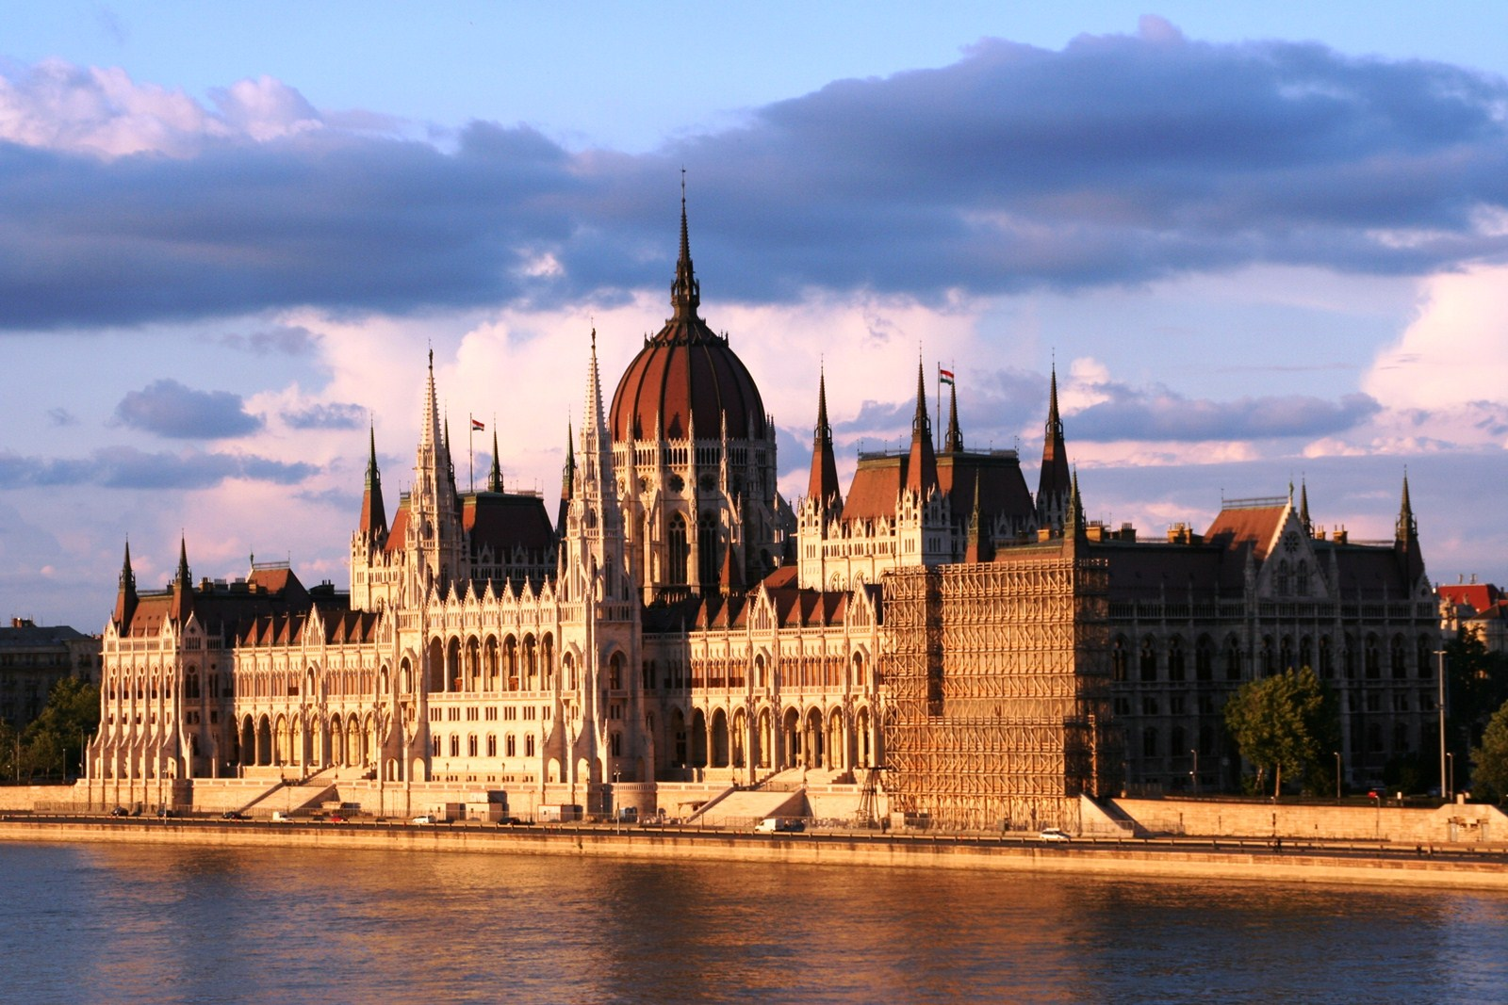

Slide 9
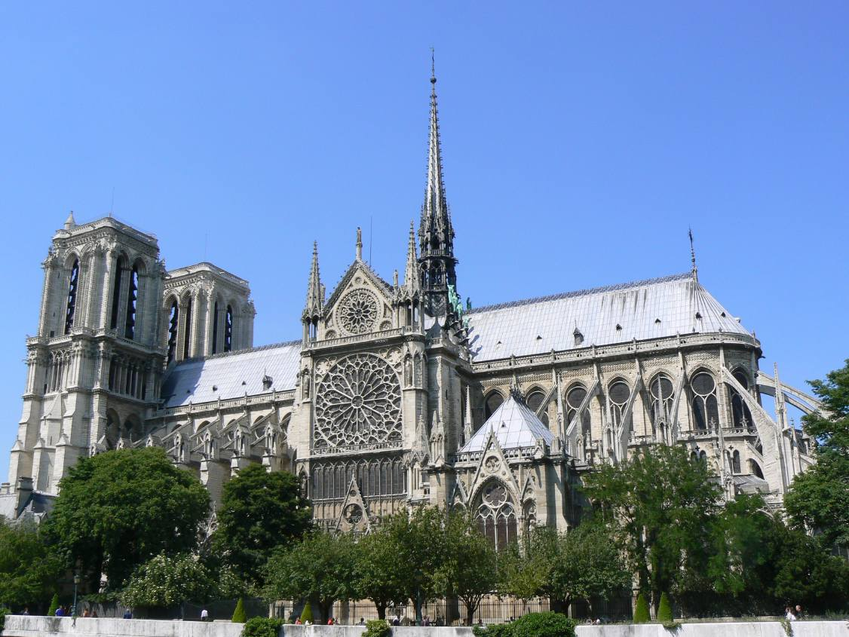
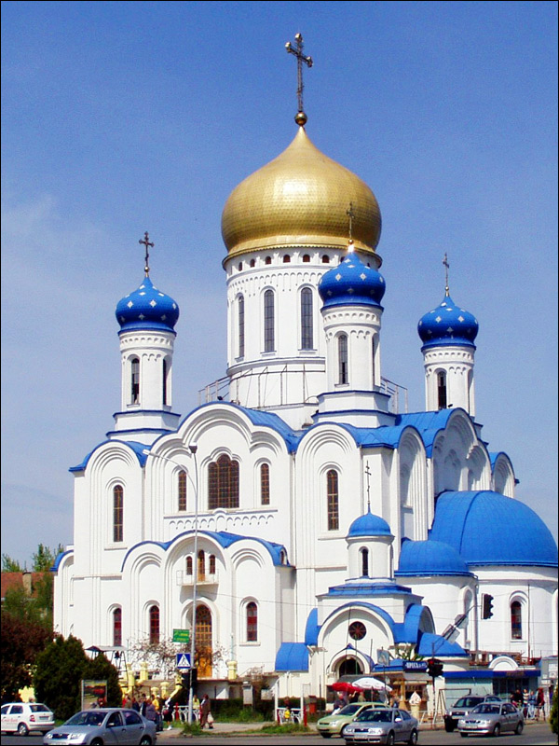
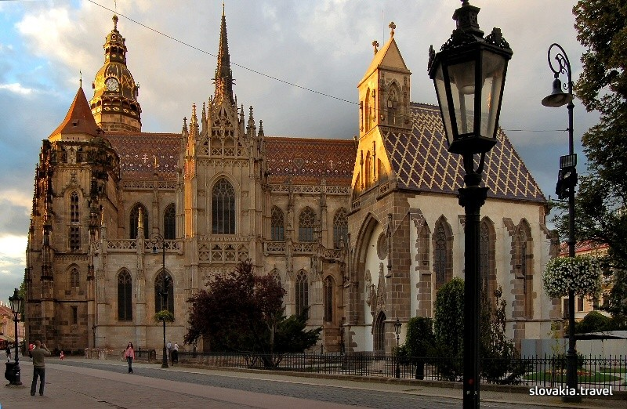

Slide 10
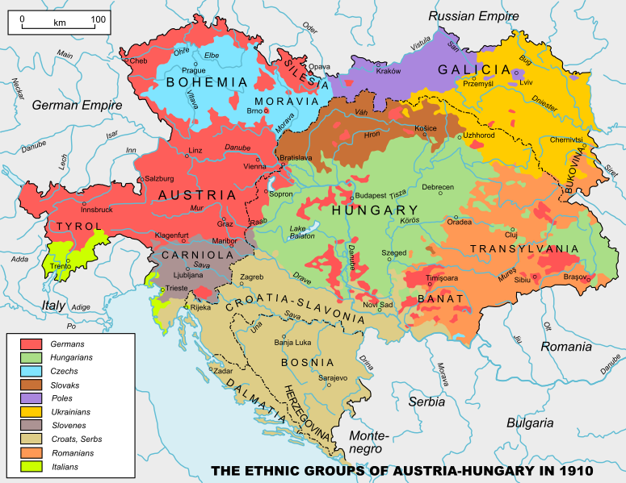

Slide 11
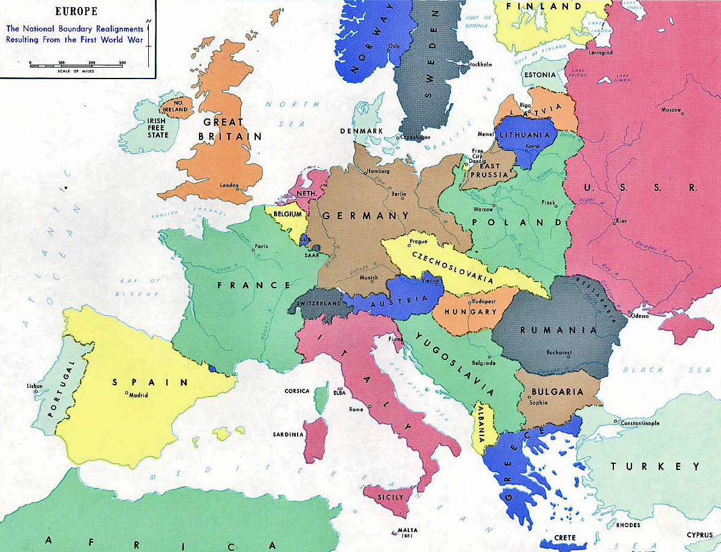

Slide 12
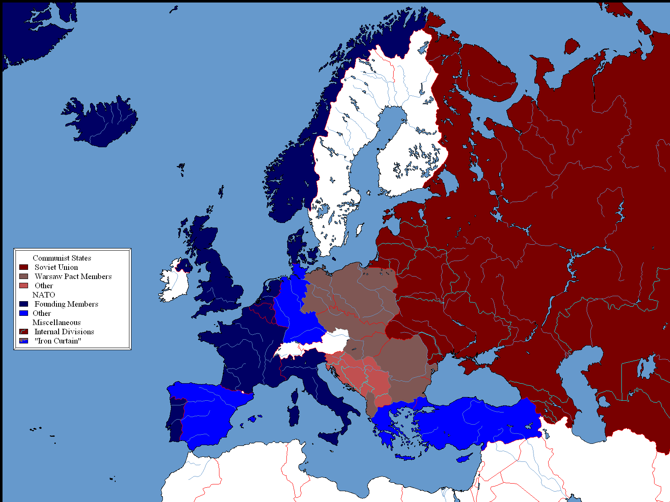

Slide 13
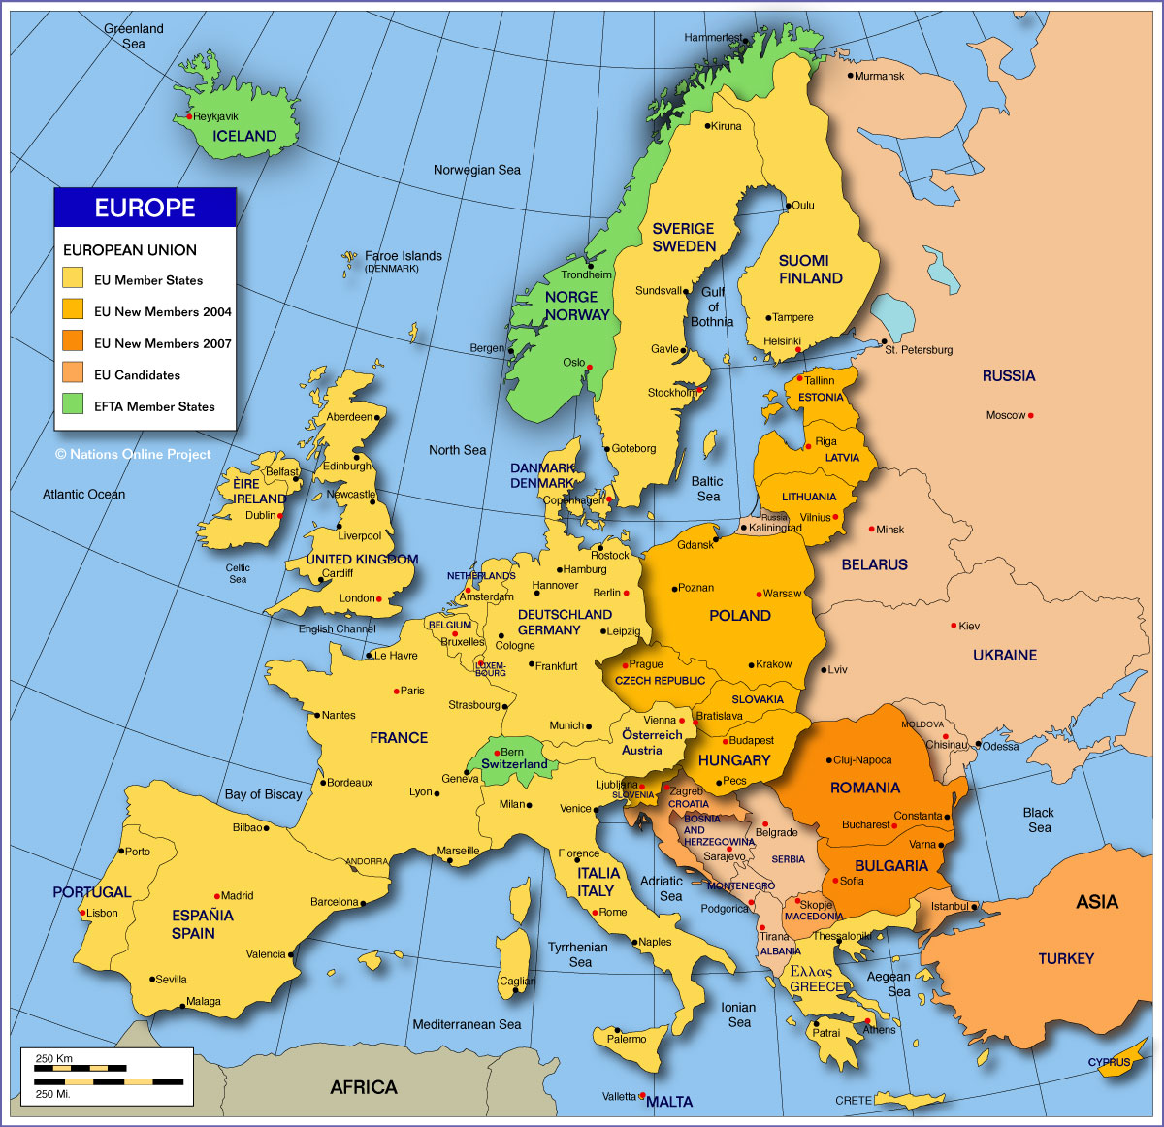

Slide 14
Why has Central Europe always lagged behind?
Loss of national sovereignty at the end of Middle Age
Parts of autocratic empires – Habsburg Austrian Empire, Russian Empire, Ottoman Empire, Prussian Empire
Military conflicts – … Tatars, Mongols, Ottomans, Thirty years war, Napoleon wars, WW I and WW II, possibly WW III, Balkan wars
Limited/belated reach of colonialism, reformation, enlightenment, liberalization and industrialism
Part of the Soviet Eastern Europe in 1948-1989

Slide 15
Current issues in the region
Economy
Growth slowed down after 2008
Investments from the Western Europe and the US were withdrawn
Politics
Rise of populism
Corruption
Security
Ukraine crisis and relations with Russia
Energy security

