Slide 1
The Rise and Fall of Central Europe: Region in the Short 20th Century
Richard Turcsanyi

Slide 2
Questions
What were the most important processes in Central Europe in 19th century?
Who are the national heroes of CE countries from the 19th century and why?
What are the gaps between the ‘real’ history and the historical memory of the Middle Age?

Slide 3
Interwar period
The end of WWI - Versailles system, Trianon Treaty
  Collapse of Austria-Hungary
  Partial collapse of Germany, Russia, territorial losses of Hungary
  New states: Czechoslovakia, Poland, (and many others)
Ideas and realities
  Self-determination
  Cordon sanitaire and Central Europe cooperation
Masaryk, Pilsiudski

Slide 4
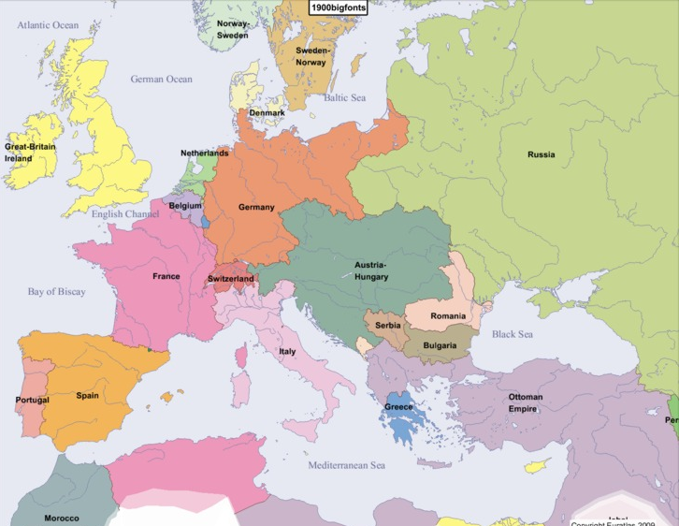

Slide 5
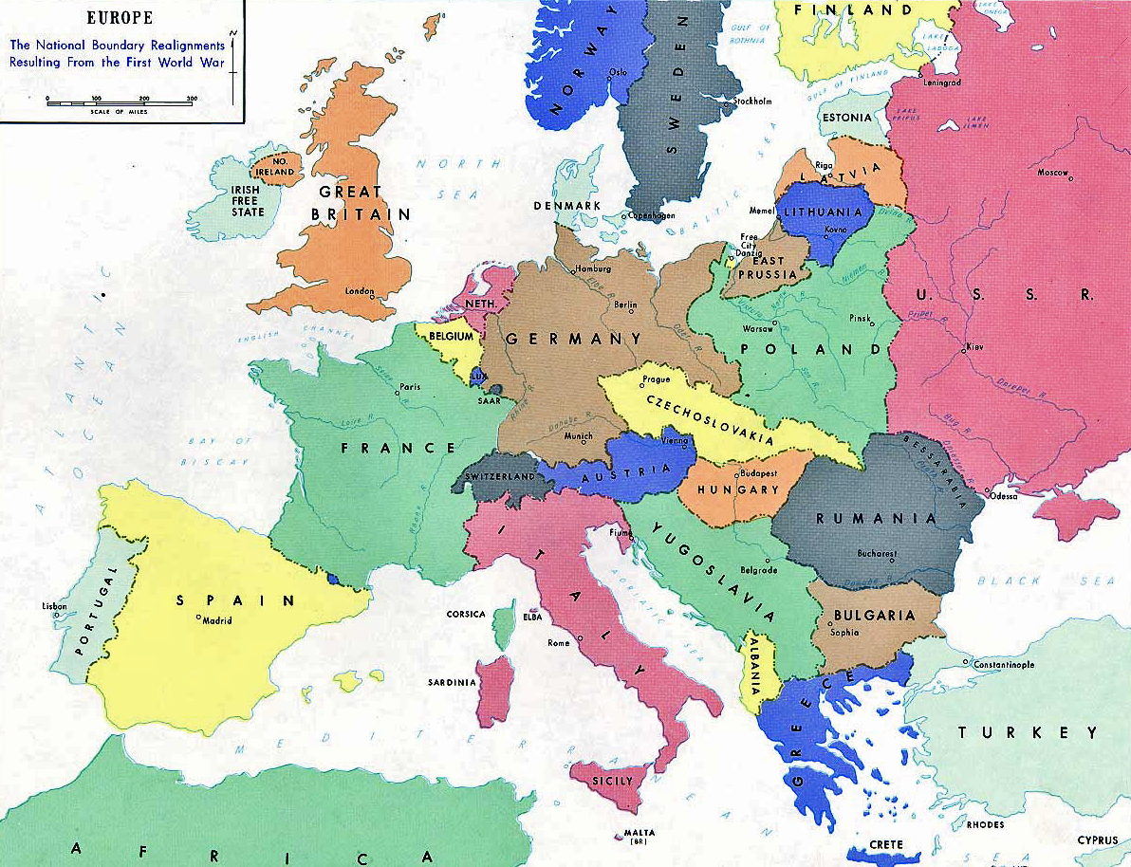

Slide 6
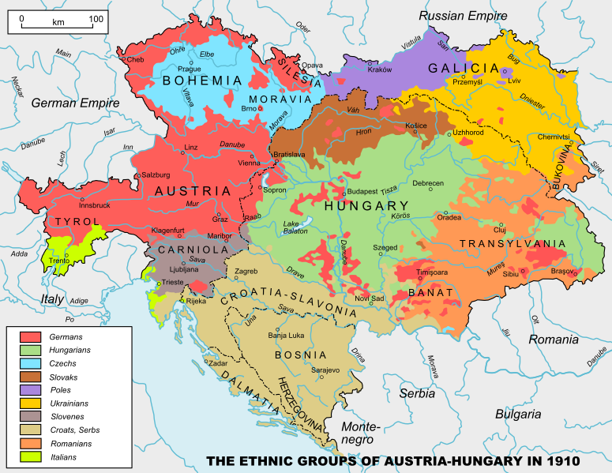

Slide 7
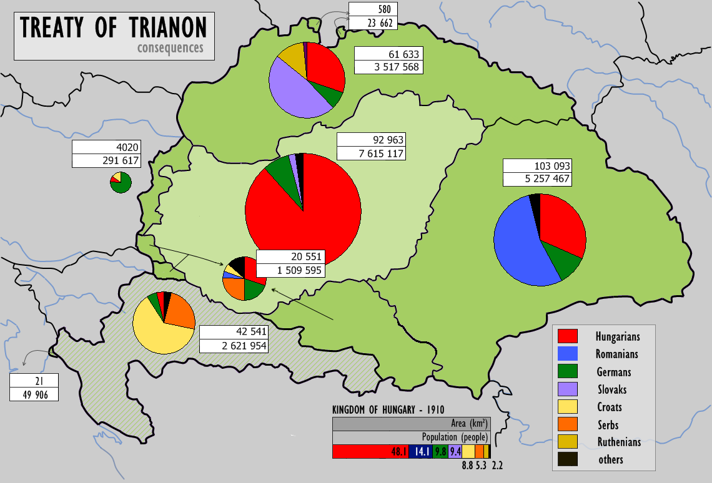

Slide 8
World War II
1933: Hitler becomes German Chancellor
March 1938: Austrian Anschluss
September 1938: Munich Agreement (Dictate)
March 1939: Protectorate of Bohemia and Moravia, independent Slovak state
August 1939: Molotov-Ribentrop Pact
September 1939: Germany (+ SK) and USSR attacks Poland
April 1940: Katyn masacre
1940: Germany invades Denmark, Norway, Benelux and France
1941: Germany (+ SK and HU) invades USSR
1942: Operation Anthropoid (killing of Rainhard Heydrich)
1944: Warsaw Uprising, Slovak National Uprising, German occupation of Hungary and Arrow Cross party rule
February 1945: Yalta conference
May 1945: Germany surrenders
Holocaust and Jewish question
The end of multicultural and multinational states in Central Europe

Slide 9
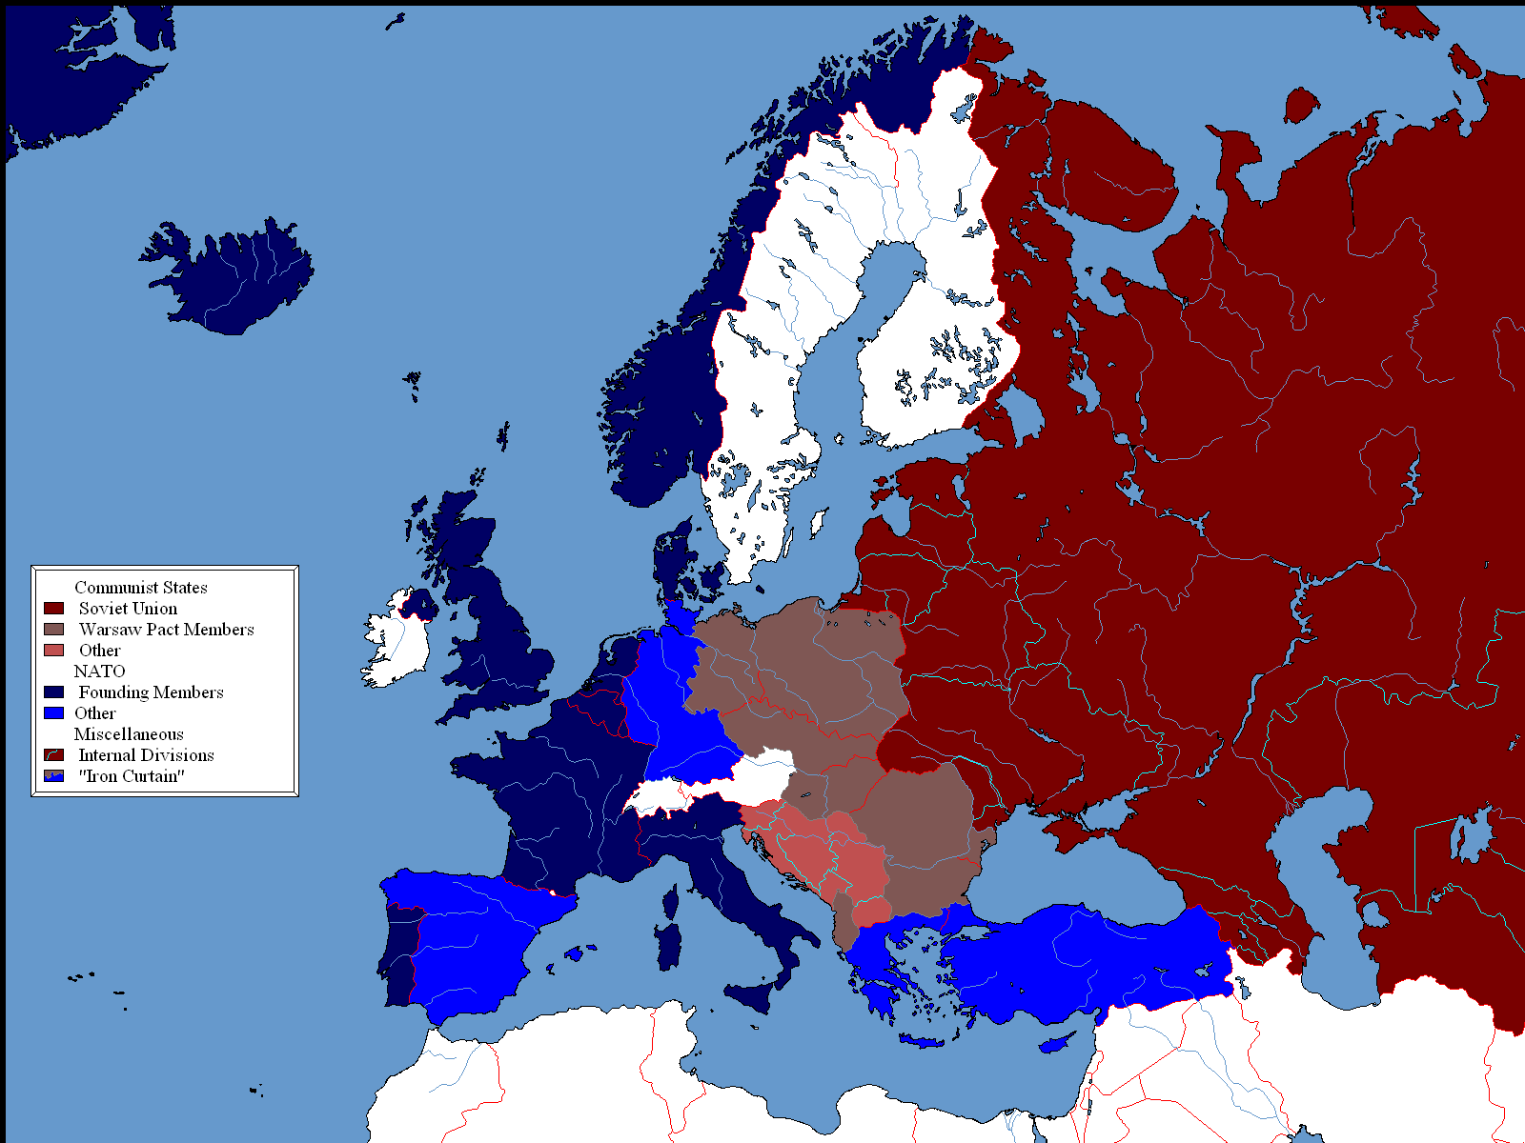

Slide 10
Central Europe under communism
1945-1948: bases for the communist regimes
1956: uprisings in Poland and Hungary
1968: Prague spring and the invasion of Czechoslovakia
1980: Solidarity general strike in Poland
1989: the end of communist regimes
Three ideas of Central Europe
  In West Germany
  In Austria
  Among dissidents and emmingrants from Eastern bloc

