Slide 1
Central Europe before and during WWI
.

Slide 2
The German Confederation existing since 1815 was dissolved
Instead of that the North German Commonwealth was constituted – 21 states – customs union, common currency and common foreign policy – the first step to unification
Prussian king became the President of this Commonwealth and the commander-in-chef of the army
Prussia provoked France to declare war on Prussia in 1870
France was defeated at the battle of Sedan in September 1870 – French king Napoleon III was captured what caused the fall of the French Empire and proclamation of the third republic
Paris was besieged since September 1870 till January 1871
January 1871 – The German Empire was proclaimed

Slide 3
International Relationships before WWI
Great powers at the end of the 19th century:
USA - the strongest
Germany (2nd world industrial area), the most powerful state in Europe, strong army, developed economy and culture
France – the bank of the world, 2nd strongest European state, succesful colonial politicis – colonies in Africa and in Asia
Great Britain – the greatest colonial power – its domain included the geatest colony – India,…
in Asia Japan – constitutional monarchy, development of industry, expansive politics
Austria-Hungary –cooperation with Germany, its foreign politics focused on the Balkan Peninsula
Russia – economicaly and politicaly the weakest state among the great powers, military-political system, absolute power of the Tsar, no political rights for citizens, social movement, expansion to Asia – conflicts with Japan and Great Britain

Slide 4
Formation of two enemy blocks in Europe at the end of 19th century
1879 – the secret agreement was concluded between Germany and Austria-Hungary – against France and Russia
1882 – Italy joined this pact → Tripple Alliance (later the Central Powers)
1893 – Russia and France made an agreement – they both were isolated and were affraid of strong and aggresive Germany
1904 – so called Entente Cordial concluded between France and Great Britain (affraid of strong Germany)
1907 – Russia + Britain → Tripple Entente

Slide 5
Balkan Wars
The first conflict in Europe after 40 years
The Balkan nations were fighting against Turkey which was occupiing them
1912–1913 - 1st Balkan War – so called Balkan League (Bulgaria, Serbia, Greece and Montenegro) X Turkey – Turkey was defeated and its European areas were liberated
But then the former allies started to fight with each other because of deviding of the liberated areas, Bulgaria had greatest war casualties and invested the most but the deliberated areas (Macedonia, Thrakia) got especially Greece and Serbia → Bulgaria was dissatisfied and declared war on Greece and Serbia → 2nd Balkan War – 1913
Turkey and Rumania joined Greece and Serbia and they were fighting against Bulgaria which was defeated and lost also the areas which obtained after the 1st Balkan War
But also Serbia was dissatisfied with the results of the wars (Serbia was expecting enlargement of its territory and wanted to raise Adriatic coast but instead of that Albania was formed)
Serbia started to prepair for the new war – wanted tu unify all the southern Slavs – who were living in Austria-Hungary

Slide 6
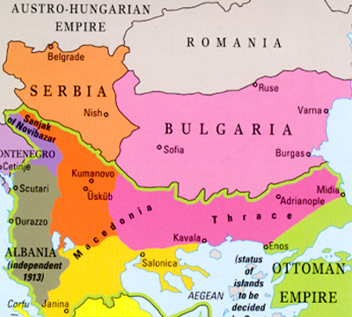
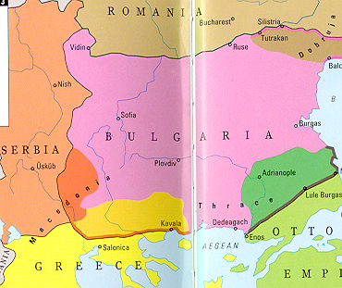
Balkan Wars
1st Balkan War
2nd Balkan War

Slide 7
Central Europe before WWI
Since the Crimean War (1853–1856) there was a period without a great war in Europe (only local conflicts)
The tensions persisted on the Balkan Peninsula (1908 – the annexation of Bosnia and Herzegovina by Austria-Hungary, 1912–1913 the Balkan Wars etc.)
Pacifist movement - peace conferences in Hague (1898 and 1907) - unsuccessful
2 blocks of powers at the beginning of the war:
Entente (Allied Powers): Great Britain + France + Russia
Central Powers: Germany + Austria-Hungary + (later) Bulgaria + Turkey
Italy – firstly neutral, in May 1915 joined the Entente (the London Treaty in April 1915 promised territorial gains to Italy)
Neutral countries: Sweden, Norway, Denmark, Netherlands, Spain, Switzerland, Albania
USA – neutral at the beginning of the war, entered the war in April 1917

Slide 8
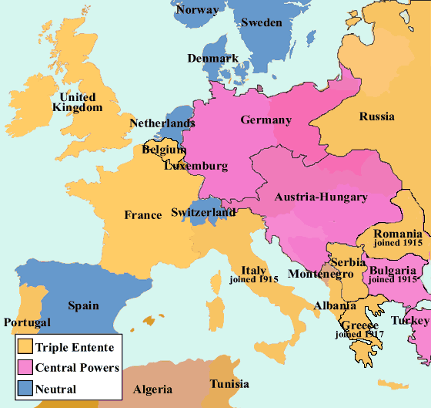
Europe during WW I
The blocs of Powers in WWI

Slide 9
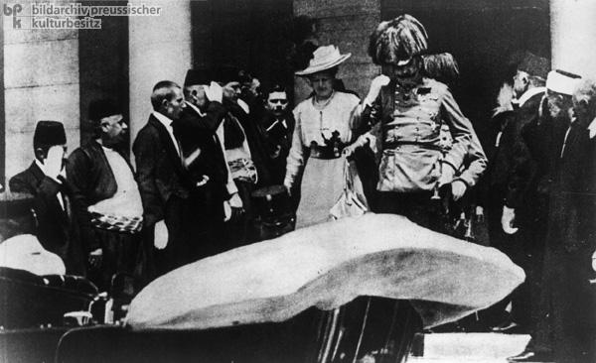
Central Europe and WW I
The pretext for starting the war was the assassination of Archduke Franz Ferdinand of Austria in Sarajevo on June 28, 1914
July 28, 1918 – Austria-Hungary declared the war on Serbia

Slide 10
The targets
Germany – the most agresive, wanted new colonies and wanted to expand to the Middle East (Berlin-Baghdad railroad), also wanted to rule in the Central, Eastern and South-East Europe (with the help of Austria-Hungary), Germany also wanted some areas in France and Belgium
Austria-Hungary – wanted to expand into the Balkan Peninsula and defeat the Kingdom of Serbia, which was independent, Serbia was the enemy for A-H also becauce of Bosnia and Herzegovina
France – wanted to get back Alsace and Loraine from Germany + keep its colonial domains
Russia – wanted Galicia (which was Austro-Hungarian province in those times), Silesia, and some parts of Balkan Peninsula, especially around the straits between Asia and Europe - Bosphorus and Dardanelles
Serbia – wanted to keep its independence and to form the Balkan federation – with Croats, Slovenes and Serbs living in Austria and Hungary
Great Britain – wanted to keep its colonies and exclude Germany from world trade, stop its expansion to the Middle East
USA – wanted to defend democracy in the world and the principle of self-determination of the nations (Woodrow Wilson)

Slide 11
Four phases of the war:
August – December 1914 – offensive operations
1915–1916 – trench warfare
1917–1918 – the era of total exhaustion
March 1918 –November 1918 – supremacy of Allied Powers (USA entered the war in April 1917)

Slide 12
Four main fronts
Balkan front (Balkan Peninsula, firstly in Serbia, then in Greece)
Western front (against France)
Eastern front (against Russia)
Italian front
Also naval war (in the Pacific Ocean – Japan + Great Britain against Germany, in the Nothern Sea – Great Britain against Germany)
Warfare in the colonies

Slide 13
Balkan Front
Austrian army was not succesful in Serbia
September 1915 – Bulgaria entered the war
During October and November 1915 German-Austrian and Bulgarian troops occupied Serbia
Spring 1915 – the Allied Powers prepared the operation in Gallipoli against Turkey, British troops under the command of Winston Churchill, but the operation was not successful
Then in 1916 the Macedonian Front in Greece was opened
The Bulgarians were defeated in September 1918

Slide 14
Western Front
The Germans attacked France according to the so called Schlieffen Plan - designed to attack France quickly through neutral Belgium
Great Britain declared war on Germany because of breaking Belgic neutrality
The German troops were stopped at the First Battle of Marne in September 1914 – the offensive war changed into the trench warfare
March 1915 – the second Battle of Ypres – the Germans used chlorine gas – 15 thousands of men were poisoned
From February till September 1916 – bloody battle of Verdun – 600 thousands of casualties,
From July till November 1916 the great battle of the Somme - totally 1 million casualties during the whole battle, the new British invention was used – the tanks

Slide 15
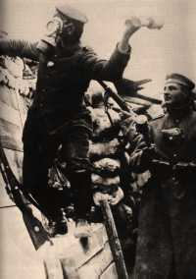
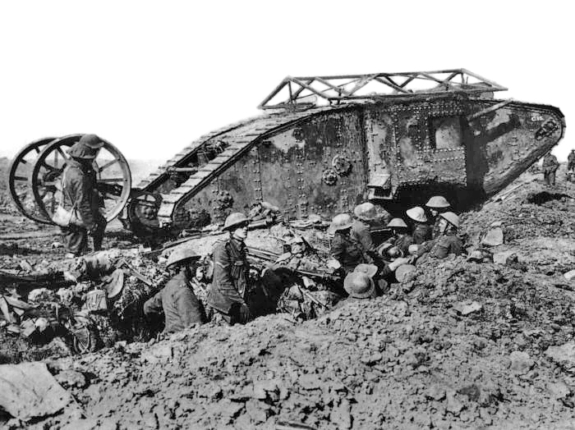
Western Front
The Second Battle of Ypres
The Battle of the Somme

Slide 16
Eastern Front
In the east, Russia attacked East Prussia but was defeated by German army at the series of battles colectively known as the Battle of Tannenberg in August 1914
Already in 1914 – the Czech Company in Russian Army – Legions (originally – the Czechs living in Russia, prisoners of war, volunteers)
summer 1916 – so called Brusilov offensive
1917 – the Czechoslovak Corps in Russia – from 38,000 to 70,000 of men
The Russians were more succesful against Austria-Hungary in Galicia (today – western Ukraine)
Russia occupied parts of Galicia and Bukovina
July 1917 – so called Kerensky offensive – the Battle of Zborov (Galicia) – Czechoslovak Legions won over the Austria-Hungary, the offensive was unsuccesfull for Russians
After the Russian Revolutions the Czechoslovak Legions were fighting against bolsheviks

Slide 17
Italian Front
Italy entered the war in April 1915 – the Allied Powers promised to Italy Istria with Trieste, Dalmacia and Trentino (Austro-Hungarian provinces), so Italy declared war on Austria-Hungary and later also on Germany
But the Italians were not very succesful, their offensives along the Isonzo River were repelled by the Austro-Hungarians
1917 – the Battle of Caporetto – Italian troops were defeated by Austro-Hungarian army and the front line was broken through, usage of poison gas
During 1916 the front stabilized at the Piave River till 1918 – June 1918 – the Battle of the Piave River – participation of Czechoslovak Legions
The Austro-Hungarians were defeated in October – the Battle of Vittorio Veneto – participation of Czechoslovak Legions again

Slide 18
The Final Period of the War
After the Russian revolutions in 1917 Russia concluded separate peace with Germany in Brest Litevski in March 1918
General exhaustion – of sources, armies, people in real (lack of labour power – participation of women)
April 1917 – USA declared war on Germany – originally USA persued the politics of non-interventions, but German submarines several times attacked merchant ships and civil ships with American passengers
The United States were never formally a member of the Allies but became a self-styled "Associated Power"
American troops came to Europe and after the great offensive of Allied Powers in summer 1918 the Central Powers collapsed very quickly
On November 3, 1918 Austria–Hungary sent a flag of truce to ask for an Armistice and the armistice with Austira was signed in Vila Giusti near Padua
On November 11, 1918– an armistice with Germany signed in railroad carriage near Compiègne
At 11 a.m. on November 11, 1918 a ceasefire came into effect

Slide 19
The Results of the WWI
Casualties:
10 million of soldiers died
7 million of civilians died
The map of Europe has changed:
dissolution of four monarchies (Russia, Austria-Hungary, German Empire and Ottoman Empire)
after dissolution of Austria-Hungary: constitution of 5 new states (Austrian Republic, Czechoslovakia, Hungary, Poland, Kingdom of Serbs, Croats and Slovenes)
Latvia, Lithuania and Estonia was established, independent and unified Poland was renewed
http://www.the-map-as-history.com/demos/tome03/index.php
Economic changes:
Development of industry (iron and steel, textiles, etc.) and technologies(armament industry, automobiles, aircrafts …)
Firstly the in many countries the war prosperity, later economic depresse
Social changes:
Social radicalism – rise of totalitarism, revaschism etc.
Social status of women has changed(sufrage)
Many veterans – problems with reintegration

Slide 20
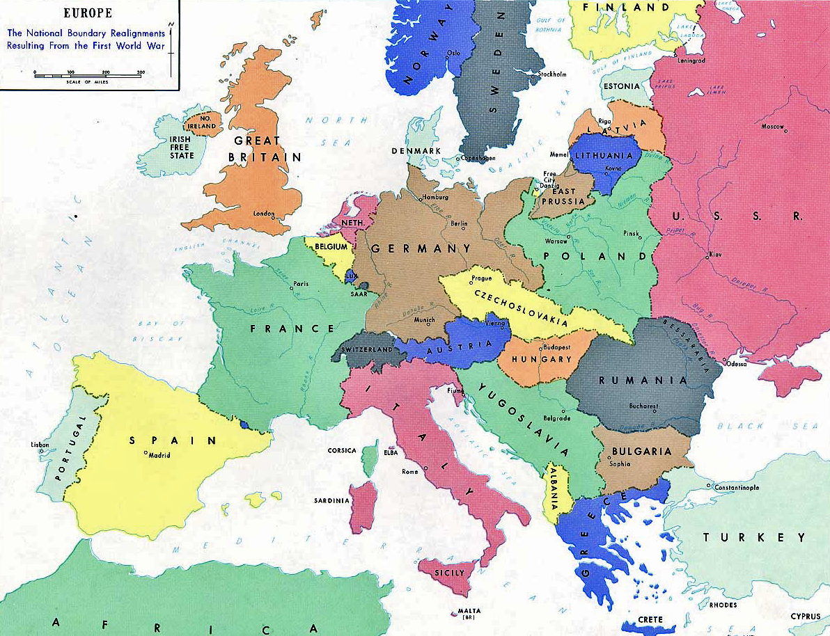
Results of WWI

Slide 21
Paris Peace Conference
The meeting of the Allied victors following the end of World War I – the aim was to set the peace terms for the defeated Central Powers following the armistices of 1918
It took place in Paris in 1919 and involved diplomats from more than 32 countries and nationalities. They met, discussed various options and developed a series of treaties ("Paris Peace Treaties") for the post-war world
The winning powers – France, Great Britain, USA, Italy, Japan
Other figthing states – Belgium, British dominiums, Poland, Kingdom of Serbs, Croats and Slovenes, Czechoslovakia, Romania, Greece, Portugal and other non-european states
Defeated states – Germany, Austria, Hungary, Turkey, Bulgaria
Russia was not invited to the Paris Peace Conference (bolshevik revolution and civil war in Russia)

Slide 22
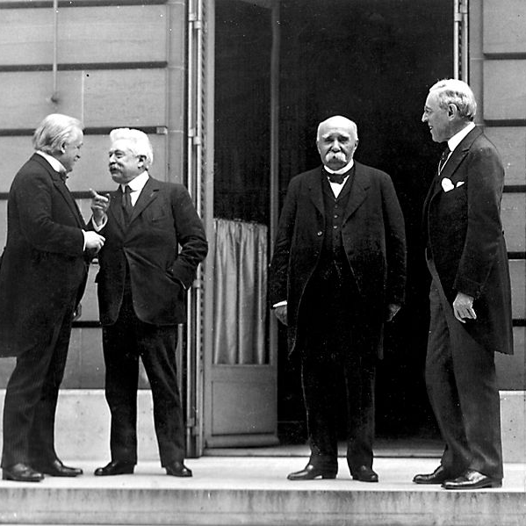
Paris Peace Conference
The Big Four –
David Lloyd Geroge (GB),
Vittorio Orlando (It), George Clemencau (Fr), Woodrow Wilson (US) – from left to right

Slide 23
Peace Treaties
The following treaties were prepared at the Paris Peace Conference:
The Treaty of Versailles, 1919, 28 June 1919, (with the German Empire in Weimar Republic form)
The Treaty of Saint-Germain, 10 September 1919, (with Austria)
The Treaty of Neuilly, 27 November 1919, (with Bulgaria)
The Treaty of Trianon, 4 June 1920, (with Hungary)
The Treaty of Sèvres, 10 August 1920; subsequently revised by the Treaty of Lausanne, 24 June 1923, (withTurkey)

Slide 24
Central Europe during the Interwar Period

Slide 25
Czech Lands during WW I
The Czech Lands were constituent part of Habsburg monarchy – no effort to destroy the monarchy till 1917/1918
Only a small conspiracy group – The Maffia – cooperation with South Slavs
Emigrants – Tomáš Garrigue Masaryk, Edvard Beneš and Milan Rastislav Štefánik – 1915 – founded The Czechoslovak National Council in Paris
Army in abroad – Legions (France, Italy, Russia) – during 1918 de facto recognized as the allied army
Masaryk travelled around Europe (Geneve, Paris, London), to Russia (summer 1917) and to the USA – looking for the support for the idea of independent Czechoslovak state
January 1918 – The Fourteen Points of the US President Woodrow Wilson – the self-determination of the nations
10th Point: The peoples of Austria-Hungary, whose place among the nations we wish to see safeguarded and assured, should be accorded the freest opportunity to autonomous development.
http://wwi.lib.byu.edu/index.php/President_Wilson%27s_Fourteen_Points
January 1918 – Czech politians in A-H – demand of independence
July 1918 – The Czechoslovak National Comitee in Prague – Karel Kramář
October 1918 – the Emperor Charles I (1916–1918) offered the federalisation of Habsburg Monarchy but its nations refused it

Slide 26
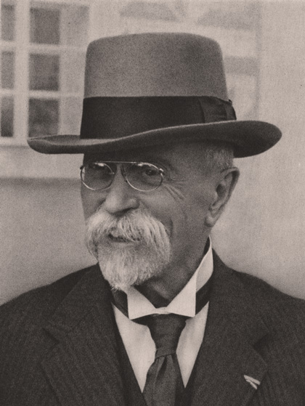
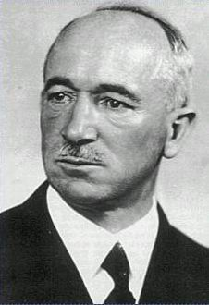
czechoslovakia
Tomaš Garrigue Masaryk
Edvard Beneš

Slide 27
czechoslovakia
the First Czechoslovak republic was proclaimed on October 28, 1918 in Prague
consisted of: Bohemia, Moravia, Silesia, Slovakia and Carpathian Ruthenia
The first Prime Minister – Karel Kramář
1920 – the constitution - plural parliament democracy
in 1920 – Tomas Garrigue Masaryk (1850–1937) was elected the first President (reelected in 1925 and 1929, served till 1935), he was a philosopher and politician, very influential personality, his wife was American – Charlotte Garrigue, their son Jan Masaryk served later as Czechoslovak Foreign Minister
most important and most influential political party - Republican Party of Agricultural and Smallholder People - Peasant party, they ussually had a Prime Minister – Antonín Švehla in 1920s, Jan Malypetr and Milan Hodža in 1930s

Slide 28
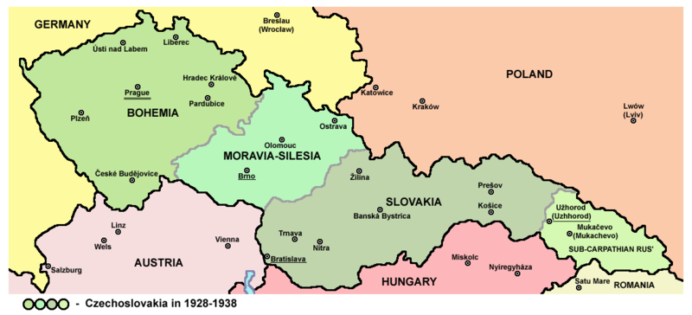
czechoslovakia
The first Czechoslovak republic consisted of: Bohemia, Moravia, Silesia, Slovakia and Carpathian Ruthenia (Sub-Carpathian Rus)

Slide 29
czechoslovakia
foreign policy – headed by Minister Edvard Beneš from 1918 to 1935 – one of the most important European diplomats during the interwar period, in 1936 he was elected second President of Czechoslovakia
1921 – the Little Entente was formed – an alliance of Czechoslovakia, Kingdom of Serbs, Croats and Slovenes and Romania – against Hungary and its revanchism and against restoration of Habsburgs, Little Entente was supported by France (1924 – Czechoslovak-French Agreement)
the Little Entente was an idea of Czechoslovak Foreign Minister Edvard Beneš
since 1925 – economic growth, cultural development
the great depression since 1930
since 1933 – Czechoslovakia was threatened by Nazi Germany
Border fortification

Slide 30
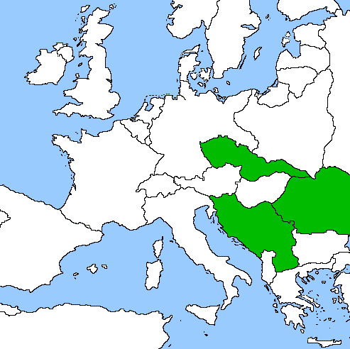
Little Entente
Czechoslovakia + Yugoslavia + Rumania

Slide 31
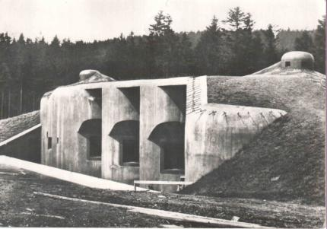
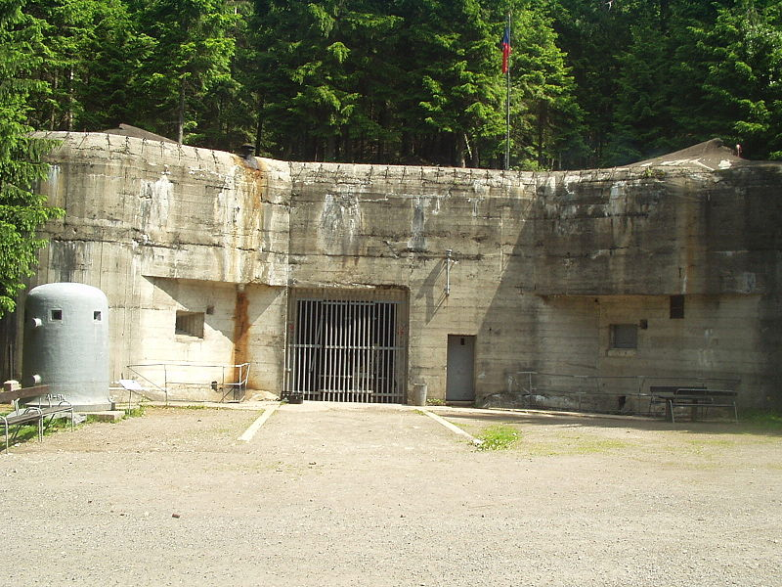
czechoslovakia
Czechoslovak border fortification –
Hanička
http://www.hanicka.cz/
Czechoslovak border fortification –
Bouda
http://www.boudamuseum.com/

Slide 32
Czechoslovakia
National minorities – more than 3 million of ethnic Germans were living in Bohemian lands, they were called Sudeten Germans
The German minority living in Sudetenland demanded autonomy from the Czech government, claiming they were suppressed and repressed by the Czech government
In the 1935 Parliamentary elections, the newly founded Sudeten German Party under leadership of Konrad Henlein, financed with Nazi money, won an upset victory, securing over 2/3 of the Sudeten German vote, which worsened the diplomatic relations between the Germans and the Czechs
Since 1937 – isolation of Czechoslovakia in internatioanl polititics
Policy of appeasement – the Great powers did not want to risk world peace for Czachoslovakia
1938 - this policy resulted in Munich Agreement

Slide 33
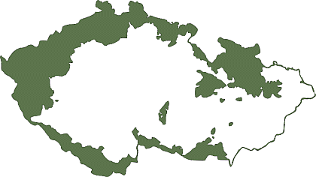
czechoslovakia
Sudetenland – the areas inhabited by Germans in Bohemia, Moravia and Silesia

Slide 34
Czechoslovakia
Readings:
TUMA, Oldrich – JINDRA, Jiri (eds.): Czechoslovakia and Romania in the Versailles System. Prague 2006.
LUKES, Igor: Czechoslovakia Between Stalin and Hitler: The Diplomacy of Edvard Beneš in the 1930s. New York1996.
LUKES, Igor – GOLSTEIN, Erich (eds.): The Munich Crisis, 1938: Prelude to WWII. London 1999.

Slide 35
Germany
strong revolutionary wave
in Bavaria – Bavarian Soviet Republic was proclaimed in October, defeated in April 1919
1919 – the first elections
1919 – 1933 – Weimar Republic, parliamentary republic, federation of 16 states
the first President – Friedrich Ebert (Social Democratic Party)
serious problems – economical crisis, reparations, restrictions of the area, lost of the colonies, restrictions of army, navy and air force
March 1920 – right-wing monarchistic Kapp Putsch
1923 – the new government – Prime Minister (Chancellor) Gustav Stresemann – stabilization of Golden mark, succesful foreign policy
1923 – suppression of Hitler-Ludendorff Putsch in Munich, Hitler was arrested and wrote his programme book Mein Kampf, his political party NSDAP was banned
1925 – the second President became Paul von Hindenburg

Slide 36
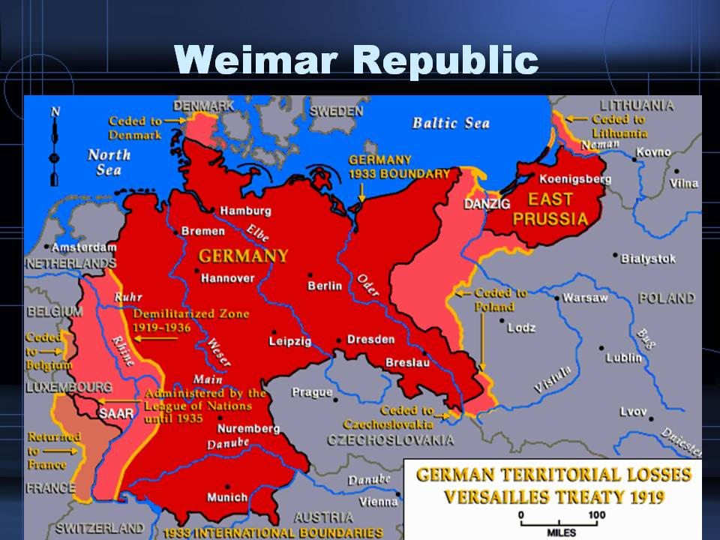
Germany

Slide 37
Germany
since 1929 – Great Depression – in Germany very serious effects (1932 – unemployment was 44,5 %), the growth of extreme nationalism and revanchism
1932 – NSDAP won the elections, 1933 – Adolf Hitler became a Chancellor
1934 – Hitler became a Führer – the head of the state
1935 – Nüremberg laws – anti-Semitism, the Jews excluded from political, economical and public life, had to wear a yellow star
1935 – Germany introduced general military service
1936 – Germany occupied de-militarized zone in Rheinland
both were breaching of Versailles Peace Treaty and of Rhineland Pact but only formal prostest of great powers
1936 – pact with Italy – Berlin-Rome Axis
1936 – Anti-Comimmntern Pact – with Japan
1938, November 9–10 – Crystal Night – great pogrom against Jews

Slide 38
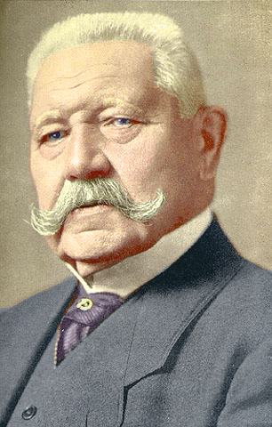
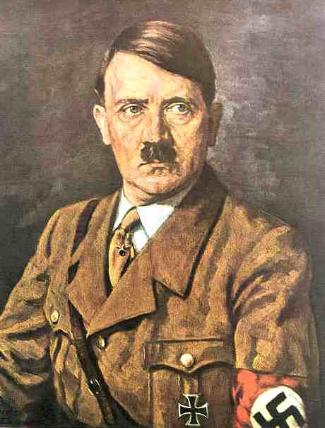
Germany
Paul von Hindenburg
Adolf Hitler

Slide 39
Germany
Readings:
Kaes, Anton – Jay, Martin – Dimendberg, Edward, (eds.): The Weimar Republic sourcebook. Berkeley: University of California Press, 1994.
http://books.google.cz/books?id=J4A1gt4-VCsC&printsec=frontcover&hl=cs&source=gbs_ViewAPI&redir_esc=y#v=onepage&q&f=false

Slide 40
Austria
1919–1934 – the Republic of Austria, first Chacellor Ignaz Siepel, Austria's government was dominated by the Christian Social Party
the country was unstable, severe economical consequences of the war
many paramilitary forces had been formed during the early 1920s - the clash between right-wing and left-wing paramilitary forces is known as July Revolt of 1927
1932 – authoritarian regime of Chancellor Engelbert Dollfuss, austrofascism, Dollfuss was assassinated by Nazi agent who attempted coup d'état in 1934 – July Putch
New Chancellor – Kurt Schuschnigg – an effort to keep Austria´s independence
1938 – Anschluss – March 11 – German troops crossed Austrian frontiers and Austria was occupied by Germany

Slide 41
Hungary
The official proclamation of democratic republic on November 16, 1918, Mihály Károlyi was named as the republic's Prime Minister
the area of Hungary was of only one third of pre-war Hungary – dissatisfaction, attpemts to restore the Great Hungary
the rapid rise of power of Hungarian Communist Party, the Hungarian Soviet Republic was proclaimed on March 21, 1919 – an attpemt to restore the Great Hungary, the head of this republic was Béla Kun, Hungarian communists wanted to connect with Soviet Russia
Czechoslovakia and Rumania were threatened by Hungarian demands → their armies attacked Hungary and the Hungarian Soviet Republic was defeated
the new Government – fascist party of Admiral Miklós Horthy
1920 – monarchy was restored in Hungary – Horthy regent 1921–1931 – the Prime Minister was István Bethlen (till 1931)

Slide 42
Hungary
the former Austrian Emperor, Charles IV, unsuccessfully attempted to retake Hungary's throne in March 1921
Hungary's signing of the Treaty of Trianon on June 4, 1920, ratified the country's dismemberment, limited the size of its armed forces, and required reparations payments
1920s – the white terror - led to the imprisonment, torture, and execution without trial of communists, socialists, Jews, leftist intellectuals, sympathizers with the Károlyi and Kun regimes, and others who threatened the traditional Hungarian political order that the officers sought to reestablish
1932–1936 – the Prime Minister was Guyla Gömbös - the radical right's ascendancy in Hungarian politics
1939 – Arrow Cross Party (Hungarian Equivalent of Nazi Party) won the elections
1940 – Hungary joined the Tripartite Pact (Germany, Italy and Japan)

Slide 43
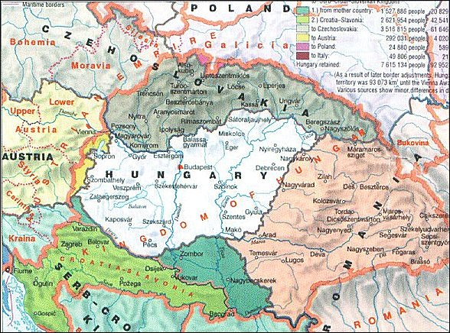
Hungary

Slide 44
Poland
The Republic of Poland reestablished in 1918
Several regional conflicts: 1918 – 1919 – Polish – Ukrainian War and border conflicts with Czechoslovakia - Juanuary 1919 – Seven day war broke out
New demarcation line – the western part of the disputed territory was given to Czechoslovakia while Poland received the eastern part
1919 – 1921 – Polish-Soviet War – Poles attacked Russia – they wanted to use Russian civil war to ensure their eastern borders, but later Soviet counteroffensive – they wanted to establish Soviet Republic in Poland
August 1920 – the battle of Warsaw - the Soviet troops were defeated
the Peace Treaty of Riga – Poland got parts of Belarus and Ukraine
1922 – annexation of Vilnius Region from Lithuania

Slide 45
Poland
1926 – the May Coup d´État – Marshall Jozef Piłsudski, he became most influential politician in Poland and became its de facto a dictator till his death in 1935
1932 – non-agression pact with Soviet Union
October 1938: annexation of Zaolzie, Górna Orawa, Jaworzyna from Czechoslovakia
March 31, 1939: military guarantees from United Kingdom and France
August 23, 1939: non-aggression pact between Soviet Union and Germany: Ribbentrop-Molotow Pact with a secret military alliance protocol targeting Poland
September 1 – October 6, 1939: Invasion of Poland

Slide 46
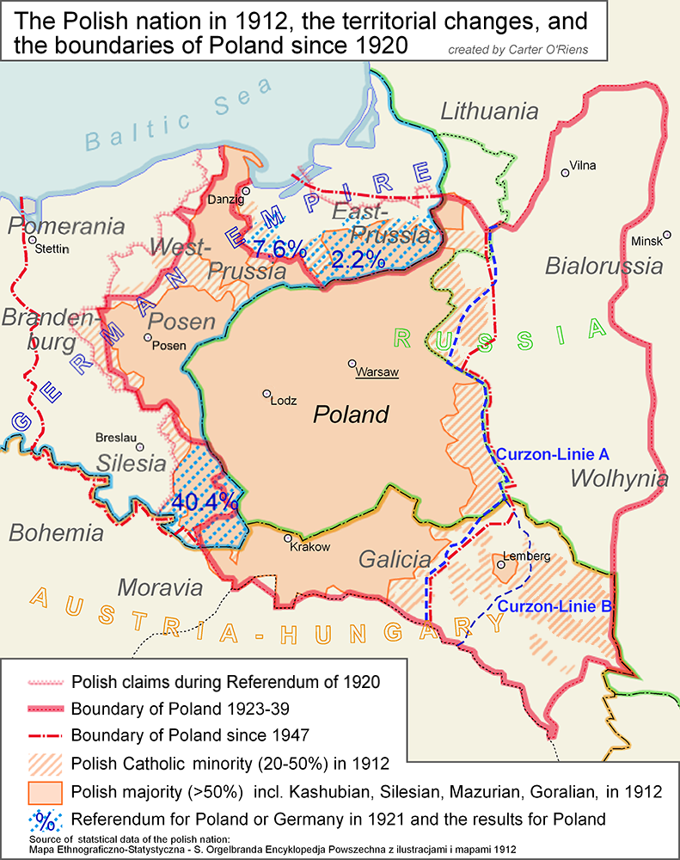
poland

