Slide 1
Dynamics in multicultural classes

Slide 2
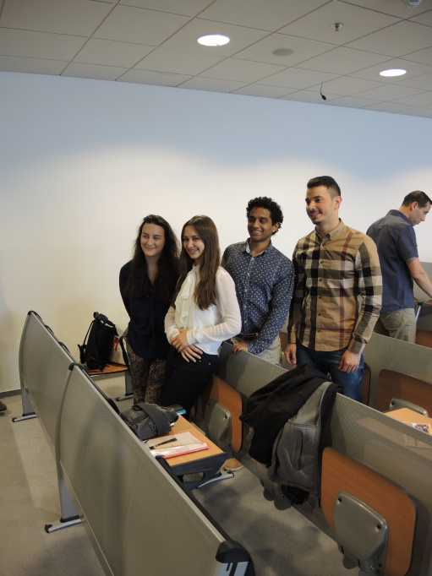
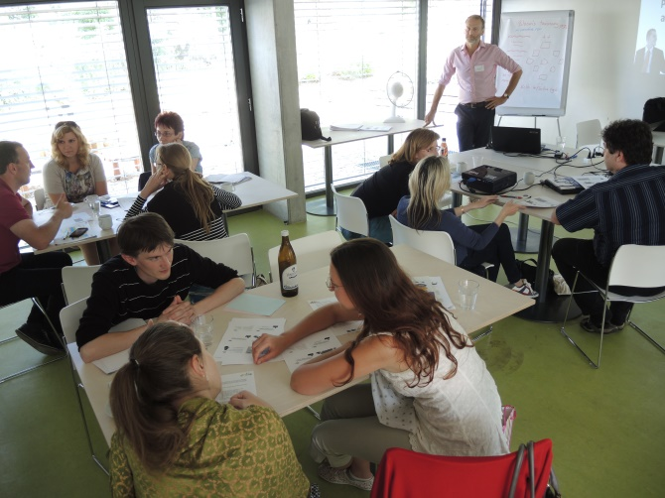
agenda
before meeting a student
thinking as a student
tools

Slide 3
…before meeting a student

Slide 4
…meeting the student

Slide 5
cultures

Slide 6
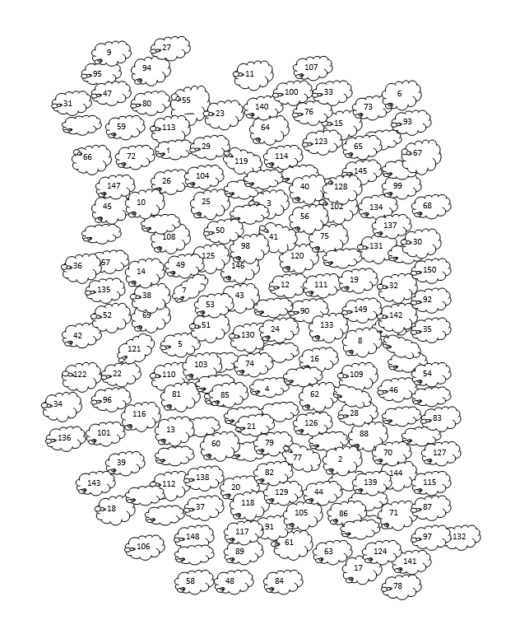
…ovejas

Slide 8
… reactions…
One of the world leading figures is the Pope. (Chinese)

Slide 9
… reactions…
One of the world leading figures is the Pope. (Chinese)
What is the Pope?

Slide 10
… reactions…
One of the world leading figures is the Pope. (Chinese)
What is the Pope?
Are you planning the trip in winter? (Argentinean)

Slide 11
… reactions…
One of the world leading figures is the Pope. (Chinese)
What is the Pope?
Are you planning the trip in winter? (Argentinean)
Yes, I´ll arrive in August.

Slide 12
… reactions…
One of the world leading figures is the Pope. (Chinese)
What is the Pope?
Are you planning the trip in winter? (Argentinean)
Yes, I´ll arrive in August.
How old are you? (Korean)

Slide 13
… reactions…
One of the world leading figures is the Pope. (Chinese)
What is the Pope?
Are you planning the trip in winter? (Argentinean)
Yes, I´ll arrive in August.
How old are you? (Korean)
Do you mean Korean or international age?

Slide 14
… reactions…
“Academic 15 minutes” means
a) it is tolerated if a teacher appears in class 15 minutes late.
b) it is tolerated if a student appears in class 15 minutes late.
c) the class has to start 15 minutes later than what is written in the official timetables.
d) it is just a saying that has no effect to the class management.

Slide 15
… reactions…
When a student comes after a session asking for help with the subject matter.
a) Always, the teacher has to deal with that issue at that moment of the student request.
b) The teacher should never deal with that issue in the time of a break. Instead, they should inform the student about their consultation hours and instruct them to come for that time to their office.
c) It depends on the student´s request, on the situation, on how busy the teacher is at the moment….

Slide 16
… it´s all about cricket…
Most people are really surprised the first time they try a cricket.
Cricket can symbolize good luck and protection.
Cricket often appears in literature.

Slide 17
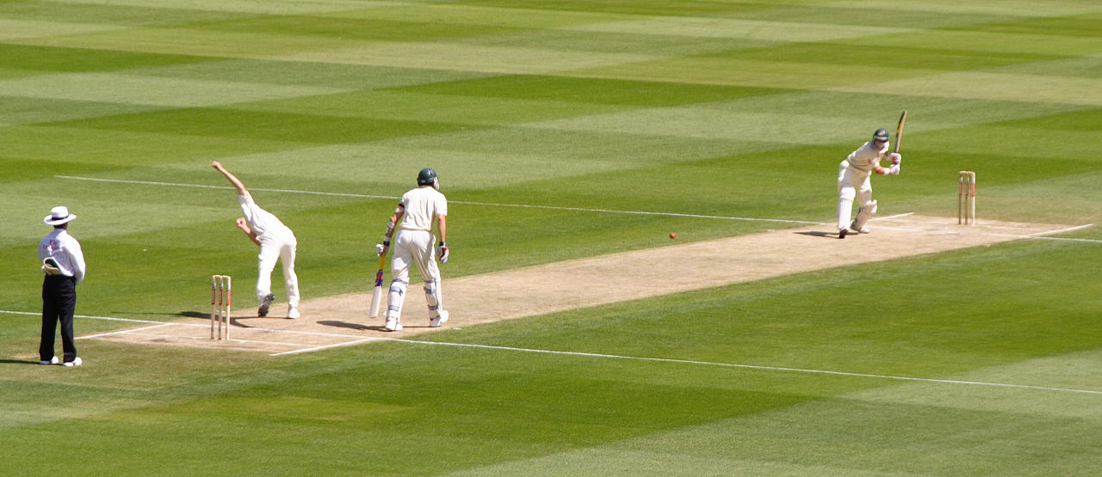

Slide 18
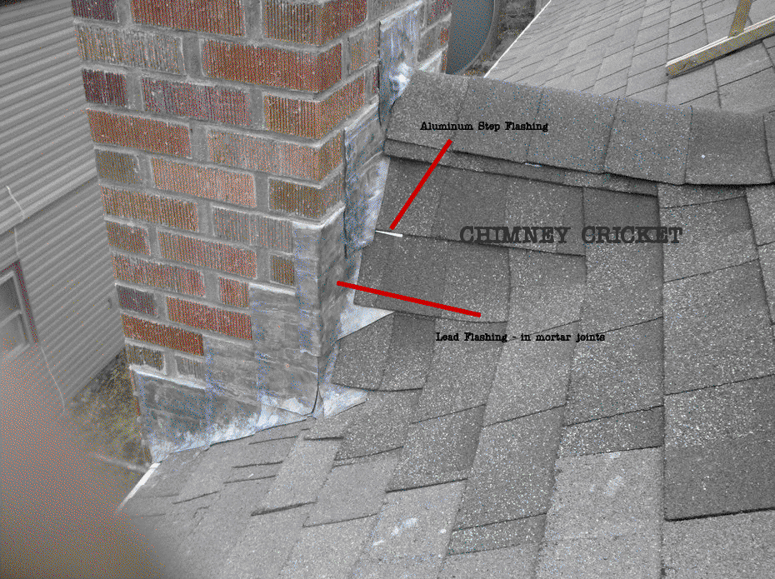

Slide 19
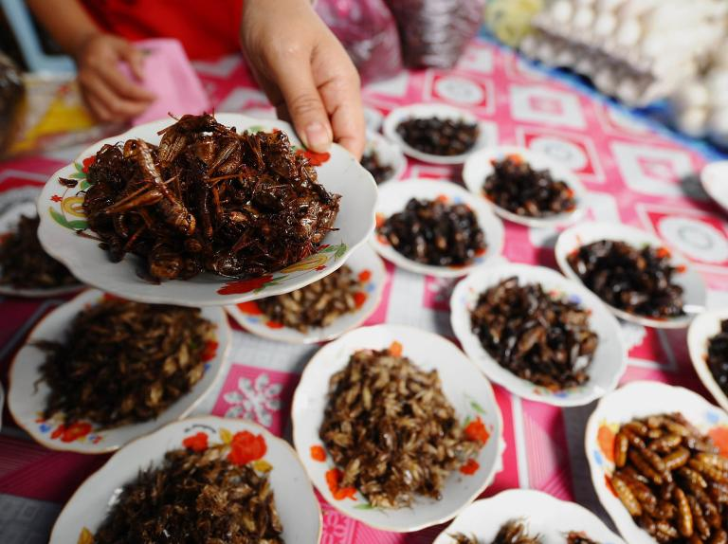

Slide 20
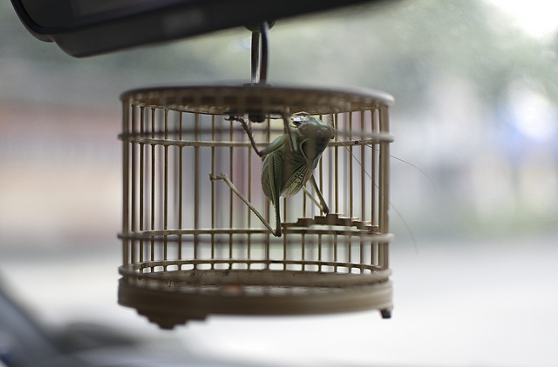
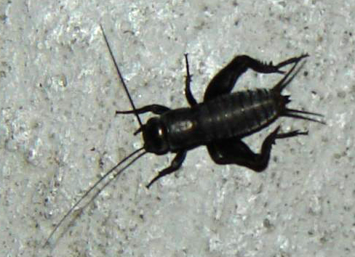

Slide 21
Notes:
21

Slide 22
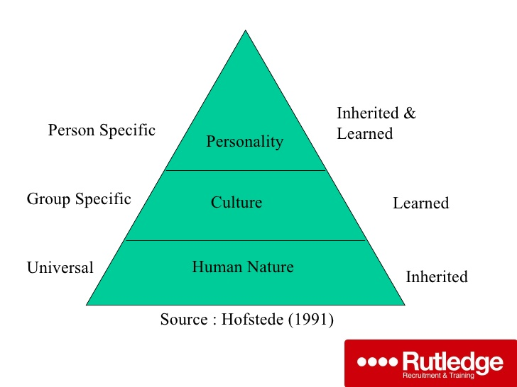

Slide 23
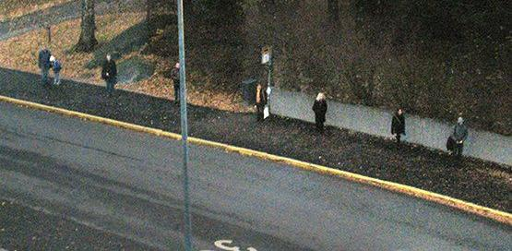
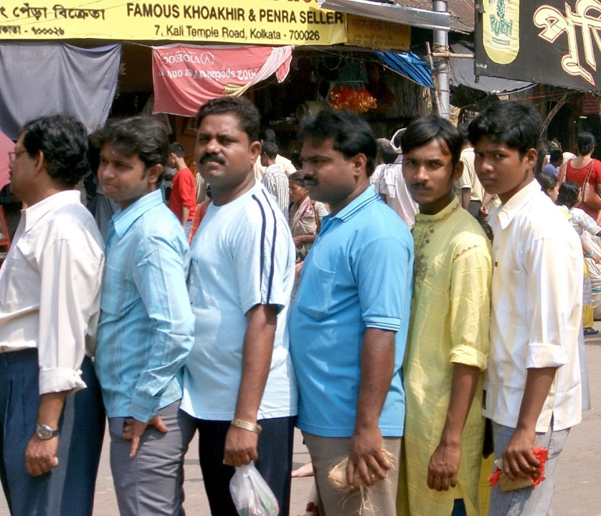

Slide 24
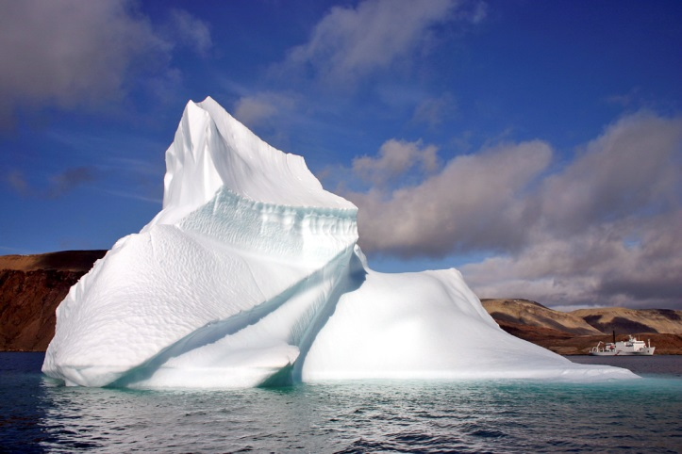
Notes:
24
24

Slide 25
Notes:
25
25

Slide 26
Notes:
26
26

Slide 27
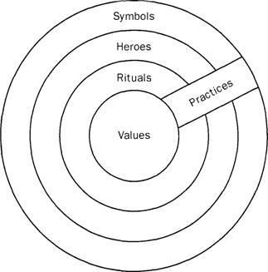

Slide 28
…theories and tools

Slide 29
Culture: Two Paradigms
Essentialist view
Non-essentialist view

Slide 30
Culture: Two Paradigms
Essentialist view
Non-essentialist view
Adrian Holliday’s Small Cultures
This suggests that ‘culture’ is a movable concept used by different people at different times to suit purposes of identity, politics and science.

Slide 31
Culture: Two Paradigms
The essentialist view (Geert Hofstede)
This suggests that ‘culture’ is a concrete social phenomenon which represents the essential character of a particular nation.

Slide 32
sources and links
Rupert Beinhauer (2013): Diversity Management in Education, seminar, https://impact.cjv.muni.cz/publikace-a-vystupy/materialy/ (Podpora jazykových soft-skills dovedností u akademických pracovníků (klíčová aktivita 5)
Janice de Haaff (2013): Intercultural Teaching, seminar, https://impact.cjv.muni.cz/publikace-a-vystupy/materialy/ (Podpora jazykových soft-skills dovedností u akademických pracovníků (klíčová aktivita 5)
Geert Hofstede (1991). Cultures and Organisations: software of the mind. Maidenhead: McGraw-Hill
Geert Hofstede : https://www.geert-hofstede.com/cultural-dimensions.html
Adrian Holliday (1999): Small cultures, Applied Linguistics 20/2, http://adrianholliday.com/wp-content/uploads/2016/06/holliday-99-smal-cultures.pdf
Pellegrino Riccardi (2014): Cross cultural communication, TEDxBergen, https://www.youtube.com/watch?v=YMyofREc5Jk
Notes:
32

