Slide 1
Brainstorm qualities of good writing!

Slide 2
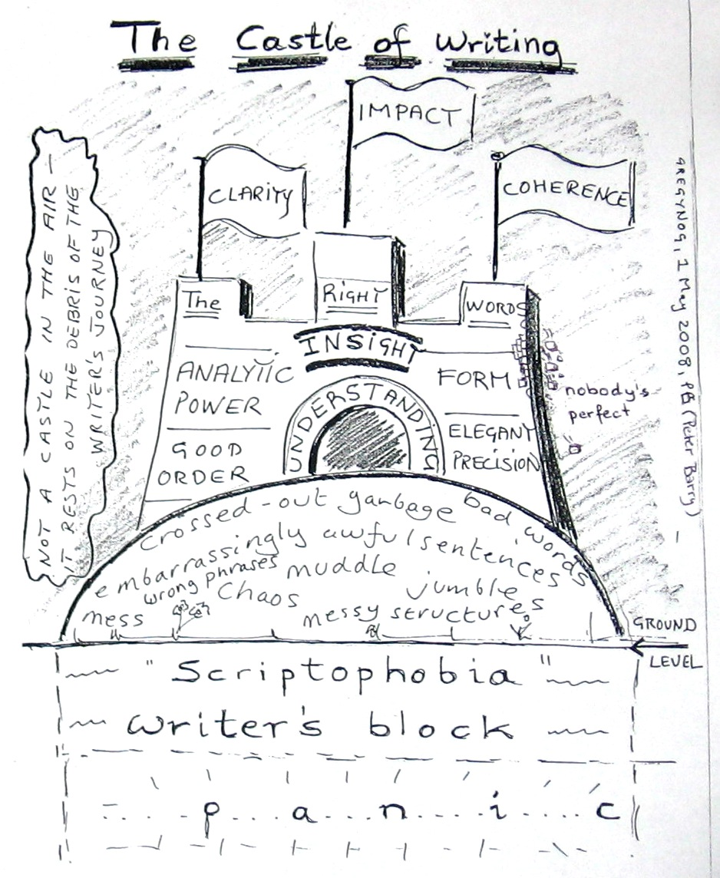

Slide 3
Peer feedback

Slide 4
Peer feedback
Now check your feedback against the qualities we brainstormed at the beginning of the session!

Slide 5
