Slide 1
Revolutions of 1989 in Central Europe
Richard Q. Turcsanyi

Slide 2
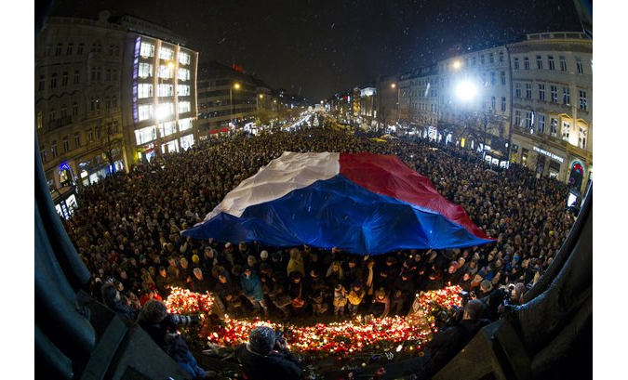
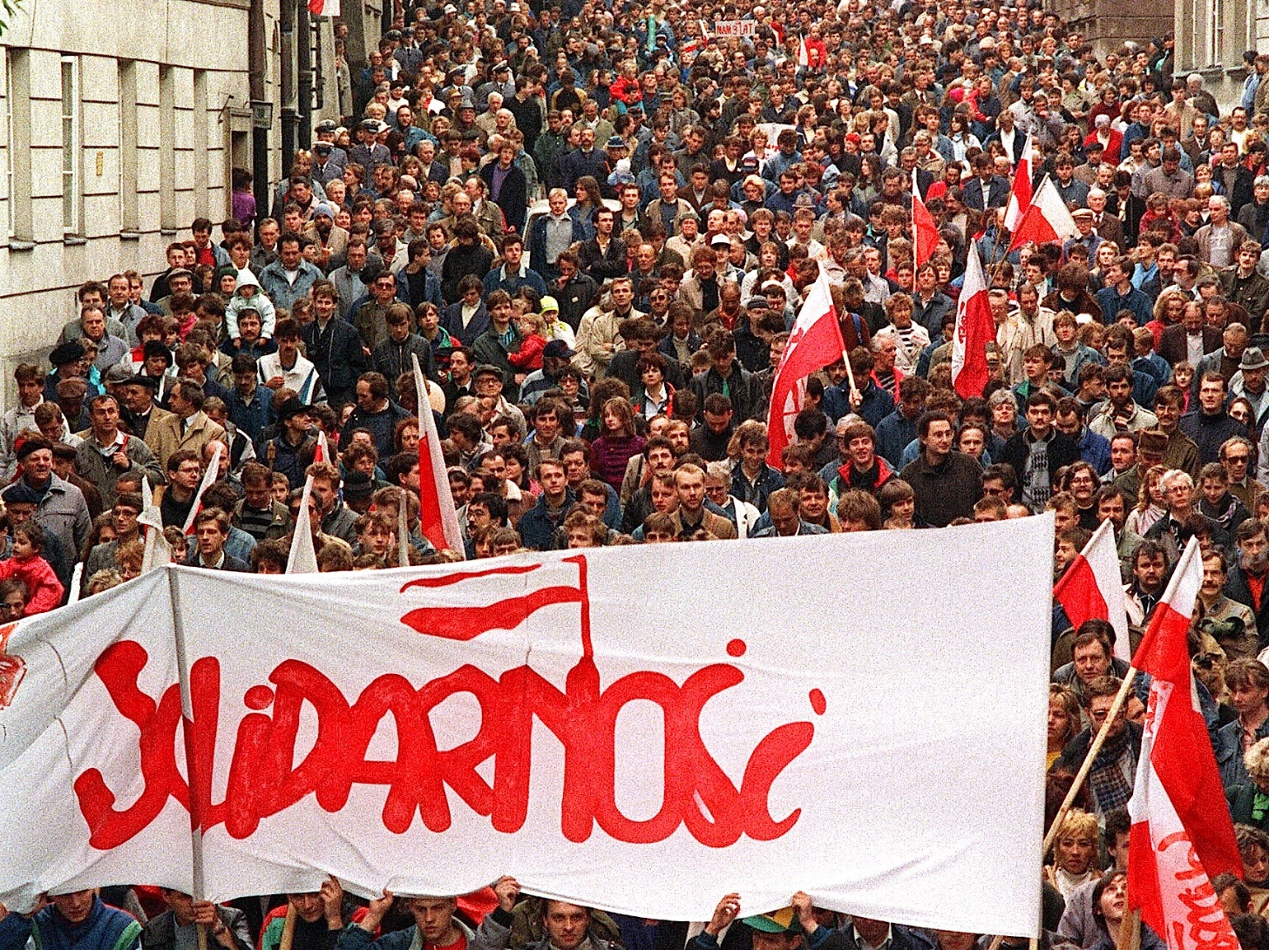
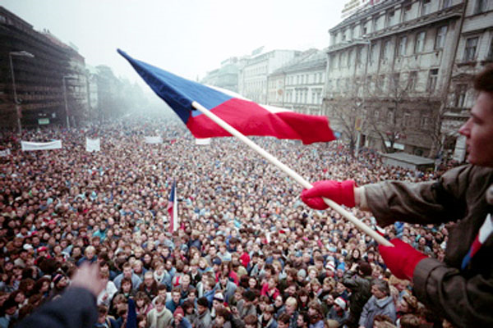
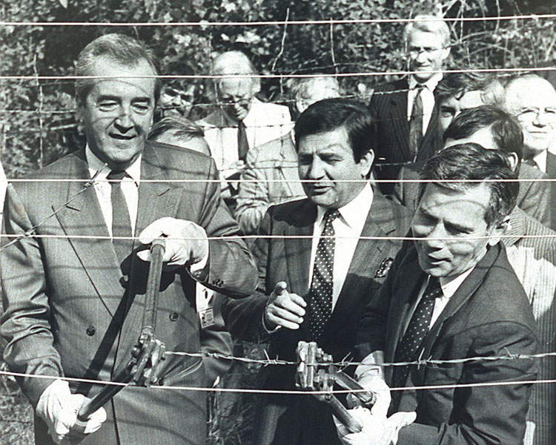

Slide 3
1989 revolutions in Central Europe
1980 Solidarity movement
1981-1983 Martial Law in Poland
1988 Easing of travel restriction in Hungary
1988 (December) Hungarian PM declares market economy the only way forward
1989 (May) destruction of wired border fence in Hungary
1989 (June 4) First semi-democratic elections in Poland
1989 (October) Hungarian Communist party renamed and reformed itself, allowed for multi-party system
1989 (November 9) Fall of Berlin Wall
1989 (November 17) Beginning of Velvet Revolution in Czechoslovakia
Nov 24: Leadership stepped down
Nov 27: General strike for two hours
Nov 28: dismantle of one-party state
Dec 29: Havel elected the president by the parliament
1990 (May) Elections in Hungary
1990 (June) Elections in Czechoslovakia
1991 Elections in Poland

Slide 4
Communism in crisis
Longstanding crisis in Communist block.
General dissatisfaction with the living conditions.
Rotten political system; corruption; gray and black economy.
Withdraw of Soviet support from local communist parties (Gorbachev’s change of foreign policy) and policies of Glasnost and Perestroika.
Rise of nationalism
Reform was discussed inside the communist parties but not the change of the regime as a whole
Dissidents and opposition groups criticized mainly the communist monopoly; liberal democracy was not the first choice; third way – best features of capitalist and socialist economies
HOWEVER, the fall of communism was totally unexpected → most actors unprepared!

Slide 5
Communism in crisis
Poland – massive unsatisfaction with economic conditions, bottom up social movements (Solidarity)
Hungary – easening of the regime in 1980s (Gulash communism), developing contacts with the West, expertimenting, organization of political opposition
Czechoslovakia – general antipathy but no massive movements, only intelectual and cultural elites organized as (peaceful) apolitical dissent

Slide 6
Collapse of Communism
As a reaction to reform ‘initiatives’ in Soviet Union, similar efforts occurred at the end of 1980s in Poland and Hungary.
Solidarity movement in Poland survived the military suppression from 1981and started to demand basic political and civil rights (again).
Followers of reform-oriented Hungarian communist Janos Kadar called for genuine transformation and political liberalization.
The rest of the region stood more or less still (Czechoslovakia, Romania, Bulgaria, Albania, East Germany).
The process surprisingly peaceful (exceptions of Romania and then Yugoslavia)

Slide 7
Poland I.
A wave of strikes hit Poland in April, May and August 1988.
Workers demanded the re-legalisation of Solidarity.
Number of factories and mines went on strike. The country was paralyzed.
Communist leaders finally agreed to meet Lech Walesa and Solidarity to ease the situation.
Major breakthrough in January 1989: Communist party supported formal negotiations with Solidarity leading to its future legalisation.

Slide 8
Poland II.
April 1989: signing of Round Table Agreement – legalisation of Solidarity and plans for partly free parliamentary election later that year.
June 1989: Solidarity sensationally won the election. Its candidates got all the allocated seats in Sejm (lower house) and 99 out of 100 seats in Senate (upper house).
Many communist candidates failed to pass the minimum votes threshold required to take the reserved seats.
August 1989: Long time coalition partners (United People's Party and Democratic Party), broke their ties with Communists and announced their support for Solidarity.

Slide 9
Hungary I.
Hungary had achieved some lasting economic reforms and limited political liberalization during the 1980s.
Following the changes, the process was further accelerated in the 1988 and 1989.
January 1989: so-called "democracy package“ was adopted (e.g. freedom of association, assembly, and press; trade union pluralism; new electoral law).
Reinterpretation of history: 1956 rebellion was a popular uprising not a foreign-initiated counterrevolution.

Slide 10
Hungary II.
March 1989: demonstrations during the National Day pushed the regimes to negotiations with non-Communist parties.
April 1989: Round Table talks.
May 1989: Hungary began dismantling its 150 mile long border fence with Austria.
June 1989: rehabilitation of Prime Minister Imre Nagy (hanged for treason; revolution in 1956).
September 1989: New constitution; call for free election.

Slide 11
Czechoslovakia: Velvet Revolution I.
Opposition was not organized; however, galvanized by the events in the neighbourhood (Poland; Hungary; GDR) and worldwide (Tiananmen Square, China).
un-readiness of all actors and strategies
Change: features of pact and reform
liberalization and democratization was parallel

Slide 12
Czechoslovakia: Velvet Revolution II.
The trigger was the student demonstration on November 17, 1989; police violently struck against the peaceful protesters (50th anniversary of the death of a student, Jan Opletal, at the hands of the Nazis).
Rumour: death of student
Students initiated protest strike (later joined by actors and artists)
November 19, 1989 – founded Civic forum (broad civic movement); Slovakia: Public against violence.
Demonstrations and protests in Prague and other cities all around the country.

Slide 13
Czechoslovakia: Velvet Revolution III.
Call for the step down of communist leaders.
Civic Forum did not envision taking power.
However, no partner for the dialogue; CP was paralyzed (no leadership at all).
CP lost support of its militia; media; satellite parties.
Army was subordinated to CP; did not initiate move on its own (Minister of defense advised to use army in a Chinese Scenario).

Slide 14
Czechoslovakia: Velvet Revolution IV.
First step made by PM of federal government – beginning of talks with CF
CF did not want to govern rather wished legal and constitutional continuity – oversaw the process of change (committees; cancelation of the leading role of CP in the society).
New (transitional) government of ’National understanding’ (formerly15+5; then CP did not have majority and CF nominated its own executives). The main goal: leadership for the country until the first democratic election in 1990.
New president: Vaclav Havel (elected by acclamation)

Slide 15
Important Patterns
Transformation in the CEE belongs to the same historical democratization wave as Latin America and South Europe – the main contextual features were however different.
Most of the regimes belonged to (post)totalitarian branch of non-democratic regimes (LA and Iberia – mostly authoritative regimes).
Economies were predominantly state-controlled (contrast: economic freedoms in Latina America a Iberia).
Ethnic division and multi-national states.

Slide 16
Post-1989 development
1991: Visegred Group first meeting
1992-1993: Dissolution of Czechoslovakia – Velvet Divorce
1994-1998: Slovakia under Meciar (semi-authoritarian period)
1995: Czech Republic joins OECD as the first V4 country (Hungary and Poland 1996, Slovakia 2000)
1997: Czech Republic experiences a financial crisis
1999: Czech Republic, Poland, Hungary enter NATO
2004: V4 enters the EU, Slovakia joins NATO
2007: Slovak GDP grows 10 % annually → „Tatra Tiger“
2009: Slovaka adopts EUR
2012: Robert Fico (Smer) Primer Minister of Slovakia (2nd term)
2010: Viktor Orban Prime Minister of Hungary (2nd term)
2015: Law and Justice wins Polish elections

Slide 17
Questions
Similarities and differences between Poland, Hungary and Czechoslovakia?
Role of Pope in Poland and elsewhere?
Was 1989 a revolution?
What to do with former communists?
Major issues after 1989?

Slide 18
Current issues in the region
Economy
Growth slowed down after 2008
Investments from the Western Europe and the US were withdrawn
Politics
Rise of populism
Corruption
Security
Ukraine crisis and relations with Russia
Energy security

