Slide 1
Political systems and party systems in Central Europe
Richard Q. Turcsanyi

Slide 2
Political systems
Republic vs. Monarchy :-)
Parliamentary vs. Presidential (Semi-presidential) systems
Constitution written or not
Legal system: continental vs. Anglo-Saxon

Slide 3
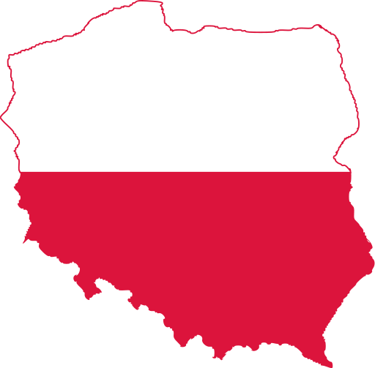
Basics: Political system of Poland
Parliamentary democracy
Sejm (460 deputies); proportional representation (4years).
Senate (100); First-past-the-post voting method, one senator per one constituency (4 years).
President elected by popular vote (5years).
Government: Council of Ministers, led by a prime minister.

Slide 4
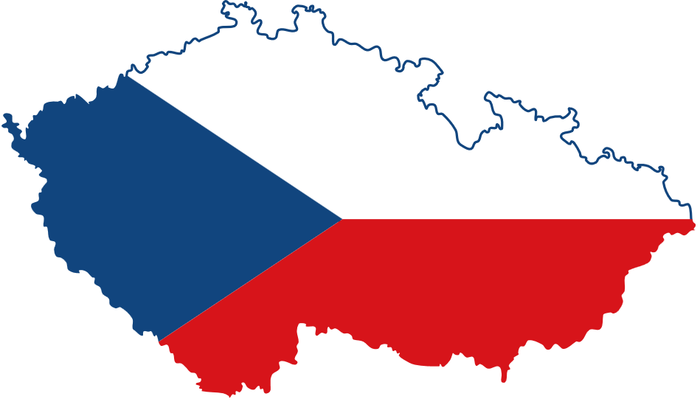
Basics: Political system of the Czech republic
Parliamentary democracy
Chamber of Deputies (200 deputies); proportional representation (4years)
Senate (81); two-round runoff election, one senator per one district (6 years).
President elected by a popular vote (5years).
Government: ministers led by a prime minister.

Slide 5
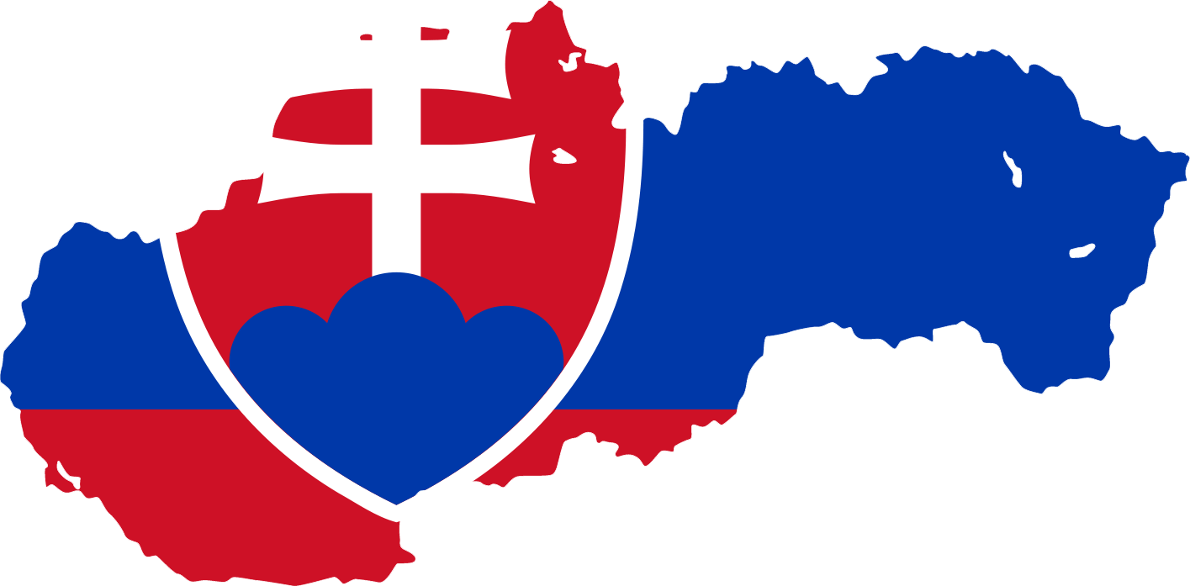
Basics: Political system of Slovakia
Parliamentary democracy
National Council of the Slovak Republic (150 deputies; unicameral); proportional representation (4years).
President elected by popular vote (5years).
Government: ministers led by a prime minister.

Slide 6
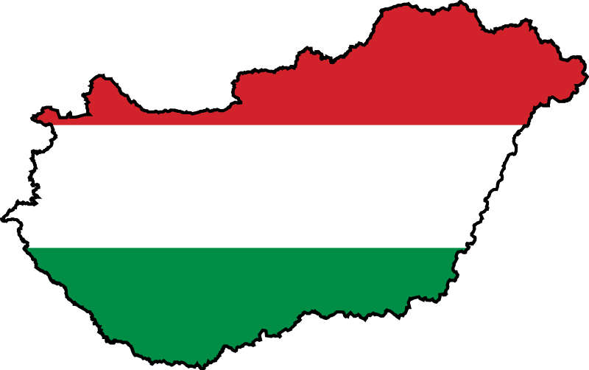
Basics: Political system of Hungary
Parliamentary democracy
National Assembly (199); first-past-the-post election with a single round (4years).
President elected by National Assembly (5years).
Government: ministers led by a prime minister.

Slide 7
Summary
 | Poland | Czech Rep. | Slovakia | Hungary
Parliament | Bicameral | Bicameral | Unicameral | Unicameral
Parliamentary Elections | Proportional | Proportional | Proportional | Majoritarian
President elected | Popular vote | Popular vote | Popular vote | Parliament
Form | Parliamentary democracy | Parliamentary democracy | Parliamentary democracy | Parliamentary democracy

Slide 8
Parliamentary vs. Semi-presidential systems
Direct election of presidents create a problem for executive branch.
Presidents can obstruct governmental politics.
Example: President Zeman (CR) and his personal attitude to Foreign Policy (Russia; China).
Due to shortcomings in constitution president can play his own ‘power game’
  E.g.: formulation in constitution: ‘president appoints prime minister’ – no further obligations

Slide 9
Party politics in Poland I.
Multi-party system
First semi-free election in 1989 (65% for CP; 35% for opposition); domination of Solidarity Movement.
1990: conflict between leaders of Solidarity about ‘thick line after communism’ (Mazowiecky YES Vs. Walesa NO). Split of Solidarity (more than 20 post-solidarity subjects)

Slide 10
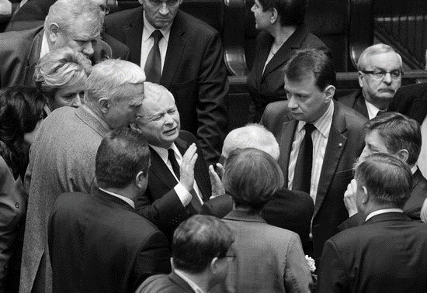

Slide 11
Party politics in Poland II.
Communist party transformed to Social democratic party (still ostracized).
First presidential elections in 1990; 2nd round: Walesa Vs. Tyminski (first signs of populism).
Early 1990s: extreme fractionalization.
  Example: 1991 election – 29 parties in the parliament
Due to extreme fractionalization, the governments were extremely week.
Permanent conflict between president, parliament and government (PM).

Slide 12
Party politics in Poland III.
1990s: situation starts to calm down (tempoarly); moderate tendencies; consolidation of two main political parties(SLD and AWS) and two smaller alternatives (PSL and UW) (left↔right).
2000s: new wave of fragmentation and polarization; rise of populism; old parties lost their support; new political subjects – the most successful Law and Justice.
Strong position of catholic church as conservative power.
Party system is not fully consolidated.

Slide 13
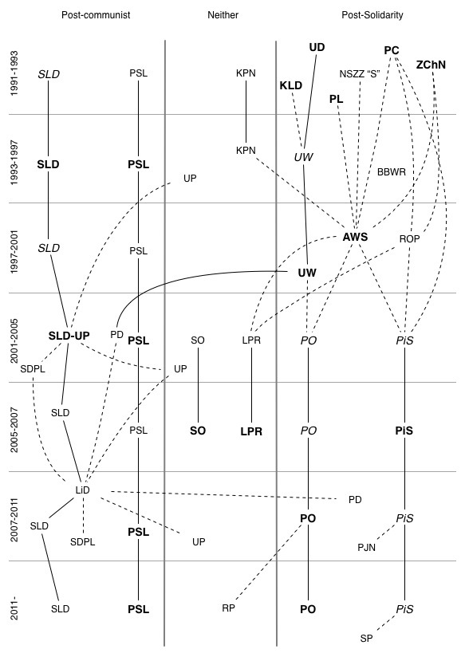
Party system of
Poland 1990-2010

Slide 14
Party politics in the Czech Republic I.
Post-revolutionary period affected by dissolution of Civic Forum (CDP, CM).
Communist party refused to reform.
Political subjects that renewed their tradition from the period of the First Republic (social democrats; national socialists).
Formation of party system that lasted more than a decade.
  Two main parties (CDP, CPSD); few smaller (CDU-CSPP; RP; CDA)

Slide 15
Party politics in the Czech Republic II.
1990s: problematic position of Communist Party. No space for cooperation. Stable support and mandates in the parliament →problem (parliamentary math).
Coalitions often week (problem with majorities) with strong position of small parties.
Big parties wanted change (not necessary fair).
  Coalition agreement
  Reform of electoral system (unsuccessful)
System stabilized and consolidated

Slide 16
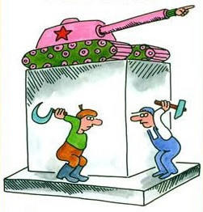
What is your opinion: Is orthodox communist party a threat to democratic regime?

Slide 17
Party politics in the Czech Republic III.
2000s: party system starts to deteriorate; corruption scandals and political crisis.
Old parties has started lost their position.
New populist parties on the stage
The process continues today.
  The main political party in 1990s – CDP is in opposition with significant lost in support. The strongest party (Social democrats) lost big share of its support.
  Main topics of new subjects: anti-corruption agenda, modern approaches, criticism of old elites.
Party system is opened again; we cannot talk about consolidation today.

Slide 18
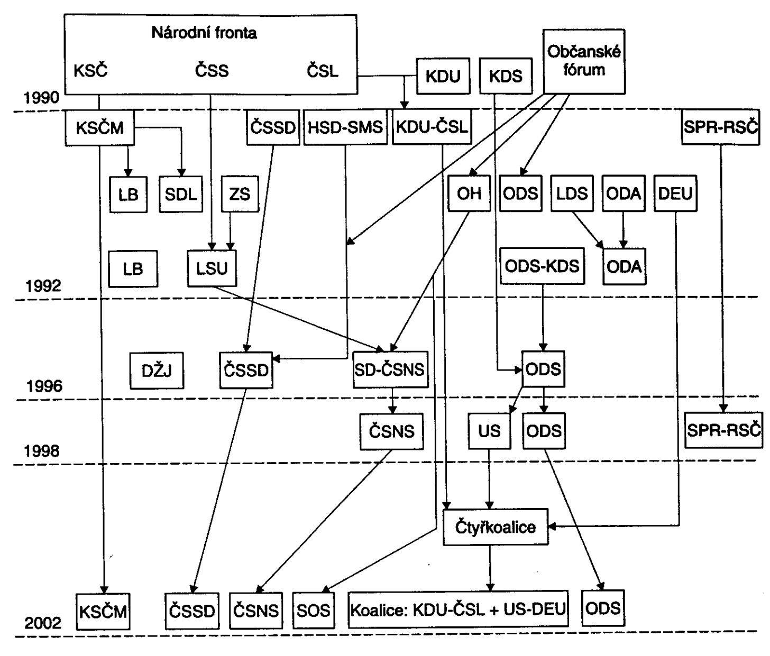
Party System of the Czech Republic 1990-2002

Slide 19
Party politics in Slovakia I.
Consolidation of party system more turbulent.
Similarly to Civic Forum, Public Against Violence (umbrella movement) split.
New political parties organized around issue of Slovak position in the federation or its independence.
Strong position of Vladimir Meciar and his Movement for democratic Slovakia.
Communist party started to reform and later disappear (swallowed by Social democrats).

Slide 20
Party politics in Slovakia II.
1990s: dominance of Vladimir Meciar; MDS created illiberal regime. Governments led by nationalistic and populist agenda.
Opposition parties oppressed (in parliament as well as outside).
Change in 1998 when Meciar won elections but could not form government. All opposition parties joined together in order overthrow the Meciar (reformed communist, Christian party, leftist party, liberal party)

Slide 21
Party politics in Slovakia III
Early 2000s: party system started to consolidate but not without problems.
Number of new political subjects due to splits in established political parties.
Dominant cleavage: left-right; secondary: conservative – liberal
Late 2000s: SMER (Direction) – Social democracy dominates the party system.
Since 2012: Single-party government.

Slide 22
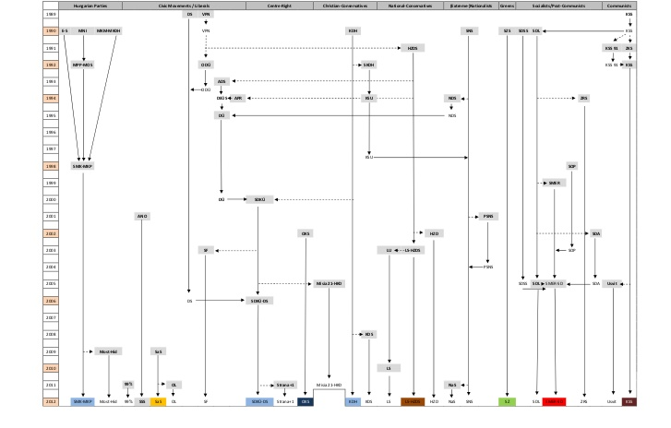
Party system of Slovkia 1990-2010

Slide 23
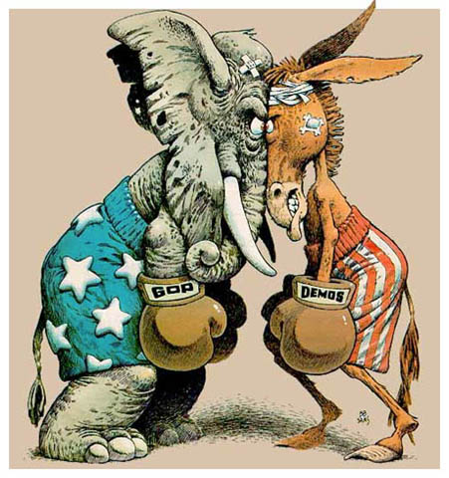
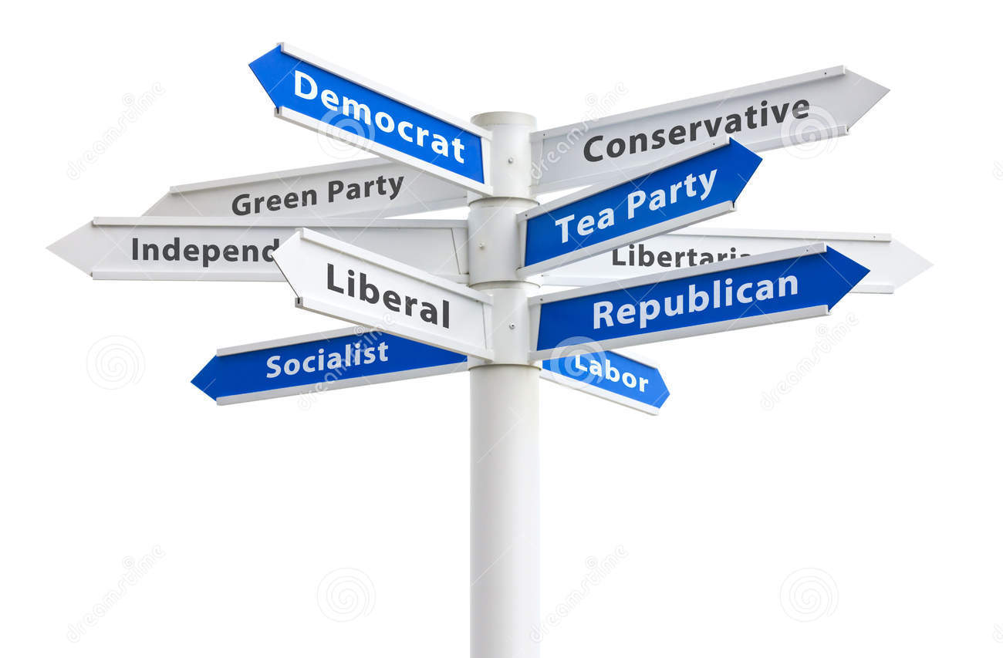
Is it better to have strong political parties (1-3) or smaller parties that better represent the nature of pluralistic society?
VS

Slide 24
Party politics in Hungary I.
After the communist breakdown, number of historical parties re-emerged (e.g. agrarian party).
Communist party started to reform →socialist party.
First election won by Hungarian democratic forum (conservatives).
Relatively smooth adaptation on party politics, however high volatility of voters.

Slide 25
Party politics in Hungary II.
Early 1990s: cultural-territorial cleavage (nationalism). Socio-economic conflict less relevant.
Late 1990s: party system starts to incline to bi-polar organization. Socio-economic issues more relevant.
Strong nationalism; revision of Treaty of Trianon. Idea of Great Hungary.

Slide 26
Party politics in Hungary III.
2000s: corruption and scandals; rise of nationalism and populism.
Voters’ frustration with economic performance
Dominance of Fidesz since 2010
Autoritarization of Hungarian politics
PM Orban: building illiberal democracy; Russia and Turkey as models for future development.

Slide 27
