Slide 1
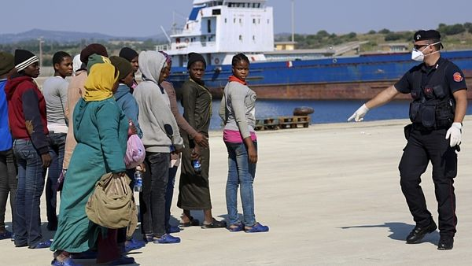
Czech media discourse on migration
Kateřina Kirkosová
and Michal Tkaczyk
CZS55
3 October 2017

Slide 2
Content of the lecture
The media discourse and construction of reality
Exercise 1
The securitization theory (outline)
The coverage of the European migration crisis in the Czech online news media
Exercise 2
Discussion

Slide 3
Media discourse and construction of reality
signifying power of media: power to influence knowledge, beliefs, values, social identities, social relations
ongoing discussions
  traditional media vs. social media
  professional vs. citizen journalism
trustworthiness and critical media literacy (sources)
nonetheless, media discourse could be crucial, especially when reporting affairs or events of which their recipients have no or only little experience
  „migration crisis“ in Czech Republic
  chance to explain – to exploit the fear of unknown

Slide 4
Media discourse and construction of reality
media discourse helps to organize social reality into meaningful blocks and patterns (Berger – Luckmann: semantic fields), i.e. media representation of family values
on the other hand, media discourse can also simplify social reality (stereotypes, prejudices, labels), i.e. media representation of LGBT
„Stories have been used to dispossess and to malign, but stories can also be used to empower and to humanize.“ https://www.ted.com/talks/chimamanda_adichie_the_danger_of_a_single_story

Slide 5
Shortcuts in media discourse
principally, media discourse may be empowering, but stigmatizing as well
practically, media discourse is necessarily selective, both on the side of its production and its reception
therefore, we should be concerned not only with whether the news chosen is based on true facts or not,
but also how and why has it been chosen – perspectives of whom it promotes and standpoints of whom it marginalizes

Slide 6
Rules for selection, media institutions
media discourse is necessarily selective, both on the side of its production and its reception
concept of newsworthiness and news values (Lippmann, 1960, Galtung and Ruge, 1965)
different aspects of the news process (Bednarek, 2016)
  News writing objectives: general goals associated with news writing, such as clarity of expression, brevity, colour, accuracy and so on;
  Selection factors: any factor or criterion impacting whether or not a story becomes published, not necessarily values, for example, commercial pressures, availability of reporters, deadlines and so on;
  News values: the ‘newsworthy’ aspects of actors, happenings and issues as established by a set of recognised values such as Negativity, Timeliness, Proximity, Superlativeness, Eliteness, Impact, Novelty, Personalisation, Consonance, Aesthetic Appeal

Slide 7
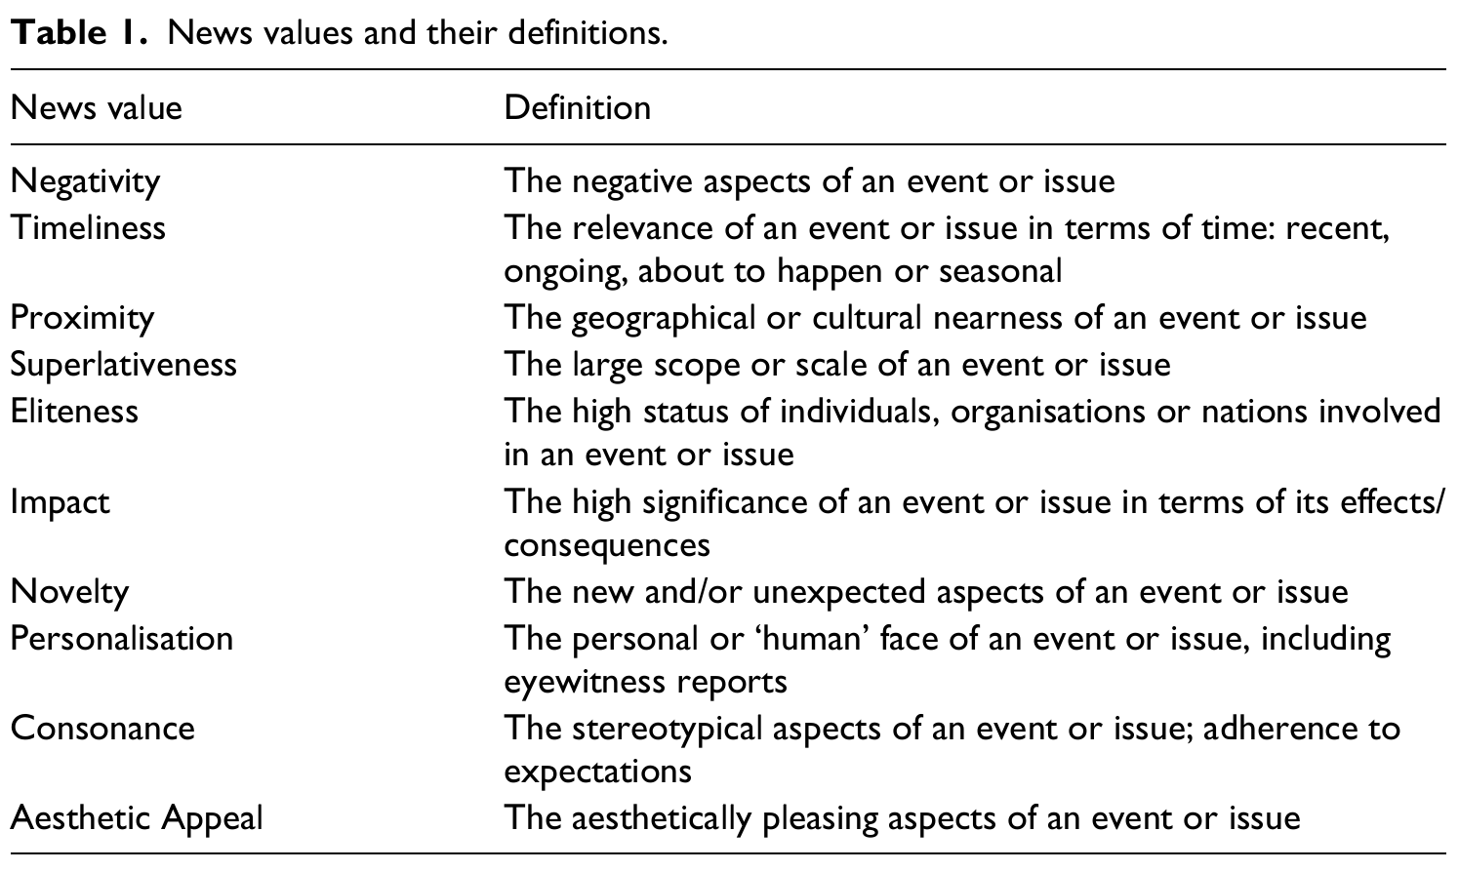
News values
    Caple, Helen - Bednarek, Monika. 2016. Rethinking news values: What a discursive approach can tell us about the construction of news discourse and news photography. Journalism 17 (4): 435-455.

Slide 8
Rules for selection, media publics
media discourse is necessarily selective necessarily selective, both on the side of its production and its reception
selective exposure
  we cannot read/watch all the newsavailable
selective perception
  we pay more attention to news which are coherent with his opinions and attitudes
selective retention
  after a period a time, we are able to recall only some informations originaly gained (usually again those which do not contradict our identities)

Slide 9
Media agenda setting
media agenda
political agenda
public agenda
media bias and concept of journalistic objectivity

Slide 10
Exercise (in small groups)
How are events represented? Which aspects of the European migration crisis are stressed or conveyed in a photo?
How actors are represented in a photo? What identities are set up for migrants? What activities and characteristics are attributed to them? What identities are set up for Europeans? Who represents them?
What relationships are set up between migrants and Europeans?
What kind of approaches to migration (if any) are displayed in this photos?

Slide 11
The migration crisis in news photography

Slide 12
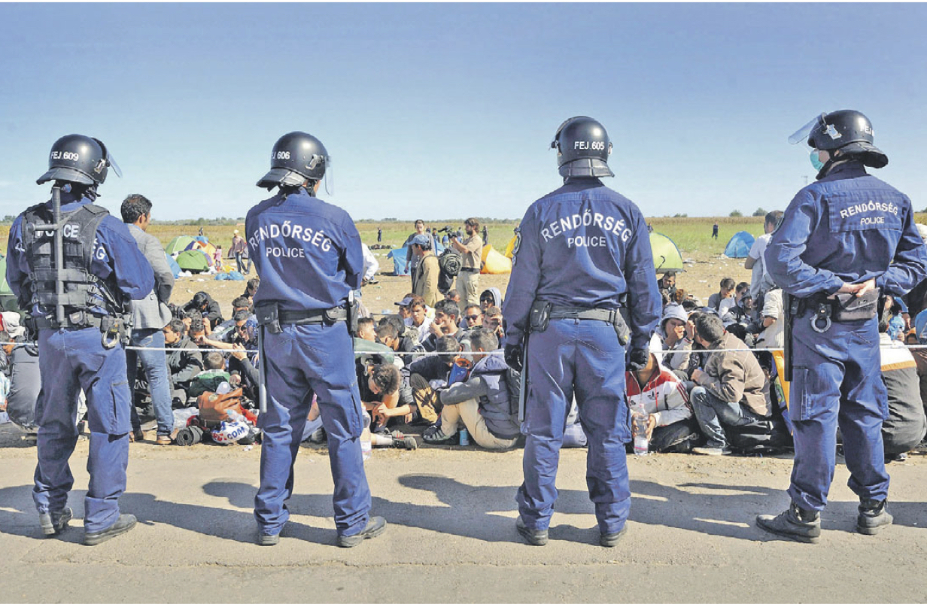
The migration crisis in news photography

Slide 13
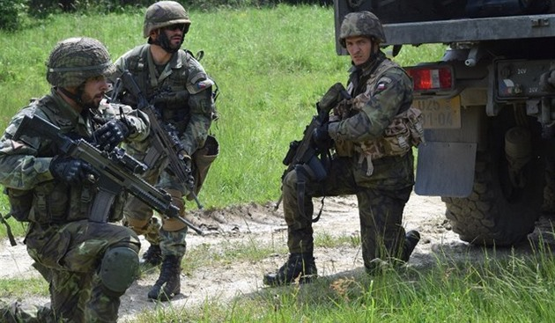
The migration crisis in news photography

Slide 14
The migration crisis in news photography

Slide 15
The migration crisis in news photography

Slide 16
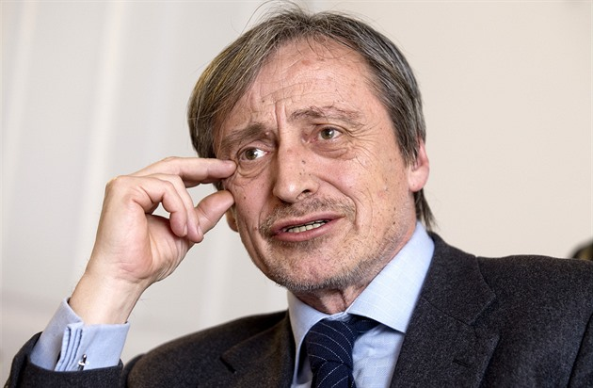
The migration crisis in news photography

Slide 17
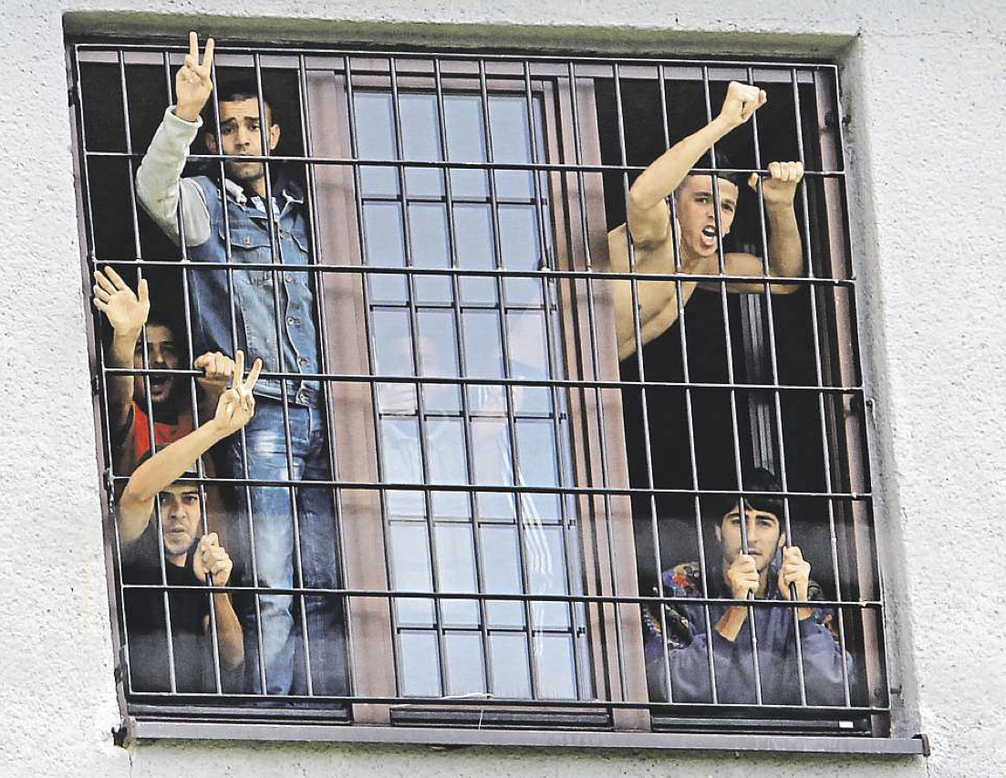
The migration crisis in news photography

Slide 18
Common trends in media coverage of migration
Victimization – migrants as victims of tragic event (Khosravinik, 2009; Van Gorp, 2005; Figenschou, Thorbjørnsrud, 2015 )
Politicization – migrants as object of policies, mediated by accounts made by politicians (Khosravninik, 2009; Threadgold, 2009; Klocker, Dunn, 2003)
Securitization – migrants as a threat (Abid, Manan, Rahman, 2017; Banda and Mawadza, 2015; Threadgold, 2009)
Criminalization – in relation to criminal offences (Rasinger, 2010; Brouwer, Woude a Leun, 2017)
Collectivization – migrants as homogenous group of people (Khosravinik, 2009)
Decontextaulization – focus on actual events, reasons like persecution in or suffering in home country are omitted (Pugh, 2004)

Slide 19
Theory of securitization
security problem – a situation, in which an event, a course of action or an actor is evaluated as a threat to the particular object of reference (person, nation, value system etc.) and thus requires safety measures to be taken in order to ensure the safety of the object of reference.
constructivist approach to security – an issue becomes a security threat not because it essentially is one, but because it is presented and perceived as such (Buzan, Weaver, de Wilde, 1998: 24; Balzacq, 2011: 1).

Slide 20
Theory of securitization
securitization is a process in which “the the issue is presented as an existential threat, requiring emergency measures and justifying action outside bounds of normal political procedure” (Buzan, Weaver, de Wilde 1998: 23-24).
Security sectors: Political, Military, Societal, Environmental, Economic (Buzan, Weaver, de Wilde 1998: 21-23)

Slide 21
Securitization theory and the media
Effect on media
Effect of media
Securitization
(Vutlee, 2011)

Slide 22
Relevant audience (volume/calibre)
Heuristic artefacts (media content)
frames, image repertoires, stereotypes, emotional appeals
Reference object
metaphors, policy tools, image repertoires, analogies, stereotypes, emotions
Heuristic artefacts (securitization speech acts)
News media organizations
professional routines new values
professional ideology
political profile of media outlet
Securitization actor
Tkaczyk (own processing)
Salience of the issue

Slide 23
Migration in Czech Republic
In 2015 only 134 citizens of Syria, 38 citizens of Iraq and a few people from Afghanistan applied for asylum in the Czech Republic.
Not-authorized stay in ČR: Syria (2 016), Afghanistan (585), Iraq (404), all (8563)
Report on migration and integration of foreigners, Ministry of Interior (2015)

Slide 24
Czech public on refugees as a threat

Slide 25
Czech public on refugees as a threat

Slide 26
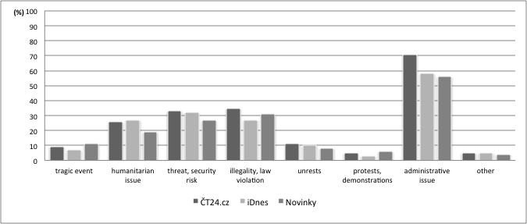
The Czech news coverage on the European migration crisis
Problem definitions in the analysed news items (Tkaczyk 2017)

Slide 27
The Czech news coverage on the European migration crisis
Discussed or presented solutions to the crisis (Tkaczyk 2017)

Slide 28
Migration in Czech Republic in Czech news media
Voices in the news coverage (Tkaczyk 2017)

Slide 29
Exercise (in small groups)
How are events represented? Which aspects of the European migration crisis are stressed or conveyed in the news story?
How actors are represented? What identities are set up for migrants? What activities and characteristics are attributed to them? What identities are set up for Europeans? Who represents them?
What relationships are set up between migrants and Europeans?
What kind of approaches to migration (if any) are conveyed in the news story? Is there any kind of evaluation of these approaches present in the news story?

Slide 30
Discussion
In general terms, how was the European migration crisis covered by news media in your country of origin?
Which frames and event definitions prevailed?
Who could speak in news?

Slide 31
Literature
BALZACQ, Thierry. 2011. A Theory of Securitization: Origins, Core Assumptions, and Variants. In BALZACQ, T. (ed.): Securitization Theory How Security Problems Emerge and Dissolve. New York : Routledge, p. 1-30.
BEDNAREK, Monika. 2016. Voices and values in the news: News media talk, news values and attribution. Discourse, Context & Media, Vol. 11, p. 27 - 37.
BERGER, Peter L. a Thomas LUCKMANN. 1967. The social construction of reality: a treatise in the sociology of knowledge. London: Penguin Press.
BUZAN, Barry, WAEVER, Oscar, DE WILDE, Jaap. 1998. Security: A New Framework for Analysis. Boulder : Lynne Rienner Publishers.
FAIRCLOUGH, Norman. 1994. Media Discourse. London: Hodder Arnold.
FOWLER, John. 1991. Language in the News: Discourse and Ideology in the Press. London and New York: Routledge.
GALTUNG, Johan, RUGE, Mari, H. 1965. “The Structure of Foreign News“ The Journal of Peace Research, Vol. 2, No. 1, p. 64-91.
van LEEUWEN, T. 2007. „Legitimation in discourse and communication.“ Discourse & Communication, Vol. 1 No. 1: 91-112.
LIPPMANN, Walter. 1960. Public opinion. New York: Macmillan Company.
THOMPSON, John B. 1990. Ideology and modern culture: critical social theory in the era of mass communication. Cambridge: Polity Press.
TKACZYK, Michal. 2017. „Between politicization and securitization: Coverage of the European migration crisis in Czech online news media.” In Communication Today, Vol. 9, No. 2
VULTEE, Fred. 2011. Securitization as Media Frame. In BALZACQ, T. (ed.): Securitization Theory How Security Problems Emerge and Dissolve. New York : Routledge, p. 77-93.

