Slide 1
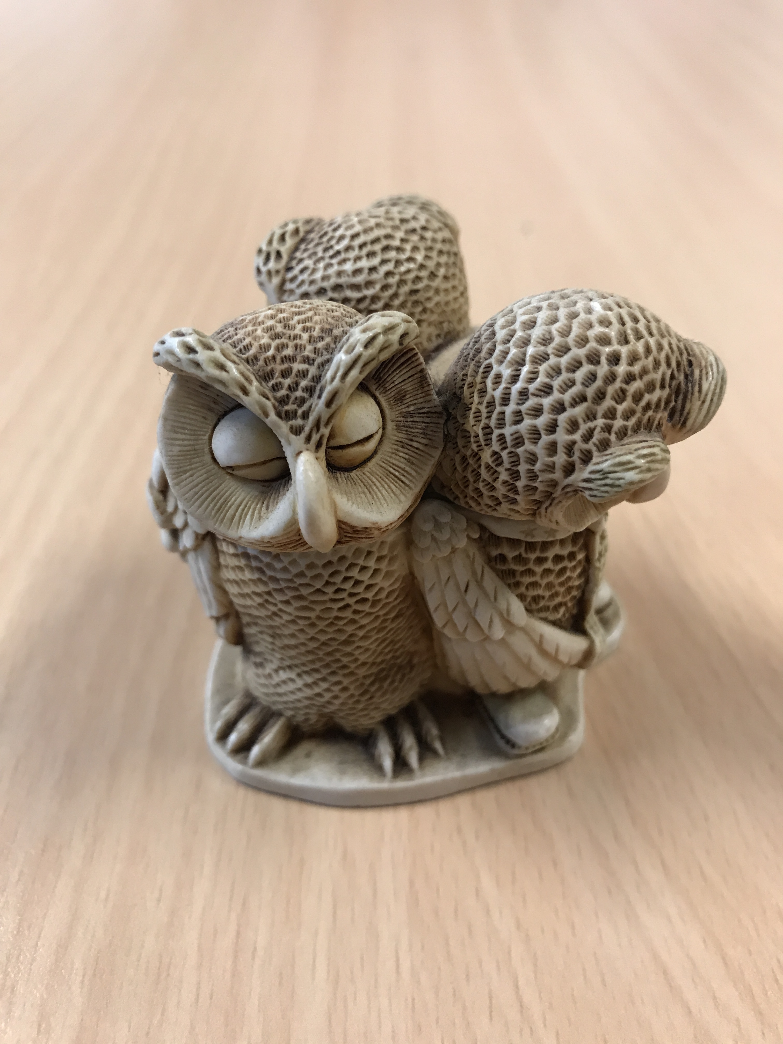
English Language Focus Summer School Masaryk July 2018
Feedback Discussion

Slide 2
In this workshop
What do we mean by feedback?
Feedback and Assessment - “two sides of the same coin”?
Feedback on Language: what are the key points
What do we do now?
Peer feedback: what, why, who, when and how?
Activity 1: presentation feedback
Written work: where is the focus
Activity 2: writing feedback
Conclusions

Slide 3
What do we mean by feedback?
Assistance not judgement - feedback is NOT “marking”!
Mutual - it flows both ways
Horizontal and vertical
Evolution not revolution!
Analysing interim and final product.
In English medium of instruction courses
Not just results, language structure is also important
Focus on what is realistic to achieve in the assignment.

Slide 4
Feedback and assessment: “two sides of the same coin?”
Feedback leads to a positive assessment
Assessment without feedback: no room for improvement
Conversation, rather than judgement
Horizontal, rather than vertical
Develops skills for student and teacher.

Slide 5
Feedback on language: what are the key points?
(applicable to both presentations and assignments)
Range: appropriate style, vocabulary, variety FLI.
Coherence: flow, fluency, linking, introductions and conclusions, comprehension.
Accuracy: grammar (and punctuation), lack of misunderstanding, FLI.
Argument: coherent, complete, balanced, understandable

Slide 6
Quick Brainstorm
What do you do now?

Slide 7
Peer Feedback:
WHAT: opportunity for improvement, developmental not judgemental.
WHY: eases the assessment load (saves time), WHY NOT??
WHO: individuals, peer review groups, whole-class discussions.
WHEN: during the preparation process, after first draft (writing), before assessment.
HOW: set aside enough time, set (agreed) guidelines and criteria, flexible groups.

Slide 8
Activity one
Presentation feedback

Slide 9
Activity 1: Presentation feedback
Use the checklist (CEFR grades if you wish)
How can you be constructive? (not just ticking boxes)
Focus on one area
https://www.youtube.com/watch?v=Y1qDNTG9lg0
https://www.youtube.com/watch?v=3kgtpl4Q5OY

Slide 10
Written Work: where is The focus?
General assignment aims.
Focus for English feedback (Range? Coherence? Grammar? Argument?)
What do you want to achieve?
“State of play” of the writer.
“State of play” of the feedback-giver(s)
“State of play” of the assessor (EMI)
Time available

Slide 11
Activity two
Writing feedback

Slide 12
Activity 2: Writing Feedback
Peer feedback sheet
CEFR codes for writing
Correction codes
Identify English-language strengths in your group.
Focus on one or two areas of feedback
Be positive and constructive

Slide 13
Conclusions
Feedback is not the same as assessment
FB is a stage towards assessment
FB is developmental, rather than judgemental
Peer feedback is an important tool for a teacher
Not time-wasting, but time-saving in the long run!
Don’t just tick boxes!!
Anything to add?

