Slide 1
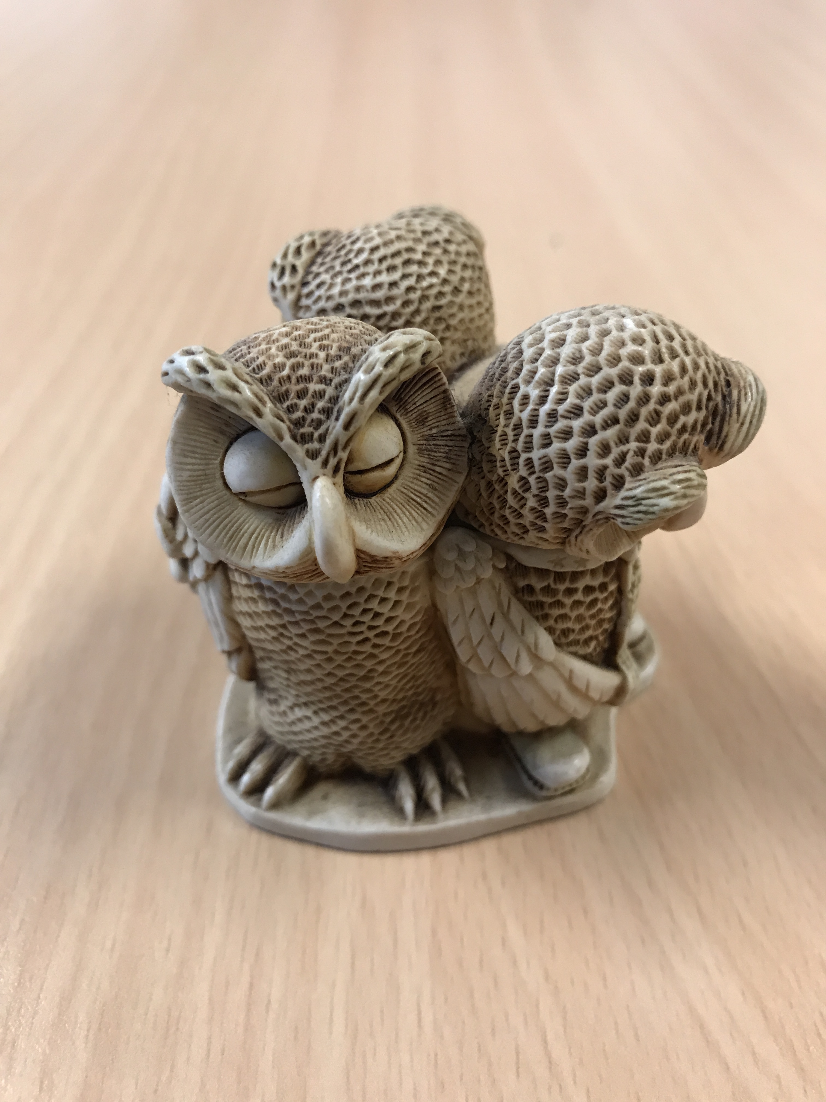
English Language Focus Summer School Masaryk July 2018
Introduction
Marcus Grollman

Slide 2
Dagal!
Introduction
Mog nimen Marcus Grollman
Nimen yoog?

Slide 3
Dagal 2
Introduction
How did you feel?
Confused?
Irritated / annoyed?
Worried?
Interested?
English as friend of foe?

Slide 4
This Workshop
Introduction
Dagal!
Introductions (personal, professional, role of English)
The State of Play

Slide 5
The State Of Play
Introduction
English as a “lingua franca”
English as THE academic language?
Movement of students (Erasmus, etc.)
Increasing number of English-medium courses (Bachelor, Master, PhD)
First language English-speaking students
The situation in Groningen
Language training for students
Language training for teachers

Slide 6
Over To You
Introduction
Groups of 2 or 3 (preferably same institution)
Think about the situation in your institution
What about your own issues?
Positive as well as critical
Be prepared to report back to the whole group

Slide 7
Some Student Opinions
Introduction
As a first-language user of English, studying at a university where English is a second language, what issues have you encountered that have affected your studies?
http://wmvideo.service.rug.nl/let/cercles/question3 16062014.wmv
How have your English Skills developed (or changed) during your first year of study? As a first-language English speaker, what advice would you give the university as it strives to become plurilingual?
http://wmvideo.service.rug.nl/let/cercles/question4 2 16062014.wmv

