Slide 1
National Funding Opportunities
Roman Badik
Head of Research Office
April 6, 2018

Slide 2
Contents
Funding research at MU
National funding opportunities
Internal Funding Opportunities
Research support at MU

Slide 3
Research funding sources at MU
2 main sources to fund research at MU:
Projects
1 039 311 000 CZK (2016)
Institutional Support (IS)*
725 641 000 CZK (2016)
Won through grant competitions at different grant providers.
In 2016:
49% National grants
5,4 % International Grants
4,6% European Structural and Investment funds (ESIF)
Received
according to the law 130/2002
41%
59%
  Projects are the main source of funding for research at MU.

Slide 4





Overview of the grant providers
National
grants
International and co-funded grants
European Structural and Investment funds
OP VVV
EMBO
EHP/Norway grants
International Visegrad funds
…….
OP PIK
Ministries

Slide 5
National grants at MU in 2016 (without ESIF)

Slide 6
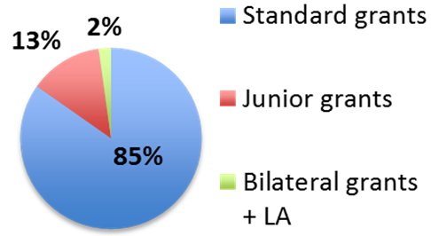
    Basic research
    Projects for 2-3 years
    The PI defines the topic
    Individual and collaborative projects
    1 call per year in the individual programmes - deadline for 2018: April 11
    Annual GAČR budget cca. 3,5 bill. CZK
    Success rate: ca. 33 %
    GAČR budget distribution
Programmes
Standard projects
Excellent basic research
Junior grants
Up to 8 years after PhD, international experience required
Bilateral projects and LA grants
International cooperation (Austria, Germany, Korea, Taiwan)
ERC Support
Additional support for GAČR Junior grant holders leading to ERC grants

Slide 7

Programmes
    Applied research
    Collaborative projects typically for 2-3 years
    Compulsory cooperation of research organization with business
    Defined research topics - linked to the goals of the National priorities of oriented research
    Expected Research results – industrial and utility model, prototype, functional sample, software, patent, methodology, map, research report, pilot plant, technology, …
    Day of Applied Research – 25 April 2018
Long-term cooperation between the
research and the application spheres
National Competence Centres
THÉTA
Applied research in the field of energy
DELTA
International collaboration in applied research (listed countries only)
EPSILON
Market exploitation of research results, new products and services
ZÉTA
Support of junior scientists in applied research
ÉTA
Applied research in area of social science and humanities

Slide 8
Programmes of resort ministries - applied and basic research
M. of Industry and Trade
Ministry of Culture
Ministry of Agriculture
Ministry of the Interior
Ministry of Health
Ministry of Education
TRIO
NAKI II
ZEMĚ
Security Research
Research in Healthcare
INTER-EXCELLENCE
Key Enabling Technologies research (KET) - photonics, micro- and nanoelectronics, nanotechnology, industrial biotech-nology, advanced materials and manufacturing technologies
Applied Research - National and cultural Identity
archaeology, language, arts, technologies and procedures for the protection of cultural heritage - For social science and humanities
Applied research in agriculture, angling, food processing industry, water and forest management, support for implementation of national policy in
agricultural sector
Applied research - national security and citizens' safety, critical infrastructures, crisis and security policy
Applied research in healthcare - Origin and development of diseases; New diagnostic and therapeutic methods and epidemiology and prevention of life-threatening diseases
Mobility
Basic and applied research -
INTER-EXCELLENCE –broad programme
MOBILITY -
projects with partner countries
Collaborative and individual projects for RO and companies
Collaborative and individual projects for RO and business
Collaborative projects – business + research organizations (RO)
RO* only - Individual and collaborative projects
Collaborative projects – business and ROs
Collaborative, bilateral and individual projects for RO*
Results:
Publications, patents, utility designs, verified technology, varieties, breeds, medical procedures, certified methodology…
Results:
Patent, software, utility and industrial design, technology, prototype, functional specimen, certified methodology…
Results:
Specialized public databases, maps, methodologies, conferences, exhibitions, publications…
Results:
Prototype, functional specimen, software, patent, map, methodology, verified technology, medical procedure…
Results:
Prototype, software, pilot production,, verified technology, industrial utility design, patent…
Results:
Articles, publication, seminars, summer schools, joint research project…

Slide 9
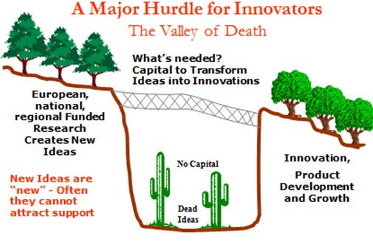
TRL - Technology Readiness Levels
Commercial exploitation and industry use
(Market pull)
Technology development
(Technology push)
Innovation phase
TRL1
TRL3
TRL4
TRL5
TRL6
TRL8
TRL7
TRL9
TRL2
Basic research
Technology formulation
Applied research
Small scale prototype
Large scale prototype
Prototype system
Demonstration system
First of a kind commercial system
Full commercial application
TRL 1-3 – From Idea through concept formulation and technology outline to confirmation of the concept
TRL 4-7 – From „ugly“ prototype to a fully functional product tested in an operating / work environment
TRL 8-9 – Successful market launch and full commercial use of the product / service
The TRL definitions are commonly used in the in the call description of many national and international grant providers

Slide 10
TRLs and National grant programmes
First of a kind commercial system
Full commercial application
Basic research
Technology formulation
Applied research
Small scale prototype
Large scale prototype
Prototype system
Demonstration system
TRL1
TRL3
TRL4
TRL5
TRL6
TRL8
TRL7
TRL9
TRL2

Slide 11
Grant Agency MU - Internal research funding scheme
https://gamu.muni.cz

Slide 12
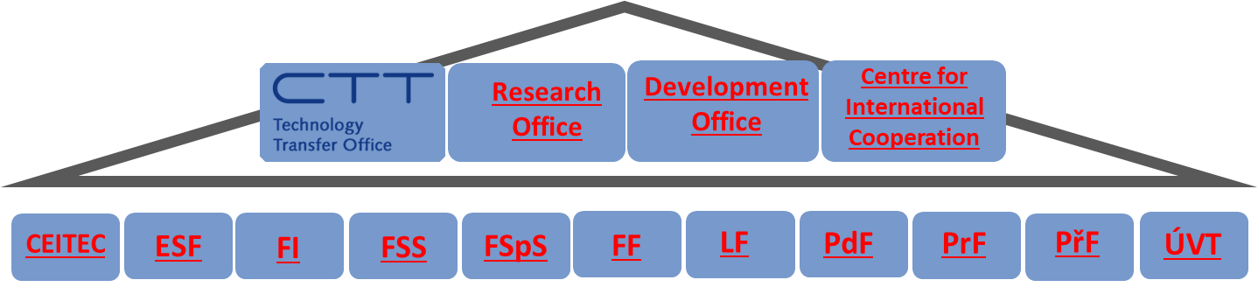
Project support at MU
Technology Transfer Office
Intellectual Property Rights (IPR), Commercialisation
Cooperation with business
Commercial use of research results
Conditions for technology and knowledge transfer, IPR protection, contracts
Support, guidance and training for MU staff
Research Office
Project and Research Support
Methodology and guidance on different grant programmes
Training and educational events, individual consultations
Internal projects GAMU
Research evaluation
PhD study programmes
Open Access, Ethics
Develpment Office
OP VVV and OP PIK
Support for grant schemes under the European Structural and Investment Funds (OP VVV, OP PIK, other operational programmes)
Development programs under Ministry of Education, Youth and Sports
Centre for International cooperation
Mobility Grants
Support for international mobility grants for MU students and employees
Help with preparation of projects (Erasmus+, Fulbright Commission and other)

Slide 13
Research Office support
Information spreading
  Research Office website (http://vyzkum.rect.muni.cz/)
  Research Office newsletter
  Information seminars, workshops, trainings
    GRANTSWEEK 2018 – October
Individual support provided
  Individual consultancy with Research Office staff
  Help with proposal development
Financial support
  For preparation of prestigious project proposals

Slide 14

Project support – faculty contacts
Research Office
Development Office
Centre for International Cooperation
CEITEC
ESF
FI
FSS
FSpS
FF
LF
PdF
PrF
PřF
ÚVT
HS | Project Support - contacts | Email
CEITEC | Mgr. Ladislav Čoček | grants@ceitec.muni.cz
ESF | Mgr. David Póč/ Ing. Jaroslav Andrle, MBA | David.Poc@econ.muni.cz; veda@econ.muni.cz
FI | Ing. Dana Komárková | dkomar@fi.muni.cz
FSS | Ing. Alena Raisová | raisova@fss.muni.cz
FSpS | Ing. Zuzana Sajdlová, Ph.D. | sajdlova@fsps.muni.cz
FF | Ing. Markéta Jurášová | jurasova@phil.muni.cz
LF | Ing. Zuzana Krejčířová | zkrejcir@med.muni.cz
PdF | Ing. Martina Legátová | legatova@ped.muni.cz
PrF | Mgr. Ing. Jiří Jaroš | Jiri.Jaros@law.muni.cz
PřF | Ing. Zdeňka Rašková | zdenar@sci.muni.cz
ÚVT | Ing. Lucie Klimentová/ Mgr. Iva Krejčí | klimentova@ics.muni.cz; krejci@ics.muni.cz

Slide 15
Thank you for your attention

