Slide 1
Technology in University
Belinda Allan
ICT Coordinator
MUNI Language Centre

Slide 2
Why?

Slide 3
How?
OK, that’s a hard question, let’s take a step back with ...

Slide 4
What? / Where?
e.g. Setting and marking these exams are taking over my life!!
Perhaps set an automatically marked quiz.
Perhaps students could create a podcast or blog post that shows their learning.
Perhaps students could interview an expert (in the field or a teacher), film it and create a mini lesson for the class.
Perhaps ...
What activity do we want to run?
Where could technology help?

Slide 5
It’s Teachers Vs Google
Notes:
Teacher reads - participants take notes of points they agree and disagree with (along with any new words)

Slide 6
What are we to do with it?
How do you deal with it?
Students would love to know!
Students have 24/7 access to information.
Information overload!
Internet has information and misinformation
(along with outright scams and lies).
Is “giving information” taking up our lessons?
If we remove the “information” part from the classroom, what will we fill our lesson with?
What do we know about the internet Vs student learning?

Slide 7
If we remove the “information” part from the classroom, what will we fill our lesson with?
Notes:
leading to flipped classroom

Slide 8
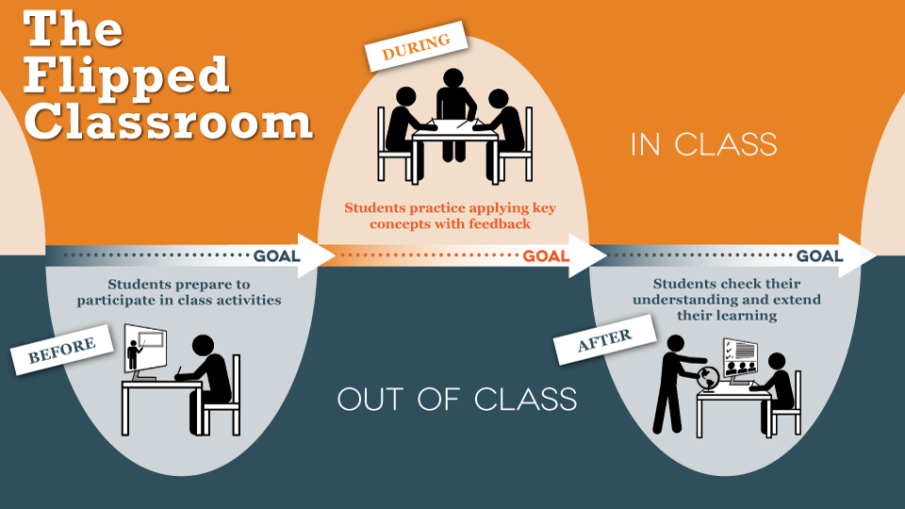
One Idea: The Flipped Classroom

Slide 9
Problems - Deal with it - Opportunities (PDO)
Problems | Deal with it | Opportunities
Students won’t study before class

Slide 10
Problems - Deal with it - Opportunities
Problems | Deal with it | Opportunities
Students won’t study before class | Stick = assess it, make it embarrassing, punishment Carrot =

Slide 11
Problems - Deal with it - Opportunities
Problems | Deal with it | Opportunities
Students won’t study before class | Stick = assess it, make it embarrassing, punishment Carrot = do revision or a quiz in class, do it as a research activity in class, have rewards for doing it

Slide 12
Problems - Deal with it - Opportunities
Problems | Deal with it | Opportunities
Students won’t study before class | Stick = assess it, make it embarrassing, punishment Carrot = do revision or a quiz in class, do it as a research activity in class, have rewards for doing it | Have a small group prepare the “information” section into a mini/micro lesson for their classmates.

Slide 13
Problems - Deal with it - Opportunities
Problems | Deal with it | Opportunities
Students won’t study before class | Stick = assess it, make it embarrassing, punishment Carrot = do revision or a quiz in class, do it as a research activity in class, have rewards for doing it | Have a small group prepare the “information” section into a mini/micro lesson for their classmates. Have the whole class prepared to debate a hot topic in which they would need to know the “information” to be able to do so.

Slide 14
Problems - Deal with it - Opportunities
Problems | Deal with it | Opportunities
Students won’t study before class | Stick = assess it, make it embarrassing, punishment Carrot = do revision or a quiz in class, do it as a research activity in class, have rewards for doing it | Have a small group prepare the “information” section into a mini/micro lesson for their classmates. Have the whole class prepared to debate a hot topic in which they would need to know the “information” to be able to do so. Have one, pairs or a group prepare a game, podcast, a poem, or a story that would teach the class the important parts.

Slide 15
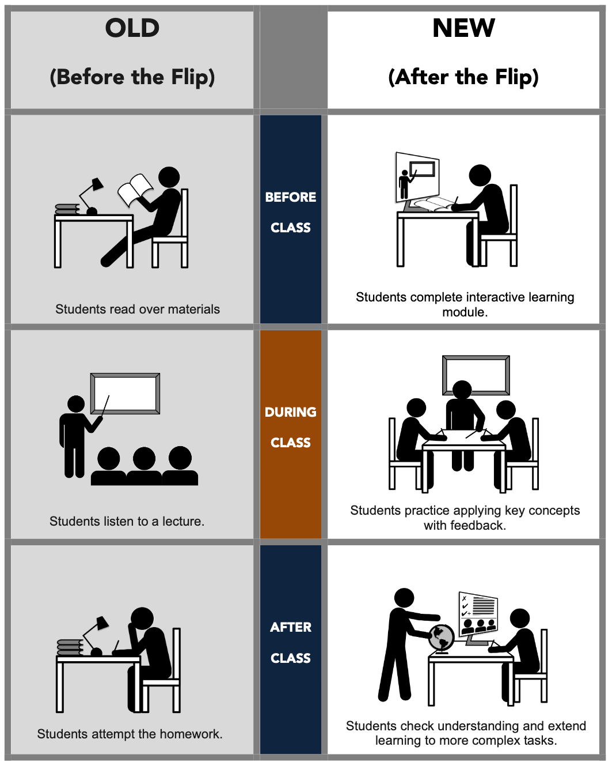
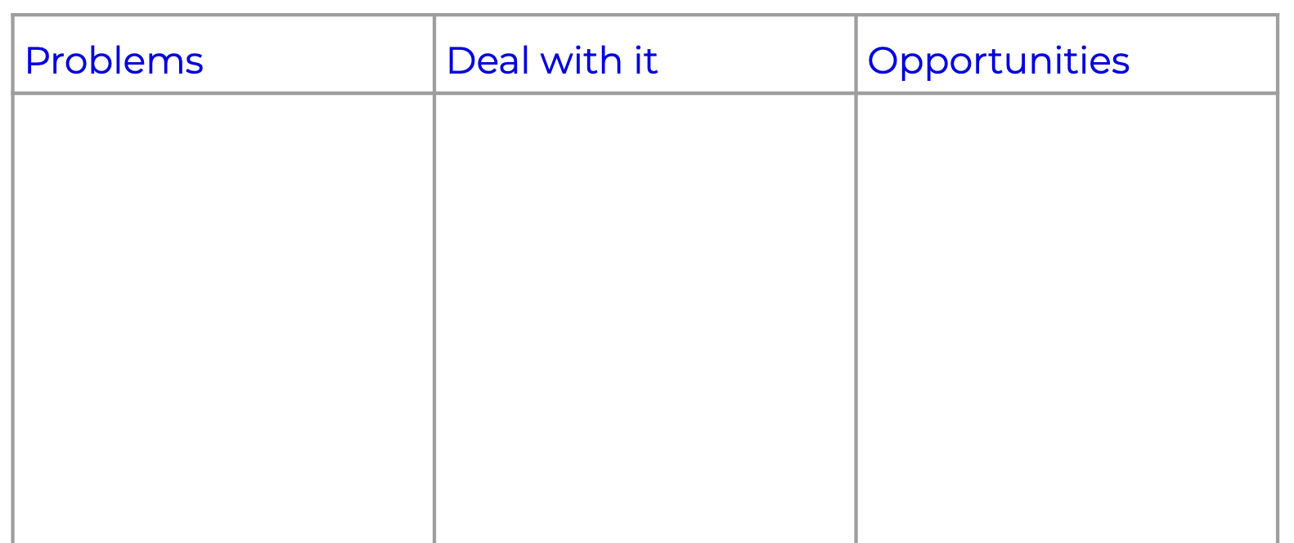

Slide 16
But which technology
could I use?

Slide 17
Technology should do MY bidding (not the other way)!

Slide 18
What do I want to achieve?
+
Where could technology help or enhance?

Slide 19
Student learning/activity + technology possible
What | Technology Ideas
A written piece A spoken piece A mid-term Collaboration

Slide 20
Student learning/activity + technology possible
What | Technology Ideas
A written piece A spoken piece A mid-term Collaboration | A blog post, magazine article, infographic, webpage,... (EduBlogs, WordPress, Lucidpress, Canva, Piktochart, Venngage, …) A voice recording, podcast, screencast, create a video, do an interview,... (Vocaroo, FlipGrid, Screencast-o-matic, phone camera, …) A quiz, hot debate, discussion, mini-lessons by students, games by students,... (Google or MS Forms, Google timer, slideshows, Prezi, Quizlet, Kahoot!, LearningPaths, …) (Google Drive and shared docs, Dropbox, Zoom, Hangouts, online to-do lists, online project management, …)

Slide 21
