Slide 1
The brief outline of the history of the Czech Lands in the Middle Ages
Jana Hrabcova

Slide 2
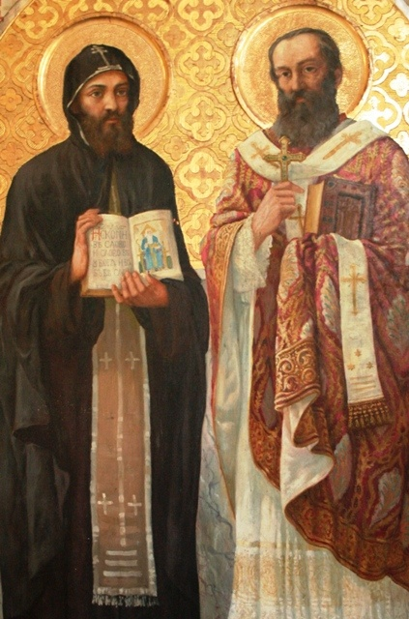
The Great Moravia in the 9th century
6th century – the Slavic tribes came
the Slavic state in the 9th century situated mostly in Moravia
cultural development resulted from the mission of Saints Cyril and Methodius – 863
translation of the Bible to the slavic language, preaching in slavic language → the Christianity widespread faster
They invented the glagolitic alphabet (glagolitsa)
885 – Methodius died → their disciples were expeled from G.M. – went to Bulgaria, Croatia, Macedonia etc., invented cyrilic script

Slide 3
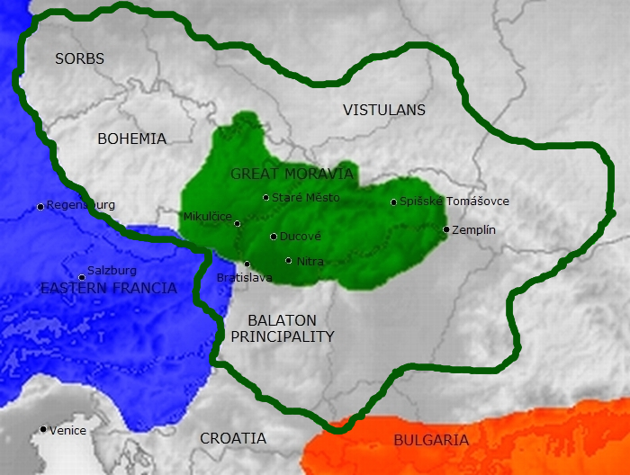
The Great Moravia in the 9th century
http://www.filmcyrilametodej.cz/en/about-film/
The movie (document) about Cyril and Methodius

Slide 4
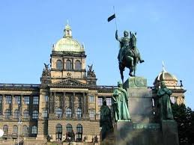
the House of Přemyslids – from 9th century till 1306
the centre of the duchy in Bohemia
Prague the capital city
10th century – duke Wenceslaus → assassinated by his brother → saint Wenceslaus – the saint patron of the Czech lands

Slide 5
the House of Přemyslids
the Kingdom of Bohemia since the end of 12th century
Ottokar II (1253–1278, Přemysl Otakar II) – The Iron and Golden King
very rich and powerful – his kingdom from the Krkonoše mountains to the Adriatic sea
1278 – killed at the battle of Dürnkrut (with Habsburgs)
Wenceslaus II of Bohemia (1278–1305) – king of Bohemia, King of Poland
Wenceslaus III (1305–1306) – assassinated without heirs

Slide 6
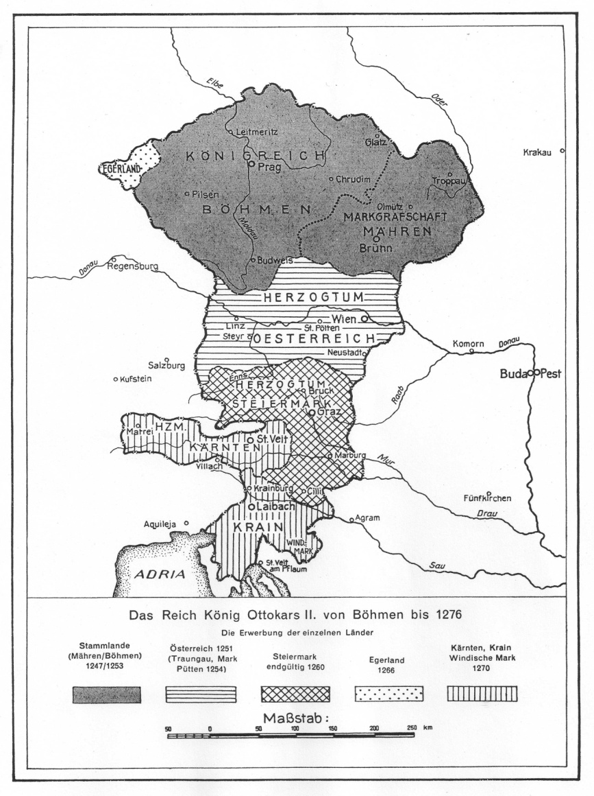
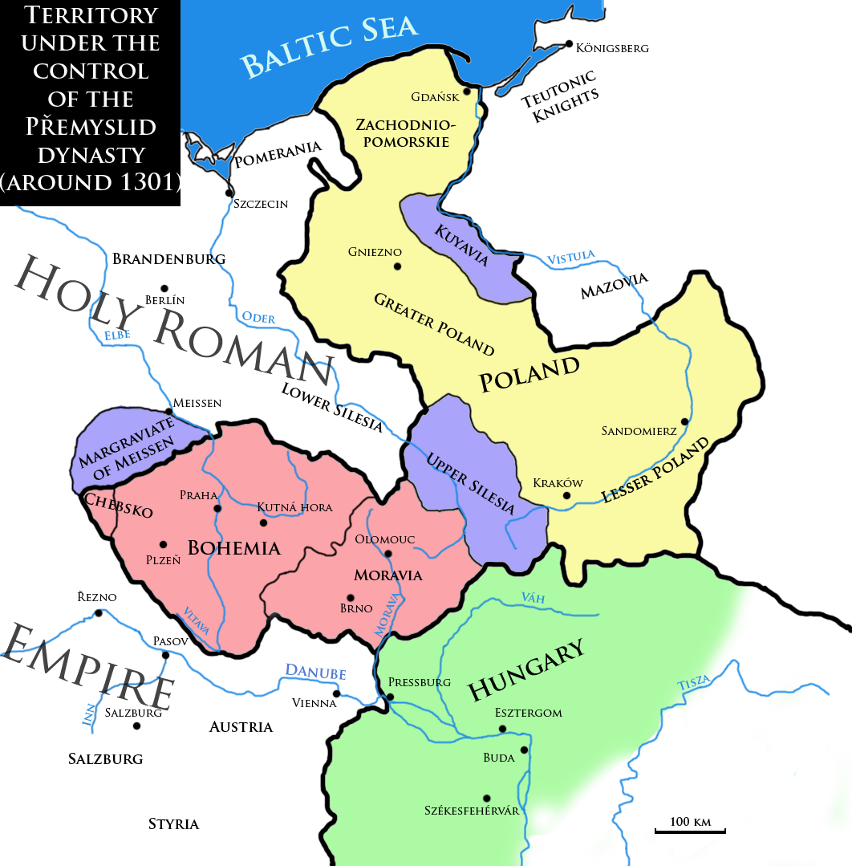
the House of Přemyslids
The kingdom of Ottokar II
Around 1270
The Kingdom of Wenceslaus II around 1301

Slide 7
the House of Luxembourgs (1310–1437)
John of Bohemia (1310–1346, John the Blind) married Wenceslaus’s sister Elizabeth (Eliška)
Charles IV
the king of Bohemia (1346–1378) and Holy Roman Emperor (1355–1378)
The Holy Roman Empire (962–1806) – an empire existing in Europe since 962 till 1806, ruled by Roman Emperor (present –day territories of Germany, Austria, the Czech Republic, Switzerland and Liechenstein, the Netherlands, Belgium, Luxembourg, Slovenia, parts of eastern France, nothern Italy and western Poland)
the most important and the best known Bohemian king
1356 - The Golden Bull – the basic law of the Holy Roman Empire
Prague became his capital, and he rebuilt the city on the model of Paris, establishing the New Town of Prague (Nové Město), Charles Bridge, and Charles Square, Karlštejn Castle etc.
1348 – he founded the University of Prague, later named after him, the first university in Central Europe

Slide 8
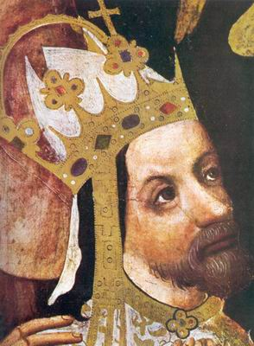
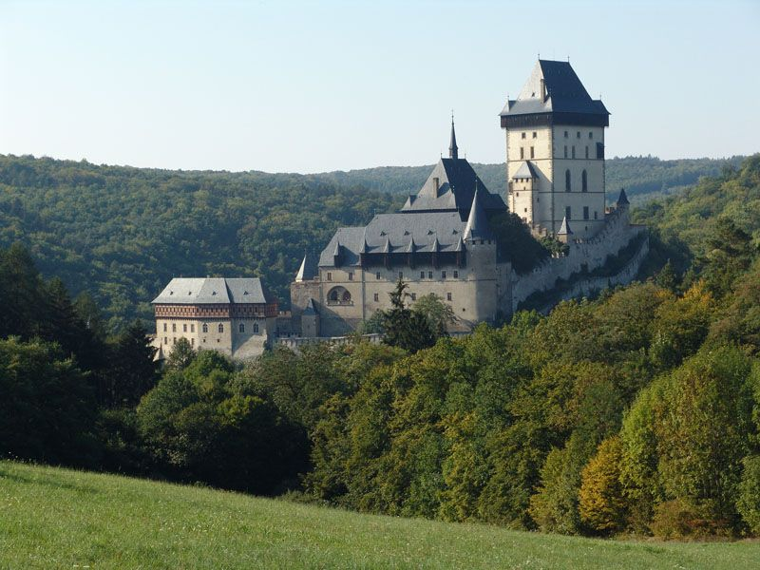
the House of Luxembourgs
Charles IV
The Karlstejn Castle

Slide 9
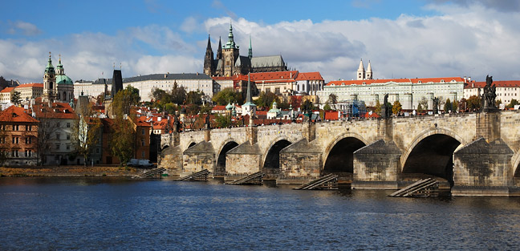
Charles IV
Readings:
Charles IV (autobiography), edited by Balázs Nagy, Frank Schaer (2001): Autobiography of Emperor Charles IV; And, His Legend of St. Wenceslas: Karoli IV Imperatoris Romanorum Vita Ab Eo Ipso Conscripta; Et, Hystoria Nova de Sancto Wenceslao Martyre, Published by Central European University Press.

Slide 10
The Hussite Revolution (1419 - 1436)
Wenceslaus IV (1378–1419) – weak ruler, King of Bohemia
Sigismund of Luxembourg(1410–1437) – king of the Romans
religious struggles in Bohemian lands
Master Jan Hus – became one of the forerunners of the Protestant Reformation
clergyman, preacher and Professor of Prague University
wanted to reform the Catholic Church
he was protesting against clerical abuses, especially the sale of indulgences (paying for forgivness of the sins during the confession)
he also declared that the clergy should live according to the Bible, in poverty, without property and a secular power
the mortal sins should be prohibited and punished
he also proclaimed that the believers should understand the Holy Writ so it should be proclaimed in the national languages

Slide 11
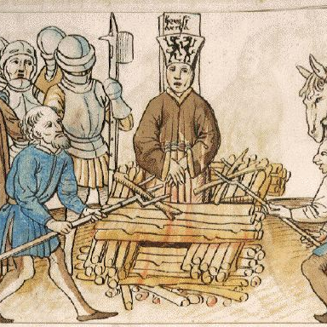
Master Jan Hus
Master Jan Hus was sentenced to death and burnt to death in 1415 at the Council of Constance

Slide 12
The Hussites
the Bohemian people blamed Emperor Sigismund for Hus´ death so they did not want him to become the king of Bohemia although he was Charles IV´s son
Hus´s followers were called the Hussites; (Men of the Chalice - the symbol of Hussites movement)
Sigismund organized five crusade campains against Hussites but all the campains were unsuccesfull
almost 15 years of religious struggles and wars – the country was destroyed and plundered
the moderate Hussites wanted to finish the warfare so they united with Catholics and destroyed the radical Hussites at the battle of Lipany in May 1434
after that both the religions – the Catholic and the Hussite became legal in Bohemia and two churches were formed
1436 – Sigismund was accepted as the King of Bohemia, but he died only one year after that

Slide 13
The Hussites
after Sigismund´s death, a Bohemian nobleman and the leader of the Hussites George of Kunštát and Poděbrady (1458–1471) was elected a king
he suggested something what could be considered as a proposal of latter European Union
he tried to prevent isolation of hussite Bohemia in catholic Europe, so he proposed a treaty among all Christian powers, the member states should pledge to settle all differences by exclusively peaceful means and fight altogether against Osman Turks who were threatening Central Europe
Readings:
Doležalová, Eva – Pánek, Jaroslav (2011): Confession and nation in the era of reformations: Central Europe in comparative Perspective). Prague.

