Slide 1
Central Europe Before, during and after
Thirty Years´ War
Jana Hrabcova

Slide 2
the House of Habsburgs
1526 – 1918
The Habsburg rule brought the re-introduction of the Roman Catholic faith, centralization and the construction of a multi-national empire. The Habsburgs included the Crownlands of Bohemia in their monarchy, and they remained a part of the Habsburg Empire until 1918

Slide 3
Ferdinand I
Ferdinand I (1526–1564)
Holy Roman Emperor since 1558 (after his brother Charles V died)
king of Bohemia and Hungary since 1526 (elected by Bohemian and Hungarian Diet because he was a husband of Anne Jagiellonica – sister of Bohemian and Hungarian king Luis II who died at the battle of Mohács in 1526)
king of Croatia, Dalmatia, Slavonia, and formally king of Serbia, Galicia (in Eastern Europe) and Lodomeria, etc.

Slide 4
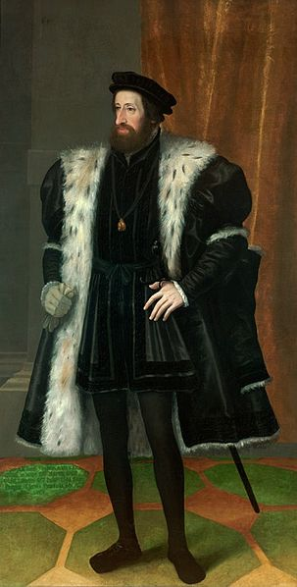
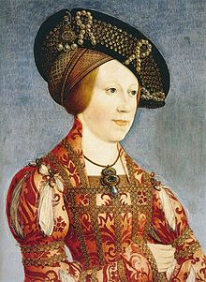
the House of Habsburgs
Ferdinand I
Anne of Hungary and Bohemia

Slide 5
Ferdinand I
The key events during his reign were:
the contest with the Ottoman Empire
Their great advance into Central Europe began in the 1520s
they unsuccessfuly assaulted Vienna, the capital of Habsburg Monarchy, in 1529
The Siege of Vienna took 150 days
the aim of the campain was securing control over all of Hungary and weakening of the power of Habsburgs
unusually bad weather conditions saved Vienna, the heavy rain and snowfall made the Turks to leave
they returned in 1533, but their army wasn´t so strong
1533 – a peace treaty with the Ottoman Empire splitting Hungary into a Habsburg sector in the west and a vassal state of the Ottoman Empire in the east

Slide 6
Ferdinand I
the contest with the protestant Reformation, which resulted in several wars of religion
1519 – The ninety-five thesis Wittneberg - was written by Martin Luther in 1517 and is widely regarded as the primary catalyst for the Protestant Reformation
The disputation protests against clerical abuses, especially the sale of indulgences
1546–1547 – the Smalkaldic war – the Smalkaldic Union of protestant towns and princes united against ruling catholic Habsburg dynasty
Ferdinad and his brother Charles V., the Emperor, formed a strong army
they also asked the Bohemian estates to form an army and send it to fight against Smalkaldic Union
the Bohemians refused to do it because they didn´t want to fight against protestants and also because the Bohemian national army could be called only to defend the country not to conquere foreign lands or to fight abroad

Slide 7
Ferdinand I
so the Bohemian estates were protesting and they rose up against Habsburgs
but the rebellion was easily supressed and represions succeded
the represions against nobility weren´t so strict (usually the noblemen lost their property) but the towns, which were also participating on the uprising, were excluded from the political life and the town goverment was under the control of the royal clerks
also the hussite church was persecuted in Bohemian Lands
Maxmilian II (1562–1576)
he ratified the religious programe of Bohemian non-catholic estates - so called The Bohemian Confession
but he ratified it only orally so it didn´t bring the religious liberty as the Bohemian estates wished

Slide 8
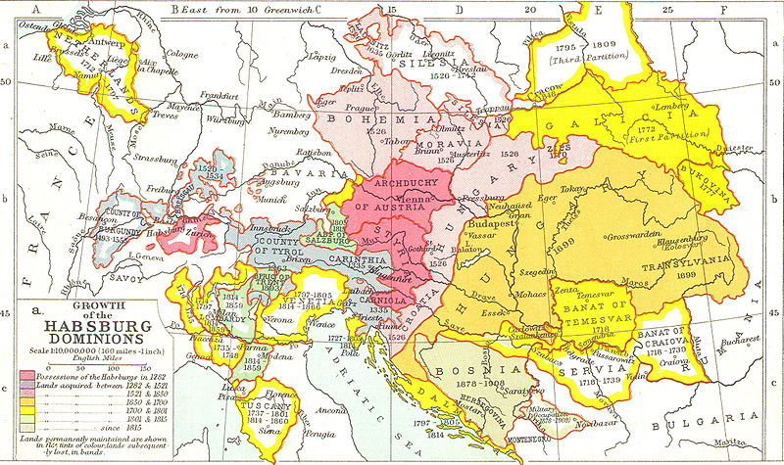
The habsburg monarchy

Slide 9
Rudolph II (1576-1611)
left Vienna for Prague, Bohemian capital grew into an important center of European culture
1593–1606 – „The Long War“ – with Osman Turks
The Czech Estates forced Rudolph II to issue a decree - so called "Maiestatus" or the Letter of Majesty - proclaiming freedom of religious confession in Bohemian Lands
1604 –1606 – uprising in Hungary
Rudolph was a weak ruler, not very interested in politics – since 1608 – he ruled only over Bohemia, Silesia and Lusitania, his brother Mathiass became a ruler in Moravia, Austria and Hungary

Slide 10
Rudolph II
Rudoplh supported culture, arts, sciences tec.
due to many artist and scientist and the development of culture and natural sciences his capital city was called „the Golden Prague“
Rudolph also supported natural philosofers such as the astronomers Tycho Brahe and Johannes Kepler, also Giordanno Bruno spent some time in Prague when he was on the run from the inquisition
Rudolf kept a menagerie of exotic animals, botanical gardens, and Europe's most extensive "cabinet of curiosities"(Kunstkammer)

Slide 11
Rudolph II
Rudolph also patronated occult sciences, many alchymists stayed in Prague during his reign
His lifelong wish was to find the Philosopher's Stone and become immortal
Rudolf invited Europe's best alchemists to court, such as Edward Kelley and John Dee
he had his private alchemy laboratory where he arranged his own experiments
apart from the Philosopher´s Stone the alchymsits also wanted to construct an artificial human being – homunkulus
Interesting web site: http://english.habsburger.net/

Slide 12
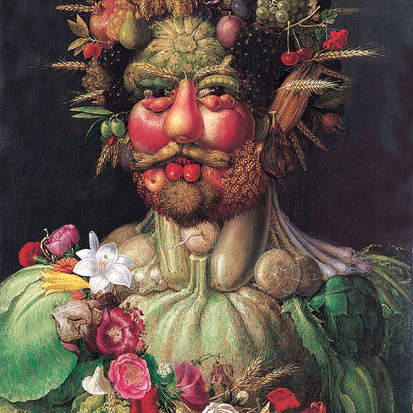
Rudoplh Ii
Rudolph loved collecting paintings and was also patron of many contemporary artists – e.g. Giuseppe Arcimboldo, Bartolomeus Spranger, Hans von Aachen, Adrian de Vries and many others

Slide 13
the Reneissance style
dominating artificial style in 16th and 17th century in Bohemia and in the Central Europe
the Prague Castle was rebuilt in this style
A villa for Queen Anna – Belveder near the Prague Castle
many Italian architects came to Bohemia
Old castles are rebiult into the modern chateaus – e. g. Chateau Litomyšl (UNESCO), Castle Český Krumlov – UNESCO
Prosperity of the towns – town halls, squares, houses
palaces of the nobility built in the towns
Town of Telč – houses with picturesque facades and arcades - UNESCO
near to the Brno – Bučovice castle – unique - newly built castle

Slide 14
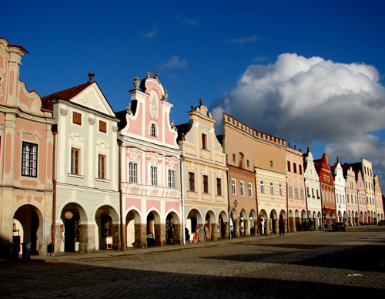
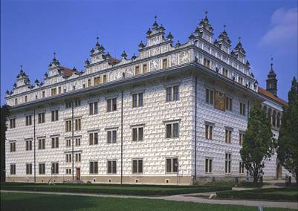
the Reneissance style
The Town of Telč
Chateau of Litomyšl

Slide 15
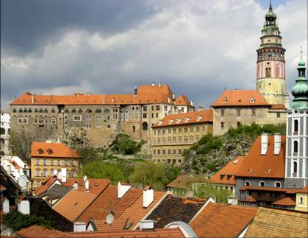
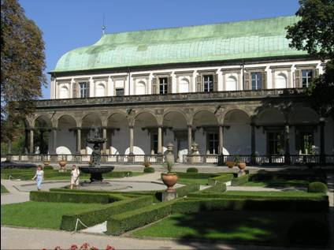
the Reneissance style
Belveder
Český Krumlov

Slide 16
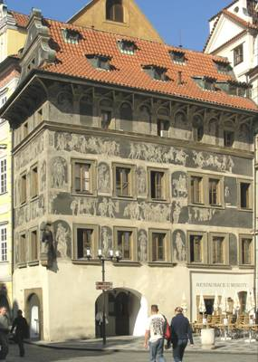
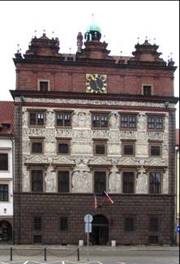
the Reneissance style
The house at the Old Town Square in Prague
The Town Hall in Pilsen

Slide 17
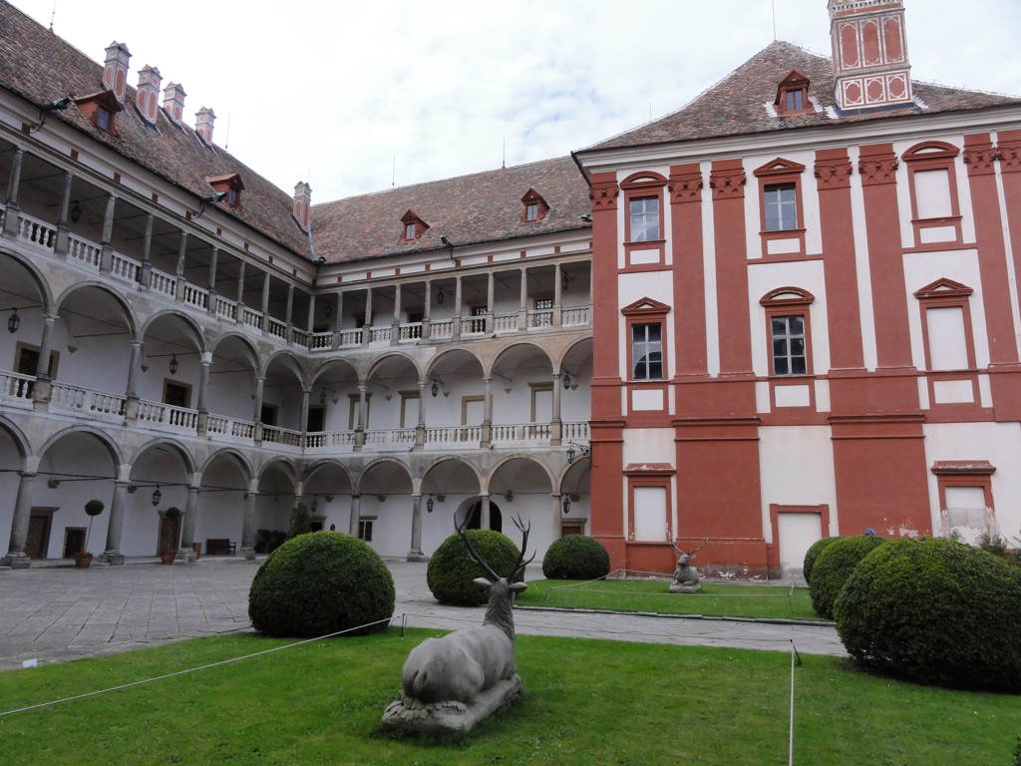
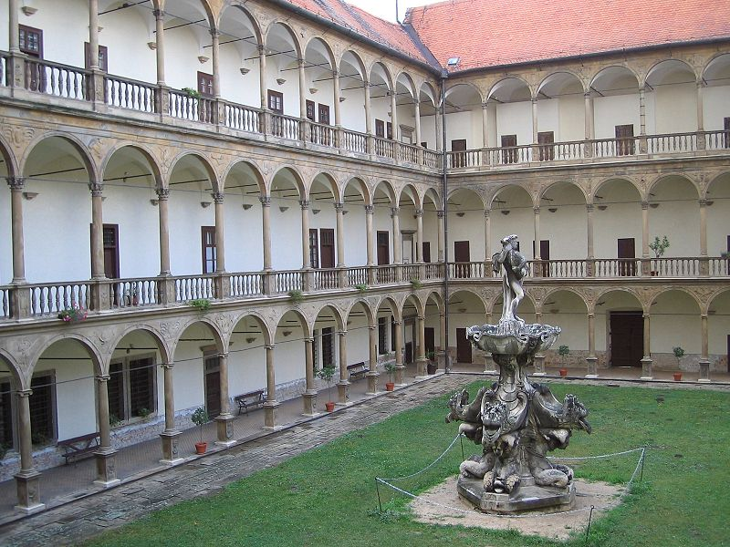
the Reneissance style
Chateau of Opočno
Chateau of Bučovice

Slide 18
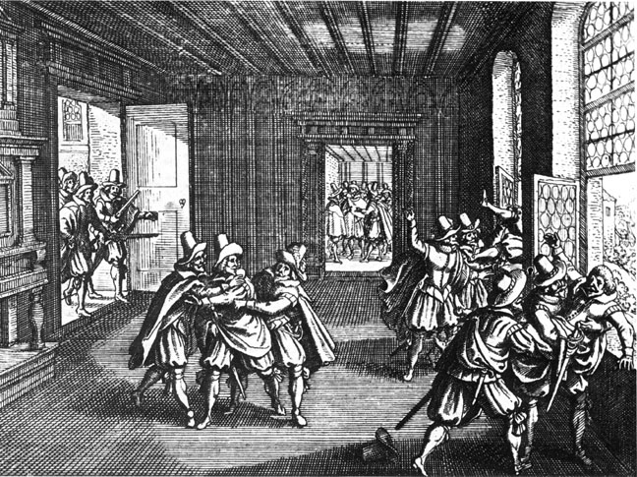
The Thirty Years' War (1618–1648)
The Emperor Ferdinand II tried to limit the freedom of religious confession and his efforts sparked a civil war between the Estates and the Catholic Emperor which later spread into Europe under the name of the Thirty Years' War
1618 – The so-called Defenestration of Prague – the unpopular king´s representatives in Bohemia (the governors) were thrown out of a window of the Prague Castle

Slide 19
The Thirty Years' War (1618–1648)
The Bohemians elected an independent king Frederick V.
The Bohemian Estates and their army were defeated in 1620 at the Battle of the White Mountain and the Kingdom of Bohemia lost its independence for the following almost 300 years
the Catholic faith was declared to be the only permitted creed in the country
The period of the Thirty Years' War brought political disorder and economic devastation to Bohemia which had far-reaching consequences on the future development of the country.

Slide 20
The Thirty Years' War (1618–1648)
The throne of Bohemia became hereditary in the Habsburg dynasty and the most important offices were transferred permanently to Vienna
Ferdinand II issued an edict, which ordered all non-Catholic noblemen to convert or to emigrate – so the large wave of emmigration succeeded
the hussite or protestant inhabitansts were often violently forced to convert
tightening of serfdom
German soon became the first language of the country

Slide 21
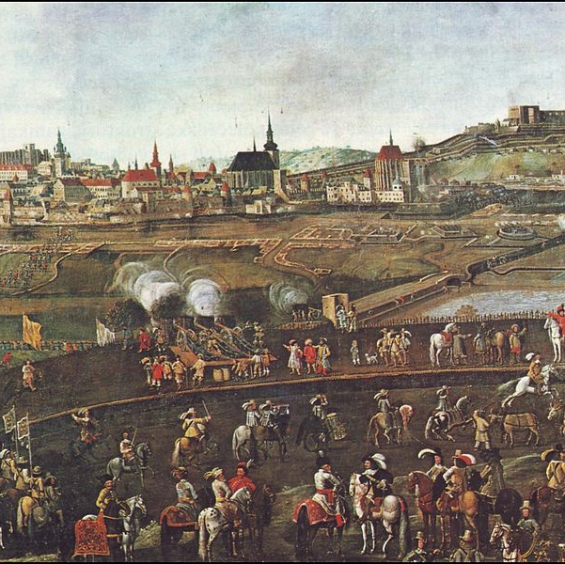
The Thirty Years' War (1618–1648)
Unsuccesful siege of Brno by Swedish army in 1645

Slide 22
The Consequences of Thirty Years´ War in Habsburg Monarchy and Czech lands:
Political:
the defeat of Czech Estates and the liquidation of the Czech Lands confederation enabled the Habsburgs to introduce a model based on a powerful´s monarch´s rule, traditionally called royal (Baroque) absolutism
in 1621 a greant trial with politicians who had been active in rebellion took place in Prague, their properties were confiscated and divided among the Catholic nobility from Bohemia, Austria and Hungary
on June 21 1621 – twenty-seven Estates oppositions leaders were executed in the old Town Square in Prague
the Habsburg were planning to establish a completely new order in the Kingdom of Bohemia and to implement radical changes in the Bohemian Lands´ status
they decided to eliminate the Estates opposition completely, to establish a strong ruling position and to incorporate the Lands of the Bohemian Crown into the Habsburg monarchy much more firmly than ever before

Slide 23
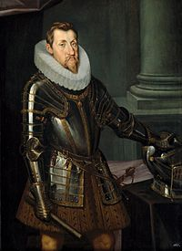
The Consequences of Thirty Years´ War:
Political:
Ferdinand II entrusted the administration of the Kingdom of Bohemia to the Catholic politician Karl I, Prince of Lichtenstein who became a royal vice-regent
in Moravia, the king was represented by a proconsul and governor – the Bishop of Olomouc, Cardinal Franz of Dietrichstein
the new relationship between king and estates was codified in the Renewed Land Ordinances, which were issued for Bohemian Kingdom in 1627 and for the Margraviate of Moravia in 1628
those were in fact new constitutions, the problem was, that they were issued without the Estates´ cooperation, the powers of the Estates were strictly limited
The Renewed Ordinance considerably augmented the ruler´s power in the Czech Lands

Slide 24
The Consequences of Thirty Years´ War
Economical and social:
the country was destroyed, many people died in the consequence of diseases, famine ...
not enough labour power – that caused tightening of serfdom
the peasants were not allowed to marry, move house, study or learn a trade without their landlord´s consent
the peasants also had to pay heavy governmental taxation
after the Battle of White Mountain unprecedented property and financial speculations
devaluation, literally cutting the coins
black death epidemies

Slide 25
The Consequences of Thirty Years´ War
Economical and social:
the fastest to recover was trade with distant countries, followed by local trade and handicraft
1666 – a commercial board (Commerzkollegium), an office for monitoring and support of economic life in Czech and Austrian lands was established – based on thoughts of leading German mercantilist Johann Joachim Becher
the first decades od 18th century – the beginning of major manufacturing development in the Czech Lands
the foreign experts were coming to the Habsburg Monarchy
in the Czech Lands, the manufacturing was oriented mainly towards linen production

Slide 26
The Consequences of Thirty Years´ War
Religious:
after two hundred years, the Catholic clergy was elevated to become the first and the most important Estate
the dominance of the Roman Catholic Church was secured – the re-Catholicization started,
the Catholic faith the only permitted creed in the country
Ferdinand II also issued an edict, which ordered all non-Catholic noblemen to convert or to emigrate – so the large wave of emmigration succeeded
among the emigrés were many outstanding scholars and intellectuals, such as Jan Amos Komenský (Comenius) a prominent thinker, teacher and scholar of European renown
the hussite or protestant inhabitansts were often violently forced to convert
forced conversion along with the tightening of serfdom and aggravating the social situation, resulted in unrest in the rural parts of the coutry and led to several peasant rebellions

Slide 27
The Thirty Years' War (1618–1648) - Summary
one of the most destructive conflicts in European history
the war was fought largely as a religious conflict between Protestants and Catholics in the Holy Roman Empire
later the war became more a continuation of the Bourbon–Habsburg rivalry for European political pre-eminence, and in turn led to further warfare between France and the Habsburg powers
all European states participated on the Thirty Years´ War – directly or indirectly
the Peace of Westphalia finished The Thirty Years´War – series of peace treaties signed between May and October of 1648

Slide 28
The Thirty Years' War (1618–1648) - Summary
The main tenets of the Peace of Westphalia:
All parties would recognize the Peace of Augsburg of 1555 (each Prince in HRE could choose the religion of his own state – or Catholicism, or Lutheranism or Calvinism) – cuius regio, eius religio
Christians living in principalities where their denomination was not the established church were guaranteed the right to practice their faith in public during allotted hours and in private at their will
General recognition of the exclusive sovereignty of each party over its lands, people, and agents abroad.
Readings:
Grafton, Anthony(2001): Thirty Years War. New York Review of Books.
Duchhardt, Heinz : Münster/Osnabrück as a Short-Lived Peace System. In: Goudoever, Albert P. van (ed.) (1993): Great Peace Congresses in History 1648–1990. Utrecht. Pp 13–19.

Slide 29
baroque
Around 1600 in Italy, in Central Europe during 17th and 18th century
The last universal style
Encouraged and supported by the Catholic Church
Paintings – Karel Škréta, Václav Vavřinec Reiner
Sculptures – Matyas Bernard Braun (Charles Bridge – sculptures, Kuks), Ferdinad Maxmilian Brokoff (Charles Bridge)
Music – Adam Václav Michna z Otradovic, Jan Dismas Zelenka
Literature
Architecture

Slide 30
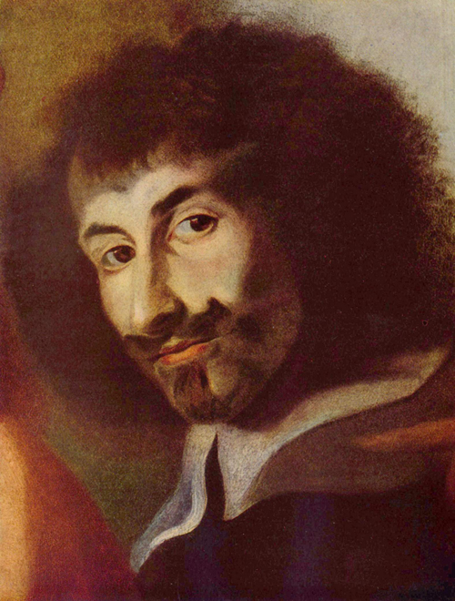
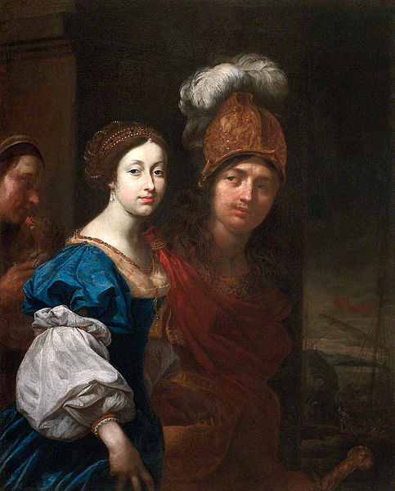
baroque
Karel Škréta – Self Portrait
Karel Škréta - Paris and Helen

Slide 31
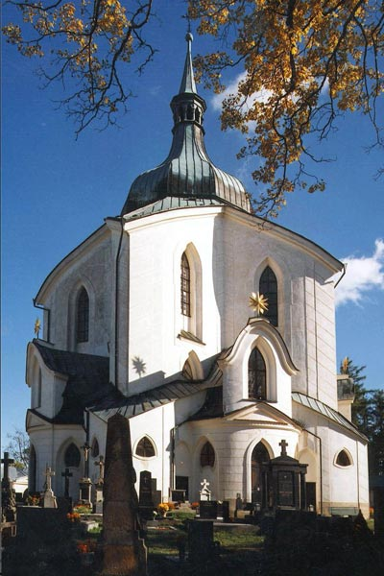
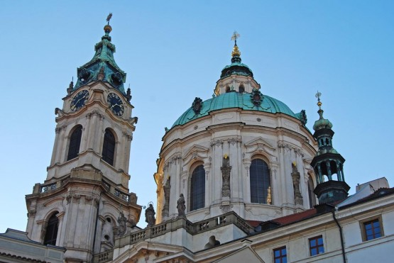
Baroque in czech lands
Pilgrimage Church of St John of Nepomuk on Zelena hora Hill
-Jan Blažej Santini-Aichel
http://www.santini.cz/index-en.aspx
Prague – St. Nicholas Church – Christof and Kilian Ignac Dienzenhofer

Slide 32
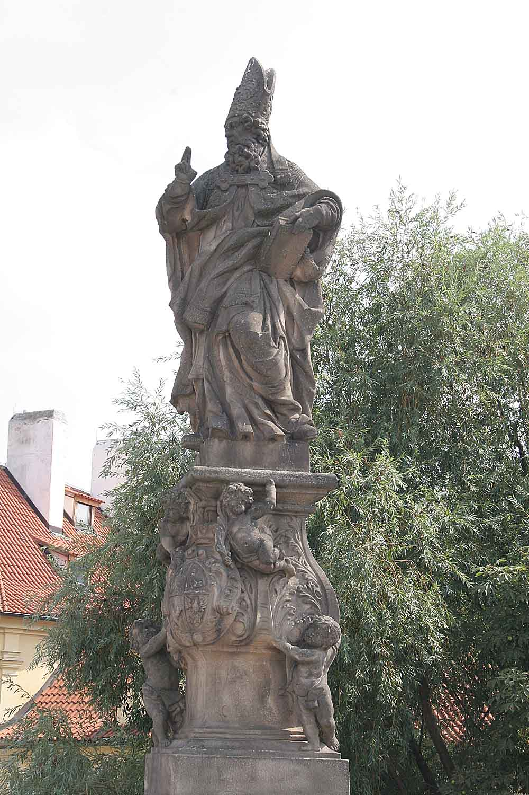
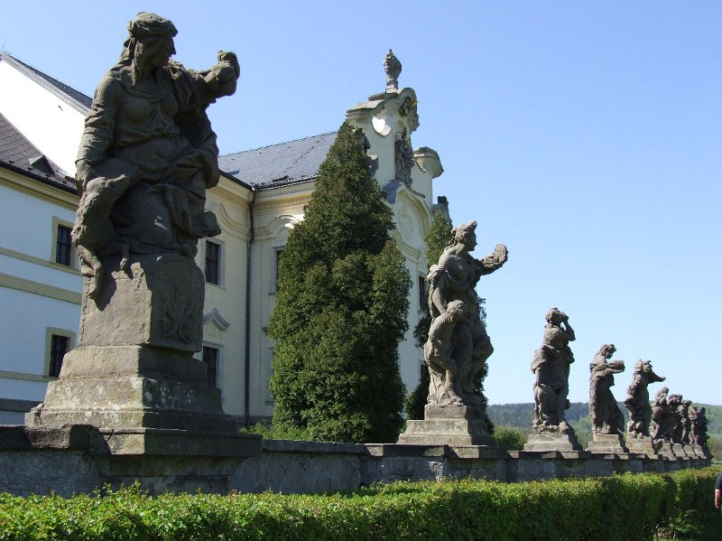
Baroque in czech lands
Kuks – Matyas Bernard Braun
Charles Bridge – St. Adalbert – F. M. Brokoff

Slide 33
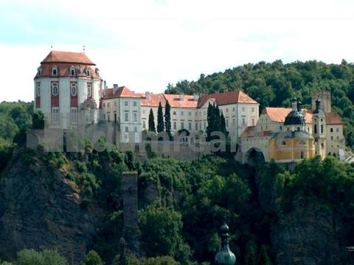
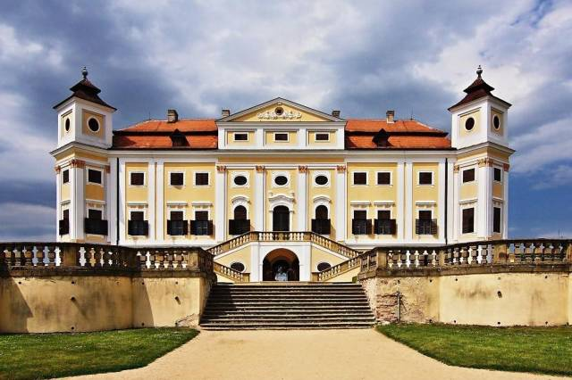
Baroque in Brno surroundings
Chateau Vranov nad Dyjí – Jan Bernard Fischer von Erlach
http://www.zamek-vranov.cz/en/
Chateau Milotice - Josef Emanuel Fischer von Erlach
http://www.zamekmilotice.cz/virtualni-prohlidka-2/

Slide 34
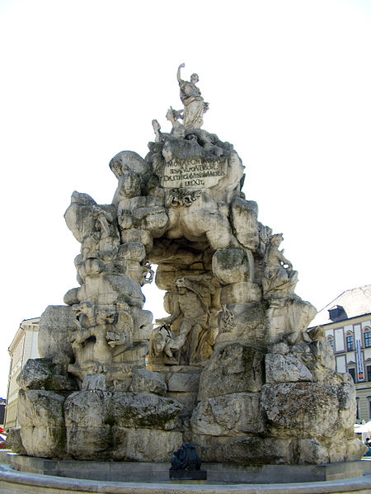
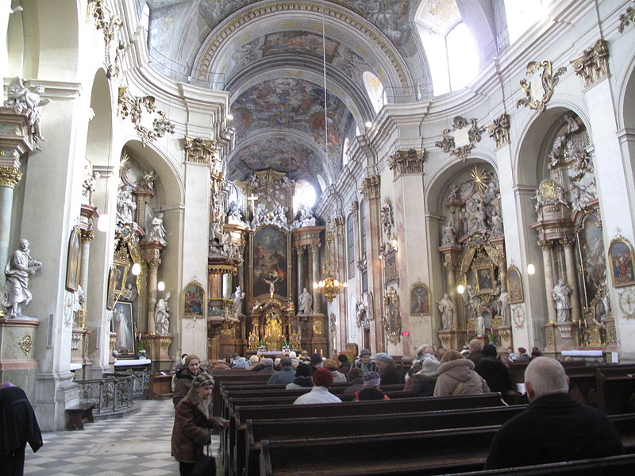
Baroque in the city of brno
Green Market - The Parnas Fountain - Johann Bernhard Fischer von Erlach
St. Johns´Church, Minoritská street, Brno

