Slide 1
Central Europe Before, during and after
Thirty Years´ War
Mgr. Jana Skerlova

Slide 2
the House of Habsburgs
Habsburgs orriginaly came from Switzerland
During 13th century – the domains in Austria
Since 14th century – the growth of their power
1526 – 1918 ruled over Bohamian lands
The Habsburg rule brought the re-introduction of the Roman Catholic faith, centralization and the construction of a multi-national empire
The Habsburgs included the Crownlands of Bohemia into their monarchy, the Habsburg domination over Bohemia, Moravia and Silesia lasted till 1918

Slide 3
Ferdinand I
Ferdinand I (1526–1564)
He became the Holy Roman Emperor in 1558 (after his brother Charles V had died)
king of Bohemia and Hungary since 1526 (elected by Bohemian and Hungarian Diet – i.e. nobles, clergy and representatives of the royal tows – because he was a husband of Anne Jagiellonica – sister of Bohemian and Hungarian king Luis II who had died at the battle of Mohács in 1526)
king of Croatia, Dalmatia, Slavonia, and formally king of Serbia, Galicia (in Eastern Europe) and Lodomeria, etc. → large and powerful empire

Slide 4
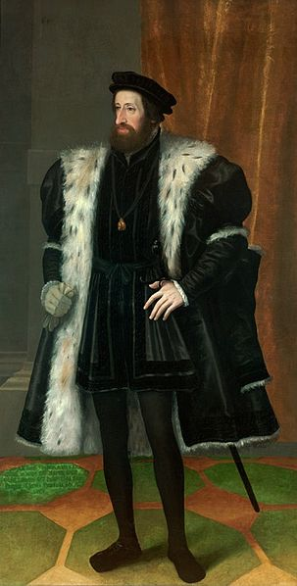
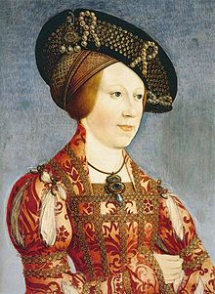
the House of Habsburgs
Ferdinand I
Anne of Hungary and Bohemia

Slide 5
Ferdinand I
The key events during his reign were:
the contest with the Ottoman Empire
Their great advance into Central Europe began in the 1520s
1529 – they unsuccessfuly assaulted Vienna, the capital of Habsburg Monarchy
The Siege of Vienna took 150 days
the aim of the campain was securing control over all of Hungary and weakening of the Habsburgs’ power
unusually bad weather conditions saved Vienna, the heavy rain and snowfall made the Turks to leave
they returned in 1533, but their army wasn’t so strong
1533 – a peace treaty with the Ottoman Empire was concluded – split Hungary into a Habsburg sector in the west and a vassal state of the Ottoman Empire in the east

Slide 6
the contest with the protestant Reformation, which resulted in several wars of religion
1519 – The ninety-five thesis of Wittenberg - was written by Martin Luther in 1517 and is widely regarded as the primary catalyst for the Protestant Reformation
The disputation protests against clerical abuses, especially the sale of indulgences
1546–1547 – the Smalkaldic war – the Smalkaldic Union of protestant towns and princes united against ruling catholic Habsburg dynasty
Ferdinad and his brother Charles V, the Emperor, formed a strong army
they also asked the Bohemian estates (nobility, clergy and towns)) to form an army and send it to fight against Smalkaldic Union
the Bohemians refused to do it because they didn’t want to fight against protestants and also because the Bohemian national army could be called only to defend the country not to conquere foreign lands or to fight abroad
so the Bohemian estates were protesting and they rose up against Habsburgs
but the rebellion was easily supressed and the represions followed
the represions against nobility weren’t so strict (usually the noblemen lost their property) but the towns, which were also participating on the uprising, were excluded from the political life and the town goverment was put under the control of the royal clerks
also the hussite church was persecuted in Bohemian Lands

Slide 7
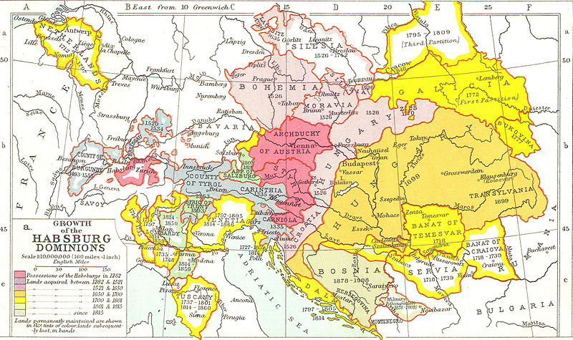
The habsburg monarchy

Slide 8
Maxmilian II (1562–1576)
He faced the rising power of new Protestant movements in Bohemia – so called Bohemian Brethern and Lutherans
he ratified the religious programe of Bohemian non-catholic estates - so called The Bohemian Confession
but he ratified it only orally so it didn’t bring the religious liberty as the Bohemian estates wished

Slide 9
Rudolph II (1576-1611)
Eccentric person
Incompetent and weak ruler, not very interested in politics
left Vienna for Prague, Bohemian capital grew into an important center of European culture
1593–1606 – „The Long War“ – with Osman Turks
1609 – The Czech Estates forced Rudolph II to issue a decree - so called "Maiestatus" or the Letter of Majesty - Rudolph was compelled to grant far-reaching consessions to the nobility and to proclaim freedom of religious confession in Bohemian Lands
1604 –1606 – uprising in Hungary
since 1608 – he ruled only over Bohemia, Silesia and Lusitania, his brother Mathiass became a ruler in Moravia, Austria and Hungary

Slide 10
Rudoplh supported culture, arts, sciences etc.
due to the presence of many artist and scientist and the development of culture and natural sciences his capital city was called „the Golden Prague“
Rudolph also supported natural philosofers such as the astronomers Tycho Brahe and Johannes Kepler, also Giordanno Bruno spent some time in Prague when he was on the run from the inquisition
Rudolph kept a menagerie of exotic animals, botanical gardens, and Europe’s most extensive "cabinet of curiosities"(Kunstkammer)
Rudolph also patronated occult sciences, many alchymists stayed in Prague during his reign such as Edward Kelley and John Dee
he had his private alchemy laboratory where he arranged his own experiments
His lifelong wish was to find the Philosopher's Stone and become immortal
apart from the Philosopher´s Stone the alchymsits also wanted to construct an artificial human being – homunkulus

Slide 11
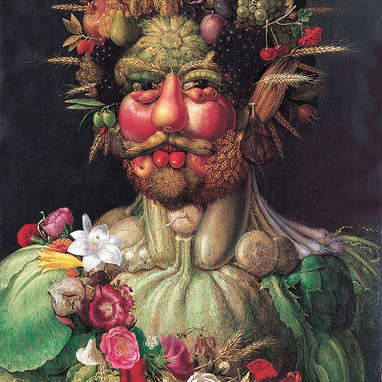
Rudoplh Ii
Rudolph loved collecting paintings and was also a patron of many contemporary artists – e. g. Giuseppe Arcimboldo, Bartolomeus Spranger, Hans von Aachen, Adrian de Vries and many others
Interesting web site: http://english.habsburger.net/

Slide 12
the Reneissance style
dominating artificial style in 16th and 17th century in Bohemia and in the Central Europe
The obvious distinguishing features of Classical Roman architecture were adopted by Renaissance architects
the Prague Castle was rebuilt in this style
A villa for Queen Anna – Belveder near the Prague Castle
many Italian architects came to Bohemia
Old castles are rebiult into the modern chateaus – e. g. Chateau Litomyšl (UNESCO), Castle Český Krumlov – UNESCO
Prosperity of the towns – town halls, squares, houses
palaces of the nobility built in the towns
Town of Telč – houses with picturesque facades and arcades - UNESCO
Town of Slavonice
near to the Brno – Bučovice castle – unique - newly built castle

Slide 13
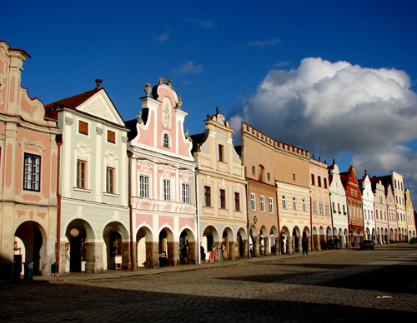
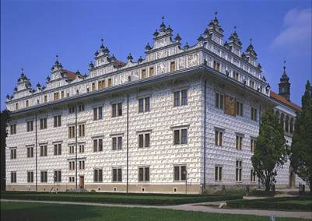
the Reneissance style
The Town of Telč
Chateau of Litomyšl

Slide 14
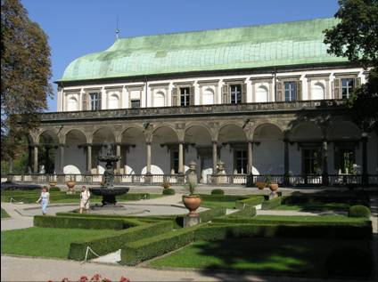
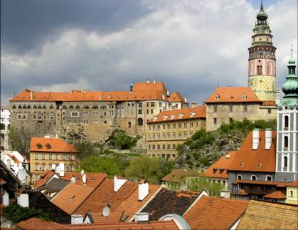
the Reneissance style
Belveder (Prague)
Český Krumlov

Slide 15
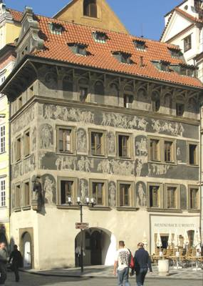
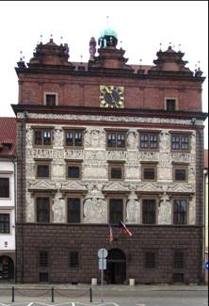
the Reneissance style
The house at the Old Town Square in Prague
The Town Hall in Pilsen

Slide 16
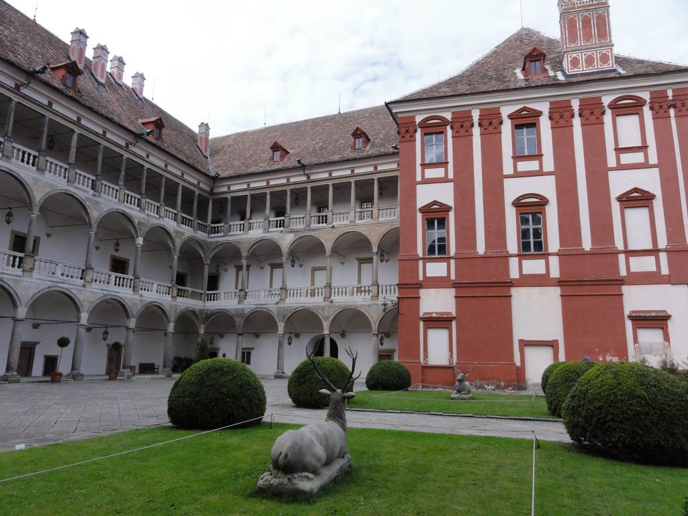
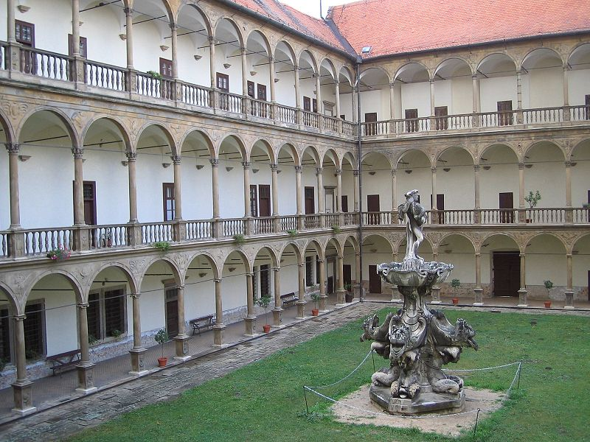
the Reneissance style
Chateau of Opočno
Chateau of Bučovice

Slide 17
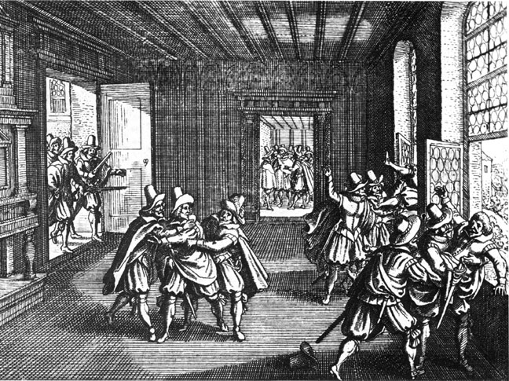
The Thirty Years' War (1618–1648)
Matthias (1611–1619) – disregarded the Letter of Majesty in an issue involving Protestant churches
The Bohemian noblemen revolted
1618 – The so-called Defenestration of Prague – the unpopular king’s representatives in Bohemia (the governors, high offcials) were thrown out of a window of the Prague Castle
The provisional government of 30 directors was established
the Bohemian nobility declared that Matthias’ son Ferdinand II was deposed, in his place Frederick V (1619–1920) was elected – called „Winter King“

Slide 18
The decisive clash between the two opposing camps took place in 1620 in Battle of the White Mountain
Frederick, Bohemian Estates and their army were defeated and the Kingdom of Bohemia lost its independence for the following almost 300 years
the Catholic faith was declared to be the only permitted creed in the country
the Bohemian revolt was an episode of the religious Thirty Years’ War that swetp over Europe between 1618 and 1648
the period of the Thirty Years’ War brought political disorder and economic devastation to Bohemia and to the Central Europe in general which had far-reaching consequences on the future development of the country

Slide 19
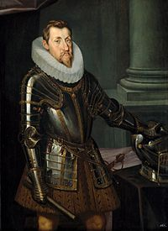
in 1621 a greant trial with politicians who had been active in rebellion took place in Prague, their properties were confiscated and divided among the Catholic nobility from Bohemia, Austria and Hungary
on June 21 1621 – twenty-seven Estates oppositions leaders were executed in the old Town Square in Prague
The throne of Bohemia became hereditary in the Habsburg dynasty and the most important offices were transferred permanently to Vienna
The property of the Protestant leaders were confiscated
German soon became the first language of the country

Slide 20
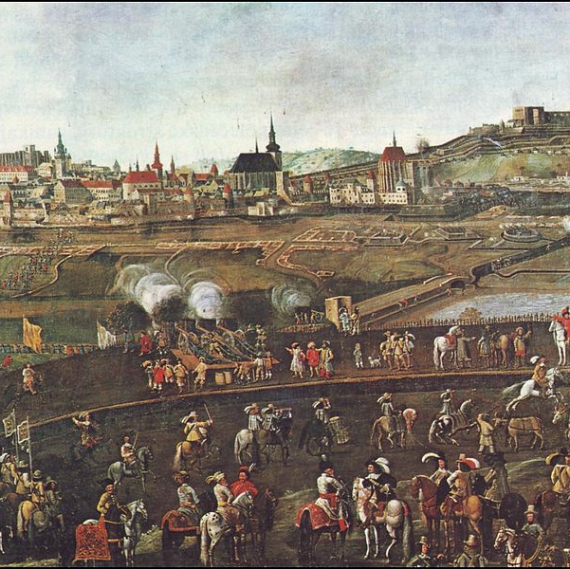
The Thirty Years' War (1618–1648)
Unsuccesful siege of Brno by Swedish army in 1645

Slide 21
The Consequences of Thirty Years´ War in Habsburg Monarchy and Czech lands:
Political:
the defeat of Czech Estates and the liquidation of the Czech Lands confederation enabled the Habsburgs to introduce a model based on a powerful´s monarch´s rule, traditionally called royal (Baroque) absolutism
the Habsburg decided to eliminate the Estates opposition completely, to establish a strong ruling position and to incorporate the Lands of the Bohemian Crown into the Habsburg monarchy much more firmly than ever before
1627 – Ferdinand II formaly declared Bohemia a Habsburg crown land
The Bohemian Diet lost its legislative autonomy and was reduced to a consultative

Slide 22
Economical and social:
the country was destroyed, many people died in the consequence of diseases, famine, black death epidemies etc.
not enough labour power – that caused tightening of serfdom
About 36 000 Czech families had been compelled to emigrate from Bohemia – replaced by foreigners
among the emigrés were many outstanding scholars and intellectuals, such as Jan Amos Komenský (Comenius) a prominent thinker, teacher and scholar of European renown

Slide 23
Economical and social:
after the Battle of White Mountain unprecedented property and financial speculations
devaluation, literally cutting the coins
the peasants were not allowed to marry, move house, study or learn a trade without their landlord’s consent
They had to work on landlord’s fields several days in a week
Ruthless taxation of Bohemian people – the peasants also had to pay heavy governmental taxation
Large number of German colonists
Germanization, national humulitation
Economic misery

Slide 24
Religious consequences:
after two hundred years, the Catholic clergy was elevated to become the first and the most important Estate in the Czech lands
the dominance of the Roman Catholic Church was secured – the re-Catholicization started
Ferdinand II issued an edict, which ordered all non-Catholic noblemen to convert or to emigrate – so the large wave of emmigration succeeded
Protestant preachers were expelled
The jesuits assumed a dominant role as close counselors of the ruler, school administrators and censors of the books

Slide 25
Religious consequences:
the Catholic faith the only permitted creed in the country
the hussite or protestant inhabitansts were often violently forced to convert
forced conversion along with the tightening of serfdom and aggravating the social situation, resulted in unrest in the rural parts of the coutry and led to several peasant rebellions

Slide 26
The Thirty Years' War (1618–1648) - Summary
one of the most destructive conflicts in European history
the war was fought largely as a religious conflict between Protestants and Catholics in the Holy Roman Empire
later the war became more a continuation of the Bourbon (French)–Habsburg (Austrian and German) rivalry for European political pre-eminence, and in turn led to further warfare between France and the Habsburg powers
all European states participated on the Thirty Years´ War – directly or indirectly
the Peace of Westphalia finished The Thirty Years´War – series of peace treaties signed between May and October of 1648

Slide 27
The Thirty Years' War (1618–1648) - Summary
The main tenets of the Peace of Westphalia (1648):
All parties would recognize the Peace of Augsburg of 1555 (each Prince in Holy Roman Empire could choose the religion of his own state – or Catholicism, or Lutheranism or Calvinism) – cuius regio, eius religio
Christians living in principalities where their denomination was not the established church were guaranteed the right to practice their faith in public during allotted hours and in private at their will
General recognition of the exclusive sovereignty of each party over its lands, people, and agents abroad.
Readings:
Grafton, Anthony(2001): Thirty Years War. New York Review of Books.
Duchhardt, Heinz : Münster/Osnabrück as a Short-Lived Peace System. In: Goudoever, Albert P. van (ed.) (1993): Great Peace Congresses in History 1648–1990. Utrecht. Pp 13–19.

Slide 28
Habsburg monarchy after 30 Years’ war
The wars with Ottoman Empire – OE was ruling over the whole Balkan Peninsula and a part of Hungary
1683 – Vienna besieged by the Ottomans
Polish king Jan (John) III Sobieski (1674–1696) helped Vienna and the Ottomans were defeated
1697 – The Ottomans were defeated at the Battle of Zenta
1699 - Peace Treaty of Karlowitz (Sremski Karlovci) – Hungary,Croatia and Slavonia incorporated into the Habsburg Monarchy again
1701–1714 – the Wars of Spanish Succession – Habsburgs x Bourbons (French ruling dynasty)
Bourbons won and got Spanish throne
Habsburgs got territories in Italy (Naples, Sardinia, Milan) and Spanish Netherlands as compensation
Habsburg Monarchy became a great power at the beginning of 18th century and a leading power in Central Europe

Slide 29
Central euroepan baroque
Around 1600 in Italy, in the Central Europe during 17th and 18th century
The last universal artifical style in Europe
Encouraged and supported by the Catholic Church – in response to the Protestant Movement – should support the influence of Catholic church
the arts should communicate religious themes in direct and emotional involvement
Paintings – Karel Škréta, Václav Vavřinec Reiner
Sculptures – Matyas Bernard Braun (Charles Bridge – sculptures, Kuks), Ferdinad Maxmilian Brokoff (Charles Bridge)
Music – Johann Sebastian Bach, Georg Friedrich Händel
Czech composers:Adam Václav Michna z Otradovic, Jan Dismas Zelenka
Literature
Architecture

Slide 30
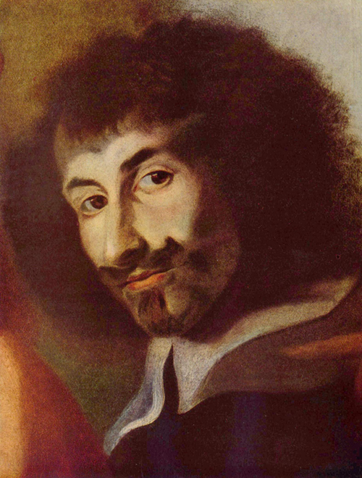
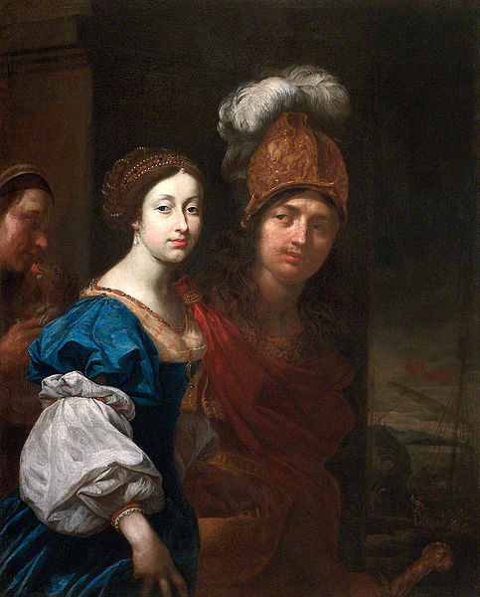
baroque
Karel Škréta – Self Portrait
Karel Škréta - Paris and Helen

Slide 31
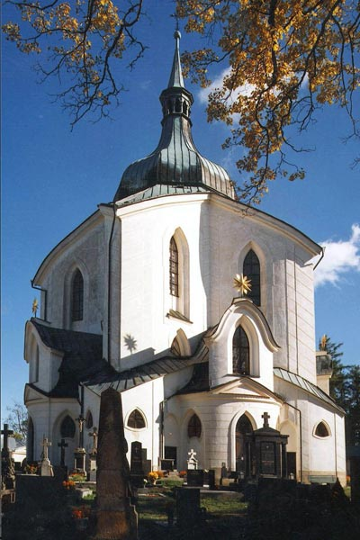
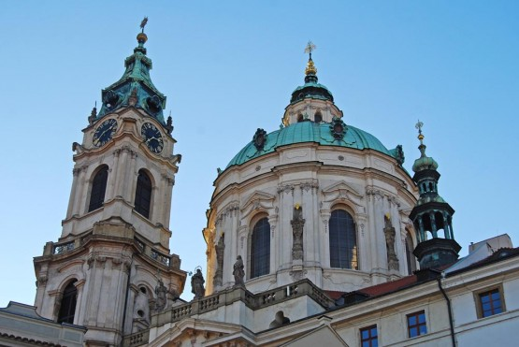
Baroque in czech lands
Pilgrimage Church of St John of Nepomuk on Zelena hora Hill
-Jan Blažej Santini-Aichel
http://www.santini.cz/index-en.aspx
Prague – St. Nicholas Church – Christof and Kilian Ignac Dienzenhofer

Slide 32
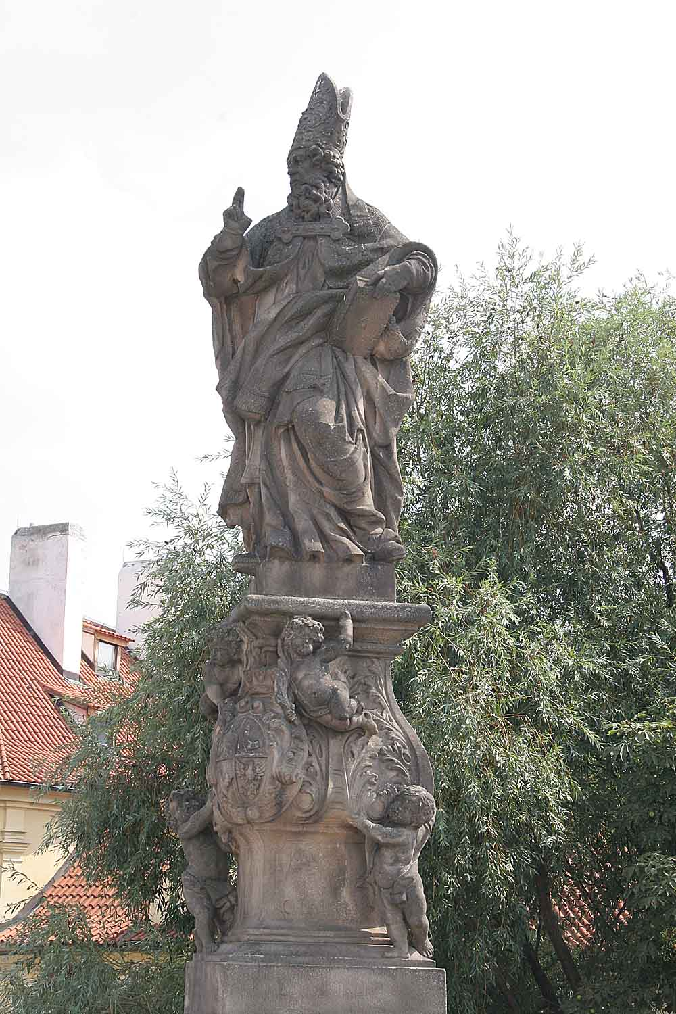
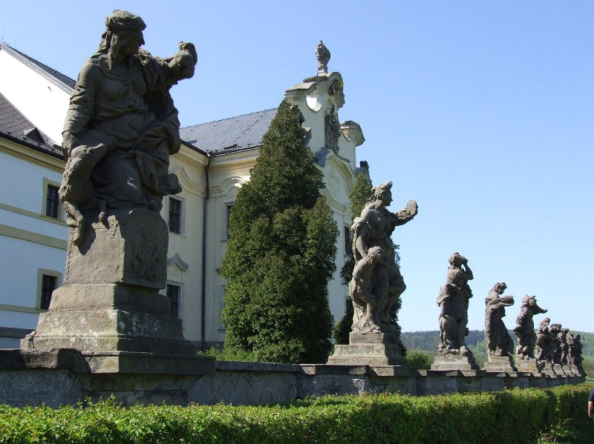
Baroque in czech lands
Kuks (western Bohemia) – Matyas Bernard Braun
Charles Bridge (Prague) – St. Adalbert – F. M. Brokoff

Slide 33
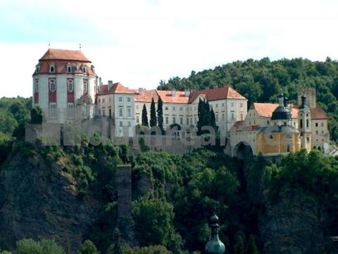
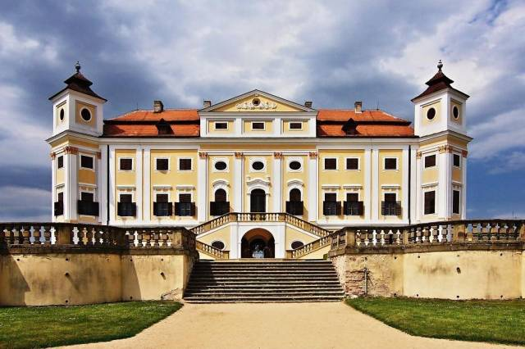
Baroque in Brno surroundings
Chateau Vranov nad Dyjí (southern Moravia) – Jan Bernard Fischer von Erlach
http://www.zamek-vranov.cz/en/
Chateau Milotice (southeastern Moravia) - Josef Emanuel Fischer von Erlach
http://www.zamekmilotice.cz/virtualni-prohlidka-2/

Slide 34
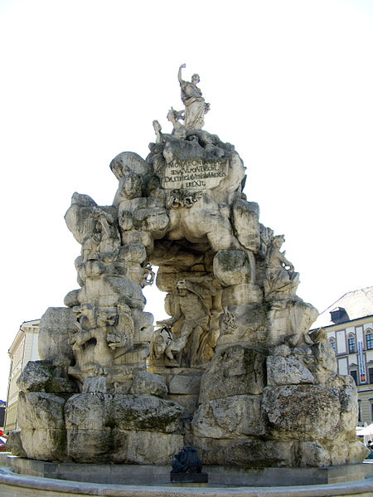
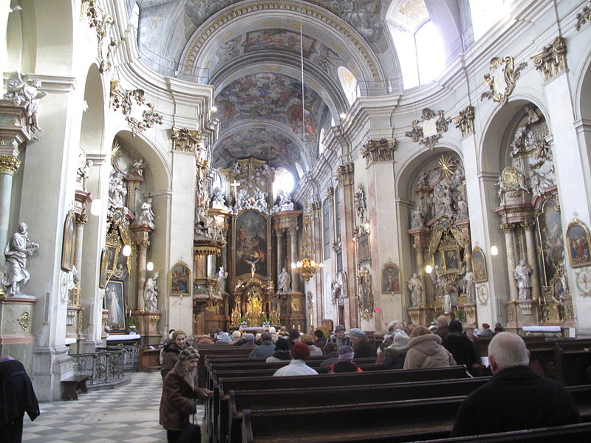
Baroque monunets in the city of brno
Green Market - The Parnas Fountain - Johann Bernhard Fischer von Erlach
St. Johns’ Church, Minoritská street, Brno

Slide 35
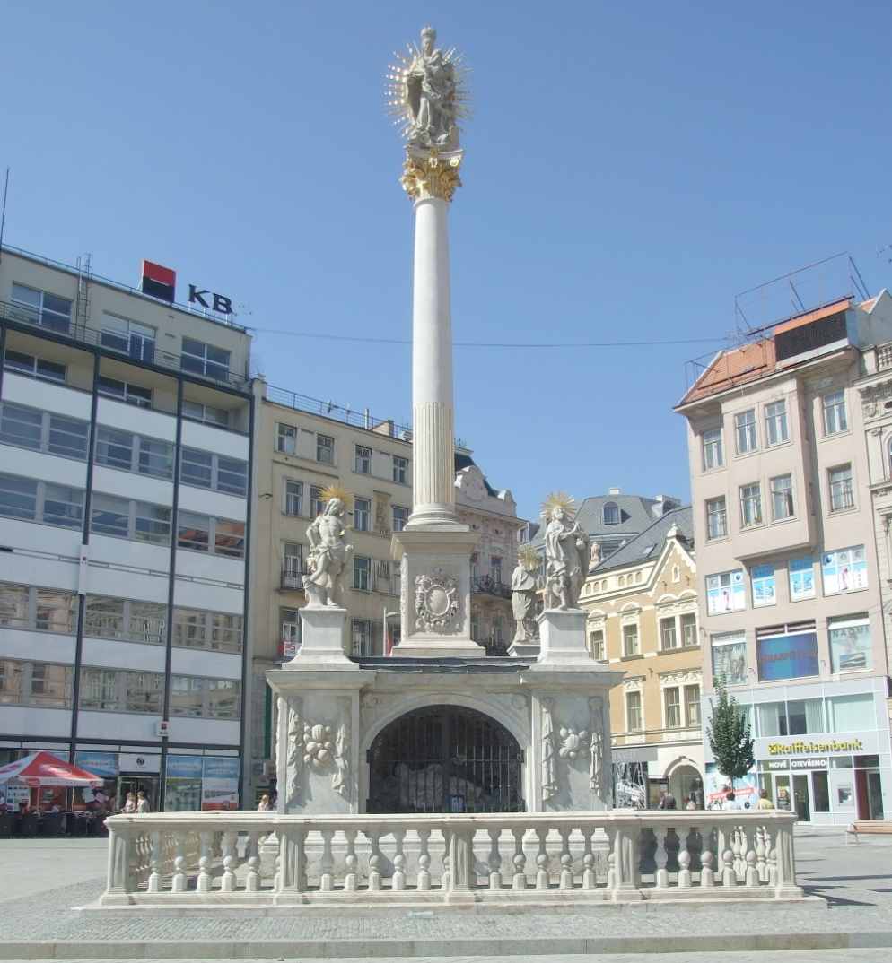
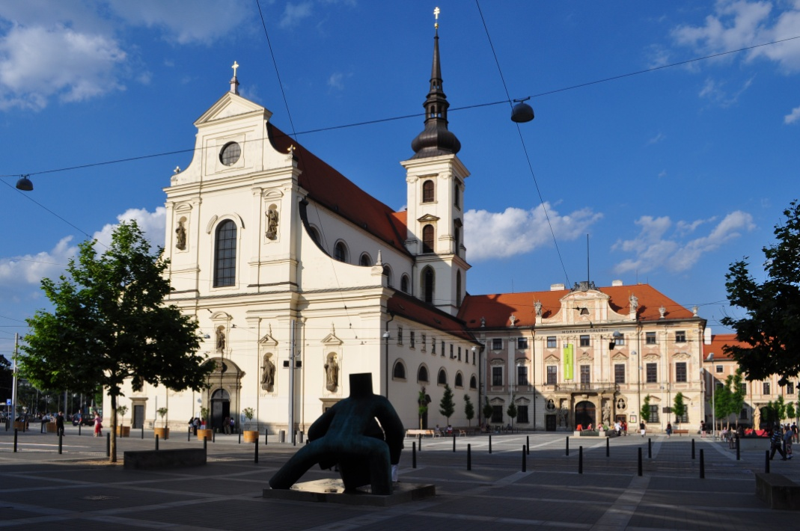
Baroque monunets in the city of brno
St. Thomas’ Church – Moravské Square
The Plague Column
Square Svobody

