Slide 1
Central at the end of 19th century
World war 1
Jana Skerlova

Slide 2
International Relationships before the WW1
Great powers at the end of the 19th century:
USA - the strongest country of the world
Germany (2nd greatest world industrial area), the most powerful state in Europe, strong army, developed economy and culture
France – the bank of the world, 2nd strongest European state, succesful colonial politicis – colonies in Africa and in Asia
Great Britain – the greatest colonial power – its domain included the geatest colony – India, also colonies in Asia
Japan – constitutional monarchy, development of industry, expansive politics
Austria-Hungary – cooperation with Germany, its foreign politics focused on the Balkan Peninsula
Russia – economicaly and politicaly the weakest state among the great powers, military-political system, absolute power of the Tsar, no political rights for citizens, social movement, expansion to Asia – conflicts with Japan and Great Britain
Ottoman Empire – „the sick man of Europe“ – weakening of its political and economical power during 18th and 19th century

Slide 3
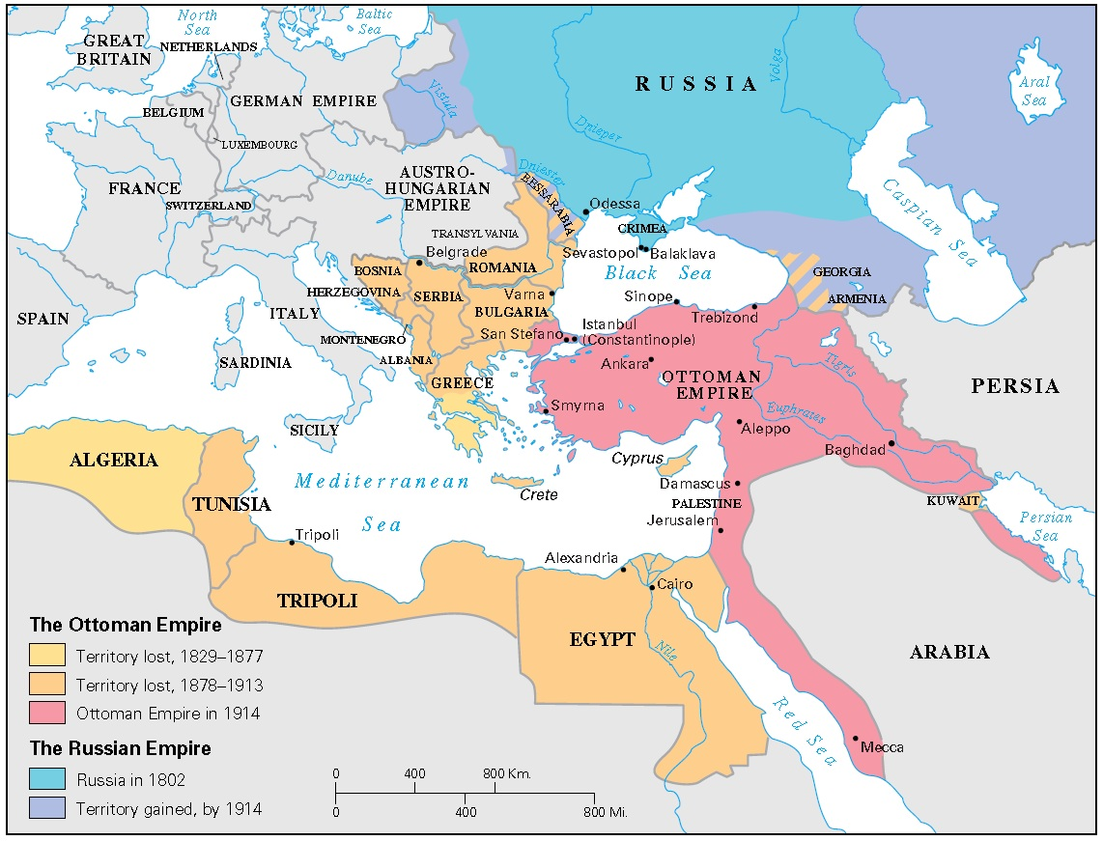
The ottoman empire

Slide 4
Balkan peninsula
Ottoman Empire – large but weak – the local national movements and wanted to use it and tried to liberate themselves
Two uprisings in Serbia during the first half of 19th century
1830 – internal autonomy of Serbia was recognized by the Ottoman Empire
1821–1830 – Greek war for independence
1828–1829 – Russo-Turkish war – Ottoman Empire was defeated, Russia supported Greek demands
1832 – the independent Greek Kingdom was established
1858 – after the Crimean war the Great powers supported the demands of Danubian Principalities (Walachia and Moldavia) – these two principalities gained authonomy and in 1861 were unified into the autonomous Romanian state, after that in 1881 the independent Romanian Kingdom was established

Slide 5
1875–1878 – Great Eastern Crisis
Started in 1875 with the uprising of ethnic Serbs against Ottoman Empire in Herzegovina
April 1976 – the uprosing in Bulgaria against Ottoman Empire
Serbia amd Montenegro supported this uprising → Serbo-Turkish War (1876–1878)
1977–1978 – Russo-Turkish war - Russia was more succesfull but under the pressure of Great Britain and France had to accept the truce offered by the Ottoman Empire
Peace Treaty of San Stefano from March 3rd – the Ottoman Empire recognized full independence of Serbia, Romania and Montenegro and the authonomy of Bulgaria
Alarmed by the extension of Russian power into the Balkans the Great Powers (Breat Britain, France, Germany, Austria-Hungary, Italy) claimed the Berlin Congress, held from June to July 1878 in German capital city.
Otto von Bismarck was the host of the Congress.
Its aim was to reorganize the countries of the Balkans and to stabilize the territory.
The great powers had their own interests in the Balkans.
Ottoman holdings in Europe declined sharply.
Bulgaria was established as an autonomous principality inside the Ottoman Empire, then after the Serbo-Bulgarian war in 1885 (Bulgaria won) the independent Bulgarian Principality was established
Romania, Serbia and Montenegro achieved the full independence – at was recognized by the Great powers
Macedonia – was returned outright to the Turks, who promised reforms
Bosnia and Herzegovina was taken over by Austria-Hungary
Cyprus was taken over by Great Britain
Many countries were dissastisfied with the results of the Berlin Congress.

Slide 6
Formation of two enemy blocks in Europe at the end of 19th century
The great power were affraid of each other so they tried to find the allies
They also wanted territorial gains
1879 – the secret agreement was concluded between Germany and Austria-Hungary – against France and Russia
1882 – Italy joined this pact → Tripple Alliance (later the Central Powers)
1893 – Russia and France made an agreement – they both were isolated and were affraid of strong and aggresive Germany
1904 – so called Entente Cordial between France and Great Britain was concluded (both countries were affraid of strong Germany)
1907 – Russia + Britain → Tripple Entente

Slide 7
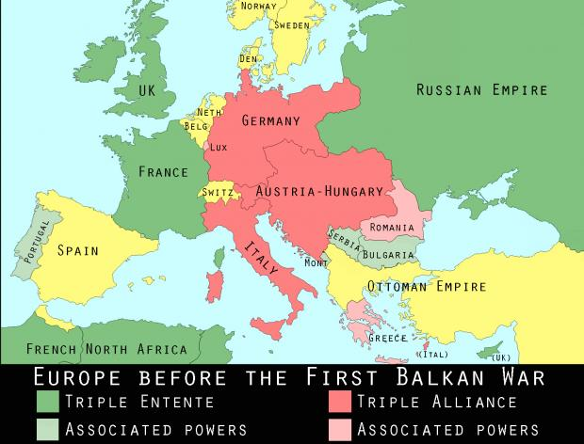

Slide 8
Balkan Wars
the first conflict in Europe after 30 years
the Balkan nations were fighting against the Ottoman Empire which was still occupiing some parts of the Balkan Peninsula
1912–1913 - 1st Balkan War
so called Balkan League (Bulgaria, Serbia, Greece and Montenegro) against the Ottomans
the Ottoman Empire was defeated and its European areas were liberated
but then the former allies started to fight with each other because of deviding of the liberated areas,
Bulgaria had greatest war casualties and invested the most but the deliberated areas (Macedonia, Thrakia) got especially Greece and Serbia → Bulgaria was dissatisfied and declared war on Greece and Serbia → a new war broke out
2nd Balkan War – 1913
Turkey and Rumania joined Greece and Serbia and they were fighting against Bulgaria which was defeated and lost also the areas which obtained after the
1st Balkan War
but also Serbia was dissatisfied with the results of the wars (Serbia was expecting enlargement of its territory and wanted to raise Adriatic coast but instead of that Albania was formed by the Great powers in 1913)
Serbia started to prepair for the new war – wanted tu unify all the southern Slavs – also those who were living in Austria-Hungary

Slide 9
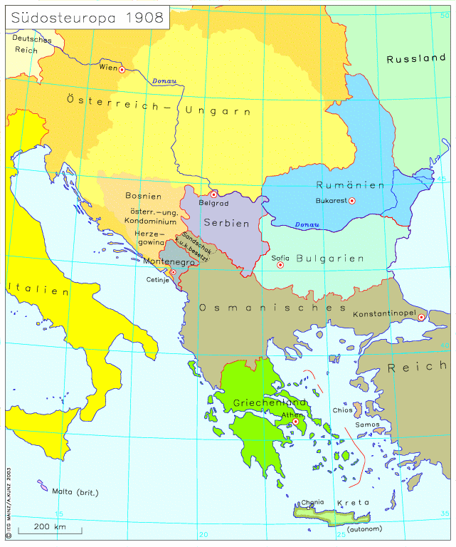
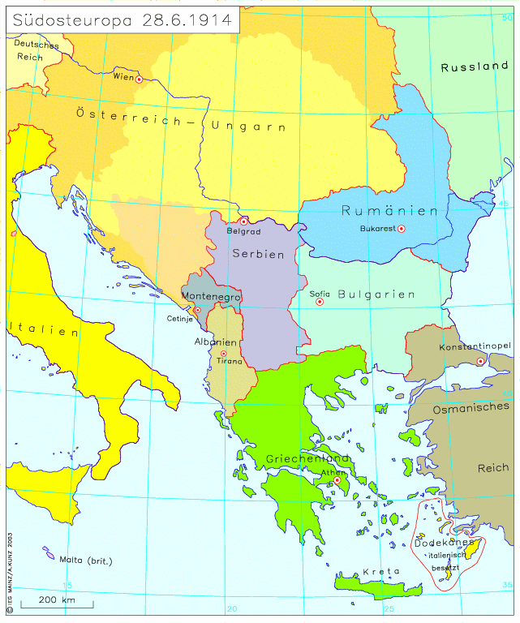
Balkan Wars
The Balkans before the 1st Balkan War
The Balkans after the 2nd Balkan War

Slide 10
Central europe before WWI
Since the Crimean War (1853–1856) there was a period without a great war in Europe (only local conflicts)
The tensions persisted on the Balkan Peninsula (1908 – the annexation of Bosnia and Herzegovina by Austria-Hungary, 1912–1913 the Balkan Wars etc.)
Pacifist movement - peace conferences in Hague (1898 and 1907) - unsuccessful
two blocks of powers at the beginning of the war:
Entente (Allied Powers): Great Britain + France + Russia
Central Powers: Germany + Austria-Hungary + (later) Bulgaria + Turkey
Italy – firstly neutral, in May 1915 joined the Entente (the London Treaty in April 1915 promised territorial gains to Italy)
neutral countries: Sweden, Norway, Denmark, Netherlands, Spain, Switzerland, Albania
USA – neutral at the beginning of the war, entered the war in April 1917

Slide 11
The targets
Germany – the most agresive, wanted new colonies and wanted to expand to the Middle East (Berlin-Baghdad railroad), also wanted to rule in the Central, Eastern and South-East Europe (with the help of Austria-Hungary), Germany also wanted some areas in France and Belgium
Austria-Hungary – wanted to expand into the Balkan Peninsula and defeat the Kingdom of Serbia, which was independent, Serbia was the enemy for A-H also becauce of Bosnia and Herzegovina
France – wanted to get back Alsace and Loraine from Germany + keep its colonial domains
Russia – wanted Galicia (which was Austro-Hungarian province in those times), Silesia, and some parts of Balkan Peninsula, especially around the straits between Asia and Europe - Bosphorus and Dardanelles
Serbia – wanted to keep its independence and to form the Balkan federation – with Croats, Slovenes and Serbs living in Austria and Hungary
Great Britain – wanted to keep its colonies and exclude Germany from world trade, stop its expansion to the Middle East
USA – wanted to defend democracy in the world and the principle of self-determination of the nations (Woodrow Wilson)

Slide 12
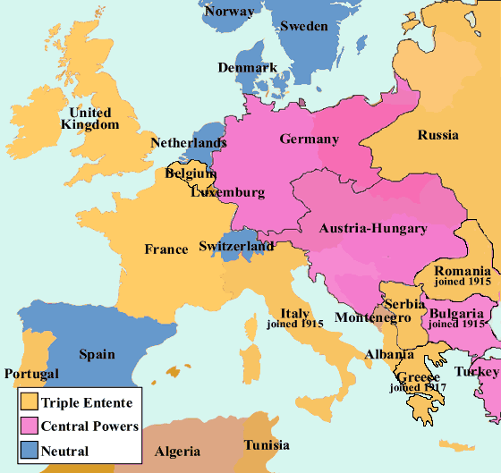
Europe during WW i
The blocs of Powers
during the WW I

Slide 13
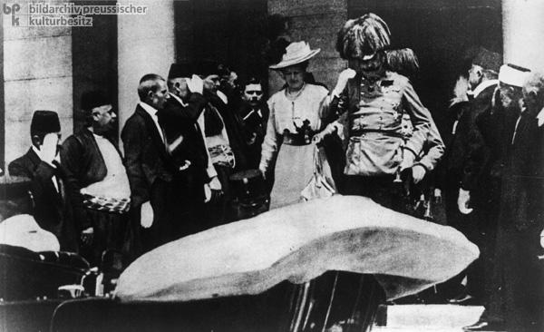
Central Europe and WW I
the pretext for starting the war was the assassination of Archduke Franz Ferdinand of Austria in Sarajevo on June 28, 1914
Franz Ferdinand was shoot by a Serbian nacionalist and terrorist Gavrilo Princip – his group „Mlada Bosna“ was probably supported by Serbian government
Austria-Hungary to Serbia the July Ultimatum – a series of ten demands that were intentionally made unacceptable to provoke a war with Serbia
July 28, 1918 – Austria-Hungary declared the war on Serbia
The video from Sarajevo: http://www.firstworldwar.com/video/ferdinand.htm

Slide 14
Four phases of the war:
August – December 1914 – offensive operations
1915–1916 – trench warfare
1917–1918 – the era of total exhaustion
March 1918 –November 1918 – supremacy of Allied Powers (USA entered the war in April 1917)

Slide 15
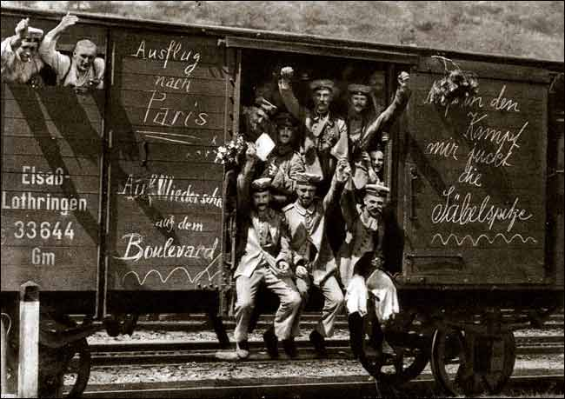
German soldiers on the way to the Western front in 1914.

Slide 16
Four main fronts
Balkan front (Balkan Peninsula, firstly in Serbia, then in Greece)
Western front (against France)
Eastern front (against Russia)
Italian front
also naval war (in the Pacific Ocean – Japan + Great Britain against Germany, in the Nothern Sea – Great Britain against Germany)
warfare in the colonies

Slide 17
Western Front
the Germans attacked France according to the so called Schlieffen Plan - designed to attack France quickly through neutral Belgium
Great Britain declared war on Germany because of breaking Belgic neutrality
the German troops were stopped at the First Battle of Marne in September 1914 – the offensive war changed into the trench warfare
March 1915 – the second Battle of Ypres – the Germans used chlorine gas – 15 thousands of men were poisoned
from February till September 1916 – bloody battle of Verdun – 600 thousands of casualties,
from July till November 1916 the great battle of the Somme - totally 1 million casualties during the whole battle, the new British invention was used – the tanks

Slide 18
Memoirs & Diaries - The German Gas Attack at Ypres, April 1915
„Utterly unprepared for what was to come, the [French] divisions gazed for a short while spellbound at the strange phenomenon they saw coming slowly toward them. Like some liquid the heavy-coloured vapour poured relentlessly into the trenches, filled them, and passed on.
For a few seconds nothing happened; the sweet-smelling stuff merely tickled their nostrils; they failed to realize the danger. Then, with inconceivable rapidity, the gas worked, and blind panic spread.
Hundreds, after a dreadful fight for air, became unconscious and died where they lay - a death of hideous torture, with the frothing bubbles gurgling in their throats and the foul liquid welling up in their lungs. With blackened faces and twisted limbs one by one they drowned - only that which drowned them came from inside and not from out.
Others, staggering, falling, lurching on, and of their ignorance keeping pace with the gas, went back.
A hail of rifle fire and shrapnel mowed them down, and the line was broken. There was nothing on the British left - their flank was up in the air. The northeast corner of the salient around Ypres had been pierced. From in front of St. Julien away up north toward Boesinghe there was no one in front of the Germans.“
Source: Source Records of the Great War, Vol. III, ed. Charles F. Horne, National Alumni 1923
http://www.firstworldwar.com/diaries/gasattackatypres.htm

Slide 19
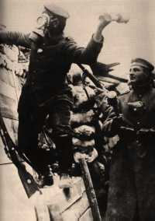
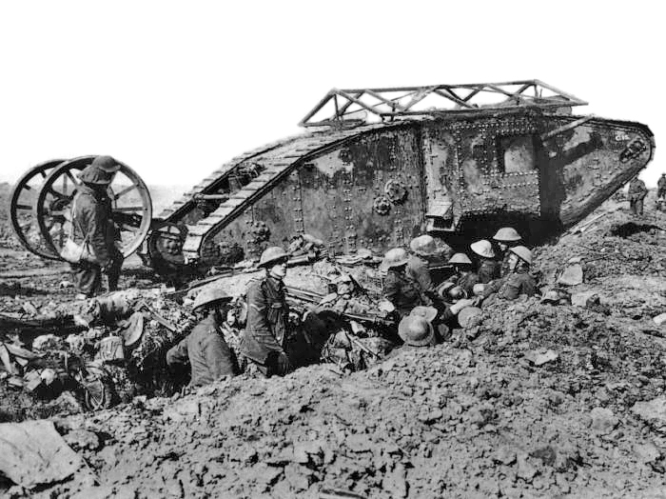
Western Front
The Second Battle of Ypres
The Battle of the Somme

Slide 20
Balkan Front
Austrian army was not succesful in Serbia
September 1915 – Bulgaria entered the war
during October and November 1915 German-Austrian and Bulgarian troops occupied Serbia
Serbian army had to be evacuated from Serbian territory – during the winter it crossed the mountains via Albania to Adriatic coast
Serbian government in exile – the Isle of Corfu
in spring 1915 – the Allied Powers prepared the operation in Gallipoli against Turkey,
British troops under the command of Winston Churchill were participating on this operation but it was not successful
January 1916 – Austria attacked the Serbian ally Montenegro
then in 1916 the Macedonian Front in Greece was opened
The Allied Army of the Orient (AAO) – the multi-national allied armed forces (French, Serbian, Italian, Russian, Greek troops) – fighting the Bulgarians and the Turks
the Bulgarians were defeated in September 1918
In October 1918 – The Ottoman Empire asked for the armistice

Slide 21
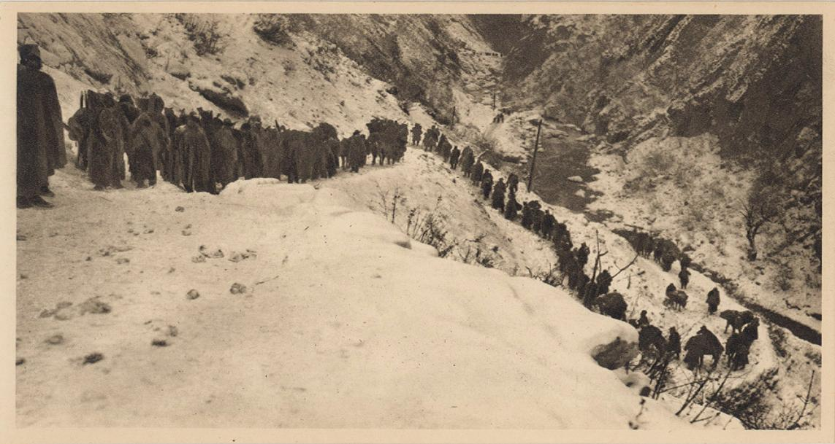
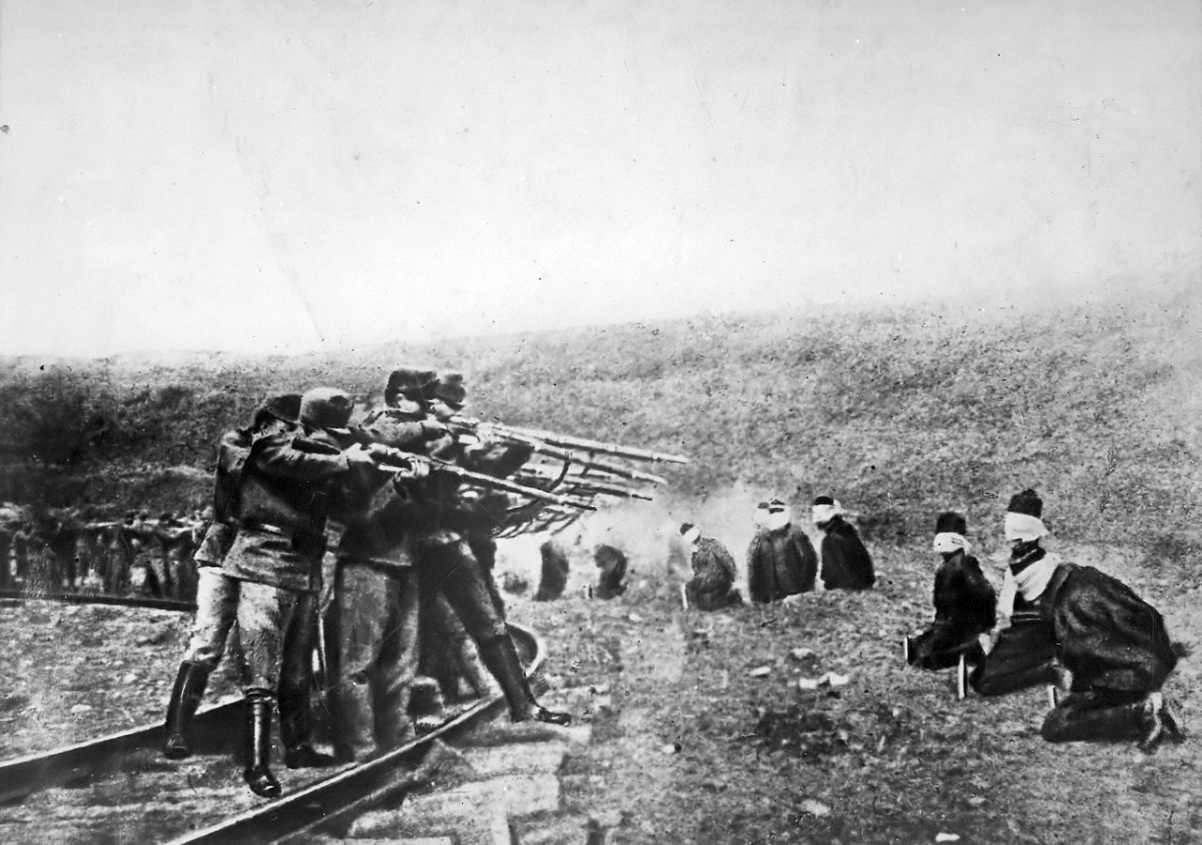
Balkan front
The retreat of the Serbian troops in the winter 1915/16 across a snowy mountain in Albania to Adriatic coast.
The Austrians are executing the captured Serbian soldiers in 1917

Slide 22
Eastern Front
In the east, Russia invaded East Prussia but was pushed back by German army at the series of battles colectively known as the Battle of Tannenberg in August 1914
Already in 1914 – the Czech Company in Russian Army – Legions (originally – the Czechs living in Russia, prisoners of war, volunteers)
To eliminate the Russian threat the Central Powers began the campaign season of 1915 with the successful Gorlice-Tarnow Offensive in Galicia in May 1915
summer 1916 –the Russians were more succesful against Austria-Hungary in Galicia (today – western Ukraine) than against German troops in nothern part of the Eastern front
1916 – so called Brusilov offensive – it was a large tactical assault carried out by Russian forces against Austro-Hungarian forces in Galicia, it is considered to be the greatest Russian victory of the First World War
1917 – the Czechoslovak Corps in Russia – from 38,000 to 70,000 of men
Russia occupied parts of Galicia and Bukovina
July 1917 – so called Kerensky offensive – the Battle of Zborov (Galicia) – Czechoslovak Legions won over the Austria-Hungary, the offensive was unsuccesfull for Russians
Fall 1916 – Romania entered the war but its army was decimated by Austro-Hungarians and Germans in January 1917
1917 – Russian Revolutions
The February Russian Revolution aimed to topple the Russian monarchy and resulted in the creation of the Provisional Government
The October Revolution – the Bolshevics came to power – Vladimir Iljič Lenin
The civil war succeded in Russia – Russia left the WW I – The Preace Treaty of Brest Litovsk in March 1918
After the Russian Revolutions in 1917 the Czechoslovak Legions were fighting against the bolsheviks

Slide 23
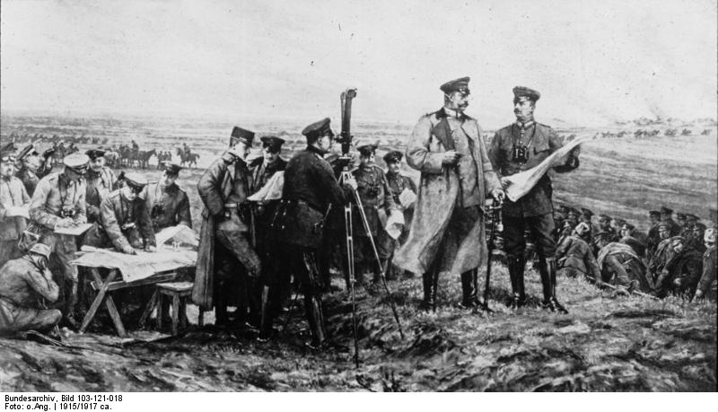
The German General Paul von Hindenburg at the Battle of Tannenberg.

Slide 24
Italian Front
Italy entered the war in April 1915 – the Allied Powers promised to Italy Istria with Trieste, Dalmacia and Trentino (Austro-Hungarian provinces), so Italy declared war on Austria-Hungary and later also on Germany
but the Italians were not very succesful, their offensives along the Isonzo River were repelled by the Austro-Hungarians
1917 – the Battle of Caporetto – Italian troops were defeated by Austro-Hungarian army and the front line was broken through, usage of poison gas
during 1916 the front stabilized at the Piave River till 1918 – June 1918 – the Battle of the Piave River – participation of Czechoslovak Legions
the Austro-Hungarians were defeated in October – the Battle of Vittorio Veneto – participation of Czechoslovak Legions again

Slide 25
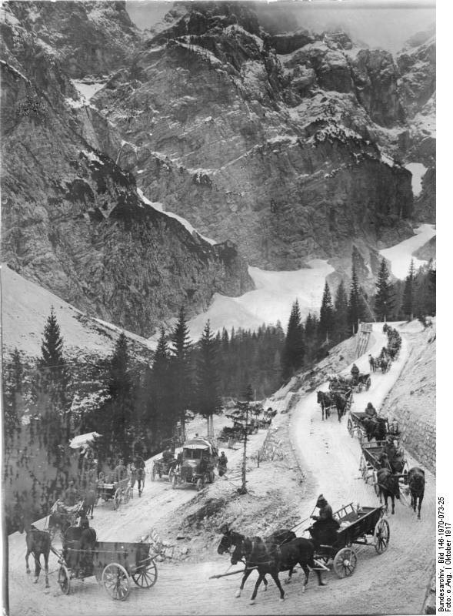
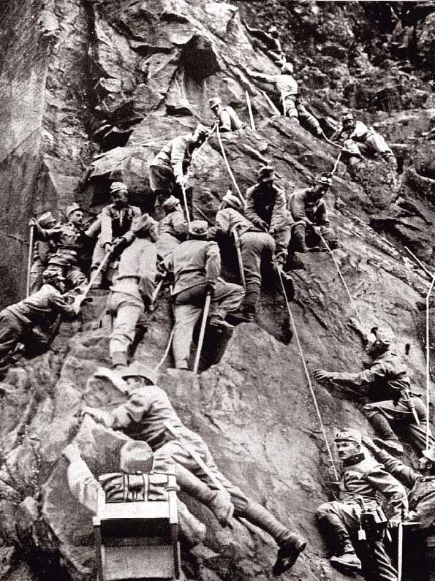
Austrian Troops in Tyrol Mountains in Italian Front
The Austro-Hungarian supply line over the Vršič pass, October 1917

Slide 26
Czech lands during WW I
The Czech lands were constituent part of Habsburg monarchy – no effort to destroy the monarchy till 1917/1918
Only a small conspiracy group called The Maffia wanted to destroy Austria-Hungary and establish the independent Czechoslovak state
cooperation with South Slavs from the Habsburg Monarchy
Emigrants – Tomáš Garrigue Masaryk, Edvard Beneš and Milan Rastislav Štefánik – 1915 – established The Czechoslovak National Council in Paris
army in abroad – Legions
The Czechoslovak Legion fought with the Entente;
their goal was to win support for the independence of Czechoslovakia.
1917 – The Legion in Russia was established,
in December 1917 in France (including volunteers from America)
in April 1918 in Italy
In Russia, they were heavily involved in the Russian Civil War fighting the Bolsheviks, at times controlling most of the Trans-Siberian railway and conquering all major cities in Siberia.
during 1918 the Czechoslovak Legions were de facto recognized as the allied army

Slide 27
Masaryk travelled around Europe (Geneve, Paris, London), to Russia (summer 1917) and to the USA – trying to win the support for the idea of independent Czechoslovak state
January 1918 – The Fourteen Points of the US President Woodrow Wilson – the self-determination of the nations
10th Point: The peoples of Austria-Hungary, whose place among the nations we wish to see safeguarded and assured, should be accorded the freest opportunity to autonomous development.
http://wwi.lib.byu.edu/index.php/President_Wilson%27s_Fourteen_Points
January 1918 – Czech politians in A-H – a demand of independence
July 1918 – The Czechoslovak National Comitee in Prague – Karel Kramář
October 1918 – the Emperor Charles I (1916–1918) offered the federalisation of Habsburg Monarchy but its nations refused it
October – the Czechoslovak National Council was reciognized by the Allied Powers as a provisional government

Slide 28
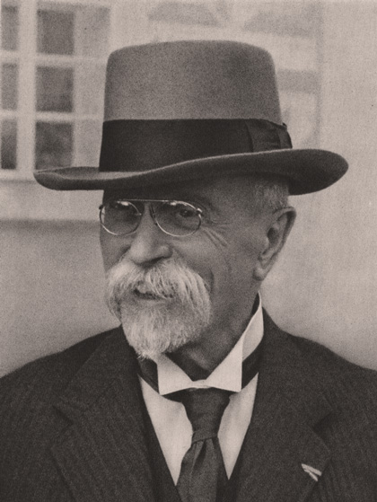
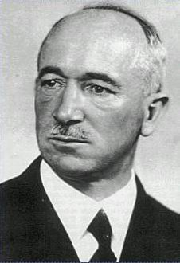
czechoslovakia
Tomaš Garrigue Masaryk
Edvard Beneš

Slide 29
The Final Period of the War
after the Russian revolutions in 1917 Russia concluded separate peace with Germany in Brest Litevski in March 1918
General exhaustion – of sources, armies, people in real (lack of labour power – participation of women)
April 1917 – USA declared war on Germany – originally USA persued the politics of non-interventions, but German submarines several times attacked merchant ships and civil ships with American passengers
The United States were never formally a member of the Allies but became a self-styled "Associated Power"
American troops came to Europe and after the great offensive of Allied Powers in summer 1918 the Central Powers collapsed very quickly
On November 3, 1918 Austria–Hungary sent a flag of truce to ask for an Armistice and the armistice with Austira was signed in Vila Giusti near Padua
on November 11, 1918– an armistice with Germany signed in railroad carriage near Compiègne
at 11 a.m. on November 11, 1918 a ceasefire came into effect

Slide 30
The Results of the War
Casualties:
10 million of soldiers died
7 million of civilians died
The map of Europe has changed:
dissolution of four monarchies (Russia, Austria-Hungary, German Empire and Otoman Empire)
after dissolution of Austria-Hungary: constitution of 5 new states (Austrian Republic, Czechoslovakia, Hungary, Poland, Kingdom of Serbs, Croats and Slovenes)
Latvia, Lithuania and Estonia was established, independent and unified Poland was renewed
http://www.the-map-as-history.com/demos/tome03/index.php
Economic changes:
Development of industry (iron and steel, textiles, etc.) and technologies(armament industry, automobiles, aircrafts …)
Firstly the in many countries the war prosperity, later economic depresse
Social changes:
Social radicalism – rise of totalitarism, revaschism etc.
Social status of women has changed(sufrage)
Many veterans – problems with reintegration

Slide 31
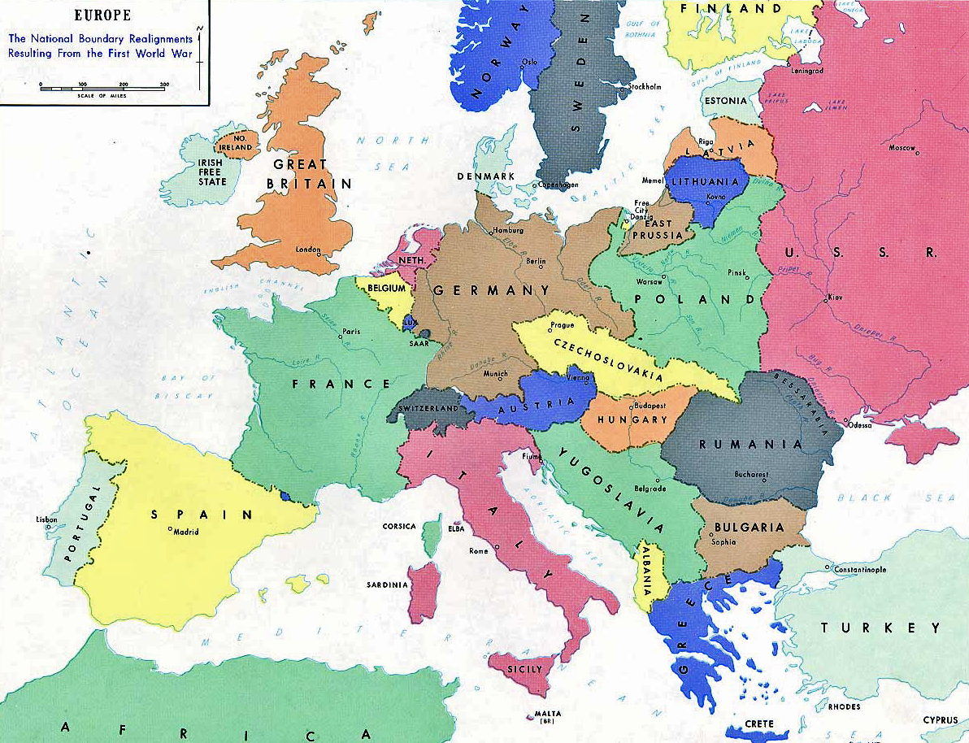
Results of the war
Europe after WW I

Slide 32
Readings and interesting web sites:
WWI:
http://www.firstworldwar.com
http://www.the-map-as-history.com/demos/tome03/index.php
http://www.gwpda.org/photos/greatwar.htm - The photo gallery
14 point of Woodrow Wilson:
http://www.ourdocuments.gov/doc_large_image.php?doc=62
MacMILLAN, Margareth: Peacemakers Six Months That Changed the World: The Paris Peace Conference of 1919 and Its Attempt to End War.
http://www.youtube.com/watch?v=L8uWgbRd8So
Henig, Ruth B. (1995). Versailles and after, 1919-1933. 2nd ed. London: Routledge.
Exhibitions:
The Great War – http://velkavalka.cz/1914/english
Moravské zemské muzeum Brno – Moravian Land Museum (Dietrichstein Palace – The Green Market)
Muzeum města Brna – Brno City Museum (Spielberg Castle)

