Slide 1
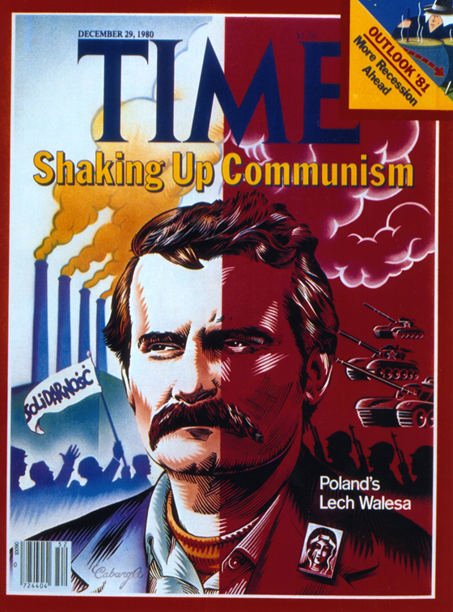
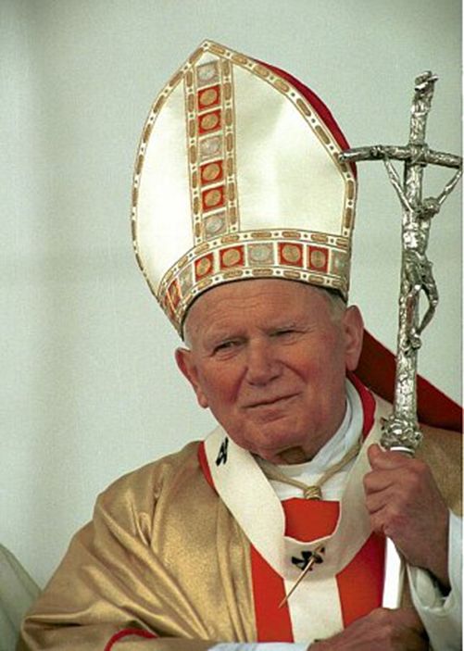
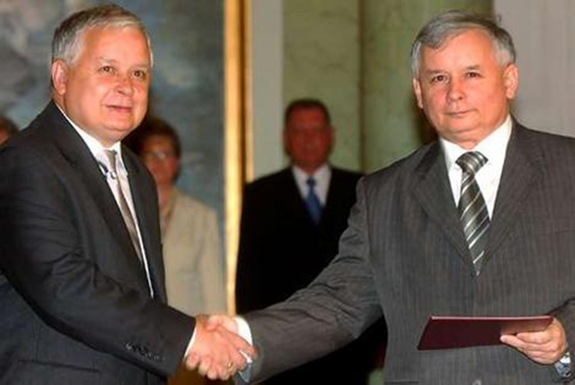
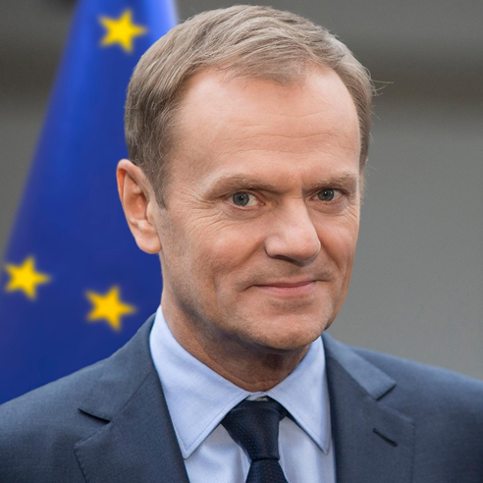
THE CASE OF poland
Mgr. Eva Taterova, M.A., Ph.D.
Democratization and Democracy in the East-Central Europe
11/6/2017

Slide 2
POLAND: BRIEF CHARACTERISTICS
Significant changes of the borders in 20th century.
Loss of ethnic diversity after WWII.
35 millions of inhabitants (8th biggest country in Europe).
Role of Catholic Church (87.6% of the population).

Slide 3
JOHN PAUL II (Karol Józef Wojtyła)

Slide 4
TRANSITION TO DEMOCRACY
1989-1991: transition to democracy, end of the People‘s Republic of Poland.
Lech Walesa – a leader of the Solidarity movement, 1990-1995 president of Poland, 1983 Nobel Prize for Peace.

Slide 5
THIRD REPUBLIC
1991-1997.
A post-communist creation whose foundations must be changed to create a truly democratic state free of its past.
Corruption, reconciliation with the past.

Slide 6
POLAND IN INTERNATIONAL ORGANIZATIONS
1991 member of Visegrad Group and CEFTA.
1999 member state of NATO.
2004 member state of EU.

Slide 7
FOURTH REPUBLIC
Poland after 1997.
Growth of conservatism in Polish politics – the attempts to implement the Catholic values (League of Polish Families, Law and Justice Party).

Slide 8
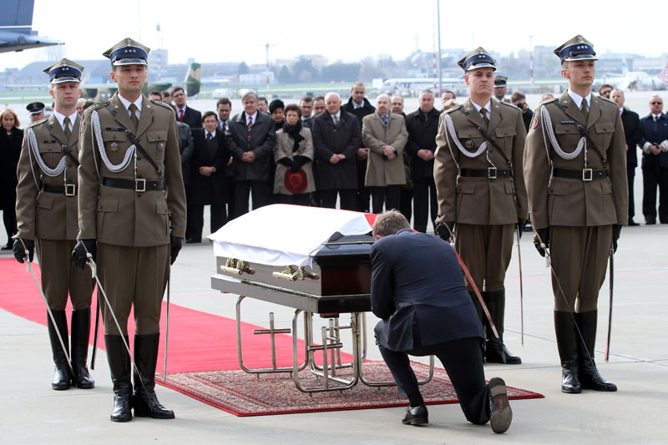
POLISH AIR FORCE TU-154 CRASH
April 10, 2010 crash of the plane nearby Smolensk, Russia.
All 96 people aboard died including president of Poland Lech Kaczynski, chief of Polish General Staff, president of National Bank of Poland, 18 members of Polish parliament and the other members of the official delegation to attend 70th anniversary of Katyn massacre.

Slide 9
LEADING FIGURES
Andrzej Duda
Donald Tusk
Beata Szydło

Slide 10
THANK YOU FOR YOUR ATTENTION

