Slide 1
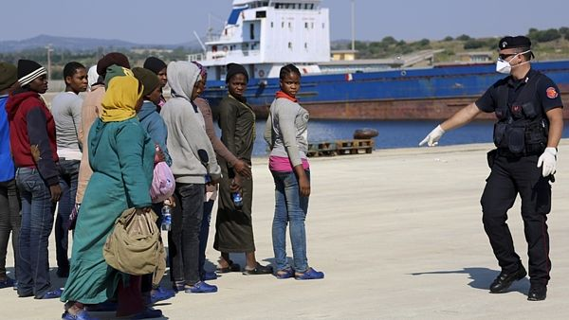
Czech media discourse on migration
Kateřina Kirkosová
and Michal Tkaczyk
CZS55
3 October 2017

Slide 2
Content of the lecture
Introduction to the securitization theory
The media discourse and construction of reality
Exercise 1
Agenda setting function of the media
Migration in ČR
Exercise 2
The coverage of the European migration crisis in the Czech online news media
Discussion

Slide 3
Theory of securitization
security problem – a situation, in which an event, a course of action or an actor is evaluated as a threat to the particular object of reference (person, nation, value system etc.) and thus requires safety measures to be taken in order to ensure the safety of the object of reference.
constructivist approach to security – an issue becomes a security threat not because it essentially is one, but because it is presented and perceived as such (Buzan, Weaver, de Wilde, 1998: 24; Balzacq, 2011: 1).

Slide 4
Theory of securitization
securitization is a process in which “the the issue is presented as an existential threat, requiring emergency measures and justifying action outside bounds of normal political procedure” (Buzan, Weaver, de Wilde 1998: 23-24).
Security sectors: Political, Military, Societal, Environmental, Economic (Buzan, Weaver, de Wilde 1998: 21-23)

Slide 5
Securitization theory and the media
Effect on media
Effect of media
Securitization
(Vutlee, 2011)

Slide 6
Media discourse and construction of reality
signifying power of media: power to influence knowledge, beliefs, values, social identities, social relations
media discourse is necessarily selective
on the side of production: limited range of media formats and products, limited sources
on the side of reception: selective exposure, selective perception, and selective retention
such selection helps to organize social reality into meaningful blocks and patterns (Berger – Luckmann: semantic fields)
on the other hand, these same selection simplify social reality (stereotypes, prejudices, labels)

Slide 7
News values as rules for selection
concept of newsworthiness and news values (Lippmann, 1960, Galtung and Ruge, 1965)
different aspects of the news process (Bednarek, 2016)
News writing objectives: general goals associated with news writing, such as clarity of expression, brevity, colour, accuracy and so on;
Selection factors: any factor or criterion impacting whether or not a story becomes published, not necessarily values, for example, commercial pressures, availability of reporters, deadlines and so on;
News values: the ‘newsworthy’ aspects of actors, happenings and issues as established by a set of recognised values such as Negativity, Timeliness, Proximity, Superlativeness, Eliteness, Impact, Novelty, Personalisation, Consonance, Aesthetic Appeal

Slide 8
Exercise (in small groups)
How are events represented? Is value of security relevant in here? How – security of whom is emphasized? At expense of who?
What identities are set up for migrants? What activities and characteristics are attributed to them?
What identities sare set up for Czech people? Who represents them?
What relationships are set up between migrants and Czech people? What about journalists-politicians relationship?

Slide 9
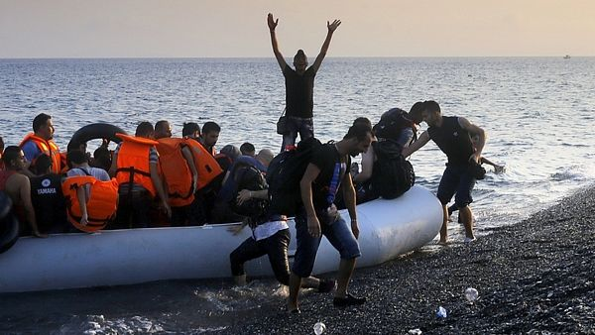
The migration crisis in news photography
Source: https://www.novinky.cz/stalo-se/377433-eu-musi-posilit-ochranu-hranic-shodl-se-zeman-se-stechem-a-hamackem.html

Slide 10
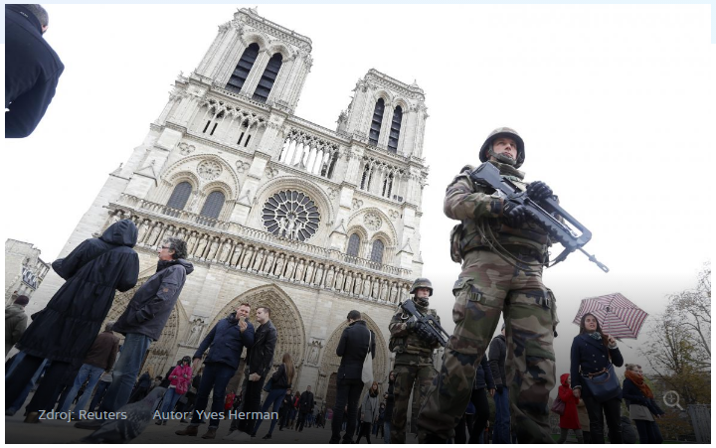
The migration crisis in news photography
Source: http://www.ceskatelevize.cz/ct24/domaci/1618867-svet-zvysuje-bezpecnostni-opatreni-cesku-pry-nebezpeci-nehrozi

Slide 11
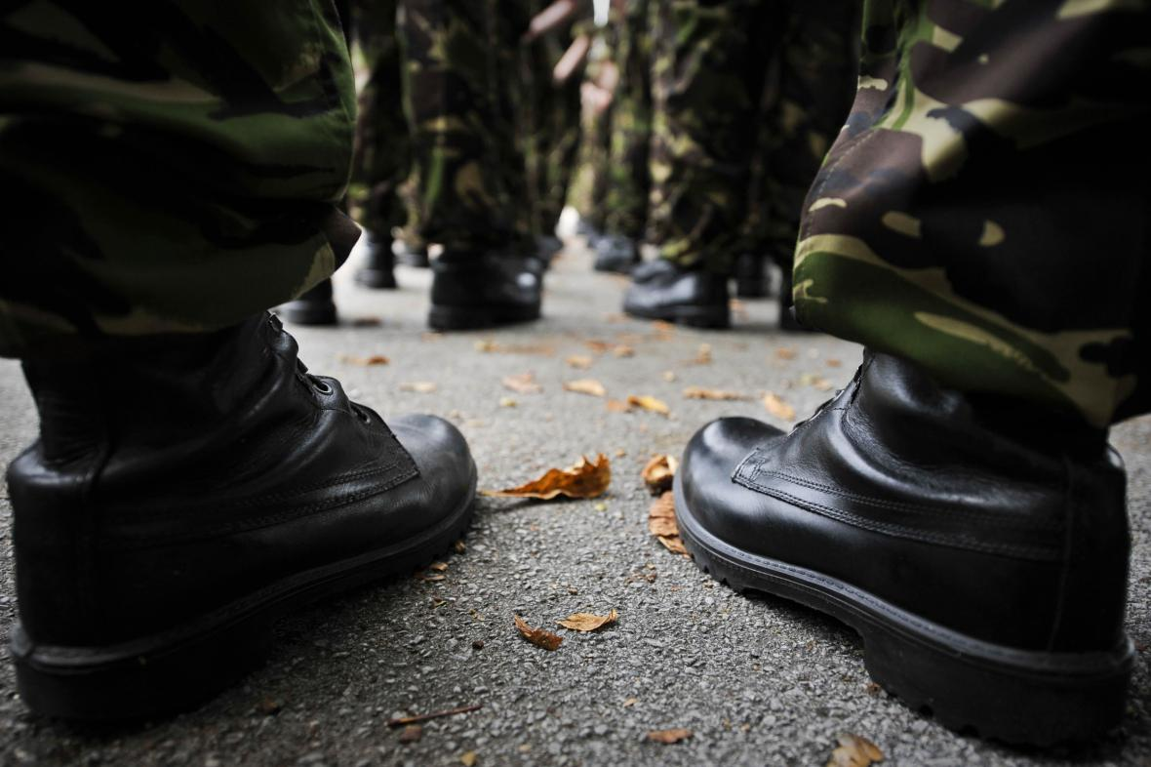
The migration crisis in news photography
Source: http://www.ceskatelevize.cz/ct24/domaci/1565662-armada-muze-pri-vazne-krizi-poslat-na-hranice-az-2600-vojaku

Slide 12
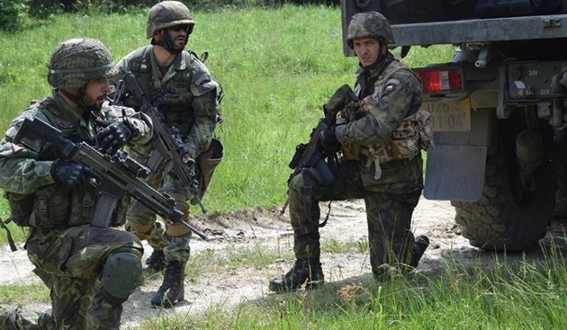
The migration crisis in news photography
Source: http://zpravy.idnes.cz/armada-je-pripravena-na-uprchliky-na-hranice-muze-jit-az-2600-vojaku-pyn-/domaci.aspx?c=A150812_123843_domaci_fer

Slide 13
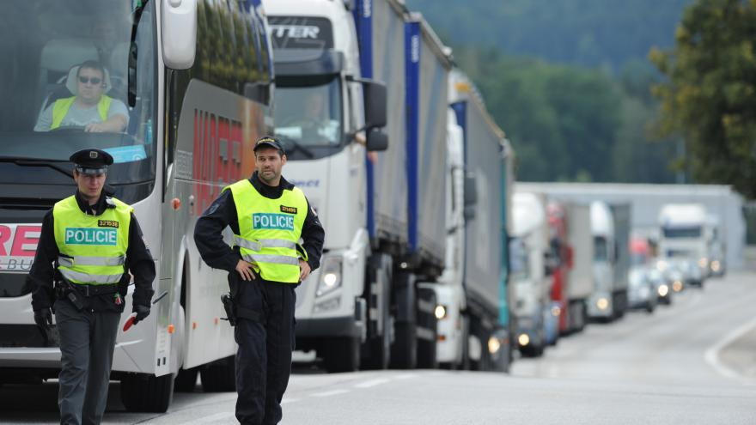
The migration crisis in news photography
Source: http://www.ceskatelevize.cz/ct24/domaci/1586774-policiste-a-vojaci-budou-nacvicovat-ochranu-hranic-proti-migrantum

Slide 14
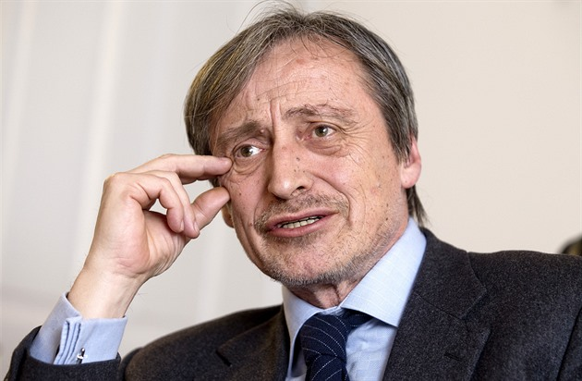
The migration crisis in news photography
Source: http://zpravy.idnes.cz/armada-a-policie-budou-spolecne-cvicit-kvuli-moznemu-naporu-uprchliku-1zk-/domaci.aspx?c=A150918_094056_domaci_kop

Slide 15
Media agenda setting
media discourse could be crucial when reporting affairs or events of which their recipient has no or only little experience
„migration crisis“ in Czech Republic
media agenda
political agenda
public agenda
media bias and concept of journalistic objectivity

Slide 16
Relevant audience (volume/calibre)
Heuristic artefacts (media content)
frames, image repertoires, stereotypes, emotional appeals
Reference object
metaphors, policy tools, image repertoires, analogies, stereotypes, emotions
Heuristic artefacts (securitization speech acts)
News media organizations
professional routines new values professional ideology political profile of media outlet
Securitization actor
Tkaczyk (own processing)
Salience of the issue

Slide 17
Migration in Czech Republic
In 2015 only 134 citizens of Syria, 38 citizens of Iraq and a few people from Afghanistan applied for asylum in the Czech Republic.
Not-authorized stay in ČR: Syria (2 016), Afghanistan (585), Iraq (404), all (8563)
Report on migration and integration of foreigners, Ministry of Interior (2015)

Slide 18
Czech public on refugees as a threat

Slide 19
Czech public on refugees as a threat

Slide 20
The Czech news coverage on the European migration crisis
Problem definitions in the analysed news items (Tkaczyk 2017)

Slide 21
The Czech news coverage on the European migration crisis
Discussed or presented solutions to the crisis (Tkaczyk 2017)

Slide 22
Migration in Czech Republic in Czech news media
Voices in the news coverage (Tkaczyk 2017)

Slide 23
Findings of CDA concerned with legitimization of security measures in the media representations of the European migration crisis in the Czech news media
News media discourse seems to echo political discourse, henceforth helps with legitimation of „army solution“.
Proposed security measures were legitimized by means of personal and impersonal authority, moral evaluation, rationalization and mythopoesis.
Czech online news media did very little or nothing at all to scrutinize or criticize the government policy.
Actually, they even failed to explain to citizens the nature of the proposed security measures (what was really pursued was mere personal reinforcement, not the deployment of military).

Slide 24
Findings of CDA concerned with legitimization of security measures in the media representations of the European migration crisis in the Czech news media
How did it happen?
At the level of text:
Lexical choices: words and phrases borrowed and undistinguishable from official speech
Grammar: it portrays politicians as those who actively decide (mental and verbal processes), refugees are presented as connected with material processes and often passivized
Cohesion and coherence: it foregrounds politicians actions and decisions and further dramatizes their results (headlines, news structure)
Intertextuality: shared presuppositions
At the level of discursive practice:
Significant dependence on government sources which manifest itself in the structure of voices in news stories Peculiar notion of objectivity: despite or rather because of journalists‘ endeavour to keep their discourse neutral, it is not – for they allow smooth dispersion of political discourse which is not unbiased. Value judgements made by political actors are not confronted with different perspectives and solutions
Us-them dichotomy
Us: prepared and reasonable
Them: passivized, unorganized, dangerous (flood)

Slide 25
Discussion
In general terms, how was the European migration crisis covered by news media in your country of origin?
Which frames and event definitions prevailed?
Who could speak in news?

Slide 26
Literature
BALZACQ, Thierry. 2011. A Theory of Securitization: Origins, Core Assumptions, and Variants. In BALZACQ, T. (ed.): Securitization Theory How Security Problems Emerge and Dissolve. New York : Routledge, p. 1-30.
BEDNAREK, Monika. 2016. Voices and values in the news: News media talk, news values and attribution. Discourse, Context & Media, Vol. 11, p. 27 - 37.
BERGER, Peter L. a Thomas LUCKMANN. 1967. The social construction of reality: a treatise in the sociology of knowledge. London: Penguin Press.
BUZAN, Barry, WAEVER, Oscar, DE WILDE, Jaap. 1998. Security: A New Framework for Analysis. Boulder : Lynne Rienner Publishers.
FAIRCLOUGH, Norman. 1994. Media Discourse. London: Hodder Arnold.
FOWLER, John. 1991. Language in the News: Discourse and Ideology in the Press. London and New York: Routledge.
GALTUNG, Johan, RUGE, Mari, H. 1965. “The Structure of Foreign News“ The Journal of Peace Research, Vol. 2, No. 1, p. 64-91.
van LEEUWEN, T. 2007. „Legitimation in discourse and communication.“ Discourse & Communication, Vol. 1 No. 1: 91-112.
LIPPMANN, Walter. 1960. Public opinion. New York: Macmillan Company.
THOMPSON, John B. 1990. Ideology and modern culture: critical social theory in the era of mass communication. Cambridge: Polity Press.
TKACZYK, Michal. 2017. „Between politicization and securitization: Coverage of the European migration crisis in Czech online news media.” In Communication Today, Vol. 9, No. 2
VULTEE, Fred. 2011. Securitization as Media Frame. In BALZACQ, T. (ed.): Securitization Theory How Security Problems Emerge and Dissolve. New York : Routledge, p. 77-93.

