Slide 1
DEPORTATIONS
Mgr. Anna Láníčková, Masaryk University, Office of Public Defender of Rights, Frontex
5.12.2018

Slide 2
Key terms return policy
Return
Return decision
Return directive
Returnee
A third-country national
Country of Return
Voluntary return/assisted
Forced Return
Fit-to-travel
Readmission agreement
Use of force
Coercive measures

Slide 3
Legal instruments (binding, non-binding)
Universal Declaration of Human Rights 1948;
International Covenant on Civil and Political Rights 1979;
Convention relating to the Status of Refugees (Geneva Convention) 1951;
Optional Protocol relating to the Status of Refugees 1967;
European Convention of Human Rights 1950 (and all related protocols);
Charter of Fundamental Rights of the European Union 2000;
European Convention for the Prevention of Torture 1987;
UN Convention against Torture and Other Cruel, Inhuman or Degrading Treatment or Punishment 1984;
UN Convention on the Rights of the Child 1989
Codes of Conduct (2x), 20 guidelines for forced-returns
+ Tokyo Convention, Chicago Convention
+ Return Directive

Slide 5
Current Migratory Flows
State of the Union (13. 9. 2017)
„When it comes to returns: people who have no right to stay in Europe must be returned to their countries of origin. When only 36% of irregular migrants are returned, it is clear we need to significantly step up our work. This is the only way Europe will be able to show solidarity with refugees in real need of protection.“
Voluntary returns
Frontex
Negotiation with third countries
© Copyright Veřejný ochránce práv, 2017; Projekt Podpora účinného systému sledování nucených návratů, registrační číslo AMIF/8/02, je spolufinancován v rámci národního programu Azylového, migračního a integračního fondu.

Slide 6
Video – European Border and Coast Agency
https://www.youtube.com/watch?v=O6NO3b6liTs
Frontex → EBCG (2016)

Slide 7
Manage external borders of MS (2002, fully operational in 2005), Warsaw
Surveillance of the borders
Return actions
Rapid intervention
Hot-spots, identification
finance/co-finance the MS´ activities … (see the hand-out)
European Ombudsman review of Frontex → complaint mechanism was created

Slide 8
Obstacles to effective return system
Lack of cooperation with third countries
Travel documents, identification, visa issue
National rules on detention – thin line!
Civil society?
Resources – financial,logistical

Slide 9
Who?
Rejected asylum seekers (no refoulement, because the claims was assessed)
Irregular migrants (individual return decision)
Person convicted for criminal offences
Third-country national
EU national can get deported for breach of public order, public security, public health (for eternity? See Donatella Calfa Case)
KEY ACTORS: MS, FRA, EBCG, CPT
PARTICIPANTS: returnee, escort officers+leader,back-up team, doctor, interpreter, monitor, return specialist from EBCG

Slide 10
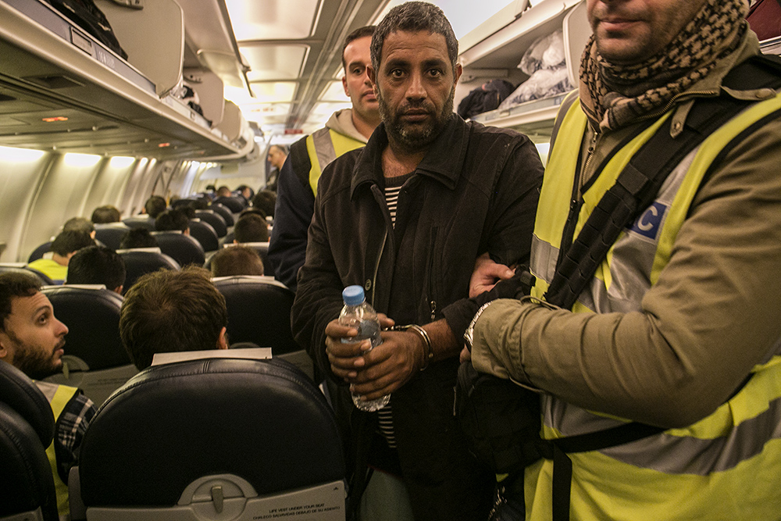
Types of RO
National,
Joint return operations
Collecting operations

Slide 11
Human rights at stake?
Brainstorming – think of possible rights that could be breached during return operation

Slide 12
Right to life, liberty and security;
Freedom from torture, cruel, inhuman and degrading treatment and punishment;
Right to human dignity;
Right to non-discrimination;
Right to Religion;
Access to information;
Right to health and access to medical assistance
Access to food and water;
Rights of vulnerable groups;
Right to family unity;
Rights of the child/best interest of the child;
Right to personal data protection;
Right to privacy;
Right to property

Slide 13
Forced Return Monitoring
Return Directive art 8/6
Member States shall provide for an effective forced-return monitoring system.
Frontex Regulation art. 29
The Agency shall, after consulting the fundamental rights officer, constitute a pool of forced-return monitors from competent bodies who carry out forced-return monitoring activities in accordance with Article 8(6) of Directive 2008/115/EC and who have been trained in accordance with Article 36 of this Regulation.
- reality? http://fra.europa.eu/en/theme/asylum-migration-borders/forced-return

Slide 14
What is forced-return monitoring?
For the monitor to see and report, whether the return is conducted in
a humane manner,
respectful of the dignity of the person and
in compliance with the EU Charter of Fundamental Rights;
Monitoring involves observation of and reporting on return operations without powers of intervention;

Slide 15
Why having a monitoring system?
Returnees → can support possible claims of mistreatment and/or excessive use of force;
EL&escorts → clear themselves of possible unfounded accusations;
Investigation;
Assesment and/or revision of future ROs
Notes:
It should be stressed that transparency created through unbiased and neutral monitoring serves the interest of all parties involved in a RO.
Monitor is not the enemy, he/she is there for everyone. It is good i tis there
DOPSAT Frontex regulation

Slide 16
Phases of RO
Pre-departure
In-flight
Arrival
Return flight

Slide 17
Pre-departure phase
Notes:
These slides are aimed at giving the opportunity to the monitor to:
explain in more detail the monitor’s role in each phase of a RO and the information monitors require for their job;
share examples of fundamental rights at stake during each phase of a RO, examples of incidents from their own monitoring experience, good practices identified – whilst giving due importance to the principle of confidentiality and data protection, hence no names, no specifics on OMS, PMS, escort leader (EL), etc.
Physical security check at the detention facility of the returnees
Transfer to the port of departure
Briefing of escort leaders and all participants, including doctor/s and monitor/s
Returnees waiting in the waiting area: children, families, medical cases, food and drinks, violent individuals…
Meeting of monitors (if more than 1)
Security check of returnees: gender considerations
Luggage handling
Use of means of restraints and force
Transport to the plane, boat, bus: waiting time.
Embarkation (safe, smooth, covered)
Complaints made and the answer provided.
CPT :
Fit to fly in all cases, access to medical personnel • Best interest of the child
Effective assessment of non refoulement, suspension of removal by court
Regular access to lawyer prior to operation
Access to information about the removal operation
Transport to the airport in safe and adequate means
Proportional use of means of restrains: length, asphyxia risk, register of restrains used,

Slide 18
In-flight phase
Notes:
What to be aware of during in-flight phase:
Seating arrangements
Special care for children, families, ethic minorities, vulnerable cases
Access to doctor and attentive/proactive approach
Interpreter – proactivity and support
Lavatory procedure: privacy, hygienic items, gender considerations
Food and beverages availability.
Incidents and responses of the Escorts
Stopover: risk of agitation. New group? New briefing!
communication
Coercive measures: how long and why (legality, necessity and proportionality)

Slide 19
Arrival phase
Notes:
Total release of coercive measures
Handover of personal belongings
First contact with national authorities
Do not forget: Applicable law
Hand-over: documents, medicaments
Handover of medical cases
Refusal to accept?

Slide 20
Return-flight phase
Notes:
Depends on the success of the RO – either we have a calm flight back, we do the debriefing and then it´s peace and quite, or we are awake and do the in-flight phase
De-briefing – last possibility for additional questions, clarification… giving a brief account of the future report, we want EL to have possibility to comment on that, not make them surprised.

Slide 21
Post-arrival phase - Pandora´s box
Economic hardship, psycho-social hardship
Vulnerable position – non/state authorities
Inhuman and degrading treatment
NON-REFOULEMENT
Who, when, how? Mandate?
The Post-Deportation Monitoring Network
Better protection
COI
Better asylum system
© Copyright Veřejný ochránce práv, 2017; Projekt Podpora účinného systému sledování nucených návratů, registrační číslo AMIF/8/02, je spolufinancován v rámci národního programu Azylového, migračního a integračního fondu.

Slide 22
Criminalisation de iure:
Tunisia, Morocco, Algeria, Cameroon, Egypt
fine, deprivation of liberty
Criminalisation de facto:
Albania, Libya, Congo, Nigeria
Threats, destroing of persona documents/not issuing, absence of investigation

Slide 23
Czech Republic – Public Defender of Rights, mandate:
1. Public Administration
Protection against unlawful or incorrect conduct or inactivity
Since 2000
2. Protection of Persons Restricted in their Freedom
Preventive systematic visits
Since 2006
3. Discrimination
Promotion of the right to equal treatment and protection against discrimination
Since 2009
4. Monitoring of Forced Returns
Monitoring of enforcement of expulsions, transfers and transits
Since 2011

Slide 24
In connection with the so-called “Return Directive” of the European Parliament and of the Council
Monitoring of decisions (expulsion, detention)
Monitoring of detention (NPM – systematic visits - to strengthen the protection of persons placed in various facilities against ill-treatment,to ensure that their fundamental rights are respected→ Formulation of standards of treatment)
Monitoring of expulsions, transfers, transits (air, land)

Slide 25
How does it work?
Authorization
enter to the facility/place
speak with returnee (in private)
check documentation (inc. medical files)
---------------------------------------------------------
be in escort vans/buses
service passports
access to the airport (Security Restricted Area)
camera (images)

Slide 26
Provided information
Personal data
Health condition
Date, time and place, where the return operation starts
Way of transport
Flight information
etc.

Slide 28
Checklist
Documents
Conditions
Treatment
Inspiration
CPT standards
Twenty guidelines of forced return
Expectations - Criteria for assessing the conditions for and treatment of immigration detainees (HM’S INSPECTORATE OF PRISONS FOR ENGLAND AND WALES)
Etc.

Slide 29
Thank you for your attention!
Anna.lanickova@seznam.cz

