Slide 1
CEFC Activities in the Czech Republic and Beyond
By Merina Schwarz, Kiran Joyce, and Jessica Fearnhead

Slide 2
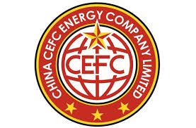
CEFC China Energy
CEFC China Energy is a conglomerate company, whilst most revenue comes from oil and gas (60%), the company also operates in other areas, including financial investment and infrastructure.
A CEFC statement said they are China’s largest private oil and gas company, with 50,000 employees and revenue of more than $40 billion. However, internationally they are listed as a financial corporation.
They are China’s 6th largest financial group.
The company has grew extremely fast after only being created in 2002
China’s increasing influence in developmental finance is backed by state owned banks. Since 2010, China Development Bank and the Export-Import Bank of China lent more money Annually to developing countries than the World Bank did.
Between 2004 & 2013, Chinese overseas investment grew 14 times, from $45 billion to $613 billion.

Slide 3
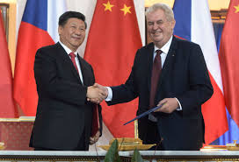
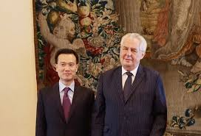
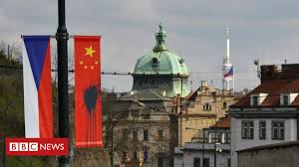
Chinese ties to the Czech Republic
China and the Czech republic have a strong relation. “One hundred years of humiliation” a term which is used to describe China’s past, has been used to sum up 20th century Czech republic, between German and Russian influence, joining and being regulated by the EU and the 2008 financial crisis which hurt Czech before it had even economic set off.
Czech and Chinese political relations are strong. President Zeman explained the ideological grounds which connects the South-South community of the “weak and oppressed”.
Zeman said that there was previous bad relations with the former Czech government and China because the government was “very submissive to the pressures from the US and the EU” however, Czech is “again an independent country” which creates foreign policy “based on its own national interest”.
The anniversary of the velvet revolution in 2014 turned into an appeal for Zeman to resign. Protestors saw him as being too sympathetic to authoritarian regimes and Russia and China
Xi Jinping And Milos Zeman
Ye Jianming and Milos Zeman

Slide 4
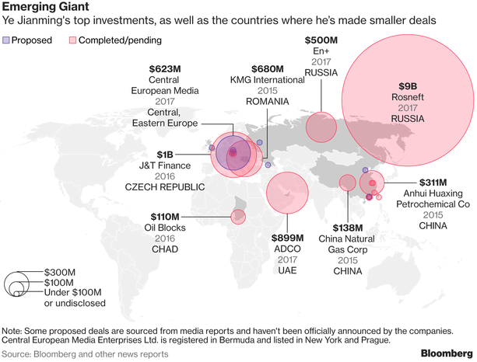
Chinese ties to Eastern Europe
The Destalinisation process led by Khrushchev resulted in the Polish October where Poland tried to use Socialism in its own way to gain sovereignty this was backed up by the Chinese government.
CEFC owns over 2,000 gas stations across Europe including Spain, France, Romania and Bulgaria.
Chinese group COSCO’s acquisition of 51% of the Port of Piraeus.
5 hungarian companies have recently started trading with China is areas like Dairy products and solar panels.

Slide 5
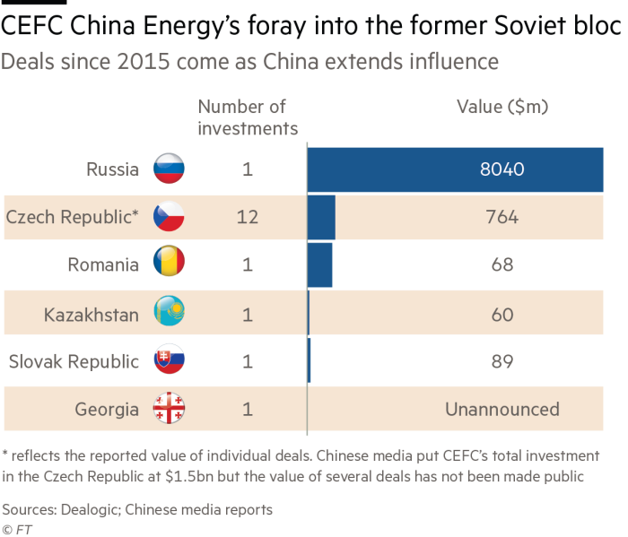
Investment projects
As of 2017 CEFC acquired 50% of Slovakian firm J&T finance groups. The deal has not gone through as of yet because the Czech national bank wanted more clarity as of where the money came from.
CEFC now acts as a holding company for Czech Lobkowicz Brewery Group, after getting a $1 billion dollar loan from J&T finance.
A 10% stake in Czechs biggest airline, Travel services.
A 60% stake in SK Slavia Prague - Czechs second biggest football club.
Between 50-90% stake in Czechs biggest online travel agency Invia, with a view to capitalise on the rapidly increasing number of Chinese tourists to Prague.
Looking to make a 15% stake in Russian energy giant Rosnef.
CEFC has a 4% stake in Abu Dhabi’s largest oil concession
They have plans to buy a half stake in Romania’s largest refinery.
It owns a gas terminal in Kazakhstan.
CEFC have acquired Czech media assets - which reportidly provide “exclusively positive coverage of China”.

Slide 6
Economic Diplomacy With Chinese Characteristics
CEFC stated its support for Beijing’s strategic interest in the Czech Republic, and aimed to foster good relations with Czech political elite and society.
01
02
2013: President Miloš Zeman led the effort to entirely reorient Czech policy, dedicating a more forthcoming Czech attitude towards China.
03
2015: After CEFC’s “shopping spree” in Prague, the Czech government announced the appointment of chairman Ye Jianming as honorary advisor to President Zeman on economic and Chinese matters. CEFC then established its European headquarters in Prague and began to hire retired Czech politicians.

Slide 7
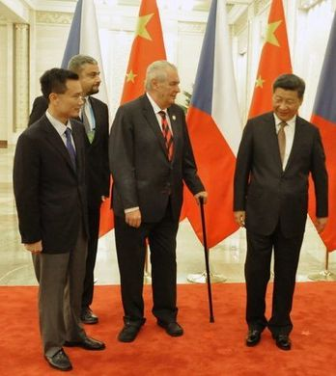
China’s Growing Political Influence
Close relationship between Chairman Ye Jianming and President Miloš Zeman
Zeman’s ideological concessions
Business involved a close-knit group of political entrepreneurs around the Czech President and his advisors.
Prime Minister Andrej Babiš takes a more cautious approach, draws attention to lack of transparency in Chinese investments, and the minimal economic results.

Slide 8
Political Fallout After Ye Jianming’s Arrest
04
High expectations for investment
Deterioration of attitudes towards CEFC investment
01
03
Growing political implications
Minimal economic results/benefits
02

Slide 9
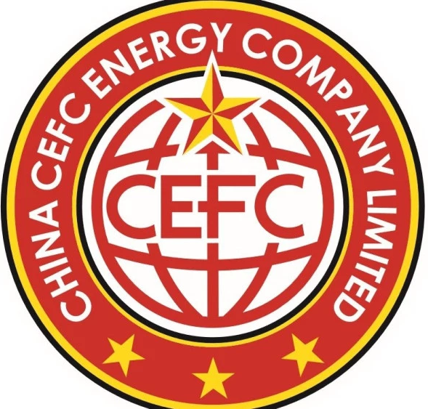
CEFC Showcases China’s danger to Foreign Security
Easily overtaken by State Interests
Minimal Transparency
Close ties between Business and State are Mandatory
State Businesses May Choose State Interests Over Profit or Function

Slide 10
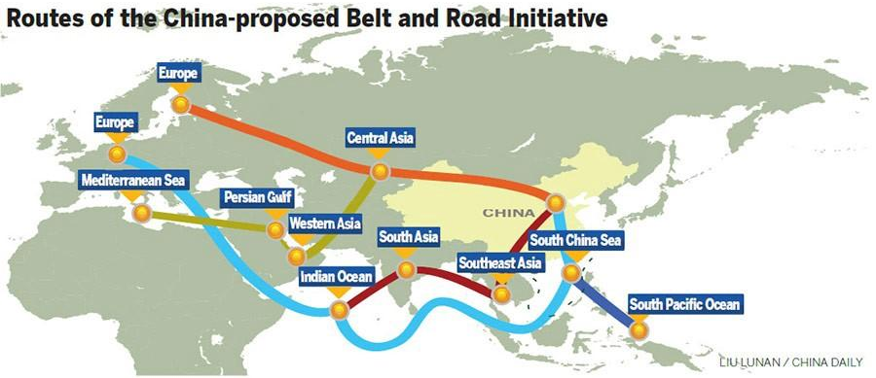
China’s Focus on Eastern Europe Could be a Dangerous Sign for EU Security
Power
Transport Infrastructure
Media
Political Influence

Slide 11
Is CEFC as powerful as it seems?
CEFC and Ye, CEFC’s chairman and founder have come under scrutiny in the past year. So much so, there has been arrests, broken deals, debt and takeovers.
Shanghai’s Guosheng Group, an investment organisation owned by Shanghai’s municipal government took temporary control over CEFC.
Later, the CITIC group acquired 49% of CEFC Shanghai, a subsidiary of CEFC, which owns CEFC Europe. CITIC is a state owned investment trust.
CITIC said that they will pay the CEFC debts, equating to 450 million Euros, to financing group J&T. However, they did not do this in the given time frame and J&T announced it had taken over the shareholder rights and ran crisis management in CEFC Europe.
Founder Ye was struggling to pay debts and had mystery ties to the Chinese Liberation Army. he has now stepped down as chairman but is under investigation under the Chinese government.
The Chinese government are heavily investigating private companies and are trying to do a “crack-down” on corporate corruption. This could be because media outlets are saying the people of China are losing out because they are being “exploited by western countries via international cooperation”
Two men were recently arrested for trying to bribe the president of Chad a Ugandan official for oil drilling contracts. The name of the company was not announced, but it is highly speculated to be CEFC and the description matched CEFC. The two men were also close to the company and had relations with Ye.
CEFC China Energy had a debt ratio of 77% at the end of 2016, and has said to be growing.

Slide 12
References
Kowalski, B. South-South Cooperation Perspective. The Case of the Czech Republic and Hungary. The Cambridge Journal of Eurasian Studies. 2017.
Hornby, L & Weinlan, D. Opaque Chinese oil group makes clear gains in former Soviet Bloc. Financial Times. 2017.
Ebrahimian, B. & Tamkin, E. Prague Opened the Door to Chinese Influence. Now It May Need to Change Course. Foreign Policy. 2018.
https://www.ft.com/content/e3f8cbd2-983f-11e7-a652-cde3f882dd7b
Beach, Sophie. “Martin Hála on CEFC and CCP Influence in Eastern Europe.” China Digital Times CDT, 8 Feb. 2018, chinadigitaltimes.net/2018/02/martin-hala-cefc-ccp-influence-eastern-europe/.
Jakóbowski, Jakub, & Krzysztof Dębiec. “Chinese Investments in the Czech Republic: Changing the Expansion Model.” OSW, 13 Nov. 2018, www.osw.waw.pl/en/publikacje/analyses/2018-06-06/chinese-investments-czech-republic-changing-expansion-model-0.
https://www.nytimes.com/2018/08/12/business/china-influence-europe-czech-republic.html
https://www.nytimes.com/2018/03/14/business/china-cefc-investigation.html
https://www.nytimes.com/2018/10/15/business/lai-xiaomin-huarong-corruption-china.html
https://www.nytimes.com/reuters/2018/11/19/business/19reuters-rosneft-privatisation-cefc.html
https://www.nytimes.com/2017/11/21/business/china-energy-cefc.html
https://www.nytimes.com/2018/10/04/business/cefc-china-weapons-iran.html
https://www.apnews.com/abb030368bfc4dc5833e07d79fbd9437
https://www.reuters.com/article/us-china-cefc-probe/chinas-cefc-chairman-investigated-for-suspected-economic-crimes-source-idUSKCN1GD3O9
https://www.mingtiandi.com/real-estate/finance-real-estate/chinas-cefc-said-selling-3-2b-in-real-estate-assets/
https://medium.com/venture-views/risk-opportunities-singapores-role-in-china-s-bri-ff6377d035b7
http://cefceurope.com/

