Slide 1
Czech New Wave
CZS36
Dr. Šárka Gmiterková
Fall 2022
29. 11. 2022

Slide 2
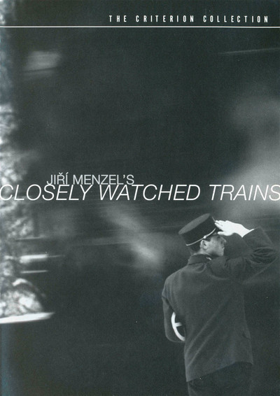
Closely Watched Trains (1969, dir. Jiří Menzel)
Screenplay: Bohumil Hrabal a Jiří Menzel, DOP: Jaromír Šofr, Music: Jiří Šust, Staring: Václav Neckář, Jitka Bendová, Vladimír Valenta, Josef Somr and others.
Jiří Menzel‘s feature debut is one of the most celebrated and awarded films of the 1960s, crowned by the Oscar for a foreign film in 1968. Another exemplary New Wave film since it attracted large audiences in Czechoslovakia (one of the reasons being Václav Neckář, an extremely popular singer, in a leading role); also it had significant export potential. And thanks to this movie, Menzel became a director with a seal of approval for adapting Hrabal‘s books on screen, as the following decade clearly demonstrated.

Slide 3
Closely Watched Trains - Questions
The story takes place at the end of the second world war, in a small Czech town and its railway station. Think about the war (or its echoes) at such place – how does it influence everyday life, what kind of heroes does it create and how big history is tied together with private, even mundane pains and joys.
Menzel always wanted to show kinder and more lightearted side of Hrabal‘s books. Try to remember and compare the world according to Hrabal, as other directors presented in the Pearls of the deep. How does Menzel‘s take on Hrabal differ in tone, meanings or character construction?
Focus on the image and style of this movie (cinematography, sound design, editing). One of the most valued aspects of the film adaption is Jaromír Šofr‘s imagery – how does it present the railway station? Are the images static or dynamic? How about the lighting and contrasts?
And finally – focus on Miloš Hrma‘s hat. What does it stand for, what values does it accentuate? And does it stand in a way of some events and actions?

Slide 4
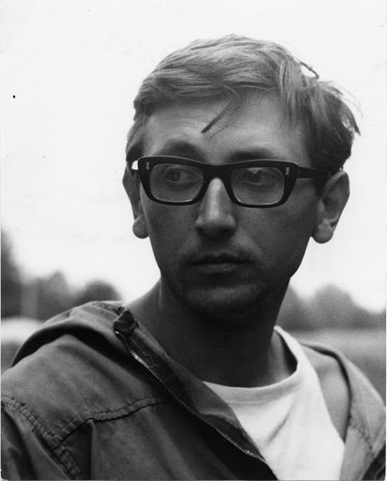
Jiří Menzel (1938–2020)
Screenwriter, actor, director
Theatre career as well
Associated mostly with the adaptations of Bohumil Hrabal and Vladislav Vančura
Softly stylized comedies (especially later in the 1970 and 1980s)
Long journey towards feature debut >> Menzel lacked autership ambitions, he makes his firts feature film later than his colleagues
Period film critic Jaroslav Boček lists Menzel among the intimist/realist branch represented by Forman-Passer-Papoušek (thanks to Trains), however Menzel is much more lyrical and poetic

Slide 5
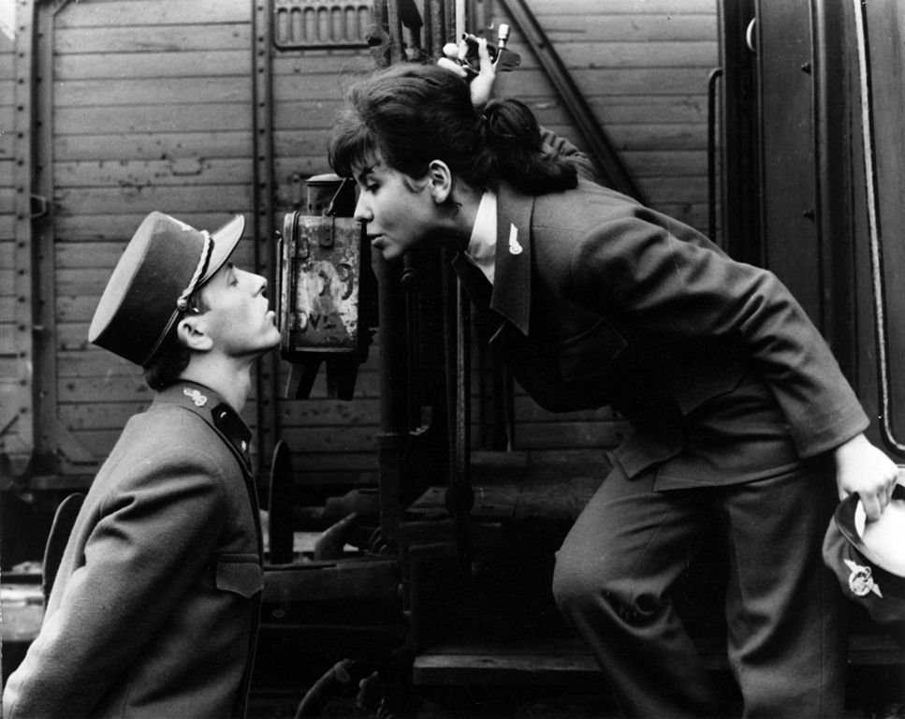
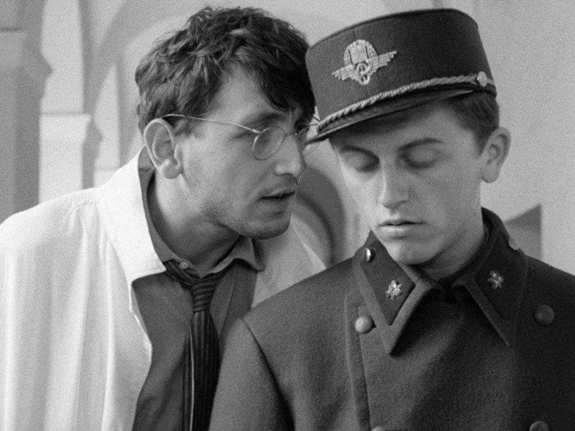
Closely Watched Trains
A Success Story
Together with Loves of a Blonde a triumphant new wave film >> forthcoming towards the audiences, commercially successful, artistically valuable
Made in 1965 – the year of problematic films
After Pearls of the deep there is an effort to capitalize on the popularity of Hrabal‘s books and novels => FSB looking for a suitable director of Trains (Schorm, Chytilová)
Heterogenous casting: professional actors, (Josef Somr, Květa Fialová, Vlastimil Brodský), singers and pop music stars (Václav Neckář, Naďa Urbánková) and untrained actors (Vladimír Valenta, Jitka Bendová)
A disproportionate combination of a war story with coming of age tale about young male sexuality..?

Slide 6
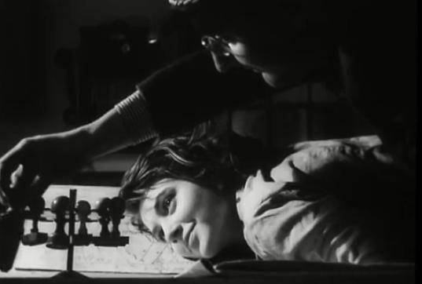
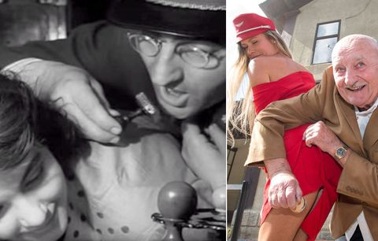
„stamping the bottom scene“
Erotica as a New Element
„a delicate poetic piece“ „it is done in a decent and tasteful way“
Nudity in the 1960s cinema is unprecedented, especially in its volume >> shifting boundaries in what can be shown on screen
Nudity as a commercial (fashionable) thing X Artistic nudity, which is an organic and necessary aspect of art cinema
  Tasteful erotica => connected with emotional level and courtship, pure sex as a consumerist thing
Erotic aspect of stamping the bottom scene was not highlighted for domestic audiences X for international audiences crucial PR aspect, Closely Watched Trains as „an erotic bomb from Prague“

Slide 7
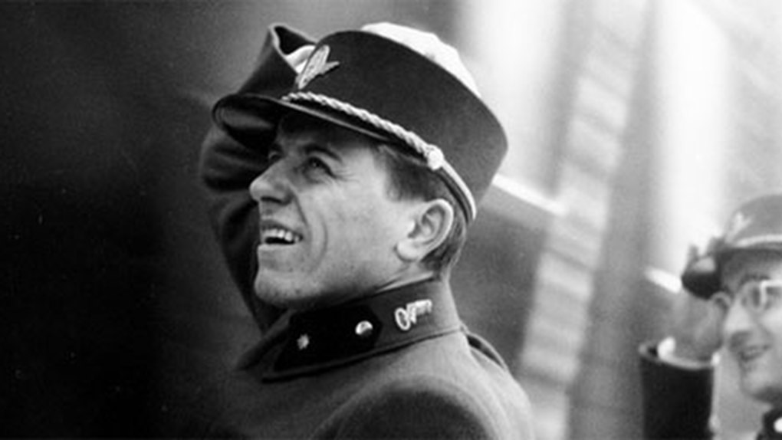
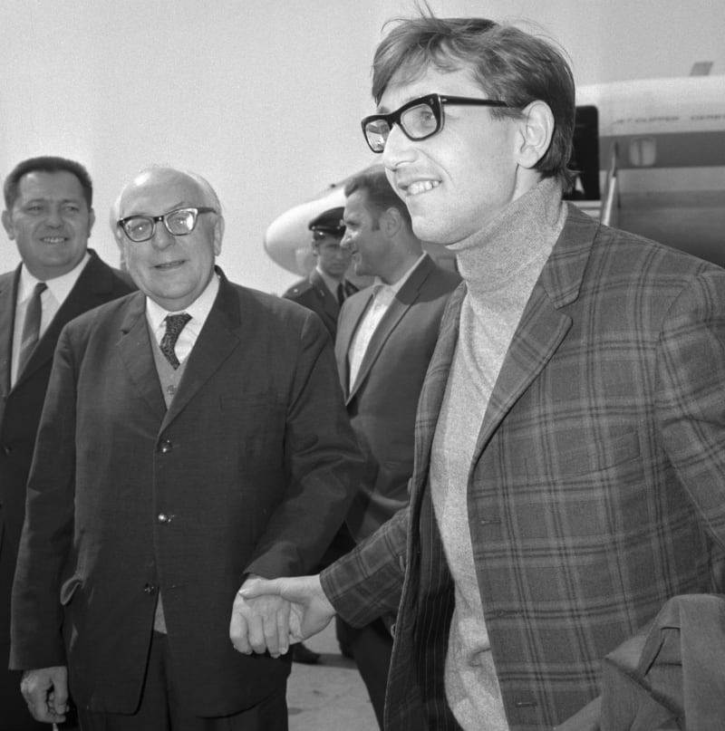
The Ideal Export Film
Perfectly balanced out combination of artistic factors and characteristics with humor, sensitivity and above all, comprehensibility
IFF Mannheim winner >> opened doors onto western markets
Carlo Ponti in charge of distribution in Italy, Switzerlan and USA >> strategic and thought out Oscar campaign
Trains cemented the Czech New Wave formula >> sense of humor, a sense of everydayness, between comedy and tragedy, small middle European man in the middle of historical turbulences (for example films of Jan Němec are not that successful, even internationally)

Slide 8
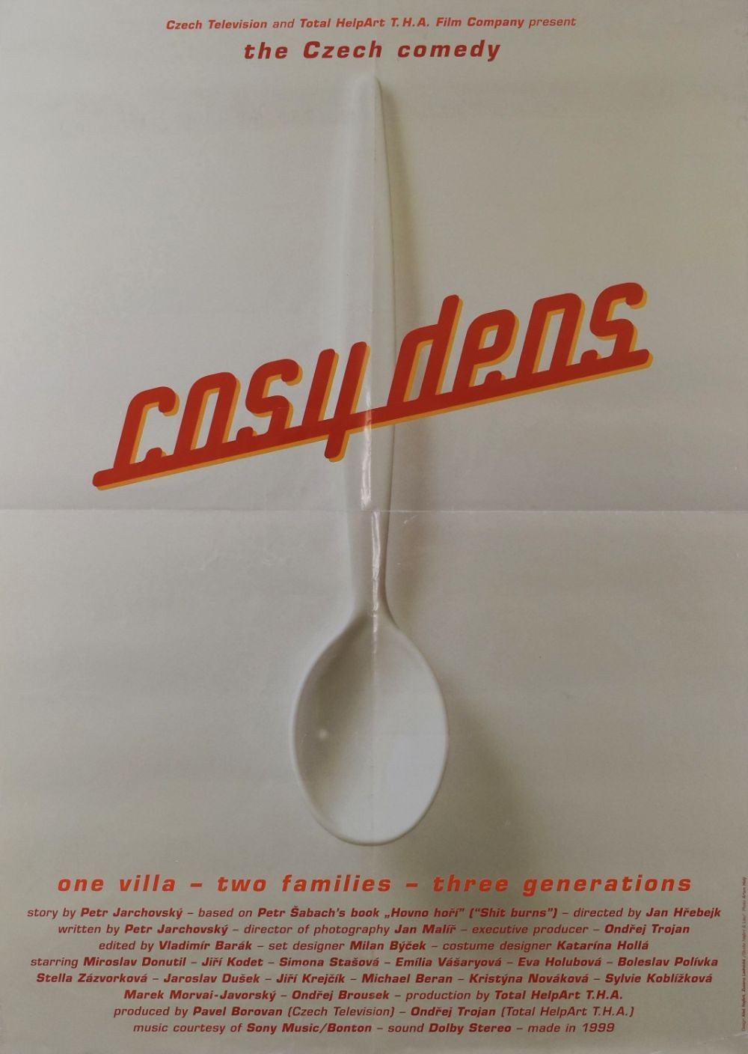
Compare… with Cosy Dens (1999, dir. Jan Hřebejk)
Available on Netflix with English subtitles
Similar success story – a crowdpuller of the 1990s
Story of multiple families during Christmas and summer of 1968
What similarities do you see with Trains? In terms of topics, values and character construction?
Feel free to include this film in your resumés and think about the comparison with New Wave titles

Slide 9
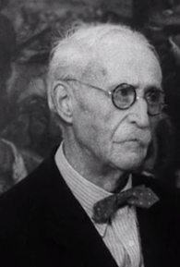
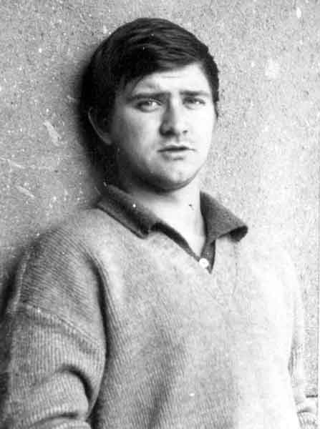
Non-professional actors
Largely associated with the trio Forman-Passer-Papoušek, but also Věra Chytilová, Jan Němec or Jaromil Jireš
Continuous casting of „untrained professionals“ – Jan Vostrčil, Josef Šebánek, Jan Stöckl, Ladislav Jakim
Has direct cosequences on the construction of the new type of hero, also on the dramaturgy and ways of storytelling; a form of social critcism
Advantages – the variability and heterogenity of performers
Miloš Forman – he lets the performers to act freely, with all their speech and gestural mannerisms, no corrections
  Despite the existing screenplay Forman just played out the scenes for the untrained actors and then let them to perform the dialogues with their own words, postures and gestures.
  Two types of non-professional actors – 1) playing themselves 2) those who are above the character and therefore can insert parodic undertones.

Slide 10
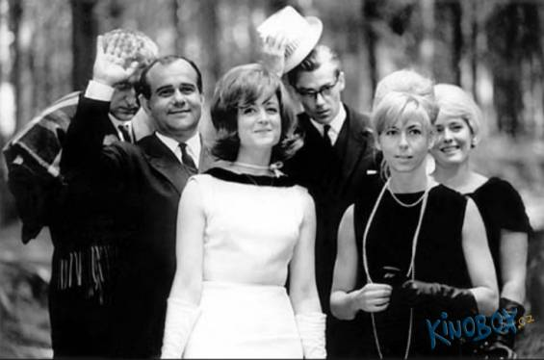
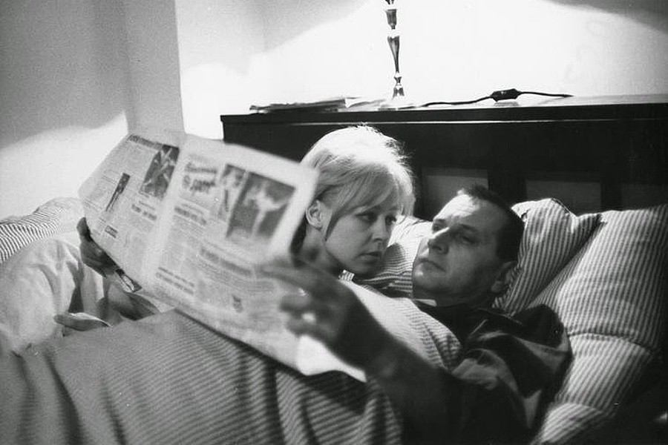
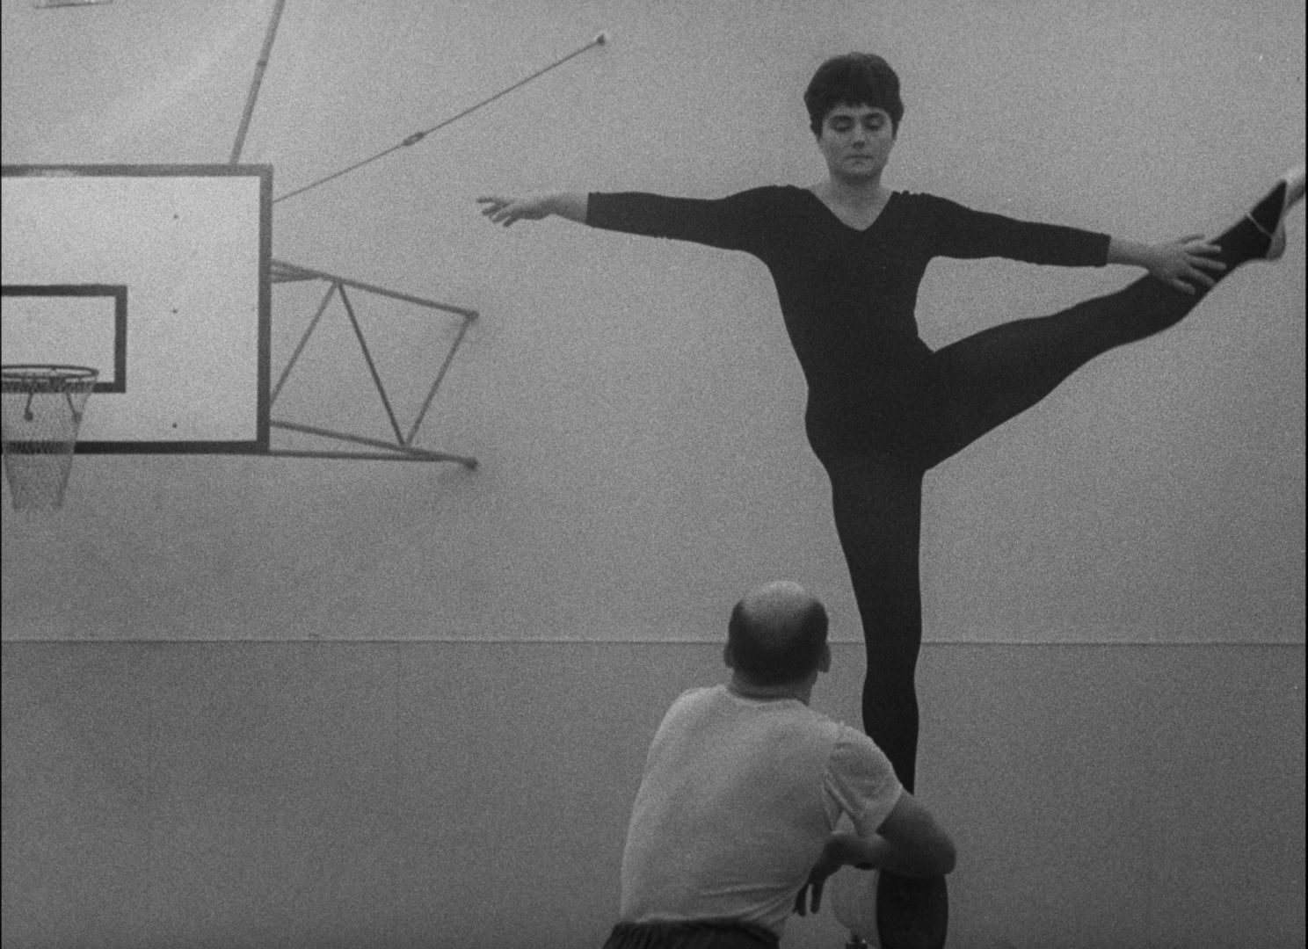
Non-professional actors in films of
Jan Němec and Věra Chytilová
For Forman and co, this type of casting is an organic and natural thing. For the two directors named above this is an issue of wider artistic and visual design.
Věra Chytilová chooses energetic and charismatic women, connected with the notion of visibility and exhibitionism (Marta the fashion model, Eva the gymnast champion, Marie and Marie in Daisies)
The Party and the Guests – the cast was recruited from Krumbachová‘s and Němec‘s inner circle of friends and colleagues >> according to the director himself, the characters do not embody psychological types but moral and ethical principles, as in medieval plays, where every single figure stands for a common human mishap and character flaw
  Jiří Němec, Jana Prachařová, Josef Škvorecký, Helena Pejšková, Karel Mareš, Zdena Salivarová, Evald Schorm, Jan Klusák

