Slide 1
Slovak new wave
Mgr. Katarína Kunkelová

Slide 2
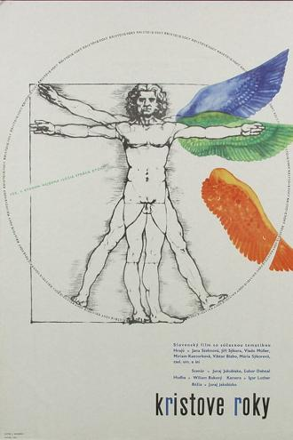
The prime of life (1967)
Director: Juraj Jakubisko
Screenwriter: Lubor Dohnal, Juraj Jakubisko
Camera: Igor Luther
Music: Wiliam Bukový
Actors: Jiří Sýkora, Jana Stehnová, Vlado Müller, Miriam Kantorková, Mária Sýkorová
Film The Prime of Life is the first feature film of important director of the emerging, new generation of creators in the 60s. In the film, Jakubisko combines his interests, desires, dilemmas or events he experienced. However, these refer to a more general social issue: the life of young people their choices and freedom.

Slide 3
The prime of life (1967) - Questions
The Prime of Life was created almost 5 years after The Sun in Net (1962) was released. It was debut of new generetion director - Juraj Jakubisko. Can you tell what makes film similar? What makes them different? Is it possible to consider The Prime of Life to be part of the new wave films?
How do you perceive the main character Juraj and his relationship with other characters, for example Jane?
In what way is folklore or the relationship of Jakubiska to his birthplace shown in the film? Is it there at all?
Jakubisko's films are full of symbols or scenes/actions that can be interpreted differently. Did something interest you?

Slide 4
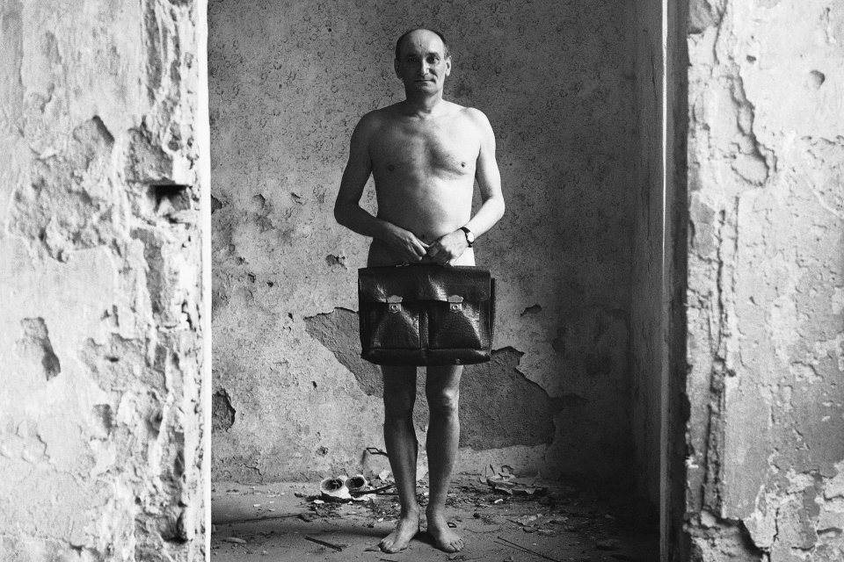
Czecho-Slovak New Wave VS. SLOVak “waving”
The impossibility of creating films in scale and aesthetics as in Czech
Creating "festival" films - demand
The first wave did not have a permanent poetics (Štefan Uher) = more emotional film.
Organizational and political changes were the same as those in the Czech territory.
Recognition at important festivals and winning prizes
Connection mainly in case of study and cooperation.

Slide 5
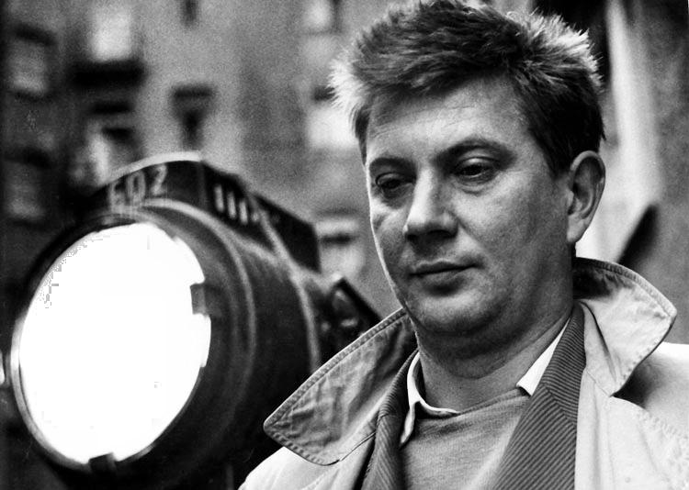
Štefan UHEr
* 4. 7. 1930 - † 29. 3. 1993
FAMU (Peter Solan, Martin Hollý)
Beginnings in documentary film
Addressing social issues
1. feature film: We from ninth grade A (1961)
Frequent collaboration with Alfonzo Bednár, Stanislav Szomolányi
Young people – coming of age, authenticity social criticism,
Trying new things.
Older – 1. generation

Slide 6
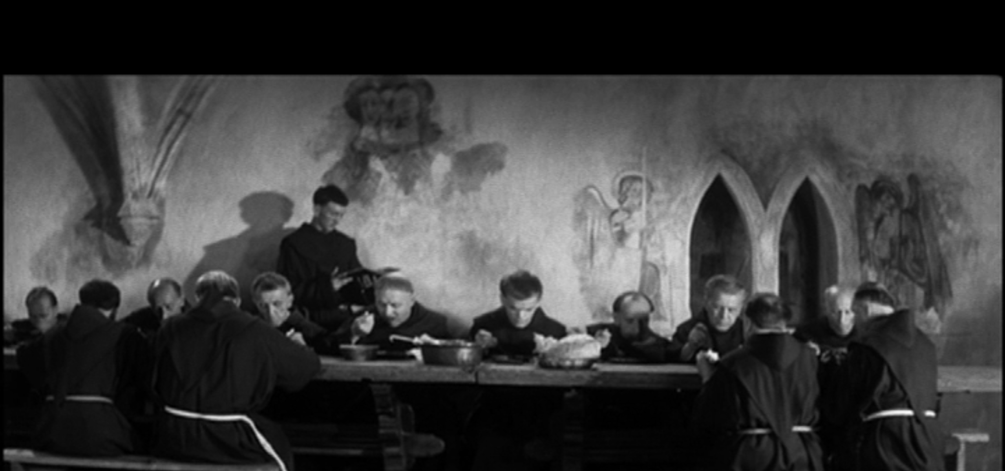
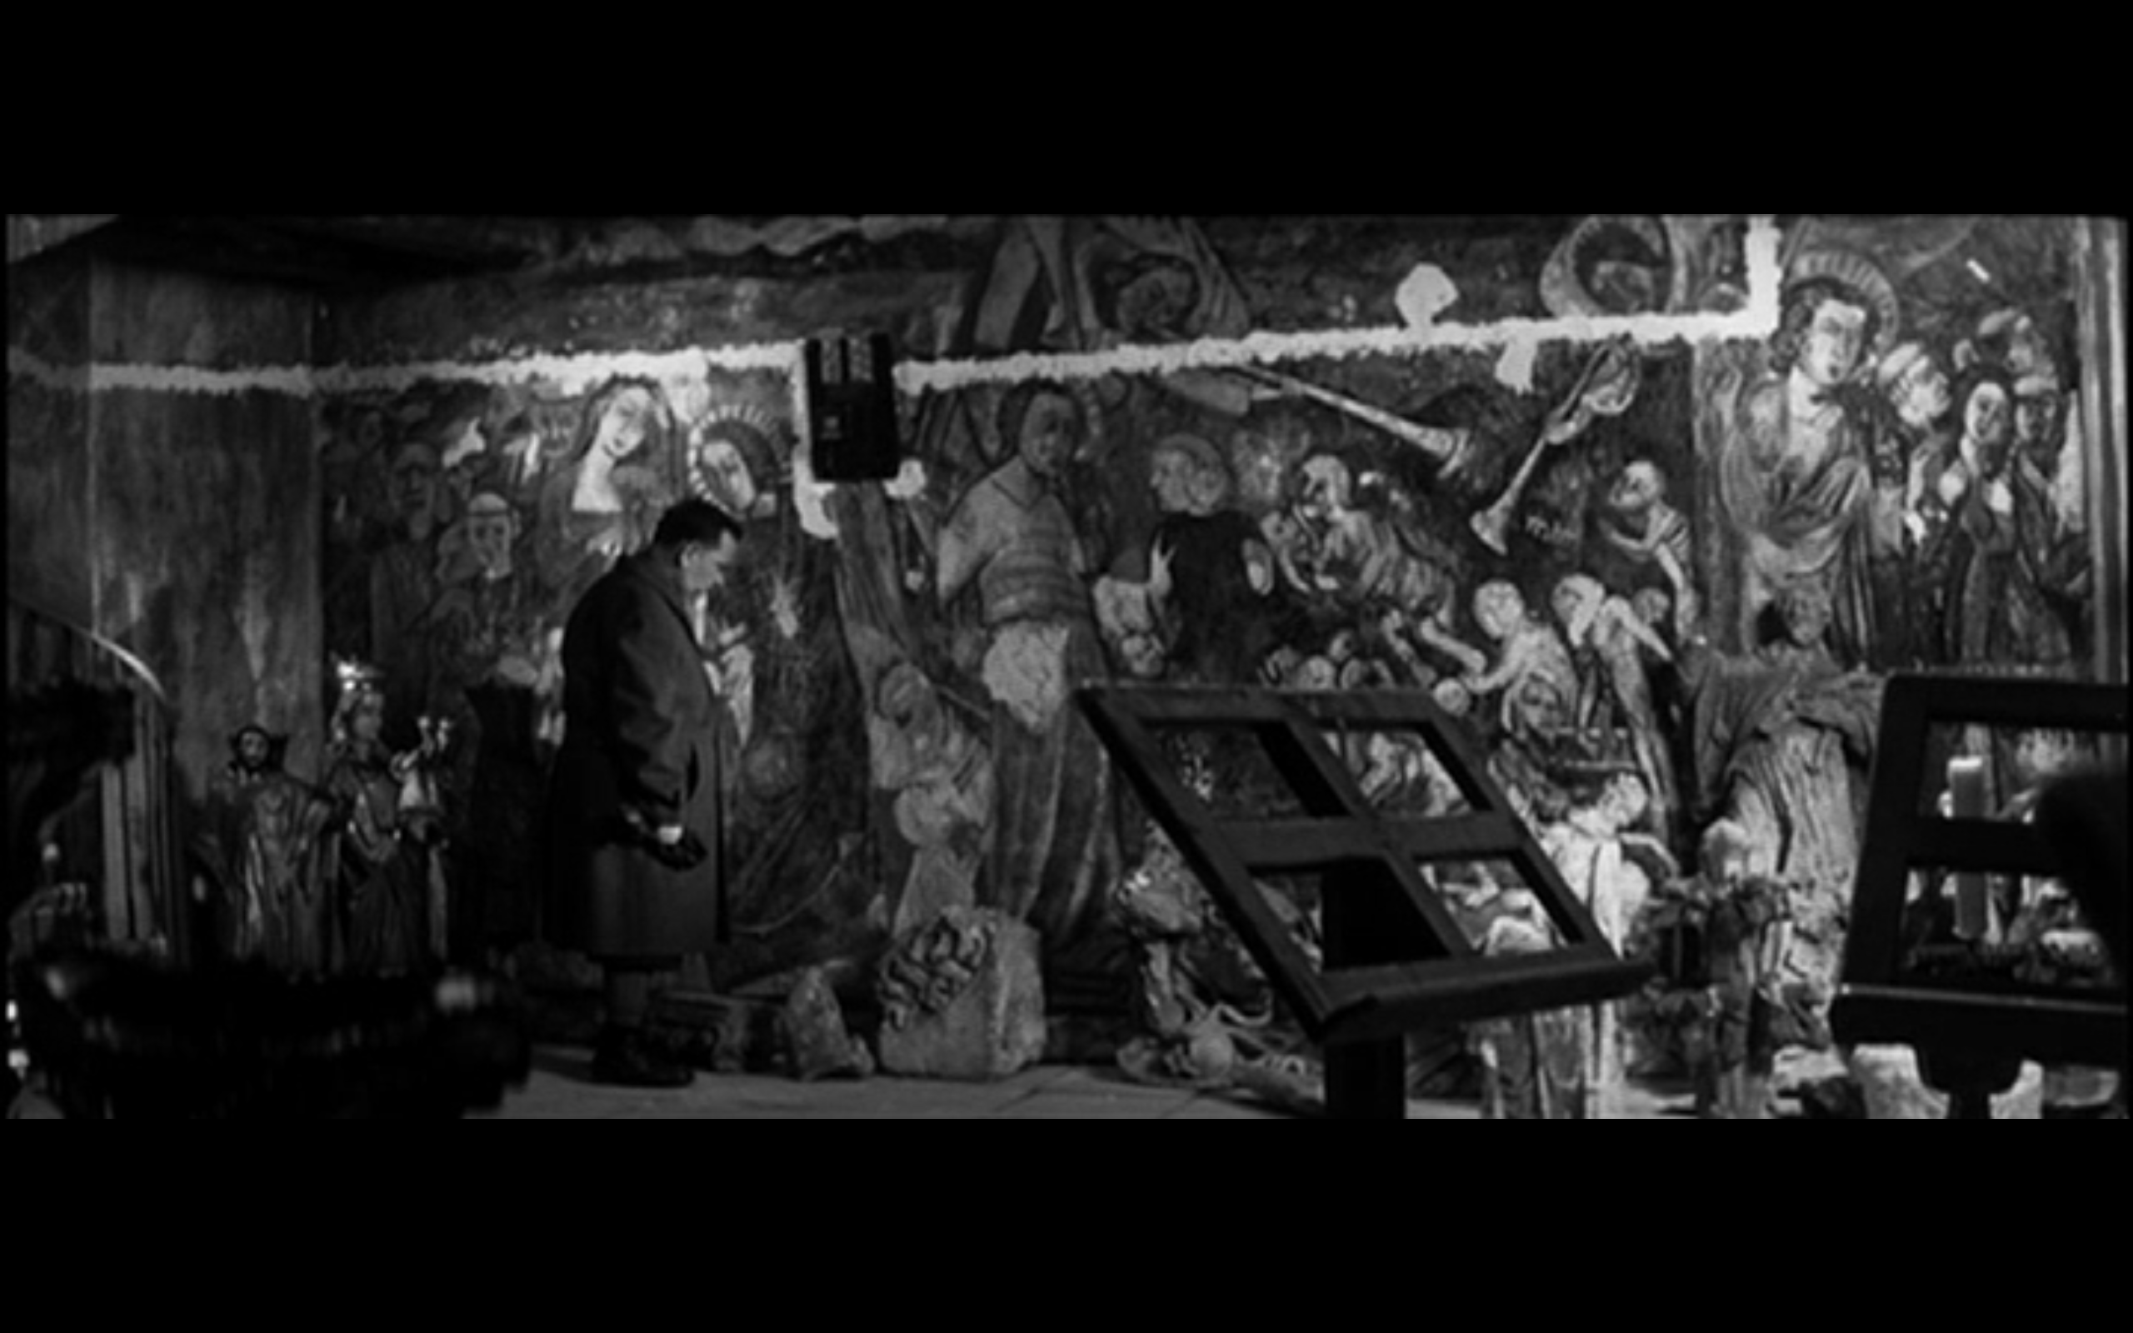
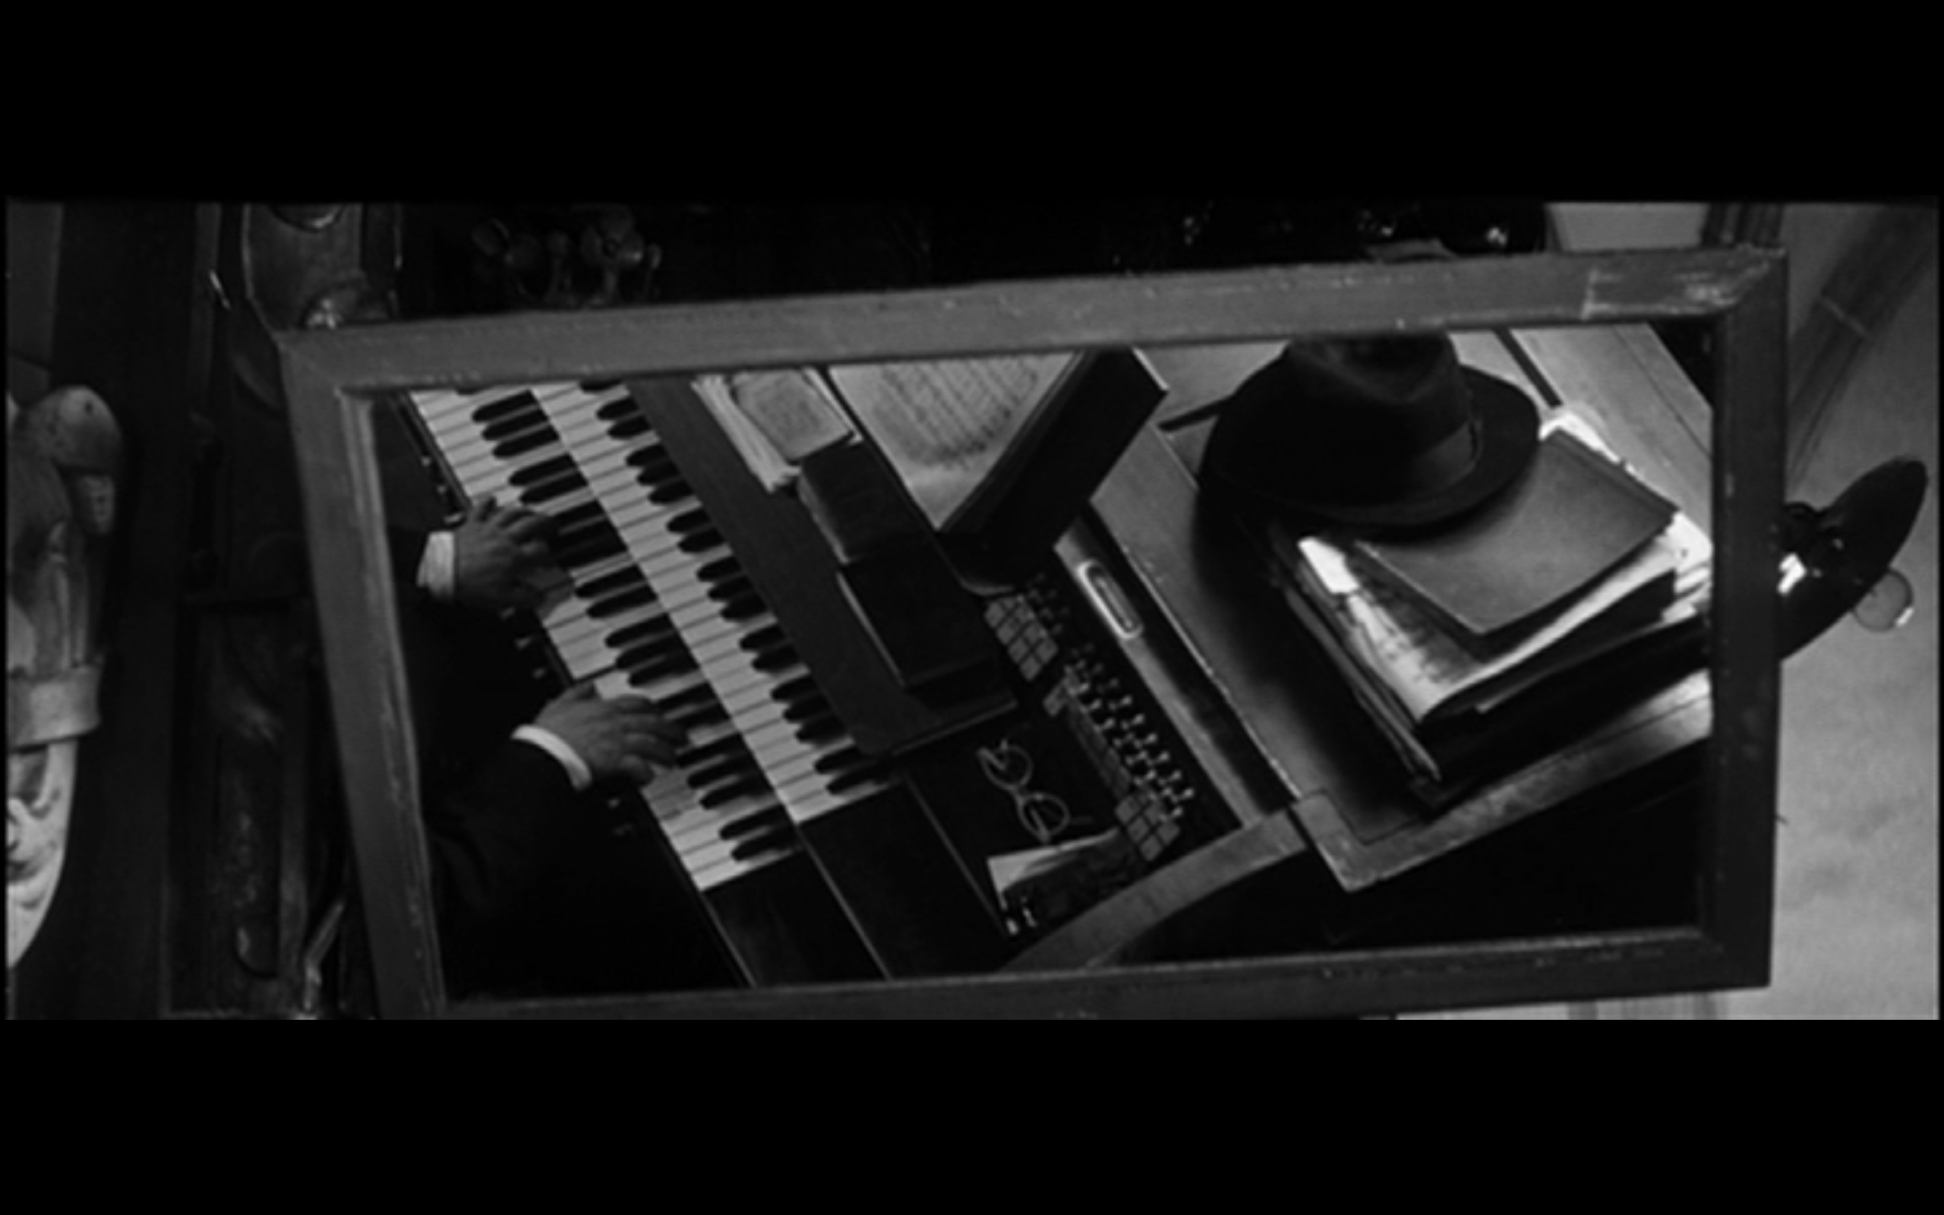
Organ (1964)
Baroque music and J. S. BACH in the gothic setting of church in small town.
Catholicism vs. Nazism
Stylized, but based on realistic motifs – 2. WW
Contrasts plays important role
Same creators – new ways

Slide 7
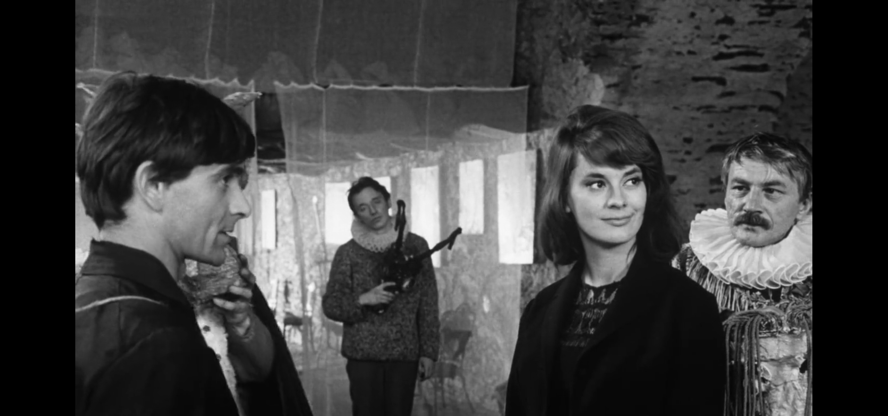
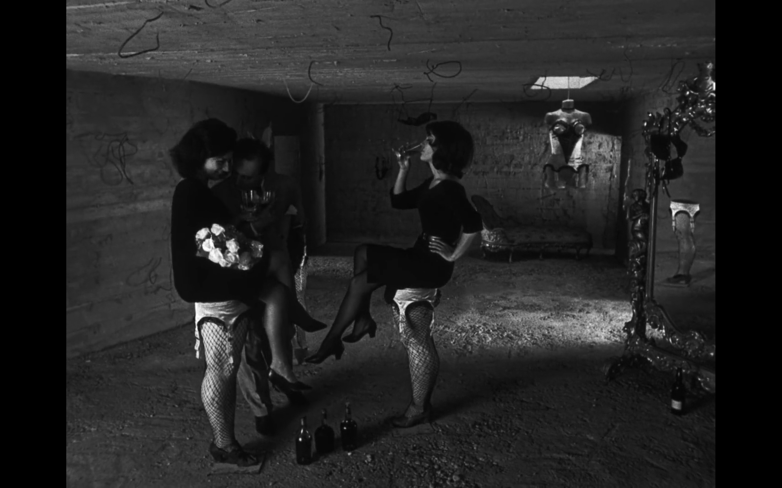
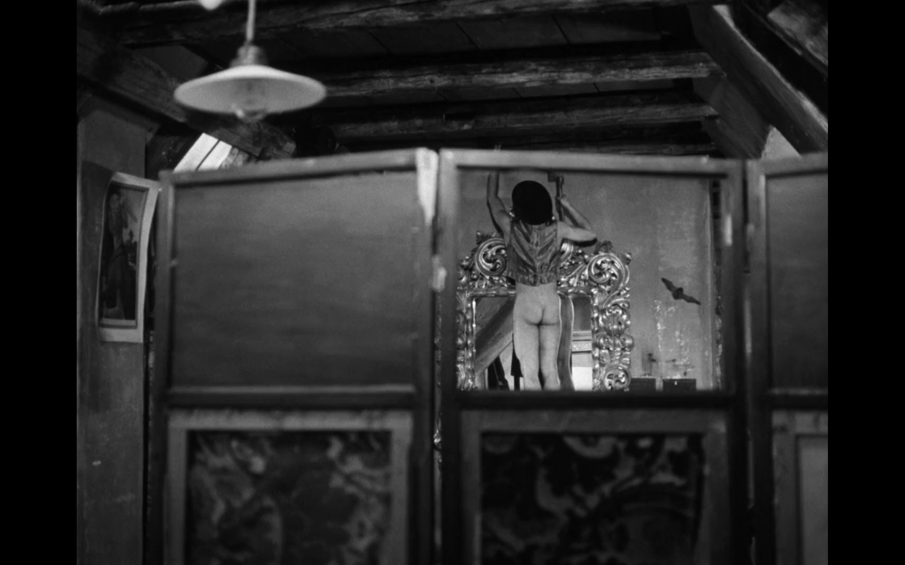
The Miraculous Virgin (1966)
Based on work of Dominik Tatarka
Notice how Uher works with characters, their inner world and motivation.
Questions of art and life of young people after WWII
Again finding new ways (modernism) and experimental (surrealism).

Slide 8
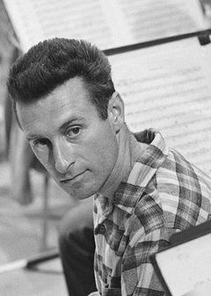
Peter Solan – Stanislav Barabáš – Martin Hollý ml.
All three of them have beginnings in short/documentary films.
Older – 1. generation
Stanislav Barabáš: A Song abot Gray Pigeon (1961), The Bells Tol for the Barefooted (1965)
Martin Hollý: Ballad of the Seven Hanged (1968)
Peter Solan: Boxer and Death (1962), Seven witnesses (1967), …Be sure to Behave… (1968), Small Survey (1969) – topics of social criticism
Mostly popular works for viewers
The Barnabáš Kos Case (1964)
Judicial environment, skepticism, realism, self-defense and respect
Kos paradox = a competent person becomes a director
It’s absurd ! Not realistic.

Slide 9
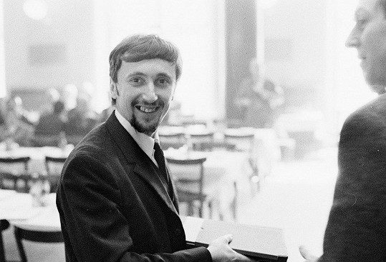
Juraj Jakubisko
* 30. 4. 1938
ŠUP Bratislava a FAMU
Student films:
Silence (1961), Waiting for Godot (1966)
Debut in feature film: The Prime of Life (1967)
Young generation (2. generation)
Notice: working with color, folklore (East), expressiveness, art as games and nature.

Slide 10
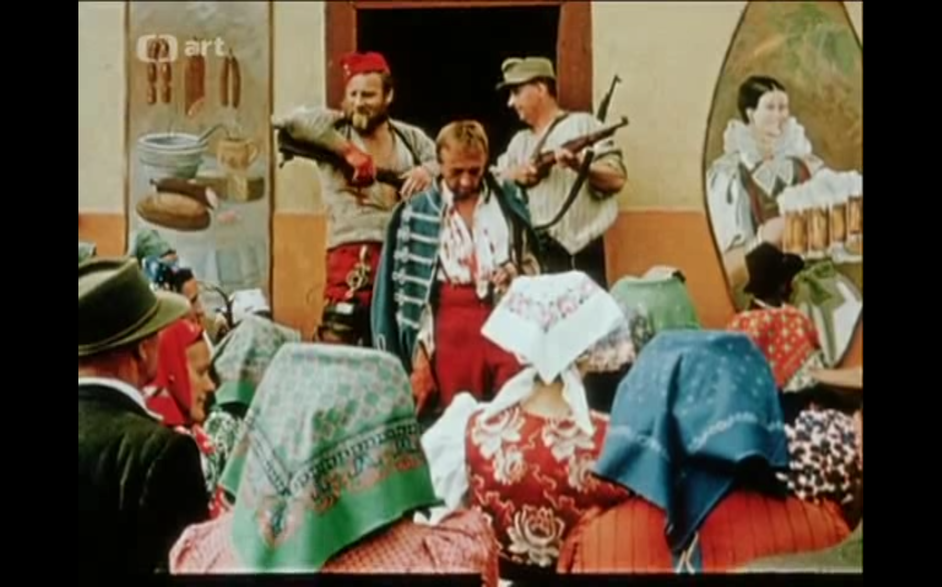
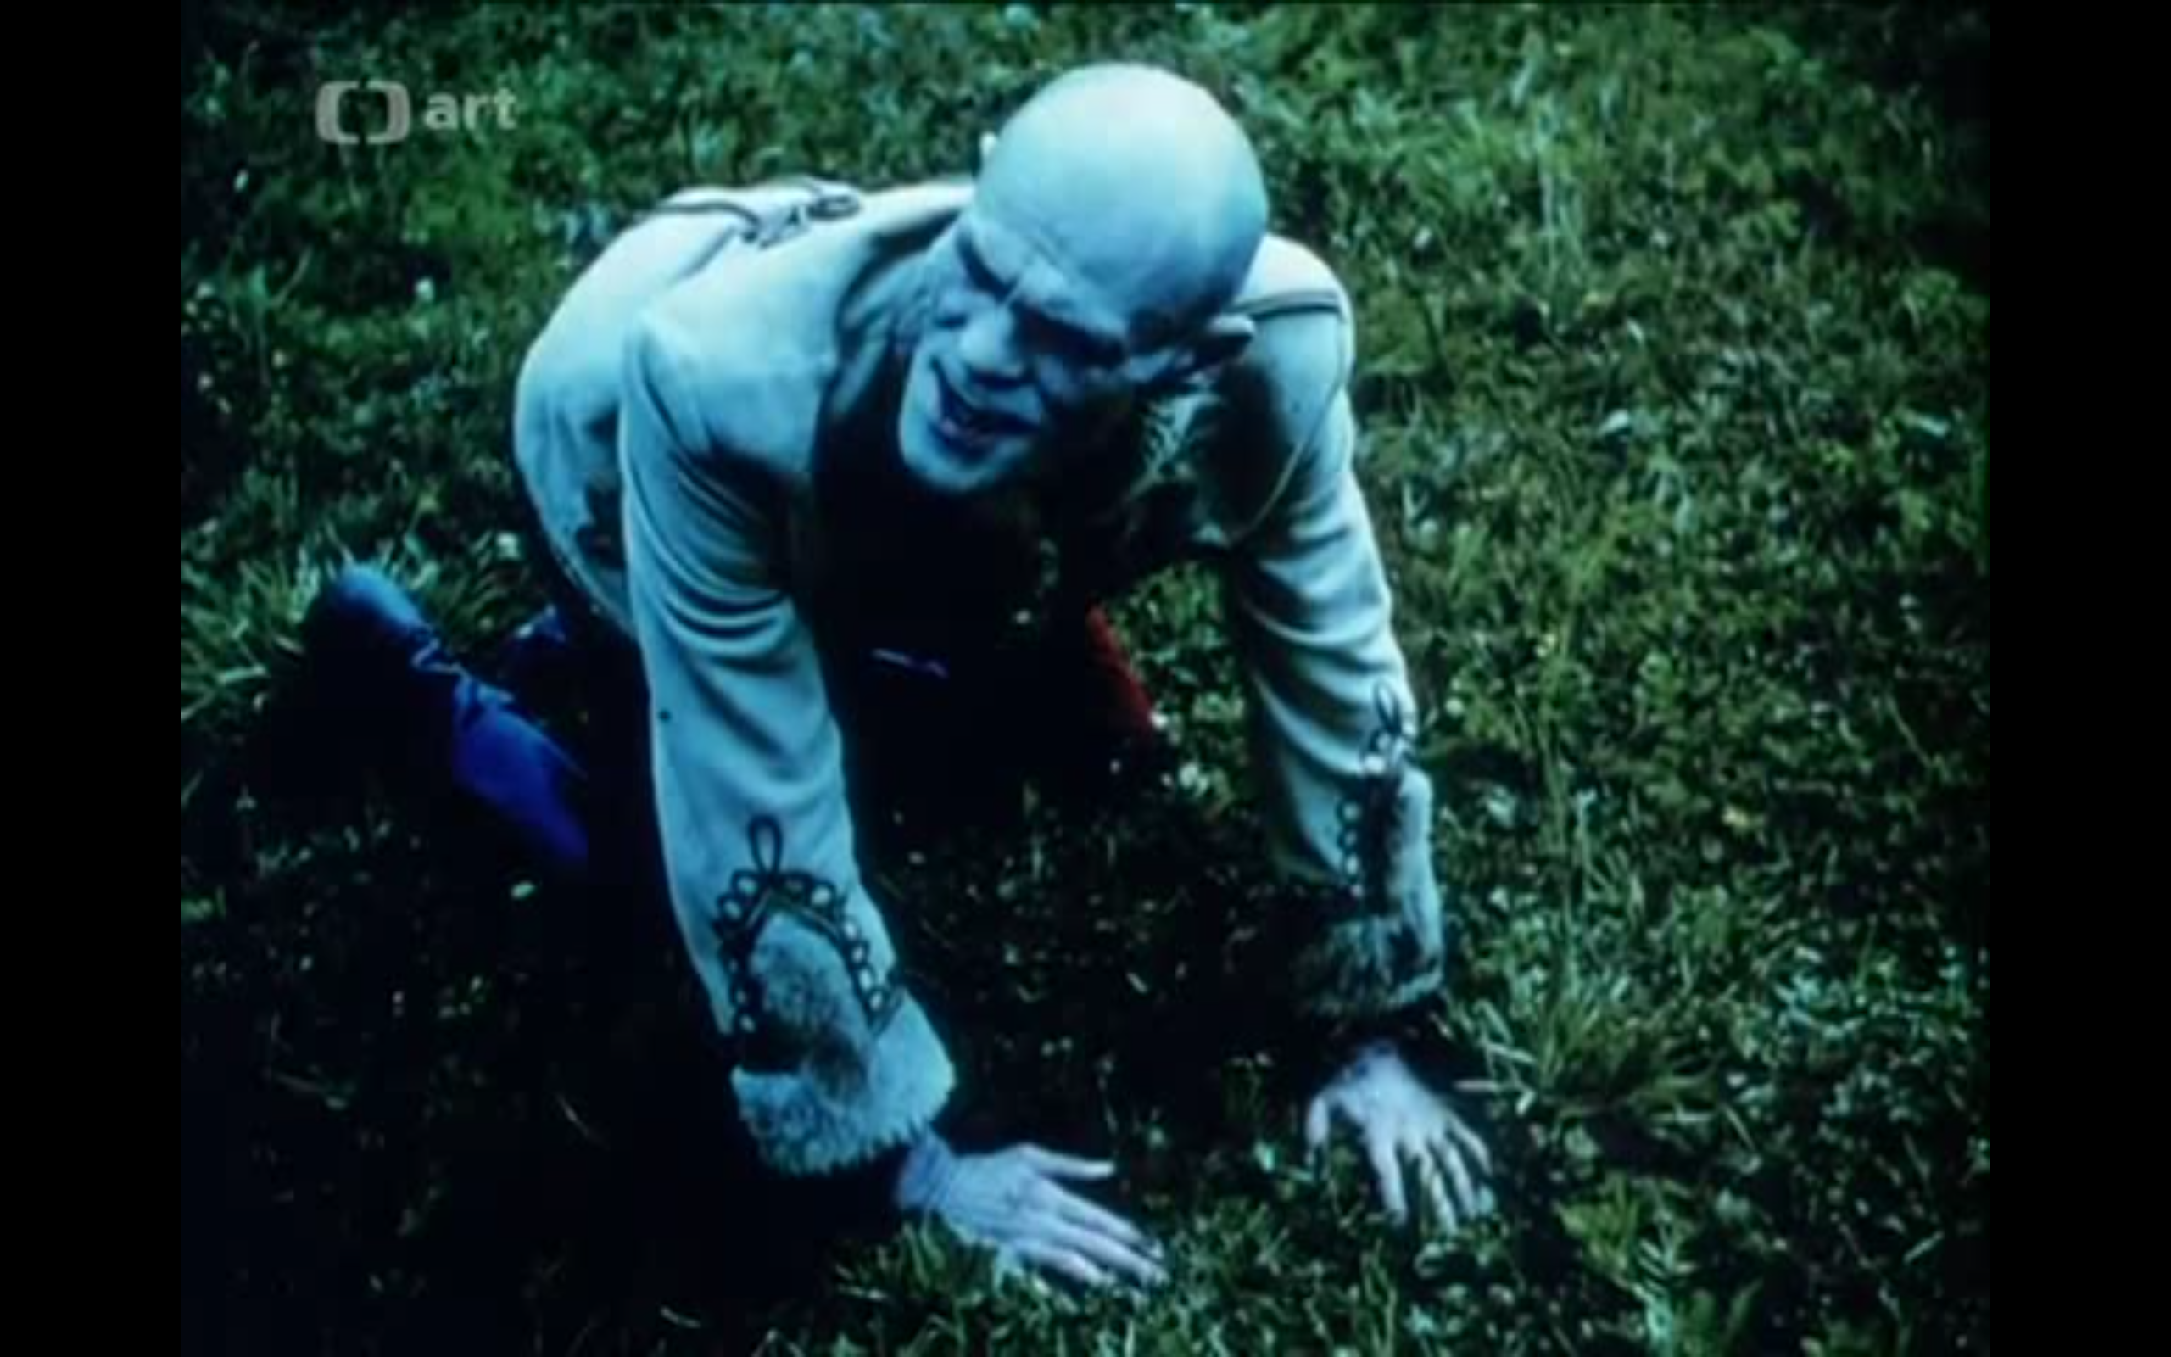
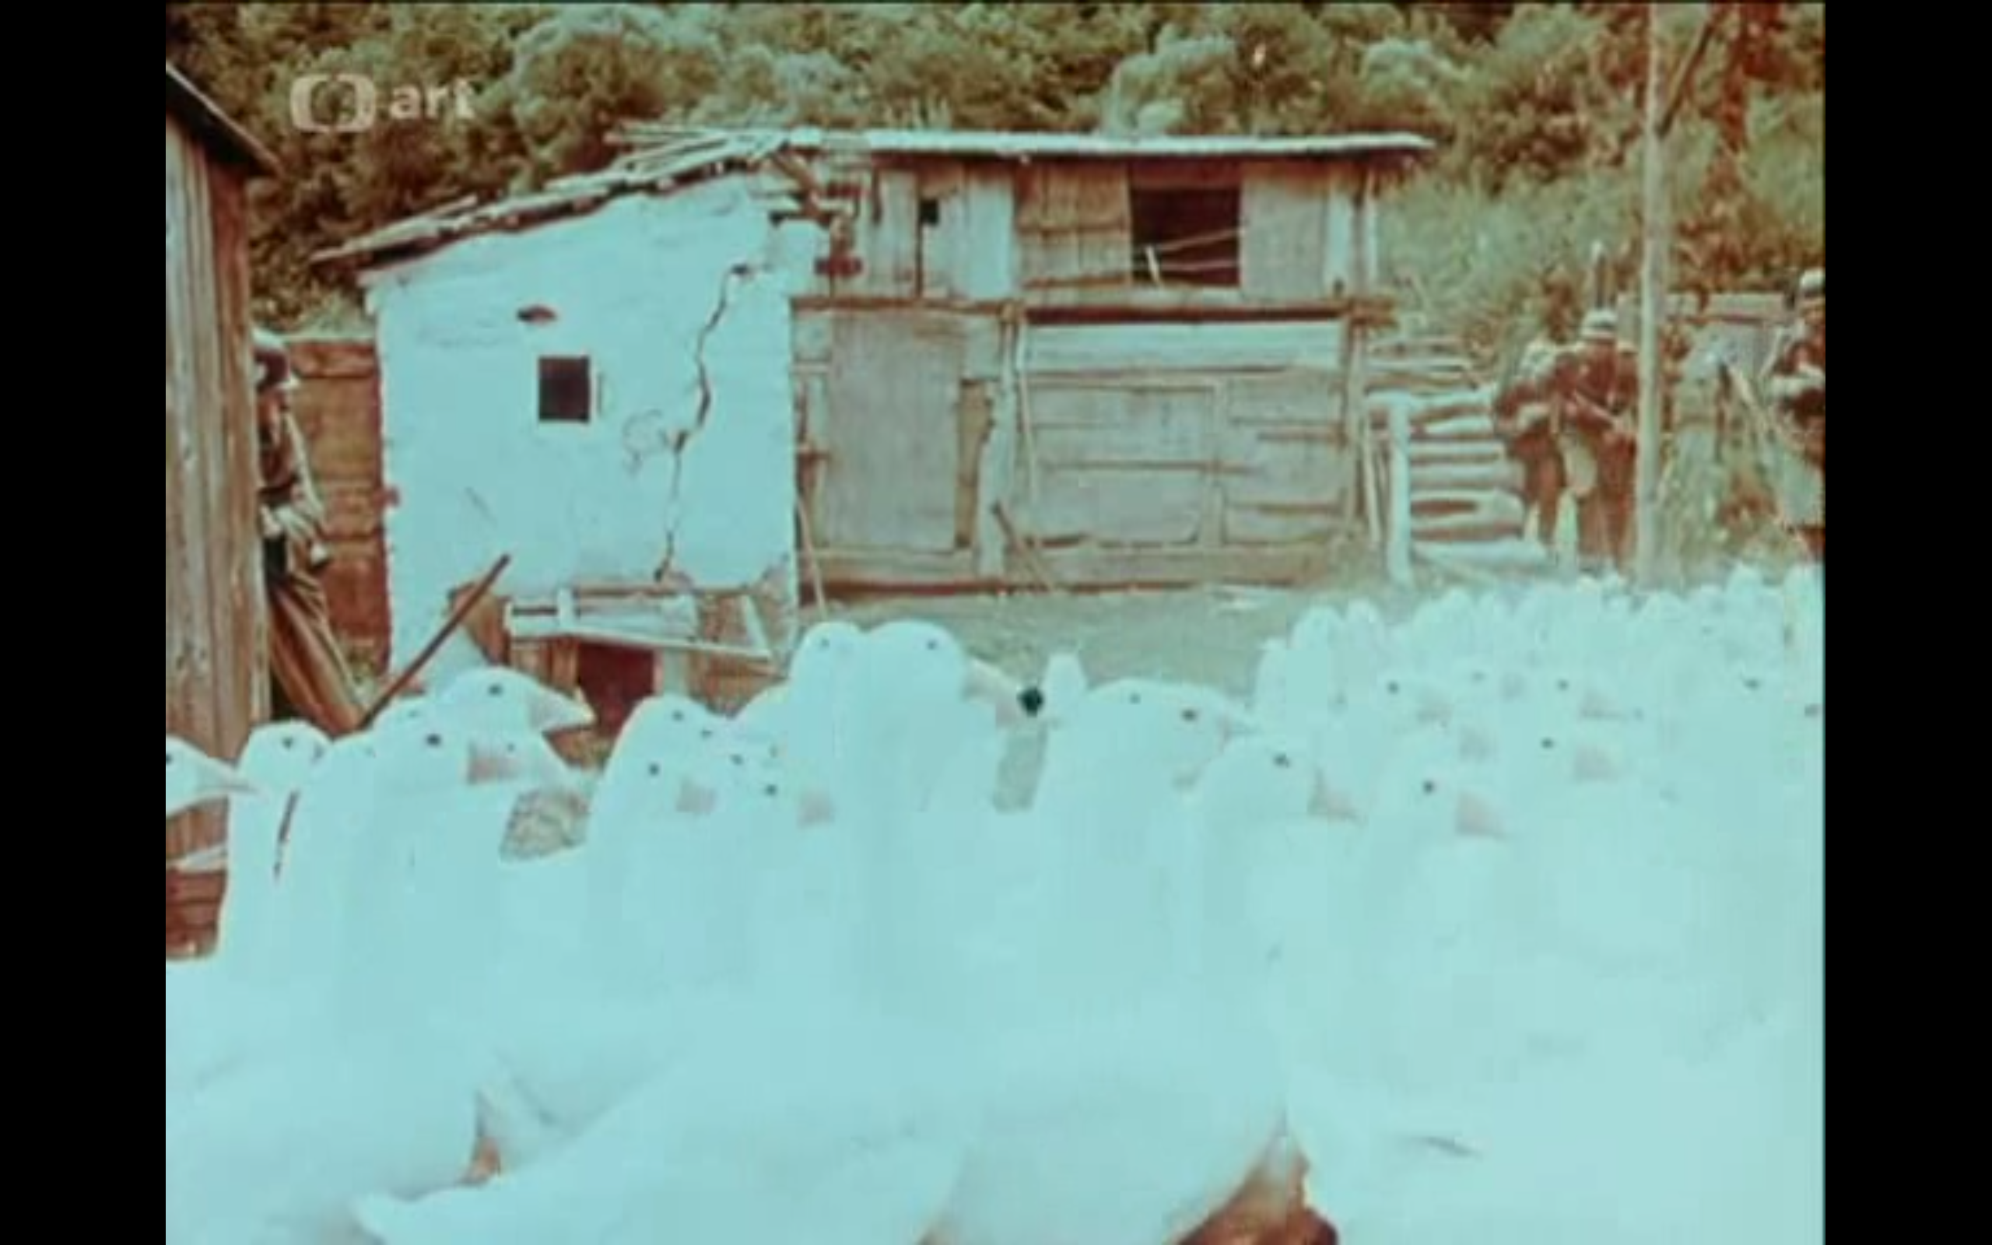
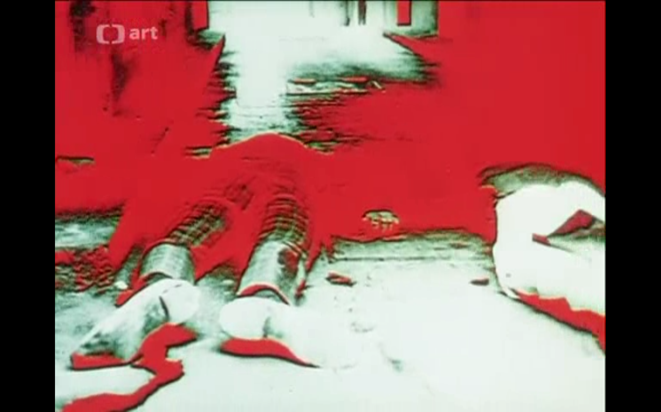
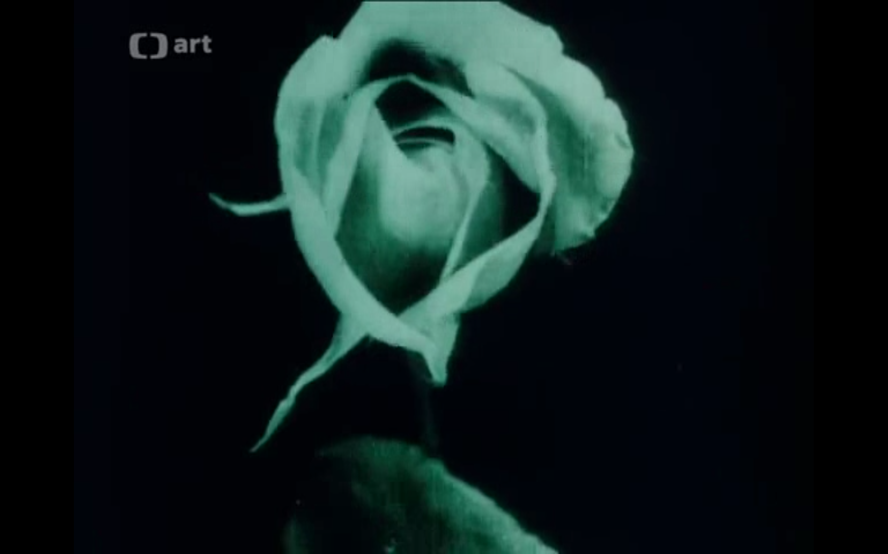
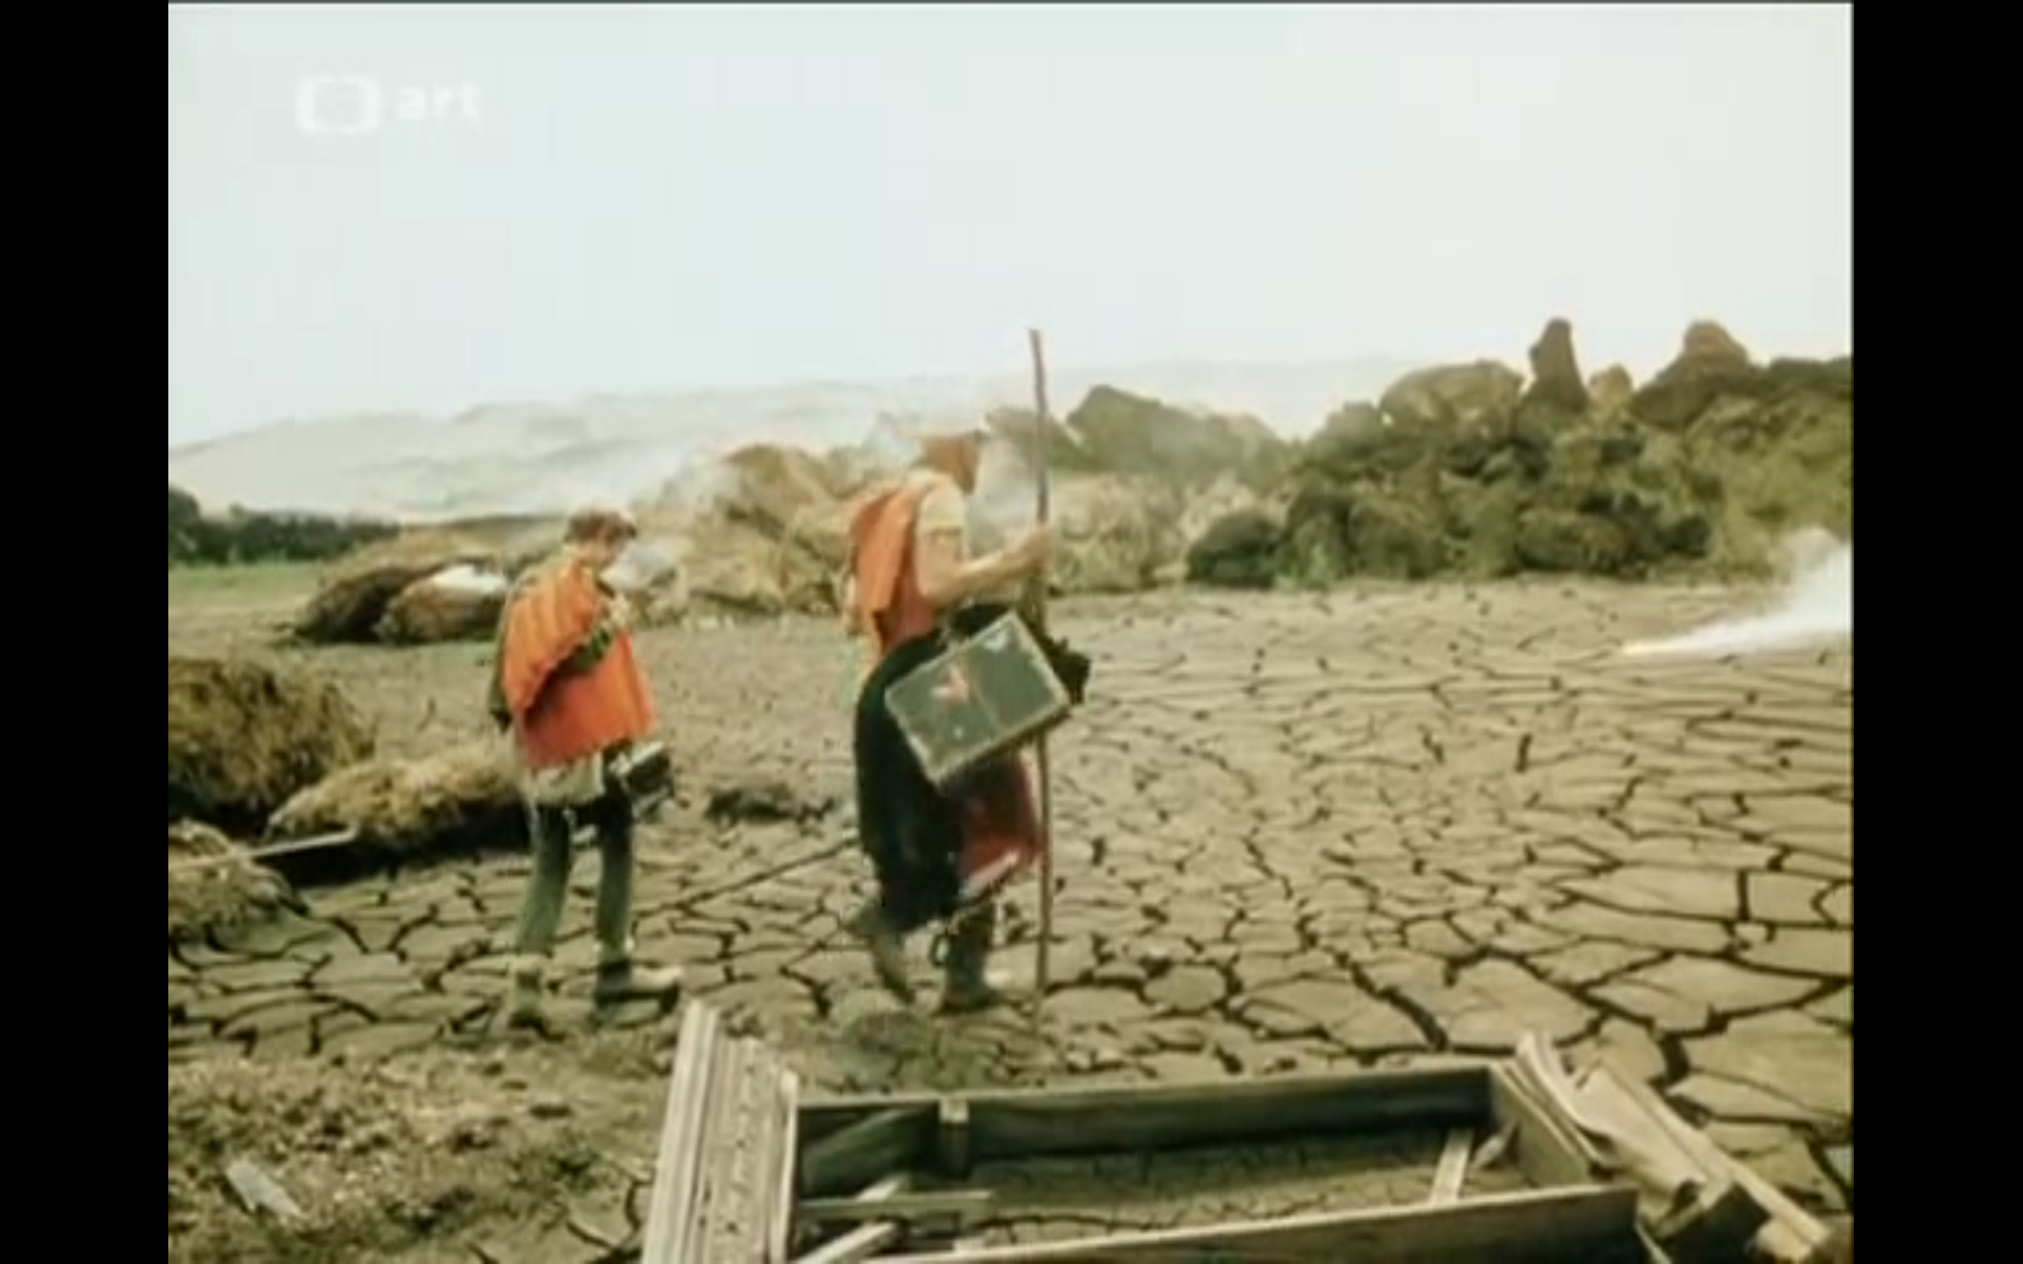
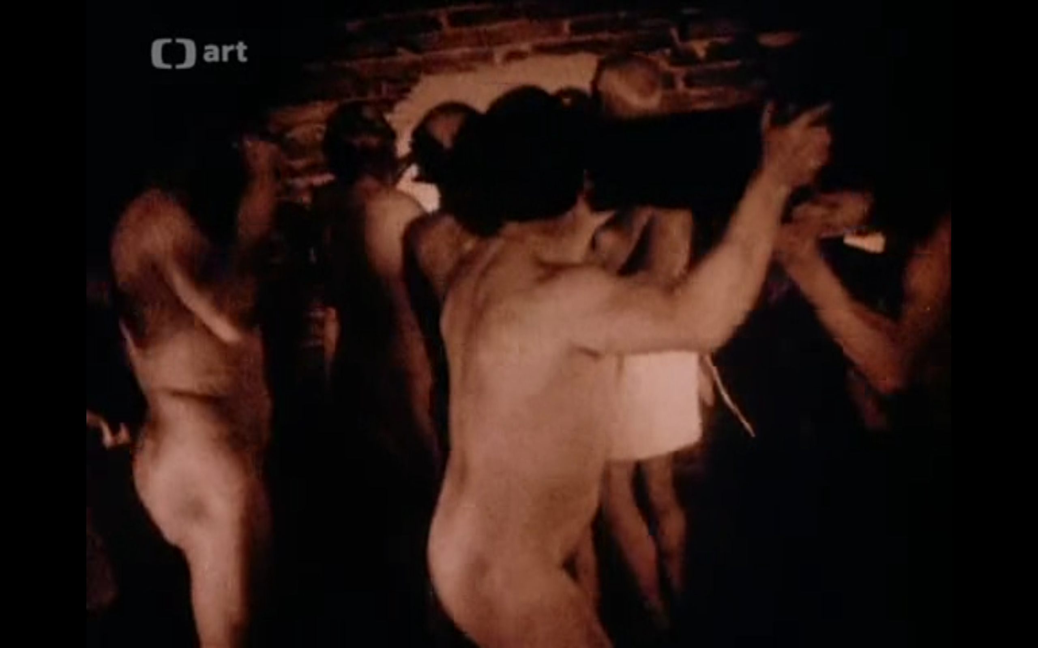
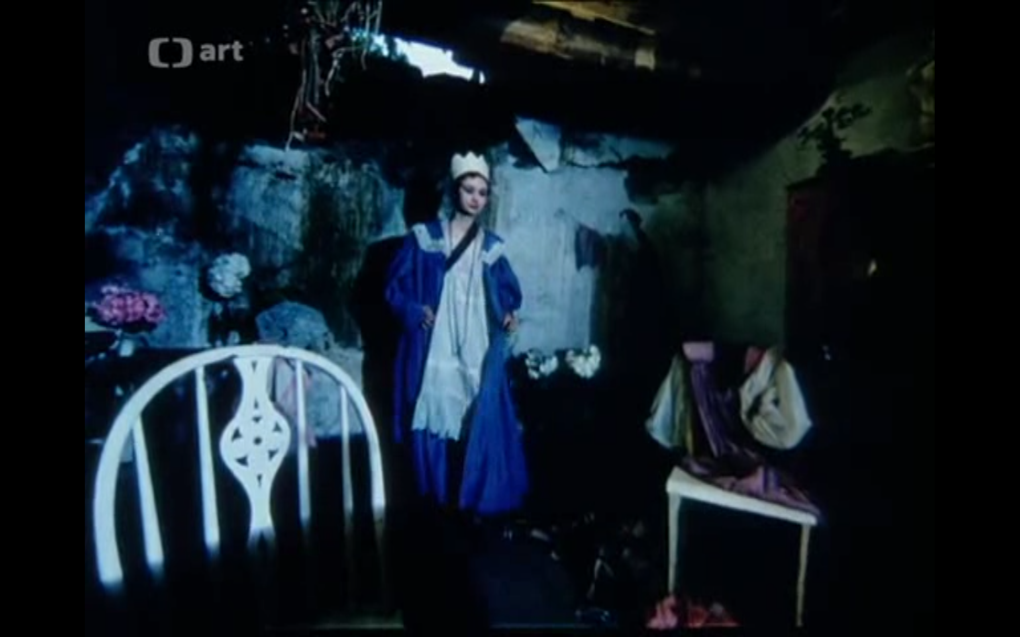

Slide 11
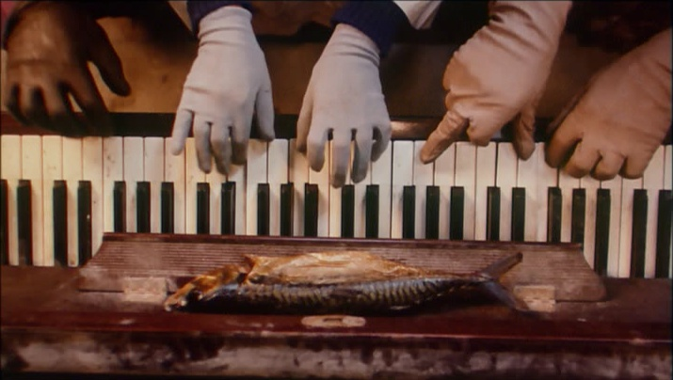
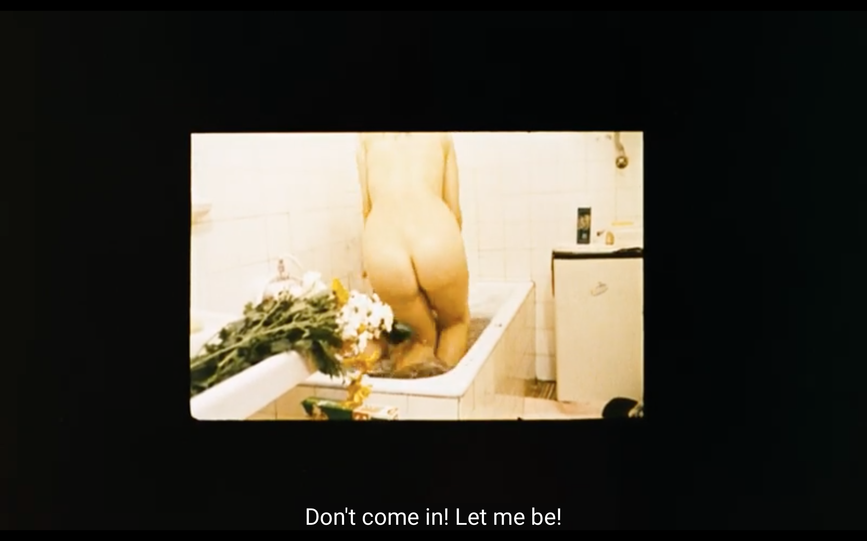
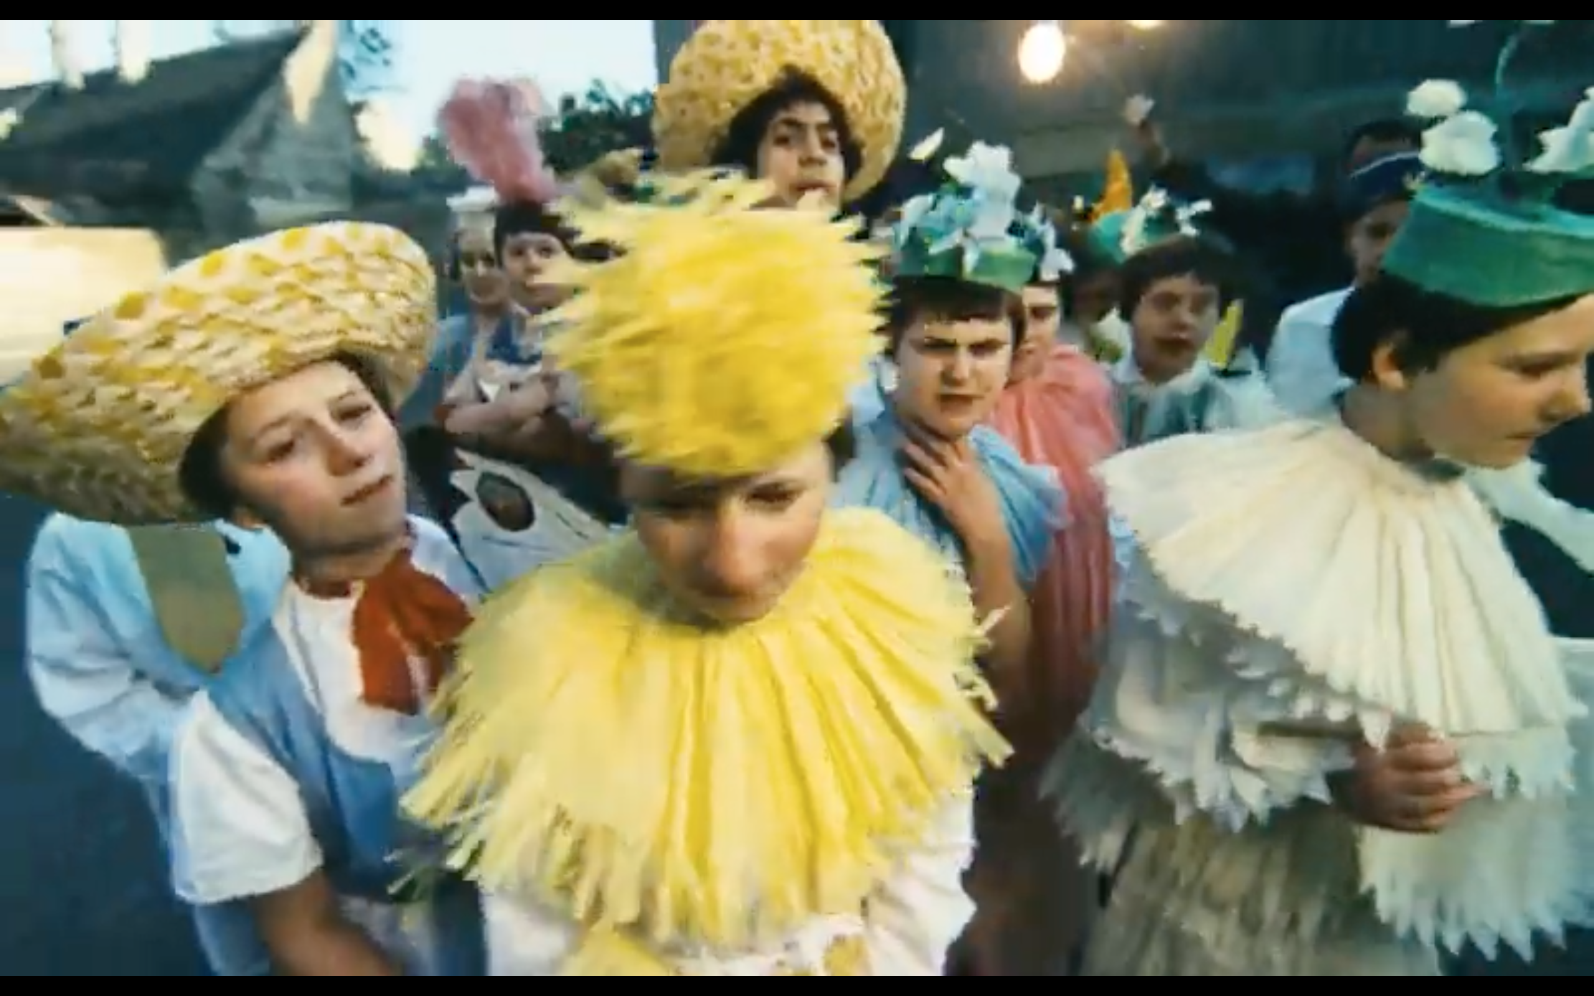
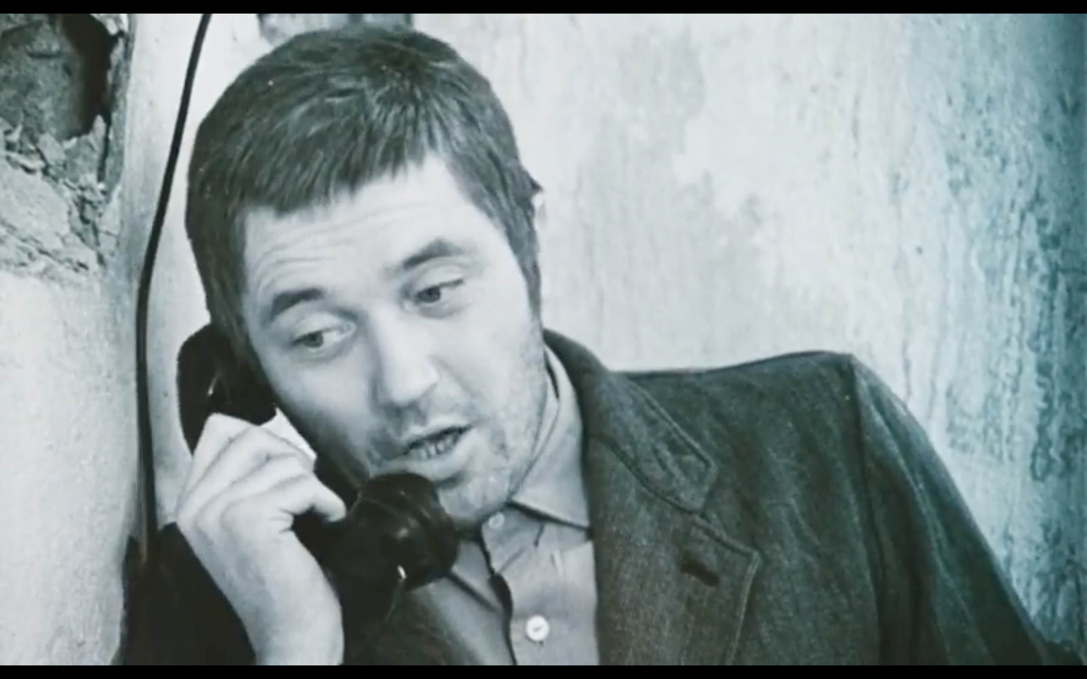

Slide 12
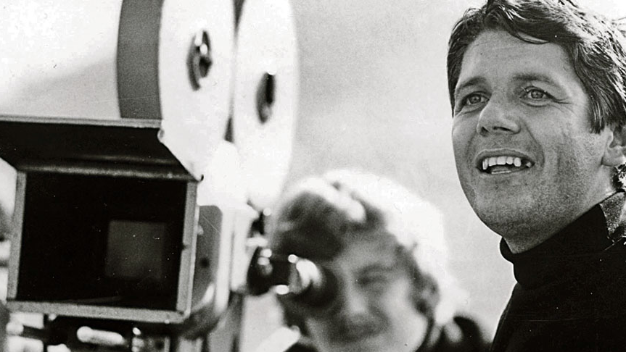
Eliáš „Elo“ HavettA
* 13. 4. 1938 - † 3. 2. 1975
ŠUP Bratislava a FAMU
Young (2. generation)
Impressionist, Imaginary, Folklore (South)

Slide 13
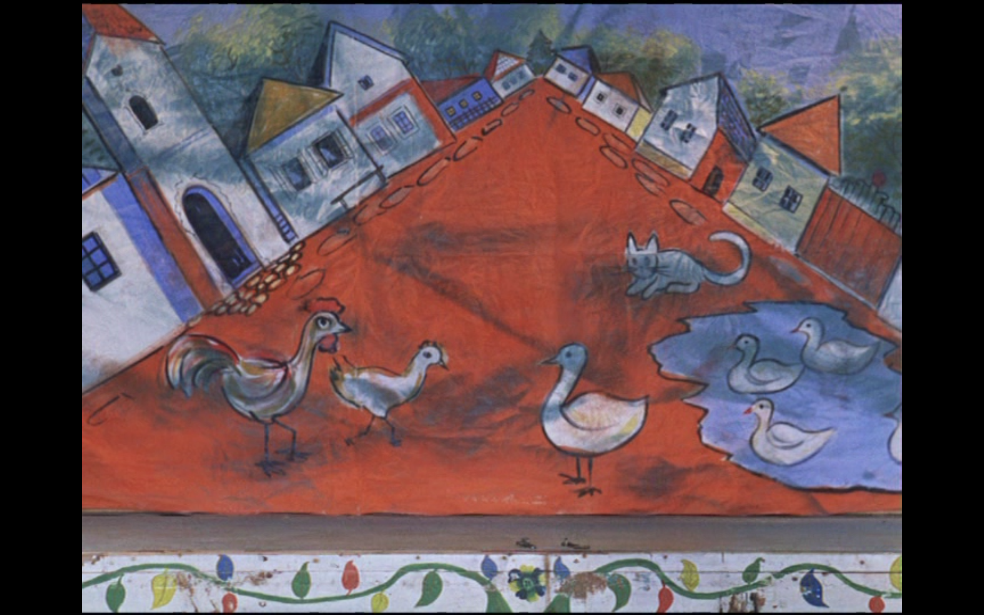
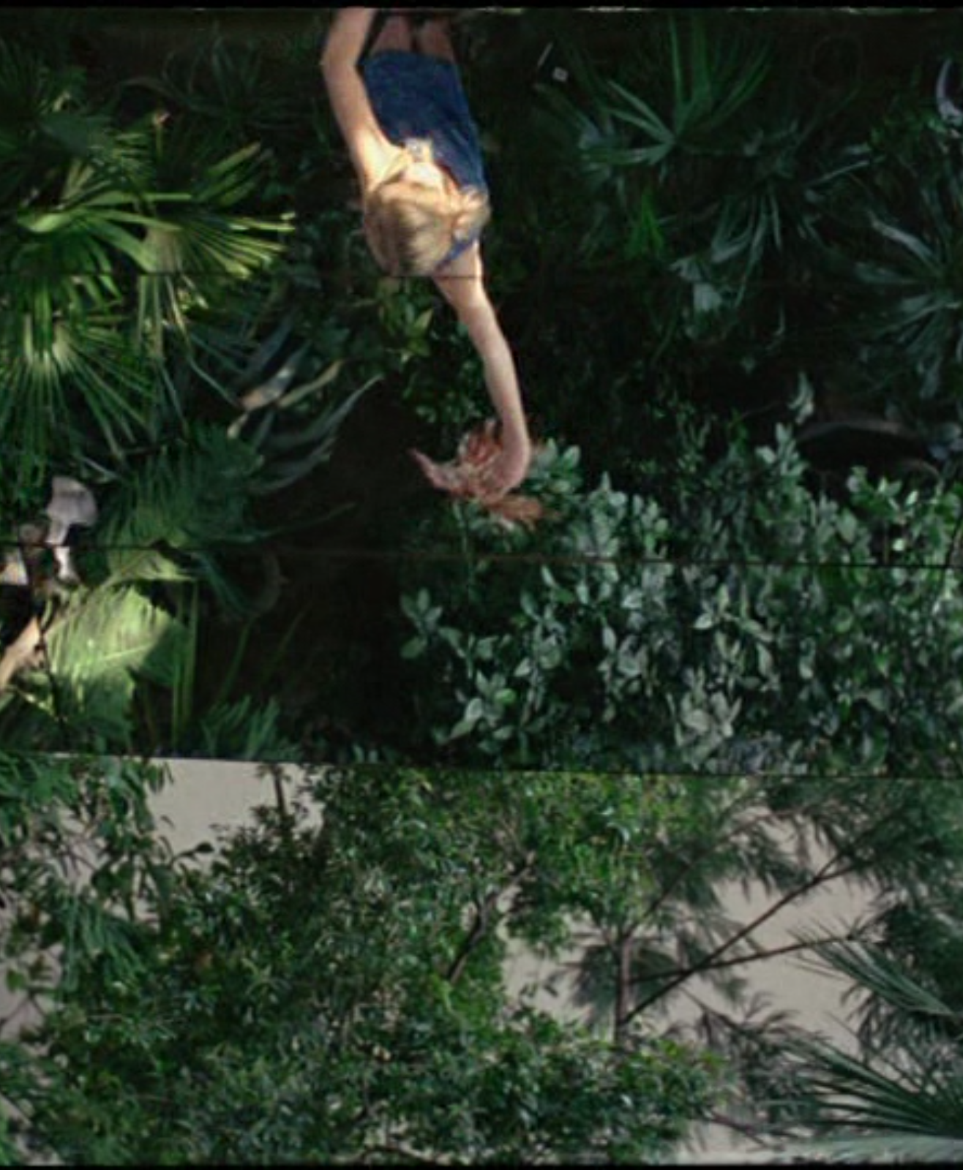
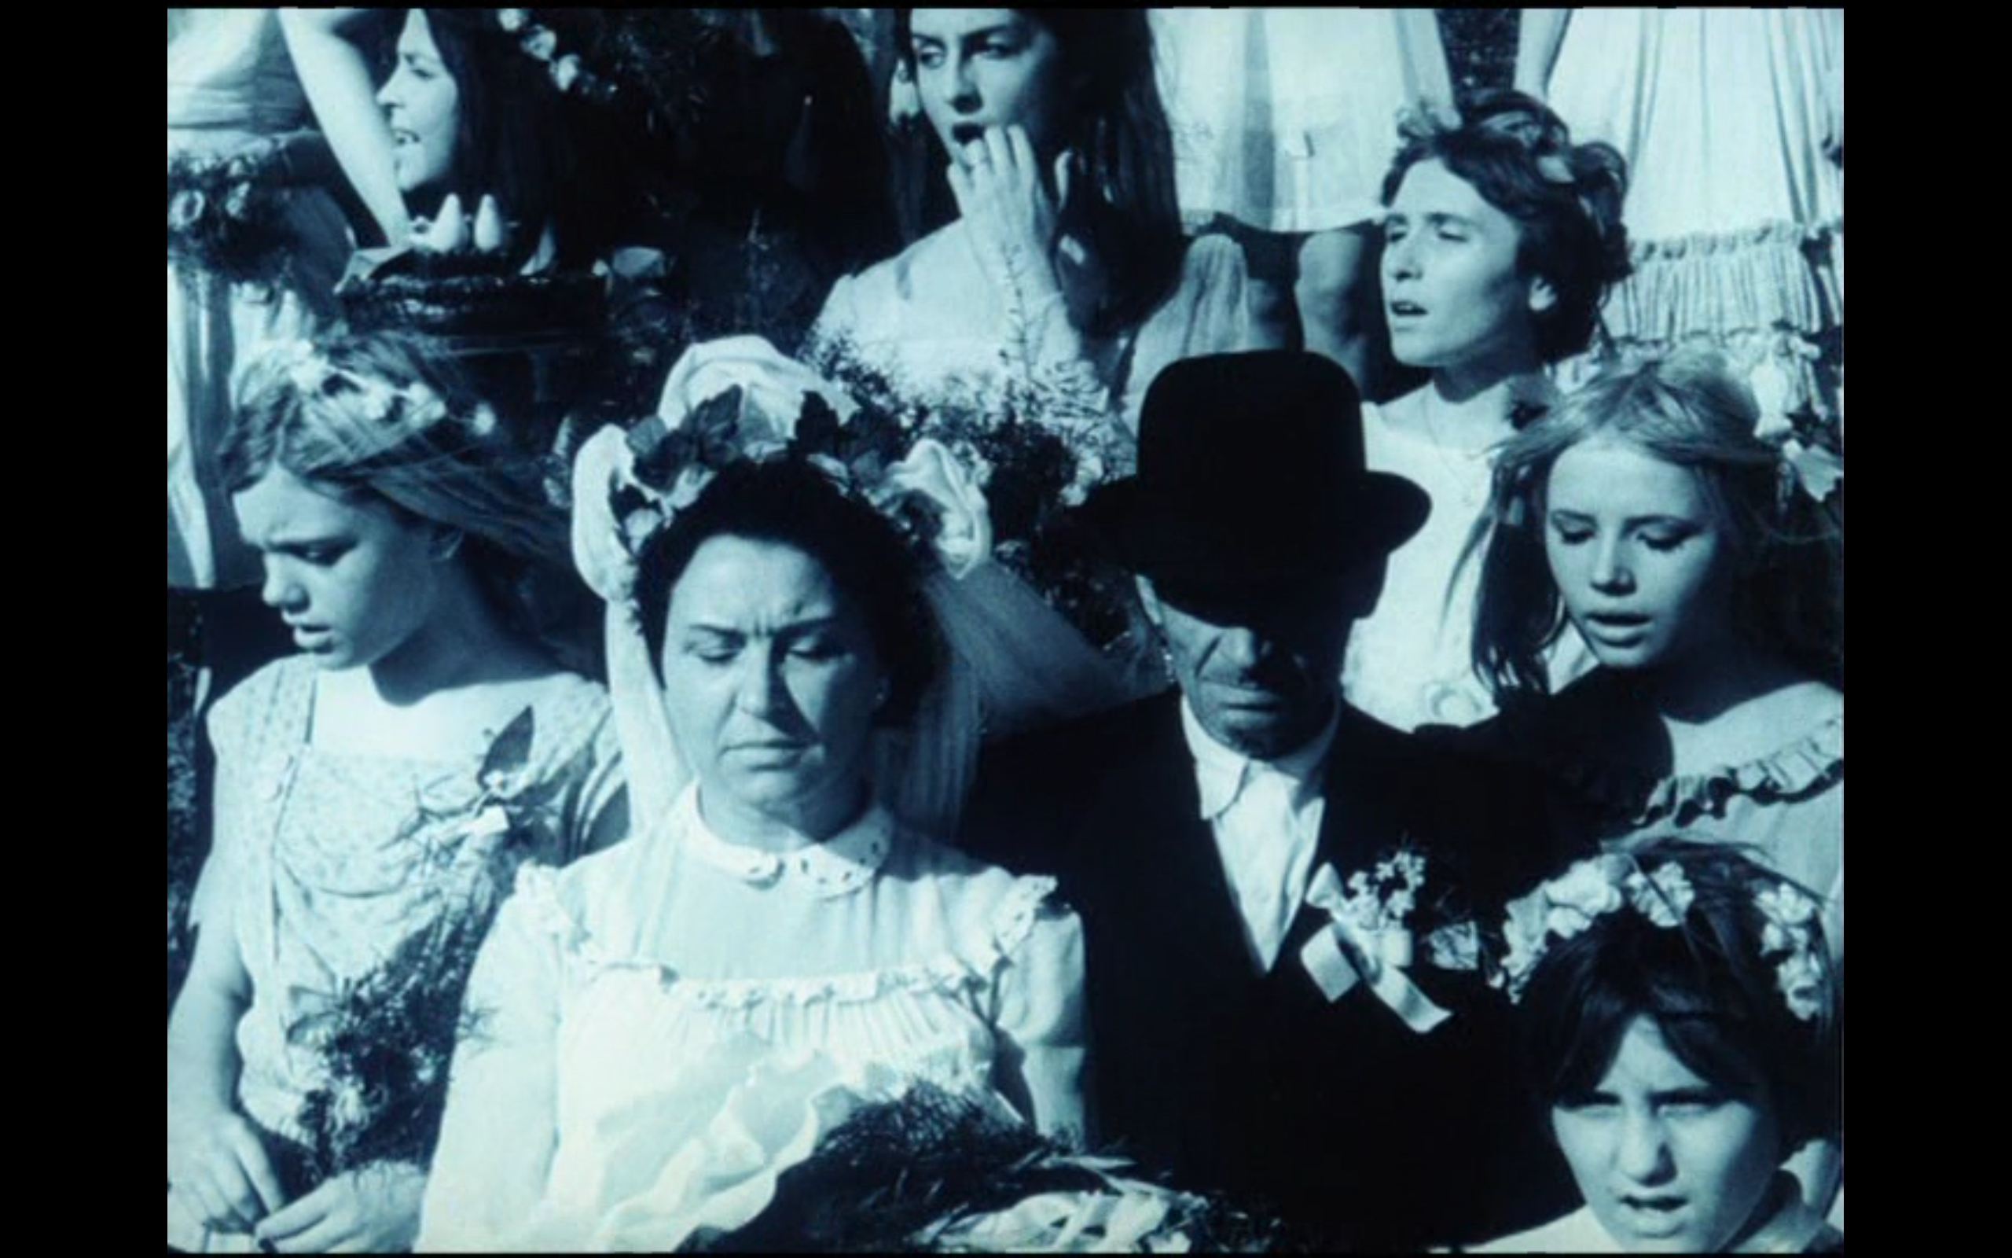
Celebration in the Botanical Garden(1969)
An allegorical film, divided into chapters.
Women have an important role
Folklore – brass music and village > celebration of nature and life
Idealization of the birth place and its connection to the author’s childhood life
Q: freedom and experiencing every moment
Film of experience not enjoyment

Slide 14
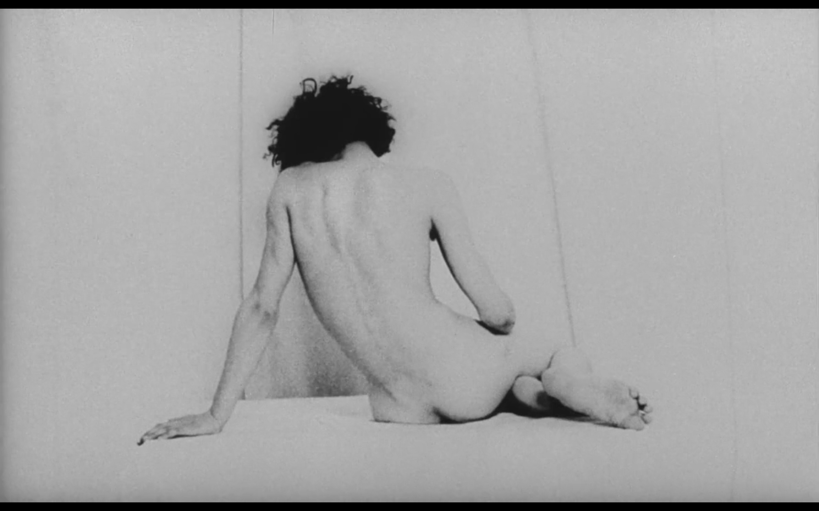
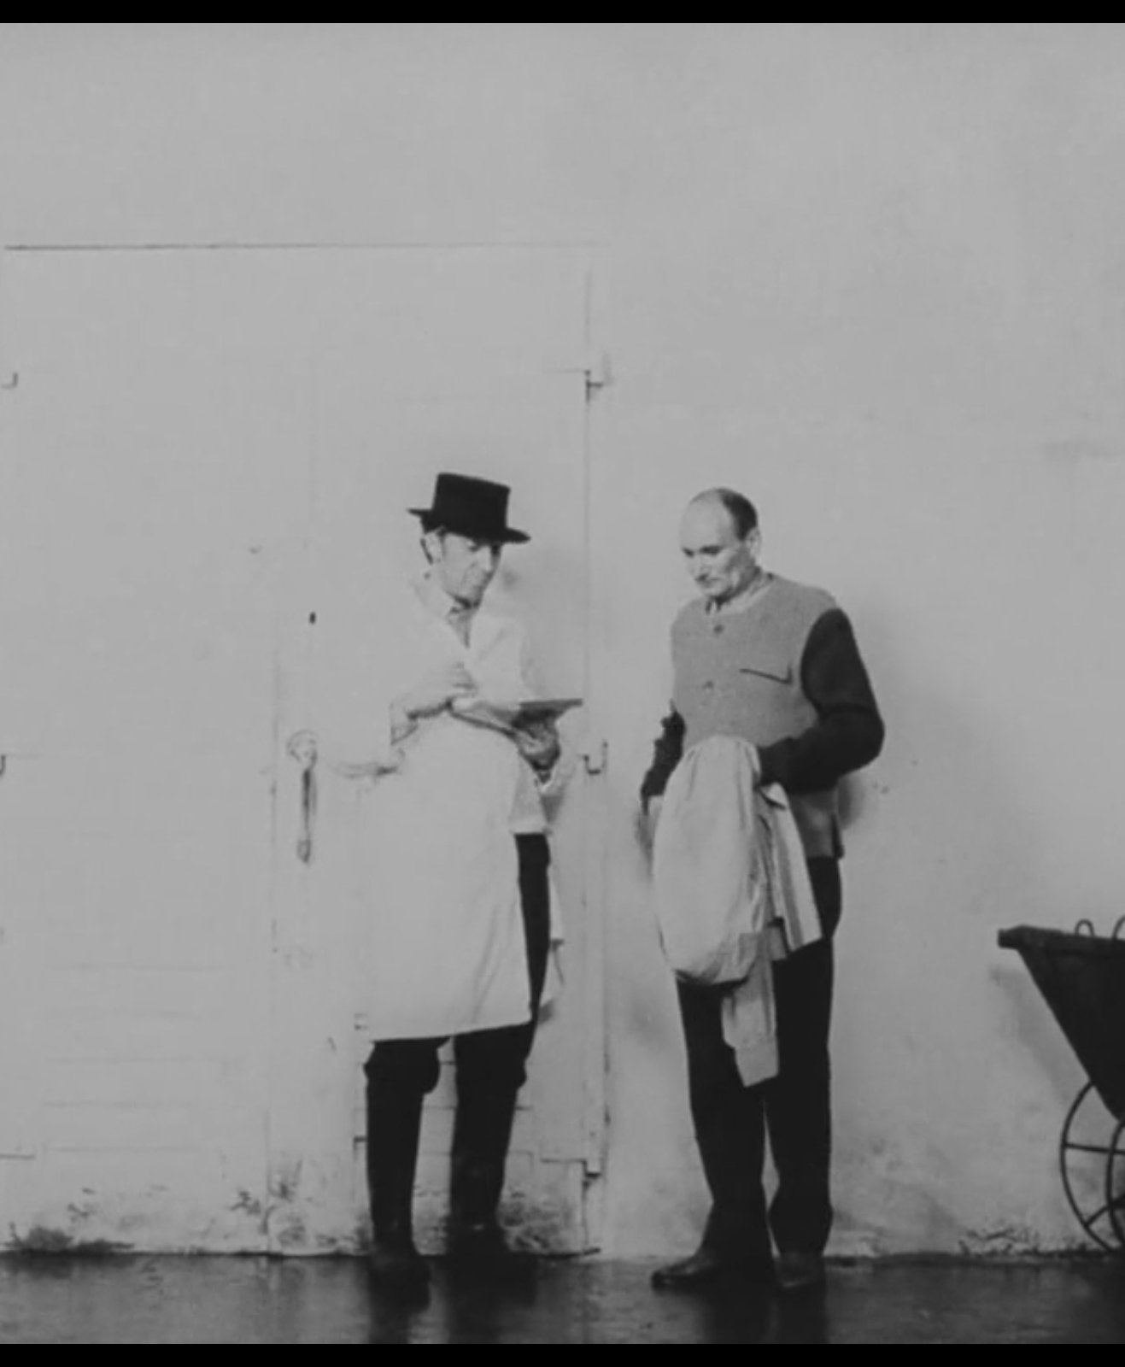
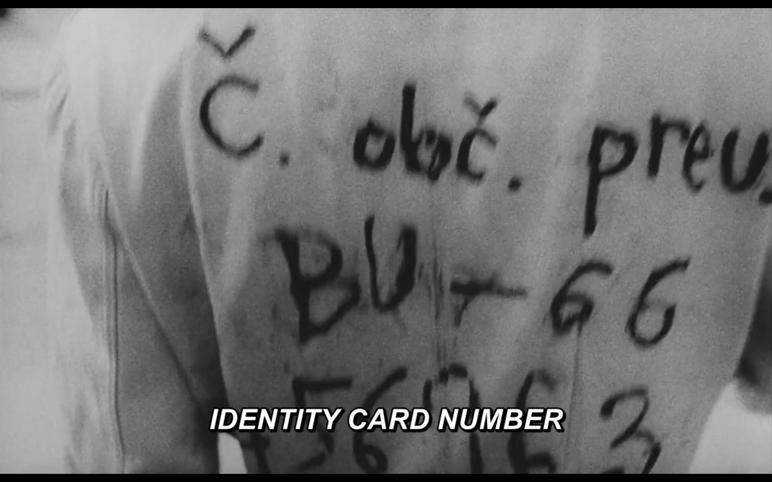
Dušan Hanák – 322 (1969)
Poetic civility
Próza Jána Johanidesa – The Sources of Sea Attract the Diver
The question of guilt, of existence
Building on authenticity and acquisition of reality (micro-existence) – but it is a strange world (absurdity)
Footage from Bratislava
Contrast image - overexposed material = "documentary roughness"

Slide 15
What to read ?
Owen, Jonathan. Slovak bohemians: revolution, counterculture and the end of Sixties in Juraj Jakubisko’s films. Studies in Eastern European Cinema. 2010, vol. 1, no. 1, s. 17– 28.
Mail: katarina.kunkelova1@gmail.com

