Slide 1
Illegal migration: detention, deportation
Anna Makarenko, 9.11.2022

Slide 2
Content of the session
Detention
Basic safeguards
Situation in Czechia
Deportation
Procedure
Human rights at stake
Monitoring

Slide 3
Key terms
Return Directive
A third-country national
Administrative detention
Vulnerable groups

Slide 4
Detention for the purpose of removal
Art. 15 – 18 of the Return Directive
„unless other sufficient but less coercive measures can be applied…..“,
„as short as possible, as long as the arrangements are made“
See the handout!
Czech Foreigners Act
Alternatives: an address, a financial guarantee, appointmens at the police, a stay at a designated place

Slide 5
Basic guarantees?
Lawyer
Medical care
Informing a third party
Consular assistance

Slide 6
…Guarantees
Detention as ultima ratio
No prison-like environment
Protection of vulnerable persons
Security
Right to information, Interpretation
Monitoring:
CPT (CoE)
NPM (UN, Czechia),
District attorney
NGOs
UNHCR
Internal inspection

Slide 7
Refugee Facilitation Administration
https://www.youtube.com/watch?v=JNamlcoWw_I
Bělá Jezová Case

Slide 8
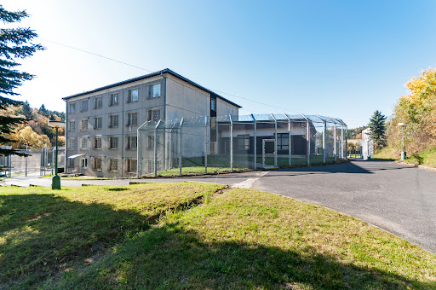
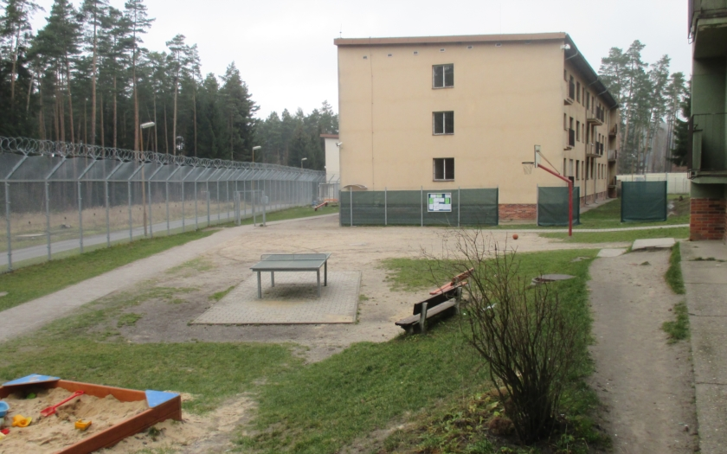
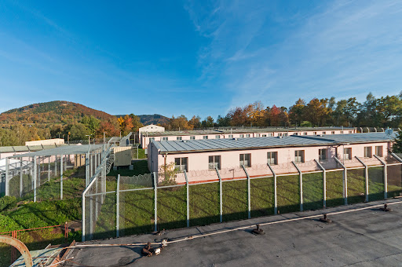
CZECHIA
ZZC Bělá-Jezová - left
ZZC Balková - right
ZZC Vyšní Lhoty - down

Slide 9
In a detention facility:
The time frame 90 days/180 days/can be prolonged… up to 365/545 days. If the time frame is not specific – inhuman treatment!
Sectors, vulnerable people
Solitary confinement– no grey zone! Record,files, 30 days
Aggression – 30+30 days
Internal rues breach
Breach of the obligations stemming from Foreigners Act

Slide 11
Key terms
Return decision
Voluntary return/assisted
Forced Return

Slide 12
Fit-to-travel form
Coercive measures
legality
necessity
proportionality

Slide 13
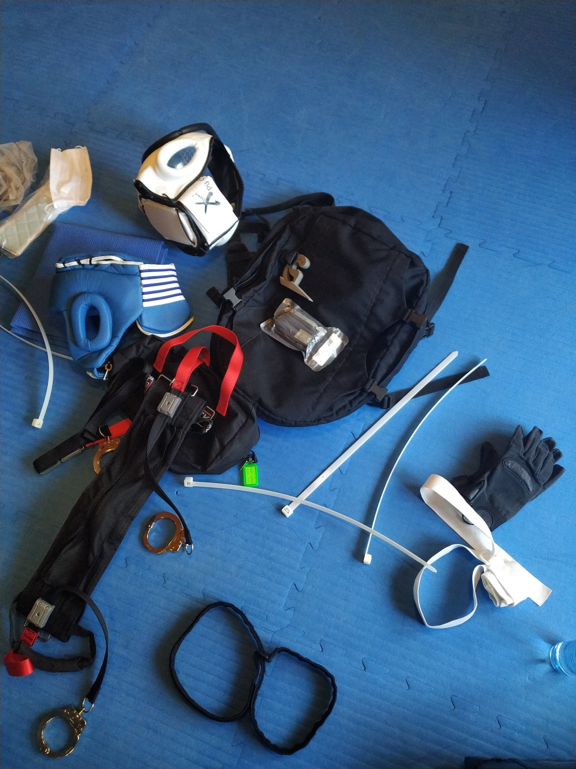
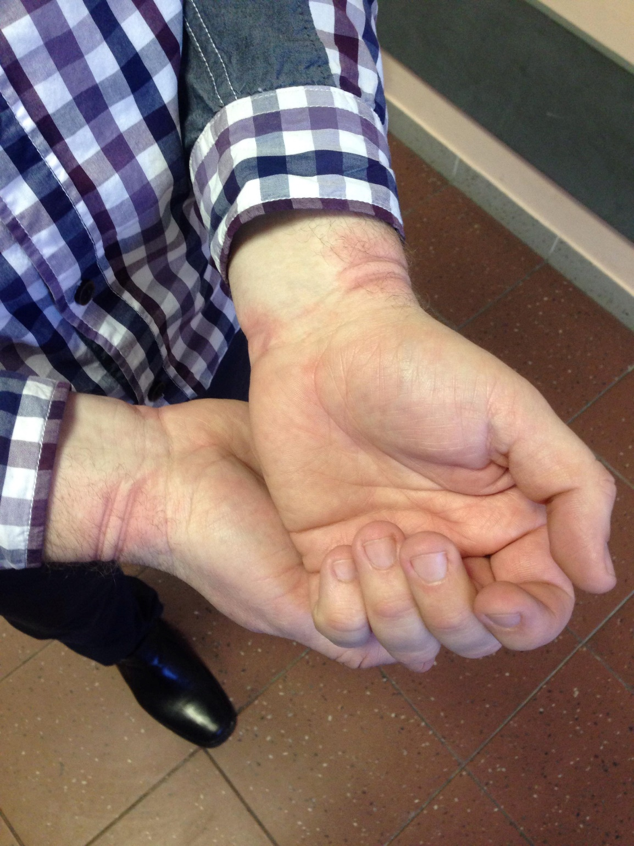
COERCIVE MEASURES

Slide 14
Notes:
Seznam úmrtí při pokusu o deportaci, vlivem zákroků přímo poziční asfyxie, nebo zástava srdce nebo poškození mozku (a smrt).

Slide 15
„the price of tranquility is death“

Slide 16
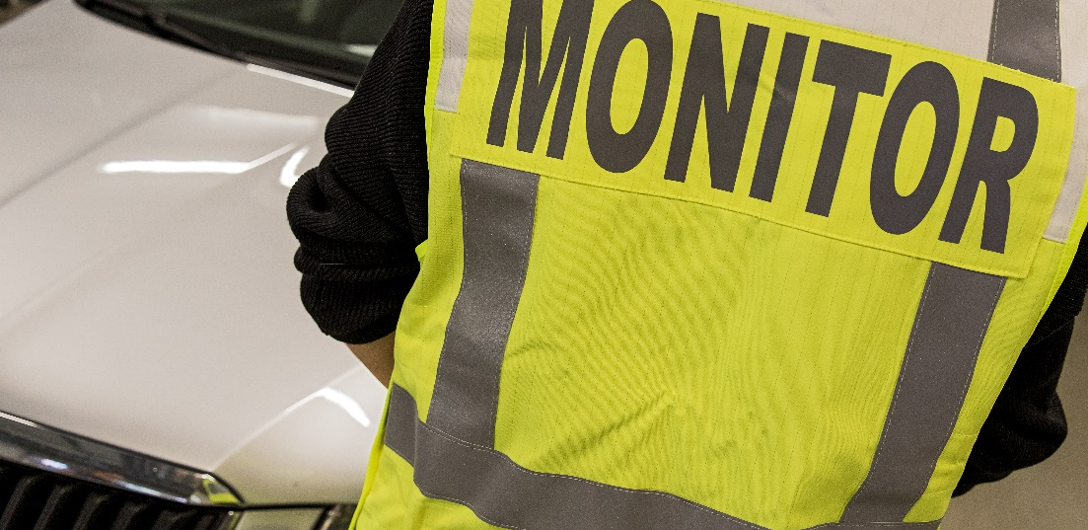
Forced Return Monitoring
Return Directive art 8/6 :
Member States shall provide for
an effective forced-return monitoring system.
reality? https://fra.europa.eu/en/publication/2022/forced-return-monitoring-systems-2022-update
AND possibly https://apt.ch/en/opcat-database
Frontex Regulation art. 29
The Agency shall, after consulting the fundamental rights officer, constitute a pool of forced-return monitors from competent bodies who carry out forced-return monitoring activities in accordance with Article 8(6) of Directive 2008/115/EC and who have been trained in accordance with Article 36 of this Regulation.

Slide 17
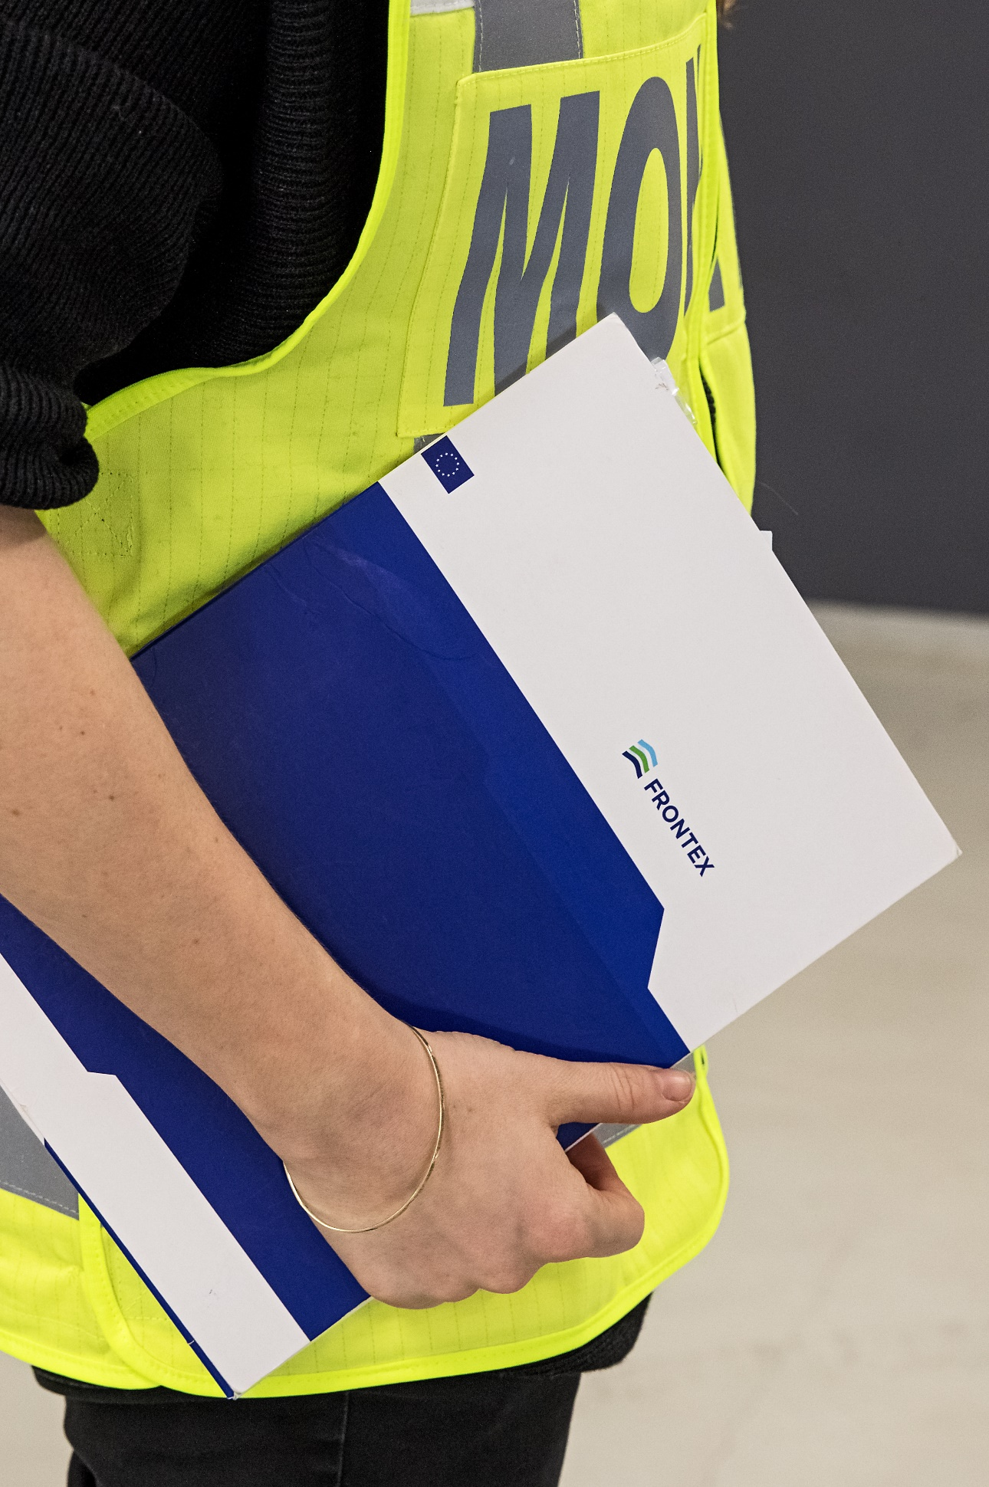
Monitoring
For the monitor to see and report, whether the return is conducted in
a humane manner,
respectful of the dignity of the person and
in compliance with the law, standards…
NO powers of intervention

Slide 18
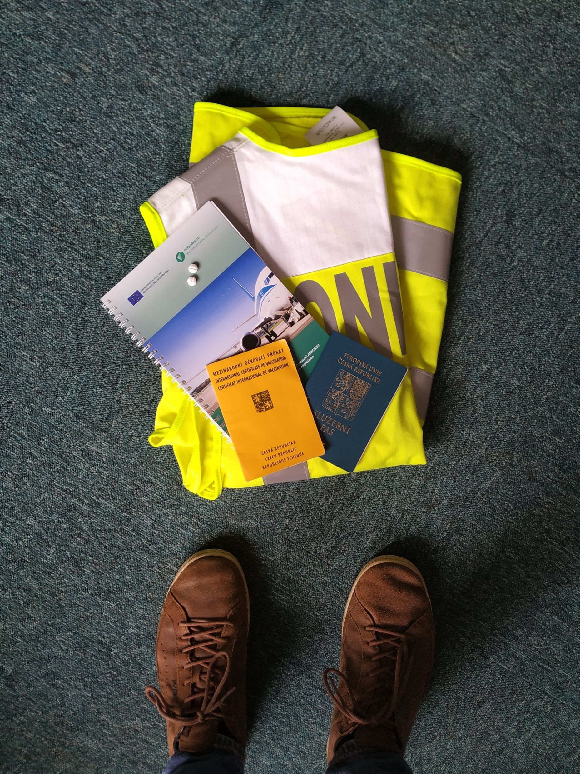
The job of a monitor
enter to the facility/place
speak with returnee (in private)
check documentation (inc. medical files)
be in escort vans/buses
service passports
access to the airport (SRA)
camera

Slide 19
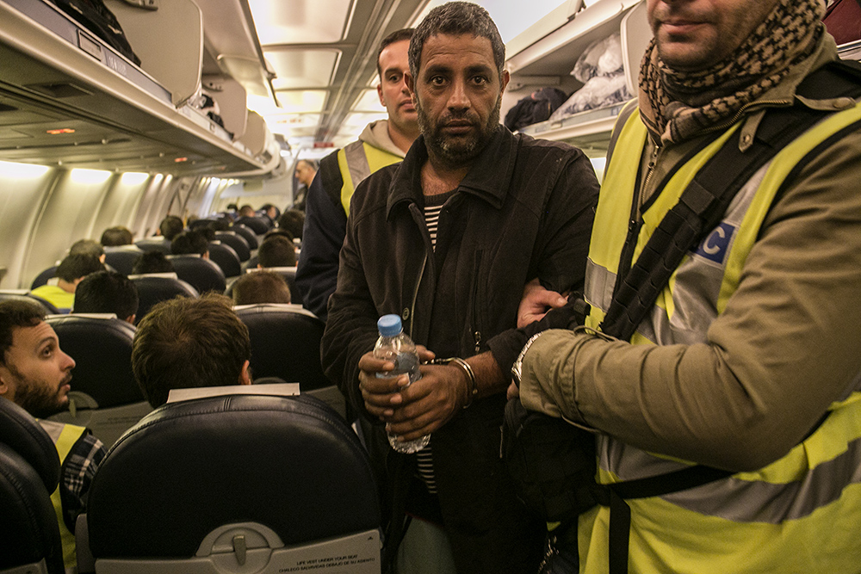
Participants: returnee, escort officers+leader,back-up team, doctor, interpreter, monitor
Rejected asylum seekers (no refoulement, because the claim was assessed)
Irregular migrants (individual return decision)
Person convicted for criminal offences

Slide 20
The procedure
Irregular situation
Return decision – possible remedy – time limit for voluntary return
detention/alternatives to detention
And Preparation, identification
Social work in the center
Pick-up……

Slide 22
Why having a monitoring system?
Returnees → can support possible claims of mistreatment and/or excessive use of force;
EL&escorts → clear themselves of possible unfounded accusations; media
Assesment and/or revision of future ROs
Notes:
It should be stressed that transparency created through unbiased and neutral monitoring serves the interest of all parties involved in a RO.
Monitor is not the enemy, he/she is there for everyone. It is good i tis there
DOPSAT Frontex regulation

Slide 23
Human rights at stake?

Slide 24
WC
Dignity, privacy, life, information, healthcare, materiál conditions, vulnerable persons, religion….

Slide 25
Right to life, liberty and security;
Freedom from torture, cruel, inhuman and degrading treatment and punishment;
Right to human dignity;
Right to non-discrimination;
Right to Religion;
Access to information;
Right to health and access to medical assistance
Access to food and water;
Rights of vulnerable groups;
Right to family unity;
Rights of the child/best interest of the child;
Right to personal data protection;
Right to privacy;
Right to property

Slide 27
Provided information
Personal data
Health condition
Date, time and place, where the return operation starts
Way of transport
Flight information
etc.

Slide 28
Obstacles to effective return system
Civil society? Media? Air-companies?
Lack of cooperation with third countries
Travel documents, identification, visa issue
National rules on detention – thin line!
Resources – financial, logistical

Slide 30
Legal instruments (binding, non-binding)
Universal Declaration of Human Rights 1948;
International Covenant on Civil and Political Rights 1979;
Convention relating to the Status of Refugees (Geneva Convention) 1951;
Optional Protocol relating to the Status of Refugees 1967;
European Convention of Human Rights 1950 (and all related protocols);
Charter of Fundamental Rights of the European Union 2000;
European Convention for the Prevention of Torture 1987;
UN Convention against Torture and Other Cruel, Inhuman or Degrading Treatment or Punishment 1984; and Optional Protocol to the Convention (OPCAT)→NPM
UN Convention on the Rights of the Child 1989
Codes of Conduct (2x), 20 guidelines for forced-returns
+ Tokyo Convention, Chicago Convention
+ Return Directive

Slide 31
Thank you for your attention!
Let´s keep in touch!
Anna Makarenko
anna.lanickova@seznam.cz

