Slide 1
Jídlo
Food in Czechia (and in Brno)
Daniel Boucník

Slide 2
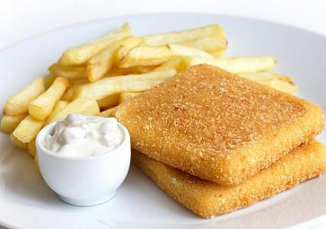
Topics
general facts
Typical dishes
Smažák, zabijačka (CONTENT WARNING), svatomartinská husa, …
Traditional dishes
Where to go for good Czech food - Brno highlights

Slide 3
general facts about Czech food
meat everywhere, although historically …
non-meat dishes usually sweet
fatty and fattier (máslo and sádlo)
typical day is a 3-meal day
breakfast https://www.cooklikeczechs.com/czech-breakfast/
showcase: https://youtu.be/BhtmANlVzvI

Slide 4
How many meals a day do people in your country eat?

Slide 5
Christmas and Easter
Christmas
Dinner is served after sunset (traditionally, it should not be served until after the first star has come out) and consists of carp and potato salad, sometimes preceded by mushroom, sauerkraut or fish soup.
Easter
http://www.myczechrepublic.com/czech_culture/czech_holidays/easter/index.html

Slide 6
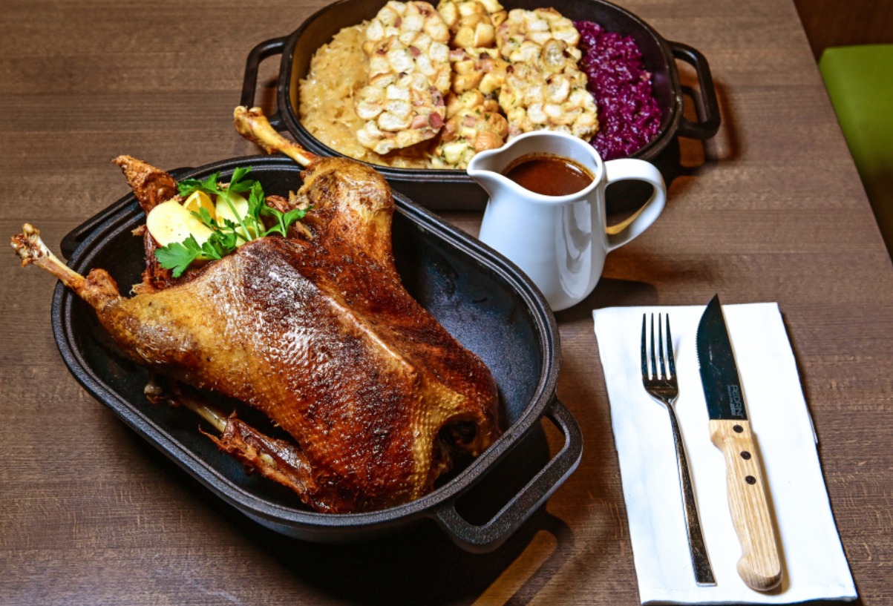
Svatomartinská husa (now in season!)
https://www.informacezbrna.cz/spolecnost/svatomartinska-husa-brno.html

Slide 7
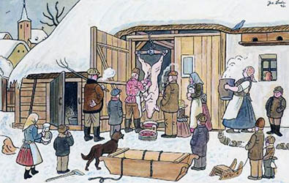
Zabijačka (pig slaughter)
https://www.czechology.com/zabijacka-pig-slaughter-czech-way/
https://www.ceskatelevize.cz/porady/1102732990-folklorika/316292320040011/ (20:55)

Slide 8
Where can I taste zabijačka products?
A LOT of public gourmet events during winter
restaurants
U Karla (tlačenka, jelito a jitrnice) - https://www.facebook.com/UKarlaBrno
shops
Krásno - https://www.krasno.cz/prodejny/
mikroFarma - https://www.facebook.com/MikrofarmaBrno

Slide 9
Which holidays in your country are traditionally connected with food?

Slide 10
Smažák (deep-fried cheese)
Czechs take their smažák seriously!
Where to eat
Brno - Lokál u Caipla https://lokal-ucaipla.ambi.cz/cz/
https://www.mapotic.com/smazakomapa

Slide 11
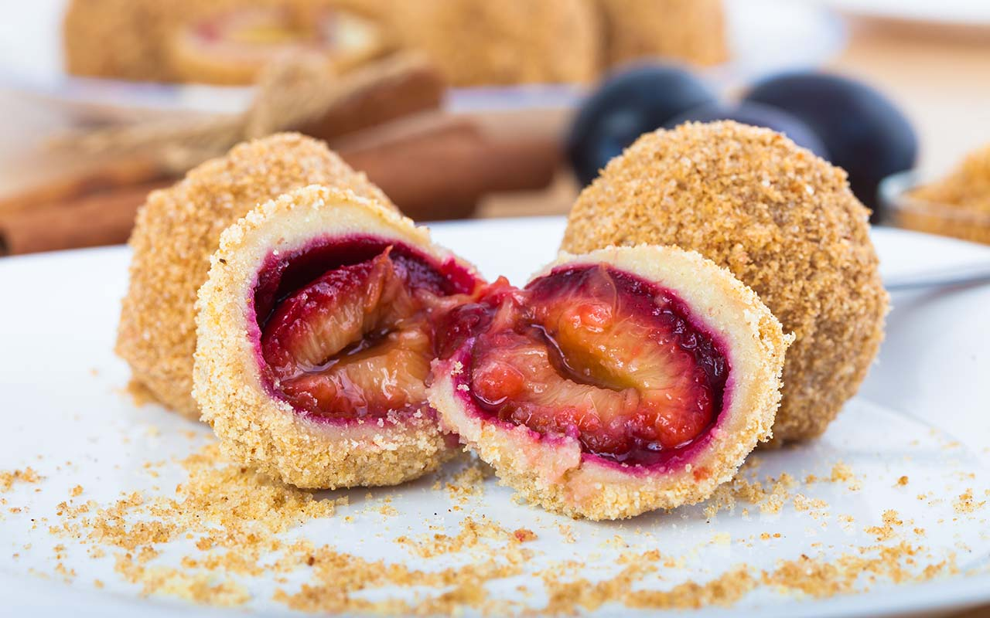
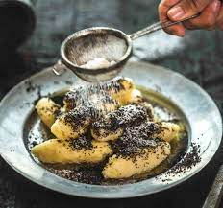
Sweet food
Šišky s mákem (below) https://www.czechology.com/sisky-s-makem-potato-dumplings-with-poppy-seed/
tvarohové knedlíky (above)

Slide 12
Food scene of Brno
Coffee
Bread and Pastries
Open sandwiches
Liquor

Slide 13
Brno = a mecca of specialty coffee
Take5
https://www.facebook.com/take5.zidenice
Industra
https://www.facebook.com/industra.coffee
tHE ROses
https://www.facebook.com/therosescoffeestore
Sk⌀g
https://www.facebook.com/skogbrno

Slide 14
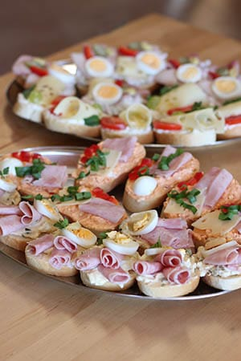
Chlebíčky (open sandwiches)
https://www.czechology.com/czech-open-sandwiches-chlebicky-are-the-star-of-any-party/
Where can I find it in Brno?
- https://www.emachlebicek.cz/

Slide 15
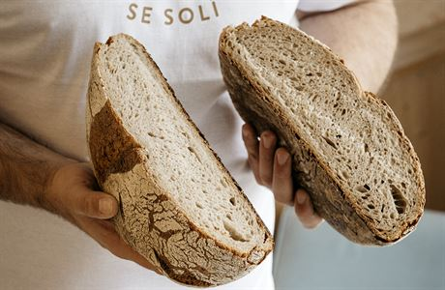
Bread and Pastries
Chleba Brno https://www.chlebabrno.cz/
Mamma Stella https://www.instagram.com/mama_stella_artisan/
William Thomas https://www.wtbakery.cz/

Slide 16
Liquor
Brno?
https://www.littleurban.cz/
https://www.hauskrecht.cz/ and many, MANY breweries
Czechia?
https://rudolfjelinek.com/

Slide 17
Where to eat in Brno
Hladinka a šnyt - https://www.facebook.com/hladinkaasnyt
U Karla -
Pivnice U Čápa - https://www.facebook.com/pivniceucapa
plus some extra tips by Honest Guide - https://youtu.be/spQwWG0BPHY

Slide 18
In your country, is there a clash between traditional and modern cuisine?
Do people in your country snack regularly between the main meals?
What is the one meal that is national for you but it is also well known abroad?
What’s your favorite brand of beer?
Discussion

