Slide 1
Czech New Wave CZS36 + CMA018
Dr. Šárka Jelínek Gmiterková
Fall 2023
14. 12. 2023

Slide 2
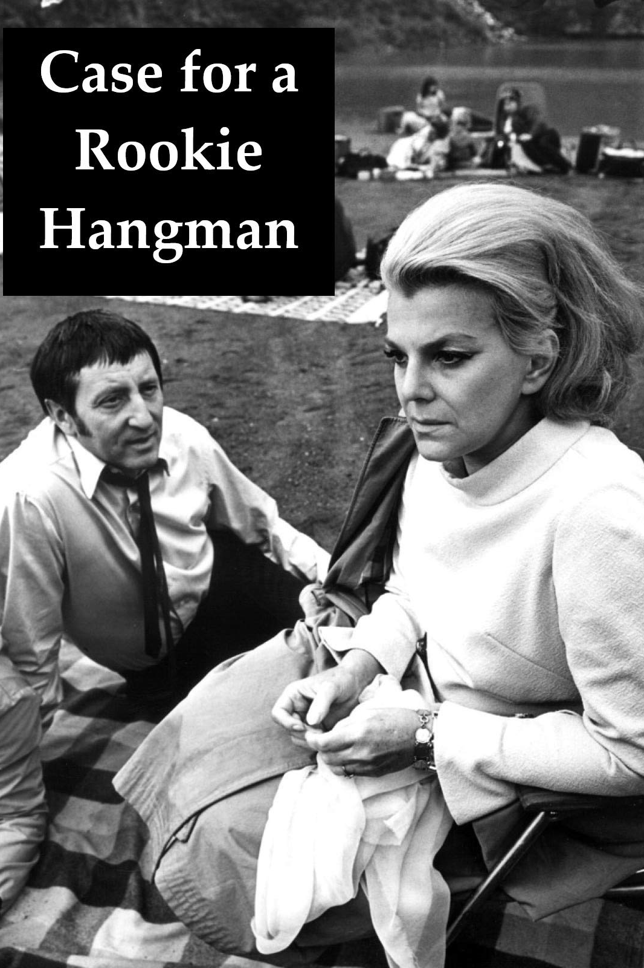
Case for a Rookie Hangman (1969, dir. Pavel Juráček
Screenplay: loose adaptation of Gulliver‘s travels by Jonathan Swift – Pavel Juráček, DOP: Jan Kališ, Music: Luboš Fišer, Staring: Lubomír Kostelka, Pavel Landovský, Milena Zahrynowská, Klára Jerneková, Slávka Budínová, Věra Ferbasová, Miroslav Macháček and others

Slide 3
Case for a Rookie Hangman Background and Questions
Pavel Juráček was a period celebrity among the new wave autheurs, especially because his published Diaries (4 volumes) provide us with an unprededented insight into the movement.
Despite making a mid-length feature Joseph Killian and a movie Every Young Man (consisting of two short stories), we consider Case as a prime example of his ambitions in direction. It was his screenwriting work that was cherished and valued by his contemporaries. He always specialized in creating fantastic genre stories infused with spectacular qualities and metaphorical imagery.
What do you think this film is about? Try to either reconstruct the storyline or consider the film as a metaphor for…
The Case is not only a fascinating film because of its storytelling, but also a movie full of lavish decor, costumes and visual design. Focus on these aspects: how does citizens of the various countries dress, eat, where they live and work and what does it tell us about them?
Is it a typical or rather atypical film of the new wave – and why?

Slide 4
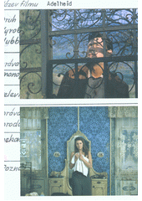
L12_Reading
ČECHOVÁ, Briana. Rookie Hangman as a Character in Need of Support – Pavel Juráček‘s Work, the Story of its Origin, Release and Echoes. In: Česálková, Lucie (ed.) Czech Cinema Revisited: Politics, Aesthetics and Techniques. Praha: NFA, 2017, pp. 59–86.

Slide 5
1968 so-called post January period or Prague Spring
The fall of the president of the Czechoslovak Socialist Republic Antonín Novotný – in January he was released from the position of a first deputy of the Communist Politbyro, in March he steps down as a president of the republic
General Ludvík Svoboda – the new president, the first deputy of the Communist party is Alexander Dubček (a reformist)
Previously taboo topics are now adressed and critically discussed in media / culture should not be limited by ideological requests / June 1968: censorship is oficially baned.
These reforms are not accepted by other countries of the Soviet bloc >> 21. 8. 1968: the invasion of the armies of the Warsaw pact
Moscow protocol (27. 8. 1969) – the organisations established during the reform proces are cancelled / censorhip reinstalled / the army and state police is strenghtened / political representatives not willing to cooperate are removed
April 1969: the party accepts Dubček‘s resignation and Gustáv Husák takes over the post >> turn away form various philosophies, ideas and artistic viewpoints coexisting is society and culture >> any alternative is being labelled as „ideologically alienating“

Slide 6
How cinema reacted to political situation
Personal changes on top strategic positions, followed by the purge among regular employees
September 23rd, 1969 Jiří Purš is the new head of the Czechoslovak State Film (instead of Alois Poledňák)
October 1970 Miloslav Fábera is the new head of Barrandov Studios (FSB)
1. 12. 1969 – the head of dramaturgy at Barrandov studios is Ludvík Toman (instead of Břetislav Kunc) >> this position gains new powers, all CG leaders have to regularly consult their intentions and projects in development, since 1972 he has a strong voice in greenlighting or vetoing films
New leadership cancels existing CGs and creates 7 dramaturgical units and reinstalls central Ideology and Artistic Council >> the production is again split from the project development, with central top down ideological control reinforced
Censorhip changes – after August 1968 the Office for Press and Information was created, with no film department, because (!) the censorship is strongly tied with cinematic structures

Slide 7
Transitional period
Filmexport – till the end of 1968 the orientation on western capitalist markets persists / import of attractive film hits from non-socialist countries; after that relationships with Eastern bloc countries are „normalized“ (coproductions, import, export)
May 1968: Alois Poledňák as a head of ČSF gives up some of his crucial powers (such as greenlighting films for distribution) – newly acquired by the head of FSB
New CG of Pavel Juráček and Jaroslav Kučera is established, they made films such as Fruits of Paradise, Larks on a String and Case for a Rookie Hangman
The number of debuts is on the rise again („second new wave“). In 1970 seven< directors finished their first feature films X later in the decade (1970s) the debuts are produced as a collection of short films (similar to Pearls of the Deep) + Zlín studios

Slide 8
Namely…
Due to the development post January 1968 delayed projects are finally greenlighted for production (The Borstal, The Joke, The End of a Priest)
Some of these films were never finalized despite their creators tried to save them as much as they could
The Borstal (dir. Hynek Bočan) – till the end of the 1980s it existed only in a rough cut
The Arch of Fools (dir. Ivan Balaďa) – there was an effort to present this film as a universal message about a society which missed its chance for a positive change. New Barrandov leadership identifies a negative image of Soviet Union >> this film was thus framed as a detergent example. The film existed in a final cut, but only rough sound edit + the reason for cancelling the CG Juráček–Kučera
Collective debut Visits (dir. Vladimír Drha, Milan Jonáš and Otakar Fuka) with a topic of political inmates in the 1950s. Existing materals were probably destroyed (extreme case).

