Slide 1
Collective expulsions
Anna Makarenko
29.11.2023

Slide 2
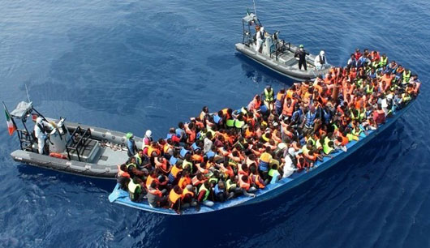
overview
Collective expulsion – legal foundation
Case Law of ECHR
Closed Sea documentary + discussion
https://www.youtube.com/watch?v=2H2k_a12g8E

Slide 3
Collective expulsion
Art. 4 Protocol 4 (1963) to the Convention (1950):
„Collective Expulsion of aliens is prohibited.“
See: https://rm.coe.int/168006b65c
Absolute character!

Slide 4
Collective expulsion, the definition:
= any measure compelling aliens, as a group, to leave a country, except where such a measure is taken on the basis of a reasonable and objective examination of the particular case of each individual alien of the group.
Similar decisions?
Number of persons affected
Territorial applicability of Protocol 4

Slide 6
Case Law
Čonka v. Belgium (2002)
The applicants, Slovakian nationals of Romani origin, had been arrested with a view to their expulsion after they had been summoned to complete their asylum requests. The applicants complained, in particular, about the circumstances of their arrest and expulsion to Slovakia.
Refoulement: yes or no?
Lack of individual assessment, lack of legal remedy.

Slide 7
Hirsi Jamaa and others v. Italy (2012),
Bilateral treaty with Libya (2009)
Outside the national territory, high seas.
Expulsion = to drive away from a place
Somalian and Eritrean migrants travelling from Libya had been intercepted at sea by the Italian authorities and sent back to Libya. The applicants complained in particular that they had been subjected to collective expulsion prohibited. They also submitted that they had had no effective remedy in Italy in that respect.

Slide 8
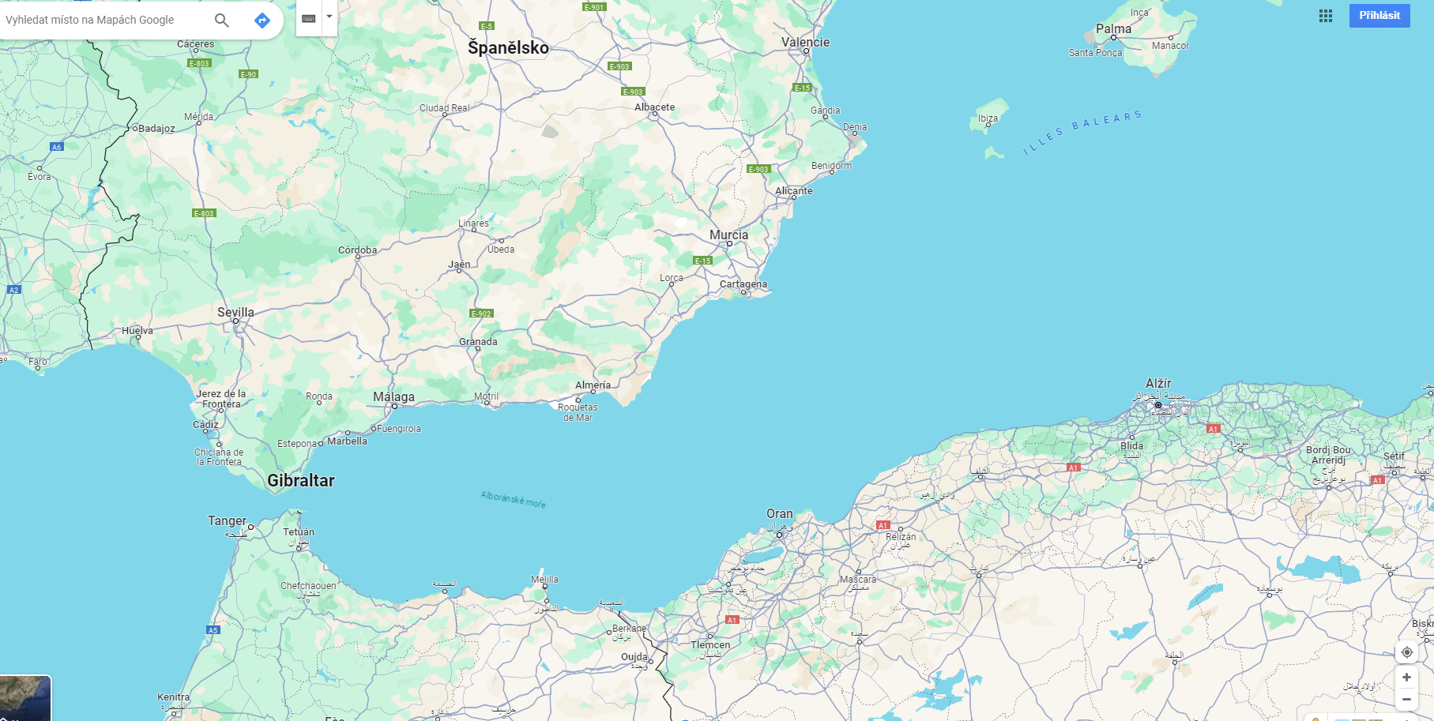
N.D. and N.T. v Spain (2017,2020)
Attempt to cross the borders in an unauthorised manner, en masse
Fences in Mellila
Non-admission
Expulsion to Morroco
other genuine, effective
means of entry?
+ consequences of own
conduct

