Slide 1
Temporary protection accepting refugees from Ukraine
Hana Lupačová

Slide 2
Stay in the territory
Regular
(e. g. Ukraine) – up to 90 days – for UKR with a biometric passport - No visa obligation
Long-term visa (on national level) – e. g. toleration visa for those who cannot be expelled
Long-term stays (EU level harmonization) – study, family reunion, research, seasonal work
Permanent Stay
Irregular (overstay of visa, without visa and documents)
International protection procedure (protection from persecution / serious harm)
Temporary protection – a type of protection institute in cases where the asylum system would not manage to process all the applications

Slide 3
International Protection
Asylum: unable or unwilling to return to his or her home country because of a “well-founded fear of persecution” due to race, membership in a particular social group, political opinion, religion, or national origin
Subsidiary protection: a) death penalty or execution; b) torture, inhuman or degrading treatment or punishment in the country of origin c) ‘serious and individual threat to a civilian's life … by reason of indiscriminate violence in situations of international or internal armed conflict’

Slide 4
Temporary protection
„(a) "temporary protection" means a procedure of exceptional character to provide, in the event of a mass influx or imminent mass influx of displaced persons from third countries who are unable to return to their country of origin, immediate and temporary protection to such persons, in particular if there is also a risk that the asylum system will be unable to process this influx without adverse effects for its efficient operation, in the interests of the persons concerned and other persons requesting protection;
Article 2 (a) directive 2001/55/EC

Slide 5
Czechoslovakia – flows of refugees before
Greek refugees (1948) –5,185 children and 8,130 adults, later returned back to Greece / or stayed – today a Greek minority
Temporary shelter: refugees from former Yugoslavia (1991-1997): 5,676 (Bosnia, Herzegovina, Serbia, Croatia, Kosovo)
EU directive on temporary protection 2001/55/EC: created in connection with the experience from war in Yugoslavia
First discussions that the directive would be used: 2014 - Syria
Instead: Turkey adopted temporary protection for Syrians
Decree No. 2014/4883; on EU level discussed but not used

Slide 6
Arrival of refugees from Ukraine to the Czech Republic
No visa needed | With biometric passport
 | Without such passport: other proof of identity
Crossing borders
Border Controls at external borders (Slovakia, Poland, Hungary)

Slide 7
Temporary protection – for whom? (Council Implementing Decison (EU) 2022/382 of 4 March 2022 )
… categories of persons displaced from Ukraine on or after 24 February 2022, as a result of the military invasion by Russian armed forces that began on that date:
Ukrainian nationals residing in Ukraine before 24 February 2022;
stateless persons, and nationals of third countries other than Ukraine, who benefited from international protection or equivalent national protection in Ukraine before 24 February 2022; and,
family members of the persons referred to in points (a) and (b).
2. Member States shall apply either this Decision or adequate protection under their national law, in respect of stateless persons, and nationals of third countries other than Ukraine, who can prove that they were legally residing in Ukraine before 24 February 2022 on the basis of a valid permanent residence permit issued in accordance with Ukrainian law, and who are unable to return in safe and durable conditions to their country or region of origin.
3. (…) may also apply (…) to other persons, including to stateless persons and to nationals of third countries other than Ukraine, who were residing legally in Ukraine and who are unable to return in safe and durable conditions to their country or region of origin.

Slide 8
Do you think these people will receive temporary protection?
1. Mr Oleg had a work visa in Poland from January 2022. He lost his work. His family from Ukraine moved to the Czech Republic. So he left Poland and applied for temporary protection in the Czech Republic.
2. June from Ghana in Africa had a study visa in Ukraine. She was studying there. She arrived in April 2023 and applied for temporary protection in the Czech Republic.
3. Joseph was from Somalia. He was a recognized refugee in Ukraine and had stayed there for ten years, with a permanent residence permit. He applies for temporary protection in 2024.
4. László came in April 2022 from Western Ukraine. He is a Roma of Hungarian origin. Apart from Ukrainian, he also had a Hungarian passport and only speaks Hungarian. He applies for temporary protection in the Czech Republic.
5. Iulia lived in the Czech Republic since 2020. She returned to Ukraine in summer 2023 but her house was bombed, so she returned to the Czech Republic. She applies for temporary protection.

Slide 9
Some issues: how temporary?
Art. 4 Temporary protection directive
(…) the duration of temporary protection shall be one year. (…) it may be extended automatically by six monthly periods for a maximum of one year. (…)
Where reasons for temporary protection persist, the Council may decide by qualified majority (…) to extend that temporary protection by up to one year.
Prolonged
until 4 March 2026

Slide 10
Statistics: Temporary protection
On 31 May 2024, approximately 4.3 million non-EU citizens, who fled Ukraine as a consequence of the Russian war of aggression against Ukraine, had temporary protection status in the EU.
At the end of May 2024, the EU countries hosting the highest number of beneficiaries of temporary protection from Ukraine were Germany (1 332 515 people; 31.3% of the EU total), Poland (953 255; 22.4%) and Czechia (356 405; 8.4%).
Compared with April 2024, the largest absolute increases in the number of beneficiaries were observed in Germany (+14 250; +1.1%), Czechia (+11 000; +3.2%) and Romania (+3 715; +2.4%).
The number of beneficiaries decreased only in 3 EU countries: France (-1 005; -1.6%), Poland (-675; -0.1%) and Latvia (-15; -0.03%).
the highest numbers of temporary protection beneficiaries per thousand people at the end of May 2024 were observed in Czechia (32.9), Lithuania (27.2) and Poland (25.9)

Slide 11
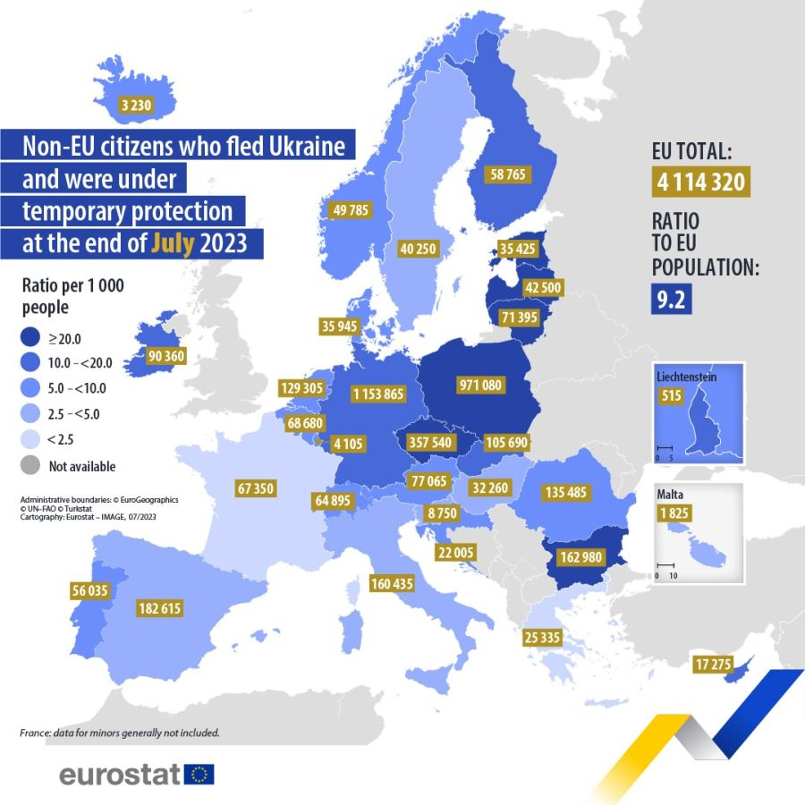

Slide 12
Exercise
What measures your respective countries have adopted in response to the war (if any) or to accept refugees from Ukraine?
Share them and try to identify best practices and also problems with integration
If there are problems think of a way to resolve them

Slide 13
Integration of Ukrainian refugees
Registration after arrival
Schools
Work
Health insurance
Legal stay
Return to Ukraine
Social benefits
Trafficking x Labour exploitation

Slide 14
Integration (PAQ Research, February 2024)
Schools: ¾ children go to kindergarden; 9 out of 10 to elementary school and about ½ to secondary schools (many others work), 1 in 10 study at universities
40% children have support with Czech language courses (in 2022 61%)
57% can communicate in Czech in common situations
Work: 72% refugees work; 2/3 work in less qualified jobs compared to their education; 2/3 earn less than 150 CZK (6 EUR)/hour; 1/3 need more jobs to survive; 57% are below poverty line
Leisure 54% have hobbies, only 1/3 meet friends from Czechs (1 in 10 regularly), 57% have been verbally attacked, 64% have been discriminated against
70% rent a place to live, 16% stay in hotels / temporary accommodation facilities
6 out of 10 want to stay for longer than 2 years

Slide 15
Integration: main issues
PAQ Research (summer 2023): Ukrainians with temporary protection
(3,200 households)
67% work (by 22% more than in summer 2022)
58% work in less qualified jobs – language knowledge being a factor
4 out of 10 have less pay than Czechs in same positions
49% rent a flat
53% have humanitarian benefit (june 2023 before changes)
Half of them work in precarious work conditions
68% below poverty line; 45% have savings for less than a month
More than half want to stay
Schools (March 23): 66% in preschool, 92% in primary schools, 43% in high schools

Slide 16
Russians and Belarussians
Government Resolution No 130 of 25 February 2022 on the suspension of the acceptance and processing of applications for visas and permits for long-term and permanent residence of nationals of the Russian Federation
Government Resolution No 152 of 2 March 2022 on the suspension of the acceptance and processing of applications for visas and permits for long-term and permanent residence of nationals of the Republic of Belarus
Government Resolution No 254 of 1 April 2022 on the adoption of a crisis measure
Government Regulation of 22 June 2022 on the inadmissibility of applications by third-country nationals for a residence permit in the territory of the Czech Republic submitted to embassies

Slide 17
What was suspended
suspend the procedure in the case of applications submitted by nationals of the Russian Federation or Republic of Belarus for short-stay visas which have not yet been decided;
stop accepting applications for visas and permits for long-term and permanent residence at embassies of the Czech Republic submitted by nationals of the Russian Federation and the Republic of Belarus,
suspend proceedings on applications for visas and permits for long-term or permanent residence submitted by nationals of the Russian Federation and the Republic of Belarus to the embassies of the Czech Republic;
FAMILY REUNION AGAIN POSSIBLE

Slide 18
Who will be admitted from Russia /Belarus
Civil society programme
provide visa support to freedom fighters, human rights defenders, civil society representatives, independent media or academics in the RF and BY
who are subject to persecution by the state authorities
have to leave their country of origin mainly for security reasons and for the active defense of democratic principles
concerned are people who are fighting against the criminal regimes of Putin and Lukashenko in their countries
Family members of EU / third country nationals
Students from Belarus: those who are persecuted for political reasons and those who oppose non-democratic circumstances in their country

Slide 19
Some interesting sources
ECRE Information Sheet 2022
https://ecre.org/wp-content/uploads/2022/03/Information-Sheet-%E2%80%93-Access-to-territory-asylum-procedures-and-reception-conditions-for-Ukrainian-nationals-in-European-countries.pdf
EU Commission guidelines – crossing borders (C(2022) 1404 final):
https://ec.europa.eu/home-affairs/communication-providing-operational-guidelines-external-border-management-eu-ukraine-borders_en -
Czechia to extend ban on visa and residence permits for Russians and Belarusians - Prague, Czech Republic

Slide 20
Statistics
2024
41,600 Russians with residence permits live in Czechia, and 7,675 Belarusians (as of the end of 2022).
2021
18,931 Russians worked in the Czech Republic
84,000 Russians arrived to the Czech Republic via airport (ranked fourth)
10% of long-term permit applications (2nd most common after Ukrainians)
ranked first to apply for student visa (31%), and second to apply for family reunion (12% after Ukrainians)
ranked 3rd to apply for permanent residence permit (after Ukraine and Slovakia)

Slide 21
Statistics Unaccompanied minors 2021: 241 (199 from AFG, mostly boys) 2022: till now 200 (mostly from UKR)
do 3 let | 3-6 let | 6-15 let | 15-18 let | 18-65 let |  | nad 65 let |  | celkem
 |  |  |  | muži | ženy | muži | Ženy
14 998 | 19 186 | 68 569 | 22 147 | 54 157 | 144 049 | 2 993 | 8 753 | 334 852
Statistiky k 12. 5 (Zdroj: Ministerstvo vnitra, evidence obyvatel, kterým byla udělena dočasná ochrana) Altogether by May 2022 124,900 children with or without an accompanying adult Not publicly available

Slide 22
Unaccompanied children
Some problems:
Children 15-18 arriving alone
Children left behind by their parents / grandparents
Children left with an adult who is unable or unwilling to take care of them
Studying or working?

